Slide 1
CHAPTER 8
CPSC 352 Computer Security
Threats (but not yet how to prevent them)
Professor: Oberta A. Slotterbeck (Obie)
Computer Science Department
Hiram College
obie@hiram.edu

Slide 2
Computer Crime and Cyberattacks
Sources of cyberattacks
  Organized crime may steal confidential information to extort money
  Cyberterrorists attack targets for political motivations
  Industrial spies steal information for competitors
  Amateur hackers are trying to establish themselves in the underground community
  Bored individuals (often teenagers) may attack organizations just to prove they can
Losses from attacks are on the increase, rising from an average of $120M in the late 90’s to $265M in 2000
Attacked organizations are not always willing to quantify losses so obtaining figures is difficult

Slide 3
Developing Attacker Profiles
Six typical categories:
  Hackers
  Crackers
  Script kiddies
  Spies
  Employees
  Cyberterrorists

Slide 4
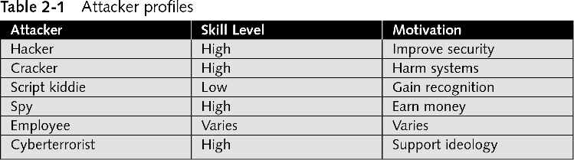
Developing Attacker Profiles (continued)

Slide 5
Hackers
Person who uses advanced computer skills to attack computers, but not with a malicious intent
Use their skills to expose security flaws supposedly
However, their motives may become blurred over time

Slide 6
Crackers
Person who violates system security with malicious intent
Have advanced knowledge of computers and networks and the skills to exploit them
Destroy data, deny legitimate users of service, or otherwise cause serious problems on computers and networks

Slide 7
Script Kiddies
Break into computers to create damage
Are typically unskilled users
Download automated hacking software from Web sites and use it to break into computers
Tend to be young computer users with almost unlimited amounts of leisure time, which they can use to attack systems

Slide 8
Spies
Person hired to break into a computer and steal information
Do not randomly search for unsecured computers to attack
Hired to attack a specific computer that contains sensitive information

Slide 9
Employees
One of the largest information security threats to business
Employees break into their company’s computer for these reasons:
  To show the company a weakness in their security
  To say, “I’m smarter than all of you”
  For money

Slide 10
Cyberterrorists
Experts fear terrorists will attack the network and computer infrastructure to cause panic
Cyberterrorists’ motivation may be defined as ideology, or attacking for the sake of their principles or beliefs
One of the targets highest on the list of cyberterrorists is the Internet itself

Slide 11
Cyberterrorists (continued)
Three goals of a cyberattack:
  Deface electronic information to spread disinformation and propaganda
  Deny service to legitimate computer users
  Commit unauthorized intrusions into systems and networks that result in critical infrastructure outages and corruption of vital data

Slide 12
Understanding Basic Attacks
Today, the global computing infrastructure is most likely target of attacks
Attackers are becoming more sophisticated, moving away from searching for bugs in specific software applications toward probing the underlying software and hardware infrastructure itself

Slide 13
Social Engineering
Easiest way to attack a computer system requires almost no technical ability and is usually highly successful
Social engineering relies on tricking and deceiving someone to access a system
Social engineering is not limited to telephone calls or dated credentials

Slide 14
Social Engineering (continued)
Dumpster diving: digging through trash receptacles to find computer manuals, printouts, or password lists that have been thrown away
Phishing: sending people electronic requests for information that appear to come from a valid source

Slide 15
Social Engineering (continued)
Develop strong instructions or company policies regarding:
  When passwords are given out
  Who can enter the premises
  What to do when asked questions by another employee that may reveal protected information
Educate all employees about the policies and ensure that these policies are followed

Slide 16
Computer Crime and Cyberattacks
Internet most common point of attack
Commonly reported computer security breaches
  Internal attacks
  Viruses
  Denial of service attacks
  Inappropriate e-mail use
  Downloading pornography and pirated software
Ninety percent of 2002 survey respondents reported that breaches were detected within 12 months of the attack

Slide 17
Cyberattack Scenarios
Food, water, electricity, transportation, industry, finance, emergency services, gas, telephones, and national security all depend on technology to function properly
Both House and Senate are considering legislation on cybersecurity
But, it is an international problem that can’t be controlled locally.

Slide 18
Northeast Cyberattack Scenario
The Northeast United States loses power for one week in the middle of Winter, due to an attack on the power grid
Business damages may put many out of work entirely
Thousands of deaths from lack of heat
Emergency services and transportation severely impacted
Air traffic control would be disrupted
Critical services do have backup power, but the supplies are finite, what happens when they run out
The lack of answers point to weaknesses in the system and the vulnerability to attack

Slide 19
Economic Impact of Malicious Code Attacks
Malicious code attack occurs when people write computer code intended to damage or disrupt computer systems and networks, and then release that code across the systems
Costs for cleanup are rising with the increasing frequency of these attack
Since “Love Bug” attack, clean up from these attacks have become highly automated, mitigating some costs

Slide 20
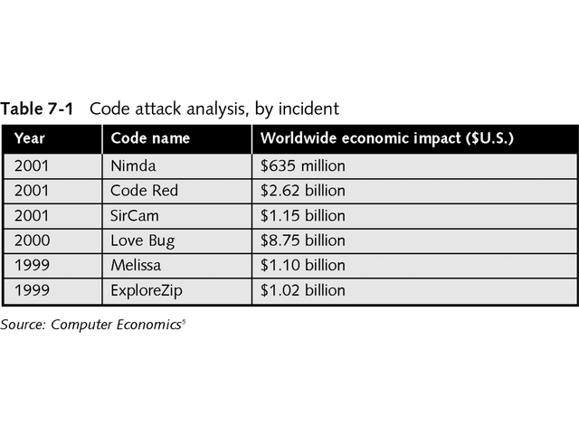
Economic Impact of Some Attacks

Slide 21
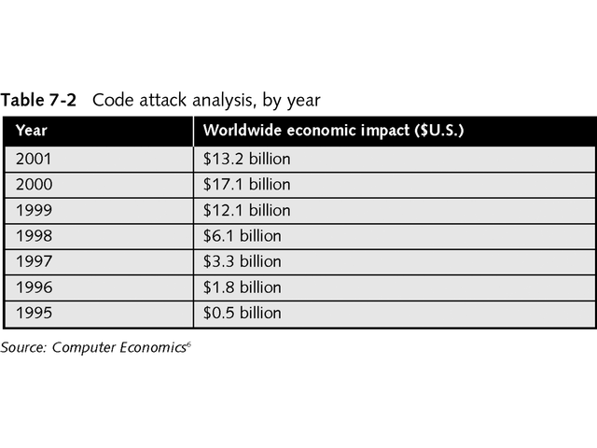
Economic Losses From Attacks

Slide 22
Including Cyberattacks in Definitions of Terrorism
Terrorist incident is a violent act that endangers human life, violates U.S. or state criminal law, and intimidates a government and its citizens, all in service of advancing a group’s political or social objectives
FBI Special Agent Mark Pollitt says, “Cyberterrorism is the premeditated, politically motivated attack against information, computer systems, computer programs, and data, which result in violence against noncombatant targets by sub-national groups or clandestine agents.”
News media are using the term “cyberterrorism” as a generic term for any computer crime incident against infrastructure targets, like nuclear power plants
The FBI performs other investigations that lead to preventing attacks

Slide 23
Domestic and International Terrorism
Domestic terrorists operate entirely within the United States and Puerto Rico without foreign direction
International terrorism is the unlawful use of force or violence by a group or person with connections to a foreign power, or by a group whose activities transcend national boundaries
Prior to September 11, 2001, terrorism was limited to the physical world, computers and cyberspace attacks are now included in this definition
The Department of Homeland Security was formed as a central authority to coordinate the roles of all Federal government agencies in national security

Slide 24
Department of Homeland Security Key Assets
In February 2003, the DHS called for cooperation among government, industry, and private citizens to protect these key assets
  Agriculture, food, and water
  Public health and emergency services
  Defense industrial base and commercial key assets
  Telecommunications, energy, transportation, banking, and finance
  Chemical industry and hazardous materials
  Nuclear power plants, dams, government facilities, and national monuments

Slide 25
Cyberspace Security Strategies
Participate in a public/private architecture for responding to national cyber incidents, and for developing continuity and contingency planning efforts
Contribute to the development of tactical and strategic analyses of cyberattacks and vulnerability assessments
Assist in enhancing law enforcement’s ability to prevent and prosecute cyberspace attacks. Organizations must report more incidents and file necessary complaints to support criminal prosecution
Provide information that contributes to national vulnerability assessments, so that all organizations can better understand the potential consequences of cyberspace threats

Slide 26
Cyberspace Security Strategies
Deploy new and more secure protocols, routing technology, digital control systems, supervisory control and data acquisition systems, and software that can reduce vulnerability
Participate in a comprehensive national awareness program to help businesses and the general population secure their own parts of cyberspace
Improve internal training and education programs to support security in cyberspace
Provide information to the government that helps to continuously assess threats to federal computer systems, and that helps to keep computer networks secure

Slide 27
Expectations of Cyberattacks
When people or groups use computer technology, software, and networks to attack systems, they launch a cyberattack
The FBI says the agency has identified a wide array of cyberthreats in the past several years
In 2002, Dale Watson, an Executive Assistant Director of Counterterrorism and Counterintelligence, told the U.S. Senate Intelligence Committee that the “threats range from defacement of Web sites by juveniles to sophisticated intrusions sponsored by foreign powers.”
All cyberattacks have consequences
  Theft of credit card numbers put many at risk
  Undermining public confidence in electronic commerce

Slide 28
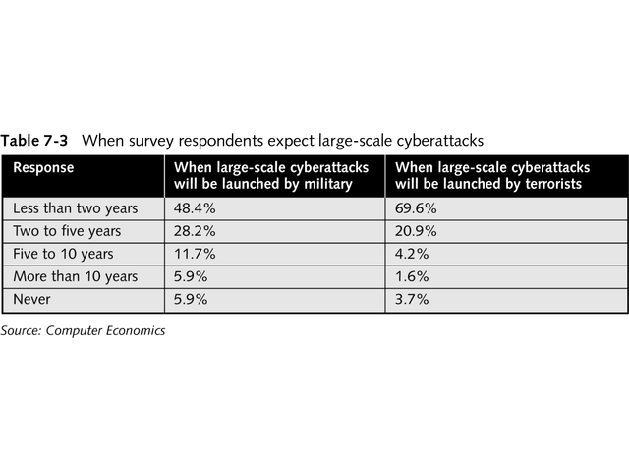
Expectancy of Cyberattacks

Slide 29
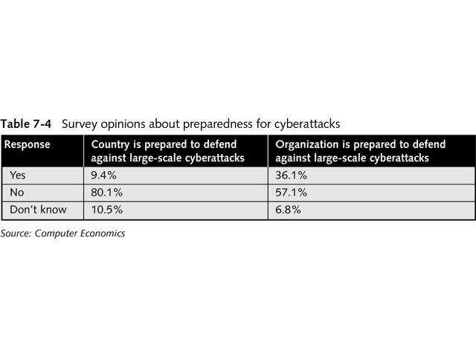
Preparedness for Cyberattacks

Slide 30
Information Warfare
Information warfare could be described as an organized effort to use cyberattacks to damage or disrupt important computer systems
Possible categories
  Personal information warfare
  Corporate information warfare
  Global information warfare
Disaster recovery planners should consider each threat as either internal or external to their organization
An internal threat would originate from any employee who has physical access to equipment and legitimate rights to information within the organization
External threats originate from people outside the organization who have no legitimate interests or rights to corporate systems or information

Slide 31
Considerations for Developing Information Warfare Procedures
Developing security policies for information systems to address legitimate uses and system operations
Implementing security measures and policies to protect information systems
Training employees in the evidence handling and forensics used to investigate computer crimes
Developing contact information for law enforcement agencies that deal with computer crime
Staying abreast of current and future legislation regarding computer crime, as well as related international standards and laws

Slide 32
Protecting Against Cyberattacks
An unfortunate fact of information systems security is that defenders must protect against all possible means of intrusion or damage, while attackers only need to find a single point of entry into a system
Any machine or network that is linked to another network is a potential target—the only secure system is one with no outside connections
To protect against cyberattacks and create an appropriate defense plan, organizations need a combination of training, manual procedures, technology, and awareness efforts

Slide 33
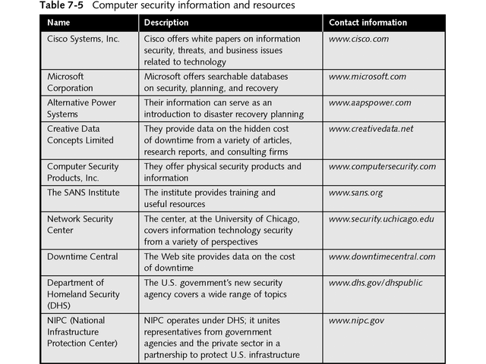
Computer Security Information Resources

Slide 34
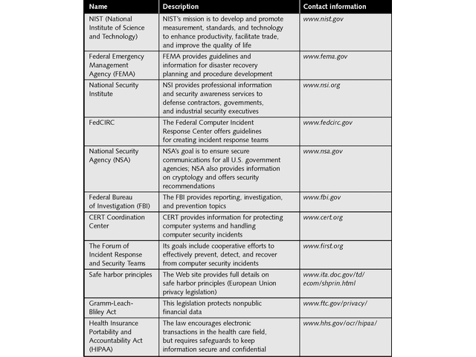
Computer Security Information Resources

Slide 35
Evolving Privacy Laws
Cybercrimes have a direct impact on privacy
Even though data security and privacy have a relationship, the concept and practice of data security is generally geared toward restricting data access
If organizational policies on the use or sale of sensitive information are not appropriate, privacy problems can still surface, even though the information and technology are secure

Slide 36
Evolving Privacy Laws
Most law enforcement agencies are not equipped to deal with cybercrimes
They probably cannot assist in information theft or the intentional violation of information privacy
Most organizations do not have insurance to cover damage caused by major privacy violations
The organization must demonstrate due care in protecting its data and clear policies for privacy management to obtain this coverage
Governments are working to develop legislation and cooperative efforts to protect privacy
The global nature of communications makes it difficult for organizations to determine their responsibilities
The Organization for Cooperation and Development has been at the forefront of addressing privacy issues
The European Union has taken the lead with the development of their safe harbor principles

Slide 37
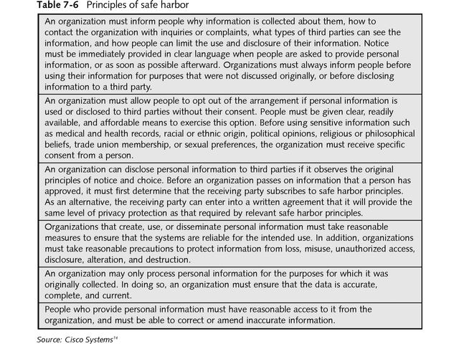
Principles of Safe Harbor

Slide 38
Evolving Privacy Laws
Privacy Act of 1974
  protect the privacy of people identified in information systems maintained by federal executive branch agencies, and to control the collection, use, and sharing of information
Computer Matching and Privacy Protection Act of 1988
  Provides an exemption to allow information disclosure to an intelligence agency for preventing terrorist acts
The Cable Communications Policy Act of 1984
  Limits the disclosure of cable television subscriber names, addresses, and other information
The Video Privacy Protection Act of 1988
  Regulates the treatment of personal information collected during video sales and rentals

Slide 39
Evolving Privacy Laws
Telecommunications Act of 1996
  Limits the use and disclosure of customer proprietary network information (CPNI) by telecommunications service providers
The Health Insurance Portability and Accountability Act of 1996
  Establishes privacy protections for individually identifiable health information held by health care providers, health care plans, and health care clearinghouses.
  It establishes a series of regulatory permissions for uses and disclosures of health information
Driver’s Privacy Protection Act of 1994
  Regulates the use and disclosure of personal information from state motor vehicle records

Slide 40
Evolving Privacy Laws
The Electronic Communications Privacy Act of 1986
  Regulates government access to wire and electronic communications such as voice mail and e-mail, transactional records access, and other devices
The USA PATRIOT Act of 2001
  Substantively amended previous federal legislation and authorized the disclosure of wiretap and grand jury information to “any federal, law enforcement, intelligence, protective, immigration, national defense, or national security official” for the performance of his duties
The Homeland Security Act of 2002
  Authorizes sharing of the federal government’s information-gathering efforts with relevant foreign, state, and local officials

Slide 41
Evolving Privacy Laws
The Gramm-Leach-Bliley Act of 1999
  Requires financial institutions to disclose their privacy policies to customers
Children’s Online Privacy Protection Act of 1998
  Requires Web site operators and online service providers to obtain parental consent to collect a child’s personal information, and requires sites that collect information from children to disclose how they plan to use the data

Slide 42
How Computer Systems Are Attacked
Attackers have a luxury of time not available to those protecting computer systems
Security is not designed into the building blocks of the Internet
Attackers have vast networks to probe for vulnerabilities with large connected networks
Attackers have access to the same hardware, software, and applications that information security specialists have
Hackers monitor all Internet communications for product information and security measures
Attackers can work in loosely organized global groups and exchange information easily

Slide 43
Overview of Types of Computer Attacks
Application-layer attacks
  Attacks against weaknesses in software, such as web servers
Autorooters are programs that automate the entire hacking process
Denial-of-service (DoS) attacks and distributed denial-of-service (DDoS) attacks
  Focus on making a service unavailable for normal use, typically by exhausting some resource within a network, operating system, or application

Slide 44
Overview of Types of Computer Attacks
TCP SYN flood
  This attack takes advantage of how connections are established between computers, creating many partial connections to a computer without completing the connection, consuming resources
Ping of death
  Occur when hackers modify the PING command to send Internet Control Message Protocol (ICMP) packets that exceed their maximum size
IP-spoofing attacks
  When a hacker inside or outside a network pretends to be a trusted computer

Slide 45
Overview of Types of Computer Attacks
Tribe Flood Network (TFN) and Tribe Flood Network 2000 (TFN2K)
  Tools for coordinating DoS attacks
Stacheldraht (German for “barbed wire”) combines features of several DoS attacks, including TFN
Packet sniffers are software applications that use a network adapter card in “promiscuous” mode. In this mode, the card sends all packets received on the physical network wire to an application for processing

Slide 46
Overview of Types of Computer Attacks
Man-in-the-middle attacks can occur when a hacker has access to packets that come across a network
Network reconnaissance is the gathering of information about a target network using publicly available data and applications
Trojan horse attacks and viruses refer to malicious software that is attached to another program to execute an unwanted function on a user’s workstation
Backdoors are paths into systems that an attacker can create during a successful intrusion or with specifically designed Trojan horse code
Password attacks are repeated attempts to identify a user account and password

Slide 47
Overview of Types of Computer Attacks
Trust exploitation attacks , hackers take advantage of a trust relationship within a network to attack several interconnected servers
Port redirection attacks are a type of trust exploitation attack that uses a compromised host to pass traffic through a firewall that would otherwise be dropped

Slide 48
Developing Procedures in the Wake of a Security Breach
To prevent prolonged business disruptions, procedures should be developed to quickly recover from a security breach
Procedures should incorporate guidelines from the FBI and National Infrastructure Protection Center (NIPC)

Slide 49
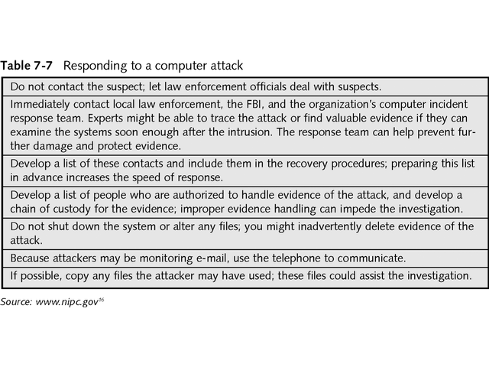
Responding to a Computer Attack

Slide 50
Procedures to Follow After an Attack
Procedures should include steps for determining how an incident occurred, and how to prevent similar attacks in the future
Information systems security staff then executes these procedures

Slide 51
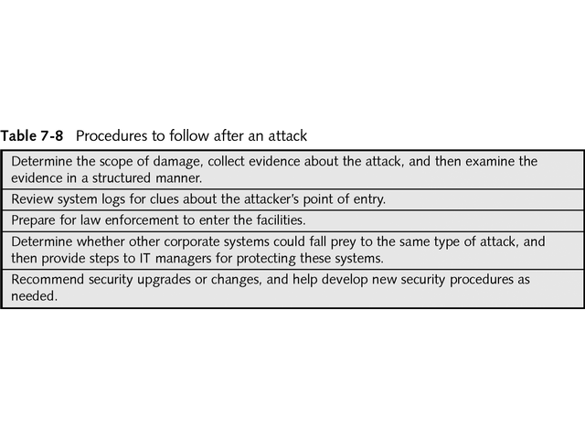
Procedures to Follow After an Attack

Slide 52
Developing Procedures for Working with Law Enforcement
NIPC established InfraGard chapters for sharing information
All 56 FBI field offices have an InfraGard chapter
The national InfraGard program provides
  An alert network using encrypted e-mail
  A secure Web site for communication about suspicious activity or intrusions
  Local chapter activities and a Help desk for questions
  A way to send information about intrusions to the local FBI field office using secure communications
General membership in InfraGard is open to anyone who wants to support its purposes and objectives

Slide 53
Developing Procedures for Working with Law Enforcement
InfraGard members are responsible for
  Promoting the protection and advancement of critical infrastructure
  Exchanging knowledge and ideas
  Supporting the education of members and the general public
  Maintaining the confidentiality of information obtained through their involvement
Disaster recovery planning team needs to develop procedures for collecting and providing information about intrusions to law enforcement investigators

Slide 54
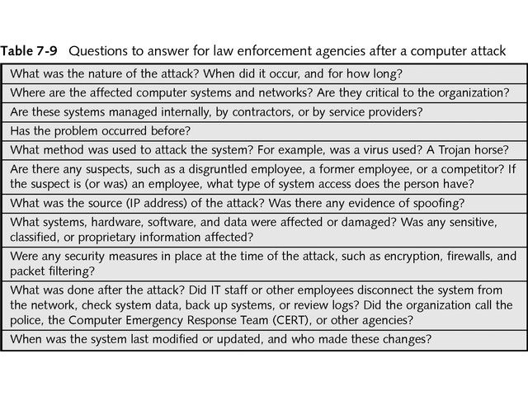
Questions to answer for law enforcement agencies after a computer attack

Slide 55
Developing Procedures to Determine Economic Losses
Types of negative economic effects as a result of a computer attack or intrusion
  Immediate —These impacts include damage to systems, the direct costs of repairing or replacing systems, and disrupted business and revenues
  Short-term —These impacts might include lost contracts, sales, or customers, a tarnished reputation, and problems in developing new business
  Long-term —These effects include reduced market valuation, stock prices, investor confidence, and goodwill toward the organization

Slide 56
Developing Procedures to Determine Economic Losses
Adverse impact in terms of losses
  Loss of Integrity
    Integrity is lost if unauthorized changes are made to the data or IT system, either intentionally or accidentally
    If this loss of integrity is not corrected, continued use of the corrupted system or data could result in inaccuracy, fraud, or erroneous decisions
  Loss of Availability
    Lost system functionality and effectiveness can result in lost productivity, which impedes users’ performance and their support of the organization’s mission
  Loss of Confidentiality
    The impact of such disclosures can range from jeopardized national security to the disclosure of Privacy Act data

Slide 57
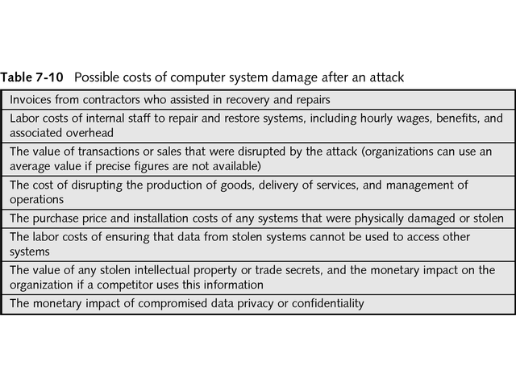
Possible Costs of Computer System Damage After an Attack

Slide 58
Developing Procedures to Ease IT Recovery
Information technology is unique in disaster recovery, in the sense that organizations can build in redundancy and automate processes to address many problems that can occur when a disaster strikes
Several concepts and recommended actions
  Value of frequent backups
  Offsite data storage
  Redundant system components
  Well-documented system configurations and requirements
  Power management systems
  Environmental controls

Slide 59
Types of Systems and Networks
An organization has many types of systems and networks, each needing their own recovery procedures
  PCs and portable computers are often used to perform automated routines within IT departments, and are therefore important to an organization’s contingency plan
  Web sites communicate corporate information to the public or internal users
  Servers support file sharing, storage, data processing, application hosting, printing, and other network services
  Mainframes are centralized groups of interconnected processors
  Distributed systems use LAN and wide area network (WAN) resources to link clients and users at different locations
  LANs are networks within an organization; they might connect two or three PCs through a hub, or they could link hundreds of employees and multiple servers

Slide 60
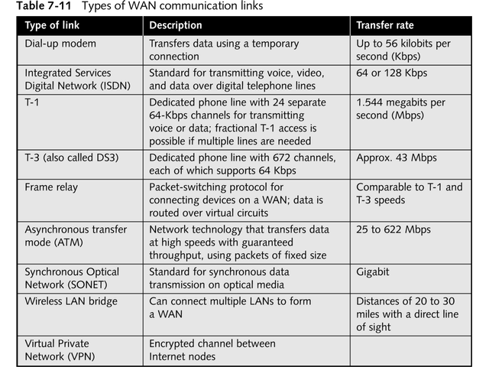
Types of WAN Communication Links

Slide 61
Recovery of Small Computer Systems
Desktop PCs, laptops, and hand-held computers are often networked to other devices, applications, and the Internet
To help recover these small systems, an organization should
  Train users to regularly back up data if PC backups are not automated from the network.
  Store backup media offsite in a secure, environmentally controlled facility
  Standardize hardware, software, and peripherals throughout the organization
  Make important hardware components compatible with off-the-shelf computer components, to avoid delays caused by ordering custom equipment
  Document system configurations in the disaster recovery plan, along with vendor and emergency contact information, in case replacement equipment is needed quickly

Slide 62
Recovery of Large Computer Systems
Because many users in an organization may rely on these systems, the following additional efforts should be made
  The use of uninterruptible power supplies
  The replication of databases
  The use of fault-tolerant computer and networking systems
  The use of redundant, critical system components

Slide 63
Network Recovery
In addition to documentation the following practices can reduce downtime
  Redundant communications links
  Multiple network service providers
  Duplicate network connecting devices
  Deployment of segmented networks
  Use of off-the-shelf network technology
  Network security systems
  Intrusion detection and prevention systems

Slide 64
Establishing a Computer Incident Response Team
The team should consider establishing a subcommittee of team members to focus on computer and network issues
A well-rounded computer incident response team should include members from
  Information Technology
  Network Management Staff
  Corporate Security
  Legal Counsel
  Public Relations Department

Slide 65
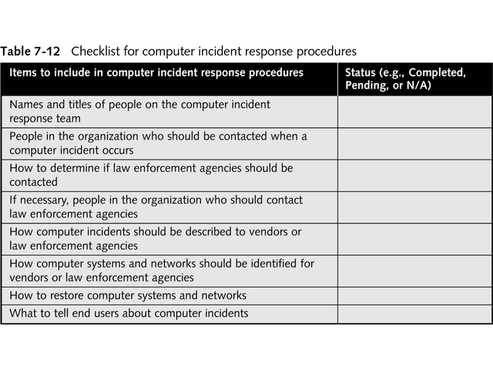
Checklist for computer incident response procedures

Slide 66
More detail on some of the computer security threats ...
Computer security threats
  Unintentional: Examples are-
    Coding faults
    Operational faults
    Environmental faults
  Intentional (malicious code): Examples are-
    Trojan horses
    Trap doors
    Viruses
    Worms

Slide 67
Physical Security
Physical security entails restricting access to some object by physical means
  Examples: locked doors and human guards
Neglecting physical security can undermine other security mechanisms that protect a system
  Example: a system with an superb file-protection mechanism
    The disk drive that stores the filesystem is publicly accessible
    An attacker could attach his or her own computer to the drive and read its contents

Slide 68
Human Factors
Human factors - the users of computer systems impact security
Users can undermine system security through their naïvete, laziness, or dishonesty
  Users of a system should also be educated about its security mechanisms so that they are unlikely to accidentally undermine them
    Explain to users why certain passwords are weak or help them choose strong ones
  Users of a system should be screened so that they are unlikely to purposely abuse the system privileges they are given
    People who have exhibited a pattern of dishonest behavior in the past are risky users

Slide 69
Program Security
Program security requires that the programs that run on a computer system must be:
  Written correctly (no coding faults)
  Installed and configured properly (no operational faults)
  Used in the manner in which they were intended (no environmental faults)
  Properly behaved (no malicious code)
Flaws in any of these areas may be discovered and exploited by attackers

Slide 70
Program Security (cont)
Coding faults – program bugs that can be exploited to compromise system security
Examples:
  Condition validation errors – a requirement is either incorrectly specified or incompletely checked
  Synchronization errors – operations are performed in an improper order

Slide 71
Condition Validation Error - Example
The uux (Unix-to-Unix command execution) utility
Used to execute a sequence of commands on a specified (remote) system
For security reasons, the commands executed by uux should be limited to a set of “safe” commands
  The date command (displays the current date and time) is a safe command and should be allowed
  The rm command (removes files) is not a safe command and should not be allowed

Slide 72
Condition Validation Error – Example (cont)
Processing uux requests:
  For each command:
    Check the command to make sure it is in the set of “safe” commands
    Skip the command’s arguments until a delimiter is reached
  Example:
    cmd1 arg1 arg2 ; cmd2 ; cmd3 arg1
  The problem: some implementations did not include the ampersand (&) in the list of delimiters though it is a valid delimiter
  The result: unsafe commands (e.g. cmd4) could be executed if they followed an ampersand:
    cmd2 & cmd4 arg1

Slide 73
Synchronization Error - Example
The mkdir utility – creates a new subdirectory
  Creates a new, empty subdirectory (owned by root)
  Changes ownership of the subdirectory from root to the user executing mkdir
The problem:
  If the system is busy, it may be possible to execute a few other commands between the two steps of mkdir
  Example:
    Delete the new directory after step one and replace it with a link to another file on the system
    When step two executes it will give the user ownership of the file

Slide 74
Program Security (cont)
Malicious code - programs specifically designed to undermine the security of a system
  Trojan horses
    Login spoof
    Root kits
  Trap doors
  Viruses
    Virus scanning
    Macro viruses
  Worms
    The Morris worm

Slide 75
Typical Methods Used by Malicious Software
Executable methods
Boot and partitions sector methods
Macro methods
E-mail methods
Software exploitation
Spyware

Slide 76
Executable Methods
Files that contain lines of computer code that can be run
  Examples: .exe, .com, .bat, .bin, .btm, .cgi, .pl, .cmd, .msi
Can infect source or execution code of a program
E-Mail Methods
Sent as attachments to e-mail

Slide 77
Boot and Partition Sector Methods
Particularly affect Windows and UNIX systems
Typically infect/replace instructions in MBR or Partition Boot Sector
Can corrupt address of primary partition
May move boot sector to another location if size of virus exceeds space allocated for boot sector
Eradication typically involves recreating MBR and Partition Boot Sector instructions

Slide 78
Software Exploitation
Particularly aimed at new software and new software versions
Examples of potential vulnerabilities
  DNS services
  Messaging services
  Remote access services
  Network services and applications

Slide 79
Spyware
Software placed on a computer
  typically without user’s knowledge
  reports back information about user’s activities
Some operate through monitoring cookies

Slide 80
Trap Doors
Trap doors are flaws that designers place in programs so that specific security checks are not performed under certain circumstances
Example: a programmer developing a computer-controlled door to a bank’s vault
  After the programmer is done the bank will reset all of the access codes to the vault
  However, the programmer may have left a special access code in his program that always opens the vault

Slide 81
Trojan Horses
History – a hollow wooden horse used by the Greeks during the Trojan War
Today - a Trojan horse is a program that has two purposes: one obvious and benign, the other hidden and malicious
Examples:
  Login spoof
  Mailers, editors, file transfer utilities, etc.
  Compilers

Slide 82
Trojan Horses (cont)
Examples (cont):
  Salami
    Programmer writes bank software that credits interest to customer accounts each month
    The result of the interest computation on many accounts may not be a whole number of cents
    Example:
      0.25 percent of $817.40 is $2.0435
      Should be rounded down to $2.04 in interest
    Programmer instructs program to deposit fractional cents into the programmer’s account

Slide 83
Trojan Horses (cont)
Examples (cont):
  Root kits
    A root kit is a collection of Trojan Horse programs that replace widely-used system utility programs:
      ls and find (instead hide files)
      ps and top (instead hide processes)
      netstat (instead hide network connections)
    Goal: conceal the intruder’s presence and activities from users and the system administrator

Slide 84
Trojan Horses and How They Spread
Programs that at first appear useful, but can cause damage or provide a back door
Examples
  Backdoor.Egghead - a backdoor Trojan horse program that uses a freeware IRC bot as its core component.
    Works only under Windows NT/2000/XP.
    Once activated, this backdoor gives a third party unrestricted access to the client's computer.

Slide 85
AOL4FREE – hoax and a trojan horse by that name
Hoax: The following message is sent:
“Anyone who receives this must send it to as many people as you can. It is essential that this problem be reconciled as soon as possible. A few hours ago, I opened an E-mail that had the subject heading of "aol4free.com." Within seconds of opening it, a window appeared and began to display my files that were being deleted. I immediately shut down my computer, but it was too late. This virus wiped me out. It ate the Anti-Virus Software that comes with the Windows '95 Program along with F-Prot AVS. Neither was able to detect it. Please be careful and send this to as many people as possible, so maybe this new virus can be eliminated.”

Slide 86
AOL4FREE Trojan Horse
The AOL4Free trojan horse program was first reported as being distributed through America Online e-mail in early March 1997.
Attached to the e-mail message is the archive file named AOL4FREE.COM, which is actually converted from a batch file using the DOS utility BAT2EXEC version 1.5. This utility is commonly used for converting large batch files to enhance speed. This trojan horse first searches for the DOS program DELTREE.EXE in various directories, and then uses DELTREE.EXE to delete all files from your C drive.
After deleting your files, it produces the DOS error message "Bad Command or file name" and continuously displays an obscene message. AOL4FREE can't delete your files if it is unable to find DELTREE.EXE, but the obscene message will always display. This works on both DOS and Windows 95 environments as long as DELTREE.EXE is present and accessible.

Slide 87
Simpsons AppleScript Virus Stopper
A Mac has no more inherent security than a PC, but virus writers appear motivated by a desire to cause widespread havoc and so have concentrated on the market leader."
This was a trojan horse written as an applescript for MACS. Message received was:
Hundreds of Simpsons episodes were just secretly produced and sent out on the internet, if this message gets to you, the episodes are enclosed on the attachment program, which will only run on a Macintosh. You must have system 9.0 or 9.1 to watch the hilarious episodes, in high quality. Just download and open it.
When launched, it takes Internet Explorer to a website and, in the background, it launches Outlook Express and sends itself to everyone in your address book, apparently using you as the sender. Doesn't appear to cause any damage, but it is inconsiderate.

Slide 88
Viruses
A virus is a fragment of code created to spread copies of itself to other programs
Requires a host (typically a program):
  In which to live
  From which to spread to other hosts
A host that contains a virus is said to be infected
  A virus typically infects a program by attaching a copy of itself to the program
Goal: spread and infect as many hosts as possible

Slide 89
Viruses (cont)
Virus may append its instructions to the program’s instructions
  Every time the program is run the virus’ code is executed
    Infection propagation – mechanism to spread infection to other hosts
    Manipulation routine – (optional) mechanism to perform other actions:
      Displaying a humorous message
      Subtly altering stored data
      Deleting files
      Killing other running programs
      Causing system crashes
      Etc.

Slide 90
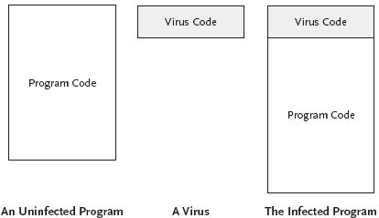
Viruses (cont)

Slide 91
Defending Against Computer Viruses
Virus scanning programs check files for signatures of known viruses
  Signature = some unique fragment of code from the virus that appears in every infected file
Problems:
  Polymorphic viruses that change their appearance each time they infect a new file
    No easily recognizable pattern common to all instances of the virus
  New viruses (and modified old viruses) appear regularly
    Database of viral signatures must be updated very frequently

Slide 92
Macro Viruses
More than just programs can serve as hosts for viruses
Examples: spreadsheet and word processor programs
  Usually include a macro feature that allows a user to specify a series of commands to be executed
  Macros provide enough functionality for a hacker to write a macro virus:
    Executed every time an infected document is opened
    Has an infection propagation mechanism
    May have a manipulation routine
  Example: Microsoft Word:
    AutoOpen macro – run automatically whenever the document containing it is opened
    AutoClose macro – run automatically whenever the document containing it is closed

Slide 93
The Melissa Macro Virus
Appeared in March, 1999
Exploited Microsoft Word macros
Spread by e-mail:
  Victim received an e-mail message with the subject line “Important Message From NAME”
  Infected Word document as an attachment:
  When an infected document was opened:
    Virus attempted to infect other documents
    E-mailed a copy of an infected document to up to fifty other people
      E-mail addresses of the new victims were taken from a user’s Outlook address book
      Value to use for NAME in the subject line was read from the Outlook settings

Slide 94
Melissa’s Impact
In three days, infected more than 100,000 computers
Some sites received tens of thousands of e-mail messages in less than an hour
  Mail server crashes
  System performance degradation
Besides spreading the virus:
  Modified the settings in Microsoft Word to conceal its presence
  Occasionally modified the contents of the documents that it infected
  Occasionally sent sensitive documents without the owner's knowledge

Slide 95
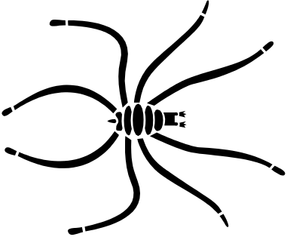




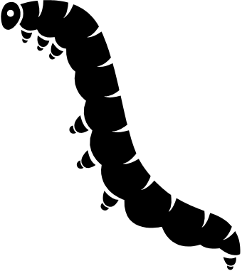

Virus Characteristics
Hard to detect
Not easily destroyed or deactivated
Spreads infection widely
Reinfect programs
Easy to create
Machine and OS independent

Slide 96
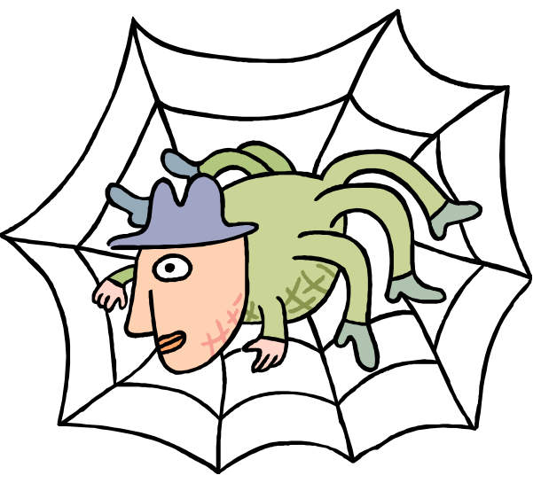
How Viruses Work
Attach
    Append to program, e-mail
        Executes with program
    Surrounds program
        Executes before and after program
        Erases its tracks
    Integrates or replaces program code
Gain control
    Virus replaces target
Reside
    In boot sector
    Memory
    Application program
    Libraries

Slide 97
How Viruses Work (Cont’d.)
Detection
    Virus signatures
    Storage patterns
    Execution patterns
    Transmission patterns
Prevention
    Don’t share executables
    Use commercial software from reliable sources
    Test new software on isolated computers
    Open only safe attachments
    Keep recoverable system image in safe place
    Backup executable system file copies
    Use virus detectors
    Update virus detectors often

Slide 98
Virus Cause /Effect Analysis
Virus Effect | How it is caused
Attach to executable | Modify file directory Write to executable program file
Attach to data/control file | Modify directory Rewrite data Append to data Append data to self
Remain in memory | Intercept interrupt by modifying interrupt handler address table Load self in non-transient memory area
Infect disks | Intercept interrupt Intercept OS call (to format disk, for example) Modify system file Modify ordinary executable program
Conceal self | Intercept system calls that would reveal self and falsify results Classify self as “hidden” file
Spread self | Infect boot sector Infect systems program Infect ordinary program Infect data ordinary program reads to control its executable
Prevent deactivation | Activate before deactivating program and block deactivation Store copy to reinfect after deactivation

Slide 99


7 Truths about Viruses
Viruses can infect any platform
Viruses can modify “hidden” / “read only files
Viruses can appear anywhere in system
Viruses spread anywhere sharing occurs
Viruses cannot remain in memory
Viruses infect software that runs hardware
Viruses can be benevolent, malevolent and benign
Source: Pfleeger & Pfleeger

Slide 100
Worms
Virus = a program fragment
Worm = a stand-alone program that can replicate itself and spread
Worms can also contain manipulation routines to perform other actions:
  Modifying or deleting files
  Using system resources
  Collecting information
  Etc.

Slide 101
The Morris Worm
Appeared in November, 1988
Created by a Computer Science graduate student at Cornell
His father was involved in computer security as a consultant to several major clients
Brought down thousands of the ~60,000 computers then attached to the Internet
  Academic, governmental, and corporate
  Suns or VAXes running BSD UNIX were attacked
  As discussed last time, he made an error in coding which exposed the worm

Slide 102
Operation of the Morris Worm
Used four different attack strategies to try to run a piece of code called the grappling hook on a target system
When run, the grappling hook:
  Made a network connection back to the infected system from which it had originated
  Transferred a copy of the worm code from the infected system to the target system
  Started the worm running on the newly infected system

Slide 103
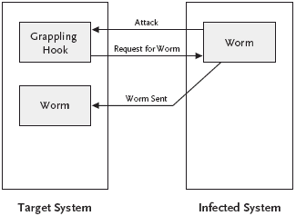
The Morris Worm’s Grappling Hook

Slide 104
Attack Strategy #1: Exploiting sendmail
Many versions of sendmail had a debug option
  Allowed an e-mail message to specify a program as its recipient
Then the named program ran with the body of the message as input
The worm created an e-mail message:
  Contained the grappling hook code
  Invoked a command to strip off the mail headers
  Passed the result to a command interpreter

Slide 105
Attack Strategy #2: Exploiting the finger daemon
daemon: Abbreviation for disk and execution monitor. A procedure that is invoked without being called explicitly whenever an alteration, an addition, or a deletion or other event occurs. Pronounced dee' mun.
The finger daemon, fingerd, is a remote user information server that shows
  Which users currently logged onto the system
  How long each has been logged on
  The terminal from which they are logged on
  Etc.
A buffer overflow bug in fingerd on VAXes allowed the worm to execute the grappling hook code

Slide 106
Buffer Overflows – what are they
A program’s stack segment must be understood to see how they work. The stack segment is
  Temporary working space for the program
  Organized as last in, first out – just like cafeteria trays
  Example: See how function calls are handled
    int foo(int P1, int P2) /* subroutine “foo” */
    { int L1, L2; /* local variables L1 and L2 */
    L1 = P1 + P2;
    return(L1); /* return value */
    }
    int main() /* main program */
    { …
    x = foo(1,2); /* call to subroutine “foo” */
    …
    }

Slide 107
Stack Frames
foo
Stack frames
main
Stack

Slide 108
Stack Frames (cont)
A stack frame contains the corresponding routine’s:
  Parameters
  Return address (i.e. next instruction to execute upon completion)
  Saved registers
  Local variables
Many architectures have registers that hold:
  SP, the stack pointer, points to the top of the stack
  BP, the base pointer, points to a fixed location within the frame
    Used to reference the procedure’s parameters and local variables

Slide 109
Stack Frames (cont)
The main routine calls foo:
  foo’s parameters are first pushed onto the stack
  The address of the next instruction in main to execute after foo finishes, the return address, is pushed
  Control is transferred to foo
  foo’s prologue:
    Saves caller’s (main’s) base pointer
    Sets callee’s (foo’s) bp equal to the current sp
    Increments sp to reserve space on the stack for foo’s local variables

Slide 110
Stack Frames (cont)
foo’s stack frame at the after the completion of the prologue:
SP
L2
L1
BP
main’s bp
return address
P2
P1
stack

Slide 111
Stack Frames (cont)
When executing foo:
  P1 = BP - 4
  P2 = BP - 3
  L1 = BP
  L2 = BP + 1
The statement “L1 = P1 + P2” would performed by the following assembly language instruction:
  add BP-4, BP-3, BP // adds first two arguments //and stores the result in the third

Slide 112
Stack Frames (cont)
foo’s epilogue cleans up the stack and returns control to the caller:
  Caller’s (main’s) bp is placed back into the bp register
  The return address is placed into the ip (instruction pointer) register
  The stack pointer is decremented to remove the callee’s frame from the stack
main
Stack frame
Stack

Slide 113
A Buffer Overflow Attack
int foo(char *s) /* subroutine “foo” */
{
char buffer[10]; /* local variable*/
strcpy(buffer,s);
}
int main() /* main program */
{
char name[]=”ABCDEFGHIJKL”; //note-12 chars
foo(name); /* call to subroutine “foo” */
}

Slide 114
A Buffer Overflow (cont)
foo’s stack frame after prologue:
SP
buffer[0]
buffer[1]
buffer[2]
buffer[3]
buffer[4]
buffer[5]
buffer[6]
buffer[7]
buffer[8]
buffer[9]
BP
main’s bp
return address
s
stack

Slide 115
A Buffer Overflow (cont)
Stack after execution of foo (but before the epilogue):
SP
A
B
C
D
E
F
G
H
I
J
BP
K
L
s
stack

Slide 116
A Buffer Overflow (cont)
The string overflowed foo’s buffer:
  Overwrote main’s bp
  Overwrote the return address with ‘L’ = 89 (ASCII) – remember letters are numbers internally
When foo finishes control will be transferred to the instruction at address 89
  An error that may not be caught!
The Morris worm sent a specially crafted 243-byte string to the finger daemon:
  Overflowed a buffer and overwrote the return address
  The fingerd executed the /bin/sh program which executed the grappling hook code

Slide 117
Attack Strategy #3: Exploiting rsh
rsh = “remote shell”
  Allows users to execute commands on a remote host from a machine that the remote host trusts
    /etc/hosts.equiv
    .rhosts
The worm used rsh to run the grappling hook code on remote computers that trusted an infected machine

Slide 118
Attack Strategy #4: Exploiting rexec
rexec = remote execution
  Protocol that enables users to execute commands remotely
    Must specify:
      A host
      A valid username and password for that host
The worm attempted to crack passwords on each computer that it infected so that it could use rexec to infect other hosts
  No password
  The username
  The username appended to itself
  The user’s last name or nickname
  The user’s last name reversed
  Dictionary attack using 432-word dictionary carried with the worm
  Dictionary attack using ~25,000 words in /etc/dict/words

Slide 119
The Cracking Code
To some extent, that was the most clever part of the worm.
The code that was crafted was, for that day and age, extremely well done.
Now cracker programs are quite common and many are based on the ideas used in this attack.

Slide 120
Operation of the Worm
Performed many actions to try to camouflage its activity:
  Changed its process name to sh
  Erased its argument list after processing it
  Deleted its executable from the filesystem once it was running
  Used various steps to make sure that a core file would not be generated
  Spent most of the time sleeping so its activity wouldn’t be detected
  Forked every three minutes, parent process exited and the child continued
    Changed the worm’s process identification number (pid) often
    This prevented the worm from accumulating too much CPU time and being noticed as a hog

Slide 121
  All constant strings inside the worm were XORed character-by-character with the value 81₁₆ – prevented readable code from being stored in memory where it could be run.
  Used a simple challenge and response mechanism to determine whether or not a machine it had just infected was already running a copy of the worm
    It was here where some coding errors by Morris were is downfall as copies of the worm ran on already infected hosts and drug the systems down until the activity was noticed.

Slide 122
Aftermath
The worm spread quickly and infected a large percentage of the computers connected to the Internet
Noticed within hours
Took days for researchers to discover how the worm worked and how to stop it
In 1990, Morris was convicted by a federal court of violating the Computer Crime and Abuse Act of 1986:
  Three years of probation
  Four hundred hours of community service
  $10,050 fine

Slide 123
Summary
Program security requires that the programs that run on a computer system be:
  Written correctly
  Installed and configured properly
  Used in the manner in which they were intended
  Do not behave maliciously
    Trojan horses - a program that has two purposes: one obvious and benign, the other hidden and malicious
    Viruses - a fragment of code created to spread copies of itself to other programs
    Worms - a stand-alone program that can replicate itself and spread

