Slide 1
ID Theft, Computer Security and the Human Factor
Tom Ryan, RU-Camden Law Harold Winshel, Camden Arts & Sciences

Slide 2
Agenda
Identity Theft
  What is identity theft?
  Why is it bad?
  How is it done?
  What can you do to prevent it?
Computer Security
  - Top 10 best practices
Social Engineering
  Actions & Reactions

Slide 3
Identity Theft
Prevention
Detection
Recovery

Slide 4
How prevalent is it?
10 Million Americans in 2003 (up 41 %)
  http://www.ftc.gov/os/2003/12/031215idthefttestimony.pdf
Costs $53 Billion
http://www.ftc.gov/os/2003/12/031215idthefttestimony.pdf
Un-reported costs…
Notes:
Most people don't realize how widespread identity theft has become, nor how personally vulnerable they are. 10 million Americans were victimized last year — 41 percent more than the year before — at a cost to the U.S. economy of $53 billion. ($5 Billion to consumers directly)
1 person in every 30 in a single year
Even the dead are not immune.
Un reported costs are your “not covered” expenses and the 30, 60 or 175 hours it will take to get cleared…
CIO magazine claims $221 Billion Worldwide in 2003 (5/03)

Slide 5
How does it happen?
Most ID theft is done through very low-tech means.
With a name, address and a credit card number, and the 3 digit card identifier, most telephone businesses will ship to any address.
Very few cross checks
Notes:
It does not take much of your personal information for someone to impersonate you.
Think of the last time you were asked to prove who you were.
In today's world the mere position of a string of 9 digits (SSN) is proof of ownership.
Credit card info (16 digits) are at least “check-summed” and most often require an expiration date and now sometimes another 3 digit code.
Steal your wallet or purse
Steal your mail
Go thru your trash
Burglarize your home
Find info on the internet
Scam you into giving out the into (social engineering) by phone, mail, email, web site, etc.
Steal a file from work or bribe a fellow employee
Hack into a computer
Get your credit report
Shoulder surfing
Pre Approved Credit cards
Checks on existing accounts

Slide 6
Why is ID Theft Done?
$$$ For financial gain. $$$

Slide 7
Detection
You start getting collection calls/mail
You are denied credit
You stop getting mail
You start getting new bills for accounts you do not have or services you did not authorize.
Your bank account balance drops.
Notes:
In NJ you can get a yearly credit report for free from each of the 3 credit bureaus.
URL’s and phone numbers are at the end of this presentation.
Check your credit rating
Check your credit card statements
Check your bank statements

Slide 8
What you can do to prevent it?
Account Information
ATM, Credit, and Debit Cards
Bills, Bank Statements, and Other Records
Calling Cards
Checks
Credit Reports
Mail
Trash
Notes:
Account Information
Don’t give your credit or debit card numbers unless you’re making a purchase with that account. If someone contacts you claiming to be from a business that already has your account number but is requesting it again, be suspicious. Contact the company directly to ask why it is needed. If you are considering doing business with an unfamiliar company, check the complaint records with your state and local consumer protection agency and the Better Business Bureau.
ATM, Credit, and Debit Cards
Don’t leave them lying around your home or office. Carry only those that you plan to use. If there are accounts you don’t use anymore, close them and cut the cards up. Debit cards that require PIN numbers are safer than those that can also be used with a signature. Memorize your PIN numbers – don’t write them down where someone may find them. Carry your cards in a separate holder from your wallet so you won’t lose them if your wallet is lost or stolen. Don’t lend to them to people; even your friends or relatives may not be as responsible as you think. Write “See ID” or “Always check ID” on the back of cards. Do not use debit cards (or cards attached to your checking account) for anything except debit, there is no reimbursement for a drained checking account.
Bills, Bank Statements, and Other Records
Don’t leave bills, statements, and other personal records around in plain site. Keep important documents in a locked file cabinet. Shred information you don’t need to keep. Do not put the entire account number on checks when paying bills, the last 4 digits will suffice.
Calling Cards
Calling cards that require a PIN number offer an extra measure of protection. When you’re using them at a payphone, block the keypad so that no one else can see the numbers that you are dialing. If you’re giving the numbers to an operator, speak softly so others nearby won’t hear.
Checks
Have them printed with your first initial, not your name. Do not put your social security number or drivers lincense number on them. Consider putting your work phone number, if any phone number. Consider a P.O. Box or work address.
Credit Reports
Check your credit reports once a year to make sure there are no accounts on it that you never opened. Some states require credit bureaus to provide consumers with one free report annually; otherwise, there will be a small fee. Follow the instructions for disputing accounts you don’t recognize or other problems you may spot.
Mail
Remove incoming mail from your mailbox promptly. Send bill payments from the post office or public mailbox, not from home. If you are going to be away, ask the post office to hold your mail. Of course, it is usuall better to have someone else pick up your mail. Otherwise, a thief working at or having a contact in the Post Office, would know that you are out of town.
Trash
Do not place your trash at the curbside the night before, instead place it out the day of trash pickup AND always use a shredder (crosscut) to shred all confidential and other sensitive material.

Slide 9
Good practices
Photocopy the contents of wallet/purse
Photocopy your passport (keep a copy at home and one with you)
Empty your wallet/purse of non-essential identifiers, especially your Social Security Card.
Do not use any information provided by the people trying to scam you… Look it up yourself.
Use a paper crosscut shredder.
When on vacation, don’t stop your newspaper.
Notes:
Go back to your office and photocopy your wallet/purse at the end of this presentation if it’s possible.
Do you really need to carry your Dental insurance card all the time?
Do not use a clickable web site in an e-mail
Do not use a 800 number provided in a phone message
Instead use information off a statement or call information for a phone number.

Slide 10
Recovery
File a report with the credit provider
File a police report
Notify the Credit bureaus
Notify the FTC

Slide 11
What you can do if you become a victim?
Contact the fraud departments of any one of the three major credit bureaus to place a fraud alert on your credit file.
Ask for new account numbers for accounts that you know or believe have been tampered with or used fraudulently.
Close Accounts that have been opened fraudulently.
File a police report. Get a copy of the report to submit to your creditors
File your complaint with the FTC.
Notes:
Contact the fraud departments of any one of the three major credit bureaus to place a fraud alert on your credit file. The fraud alert requests creditors to contact you before opening any new accounts or making any changes to your existing accounts. As soon as the credit bureau confirms your fraud alert, the other two credit bureaus will be automatically notified to place fraud alerts, and all three credit reports will be sent to you free of charge.
Close the accounts that you know or believe have been tampered with or opened fraudulently. Use the ID Theft Affidavit when disputing new unauthorized accounts. Actually, closing established accounts might hurt your credit even more. Existing accounts that you know or believe have been tampered with or used fraudulently, you should request new account numbers. For accounts that were opened fraudulently, you should close them immediately.
File a police report. Get a copy of the report to submit to your creditors and others that may require proof of the crime.
File your complaint with the FTC. The FTC maintains a database of identity theft cases used by law enforcement agencies for investigations. Filing a complaint also helps us learn more about identity theft and the problems victims are having so that we can better assist you.

Slide 12
What will the future bring ?
The trend is that it is getting worse
Continue with awareness and education
Review policies and procedures
Improve the security web site
Seek input from our user community
Security is everybody’s business
Notes:
YES, Security is everybody’s business.
It’s not possible to have “absolute” security
Security tools are not going to completely protect you
There will be security problems and if you’re not involved, you are fortunate

Slide 13
Your computer and ID Theft
What you can do to
Protect your confidential information
Prepare for an incident (just in case)
Prevent identity theft

Slide 14
Your computer and ID theft
Protect yourself
  When ordering online, make sure the site is secure (https://)
Protect others
  Have your antivirus software keeping you up to date
  Set your system to auto update patches
Notes:
There is lots of information out there about prevention.
Not all of it is great.
Expecting your bank to know how you sign your checks, and not approve of an incorrectly signed one, is not a good idea.

Slide 15
Good Computing Practices
Encryption (SSL, the lock, SHTTP or HTTPS)
Firewall
Anti-Adware/Anti-Trojan
Wireless
P2P file sharing
Separate passwords
Password “Safe” software
E-mail is not secure
Disconnect from the internet when not in use
Check our security and smoke alarm batteries at the bi-annual time changes (April & November)
Do not use phone numbers or web links provided by others
Notes:
Here are more steps YOU can take to increase your personal computer security, especially your internet usage.
Use caution when downloading files
Practice good physical security

Slide 16
Good computing practices
Use automatic updating anti-virus software (Rutgers Antivirus Delivery Service - RADS)
Exercise caution when opening email attachments
Select hard to guess passwords and keeping them private
Back up important files
Download and install operating system update patches
Become aware of the risks in file sharing (turn off or password protect)
Use a password protected screen saver
Lock up your computer when not in use
Know how to report a computer abuse incident
Protect your computer by using a firewall
Notes:
Here are 10 basic steps YOU can take to make a difference in your personal computer security
Security is like an onion, many layers.
Security is not a goal or destination but a never ending journey.
Security is never finished.

Slide 17
Phishing / Spoofing
Sending an email to a user falsely claiming to be an established legitimate enterprise in an effort to scam the user into surrendering private information that will be used for identity theft (www.webopedia.com)
Phishing – bait.
Spoof – fake the appearance of a popular web site
Notes:
Paypal
Ebay
Citibank
Extremely long URL’s are suspicious
https://userspamq.crbard.com:443/euser/view.jsp?db1dc0d2ceab48dd3c3e6a29e1124aba5923b3b900000000000000589393
An attempt to get users to connect to a different website than it first appears.
Note the " https://userspamq.crbard.com:443/"...
The ":" causes a redirect.
Certificates can be issued to almost any warm body who has the money.
There are even instances where a Microsoft cert was issued to a non-Microsoft person.

Slide 18
Phishing E-mail
From: Fleet bank [mailto:user-billing06@fleet.com]
Sent: Tuesday, February 10, 2004 6:31 PM
To: abuse@rutgers.edu
Subject: To aII Fleet bank users

Slide 19
Damages to you
Time
Money
Credit rating
Reputation
Notes:
On average, a victim of identity theft spends 175 hours notifying credit bureaus, canceling credit cards and negotiating with creditors. While some creditors will not hold customers responsible for fraudulent charges, victims must still pay for legal fees, long-distance phone calls, travel costs and missed work days related to correcting any damage to their credit.

Slide 20
Damages to Rutgers…
Reputation
Violation of federal and state laws.
Fines
Reparations costs
Recovery costs
Increased prevention costs
Georgia Tech release of credit cards to the internet cost them over $1,000,000.
Notes:
Example:
The trouble started when a lab worker at Ligand Pharmaceuticals in San Diego came across a box in a storage closet. Inside, she found the personnel records of 38 former employees of Glycomed, a company Ligand had acquired in 1995. With the information from those files — names, addresses, Social Security numbers, birthdates, and other data — the lab worker and her acquaintances fraudulently rented three apartments, opened 20 cellular telephone accounts, and set up more than 25 credit card accounts, which they used to purchase $100,000 in goods.
The Ligand lab worker was eventually caught, convicted, and sentenced — but not soon enough for 14 of the 38 victims, who sued Ligand for negligence. They claimed the crime would never have happened had the company taken better care of their personnel records. Ligand settled out of court; although attorneys declined to discuss the settlement, news reports said the company paid out a "significant six-figure amount."

Slide 21
Links and Resources
http://www.consumer.gov/idtheft/index.html
http://www.usps.com/postalinspectors/idthft_ncpw.htm
http://www.ed.gov/about/offices/list/oig/misused/index.html
http://www.ssa.gov/pubs/10064.html
  1-800-269-0271
  http://rusecure.rutgers.edu/sec_aware/phish.php#identity
Notes:
These are some of the official federal government sites.
The first one is the FTC’s site, the main owner of the problem.

Slide 22
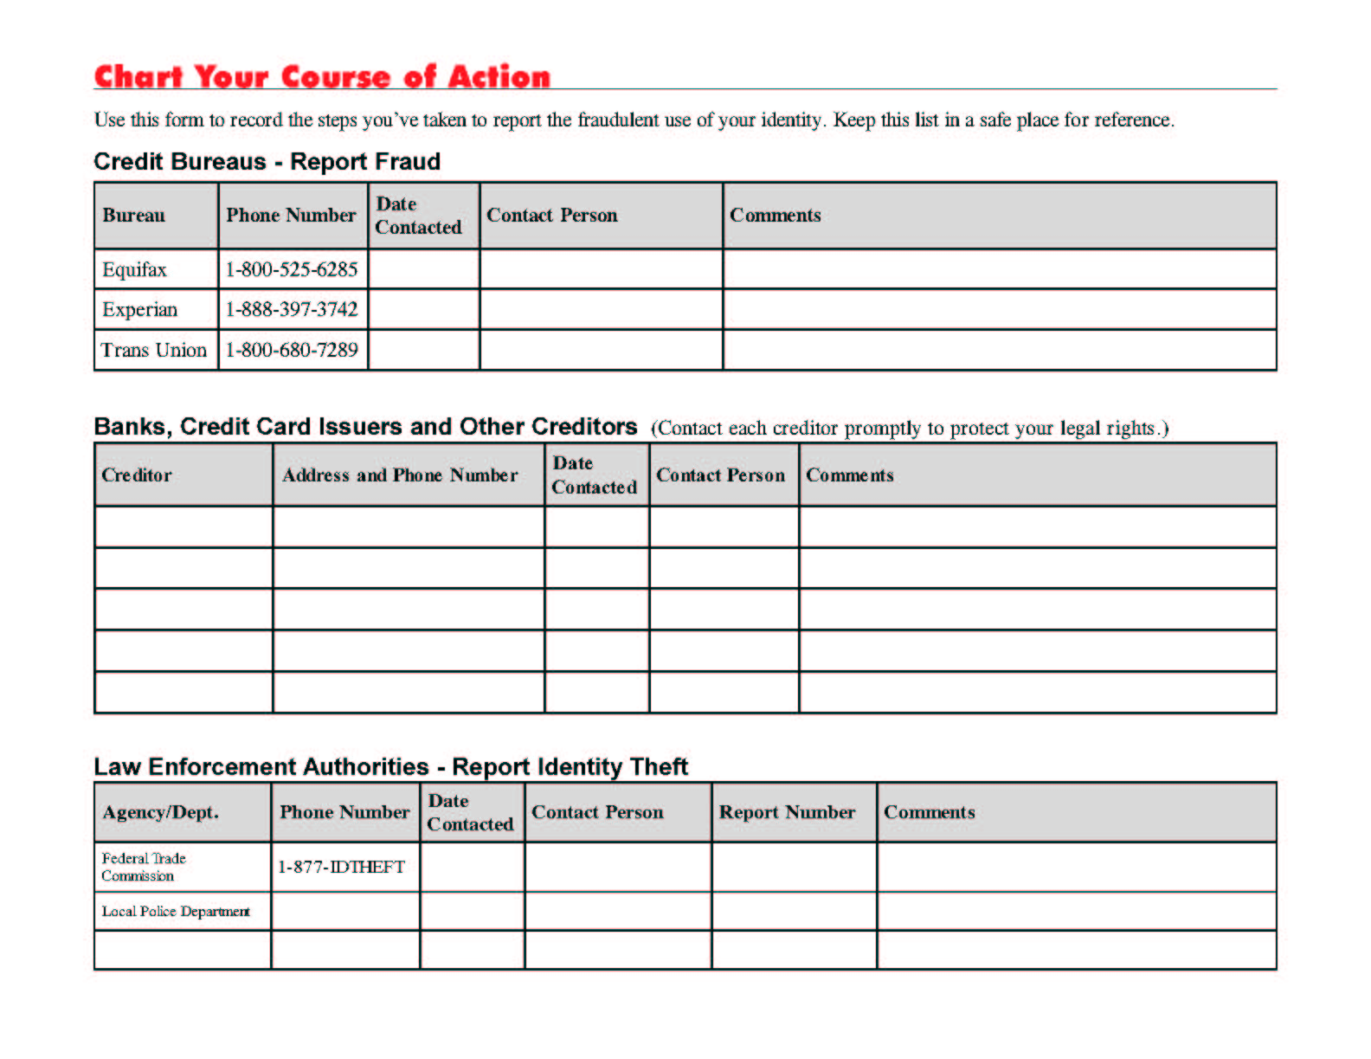
ID Theft Action form
Notes:
Here is a easy to use form…

Slide 23
Services available at Rutgers University for Faculty, Staff and Students
Help Desk for computer problems
Identity Theft 911
  http://adminaffairs.rutgers.edu/IdentityTheft911.shtml
Computer abuse
Notes:
Note your campus phone and URL
ID Theft 911 is a new RU program that began 9/1/05. Check-out the URL http://adminaffairs.rutgers.edu/IdentityTheft911.shtml
Abuse@rutgers.edu handles abuse emanating from within RU though all abuse can be reported. Anything life threatening should be reported to authorities (police).

