Slide 1
Computer User
Security Responsibilities for Computer Systems & Electronic Data
End-User Tutorial
Revised November 2006
Derived from UC Berkeley’s Online Tutorial
Graphics: permissions pending.
Notes:
Revised 11/3/2005 - JM

Slide 2
  This short tutorial will:
  Discuss the important role you play in maintaining the security of computer systems and electronic information
  Review current computer security threats
  Discuss the security risks to your desktop computer or laptop
  Provide some guidelines for avoiding unnecessary computer security risks
  Suggest some practical and easy solutions

Slide 3
Information security is a part of all our jobs. Each member of the campus community is responsible for the security and protection of electronic information resources over which he or she has control
Information technology security is everyone’s problem.
Information technology security requires the active cooperation of people and technology

Slide 4
User Responsibilities
Be familiar with university information security policies and practices
Protect your computer system and electronic data from unauthorized use, malicious programs and theft
Report to your supervisor any security policy violations, security flaws/weaknesses you discover or any suspicious activity by unauthorized individuals in your work area

Slide 5
Responsibility Reinforcement
Workforce members who violate university policies and/or state or federal laws regarding information privacy are subject to corrective and disciplinary actions according to existing policies and collective bargaining agreements and/or civil lawsuit or criminal prosecution

Slide 6

The Internet can be hazardous place:
Unless operating systems, security software and network aware applications are properly maintained, most computers are vulnerable to corruption and unauthorized use
How many computers on campus do you think are attacked on a daily basis?

Slide 7
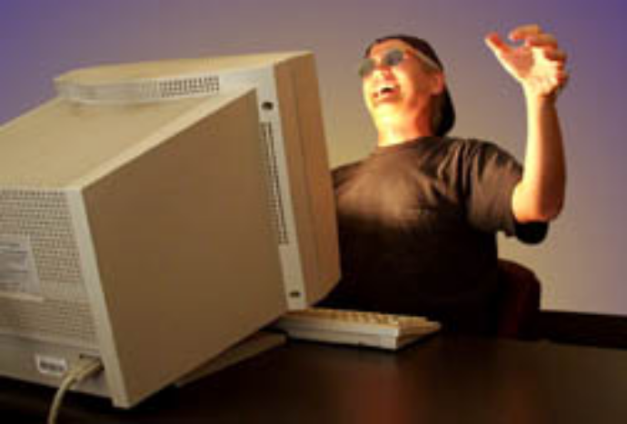
  The UC Davis computing network is aggressively attacked on a daily basis. All devices connected to the campus network must be secured to help prevent a successful computer compromise.
  Thousands of attacks per second bombard our campus network. An unprotected computer can become infected or compromised within a few seconds after it is connected to the campus network
  Attackers may be seeking data with personal identifiers and/or remotely using a compromised computer to attack other computers or for storage of unlicensed commercial software
“I just keep finding new ways to break in!”

Slide 8

A compromised computer is a hazard to everyone else, too – not just to you.

Slide 9
Possible Consequences
Risk to patient/research subject information, loss of information
Risk to personal information, identity theft
Loss of valuable university information & your time!
Loss of confidentiality, integrity & availability of data
Embarrassment, bad publicity / media news
Loss of public trust
Costly reporting requirements specified under 1798 California Civil Code
Lawsuit from angry record owner
Internal disciplinary action(s), termination of employment
Regulatory penalties, prosecution

Slide 10
What can you do to improve the security of your computer?
Use software products that are currently maintained by their publisher and keep the software products updated with critical* security patches.
Use anti-virus and anti-spyware tools and check to see that these tools are regularly updated
Do not share your computing accounts. You do not want to be accountable for the actions of unauthorized users
Use secure passwords that cannot be easily guessed and do not share your password
* Critical security update: An operating system or application update that corrects a vulnerability that could allow an unauthorized party to control the computer, permit the spread of a malicious program over the Internet, prevent the availability of computer resources or permit an unauthorized escalation or reduction of user permissions.

Slide 11
What else can you do to protect your computer?
Reduce your computer’s risk to attack and compromise by verifying with your campus unit technical staff:
  Have unneeded and insecure network programs been disabled or removed from my computer?
  Has the operating system firewall within my computer been enabled to restrict network traffic that is permitted to enter or leave the computer?

Slide 12
What else can you do to protect your computer?
Remove unneeded electronic information with personal identifiers (Examples of personal data include name with Social Security numbers, ethnicity, date of birth, and financial information such as credit card number or bank account number)
Keep sensitive information on removable media and insert it into the computer only when necessary
Ensure critical data files are backed up and the backups are securely stored in another location
Where possible, physically secure your computer by using security cables and locking building/office doors and windows

Slide 13
What can you do to protect your computer against EMAIL threats?
Use caution before opening email attachments as the attachments may be infected with a computer virus
Do not send personal information in an email message
    Email is like a postcard and the content can be intercepted and inspected without great difficulty
Don’t open email attachments or clickable website addresses unless you REALLY know what you’re opening.
Beware of fake “security warning” messages; use known and trusted web addresses to go to software and security sites.

Slide 14
  Have you seen these email tricks?
  You receive an email that seems funny, cute, scary, or pretends to provide very useful information, or contains a desirable image
  But it turns out that the sender is only trying to trick you into giving personal information, send you to a website to buy something and/or infect your computer with a virus
  Malicious people will try to get you to open harmful email
Delete suspect email. Resist the urge to use the campus email system to forward clever, funny or sad messages or non-work related image attachments to your friends.

Slide 15
  Some sure signs of fraudulent email:
  It asks you for personal or financial account information
  It asks you for a password
  It asks you to forward it to lots of other people
  If you are in doubt of the email authenticity, telephone the sender and confirm the message content
Don’t use a “Microsoft software security update” link in unsolicited email-- go to the Microsoft security web page directly on your own. The unsolicited email message may be harmful.

Slide 16
Important UC Davis Security Policies
Electronic Communications Policy (PPM310-023 and PPM310-024)
  Defines acceptable use and privacy policies
Campus Vulnerability Scanning (PPM310-021)
  States that electronic devices connected to the campus network will be free of critical security vulnerabilities
UC Davis Cyber-safety Program Policy (PPM310-022)
  Defines 16 security standards for electronic devices connected to the campus network
  Defines compliance reporting requirements

Slide 17
UC Davis Cyber-safety Policy
There is a high probability that insecure computers will be successfully compromised if they are connected to the network.
The campus has issued 16 security standards for computers (and other types of devices) that are connected to the network.
Each dean, vice provost and vice chancellor must submit an annual report to the Office of the Chancellor and Provost discussing compliance status and, if necessary, plans to address gaps where the security standards are not currently being met.
Reports are subject to review by Internal Audit Services
Reference: http://manuals.ucdavis.edu/ppm/310/310-22a.htm

Slide 18
Topics covered by the Cyber-safety Program Security Standards for Networked Devices:
  Application of software patch updates
  Application of anti-virus software updates
  Disable unneeded network services
  Protect personal information
  Deploy VLAN and host-based firewalls with restrictive rulesets
  Authentication
  Implement physical security
  Remove email relays
  Remove/control open proxy services
  Employ backup and recovery strategies
  Define audit log requirements
  Identify training for end-users, managers and technical staff
  Deploy anti-spyware utilities
  Securely remove personal data from portable storage devices
  Develop and maintain incident response plans
  Deploy Web application security measures
Highest priority standards are in “red”

Slide 19
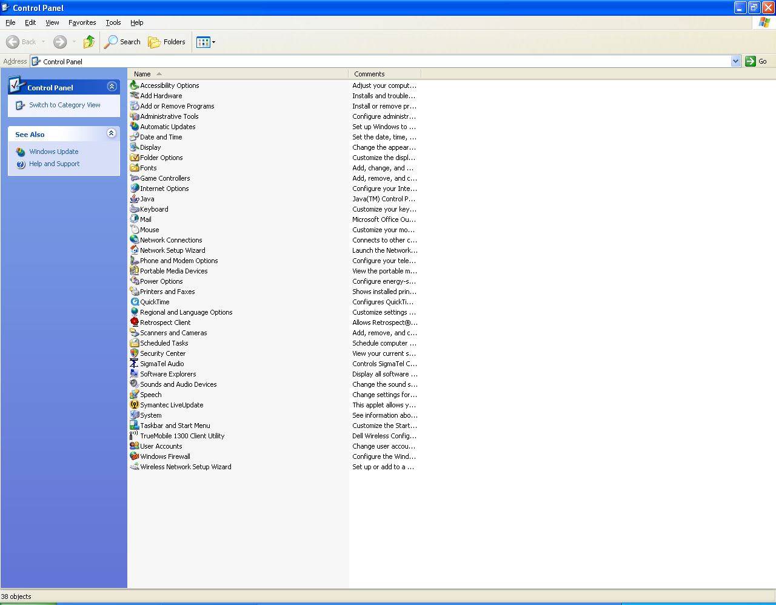
How Do I Check the Security Status on Windows XP?
Run Windows
“control panel”
and mouse-click
on “security center.”

Slide 20
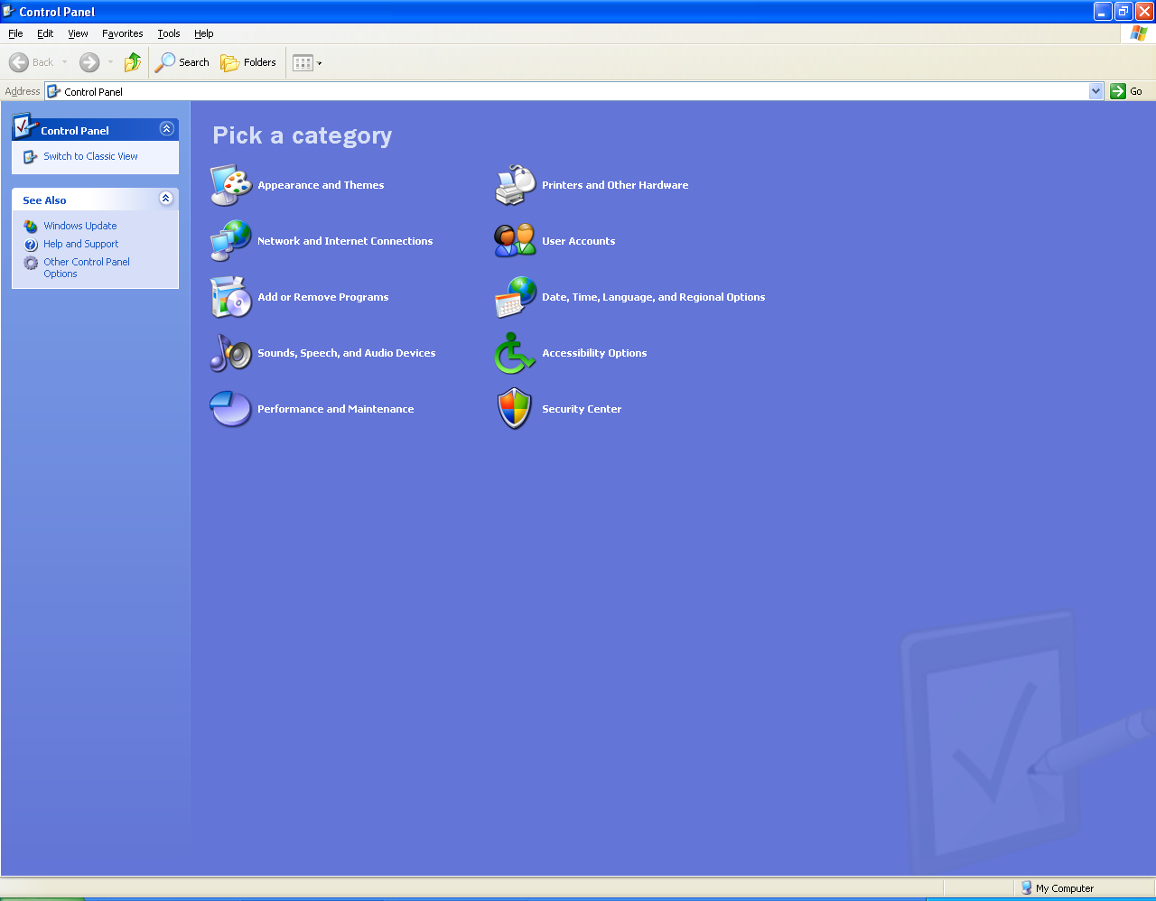
How Do I Check the Security Status on Windows XP?
If the control panel
screen looks like this,
mouse-click on the
“security center” icon.

Slide 21
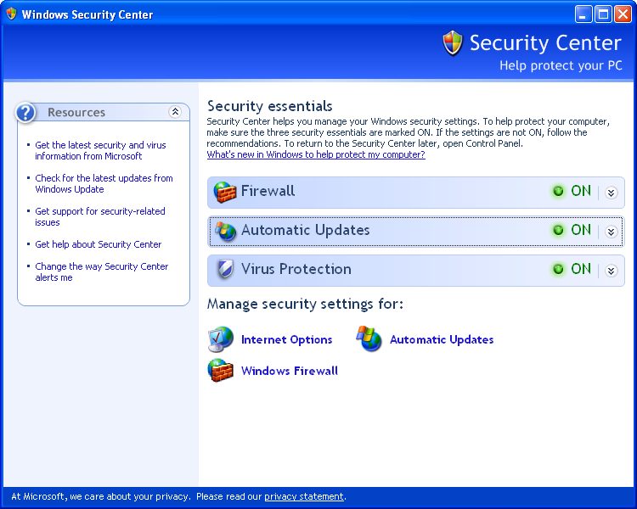
How Do I Check the Security Status on Windows XP?
Verify that these
three status
icons are “green.”
If not, report condition to your campus unit technical support representative.

Slide 22
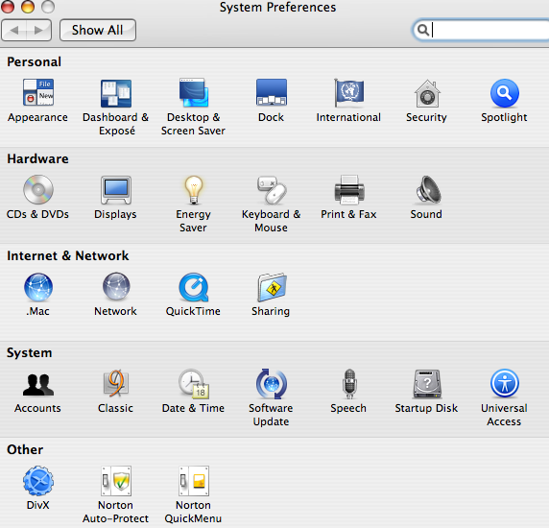
How Do I Check that Software Updates Are Being Applied to Mac OSX?
Mouse-click on
“software update”
under “system
preferences”
to verify software is
being updated.

Slide 23
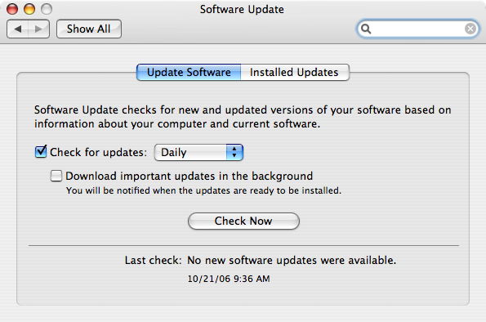
How Do I Check that Software Updates Are being Applied to Mac OSX?
If the date is more than a week old, mouse-click on “Check Now” and install updates or consult with your technical campus unit representative.

Slide 24
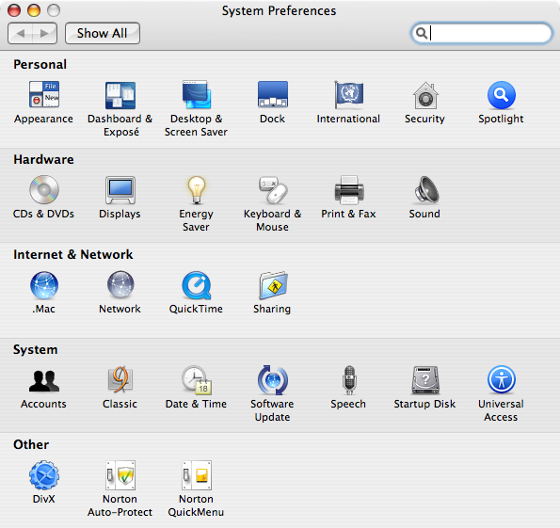
How Do I Check the Anti-Virus Status on Mac OSX?
If using
Norton Anti-Virus, mouse-click on the “Auto-Protect” icon

Slide 25
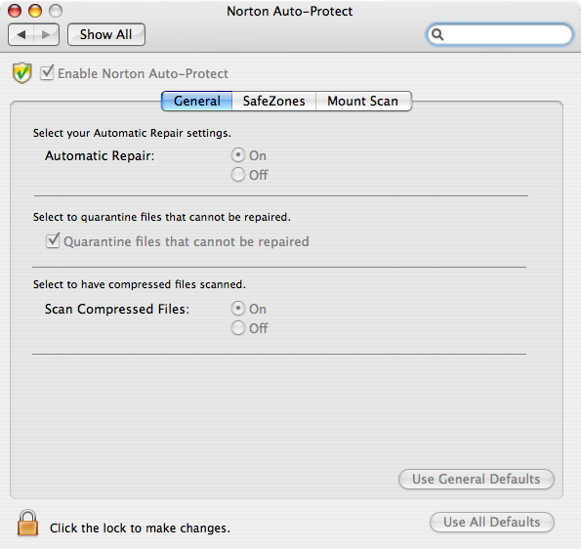
How Do I Check the Anti-Virus Status on Mac OSX?
If using Norton
Anti-Virus,verify
that “Auto-Protect”
is enabled. This
function ensures
files are virus scanned
as they are accessed.

Slide 26
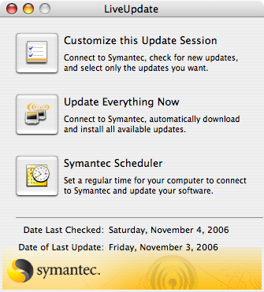
How Do I Check the Anti-Virus Status on Mac OSX?
If using Norton Anti-Virus,
verify that anti-virus
update has completed within
the past week. If not,
mouse-click on
“Update Everything Now” or consult with your campus unit
technical representative for assistance.

Slide 27
How Do I Check the Status of the Host-based OSX Firewall?
Mouse-click on the “sharing” icon

Slide 28
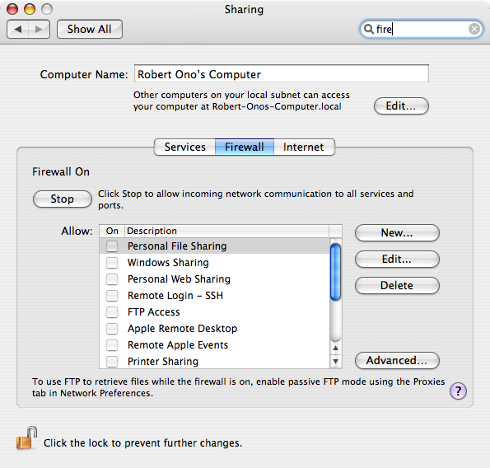
How Do I Check the Status of the Host-based OSX Firewall?
Mouse-click on these three selections to verify that no unauthorized services/ports
are enabled. Consult your campus unit technical staff for assistance.

Slide 29
Are you aware of where to find campus security information, tools and resources?
Refer to the campus security Web site (http://security.ucdavis.edu) to find:
  Campus Vulnerability Scanning Information
  Campus Security News Alerts
  Identity Theft Prevention Resources
  Spam Filtering Guidance
  Virus Protection Information
  Firewall Use Resources
  System Administration Resources (Access Restricted)

Slide 30
Review Questions

Slide 31
Question #1: Shared Authorizations
Your supervisor is very busy and asks you to log into the clinical information system using her login account-ID and password to retrieve some patient reports. What should you do?
A. It’s your boss, so it’s okay to do this.
B. Ignore the request and hope she forgets.
C. Decline the request and refer to the UC information security policies.
Answer: C. User IDs and passwords must not be shared. If accessing the information is part of your job duties, ask your supervisor to request a user access code for you.

Slide 32
Question #2: Shared Workstations
A co-worker is called away for a short errand and leaves an office computer logged onto the confidential information system. You need to look up information using the same computer. What should you do? <Select all that apply>
A. Log your co-worker off and re-log in under your own login account-ID and password.
B. To save time, just continue working under your co-worker’s login account-ID.
C. Wait for the co-worker to return before disconnecting him/her; or take a long break until the co-worker returns.
D. Find a different computer to use.
Answer: A or D. Never log in under someone else’s user login account. Remind the co-worker to log-off when leaving!

Slide 33
Question #3: Special Screensavers
Your sister sends you an e-mail at work with a screen saver attachment that she says you would love. What should you do?
<Select all that apply>
A. Download it onto your computer, since it’s from a trusted source.
B. Forward the message to other friends to share it.
C. Call IT Express and ask them to help install it for you.
D. Delete the message.
Answer: D. Never put unapproved programs or software on your work computer. Your UC Davis computer is for work use. Some email attachments may contain viruses.

Slide 34
Question #4: Computer Safeguards
Which workstation security safeguards are YOU responsible for using? <There may be more than 1 correct answer>
A. Selecting a good password and keeping it confidential
B. Screen locking your unattended computer
C. Avoiding the opening of suspicious email attachments
D. Physical security, such as locking the office or work area (doors, windows) and using anti-theft devices for computers
E. Reporting suspicious computer activity to your supervisor
E. All of the above
Answer: E – All responses are safeguards for end-users.

Slide 35
Question #5: Web Server Error
A list of student names and student identification numbers, including a few Social Security Numbers, was inadvertently posted to a publicly accessible Web page for several hours before discovery. What actions should immediately be taken? <Select all answers that apply>
A. You should contact your supervisor immediately following discovery.
B. The campus Information Security Coordinator should be contacted to investigate the incident and determine whether students should be notified of the risk of possible identity theft.
C. The information should be removed from the Web site and Web site administrators should be advised not make name and Social Security number and other sensitive personal identifiers publicly available.
D. The students for which Social Security numbers were displayed may need to be notified of the security breach according to state law.
Answer: A and B are the first two responses to be taken. The campus IT Security Coordinator will open an incident investigation and coordinate actions to reduce further disclosure, determine notification requirements and prepare official university notification of the security breach to the affected parties.

Slide 36
Question #6: Computer and Data Risks
Why should I care if my computer is hacked? <select all answers that apply>
A compromised computer could be used to hide programs that launch attacks on other computers.
A compromised computer could be generating large volumes of unwanted traffic.
Someone could be illegally distributing commercial software from my computer, without my realizing it.
Electronic information on my computer with personal identifiers may be at risk.
Answer: All of the above. A compromised computer can be used for many unauthorized activities.

Slide 37
Question #7: Security Policy Question
Which of the following policies states that software shall not be copied except as permitted by copyright law or software license agreement? <select all answers that apply>
UC Davis Cyber-safety Program Policy
UC Davis Electronic Communications Policy
UC Computer Vulnerability Scanning Policy
UC Telecommunications Policy
Answer: B - Copyright compliance is discussed within the Acceptable Use Policy exhibit of the UC Davis Electronic Communications Policy.

Slide 38
Question #8: Security Alerts
Where could you find an alert about a current significant security threat to campus computing systems? <select all answers that apply>
UC Davis Security Web Site (http://security.ucdavis.edu)
SANS Internet Storm Center
MyUCDavis via “UCD Resources” tab
IT Express Web Site
Answer: A and C - Descriptions of significant threats to UC Davis computing systems are posted to the campus security Web site. This site is also available via the MyUCDavis portal.

Slide 39
Question #9: Security Reporting
You suspect your work computer has been compromised and you have information about the source of the attack. Who should be informed about the incident? <select all answers that apply>
UC Davis abuse email (abuse@ucdavis.edu)
City of Davis law enforcement
UC Davis law enforcement
Your campus unit technical specialist and/or your MSO
Campus IT Security Coordinator (security@ucdavis.edu)
The suspected attacker
Answer: A, D and E – The incident should be reported to your campus unit management, UC Davis abuse and Campus IT Security Coordinator. Incidents are tracked and monitored. Abuse reports may trigger a broader campus security alert.

Slide 40

Additional References
(print and keep handy)
  UC Davis Security Web Site
  (http://security.ucdavis.edu/)
  Cyber-Safety Basics: Security for Everyone
  (http://security.ucdavis.edu/cybersafetybasics.cfm)
  UC Davis Cyber-safety Program
  (http://security.ucdavis.edu/cybersafety.cfm)
  Reporting a Security Incident
  (http://security.ucdavis.edu/report.cfm)
  Security Resources
  (http://security.ucdavis.edu/links.cfm)
  UC Davis Electronic Communications Policy – Acceptable Use and Privacy
  (http://manuals.ucdavis.edu/ppm/310/310-23.htm and
  http://manuals.ucdavis.edu/ppm/310/310-24.htm)
  UC Davis Computer Vulnerability Scanning Policy
  (http://manuals.ucdavis.edu/ppm/310/310-21.htm)
  UC Davis Cyber-Safety Policy
  (http://manuals.ucdavis.edu/ppm/310/310-22.htm)

Slide 41
Would you like to:
Start again?
Finish?

Slide 42

CERTIFICATE OF COMPLETION
This is to certify that
____________________
has completed the UC Davis
Online Computer Security Tutorial
Issued the _____ day of ___________ 2005
_________________
Supervisor's Signature

