Slide 1
FYI
> >>
> >> THIS IS VERY SERIOUS, PLEASE SEND TO EVERYONE ON
> >> YOUR E-MAIL LIST!!
> >>
> >>
> >>
> >>
> >>
> >> Anyone-using Internet mail such as Yahoo,
> >> Hotmail,
> >> AOL and so on.
> >>
> >> This information arrived this morning,
> >> Direct from both Microsoft and Norton
> >>
> >> Please send it to everybody you know who has
> >> access to the Internet.
> >>
> >> You may receive an apparently harmless e-mail
> >> titled 'Mail Server Report'
> >>
> >> If you open either file, a message will appear on
> >> your screen saying:
> >> 'It is too late now, your life is no longer
> >> beautiful.'
> >>

Slide 2
> >> Subsequently you will LOSE EVERYTHING IN YOUR PC,
> >> And the person who sent it to you will gain
> >> access to your
> >> name, e-mail and password.
> >>
> >> This is a new virus which started to circulate on
> >> Saturday afternoon.
> >> AOLhas already confirmed the severity, and the
> >> anti virus software's are not capable of destroying it.
> >>
> >> The virus has been created by a hacker who calls
> >> himself
> >> 'life owner'.
> >>
> >> PLEASE SEND A COPY OF THIS E-MAIL
> >> TO ALL YOUR FRIENDS, And ask them to
> >> PASS IT ON IMM EDIATELY!
> >>
> >> THIS HAS BEEN CONFIRMED BY SNOPES.
> >>
> >>

Slide 3
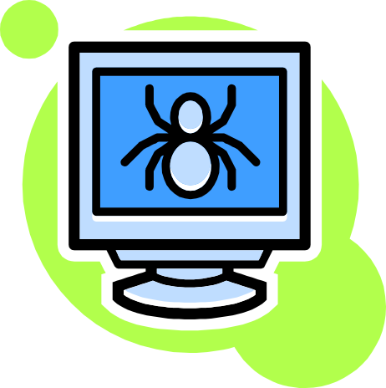
5/12 Students approached inserted CD (41.7%)
0/5 staff/faculty approached inserted CD
5/17 total people approached inserted CD (29.4%)
Remember that staff/faculty had been previously warned of the experiment, so 29.4% is not accurate
41.7% is more accurate

Slide 4

Where Social Engineering was
Performed
Library
KC Welcome Desk
KC Computer Room
KC Commons Area
Weekend College Office
Teachout-Price
Colton Computer Center
Two Professors (Hinsdale & Colton)

Slide 5

Where Security was Breached
All 5 incidents occurred at the library on Hiram College computers by students

Slide 6
Why They Inserted the CD
Intimidated
Did not want to be rude
Totally agreed with reducing the risk
Thought person looked trustworthy

Slide 7
Why They Did Not Insert the CD
Didn’t need the fix
Had a Mac
Not Allowed (Dray updates computer)

Slide 8
Conclusion
These social engineering experiments proved that humans are the highest security risk to computers.
It is scary to think that strangers can convince people to insert unknown CDs and memory sticks into their computers.
The damage that could have been done by the inserted CD was much worse than the possible risk of a virus.

Slide 9
Statistics on Followup
2 out of 4 students approached inserted the CD (50%)
One of them had a knowledge of how the lab computers were managed by the computer center
One thought it was weird to fix a security hole in the Kennedy Center without Dray involved

Slide 10
“Could I please use your computer?”
Approached 4 acquaintances in their dorm rooms
Claimed there were problems with personal computer
Asked for their computer to either:
  Submit an assignment
  Print something out

Slide 11
Results
All 4 of the students approached allowed a CD to be inserted into their computer
Shows how a social engineer can build trust with a target and use that against the target

Slide 12
“Do You Trust Me?”
Students and Faculty/Staff members were approached (not as a complete stranger, rather as an acquaintance)
Were asked to insert USB drive into computer for a specific reason, non-virus related
“Could you please proofread a paper of mine real quickly?”
“The minix virtual machine won’t work on my computer, can we try it on yours?”

Slide 13
Results
Out of 7 people tested, 5 freely allowed the USB drive to be inserted into their computer.
2 out of 5 were Faculty/Staff members
Remaining three were fellow students
Used “spoofing-group” to my advantage on one fellow student

