Slide 1
Objective
Obtain Passwords using social engineering.
How?
  Mass email to reach entire campus
  Email addresses easily copied and pasted from campus directory
  Scare tactic involving a fictional virus used to induce minor panic and stall critical thinking
  Posing as a fictional computer help center to gain trust

Slide 2
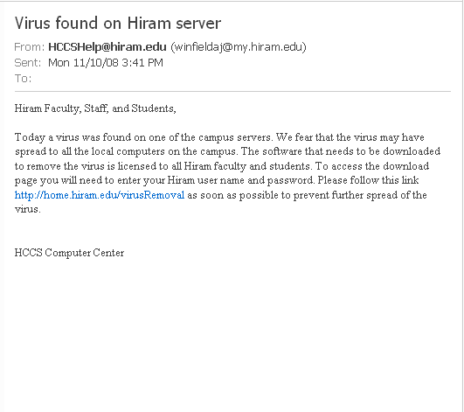


The Bait

Slide 3
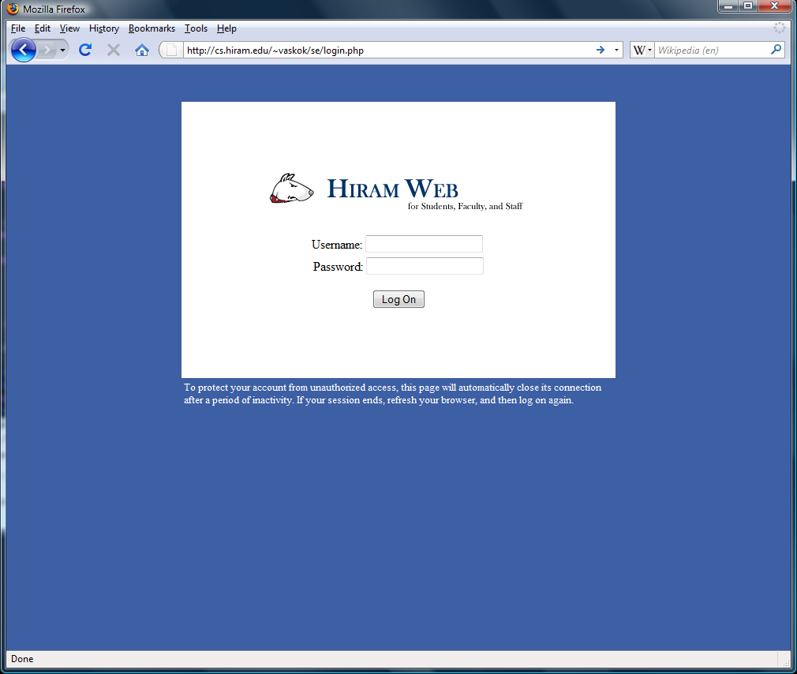
The Trap

Slide 4
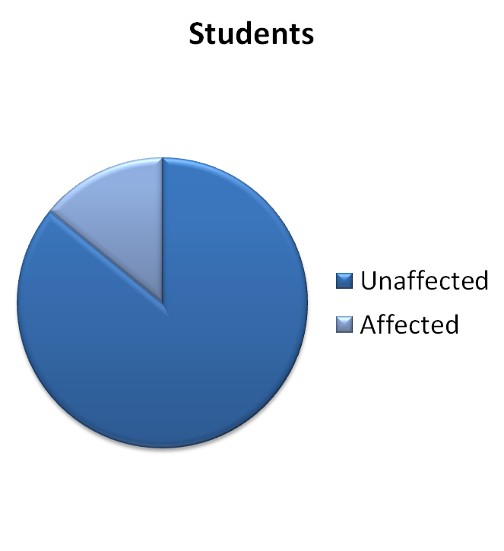
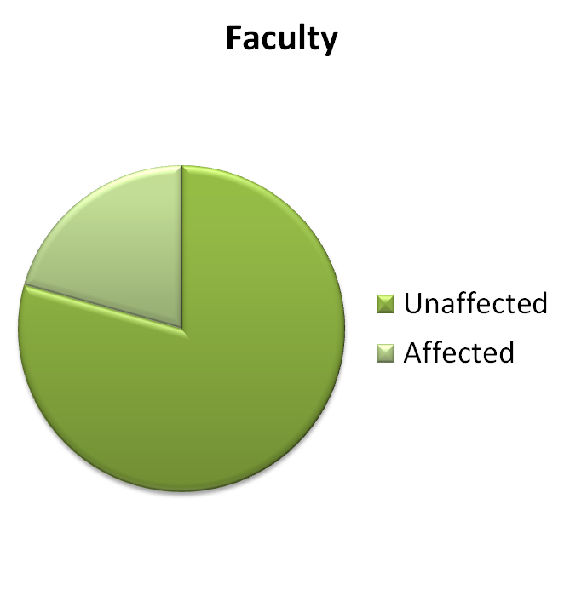
Results
14.07%
20.67%

Slide 5
Conclusions
People will reveal their passwords.
A massive pharming attack is simple and easy to execute.
The affected people are either extremely lazy or highly susceptible to panic.

Slide 6
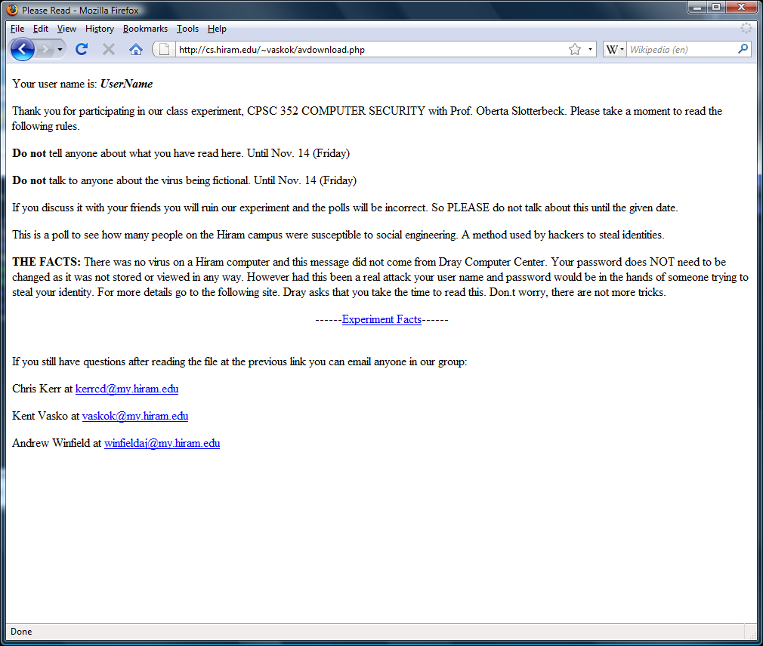
If only they took the time to read

