Slide 1
CHAPTER 2
CPSC 171
Dr. Oberta A. Slotterbeck (Obie)

Slide 2
HOW DO WE REPRESENT ALGORITHMS?
Use natural language?
  Advantages?
    Don't have to learn something else.
  Disadvantages?
    Verbose.
    Unstructured.
    Multiple meanings - too rich in interpretation.
    Difficult to isolate parts of the algorithm.
    Lacks clarity.

Slide 3
AN EXAMPLE: Algorithm for Adding Two m-Digit Numbers
Start with a number m >= 1 and two m digit numbers
a= a_{m-1} a_{m-2} ...a₀ and b= b_{m-1}b_{m-2} ... b₀
We wish to produce c = c_{m}c_{m-1} c_{m-2} ...c₀ where c = a + b.
For example, we wish to add
1234 and 7982
Then what are
a_{m-1,}, a_{m-2} ,...a₀ , b_{m-1},b_{m-2 ,}, ... b₀,, and c_{m}, c_{m-1},c_{m-2 ,}, ... c_{0,}?
Note: This was an algorithm you knew by the third grade (or earlier)!--- you just didn't use the formal notation.

Slide 4
EXAMPLE: Figure 2.1, page 41.
The addition algorithm expressed in natural language:
Initially, set the value of the variable carry to 0 and the value of the variable i to 0. When these initializations have been completed, begin looping until the value of the variable i becomes greater than m-1. First, add together the values of the two digits a_{i} and b_{i} and the current value of the carry digit to get the result called c_{i}. Now check the value of c_{i} to see whether it is greater than or equal to 10. If c_{i} is greater than or equal to 10, then reset the value of carry to 1 and reduce the value of c_{i} by 10; otherwise, set the value of carry to zero. When you are done with that operation, add 1 to i and begin the loop all over again. When the loop has completed execution, set the leftmost digit of the result c_{m} to the value of carry and print out the final result, which consists of the digits c_{m}c_{m-1}...c₀. After printing the result, the algorithm is finished and it terminates.

Slide 5
HOW DO WE REPRESENT ALGORITHMS?
Use a programming language?
  Advantages?
    Very precise.
    Ultimately, if we are going to execute an algorithm on a computer, why not write it in a computer language at the beginning?
  Disadvantages?
    Each programming language is syntactically different. Which one should we use?
    Lose abstraction (i.e., high level overview)
    Need to worry about irrelevant details of punctuation, grammar, and syntax.

Slide 6
EXAMPLE: Figure 2.1, page 31.
The start of the addition algorithm expressed in Java:
If you have ever seen a programming language you should be asking about rules for:
1. Semicolon placement
2. Parenthesis placement
3. Capitals vs lower case
4. Brace placement
Also
5. What is the Console thing?
6. What does i = 0 mean? j++?
7. What does a[j] mean?
etc....
{ int i, m, Carry;
int[] a = new int(100);
int[] b = new int(100);
int[] c = new int(100);
m = Console.readInt();
for (int j = 0; j <= m-1; j++) {
a[j] = Console.readInt();
b[j] = Console.readInt(); }
Carry = 0; i = 0;
while (i < m) {
c[i] = a[i] + b[i] + Carry;
if (c[i] >= 10) .......

Slide 7
Moreover, another programming language may look entirely different.
Both natural languages and programming languages are too extreme for designing algorithms.
Typically we use a higher level language called pseudocode which captures the type of algorithmic operations we will be considering.

Slide 8
Pseudocode
English language constructs modeled to look like statements available in most programming languages
Steps presented in a structured manner (numbered, indented, and so on)
No fixed syntax for most operations is required

Slide 9
Pseudocode (continued)
Less ambiguous and more readable than natural language
Emphasis is on process, not notation
Well-understood forms allow logical reasoning about algorithm behavior
Can be easily translated into a programming language

Slide 10
TYPES OF OPERATIONS WE WILL USE
Sequential operations to carry out
  computation,
  input, and
  output.
Conditional operations.
Iterative operations.
Within these categories, we will use a stylized language that need not be exactly the same for all of us, as long as the intent is understood.

Slide 11
EXAMPLES
Sequential operations to carry out
  computation,
    Set the value of X to 3.
    Assign X a value of A + B.
    Let X be 2 - C.
    Set the value of Name to the first person's name.
  input
    Get a value for X, Y, and Z.
    Input values for A1, A2, ..., Am.
    Read X, Y, and Carry.
  output
    Output the value of X.
    Print values for X, Y, and Carry.
    Print the message, "Error".

Slide 12
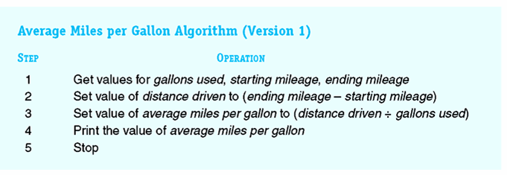
Figure 2.3
Algorithm for Computing Average Miles per Gallon

Slide 13
EXAMPLES
Conditional operation
  if the Name matches "End" then Print the message "Finished" Print the value of Count Stop else Fetch another value for Name Increment the value of Count
We follow the convention that indented operations are grouped together under the same branch.

Slide 14
Pictorially
true
true-false
statement
false
true
branch
false branch
operation
operation
operation
Note: either branch can be missing
operation

Slide 15
Pictorially
true
true-false
statement
false
true
branch
false branch
operation
operation
operation
Note: either branch can be missing
operation

Slide 16
Pictorially
true
true-false
statement
false
true
branch
false branch
operation
operation
operation
Note: either branch can be missing
operation

Slide 17
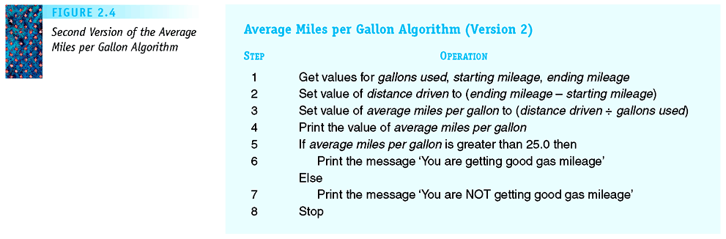
Figure 2.5
Second Version of the Average Miles per Gallon Algorithm

Slide 18
EXAMPLES
Iterative (or looping) operations:
  Repeat step 1 to 2 until count > 4 1. Add 1 to count. 2. Print count.
  Repeat until count > 4 Add 1 to count. Print count. Fetch X. End of loop.
  Repeat while count <= 4 Add 1 to count. Print count. End of loop.
Note: The until condition is checked after the loop is executed. The while condition is checked before the loop is executed.

Slide 19
Pictorially
true-false
statement
false
operation
true
operation
operation
operation
true-false
statement
true
false
while loop
until loop

Slide 20
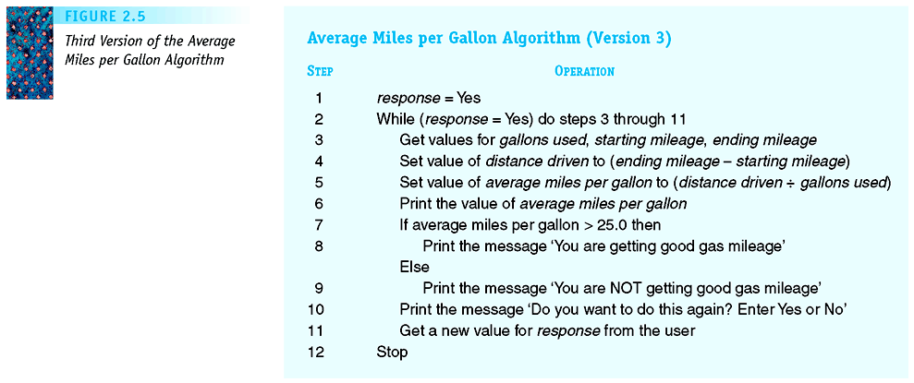
Figure 2.7
Third Version of the Average Miles per Gallon Algorithm

Slide 21
SUMMARY OF TYPES OF OPERATIONS WE WILL USE
Sequential operations to carry out
  computation,
  input, and
  output.
Conditional operations.
Iterative operations.
Although these seem to be very few primitives, there is a theorem in theoretical computer that proves that these operations are sufficient to represent ANY algorithm!

Slide 22
NOTE HOW POWERFUL THIS STATEMENT IS:
There is a theorem in theoretical computer science that proves that these operations are sufficient to represent ANY algorithm!
Algorithms are used to do everything you see on a computer!
Do word processing.
Fly NASA probes to the planets.
Run the international telephone switching system.
Create CAT scan images.
Process your pay checks.
Run computer games.
Etc.

Slide 23
Another EXAMPLE OF AN ALGORITHM
We'll come back to the addition algorithm soon
PROBLEM: Start with a collection of names N₁, N₂, ..., N₁₀₀₀₀, and corresponding telephone numbers T₁, T₂, ..., T₁₀₀₀₀. Given a name, Name, find a telephone number for that name if a match on an Ni occurs; otherwise, print "Not Found".
Given a problem, there are often many ways to provide an algorithm for solving the problem.
Note: You must understand the methodology for solving the problem in order to write an algorithm for the solution!!!

Slide 24
A FIRST ATTEMPT AT A SOLUTION TO THE TELEPHONE SEARCH PROBLEM
1. Get values for N₁, N₂, ..., N₁₀₀₀₀, T₁, T₂, ,,,, T₁₀₀₀₀, and
Name.
2. If Name is N₁, then
print T₁
Stop
3. If Name is N₂, then
print T₂.
Stop.
{a lot of tedious writing here that is being skipped}
10001. If Name is N₁₀₀₀₀, then
print T₁₀₀₀₀.
Stop.
10002. Print "Not found"
10003. Stop.

Slide 25
A SECOND ATTEMPT AT A SOLUTION TO THE TELEPHONE SEARCH PROBLEM
1. Get values for N₁, N₂, ..., N₁₀₀₀₀, T₁, T₂, ,,,, T₁₀₀₀₀, and Name.
2. Set the value of i to 1 and the value of Found to NO.
3. Repeat steps 4 through 7 until Found is Yes.
4. If Name is equal to N_{i}, then
5. Print the telephone number T_{i}
6. Set the value of Found to Yes
Else
7. Add 1 to the value of i
8. Stop.

Slide 26
ANOTHER ATTEMPT AT A SOLUTION TO THE TELEPHONE SEARCH PROBLEM
1. Get values for N₁, N₂, ..., N₁₀₀₀₀, T₁, T₂, ,,,, T₁₀₀₀₀, and Name.
2. Set the value of i to 1 and the value of Found to NO.
3. Repeat steps 4 through 7 until Found is Yes or i > 10000
4. If Name is equal to N_{i}, then
5. Print the telephone number T_{i}
6. Set the value of Found to Yes
Else
7. Add 1 to the value of i
8. If (Found is No) then
9. Print "Not found"
10. Stop.

Slide 27
OR ANOTHER FORM OF THIS SOLUTION TO THE TELEPHONE SEARCH PROBLEM
Get values for N₁, N₂, ..., N₁₀₀₀₀, T₁, T₂, ,,,, T₁₀₀₀₀, and Name.
Set the value of i to 1 and the value of Found to NO.
Repeat steps until Found is Yes or i > 10000.
If Name is equal to N_{i}, then
Print the telephone number T_{i}
Set the value of Found to Yes
Else
Add 1 to the value of i
End of loop
If (Found is No) then
Print "Not found"

Slide 28
DESIGNING ALGORITHMS
Computer scientists design algorithms to solve problems for other people.
Do I expect you to be able to design algorithms at this point? No!
What do I expect you to be able to do after some practice?
  Read a collection of steps that are presented to you.
  Determine if the collection is an algorithm or not.
  If it is an algorithm, determine whether it solves the problem or not.
  Determine what happens if modifications are made to algorithms we have studied.
  If changes are made and the algorithm is no longer correct, what must be done to make it correct.

Slide 29
DOES THIS SOLVE THE TELEPHONE SEARCH PROBLEM?
Get values for N₁, N₂, ..., N₁₀₀₀₀, T₁, T₂, ,,,, T₁₀₀₀₀, and Name.
Set the value of i to 1 and the value of Found to NO.
Repeat steps until Found is Yes or i < 10000.
If Name is equal to N_{i}, then
Print the telephone number T_{i}
Set the value of Found to Yes
Else
Add 1 to the value of i
End of loop
If (Found is No) then
Print "Not found"

Slide 30
DOES THIS SOLVE THE TELEPHONE SEARCH PROBLEM?
Get values for N₁, N₂, ..., N₁₀₀₀₀, T₁, T₂, ,,,, T₁₀₀₀₀, and Name.
Set the value of i to 1 and the value of Found to NO.
Repeat steps until Found is Yes and i < 10000.
If Name is equal to N_{i}, then
Print the telephone number T_{i}
Set the value of Found to Yes
Else
Add 1 to the value of i
End of loop
If (Found is No) then
Print "Not found"

Slide 31
DOES THIS SOLVE THE TELEPHONE SEARCH PROBLEM?
Get values for N₁, N₂, ..., N₁₀₀₀₀, T₁, T₂, ,,,, T₁₀₀₀₀, and Name.
Set the value of i to 1 and the value of Found to NO.
Repeat steps while Found is Yes or i < 10000.
If Name is equal to N_{i}, then
Print the telephone number T_{i}
Set the value of Found to Yes
Else
Add 1 to the value of i
End of loop
If (Found is No) then
Print "Not found"

Slide 32
DOES THIS SOLVE THE TELEPHONE SEARCH PROBLEM?
Get values for N₁, N₂, ..., N₁₀₀₀₀, T₁, T₂, ,,,, T₁₀₀₀₀, and Name.
Set the value of i to 1 and the value of Found to NO.
Repeat steps until Found is Yes or i > 10000.
If Name is equal to N_{i}, then
Print the telephone number T_{i}
Else
Set the value of Found to Yes
Add 1 to the value of i
End of loop
If (Found is No) then
Print "Not found"

Slide 33
DOES THIS SOLVE THE TELEPHONE SEARCH PROBLEM?
Get values for N₁, N₂, ..., N₁₀₀₀₀, T₁, T₂, ,,,, T₁₀₀₀₀, and Name.
Set the value of i to 1 and the value of Found to NO.
Repeat steps until Found is Yes or i ≥ 10000.
If Name is equal to N_{i}, then
Print the telephone number T_{i}
Set the value of Found to Yes
Else
Add 1 to the value of i
End of loop
Print "Not found"

Slide 34
DOES THIS SOLVE THE TELEPHONE SEARCH PROBLEM?
Get values for N₁, N₂, ..., N₁₀₀₀₀, T₁, T₂, ,,,, T₁₀₀₀₀, and Name.
Set the value of i to 1 and the value of Found to NO.
Repeat steps until Found is Yes or i > 10000.
If Name is equal to N_{i}, then
Print the telephone number T_{i}
Set the value of Found to Yes
Else
Add 1 to the value of i
End of loop
If (Found is No) then
Print "Not found"

Slide 35
FIND LARGEST ALGORITHM
PROBLEM: Given n, the size of a list, and a list of n numbers, find the largest number in the list.
Get a value for n and values A₁, A₂, ..., A_{n} for the list items.
Set the value of Largest-so-far to A₁.
Set the Location to 1.
Set the value of i to 2.
While (i ≤ n) do
If A_{i} > Largest-so-far then
Set Largest-so-far to A_{i}
Set Location to i
Add 1 to the value of i.
End loop.
Print the labeled values of Largest-so-far and Location.

Slide 36
BACK TO AN EARLIER EXAMPLE
Algorithm for Adding Two m-Digit Numbers
Start with a number m >= 1 and two m digit numbers
a= a_{m-1} a_{m-2} ...a₀ and b= b_{m-1}b_{m-2} ... b₀
We wish to produce c = c_{m}c_{m-1} c_{m-2} ...c₀ where c = a + b.
For example, we wish to add
1234 and 7982
Then what are m,
a_{m-1,}, a_{m-2} ,...a₀ , b_{m-1},b_{m-2 ,}, ... b₀, c_{n}, c_{m-1},c_{m-2 ,}, ... c_{0,}?
Note: This was an algorithm you knew by the third grade (or earlier)!--- you just didn't use the formal notation.

Slide 37
Algorithm for Adding Two m-Digit Numbers
Get m
Get a(m-1), a(m-2), ...., a(0) and b(m-1), b(m-2), ...., b(0) values.
Set the value of carry to 0
Set the value of i to 0
Repeat until the value of i is greater than m-1
Add a(i) and b(i )to the current value of carry to get c(i)
If c(i) > = 10, then
Reset c(i) to c(i)-10
Reset carry to 1.
Else set the new value of carry to 0.
Increment i, which effectively moves us one column to the left.
End loop.
Set c(m) to the value of carry.
Print c(m), c(m-1), .... c(0) in that order.

Slide 38
PATTERN MATCHING ALGORITHM
PROBLEM: Given a text composed of n characters referred to as T(1), T(2), ..., T(n) and a pattern of m characters P(1), P(2), ... P(m), where m ≤ n, locate every occurrence of the pattern in the text and output each location where it is found. The location will be the index position where the match begins. If the pattern is not found, provide an appropriate message stating that.
Let's see what this means.
Often when designing algorithms, we begin with a rough draft and then fill in the details.

Slide 39
PATTERN MATCHING ALGORITHM
(Rough draft)
Get all the values we need.
Set k, the starting location, to 1.
Repeat until we have fallen off the end of the text
Attempt to match every character in the pattern beginning at position k of the text.
If there was a match then
Print the value of k
Increment k to slide the pattern forward one position.
End of loop.
Note: This is not yet an algorithm, but an abstract outline of a possible algorithm.

Slide 40
PATTERN MATCHING ALGORITHM
(Rough draft)
Get all the values we need.
Set k, the starting location, to 1.
Repeat until we have fallen off the end of the text
Attempt to match every character in the pattern beginning at position k of the text.
If there was a match then
Print the value of k
Increment k to slide the pattern forward one position.
End of loop.
Note: This is not yet an algorithm, but an abstract outline of a possible algorithm.

Slide 41
Attempt to match every character in the pattern beginning at position k of the text.
Situation:
T(1) T(2) ... T(k) T(k+1) T(k+2) .... T(?) ... T(0)
P(1) P(2) P(3) P(m)
So we must match
T(k) to P(1)
T(k+1) to P(2)
...
T(?) to P(m)
So, what is ?
Answer:
k + (m-1)
Now, let's write the algorithm.

Slide 42
Match T(k) to P(1)
T(k+1) to P(2)
...
T(k + (m-1)) to P(m)
i.e. match
T(i) to T(k + (i-1))
Set the value of i to 1.
Set the value of Mismatch to No.
Repeat until either i > m or Mismatch is Yes
If P(i) doesn't equal T(k + (i-1)) then
Set Mismatch to Yes
Else
Increment i by 1
End the loop.
Call the above: Matching SubAlgorithm

Slide 43
PATTERN MATCHING ALGORITHM
(Rough draft)
Get all the values we need.
Set k, the starting location, to 1.
Repeat until we have fallen off the end of the text
Attempt to match every character in the pattern beginning at position k of the text.
If there was a match then
Print the value of k
Increment k to slide the pattern forward one position.
End of loop.
Note: This is not yet an algorithm, but an abstract outline of a possible algorithm.

Slide 44
Repeat until we have fallen off the end of the text- what does this mean?
Situation:
T(1) T(2) ... T(k) T(k+1) T(k+2) .... T(n)
P(1) P(2) P(3) P(m)
If we move the pattern any further to the right, we will have fallen off the end of the text.
So what must we do to restrict k?
Play with numbers:
n = 4; m = 2
n = 5; m = 2
n = 6; m = 4
n = 6; m = 7
Repeat until k > (n - m + 1)

Slide 45
PATTERN MATCHING ALGORITHM
(Rough draft)
Get all the values we need.
Set k, the starting location, to 1.
Repeat until we have fallen off the end of the text
Attempt to match every character in the pattern beginning at position k of the text.
If there was a match then
Print the value of k
Increment k to slide the pattern forward one position.
End of loop.
Note: This is not yet an algorithm, but an abstract outline of a possible algorithm.

Slide 46
Get all the values we need.
Let's write this as an INPUT SUBALGORITHM
Get values for n and m, the size of the text and the pattern.
If m > n, then
Stop.
Get values for the text,
T(1), T(2), .... T(n)
Get values for the pattern,
P(1), P(2), .... P(m)
Note that I added a check on the relationship between the
values of m and n that is not found in the textbook.

Slide 47
THE PATTERN MATCHING ALGORITHM
Note: After the INPUT SUBALGORITHM is executed, n is the
size of the text, m is the size of the pattern, the values T(i) hold the text, and the values P(i) hold the pattern.
Execute the INPUT SUBALGORITHM.
Set k, the starting location, to 1.
Repeat until k > (n-m +1)
Execute the MATCHING SUBALGORITHM.
If Mismatch is No then
Print the message "There is a match at position "
Print the value of k
Increment the value of k.
End of the loop

Slide 48
Summary
Algorithm design is a first step in developing an algorithm
Algorithm design must
  Ensure the algorithm is correct
  Ensure the algorithm is sufficiently efficient – How this is determined is the thrust of Chapter 3
Pseudocode is used to design and represent algorithms

Slide 49
Summary
Pseudocode is readable, unambiguous, and able to be analyzed
Algorithm design is a creative process; uses multiple drafts and top-down design to develop the best solution
Abstraction is a key tool for good design

