Slide 1
The Efficiency of Algorithms
Chapter 3
CPSC 171
Dr. Oberta A. Slotterbeck (Obie)

Slide 2
OUR NEXT QUESTION IS:
"How do we know we have a good algorithm?"
In the lab session, you will explore algorithms that are related as they all solve the same problem:
Problem: We are given a list of numbers which include good data (represented by nonzero whole numbers) and bad data (represented by zero entries).
We want to "clean-up" the data by moving all the good data to the left, preferably keeping it in the same order, and setting a value legit that will equal the number of good items. For example,
0 24 16 0 0 0 5 27 becomes
24 16 5 27 ? ? ? ? with legit being 4.
The ? means we don't care what is in that old position.

Slide 3
WE'LL LOOK AT 3 DIFFERENT ALGORITHMS
Shuffle-Left Algorithm
The Copy-Over Algorithm
The Converging-Pointers Algorithm
All solve the problem, but differently.

Slide 4
These three algorithms will enable us to investigate the notion of the complexity of an algorithm.
Algorithms consume resources of a computing agent:
TIME: How much time is consumed during the execution of the algorithm?
SPACE: How much additional storage (space), other than that used to hold the input and a few extra variables, is needed to execute the algorithm?

Slide 5
HOW WILL WE MEASURE THE TIME FOR AN ALGORITHM?
Code the algorithm and run it on a computer?
  What machine?
  What language?
  Who codes?
  What data?
Doing this (which is called benchmarking) can be useful, but not for comparing algorthms.

Slide 6
Instead, we determine the time complexity of an algorithm and use it to compare that algorithm with others for which we also have their time complexity.
What we want to do is relate
1. the amount of work performed by an algorithm
2. and the algorithm's input size
by a fairly simple formula.
You will do experiments and other work in the lab to reinforce these concepts.

Slide 7
STEPS FOR DETERMING THE TIME COMPLEXITY OF AN ALGORITHM
1. Determine how you will measure input size. Ex:
  N items in a list
  N x M table (with N rows and M columns)
  Two numbers of length N
2. Choose an operation (or perhaps two operations) to count as a gauge of the amount of work performed. Ex:
  Comparisons
  Swaps
  Copies
  Additions
Normally we don't count operations in input/output.

Slide 8
STEPS FOR DETERMING THE TIME COMPLEXITY OF AN ALGORITHM
3. Decide whether you wish to count operations in the
  Best case? - the fewest possible operations
  Worst case? - the most possible operations
  Average case?
    This is harder as it is not always clear what is meant by an "average case". Normally calculating this case requires some higher mathematics such as probability theory.
4. For the algorithm and the chosen case (best, worst, average), express the count as a function of the input size of the problem.
For example, we determine by counting, statements such as ...

Slide 9
EXAMPLES:
For n items in a list, counting the operation swap, we find the algorithm performs 10n + 5 swaps in the worst case.
For an n X m table, counting additions, we find the algorithm perform nm additions in the best case.
For two numbers of length n, there are 3n + 20 multiplications in the best case.

Slide 10
STEPS FOR DETERMING THE TIME COMPLEXITY OF AN ALGORITHM
5. Given the formula that you have determined, decide the complexity class of the algorithm.
What is the complexity class of an algorithm?
Question: Is there really much difference between
3n
5n + 20
and 6n -3
especially when n is large?

Slide 11
But, there is a huge difference, for n large, between
n
n²
and n³
So we try to classify algorithm into classes, based on their counts and simple formulas such as n, n², n³, and others.
Why does this matter?
It is the complexity of an algorithm that most affects its running time---
not the machine or its speed

Slide 12
ORDER WINS OUT
The TRS-80
Main language support: BASIC - typically a slow running language
For more details on TRS-80 see:
http://en.wikipedia.org/wiki/TRS-80
The CRAY-YMP
Language used in example: FORTRAN- a fast running language
For more details on CRAY-YMP see:
http://en.wikipedia.org/wiki/Cray_Y-MP

Slide 13
CRAY YMP TRS-80
with FORTRAN with BASIC
complexity is 3n³ complexity is 19,500,000n
n is:
10
100
1000
2500
10000
1000000
3 microsec
200 millisec
3 millisec
2 sec
3 sec
20 sec
50 sec
50 sec
49 min
3.2 min
95 years
5.4 hours

Slide 14
Trying to maintain an exact count for an operation isn't too useful.
Thus, we group algorithms that have counts such as
n
3n + 20
1000n - 12
0.00001n +2
together. We say algorithms with these type of counts are in the class Θ(n) -
read as the class of theta-of-n or
all algorithms of magnitude n or
all order-n algorithms

Slide 15
Similarly, algorithms with counts such as
n² + 3n
1/2n² + 4n - 5
1000n² + 2.54n +11
are in the class Θ(n²).
Other typical classes are those with easy formulas in n such as
1
n³
2^{n}
lg n k = lg n if and only if 2^{k} = n

Slide 16
lg n k = lg n if and only if 2^{k} = n
lg 4 = ?
lg 8 = ?
lg 16 = ?
lg 10 = ?
Note that all of these are base 2 logarithms. You don't use any logarithm table as we don't need exact values (except on integer powers of 2).
Look at the curves showing the growth for algorithms in
Θ(1), Θ(n), Θ(n²), Θ(n³), Θ(lg n), Θ(n lg n), Θ(2^{n})
These are the major ones we'll use.

Slide 17
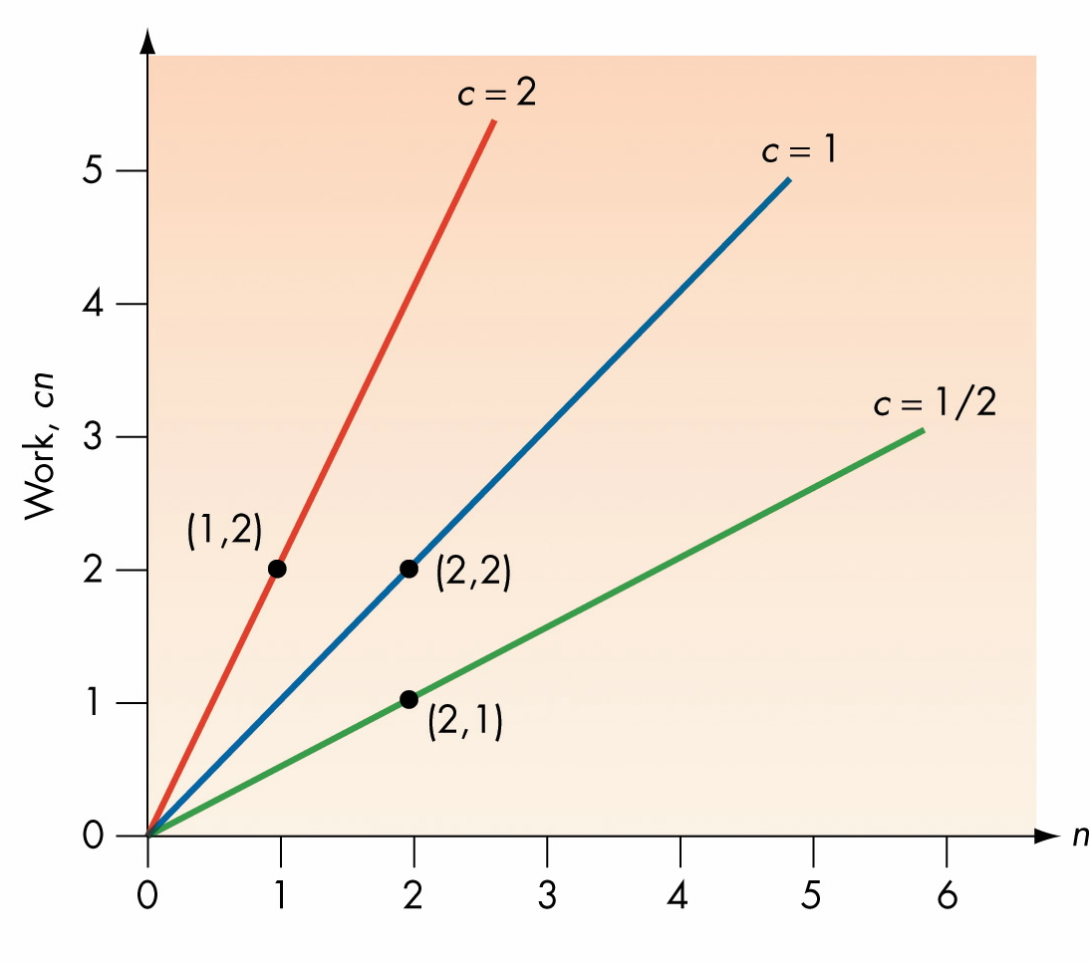
Figure 3.4
Work = cn for Various Values of c

Slide 18
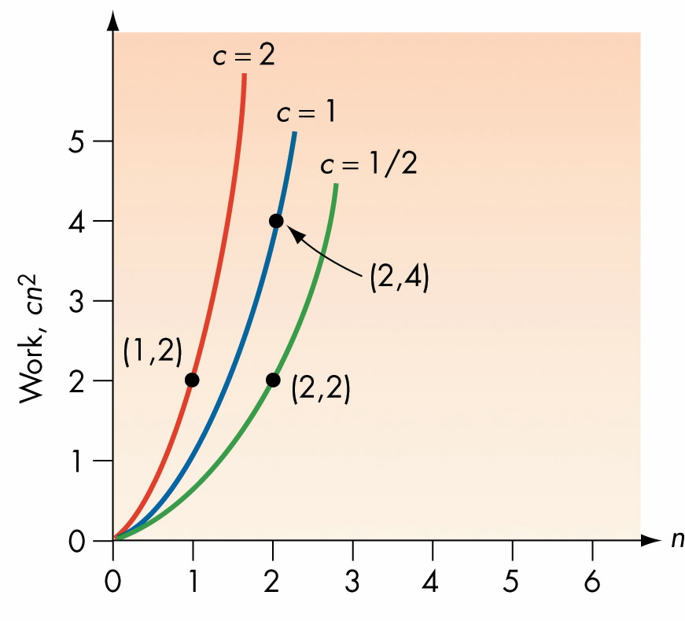
Figure 3.10
Work = cn² for Various Values of c

Slide 19
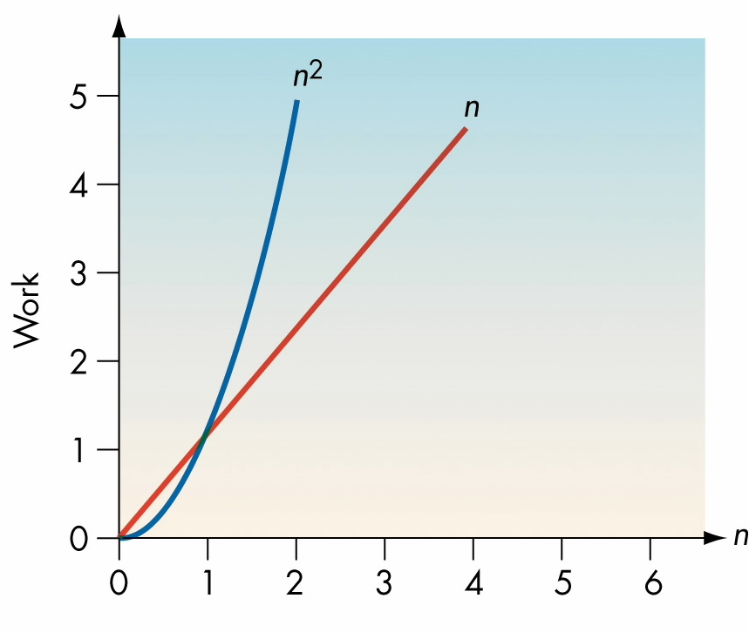
Figure 3.11
A Comparison of n and n²

Slide 20
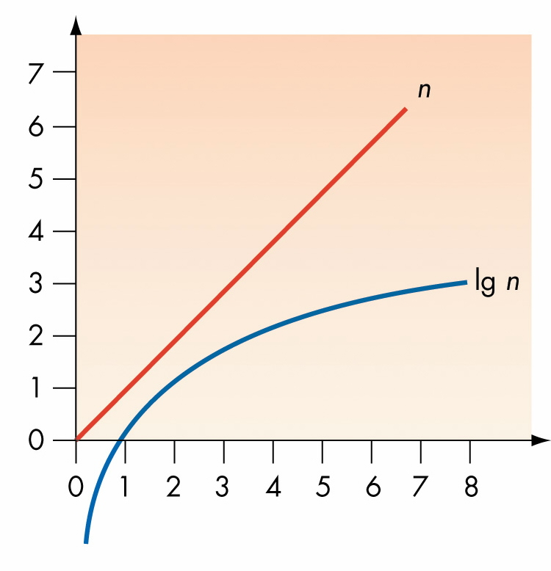
Figure 3.21
A Comparison of n and lg n

Slide 21
Figure 3.21
A Comparison of n and lg n

Slide 22
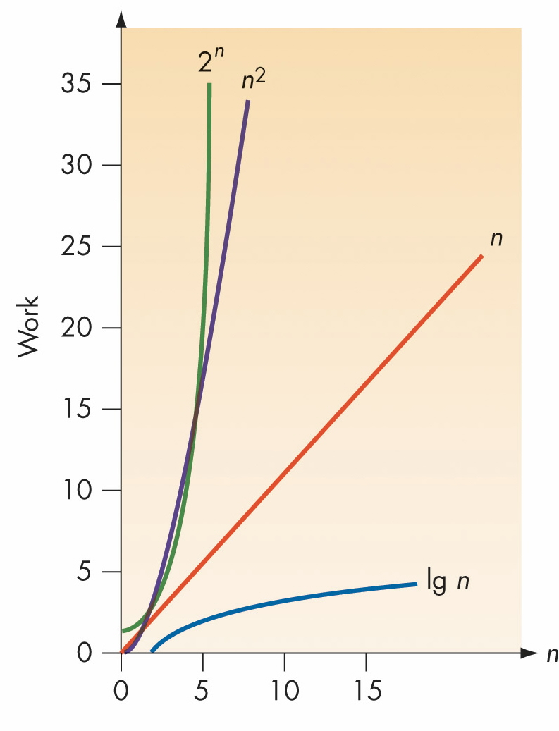
Figure 3.25
Comparisons of lg n, n, n² , and 2^{n}

Slide 23
ANOTHER COMPARISON
n =
order 10 50 100 1,000
lg n 0.0003 sec 0.0006 sec 0.0007 sec 0.001 sec
n 0.001 sec 0.005 sec 0.01 sec 0.1 sec
n² 0.01 sec 0.25 sec 1 sec 1.67 min
2^{n} 0.1024 sec 3570 years 4 x 10¹⁶ why centuries? bother?
Does order make a difference?
You bet it does, but not on tiny problems.
On large problems, it makes a major difference and can
even predict whether or not you can execute the algorithm.

Slide 24
Why not just build a faster computing agent?
Why not use parallel computing agents?
No matter what we do, the complexity (i.e. the order) of the algorithm has a major impact!!!
So, can we compare two algorithms and say which is the better one with respect to time?
Yes, provided we do several things:

Slide 25
COMPARING TWO ALGORITHMS WITH RESPECT TO TIME
1. Count the same operation for both.
2. Decide whether this is a best, worst, or average case.
3. Determine the complexity class for both, say Θ(f) and Θ(g) for the chosen case.
4. Then, for large problems, data that is for the case you analyzed, and no further information:
  If Θ(f) = Θ(g), they are essentially the same.
  If Θ(f) < Θ(g), , choose the Θ(f) algorithm.
  Otherwise, choose the Θ(g) algorithm.

Slide 26
A MORE PRECISE DEFINITION OF Θ
(only for those with calculus backgrounds)
Definition: Let f and g be functions defined on the positive real numbers with real values.
We say g is in O(f) if and only if
lim g(n)/f(n) = c
n -> ∞
for some nonnegative real number c--- i.e. the limit exists and is not infinite.
We say f is in Θ(g) if and only if
f is in O(g) and g is in O(f)
Note: Often to calculate these limits you need L'Hopital's Rule.

Slide 27
CHAPTER 3
Section 3.4
Three Algorithms That Will Serve as Important Examples

Slide 28
3 EXAMPLES ILLUSTRATE OUR COMPLEXITY ANALYSIS
Problem: We are given a list of numbers which include good data (represented by nonzero whole numbers) and bad data (represented by zero entries).
We want to "clean-up" the data by moving all the good data to the left, keeping it in the same order, and setting a value legit that will equal the number of good items. For example,
0 24 16 0 0 0 5 27 becomes
24 16 5 27 ? ? ? ? with legit being 4.
The ? means we don't care what is in that old position.

Slide 29
WE'LL LOOK AT 3 DIFFERENT ALGORITHMS
Shuffle-Left Algorithm
Copy-Over Algorithm
The Converging-Pointers Algorithm
All solve the problem, but differently.

Slide 30
THE SHUFFLE LEFT ALGORITHM FOR DATA CEANUP
0 24 16 0 36 42 23 21 0 27 legit = 10
. . .
Detect a 0 at left finger so reduce legit and copy values under a right finger that moves:
legit = 9
24
16
0
36 42 23 21 0
27
27
didn't move
------------------end of round 1 ----------------

Slide 31
Reset the right finger:
24 16 0 36 42 23 21 0 27 27 legit = 9
No 0 is detected, so march the fingers along until a 0 is under the left finger:
24 16 0 36 42 23 21 0 27 27 legit = 9
24 16 0 36 42 23 21 0 27 27 legit = 9

Slide 32
Now decrement legit again and shuffle the values left as before:
Starting with:
24 16 0 36 42 23 21 0 27 27 legit = 9
After the shuffle and reset we have:
24 16 36 42 23 21 0 27 27 27 legit = 8
------------------end of round 2 ----------------

Slide 33
Now decrement legit again and shuffle the values left as before:
Starting with:
24 16 36 42 23 21 0 27 27 27 legit = 8
After the shuffle and reset we have:
24 16 36 42 23 21 27 27 27 27 legit = 7
------------------end of round 3 ----------------

Slide 34
Now we try again:
Starting with:
24 16 36 42 23 21 27 27 27 27 legit = 7
We move the fingers once:
24 16 36 42 23 21 27 27 27 27 legit = 7
But, now the location of the left finger is greater than legit, so we are done!
-----------end of the algorithm execution ----------------

Slide 35
Here's the pseudocode version of the algorithm:
The textbook uses numbered steps which I don't. I have added some comments in red that provide additional information to the reader.
Input the necessary values:
Get values for n and the n data items.
Initialize variables:
Set the value of legit to n. Legit is the number of good items.
Set the value of left to 1. Left is the position of the left finger.
Set the value of right to 2. Right is the position of the right finger.

Slide 36
While left is less than or equal to legit
If the item at position left is not 0
Increase left by 1 moving the left finger
Increase right by 1 moving the right finger
Else in this case the item at position left is 0
Reduce legit by 1
While right is less than or equal to n
Copy item at position right to right-1
Increase right by 1
End loop
Set the value of right to left + 1
End loop
end of shuffle left algorithm for data cleanup

Slide 37
ANOTHER ALGORITHM FOR DATA CLEANUP - COPY-OVER
0 24 16 0 36 42 23 21 0 27
...
The idea here is that we write a new list by copying only those values that are nonzero and using the position of n moved item to be the count of the number of good data items:
24
16
36
42 23 21
27
At the end, newposition (i.e. legit) is 7.

Slide 38
COPY-OVER ALGORITHM PSEUDOCODE
Input the necessary values and initialize variables:
Get the values for n and the n data items.
Set the value of left to 1. Left is an index in the original list.
Set the value of newposition to 1. This is an index in a new list.
Copy good items to the new list indexed by newposition
While left is less than or equal to n
If the item at position left is not 0 then
Copy the position left item into position newposition
Increase left by 1
Increase newposition by 1
Else the item at position left is zero
Increase left by 1
End loop

Slide 39
OUR LAST DATA CLEANUP ALGORITHM- CONVERGING-POINTERS
0 24 16 0 36 42 23 21 0 27 legit = 10
We again use fingers (or pointers). But, now we start at the far right and the far left.
Since a 0 is encountered at left, we copy the item at right to left, and decrement both legit and right:
27 24 16 0 36 42 23 21 0 27 legit = 9
------------------end of round 1 ----------------

Slide 40
Starting with:
27 24 16 0 36 42 23 21 0 27 legit = 9
Move the left pointer until a zero is encountered
or until it meets the right pointer:
27 24 16 0 36 42 23 21 0 27 legit = 9
Since a 0 is encountered at left, we copy the item at right to left, and decrement both legit and right:
27 24 16 0 36 42 23 21 0 27 legit = 8
Because a 0 was copied to a 0 it doesn't look as if the data changed, but it did! This is the end of round 2.

Slide 41
Starting with:
27 24 16 0 36 42 23 21 0 27 legit = 8
We again encountered a 0 at left, so we copy the item at right to left, and decrement both legit and right to end round 3:
27 24 16 21 36 42 23 21 0 27 legit = 7
On the last round, the left moves to the right pointer
27 24 16 21 36 42 23 21 0 27 legit = 7
NOTE: If the item is 0 at this point, we would need to decrement legit by 1. This ends the algorithm execution.

Slide 42
CONVERGING-POINTERS ALGORITHM PSEUDOCODE
Input the necessary values:
Get values for n and the n data items.
Initialize the variables:
Set the value of legit to n.
Set the value of left to 1.
Set the value of right to n.

Slide 43
While left is less than right
If the item at position left is not 0 then
Increase left by 1
Else the item at position left is 0
Reduce legit by 1
Copy the item at position right into position left
Reduce right by 1
End loop.
If the item at position left is 0 then
Reduce legit by 1.
End of algorithm.

Slide 44
NOW LET US COMPARE THESE THREE ALGORITHMS BY ANALYZING THEIR ORDERS OF MAGNITUDE
All 3 algorithms must measure the input size the same. What should we use?
    The length of the list is an obvious measure of the size of the data set.

Slide 45
All 3 algorithms must count the same operation (or operations) for a time analysis. What should we use?
  All examine each element in the list once. So all do at least Θ(n) work if we count examinations.
  All use copying, but the amount of copying done by each algorithm differs. So this is a nice operation to count.
  So we will analyze with respect to both of these operations.

Slide 46
Which case (best, worst, or average) should we consider?
We'll analyze the best and worst case for each algorithm.
The average case will not be analyzed, but final result will just stated. Remember, this case is often much harder to determine.

Slide 47
With respect to space, it should be clear that
  The Shuffle-Left Algorithm and the Converging Pointers use no extra space beyond the original input space and space for variables such as counting variables, etc.
  But, the Copy-Over Algorithm does use more space, although the amount used depends upon which case we are considering.

Slide 48
THE COPY-OVER ALGORITHM IS THE EASIEST TO ANALYZE
With respect to copies, for what kind of data will the algorithm do the most work?
Try to design a set of data for an arbitrary length, n, that does the most copying---i.e. a worst case data set?
Example: For n = 4: 12 13 2 5
We could characterize worst case data as data with no zeroes.
Note: There are lots of examples of worst case data.

Slide 49
THE COPY-OVER ALGORITHM
WORST CASE ANALYSIS
Data set of size n contains no zeroes.
Number of examinations is n.
Number of copies is n.
Amount of extra space is n.
So the time complexity in the worst case counting both of these operations is Θ(n), and
the space complexity in the worst case is 2n (input size of n plus an additional n).
Note: With space complexity, we often keep the formula rather than use the Θ class.

Slide 50
THE COPY-OVER ALGORITHM
BEST CASE ANALYSIS
Data set of size n contains
all zeroes.
Number of examinations is
n.
Number of copies is
0.
Amount of extra space is
0.
So the time complexity in the best case counting both of these operations is Θ(n).
If only copies are being counted, the amount of work is Θ(1) [but this seems to not be "fair" ;-) ]
The space complexity in the best case is n.

Slide 51
THE COPY-OVER ALGORITHM
WHAT IF YOU WANTED TO DO AN AVERAGE CASE ANALYSIS?
The difficulty lies in first defining "average".
Then you would need to consider the probability of an average set being available out of all possible sets of data.
These questions can be answered, but they are beyond the scope of this course. For this algorithm, Θ(n) is the amount of work done in the average case.
Computer scientists who analyze at this level usually have strong mathematical backgrounds.

Slide 52
Space complexity is easy to analyze for the other two algorithms:
Neither use extra space in any case so for
Shuffle-Left and Converging-Pointers, the space complexity is n.
If we are concerned only about space, then the Copy-Over Algorithm should not be used.

Slide 53
THE SHUFFLE-LEFT ALGORITHM
WORST CASE ANALYSIS
Data set of size n contains
all zeroes.
Note: This data was the best case for the copy-over algorithm!
Number of copies is ?
Element 1 is 0, so we copy n-1 items in the first round.
Again, element 1 is 0, so we copy n-1 items in the second round.
Continuing, we do this n times (until legit becomes 0).
How much work?
n (n-1) = n² - n
Number of examinations is
n × n = n²

Slide 54
So, the time complexity in the worst case for the shuffle-
left algorithm, counting both of these operations, is
n² + n(n-1) = 2n² -n
i.e. the algorithm is Θ(n²).
The amount of extra space needed in the worst case for the shuffle-left algorithm is 0 so the space complexity is n.

Slide 55
THE SHUFFLE-LEFT ALGORITHM
BEST CASE ANALYSIS
Data set of size n contains
no zeroes.
Note: This data was the worst case for the copy-over algorithm!
Number of examinations is
n.
Number of copies is ?
With no zeroes, there are no copies.
So, the complexity of both operations is Θ(n).
The amount of extra space needed in the worst case for the shuffle-left algorithm is 0 so the space complexity is n.

Slide 56
THE CONVERGING-POINTERS ALGORITHM
WORST CASE ANALYSIS
Data set of size n contains
all zeroes.
Note: This data was the best case for the copy-over algorithm!
Number of examinations is
n.
Number of copies is
n - 1
There is 1 copy for each decrement of right from n to 1 -- for a total of n
Thus, the time complexity in this case is Θ(n).
No extra space is needed, so the space complexity is n.

Slide 57
THE CONVERGING-POINTERS ALGORITHM
BEST CASE ANALYSIS
Data set of size n contains
no zeroes.
Note: This data was the worst case for the copy-over algorithm!
Number of examinations is
n.
Number of copies is ?
With no zeroes, there are no copies.
So, the complexity of both operations is Θ(n).
The amount of extra space needed in the worst case for the shuffle-left algorithm is 0 so the space complexity is n.

Slide 58
ALL CASES-summary
time complexity in blue; space complexity in red
BEST WORST AVERAGE
Shuffle-left Θ(n) Θ(n²) Θ(n²)
n n n
Copy-over Θ(n) Θ(n) Θ(n)
n 2n n <=x<=2n
Converging-
Pointers Θ(n) Θ(n) Θ(n)
n n n
Conclusions??

Slide 59
CONCLUSIONS
Which data cleanup should be used...
1. If you have a very small data cleanup problem?
Any of them OK. On small problems, complexity considerations don't help.
  One choice may be best, but would need more information to identify, such as exact running time.
2. If you have a very large data cleanup problem and you have average or possibly worst case data, but you also have no space concerns?
Copy-over or Converging Pointers would be best. Remember that Θ(n²) algorithms are not good choices if a Θ(n) algorithm is available.

Slide 60
CONCLUSIONS
Which data cleanup should be used...
3. If you have a very large data cleanup problem and you have average or possibly worst case data, but you also have space concerns?
Converging Pointers would be a good choice. See the comments on #2 on the previous slide.
4. If you know nothing about the data set--- i.e. neither its size nor its composition?
Since the Converging Pointers is one choice for all the previous questions, it is probably the best choice.

Slide 61
CHAPTER 3
Sections 3.3 & 3.4.2 - 3.4.4
A Few Other Algorithms
and
Their Complexity

Slide 62
3 Data Cleanup Algorithms- summary
time complexity in blue; space complexity in red
BEST WORST AVERAGE
Shuffle-left Θ(n) Θ(n²) Θ(n²)
n n n
Copy-over Θ(n) Θ(n) Θ(n)
n 2n n ≤ x ≤ 2n
Converging-
Pointers Θ(n) Θ(n) Θ(n)
n n n

Slide 63
RECALL: The Sequential Search Algorithm
A second search algorithm: Binary Search Algorithm,
    Requires that the data be sorted initially.
Obviously, both could be written to handle searches for numbers, just as the Sequential Search Algorithm was handled in the lab.

Slide 64
Binary Search Algorithm (Adapted to integers)
1 4 5 12 15 18 27 30 35
Find 17.
1. Compare 17 to the middle value.
2. Since 17 > 15, we need only look on the right.
3. Compare 17 to the middle value of the right side (as there is no middle value, move to the left).
4. Since 17 < 27, we need only look between 15 and 27.
5. 17 is not at the middle value, so we are done.

Slide 65
1 4 5 12 15 18 27 30 35
Where do we probe? If the target is less than the number, go left; else go right.
15
4 27
1 5 18 30
12 35
The probes in this tree for a target of 17 are given in
red; for a target of 14 are given in yellow.
Note that the maximum number of probes is 4.

Slide 66
Analyze the sequential search and the binary search algorithms:
Input size : length of list
Count: comparisons
Sequential search:
Worst case:
target not in list
Comparisons:
n
Best case:
target in 1st slot
Comparisons:
1

Slide 67
Analyze the sequential search and the binary search algorithms:
Binary search:
Best case:
target in the middle slot
Comparisons:
1
Worst case:
not in the list
We need to consider this tree:
15
4 27
1 5 18 30
12 35

Slide 68
15
4 27
1 5 18 30
12 35
For n= 9, the maximum number of probes is 4.
For n=8, the maximum number of probes is ?
For n=7, the maximum number of probes is ?
For n=6, the maximum number of probes is ?
Recall, lg n = k if and only if 2^{k} = n.

Slide 69
So, in the worst case the binary search does
⎣lg (n)⎦ + 1 or Θ(lg n)
comparisons (i.e. probes).
Note how much better this is than sequential search.
For 1024 items, sequential search in the worst case does 1024 comparisons.
Since 1024 = 2¹⁰, binary search will do 11 comparisons.
As n grows, the amount of work will grow slowly.

Slide 70
This growth is very dramatic for large values of n (= length of list)
n = 2²⁰ (i.e. 1 M or more than 1 million)
  sequential search worst case, 2²⁰ probes
  binary search worst case, 21probes
n = 2³⁰ (i.e. 1 G or more than 1 trillion)
  sequential search worst case, 2³⁰ probes
  binary search worst case, 31probes

Slide 71
So, is the binary search always better than the sequential search?
1. Remember the binary search algorithm requires that the data be sorted.
2. So one questions is how much does sorting cost us?
3. What if we have a very small problem?
4. What do we mean by "small"?

Slide 72
Sorting
In the labs, you will consider several sorts and, again, look at the algorithms experimentally and visually.
How would you design a sort algorithm for numbers?
Probably the one most people will design is one called
the selection sort
which uses the Find Largest Algorithm.

Slide 73
THE SELECTION SORT
2 4 5 1 6 8 2 3 0 |
Find the largest number in the unsorted list and switch it with the value to the left of the marker. Move the marker to the left by one slot showing the unsorted list is reduced by one in size.
2 4 5 1 6 0 2 3 | 8
At the next round:
2 4 5 1 3 0 2 | 6 8

Slide 74
The last round would yield:
| 0 1 2 2 3 4 5 6 8
Let's analyze this algorithm:
Size of input: length of list
Count: comparisons
Choose data for best and worst cases:
any
How many comparisons?
(n-1) + (n-2) + (n-3) + ... + 2 + 1 = ?
Gauss's approach yields:
n (n-1)/2
So this yields a complexity of Θ(n²) for this sort.

Slide 75
Briefly, we'll consider 2-3 additional sorts
You will see sone of these in the labs)
Insertion sort
Bubble sort: In problem section
Quicksort: Next few slides

Slide 76
QUICKSORT
High level description of quicksort:
Get a list of n elements to sort.
Partition the list with the smallest elements in the first part and the largest elements in the second part.
Sort the first part using Quicksort.
Sort the second part using Quicksort.
Stop.

Slide 77
Two Problems to Deal With:
1) What is the partitioning and how do we accomplish it?
2) How do we sort the two parts?
Let’s deal with (2) first:
  To sort a sublist, we will use the same strategy as on the entire list- i.e.
  Partition the list with the smallest elements in the first part and the largest elements in the second part.
  Sort the first part using Quicksort.
  Sort the second part using Quicksort.
Obviously when a list or sublist has length 1, it is sorted.

Slide 78
The First Quicksort Problem
Question (1): What is the partitioning and how do we accomplish it?
An element from the list called pivot is used to divide list into two sublists
  We follow common practice of using the first element of list as the pivot.
We use the pivot to create
  A left sublist contains those elements ≤ the pivot
  A right sublist contains those elements > the pivot.

Slide 79
Partitioning Example
3 4 5 1 6 8 7 3 0
The left pointer moves right until a value > 3 is found
Next, right pointer moves left until a value ≤ 3 is found
These two values are swapped, and process repeats
3 4 5 1 6 8 7 3 0
3 0 5 1 6 8 7 3 4
3 0 5 1 6 8 7 3 4
3 0 3 1 6 8 7 5 4
3 0 3 1 6 8 7 5 4

Slide 80
Partitioning Example (cont)
3 0 3 1 6 8 7 5 4
Partitioning stops when the left (white) pointer ≥ the right (blue) pointer.
At this point, the list items at the pivot and right pointer are swapped.
1 0 3 3 6 8 7 5 4
≤ pivot pivot > pivot

Slide 81
Partitioning Algorithm
1. Set the pivot to the first element in list
2. Set the left marker L to the first element of the list
3. Set the right marker R to the last element (n^{th}) of the list
4. While L is less than R, do Steps 5-9
5. While element at L is not larger than pivot and L≤n
6. Move L to the right one position
7. While element at R is larger than pivot and R≥1
8. Move R to the left one position
9. If L is left of R then exchange elements at L and R.
10. Exchange the pivot with element at R.
11. Stop

Slide 82
Example Partition Results
3 4 5 1 6 8 7 3 0
1 0 3 3 6 8 7 5 4
0 1 3 3 5 4 6 7 8
0 1 3 3 4 5 6 7 8
0 1 3 3 4 5 6 7 8

Slide 83
Quicksort Complexity
Best case time complexity
  Θ(n lg n)
Average case time complexity
  Θ(n lg n)
Worst case running time
  Θ(n²)
Worst case examples???
  A list that is already sorted
  A list that is reverse sorted (largest to smallest)

Slide 84
PATTERN MATCHING ALGORITHM
PROBLEM: Given a text composed of n characters referred to as T(1), T(2), ..., T(n) and a pattern of m characters P(1), P(2), ... P(m), where m <= n, locate every occurrence of the pattern in the text and output each location where it is found. The location will be the index position where the match begins. If the pattern is not found, provide an appropriate message stating that.
Let's recall how this is done.
Often when designing algorithms, we begin with a rough draft and then fill in the details.

Slide 85
PATTERN MATCHING ALGORITHM
(Rough draft)
Get all the values we need.
Set k, the starting location, to 1.
Repeat until we have fallen off the end of the text
Attempt to match every character in the pattern beginning at position k of the text.
If there was a match then
Print the value of k
Increment k to slide the pattern forward one position.
End of loop.
Note: This is not yet an algorithm, but an abstract outline of a possible algorithm.

Slide 86
PATTERN MATCHING ALGORITHM
(Rough draft)
Get all the values we need.
Set k, the starting location, to 1.
Repeat until we have fallen off the end of the text
Attempt to match every character in the pattern beginning at position k of the text.
If there was a match then
Print the value of k
Increment k to slide the pattern forward one position.
End of loop.
Note: We will develop this algorithm in parts.

Slide 87
Attempt to match every character in the pattern beginning at position k of the text.
Situation:
T(1) T(2) ... T(k) T(k+1) T(k+2) .... T(?) ... T(0)
P(1) P(2) P(3) P(m)
So we must match
T(k) to P(1)
T(k+1) to P(2)
...
T(?) to P(m)
So, what is ?
Answer:
k + (m-1)
Now, let's write this part of the algorithm.

Slide 88
So, match T(k) to P(1)
T(k+1) to P(2)
...
T(k + (m-1)) to P(m)
i.e. match
T(i) to T(k + (i-1))
Set the value of i to 1.
Set the value of Mismatch to No.
Repeat until either i > m or Mismatch is Yes
If P(i) doesn't equal T(k + (i-1)) then
Set Mismatch to Yes
Else
Increment i by 1
End the loop.
Call the above pseudocode: Matching SubAlgorithm

Slide 89
PATTERN MATCHING ALGORITHM
(Rough draft, continued)
Get all the values we need.
Set k, the starting location, to 1.
Repeat until we have fallen off the end of the text
Attempt to match every character in the pattern beginning at position k of the text.
If there was a match then
Print the value of k
Increment k to slide the pattern forward one position.
End of loop.
Note: This is not yet an algorithm, but an abstract outline of a possible algorithm.

Slide 90
Repeat until we have fallen off the end of the text- what does this mean?
Situation:
T(1) T(2) ... T(k) T(k+1) T(k+2) .... T(n)
P(1) P(2) P(3) P(m)
If we move the pattern any further to the right, we will have fallen off the end of the text.
So what must we do to restrict k?
Play with numbers:
n = 4; m = 2
n = 5; m = 2
n = 6; m = 4
n = 6; m = 7
Repeat until k > (n - m + 1)

Slide 91
PATTERN MATCHING ALGORITHM
(Rough draft, continued)
Get all the values we need.
Set k, the starting location, to 1.
Repeat until we have fallen off the end of the text
Attempt to match every character in the pattern beginning at position k of the text.
If there was a match then
Print the value of k
Increment k to slide the pattern forward one position.
End of loop.
Note: This is not yet an algorithm, but an abstract outline of a possible algorithm.

Slide 92
Get all the values we need.
Let's write this as an INPUT SUBALGORITHM
Get values for n and m, the size of the text and the pattern.
If m > n, then
Stop.
Get values for the text,
T(1), T(2), .... T(n)
Get values for the pattern,
P(1), P(2), .... P(m)
Note that I added a check on the relationship between the
values of m and n that is not found in the textbook.

Slide 93
THE PATTERN MATCHING ALGORITHM
Note: After the INPUT SUBALGORITHM is executed, n is the
size of the text, m is the size of the pattern, the values T(i) hold the text, and the values P(i) hold the pattern.
Execute the INPUT SUBALGORITHM.
Set k, the starting location, to 1.
Repeat until k > (n-m +1)
Execute the MATCHING SUBALGORITHM.
If Mismatch is No then
Print the message "There is a match at position "
Print the value of k
Increment the value of k.
End of the loop

Slide 94
COMPLEXITY ANALYSIS OF THE PATTERN MATCHING ALGORITHM
What do we choose for the input size?
  This algorithm is different than the others as it requires TWO measures of size,
    n = length of the text string and
    m = length of the pattern
What operation should we count?
  Comparisons
Again we only analyze the best and the worst case as the average case is more difficult to determine.

Slide 95
BEST CASE FOR PATTERN MATCHING
What kind of data set would require the SMALLEST number of comparisons?
  Pattern is not in the text
  And the first pattern character is nowhere in the text.
  Example:
    Text: ABCDEFGH
    Pattern: XBC
  The algorithm tries to match the ‘X’ with each letter in the text.
How many comparisons are made in this case?
  We need n –m + 1 comparisons.
  As n > m, the best case is
    Θ(n)

Slide 96
WORST CASE FOR PATTERN MATCHING
What kind of data set would require the LARGEST number of comparisons?
  Pattern is not in the text
  And the pattern almost matches on each try.
  Example:
    Text: AAAAAAAA
    Pattern: AAAX
  The algorithm almost finds a match, but fails on the last attempt.
How many comparisons are made in this case?
  For each of the n-m+1 items we consider, we must try m matches before we see the failure.
  Thus, the amount of work is
    (n-m+1)m = nm –m² + m
  As n > m, we say this is Θ(nm)

Slide 97
WHEN THINGS GET OUT OF HAND
Polynomially bounded algorithms--- Have a polynomial running time.
Exponential algorithms--- Have an exponential running time (e.g., Θ(2^{n})
Intractable problems--- No polynomial bound solution is possible
Today, many problems have only exponential algorithms and are suspected to be intractable.
Traveling Salesperson Problem
Bin Packing Problem- described next
But, nobody knows it they are intractable!!!

Slide 98
HOW DO WE SOLVE PROBLEMS THAT HAVE VERY HIGH COMPLEXITY?
Use approximation algorithms.
AN EXAMPLE: The Bin Packing Problem: Given an unlimited number of bins of volume 1 and n objects each of volume between 0.0 and 1.0, find the minimum number of bins needed to store the n objects.
Known algorithms for solving this exactly are Θ(2^{n}).
But, a solution is of interest in many areas:
  Minimize the number of boxes needed to ship orders.
  Minimize the number of disks need to store music.
  etc.

Slide 99
An Approximation Algorithm for the Bin Packing Problem
Sort the items according to size, from smallest to largest.
Put the first item into the first bin. Then continue to place each items into the first bin that will hold it.
This works- but doesn’t find the minimum number of bins.
Above algorithm is called a heuristic.
Some of the algorithms without known polynomial time solutions also do not even have
  An approximation algorithm that can provide approximate solutions with error guarantees.

