Slide 1
CHAPTER 4
CPSC 171
BUILDING BLOCKS:
BINARY NUMBERS,
BOOLEAN LOGIC,
GATES
Dr. Oberta lotterbeck (Obie)

Slide 2
WHERE WE ARE NOW
Chapters 1-3 dealt with the bottom part of the pyramid shown on the cover--- namely, the algorithmic foundations of computer science.
We have investigated the questions:
What is an algorithm?
What are some examples of basic algorithms?
How do we determine time and space complexity of algorithms?
How do we compare algorithms in order to choose a "good" algorithm?

Slide 3
REMEMBER ...
Everything you see a computer do and everything you do with a computer is based on an algorithm or algorithms.
Computer science is the study of algorithms including
* Their formal and mathematical properties--- Chpts 1-3
* Their hardware realizations --- Chpts 4-5
Their linguistic realizations.
Their applications.

Slide 4
THE HARDWARE WORLD
Now we turn the abstract entity called a computing agent into a computer and a computer system.
Chapter 4 deals with the hardware design at the logical level by looking at
the internal representation of data
the building of circuits for carrying out fundamental operations.
In biology, this would be like studying DNA, genes, cells, and tissues.

Slide 5
Chapter 5 will deal with the organization of the computer systems.
We will build a computer logically.
Chapter 5 in biology would describe how our organs (heart, lungs, etc.) and bodily systems (circulator, respiratory, etc.) are built from the basic units.
First we see how data is represented.

Slide 6
EXTERNAL vs INTERNAL
REPRESENTATIONS
Externally, for data we use
digits 0 1 ... 9
characters A a % $
whole numbers (integers) 23 -404
decimal numbers 1.23 0.000345
fractions 2/3 1/456
strings of characters this is an example
symbols Â Θ ∑
and combinations of these organized in various ways.

Slide 7
INTERNALLY, THE BASIC BUILDING BLOCK FOR A DIGITAL COMPUTER IS A BIT
Definition: A bit (binary digit) is a 0 or a 1.
These are organized into bytes which are 8 contiguous bits:
Example: 0011 1001
Representing positive integers: Almost all digital computers use a base 2 (or binary) representation.

Slide 8
Recall what a base 10 representation means:
3067 means 3*10³ + 0*10² + 6*10¹ + 7*10⁰
A similar approach can represent a number (which is an entity independent of its representation) with a base 2 or binary representation. Note the subscript which says this is a base 2 numeral:
1011₂ means 1*2³ + 0*2² + 1*2¹ + 1*2⁰
which represents the number we typically call eleven and write as 11₁₀.

Slide 9
WHY IS A BINARY REPRESENTATION USED AND NOT A DECIMAL REPRESENTATION?
We need a device that has only 2 stable energy states, not 10.
  Examples:
    light bulb
    toggle switch
    a voltage threshold where all voltages above that threshold represent 1 and all below represent 0
Note: Charles Babbage and Ada Lovelace and the Analytic Engine in the late 1800s.

Slide 10
Why do we need a device that has only 2 stable energy states, not 10?
1. There is no reason theoretically why a decimal computer couldn't be built.
2. Binary computers are built for reliability reasons:
a. As electric devices age, they become unreliable and their energy states drift.
b. A base-10 device needs 10 reliable states.
c. A base-2 device needs only 2 reliable states.

Slide 11
Most computers fix the size used to represent positive integers. Typical sizes today are 8, 16, 32, or 64 bits with 32 bits being the most commonly used size.
The first bit is zero to represent a positive integer and then 31 zeroes or ones follow to the right.
If we used only 8 bits for a positive integer,
Is there a largest integer?
yes
What is it?
2⁷ - 1 or 127
Note: Having a largest positive integer can mess up arithmetic! Overflow can occur if only the hardware representation is used!!!!!

Slide 12
HOW ARE NEGATIVE INTEGERS REPRESENTED?
We use a sign magnitude representation:
345 or +345 is a positive integer
-345 is a negative integer
If we were to use a sign magnitude representation for a computer, we would just put a 1 in the leftmost bit to represent a negative number:
i.e 0111 would be +7 and 1111 would be -7
But, today most computers do NOT use sign-magnitude.

Slide 13
There are several problems with sign-magnitude representations:
There are two representations for zero.
The addition-subtraction algorithms are unnecessarily complicated.
A representation called two's complement avoids these problems
Example: To represent -7 in 4 bits,
1. Write the representation for +7--- i.e. 0111
2. Flip the bits: 1000
3. Add 1: 1001 (this represents -7)

Slide 14
REPRESENTING DECIMAL NUMBERS
The binary representation, can be expanded to handle decimal numbers. Note: we deal with only simple fractional parts, although that restriction is not necessary.
13.75 is 13 + 1/2 + 1/4 or
1101.11₂
Even decimal numbers such as 13.1 can be represented although 13 + 1/10 can't be represented exactly without using an infinitely repeating expression. E.g., we can not find values for the “?” symbols to satisfy the equality 1/10 = ?/2 + ?/4 +?/8

Slide 15
Once the decimal representation is written in binary form, it can be expressed in binary --- i.e.,
13.75 is 13 + 1/2 + 1/4 or
1101.11₂
Different computer designers use different representations internally.
Most normalize the number first:
i.e. 1101.11₂ = .110111₂ * 2⁴
mantissa exponent (with sign)
and then put the pieces together in different ways.

Slide 16
We will use the below 16 binary digit representation, which the computer designers for our textbook (i.e. the authors) chose. Moving left to right,
sign of number : 1 bit
mantissa (left- justified) : 9 bits
sign of exponent : 1 bit
exponent as a positive integer: 5 bits
Example:
1101.11₂ = .110111₂ * 2⁴
would become: 0 110111000 0 00100

Slide 17
-0.00000110111₂ = - 0.110111₂ * 2⁻⁵
would become: 1 110111000 1 00101
Note: If you move the binary point left, the exponent for 2 is positive. If you move the binary point right, the exponent is negative.
Note: You always have a one after the decimal point.
Caution: Each computer designer team can chose its own fractional representation.
But, this form we have here is fairly generic and somewhat typical.

Slide 18
WHAT ABOUT CHARACTER REPRESENTATIONS
Various encoding schemes have been used. All use numbers to represent the characters.
One common encoding scheme is the ASCII (American Standard Code for Information Interchange) scheme.
Non-printing characters are encoded as 0 to 32.
See page 141: A is 65 (or 0100 0001 in binary)
a is 97 (or 0110 0001 in binary)
Another scheme is the Unicode symbol set which provides a major expansion of the ASCII encodings.

Slide 19
SO, HOW DOES THE COMPUTER INTERPRET
0100 0001 ?
Is this 65?
or A?
or the left byte of the number +.1000001 .... ?
We will see that "meaning" is attached to the bits by either
the programmer saying which is to be used
or the context in which the byte is used.
For example,
if the byte is sent to a printer, it is ASCII.
If the byte is sent to an add circuit, it is 65.

Slide 20
BOOLEAN LOGIC
Boolean logic is a branch of mathematics that deals with rules for manipulating the two logical values:
true (represented by a single bit 1) and
false (represented by a single bit 0)
The word Boolean is usually capitalized because the area is named after George Boole (1815-1864) an English mathematician and logician who developed the logic rules that have proved useful in computing and in designing circuits.

Slide 21
A Boolean expression is any expression that evaluates to either true or false.
Boolean expressions can be combined with three operators we will use:
AND (other symbols: & ∧ • )
Note: 0 1 will denote 0•1 just as in usual algebra.
OR (other symbols: ∨ + )
NOT (other symbols: a bar or ' )
-
Note:The book uses a bar such as 0
for NOT 0, but it is easier to type 0' for these slides.

Slide 22
The Boolean logic rules:
Let p and q be Boolean variables that have the values of true (1) or false (0):
p q pq p q p+q p p'
0 0 0 0 0 0 0 1
0 1 0 0 1 1 1 0
1 0 0 1 0 1
1 1 1 1 1 1
Examples: 0 1 is 0 1+1 is 1 0' is 1 1 1 is 1
0+0+1 is either (0+0)+1 or 0+(0+1) or 1.

Slide 23
The easy way to remember the rules is to remember you have used the logic for AND and NOT before:
Is 2 = 3 and 4 =4? false, as both are not true.
Is 2 not equal to 3? (i.e. not(2=3)?) true
OR is used differently. When you ask
Is it hot or cold?
You are usually asking, which of two mutually exclusive conditions is true.
In Boolean logic, we can ask:
Is 4=1+3 and 5=3+2?
The response would be true, because both statements are true.

Slide 24
GATES
A gate is an electronic device that operates on a collection of binary inputs to produce a binary output.
We will use 3 basic gates that correspond to the
3 Boolean operations:
An OR gate.
An AND gate.
A NOT gate.

Slide 25
CIRCUITS
The 3 basic gates can be combined into circuits.
An Example:
a
b
output
c
d
This circuit can be represented as a Boolean expression: (a AND b) AND (NOT (c OR d))
or, equivalently, ab(c+d)'

Slide 26
a
b
output
c
d
So, if a is 0, b is 1, c is 0, and d is 1, the above circuit has an output of
0•1 • (0+1)' = 0 • 1' = 0 • 0 = 0
Similarly, if a is 1, b is 1, c is 0, and d is 0, the above circuit has an output of
1•1 • (0+0)' = 1 • 0' = 1 • 1 = 1

Slide 27
a
b
output
c
Every circuit can be represented by a truth table:
a b c output
0 0 0 1
0 0 1 0
0 1 0 1
0 1 1 0
1 0 0 1
1 0 1 0
1 1 0 1
1 1 1 1
or by the Boolean expression
ab +c'
Note 3 input values require
2³ rows in the table.

Slide 28
If we start with a circuit, we can construct the truth table for it:
Step 1: List all combinations of 0 and 1 for the number of input values.
Example: If there are 2 input
values, the combinations are:
0 0
0 1
1 0
1 1
Hint: Just count from 0 to 3 in binary notation!
Look at the last slide to see this for 3 input values ...

Slide 29
Step 2: For each row, use the input values given and trace (by hand or with the lab software) the values through the circuit.
Example:
See board work to produce values for o:
a b o
0 0
0 1
1 0
1 1
a
b
o
This hand tracing can be done with the lab software.

Slide 30
a
b
We can write a Boolean expression for the circuit, also.
o
o = (a+b)b'
We could obtain the truth table from the Boolean expression by substituting the appropriate values for a and b into the Boolean expression.

Slide 31
So, every circuit built from AND, OR, and NOT gates has associated with it
1. A truth table
2. A Boolean expression
The interesting fact is that if we start with a truth table, we can construct very easily (by a simple algorithm called the sum-of-products algorithm)
1. Its Boolean expression and
2. A circuit that produces that truth table.
This means we can easily build circuits to do useful operations!!!

Slide 32
DEMONSTRATE THE SUM-OF-PRODUCTS ALGORITHM FOR BUILDING A CIRCUIT
The truth table for the OR gate is:
p q p+q
0 0 0
1 0 1
0 1 1
1 1 1
Suppose we want a circuit that calculates the "exclusive or", i.e. it has truth table:
p q p X q
0 0 0
1 0 1
0 1 1
1 1 0
This is called an "inclusive or".

Slide 33
SUM-OF-PRODUCTS ALGORITHM
p q p X q
0 0 0
1 0 1
0 1 1
1 1 0
1. Ignore rows where the output is 0.
2. For each row with output 1, encode the input as follows:
If the input is 1, select the variable name.
If the input is 0, select the NOT of the variable name.
Create the product of the selections.
pq'
+
p'q
Verify this by checking the 4 possible values!
3. Sum each of the encodings created in step 2. This is the Boolean expression for the circuit to be constructed.

Slide 34
ANOTHER EXAMPLE
a b c output
0 0 0 1
0 0 1 0
0 1 0 1
0 1 1 0
1 0 0 1
1 0 1 0
1 1 0 1
1 1 1 1
a'b'c' +
a'bc' +
ab'c' +
abc' +
abc
or output = a'b'c' + a'bc' +ab'c' + abc' + abc
Verify this by checking all possible values!

Slide 35
A COMPARE FOR EQUALITY CIRCUIT
(i.e. CE circuit)
Problem:
Given two n-bit numbers, a = a₀a₁a₂…a_{n-1} and b = b₀b₁b₂…b_{n-1}
Output
  1 if the numbers are the same and 0 if they are not
  i.e. 1 if and only if a_{i} = b_{i} for all i and 0 otherwise.

Slide 36
A COMPARE FOR EQUALITY CIRCUIT
(i.e. CE circuit)
We use the technique of simplifying a problem, solving the easier problem, and then extending the solution to the harder problem.
This approach is used often in science ---i.e.
  simplify
  solve
  generalize
Start by building a 1-bit CE circuit.

Slide 37
THE SIMPLER 1-BIT CE CIRCUIT’S TRUTH TABLE and
BOOLEAN EXPRESSION
a b output
0 0 1
0 1 0
1 0 0
1 1 1
a’b’ + ab
is the Boolean expression
See next slide or pg 171
for a circuit representing
this expression.

Slide 38
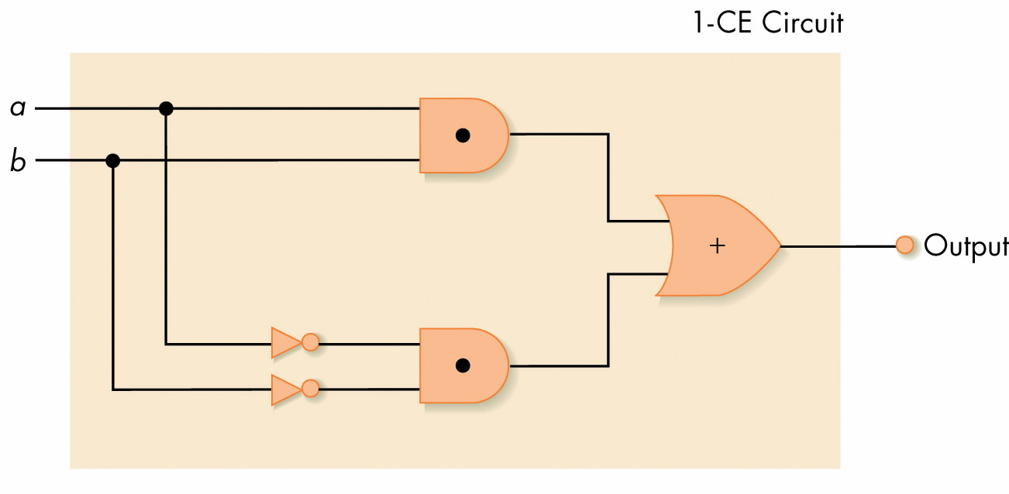
One Bit Equality Circuit
Boolean: a’b’ + ab
Figure 4.22
One-Bit Compare-for-Equality Circuit

Slide 39
BUILDING THE COMPLETE CIRCUIT
If we think of X_{i} as the 1-bit CE circuit with input a_{i} and b_{i}, then the n-bit CE circuit is X₀X₁X₂…X_{n-1} i.e.
X₀ AND X₁ AND X₂ AND… AND X_{n-1}

Slide 40
GENERALIZE FOR AN n-BIT CIRCUIT
Let the 1-CE circuit be represented by the blue box. Note: In the text, it has 1-CE inside. Now, replicate this:
1-CE
a₀
b₀
a₁
b₁
a₂
b₂
a_{n-1}
b_{n-1}
o
o
o
o o o
out

Slide 41
ANOTHER IMPORTANT CIRCUIT--- AN ADDER
Problem:
Given two n-bit non-negative integers, a = a₀a₁a₂…a_{n-1} and b = b₀b₁b₂…b_{n-1}
Find their sum, s_{n}s_{n-1}…s₂s₁s₀.
We need to identify an easier problem and the number of input values and the number of output values for the easier problem.

Slide 42
WHAT IS AN EASIER PROBLEM?
Add two 1 bit numbers a and b.
How many input values and how many output values are needed?
  Recall, you need to expand the solution later to solve the larger problem.
  Therefore, you need to think in terms of column addition.
  Think back on the addition algorithm in Chapter 1.
  For each column, how many input values were needed and how many output values?

Slide 43
EACH COLUMN i NEEDS …
3 input values:
  a_{i} - the ith digit of a
  b_{i} - the ith digit of b
  c_{i} - the carry from the previous column or initially 0
2 output values:
  s_{i} - the ith sum digit of a + b
  c_{i} - the carry to the next column
Pictorially, ….

Slide 44
PICTORIALLY
  a_{i}
  b_{i}
  c_{i}
What is the truth table for this 1-Add circuit?
  s_{i}
  c_{i}
See Fig. 4.24
  a_{i} b_{i} c_{i} s_{i} c_{i}

Slide 45
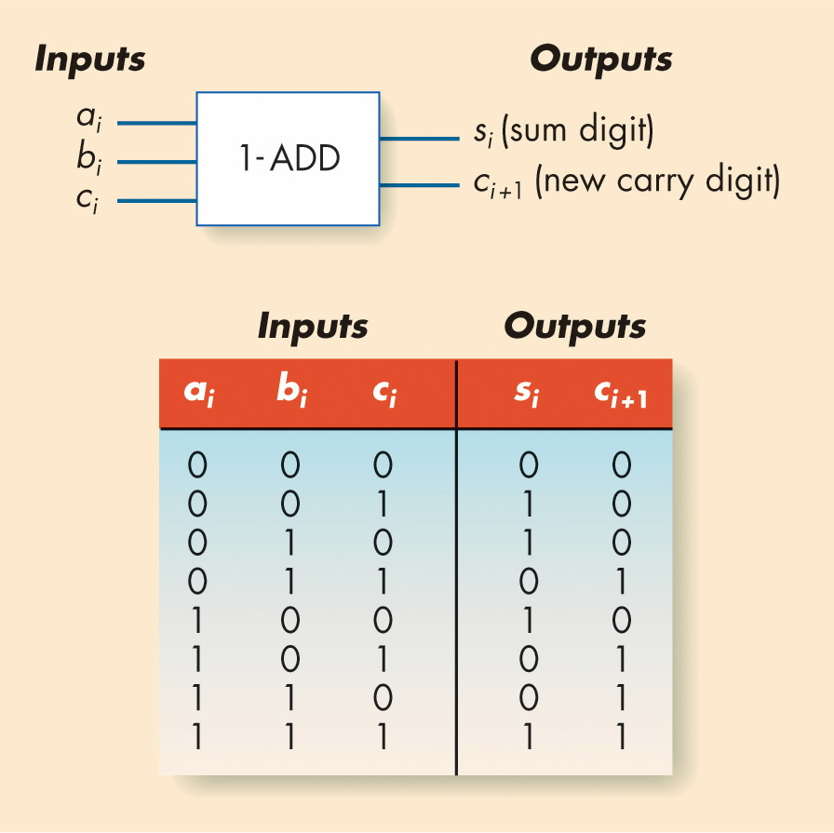
The 1-ADD Circuit and Truth Table
Figure 4.24

Slide 46
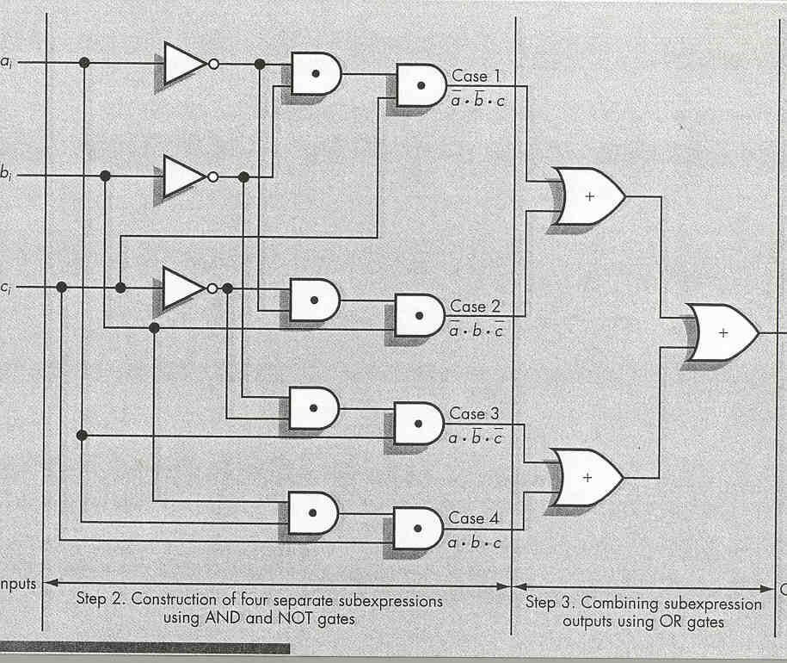
Sum Circuit for 1-Bit Adder

Slide 47
Completing the Full 1-Bit Adder
Design the remainder circuit for the 1-bit adder
Combine the sum and remainder circuits.
  This produces two outputs, a sum and a carry
  Resulting circuit given in next slide or on Figure 4.26, pg 175

Slide 48
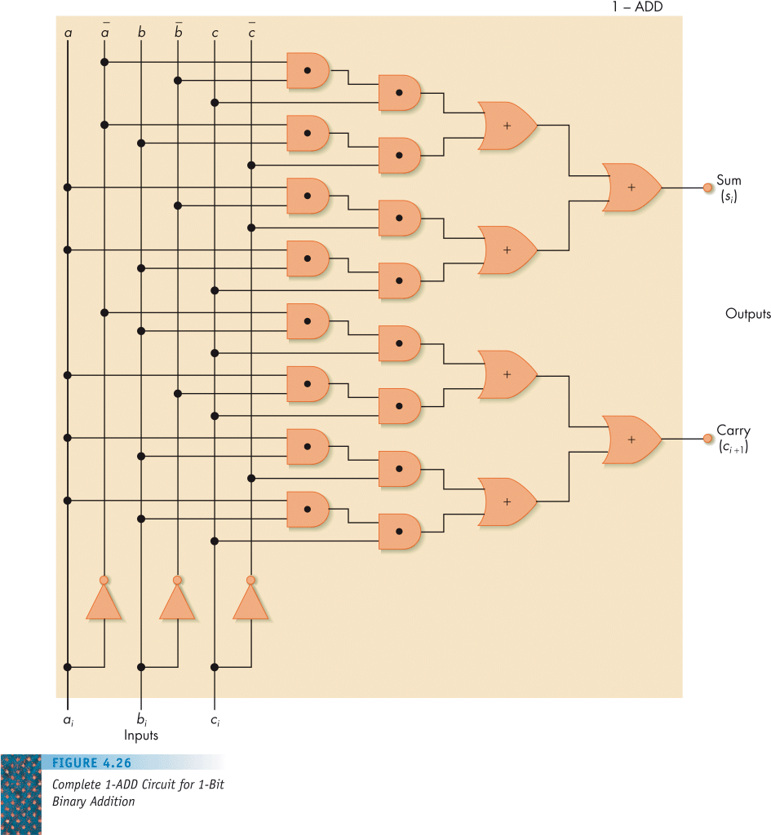

Slide 49
An Addition Circuit for n-Bit Adder
Building the full adder
  Put rightmost bits into 1-ADD, with zero for the input carry
  Send 1-ADD’s output value to output, and put its carry value as input to 1-ADD for next bits to left
  Repeat process for all bits
Final circuit given on next slide & Figure 4.27, pg 176
More than 2,200 transistors are needed to build a 32-bit adder
  1 transistor per NOT gate
  3 transistors per AND/OR gate

Slide 50
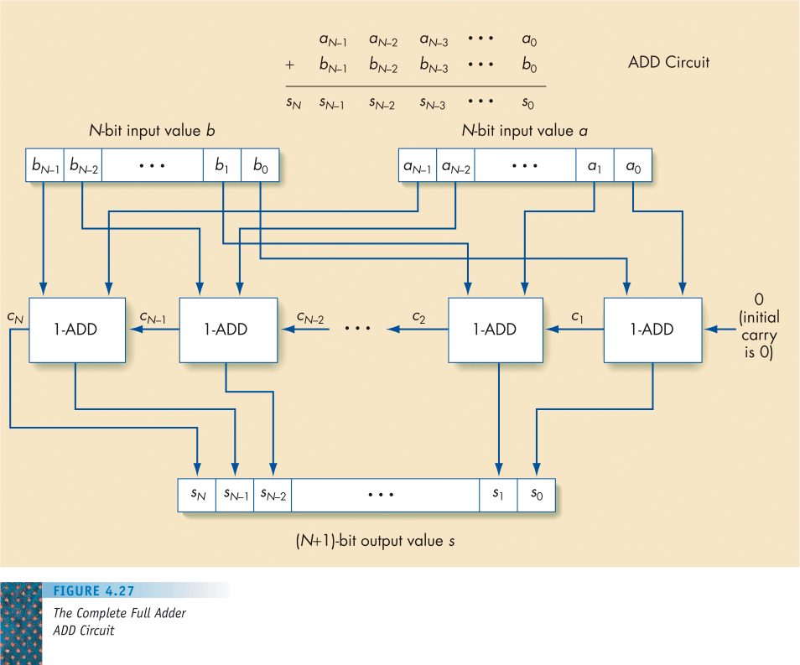

Slide 51
Control Circuits
Do not perform computations
Choose order of operations or select among data values
Major types of controls circuits
  Multiplexors
    Select one of inputs to send to output
  Decoders
    Sends a 1 on one output line based on what input line indicates

Slide 52
Control Circuits (continued)
Multiplexor form
  2^{N} regular input lines
  N selector input lines
  1 output line
Multiplexor purpose
  Given a code number for some input, selects that input to pass along to its output
  Used to choose the right input value to send to a computational circuit

Slide 53
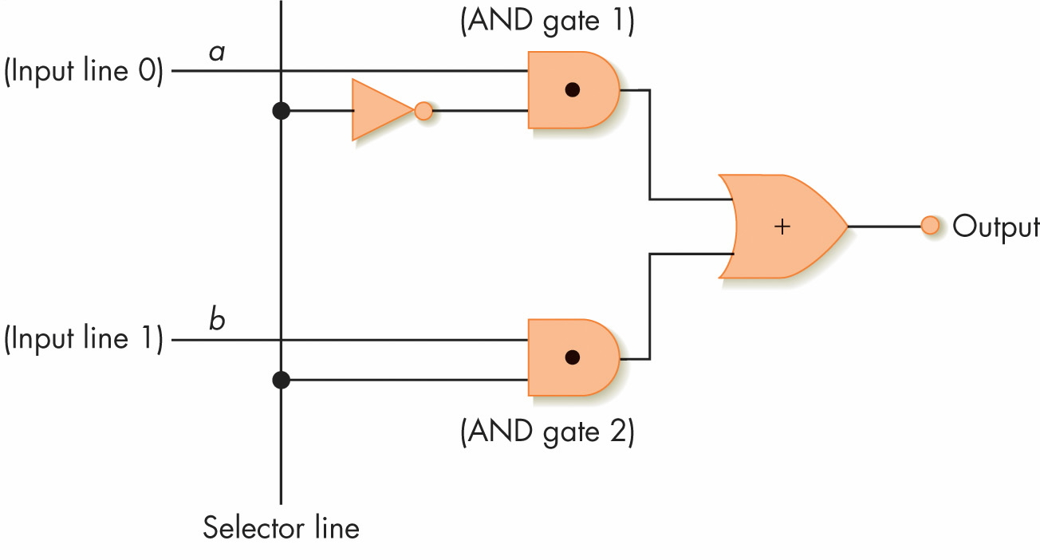
Figure 4.28
A Two-Input Multiplexor Circuit

Slide 54
Control Circuits (continued)
Decoder
  Form
    N input lines
    2^{N} output lines
  N input lines indicate a binary number, which is used to select one of the output lines
  Selected output sends a 1, all others send 0

Slide 55
Control Circuits (continued)
Decoder purpose
  Given a number code for some operation, trigger just that operation to take place
  Numbers might be codes for arithmetic (add, subtract, and so on)
  Decoder signals which operation takes place next

Slide 56
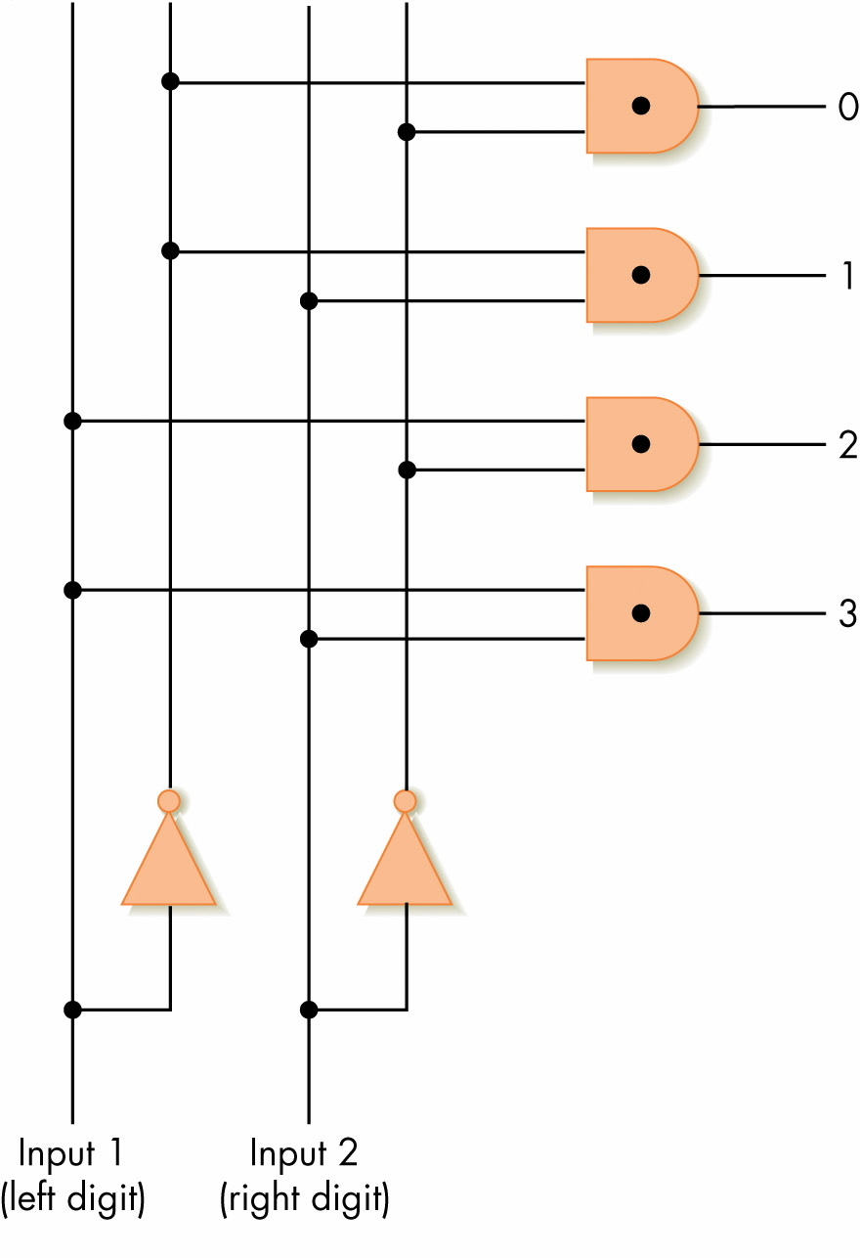
Figure 4.29
A 2-to-4 Decoder Circuit

Slide 57
Summary
Digital computers use binary representations of data: numbers, text, multimedia
Binary values create a bistable environment, making computers reliable
Boolean logic maps easily onto electronic hardware
Circuits are constructed using Boolean expressions as an abstraction
Computational and control circuits can be built from Boolean gates

