Slide 1
CHAPTER 4 – More on Data Representation
CPSC 171
Professor: Oberta A. Slotterbeck (Obie)
Computer Science Department
Hiram College
obie@hiram.edu

Slide 2
Data and Computers
Computers are multimedia devices, dealing with a vast array of information categories. Computers store, present, and help us modify:
  Numbers
  Text
  Sounds
  Images and graphics
  Video

Slide 3
Analog and Digital Information
Information can be represented in one of two ways: analog or digital.
Analog data is a continuous representation, analogous to the actual information it represents.
Digital data is a discrete representation, breaking the information up into separate elements.
Examples: A mercury thermometer is an analog device. The mercury rises in a continuous flow in the tube in direct proportion to the temperature.

Slide 4
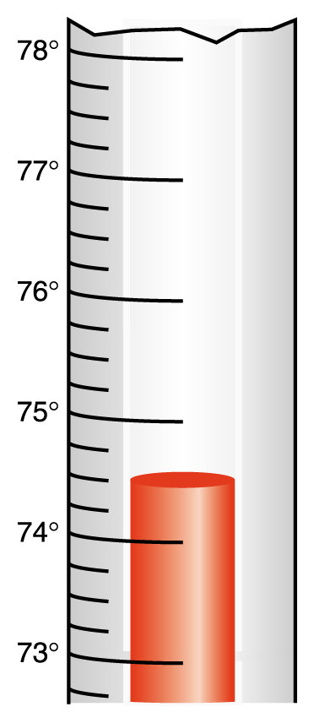
Analog and Digital Information (Cont’d)
Figure 3.1
A mercury thermometer continually rises in direct proportion to the temperature

Slide 5
Analog and Digital Information (Cont’d)
Most computers, cannot work well with analog information. So we digitize information by breaking it into pieces and representing those pieces separately.
Why do we use binary? Modern computers are designed to use and manage binary values because the devices that store and manage the data are far less expensive and far more reliable if they only have to represent two possible values.
Note: There are analog computers, but we won’t study those here.

Slide 6
Electronic Signals
An analog signal continually fluctuates in voltage up and down. But a digital signal has only a high or low state, corresponding to the two binary digits.
All electronic signals (both analog and digital) degrade as they move down a line. That is, the voltage of the signal fluctuates due to environmental effects.

Slide 7

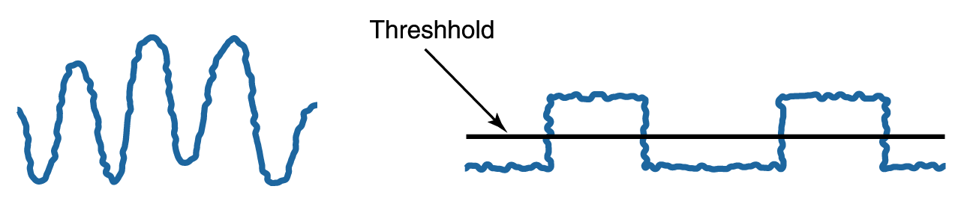
Electronic Signals (Cont’d)
Periodically, a digital signal is reclocked to regain its original shape.
Figure 3.2
An analog and a digital signal
Figure 3.3
Degradation of analog and digital signals

Slide 8
Binary Representations
One bit can be either 0 or 1. Therefore, one bit can represent only two things.
To represent more than two things, we need multiple bits.
Two bits can represent four things because there are four combinations of 0 and 1 that can be made from two bits: 00, 01, 10,11.
Three bits can represent eight things because there are eight combinations of 0 and 1 that can be made from three bits.

Slide 9
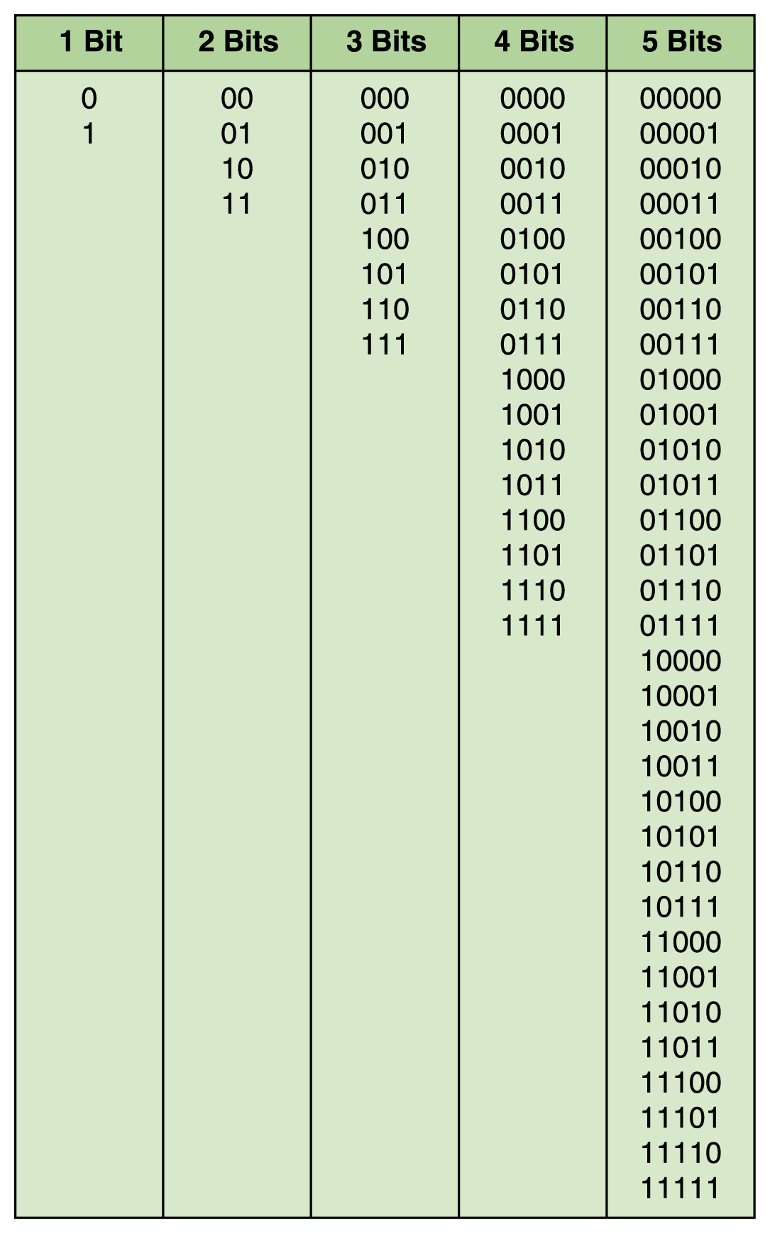
Binary Representations (Cont’d)
Figure 3.4
Bit combinations

Slide 10
Binary Representations (Cont’d)
In general, η bits can represent 2^{η} things because there are 2^{η} combinations of 0 and 1 that can be made from n bits.
Note that every time we increase the number of bits by 1, we double the number of things we can represent.

Slide 11
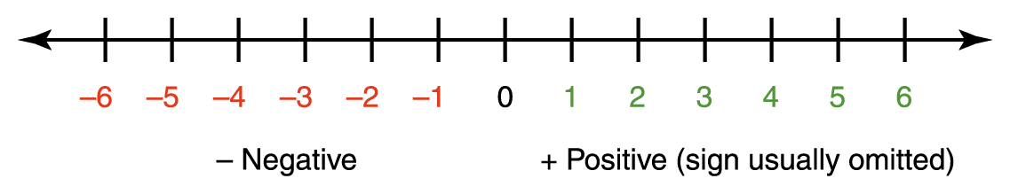
Representing Negative Values
You have used the signed-magnitude representation of numbers since grade school. The sign represents the ordering, and the digits represent the magnitude of the number.

Slide 12
Representing Negative Values
There is a problem with the sign-magnitude representation: There are two representations of zero.
There is a plus zero (+0) and a minus zero (-0).
Two representations of zero within a computer can cause unnecessary complexity. Why?
If we allow only a fixed number of values, we can represent numbers as integer values, where half of them represent negative numbers.

Slide 13
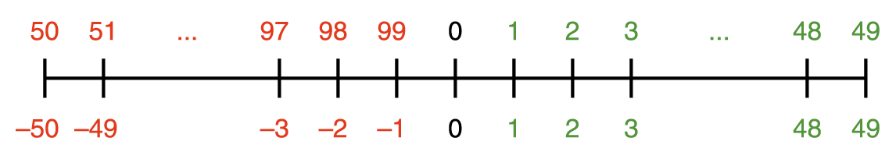
Representing Negative Values
For example, if the maximum number of decimal digits we can represent is two, we can let 1 through 49 be the positive integers 1 through 49 and let 50 through 99 represent the negative integers -50 through -1.
Note- all we are doing is changing the representation of the number – i.e. instead of using -3, we use 97.

Slide 14
There are some very good features of this new representation scheme:
  We have only one representation for each integer, not two for zero.
  Also, we can use a simpler algorithm for adding and subtracting two numbers.
  Other needed algorithms, such as negating a number, do not become unduly complicated with this new representation.

Slide 15
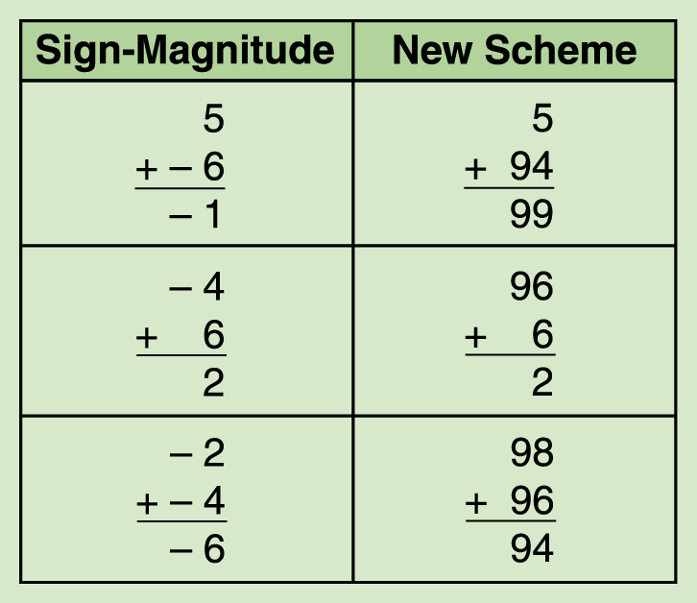
Adding integers represented with the new scheme:
To perform addition within this scheme, you 1) add the numbers together and 2) discard any final carry that takes place.
Note that if we don’t
have to worry about
doing the conversion to
negative numbers, the
algorithm for computing
with the new scheme is
less complicated than
computing with the old
scheme.

Slide 16
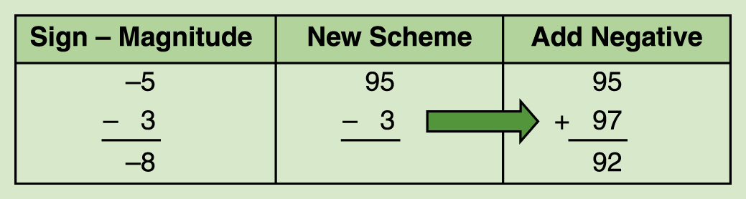
Representing Negative Values (Cont’d)
A-B=A+(-B). We can subtract one number from another by adding the negative of the second to the first.

Slide 17

Representing Negative Values
There is a simple formula that you can use to compute the negative representation in base 10:
So, if k = 2,
Negative(3) is 100-3 or 97.
This representation of negative numbers is called the ten’s complement representation.
Caution: You must fix the number of digits you are using for the representation.

Slide 18
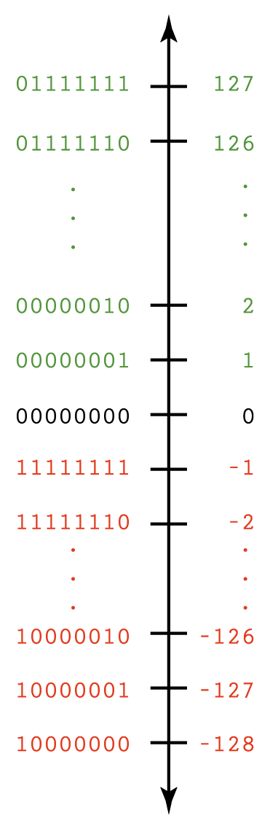
Representing Negative Values (Cont’d)
Negative (I) =
2^{I} – I, where I is the number of digits.
Ex:
Negative(126) =
2⁸ - 126=
256 – 126 =
130 =
1000 0010₂
Note: All negative numbers begin with a 1.
Two’s Complement:
To make it easier to look at long binary numbers, we make the number line vertical.
The negative number representation formula is the like the one for base 10, although, as we will see, there is an even easier way to negate a number in base 2.

Slide 19
Representing Negative Values (Cont’d)
Addition and subtraction are accomplished the same way as in 10’s complement arithmetic –ie
  Add the numbers.
  If there is a carry out of the leftmost bit, drop the carry.
  Notice that with this representation, the leftmost bit in a negative number is always a 1.

Slide 20
How do we obtain a two’s complement number, if we start with a decimal number?
If the number is positive, its two’s complement representation is just the binary representation for the number.
The formula is similar to the one for 10’s complement, but then you have to do binary computation.
There is an easier algorithm.
However, you must decide in advance how many bits you are going to use for the representation.

Slide 21
Convert from decimal to two’s complement representation
We already know how to convert a positive integer to binary:
  127₁₀ = 0111 1111₂
To convert -127 to binary,
1. First convert +127 as above.
2. Flip the bits: 1000 0000
3. Add 1 to the flipped numeral:
    1000 0001
This is the two’s complement representation for
    -127.

Slide 22
Instead of using the formula for finding the negative of a base 2 number, computers use the flipping bit algorithm we just used. Why?
As we will see later, multiplication is a slow operation compared to addition.
Thus, calculating 2^{I} –I is slower than flipping bits and adding 1.
As integers are stored in binary notation, calculating the negative of an integer is easy.

Slide 23
Examples: Find the negatives of each of the following which use 3 bits for the representation and check that they are correct.
Note: The same algorithm is used whether you are converting a positive or a negative number.
1 0 1 flip 0 1 0
add 1: 0 1 1
Check: 0 1 1 is 3 and 2³ – 3 is 5. It’s OK
0 0 1 flip 1 1 0
add 1 1 1 1
Check: 0 0 1 is 1 and 2³ – 1 is 7. It’s OK
Caution: 1 0 1 as a signed number is -3
But 1 0 1 as an unsigned number is 5.

Slide 24
Almost every computer today uses two’s complement to store integers
Why?
Recall the algorithms for addition and subtraction are more simple when two’s complement rather than sign magnitude is used for the representation.
As we will see, simpler algorithms translate into less complex circuitry.

Slide 25
One more example:
Using a five bit representation, use two’s complement to compute the following and verify the answers are correct.
4 + 8
4 – 8 [or 4 + (-8)]
-4 + 8
-4 – 8 [ or -4 + (-8)]
Ex 1: Compute 4 + 8:
4 = 00100
8 = 01000
4 + 8 = 01100 (or 12) which is correct.

Slide 26
Ex 2: Compute 4 - 8
4 – 8 = 4 + (-8)
8 is 01000 and -8 is 10111 + 1 (or 11000)
4 = 00100
-8 = 11000
4 + -8 = 11100.
The answer is a negative number, so to find its value we must flip and add: 00011 + 1 = 00100 or 4.
This says 11100 is -4 and the answer is correct.

Slide 27
Ex 3: Compute -4 + 8
-4 = 11100 (from last slide)
8 = 01000
-4 + 8 = 00100 which is clearly 4
Note the sum in the leftmost column was 11 and the leftmost bit was dropped.
Ex 4: Compute -4 -8 (which equals -4 + -8)
From earlier slides,
-4 = 11100
-8 = 11000
-4 + -8 =10100. a negative number. So, flip and add to see what it is: 01011 + 1 = 01100 or 12.
So the answer is -12 which is correct.

Slide 28
Why this algorithm is so much better for a computer to use than the one we tend to use.
When a number is typed at the keyboard, it is transmitted to the computer and immediately converted to binary.
All of the arithmetic is done in binary form and the number is not converted back to decimal form until output is desired.
Then to add or subtract, the two numbers are just added in binary with the leftmost bit being dropped if there is a carry.
Negating is also an easy algorithm as instead of multiplying and then subtracting, the bits are just flipped and 1 is added.

Slide 29
Think how you do the following and describe exactly what you do:
One rule- You can’t use a number line to describe the addition.
4 + 8 – a basic fact learned in an early grade
4 + -8
-4 + 8
- 4 + -8
Notice that you need to introduce the concept of subtraction and also the concept of absolute value (or the magnitude of a number).

Slide 30
Number Overflow
Overflow occurs when the value that we compute cannot fit into the number of bits we have allocated for the result. For example, if each value is stored using eight bits, adding 127 to 3 produces overflow:
  0111 1111
  + 0000 0011
  1000 0010 Why is this obviously wrong?
Overflow is a classic example of the type of problems we encounter by mapping an infinite world onto a finite machine.

Slide 31
Important Facts About Computers
Assume you are using the hardware representations of numbers.
If integer arithmetic is used, you can encounter an overflow situation (just like an odometer on your car!)
If floating-point arithmetic is used,
  1) You may introduce an error when representing the number.
  123456789.00 becomes 12345*10⁴ with a loss of 6789.
  2) This error is compounded when arithmetic is performed.
  Think of adding 123456789.00 one million times!
  You will have an error of 6,789,000,000 when you finish.
(Note: When these situations arise, these types of problems can be avoided by programming the arithmetic operations rather than using the hardware operations. However, hardware operations execute faster than software operations.)

Slide 32
Representing a binary floating point value
Likewise, a binary floating point value is defined by the following formula:
  sign * mantissa * 2^{exp}
  where the mantissa and exp are integers written in binary.
The number of bits used for the mantissa and the number of bits used for exp differ in different computers.
Moreover, the exact scheme that is used is not standardized.
Many move the radix point so it is to left of the leading 1.

Slide 33
Representing Decimal Numbers
The binary representation, can be expanded to handle decimal numbers. Let’s deal first with only simple fractional parts, although that restriction is not necessary as we will see.
13.75 is 13 + 1/2 + 1/4 or
1101.11₂
Even decimal numbers such as 13.1 can be represented although 13 + 1/10 can't be represented exactly since we can't write
1/10 = ?/2 + ?/4 + ?/8 + ...
without using an infinitely repeating expression.

Slide 34
Once the decimal representation is written in binary form--- i.e.
13.75 is 13 + 1/2 + 1/4 or
1101.11₂
different computer designers use different representations internally.
Most normalize the number first (i.e. move the radix point to the left of the first 1 in the fractional part):
i.e. 1101.11₂ = .110111₂ * 2⁴
mantissa exponent (with sign)
and then put the pieces together in different ways.

Slide 35
We will use the following as a simple example: (moving left to right):
number sign 1 bit | mantissa left-justified 9 bits | exponent sign 1 bit | exponent right justified 5 bits
sign of number : 1 bit
mantissa (left- justified) : 9 bits
sign of exponent : 1 bit
exponent (right-justified) as a positive binary integer: 5 bits
Example:
1101.11₂ = .110111₂ * 2⁴ (normalize first)
would become: 0 110111000 0 00100

Slide 36
Example:
-0.00000110111₂ = - 0.110111₂ * 2⁻⁵
would become: 1 110111000 1 00101
Note: If you move the radix point left, the exponent for 2 is positive. If you move the radix point right, the exponent is negative.
Note: You always have a one after the radix point.
Caution: Each computer designer team can chose its own fractional representation.
But, this form we have here is fairly generic and somewhat typical in style to ones used in actual computers.

Slide 37
Converting from base 10 to binary – an algorithm
To convert a positive integer x,
call x the quotient.
originally there are no bits in the result.
while the quotient is greater than zero repeat the next two commands:
[divide the quotient by 2 to obtain (a new) quotient.
  record the remainder as the next bit to the left of the previous result.]
  Example: convert 20 to binary using the above algorithm
  20 ÷ 2 is 10 with remainder of 0 result is 0
  10 ÷ 2 is 5 with remainder of 0 result is 00
  5 ÷ 2 is 2 with remainder of 1 result is 100
  2 ÷ 2 is 1 with remainder of 0 result is 0100
  1 ÷ 2 is 0 with remainder of 1 result is 10100
  Therefore, 20₁₀ is 10100₂.

Slide 38
Converting from base 10 to binary – an algorithm
To convert the fractional part, x, of a floating point number, we multiply by the new base:
  call x the product.
  originally there are no bits in the result.
  repeat the next three commands until the desired number of bits is obtained
  [multiply the product by 2 to obtain (a new) product.
  record the number to the left of the radix point (It will be a 0 or 1) as the next bit on the right of the new result.
  call the fractional part of the product the product.]
Example: convert .435₁₀ to a 5 bit binary representation
.435 * 2 is 0.870 result is 0.0
.870 * 2 is 1.740 result is 0.01
.740 * 2 is 1.480 result is 0.011
.480 * 2 is 0.960 result is 0.0110
.960 * 2 is 1.920 result is 0.01101
Therefore, 0.435₁₀ is 0.01101₂ , correct to 5 bits.

Slide 39
Checking
0.01101₂ = 1/4 + 1/8 + + 1/32
        = 8/32 + 4/32 + 1/32
        = 13/32
        = 0.40625 ≠ 0.435
Fact: About 3 1/3 bits are needed for one decimal digit of precision. As we only computed 5 bits, we can only expect the first digit (the 4) to be correct. It is.
We would need to compute 10 bits to see if we were really correct.
If we do so, we obtain
0.0110 1111 01 = 445/1024
= 0.4345703125
= 0.435 (correct to 3 decimal places.)
Note that an error of 0.0000011101 is introduced by the finite size of the representation.
That is an error of 1/64 + 1/128 + 1/256 + 1/1024 or 29/1024

Slide 40
Note- this conversion for fractional numbers is another source of errors in a computer
0.10 in base 10 is a terminating decimal – i.e. it is represented exactly.
However, 1/3 cannot be represented exactly in base 10. It is 0.3333.... where the number of threes is infinite.
If you were to allow only 4 digits after the decimal point in the representation, then every time you should work with 0.33333333...., you would be working with 0.3333 and you would introduce a 0.00003333 error due to the representation.
The same thing happens in binary, but since the base is different, some numbers with terminating representations in base 10 will have non-terminating representations in base 2, and vice versa.

Slide 41
Note the errors we have been discussing that are introduced by finite representations of infinite phenomena
Hold for not only computers, but calculators.
The question is, “How much error are you willing to tolerate?”

Slide 42
Representing Real Numbers
Scientific notation is a term with which you may already be familiar, so we mention it here.
Scientific notation is a form of floating-point representation in which the decimal point is kept to the right of the leftmost digit.
For example, 12001.32708 would be written as 1.200132708E+4 in scientific notation.

Slide 43
Representing Text
To represent a text document in digital form, we simply need to be able to represent every possible character that may appear.
There are finite number of characters to represent. So the general approach for representing characters is to list them all and assign each a binary string.
A character set is simply a list of characters and the codes used to represent each one. By agreeing to use a particular character set, computer manufacturers have made the processing of text data easier.
This was not the case in the early days of computing.

Slide 44
The ASCII Character Set
ASCII (pronounced askie) stands for American Standard Code for Information Interchange. The ASCII character set originally used seven bits to represent each character, allowing for 128 unique characters.
Later ASCII evolved so that all eight bits were used which allows for 256 characters.

Slide 45
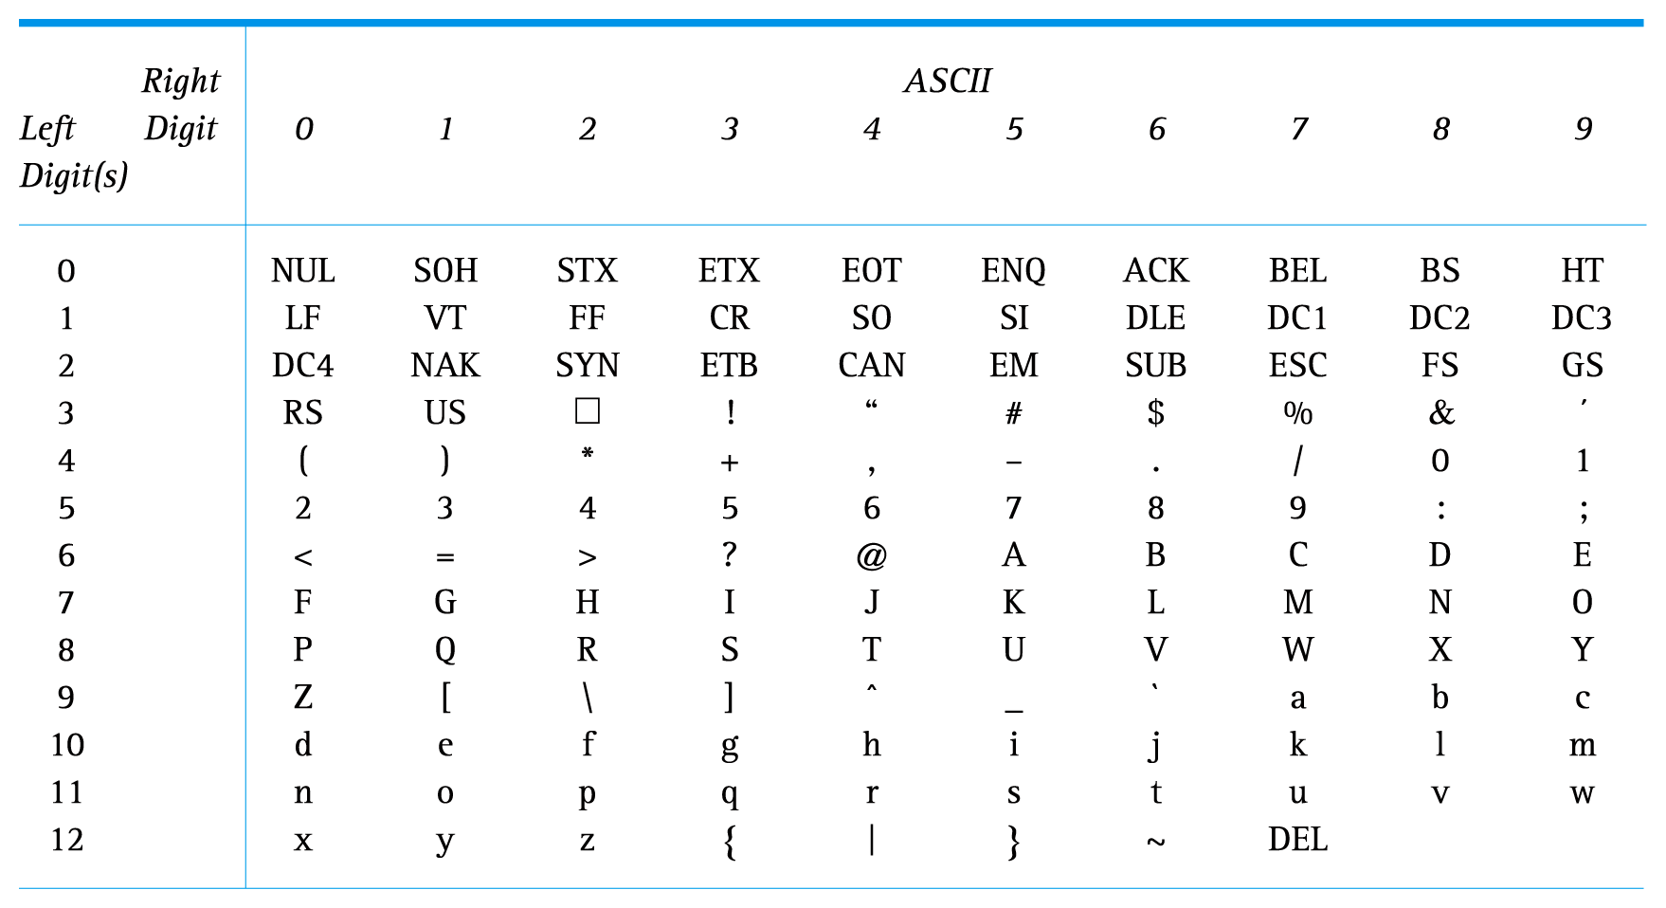
The ASCII Character Set (Cont’d)
Note: These are given in decimal. So,
“A” is 65 which is 0100 0001 in binary.

Slide 46
The ASCII Character Set (Cont’d)
Note that the first 32 characters in the ASCII character chart do not have a simple character representation that you could print to the screen.

Slide 47
The Unicode Character Set
The extended version of the ASCII character set is not enough for international use.
The Unicode character set uses 16 bits per character. Therefore, the Unicode character set can represent 2¹⁶, or over 65 thousand, characters.
Unicode was designed to be a superset of ASCII. That is, the first 256 characters in the Unicode character set correspond exactly to the extended ASCII character set.

Slide 48
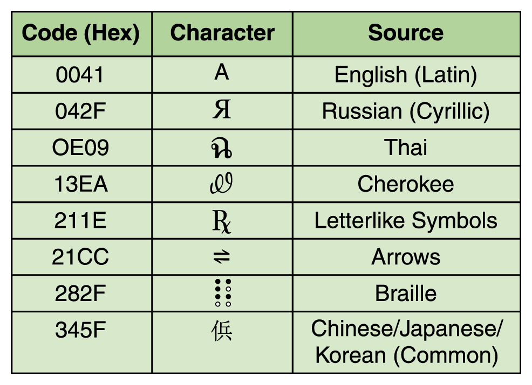
The Unicode Character Set (Cont’d)
Figure 3.6 A few characters in the Unicode character set

Slide 49
Data and Computers
Compression techniques have always been important –
  In earlier years : Because the size of computer memory was limited and expensive.
  Today: Because bandwidth (the number of bits or bytes that can be transmitted over the internet) is limited.

Slide 50
Data and Computers (Cont’d)
Data compression–reducing the amount of space needed to store a piece of data.
Compression ratio–is the size of the compressed data divided by the size of the original data.
A data compression technique can be lossless, which means the data can be retrieved without losing any of the original information.
Or it can be lossy, in which case some information is lost in the process of compaction.

Slide 51
Text Compression
It is important that we find ways to store text efficiently and transmit text efficiently
We will look briefly at three types of text compression:
  keyword encoding
  run-length encoding
  Huffman encoding

Slide 52
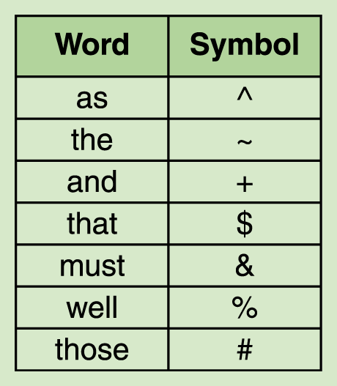
Keyword Encoding
Frequently used words are replaced with a single character. For example:, we could use the following:

Slide 53
Keyword Encoding (Cont’d)
Using the previous table, encode the text:
  The human body is composed of many independent systems, such as the circulatory system, the respiratory system, and the reproductive system. Not only must all systems work independently, they must interact and cooperate as well. Overall health is a function of the well-being of separate systems, as well as how these separate systems work in concert.

Slide 54
Keyword Encoding (Cont’d)
The encoded paragraph is:
  The human body is composed of many independent systems, such ^ ~ circulatory system, ~ respiratory system, + ~ reproductive system. Not only & each system work independently, they & interact + cooperate ^ %. Overall health is a function of ~ %- being of separate systems, ^ % ^ how # separate systems work in concert.

Slide 55
Keyword Encoding (Cont’d)
There are a total of 349 characters in the original paragraph including spaces and punctuation.
The encoded paragraph contains 314 characters, resulting in a savings of 35 characters.
The compression ratio for this example is 314/349 or approximately 0.9.
The characters we use to encode cannot be part of the original text.

Slide 56
Run-Length Encoding
A single character may be repeated over and over again in a long sequence. This type of repetition doesn’t generally take place in English text, but often occurs in large data streams such as genome sequences.
In run-length encoding, a sequence of repeated characters is replaced by a flag character, followed by the repeated character, followed by a single digit that indicates how many times the character is repeated.

Slide 57
Run-Length Encoding (Cont’d)
AAAAAAA would be encoded as: *A7
*n5*x9ccc*h6 some other text *k8eee would be decoded into the following original text:
nnnnnxxxxxxxxxccchhhhhh some other text kkkkkkkkeee
The original text contains 51 characters, and the encoded string contains 35 characters, giving us a compression ratio in this example of 35/51 or approximately 0.68.
Since we are using one character for the repetition count, it seems that we can’t encode repetition lengths greater than nine. Instead of interpreting the count character as an ASCII digit, we could interpret it as a binary number.
Thus, AAAA AAAA AAAA would be encoded as
  0010 1010 0100 0001 0000 1100
2A₁₆ (or “*”) 41₁₆ (or “A”) 12 in binary

Slide 58
Huffman Encoding
Why should the character “X”, which is seldom used in text, take up the same number of bits as the blank, which is used very frequently?
Huffman codes use variable-length bit strings to represent each character.
A few characters may be represented by five bits, and others by six bits, and yet others by seven bits, and so forth.

Slide 59
Huffman Encoding (Cont’d)
If we use only a few bits to represent characters that appear often and reserve longer bit strings for characters that don’t appear often, the overall size of the document being represented is small.

Slide 60
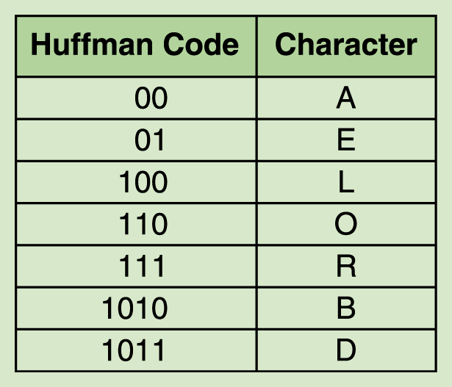
Huffman Encoding (Cont’d)
For example

Slide 61
Huffman Encoding (Cont’d)
DOORBELL would be encoded in binary as: 1011 110 110 111 1010 01 100 100.
If we used a fixed-size bit string to represent each character (say, 8 bits), then the binary from of the original string would be 64 bits. The Huffman encoding for that string is 25 bits long, giving a compression ratio of 25/64, or approximately 0.39.
An important characteristic of any Huffman encoding is that no bit string used to represent a character is the prefix of any other bit string used to represent a character.

Slide 62
Note: We did not see how to arrive at a Huffman encoding although the text gives an intuitive explanation of the process if you are interested. (pg 73)

Slide 63
Representing Audio Information
We perceive sound when a series of air compressions vibrate a membrane in our ear, which sends signals to our brain.
A stereo sends an electrical signal to a speaker to produce sound. This signal is an analog representation of the sound wave. The voltage in the signal varies in direct proportion to the sound wave.

Slide 64
Representing Audio Information (Cont’d)
To digitize the signal we periodically measure the voltage of the signal and record the appropriate numeric value. The process is called sampling.
In general, a sampling rate of around 40,000 times per second is enough to create a reasonable sound reproduction.

Slide 65
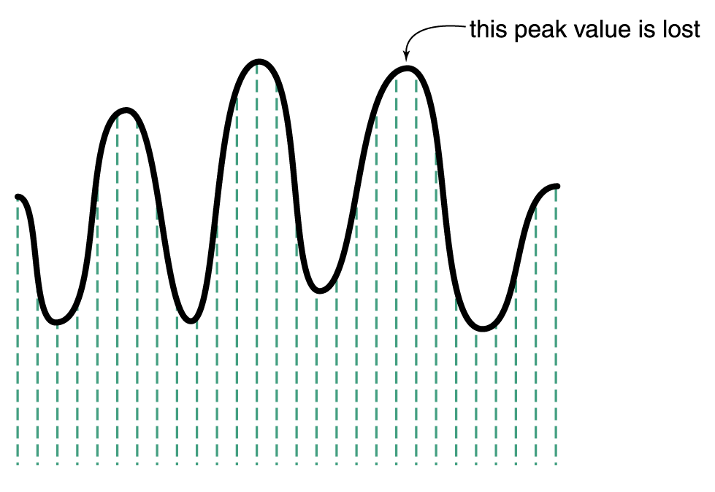
Representing Audio Information (Cont’d)
Figure 3.8 Sampling an audio signal

Slide 66
Representing Audio Information (Cont’d)
A compact disk (CD) stores audio information digitally.
On the surface of the CD are microscopic pits that represent binary digits.
A low intensity laser is pointed at the disc.
The laser light reflects strongly if the surface is smooth and reflects poorly if the surface is pitted.

Slide 67
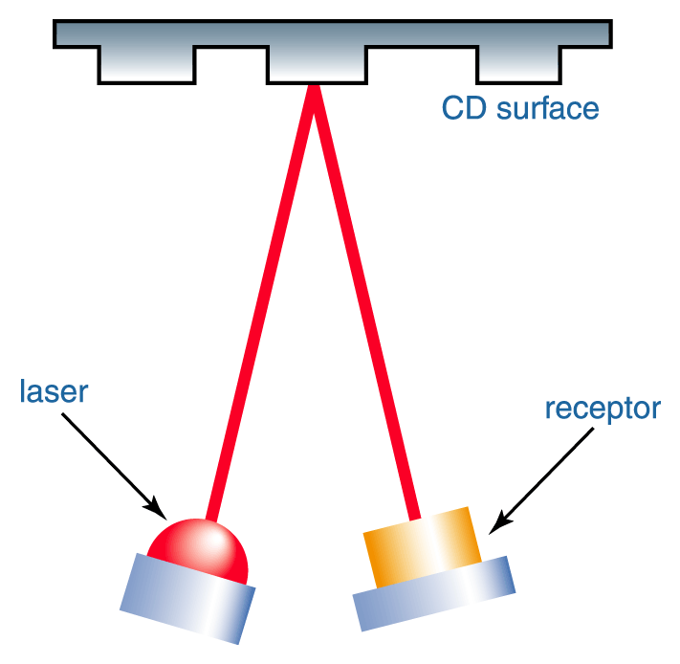
Representing Audio Information (Cont’d)
Figure 3.9
A CD player reading binary information
The receptor analyzes the reflection and recreates the string of binary data which stored the original numeric voltage data.

Slide 68
Audio Formats
Several popular formats are: WAV, AU, AIFF, VQF, and MP3. Currently, the dominant format for compressing audio data is MP3.
MP3 is short for MPEG-2, audio layer 3 file.
MP3 employs both lossy and lossless compression.
  First it analyzes the frequency spread and compares it to mathematical models of human psychoacoustics (the study of the interrelation between the ear and the brain).
  It discards information that can’t be heard by humans.
  The bit stream is compressed using a form of Huffman encoding to achieve additional compression.

Slide 69
Representing Images and Graphics
Color is our perception of the various frequencies of light that reach the retinas of our eyes.
Our retinas have three types of color photoreceptor cone cells that respond to different sets of frequencies. These photoreceptor categories correspond to the colors of red, green, and blue.

Slide 70
Representing Images and Graphics (Cont’d)
Color is often expressed in a computer as an RGB (red-green-blue) value, which is actually three numbers that indicate the relative contribution of each of these three primary colors.
For example, an RGB value of
(255, 255, 0) maximizes the contribution of red and green, and minimizes the contribution of blue, which results in a bright yellow.

Slide 71
Additive Mixing – What is It?
Mixes different spectral wavelengths producing an increase in the number of frequencies.
Adding more light energy makes the mixture brighter.
  Example: Theater lights on stage or set.
  Example: For all practical purposes, a computer monitor.
With additive color, the primary colors are
  red
  green
  blue
When mixed, these produce the color white.

Slide 72
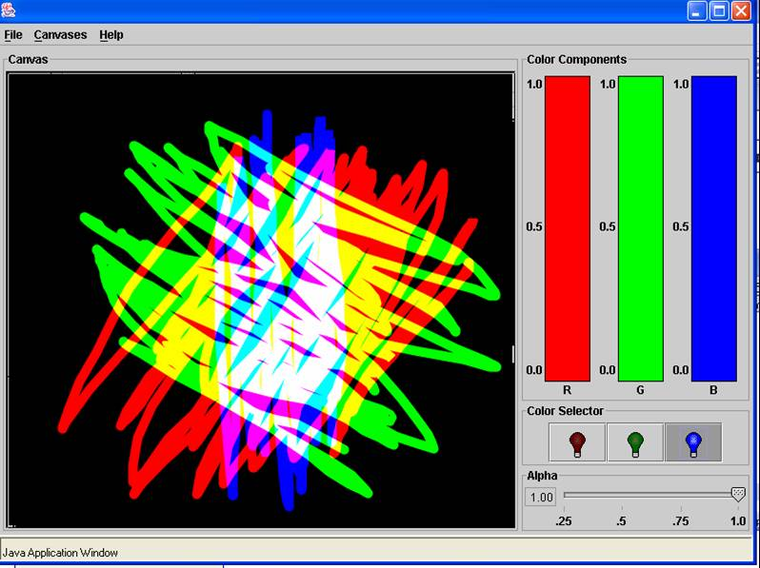
Additive mixing:

Slide 73
Subtractive Mixing – What is It?
Each color when mixed with another acts as a filter, subtracting some set of light frequencies from the total mixture.
Example: Mixing paints or pigments
  The color of paint is a filter that removes all the light frequencies except the one meeting the eye.
  For example, red objects reflect wavelengths that look red to our eye.
  Mixing different paints lead to darker and darker paints.
Printing uses subtractive mixing.

Slide 74
Subtractive Color
The primary colors for subtractive colors, used in printing,
  cyan
  magenta
  yellow
When mixed, these produce a dirty looking brown.

Slide 75
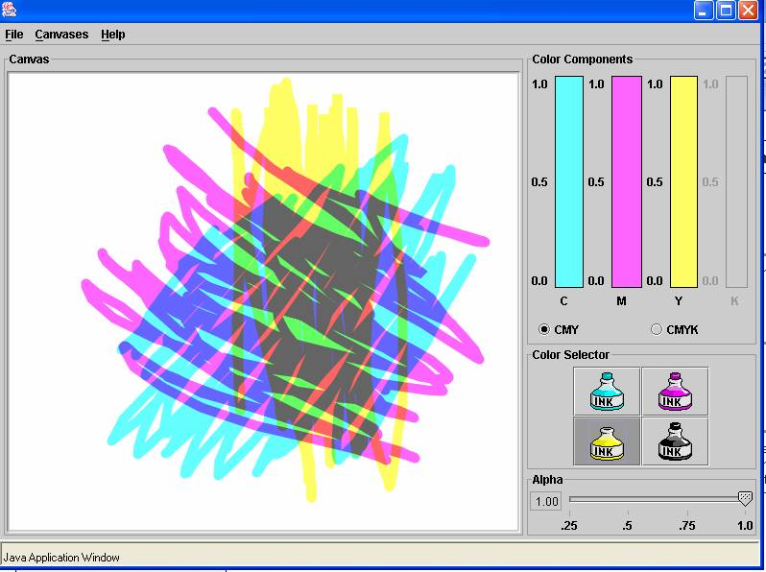
Subtractive mixing:

Slide 76
Primary Colors (Primaries)-summary
The additive primaries for light (RGB color):
  Red
  Green
  Blue
The subtractive primaries for paint (CMY)
  Cyan
  Magenta
  Yellow

Slide 77
Part Additive – Part Subtractive
There are drawbacks to both schemes to the computer artist:
  White is produced too quickly when additive mixing is used.
    In physical world, red + white = pink.
  A muddy looking black is produced too quickly when subtractive mixing is used.
Most computer programs for art work simulate both mixing schemes even thought the final monitor image is produced additively.
Brushes with different flow and hardness settings also allow us to control the percentages of color that are added.

Slide 78
Representing Images and Graphics (Cont’d)
The amount of data that is used to represent a color is called the color depth.
HiColor is a MS term that indicates a 16-bit color depth.
Five bits are used for each number in an RGB value and the extra bit is sometimes used to represent transparency.
TrueColor ,another MS term, indicates a 24-bit color depth. Therefore, each number in an RGB value gets eight bits.

Slide 79
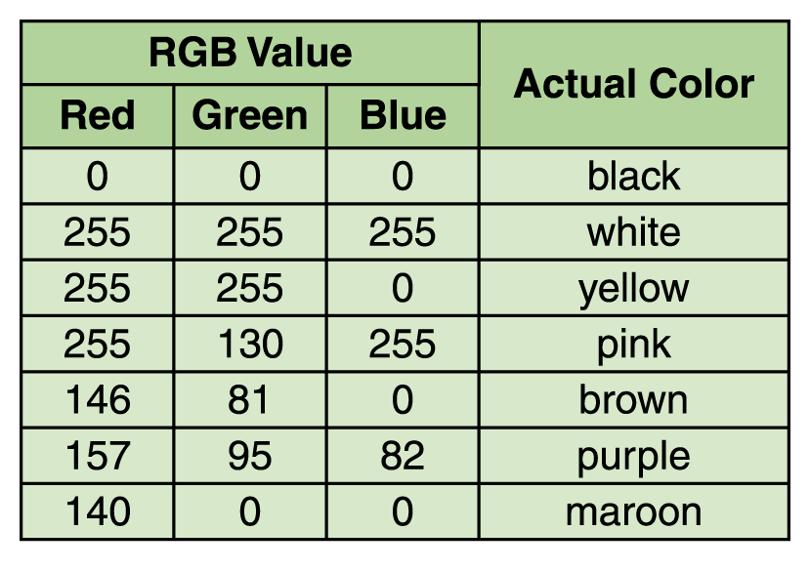
Representing Images and Graphics (Cont’d)

Slide 80
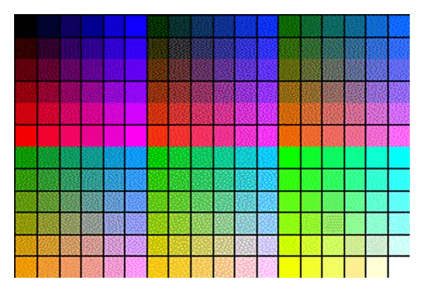
Indexed Color
A particular application such as a browser may support only a certain number of specific colors, creating a palette from which to choose. For example, the Netscape Navigator’s color palette:
Figure 3.11
The Netscape color palette

Slide 81
Digitized Images and Graphics
Digitizing a picture is the act of representing it as a collection of individual dots called pixels.
The number of pixels used to represent a picture is called the resolution.
The storage of image information on a pixel-by-pixel basis is called a raster-graphics format. Several popular raster file formats include bitmap (BMP), GIF, and JPEG.

Slide 82
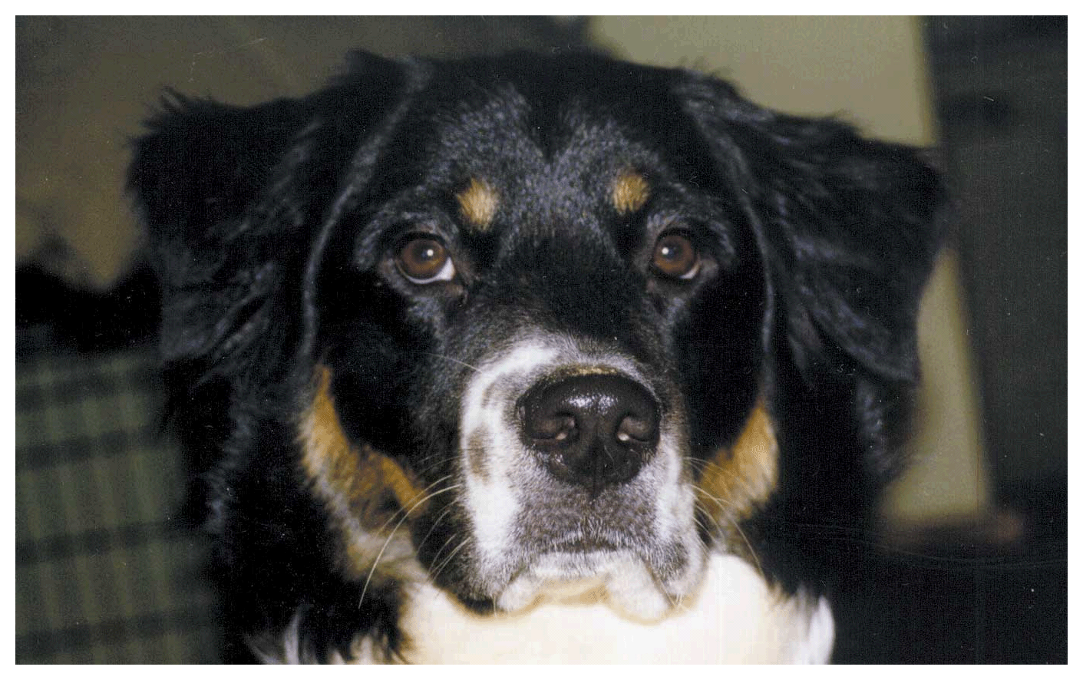
Digitized Images and Graphics (Cont’d)
Figure 3.12 A digitized picture composed of many individual pixels

Slide 83
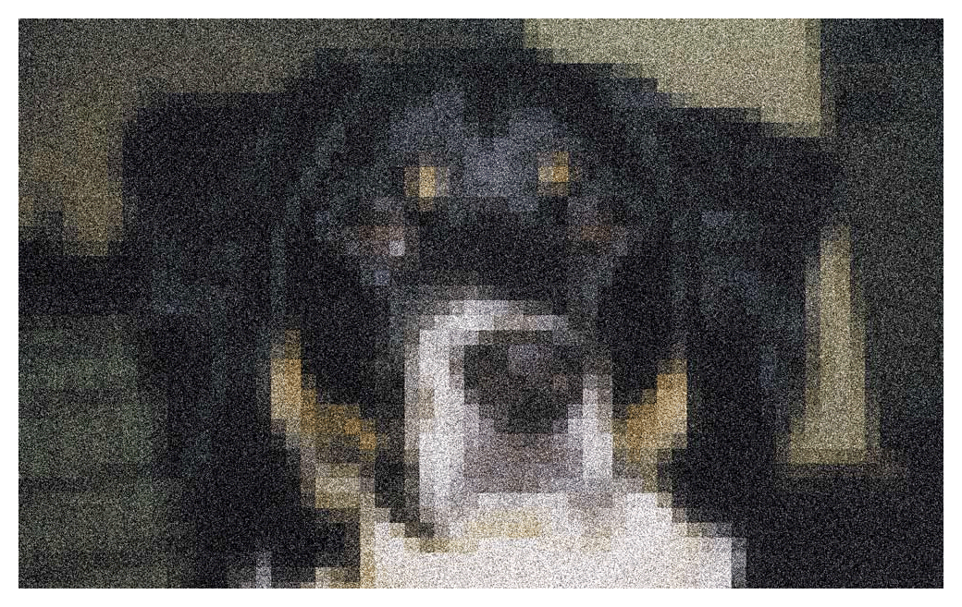
Digitized Images and Graphics (Cont’d)
Figure 3.12 A digitized picture composed of many individual pixels

Slide 84
Vector Graphics
Instead of assigning colors to pixels as we do in raster graphics, a vector-graphics format describes an image in terms of lines and geometric shapes.
A vector graphic is a series of commands that describe a line’s direction, thickness, and color.
The file size for these formats tend to be small because every pixel does not have to be accounted for.

Slide 85
Vector Graphics (Cont’d)
Vector graphics can be resized mathematically, and these changes can be calculated dynamically as needed.
However, vector graphics is not good for representing real-world images.
Adobe Photoshop supports predominately raster graphics, although if you use the drawing tool you obtain vector graphics.
Adobe Illustrator supports vector graphics.
In the Adobe products, you can’t print vector graphics images unless you convert them to raster images (using the stroke command).

Slide 86
Still Picture Compression – raster graphics
If you take a picture of a blue sky with clouds in it, probably there will be large areas of blue and large areas of white.
In an uncompressed picture, you might have the following data: PIXEL 1,1=BLUE, PIXEL 2,1=BLUE, PIXEL 3,1=BLUE, PIXEL 4,1=BLUE, PIXEL 5,1=BLUE and so forth for a few hundred thousand pixels.
Then, you begin to see the cloud: PIXEL 443,540=WHITE, PIXEL 443,541=WHITE, PIXEL 443,542=WHITE, PIXEL 443,543=SLIGHTLY-OFF-WHITE, and so on.
This is a tremendous amount of data to describe for just one picture, which is why an uncompressed picture can often take up 5 or 10 MB of storage space.
Methods similar to those used for text can be used to compress still pictures.

Slide 87
Representing Video
A video codec COmpressor/DECompressor refers to the methods used to shrink the size of a movie to allow it to be played on a computer or over a network. Almost all video codecs use lossy compression to minimize the huge amounts of data associated with video.

Slide 88
Representing Video (Cont’d)
Two types of compression: temporal and spatial.
Temporal compression looks for differences between consecutive frames. If most of an image in two frames hasn’t changed, why should we waste space to duplicate all of the similar information?
Spatial compression removes redundant information within a frame. This problem is essentially the same as that faced when compressing still images.

Slide 89
A Bit More on Circuits

Slide 90
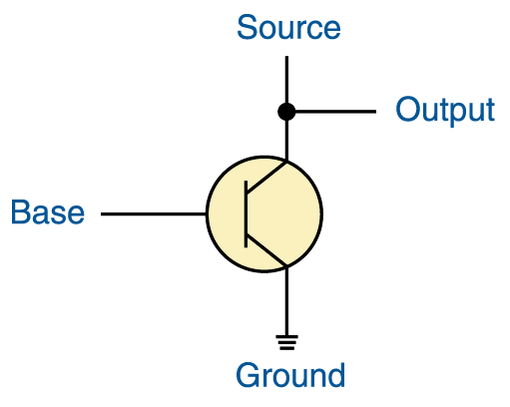
Constructing Gates
A transistor has three terminals
  A source
  A base
  An emitter, typically connected to a ground wire
The source produces a high value of ~5 volts.
The base value regulates a gate that determines whether the connection between the source and the ground is made.
Figure 4.8 The connections of a transistor

Slide 91
Constructing Gates
If the source value is grounded, it is pulled downward and the output value is low. This is interpreted as a 0.
If the source value is not grounded, the value stays high and the output value is high. This is interpreted as a 1.
Figure 4.8 The connections of a transistor
A high voltage (~5 volts) on the base line will ground the source and the transistor is off.
A low voltage on the base line will not ground the source and the transistor is on.

Slide 92
Summary of How a Transistor Reacts in Terms of 0s and 1s
The source produces a high voltage.
If the base is 0 (low voltage), the output is 1 (high voltage). The “switch” is closed.
If the base is 1 (high voltage), the output is 0 (low voltage). The “switch” is open.
Figure 4.8 The connections of a transistor

Slide 93
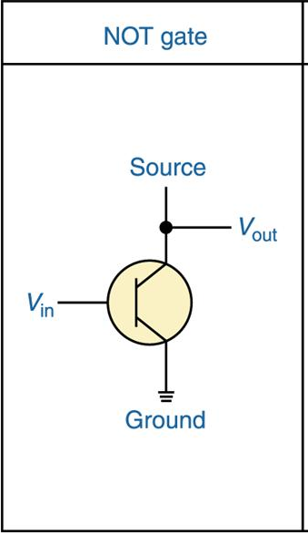
Constructing Gates - NOT
Because of the way a transistor works, the easiest gates to create are the NOT, NAND, and NOR gates.
The NOT gate is the simplest as it is just a transistor with the input line being the base and the output line as before!
Thus, if you remember how a NOT gate works, you can remember how a transistor works!

Slide 94
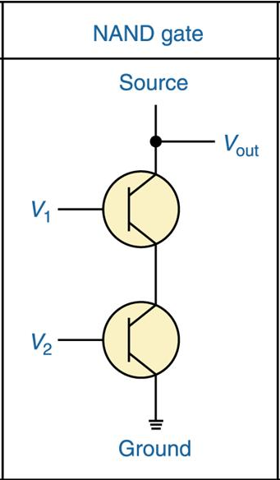
Constructing Gates - NAND
This gate requires two transistors connected in serial.
The two input values are the base values on the left.
If both input values are high (1s), the source is grounded and the output is low (0).
If either input value or both are low (0), the source is not grounded and the output is high (1).

Slide 95
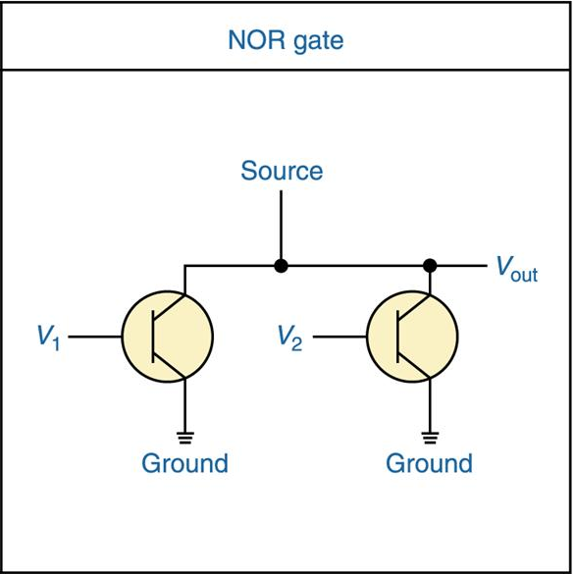
Constructing Gates - NAND
This gate requires two transistors also, but connected in parallel.
The two input values are the base values on the left of each transistor.
If either transistor allows the source to be grounded, the output is 0.
So, the output is a 1 only when both inputs are 0.

Slide 96
CPU Chips
The most important integrated circuit
in any computer is the Central Processing Unit, or CPU
Each CPU chip has a large number
of pins through which essentially all communication in a computer system occurs.

Slide 97
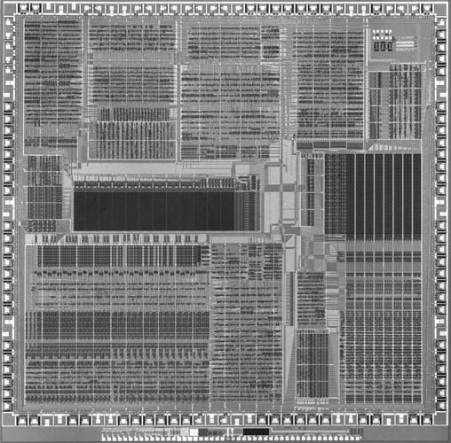
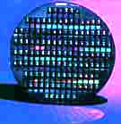
An example of an integrated chip
A silicon wafer holding many ICs

Slide 98
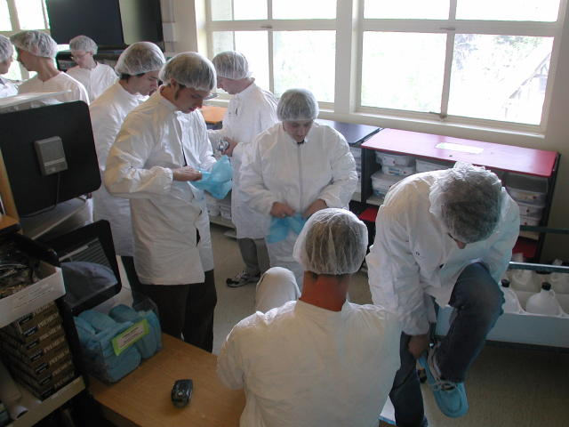
Chip Manufacturing in Sterile Rooms
Hiram College’s VSLI Class Suiting Up
Led by Ellen Walker 2 years ago

Slide 99
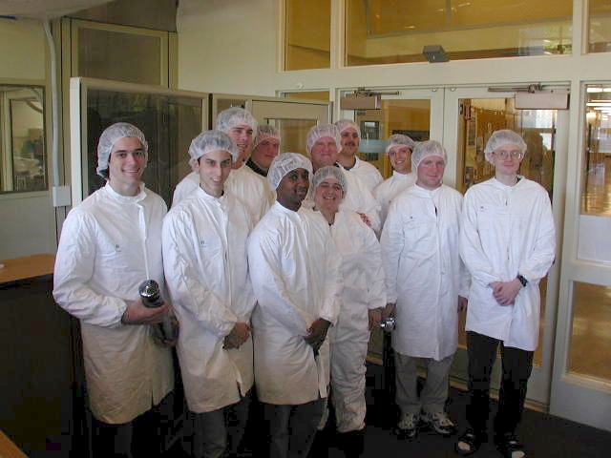
Ready to Go

Slide 100
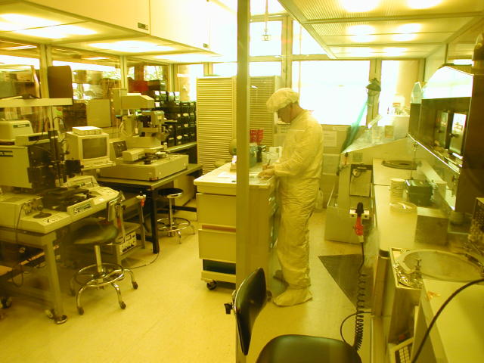
In a Chip Fabrication Facility

Slide 101
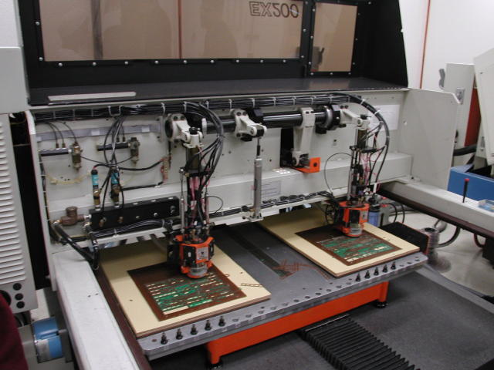

Slide 102
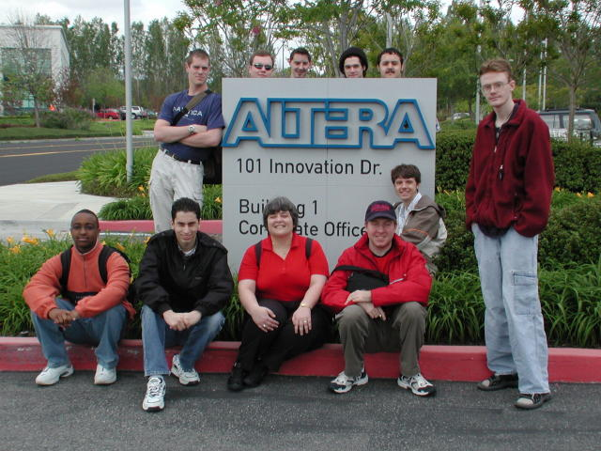
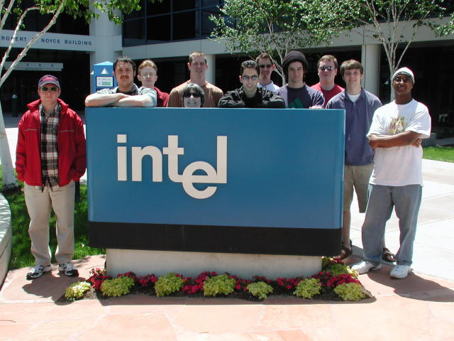

Slide 103
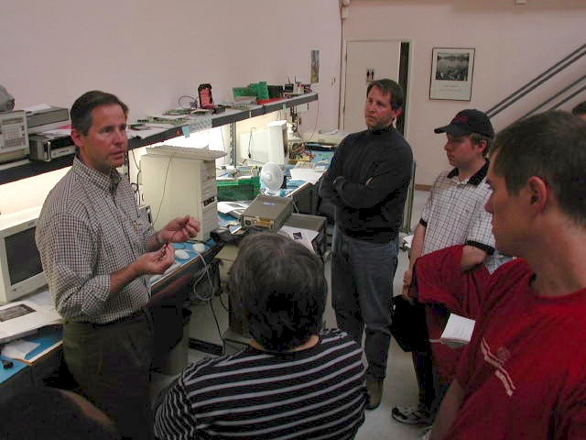
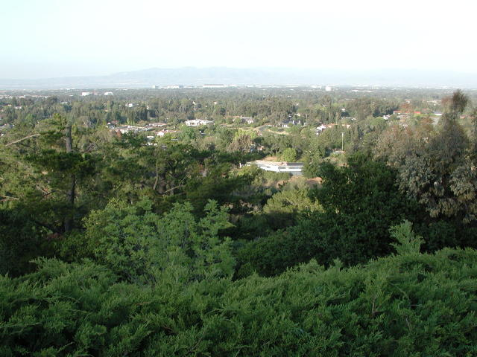
Two graduates of Hiram College's CPSC program, Tom and Jim Waschura, explaining how their Silicon Valley business, Synthesis Research Inc. works.
Below, a magnificent view of Silicon Valley from Jim's back yard.

