Slide 1
CHAPTER 5
COMPUTER SYSTEMS ORGANIZATION

Slide 2
REMEMBER ...
Computer science is the study of algorithms including
* Their formal and mathematical properties--- Chpts 1-3
* Their hardware realizations --- Chpts 4-5
Their linguistic realizations.
Their applications.
We continue with a study of the hardware and the building of a virtual machine in Chapter 5.

Slide 3
THE HARDWARE WORLD
We began to turn the abstract entity called a computing agent into a computer and a computer system in Chapter 4.
Chapter 4 dealt with the hardware design at the logical level by looking at
the internal representation of data
the building of circuits for carrying out fundamental operations.
In biology, this would be like studying DNA, genes, cells, and tissues.

Slide 4
Chapter 5 will deal with the organization of the computer systems.
We will build a computer logically.
Chapter 5 in biology would describe how our organs (heart, lungs, etc.) and bodily systems (circulator, respiratory, etc.) are built from the basic units.
There are many different computer systems on the market, manufactured by many different vendors, yet MOST follow the same basic organization.

Slide 5
COMPUTER ARCHITECTURE
There are many different computers:
Multi-million dollar supercomputers
Million dollar mainframes
Minicomputers
Workstations
Laptops
Less than $100 hand held personal digital assistants
Although the price tags on these and the speed, capacity, and software differ significantly, they MOST are basically designed the same.

Slide 6
Fastest Computers in the World
See the site below for information:
http://www.top500.org/lists/2008/06/100

Slide 7
VON NEUMANN ARCHITECTURE
There are 3 major units in a computer tied together by buses:
1) Memory The unit that stores and retrieves instructions and data.
2) Processor: The unit that houses two separate components:
The control unit: Repeats the following 3 tasks repeatedly
Fetches an instruction from memory
Decodes the instruction
Executes the instruction
The arithmetic/logic unit (ALU): Performs mathematical and logical operations.
3) Input/Output (I/O) Units: Handles communication with the outside world.

Slide 8
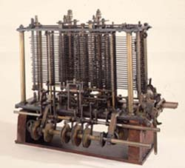
Von Neumann Architecture
The architecture is named after the mathematician, John Von Neumann, who supposedly proposed storing instructions in the memory of a computer and using a control unit to handle the fetch-decode-execute cycle:
fetch an instruction
decode the instruction
execute the instruction
Interestingly, a similar architecture was proposed in 1830 by Charles Babbage for his Analytic Engine:
Portion of the mill of the Analytical Engine with printing mechanism, under construction at the time of Babbage’s death. © Science Museum/Science & Society Picture Library
ALU mill
memory store
control unit operator (process cards storing instructions)
I/O units output (typewriter)

Slide 9
Pictorial View of
Computer Organization
Memory
Processor
Input / Output
Control
Unit
ALU

Slide 10
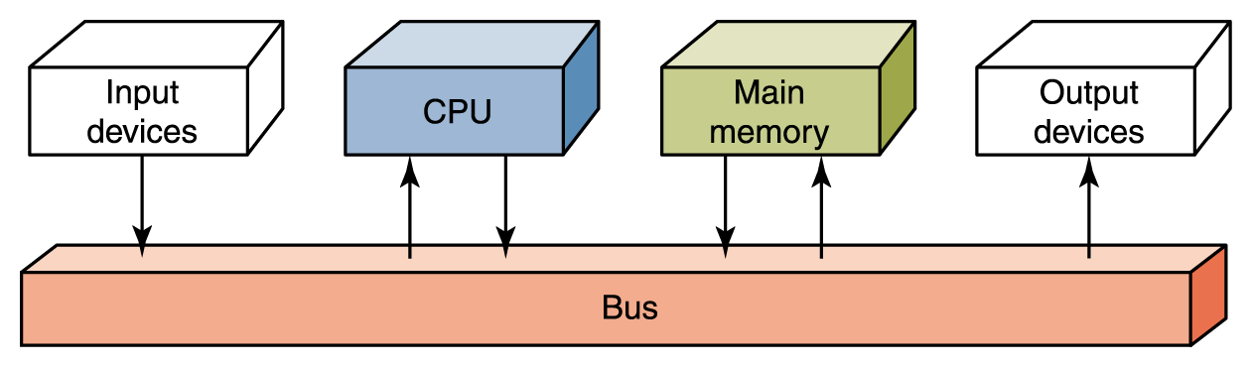
Flow of Information
The parts are connected to one another by a collection of wires called a bus
Processor
Figure 5.2 Data flow through a von Neumann architecture

Slide 11
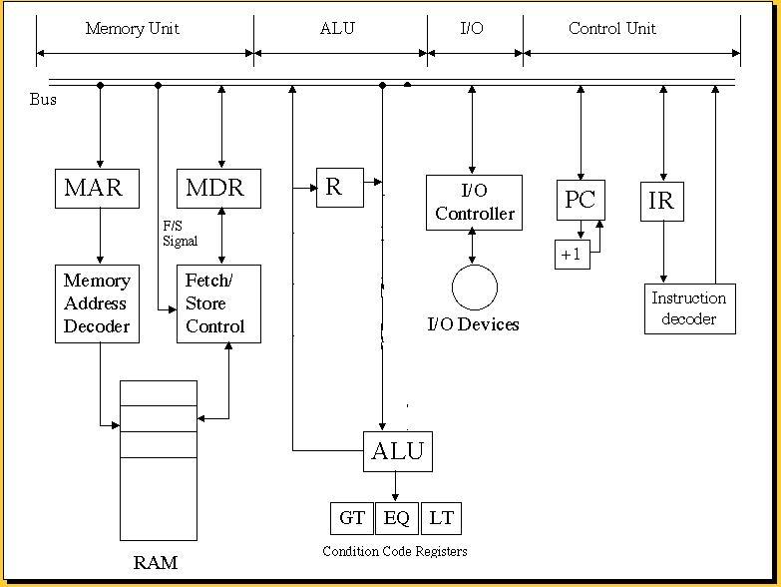
THE UNITS OF A COMPUTER
(Note this MODIFIES Figure 5.18 on page 220

Slide 12
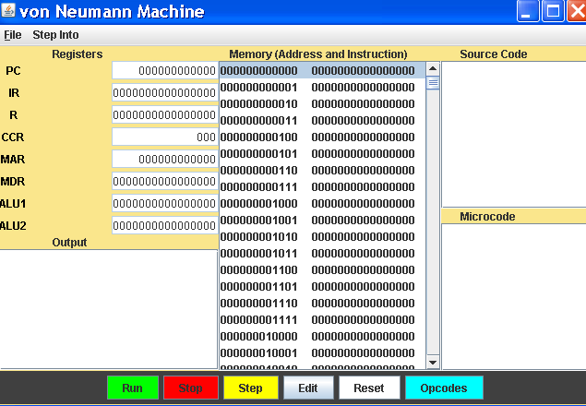
The Lab Simulator

Slide 14
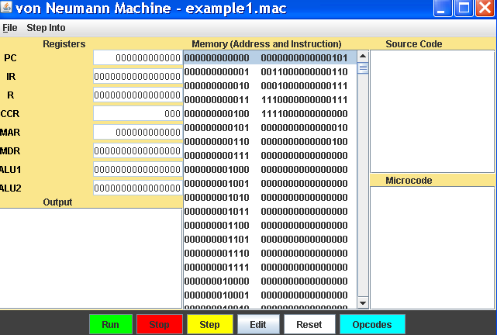
After Loading a Program

Slide 15
RAM and ROM
RAM stands for Random Access Memory
  Inherent in the idea of being able to access each location is the ability to change the contents of each location
ROM stands for Read Only Memory
  The contents in locations in ROM cannot be changed
RAM is volatile, ROM is not
  This means that RAM does not retain its bit configuration when the power is turned off,
  but ROM does

Slide 16
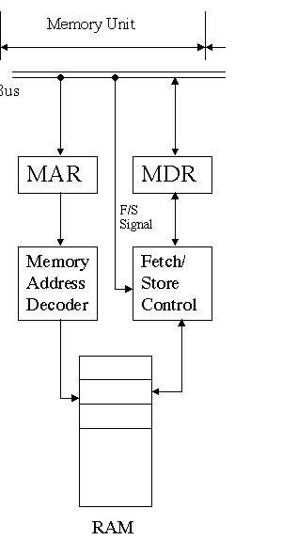
MEMORY UNIT
(or RAM- Random Access Memory)
Each cell has an address, starting at 0 and increasing by 1 for each cell.
A cell with a low address is just as accessible as one with a high address- hence the name RAM.
The width of the cell determines how many bits can be read or written in one machine operation & is normally a power 2
A cell is typically a byte today

Slide 17
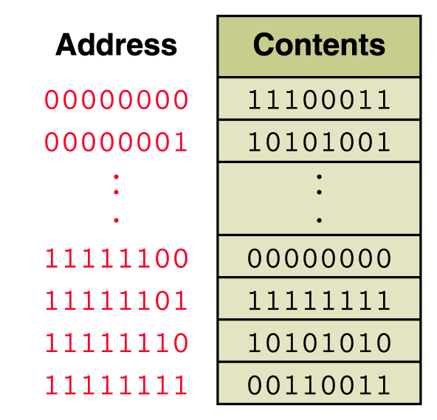
Memory
Memory is a collection of cells,
each with a unique physical address
The size of a cell is normally a power of 2, typically a byte today.

Slide 18
Memory
A cell is the smallest addressable unit of memory – i.e. one cell can be read from memory or one cell can be written into memory, but nothing smaller.

Slide 19
What is a Register?
Data can be moved into and out of registers faster than from memory.
If we could replace all of memory with registers, we could produce a very, very fast computer ...
But, the price would be terribly prohibitive.
Most computers have quite a few registers that serve different purposes.
We’ll see how the MAR and the MDR are used.

Slide 20
Another Type of Memory : Cache
Cache speed is faster than main memory and slower than registers.
Our lab simulator will not use any cache memory, but computers today do use it.
To speed up retrievals from memory, items are prefetched into cache memory and then, when needed by the CPU, they are retrieved from cache memory rather than memory.
However, to keep things simple, we’ll assume fetches will occur from main memory.

Slide 21
THE UNITS OF A COMPUTER
MEMORY:
Stores and retrieves instructions and data.
We saw in Chapter 4 that numbers and characters (the data) can be represented in binary formats.
Instructions are also represented in binary form:
Different computers use different instruction sets and formats. We will use a very simple, generic format for what is called a 1-address machine:
op code of 4 bits
address of 12 bits
Other machines use 2-address, 3-address, and mixed format instructions. A 2-address memory will be discussed later.

Slide 22
OP CODES (i.e. 1-Address Operation Codes)
REF: page 220-221, Fig 5.19
Arithmetic OpCodes
0000 load
0001 store
0010 clear
0011 add
0100 increment
0101 subtract
0110 decrement
I/0 OpCodes
1101 in
1110 out
Logic/Control OpCodes
0111 compare
1000 jump
1001 jumpgt
1010 jumpeq
1011 jumplt
1100 jumpneq
1111 halt
We will see how these are used later.

Slide 23
STRUCTURE OF RANDOM ACCESS OR MAIN MEMORY
1 bit
one memory cell
Memory
W bits wide
addresses:
0
1
2
•
•
•
2^{N}- 1
MAR -N bits
Memory Address Register
•
•
•
MDR- kW bits
Memory Data Register

Slide 24
ALL A COMPUTER DOES IS ...
Repeat forever (or until you pull the plug or the system crashes)
1) FETCH
2) DECODE
3) EXECUTE

Slide 25
SOME SIZES DICTATED BY THE STRUCTURE OF MAIN MEMORY
With our instruction having the form of
4 bits for the op code
12 bits for the address
if we plan to have one instruction per memory cell, then
we need to have for our computer
An MAR (memory address register) of 12 bits.
A memory size of at most 2¹² = 2²* 2¹⁰ = 4K
A memory width of 4 + 12 = 16 bits
If MDR (memory data register) is 16 bits, then the largest sized number is
0111 1111 1111 1111₂= 2¹⁵ -1 = 32,768.

Slide 26
OTHER COMPONENTS OF THE MEMORY UNIT
Besides the Random Access Memory and the MAR and MDR, two other components exist:
1) Fetch/store controller: Sends a signal to Fetch or Store
2) Memory decoder circuits: (Ref, Chpt 4, pg 180-182)
A N x 2^{N} decoder has N input lines and 2^{N} output lines.
When the N input lines are set to 0s or 1s and the N values are interpreted as a binary number, they represent all the numbers between 0 and 2^{N}-1.
The output to the decoder is a 1 on the line identified by the value of the input and a 0 on all the other lines.

Slide 27
Example:
0
1
1
3 x 8 decoder
011₂ = 3 so the line labeled 3, the 4th from the top outputs a 1 and all other lines output a 0.
A decoder selects one line for a pulse, when the input lines are interpreted as a binary number.
Why is this useful for a memory unit?

Slide 28
USING THE DECODER CIRCUIT TO SELECT MEMORY LOCATIONS
MAR
0
1
2
3
4
5
6
7
•
•
•
15
0 1 1 1
0
4 x 2⁴ decoder
0
1
0
0

Slide 29
THE DECODER CIRCUIT CAN BE BUILT FROM AND-OR-NOT GATES
See Figure 4.29 on page 181 for a 2 x 4 decoder circuit.
As with all circuits, to build a decoder,
1) Build a truth table for the circuit
(For example, for a 3 x 8 decoder, there are 8 rows, 3 input choices, and 8 output values).
2) Use the sum-of-products algorithm to find the Boolean expression for the truth table.
3) Build the circuit.

Slide 30
The decoder circuit doesn't scale well--- i.e. as the number of bits in the MAR increases, the number of output lines for the decoder goes up exponentially.
Most computers today have an MAR of 32 bits. Thus, if the memory was laid out as we showed it, we would need a 32 x 2³² decoder!
Note 2³² is 2² 2³⁰ = 4 G
So most memory is not 1 dimensional, but 2-dimensional (or even 3-dimensional if banked memory is used).

Slide 31
2-D MEMORY
MAR
0 1 1 1
Note that a 4 x 16 decoder was used for the 1-D memory.
2 x 4
decoder
columns
2 x 4
decoder
rows

Slide 32
How does the memory unit work?
Trace the following operation:
s
Store data D in memory location 0.
0
0
D
0
D
D
D
D

Slide 33
How does the memory unit work?
Trace the following operation:
f
1) Fetch data D from memory location 1.
2) Obtain an instruction I from memory
location 7.
1
D
How does the computer distinguish
between 1) and 2) above?
D
I
We need to look at the control unit later.

Slide 34
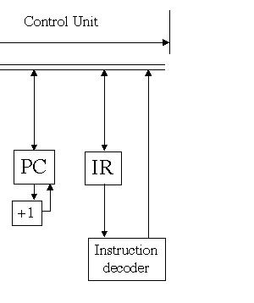
How Does the Control Unit Work?

Slide 35
Control Unit
A Control Unit is the unit that handles the central work of the computer.
There are two registers in the control unit
  The instruction register (IR) contains the instruction that is being executed
  The program counter (PC) contains the address of the next instruction to be executed
The ALU and the control unit together are called either the
  Processor
  Central Processing Unit (i.e., CPU)

Slide 36
How Does the Control Unit Work?
Once the instruction is fetched, the PC is incremented.
The PC holds the address of the next instruction to be executed.
Whatever is stored at that address is assumed to be an instruction.

Slide 37
THE CONTROL UNIT
IR
PC
0 01 1 | address
+1
instruction
decoder
line 3
Trace what happens during
fetch
decode
execute
enable add
Note: The PC is incremented after each fetch.

Slide 38
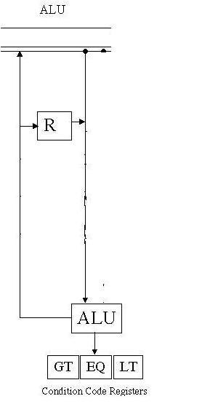
THE ARITHMETIC-LOGIC UNIT
(ALU)
The text shows multiple registers which is typical.
However, we are working with a 1-address machine which has a single system register R.
Other registers are attached to the ALU.

Slide 39
THE ARITHMETIC/LOGIC UNIT
R
Register R
What is a multiplexor and how does it work?
Other registers
AL1
ALU
AL2
condition code register
circuits
GT EQ LT
multiplexor
output
(In the lab you will see where this will go)
selector lines

Slide 40
MULTIPLEXOR CIRCUIT
Interpret the selector lines as a binary number A.
0
1
2
2^{N}-1
multiplexor
circuit
output
The output is the value on the line numbered A
2^{N} input lines
N selector lines

Slide 41
Example:
Note: A multiplexor is a switch.
multiplexor
with N=2
It should be obvious that a multiplexor can be built with AND-OR-NOT gates.
(see page 179)
0 1

Slide 42
THE CONDITION CODE REGISTER part of the ALU
Whenever a
COMPARE X
command is executed, a condition code (which is a single bit) is set (to a 1). These codes are used to control JUMP commands.
GT is set if CON(X) > R
1) if address 1 holds 15 and address 2 holds 12?
EQ is set if CON(X) = R
LT is set if CON(X) < R
What happens with the sequence:
LOAD 1
COMPARE 2
JUMPGT 5
2) if address 1 holds 12 and address 2 holds 15?

Slide 43
ADD X
f
D
E+D
X
E
E
D
ADD X
E+D
ALU1 & ALU2
D
E+D

Slide 44
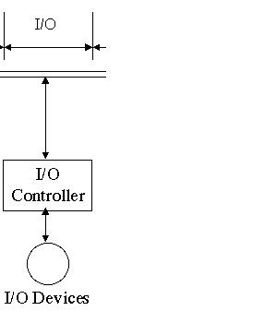
LAST, BUT NOT LEAST, THE I/O DEVICES
Pictorially, these look the simplest, but in reality, they form the most diverse part of a computer.
Includes:
keyboards, monitors, joysticks, mice, tablets, lightpens, spaceballs, ....

Slide 45
Input/Output Units
An input unit is a device through which data and programs from the outside world are entered into the computer
  Keyboard, the mouse, and scanning devices
An output unit is a device through which results stored in the computer memory are made available to the outside world
  Printers and video display terminals

Slide 46
I/O UNITS
Processor
Memory
I/O buffer
Each device is different, but most are interrupt driven.
This means when the I/O device wants attention, it sends a signal (the interrupt) to the CPU.
Control-logic
I/0 device

Slide 47
NOW USE THE COMPLETE ARCHITECTURE TO TRACE THE ACTIONS TAKEN FOR EXECUTING
IN X
OUT X
LOAD X
STORE X
INCREMENT X
We already have done:
ADD X
COMPARE X
JUMP X
JUMPLT X

Slide 48
IN X
s
X
D
D
IN X
D

Slide 49
OUT X
f
X
D
D
OUT X
D

Slide 50
LOAD X
f
X
D
D
LOAD X
D

Slide 51
STORE X- you should be able to do this now

Slide 52
INCREMENT X
X
INCR X
D+1
D

Slide 53
COMPARE X
D
COMP X
as with other
ops fetch D
D
Set these according to comp op

Slide 54
JUMP X
X
JUMP X

Slide 55
JUMPLT X
If LT = 1, move X to PC

Slide 56
The Jump Commands
Allow us to construct branches and loops as we will see.
Their purpose is to change the PC – program counter
JUMP X – always change PC to address X
JUMPGT X – change PC to address X if and only if GT= 1
JUMPEQ X - change PC to address X if and only if EQ = 1
JUMPLT X - change PC to address X if and only if LT = 1
JUMPNEQ X - change PC to address X if and only if EQ = 0

Slide 57
Secondary Storage Devices
Because most of main memory is volatile and limited, it is essential that there be other types of storage devices where programs and data can be stored when they are no longer being processed
Secondary storage devices can be installed within the computer box at the factory or added later as needed

Slide 58
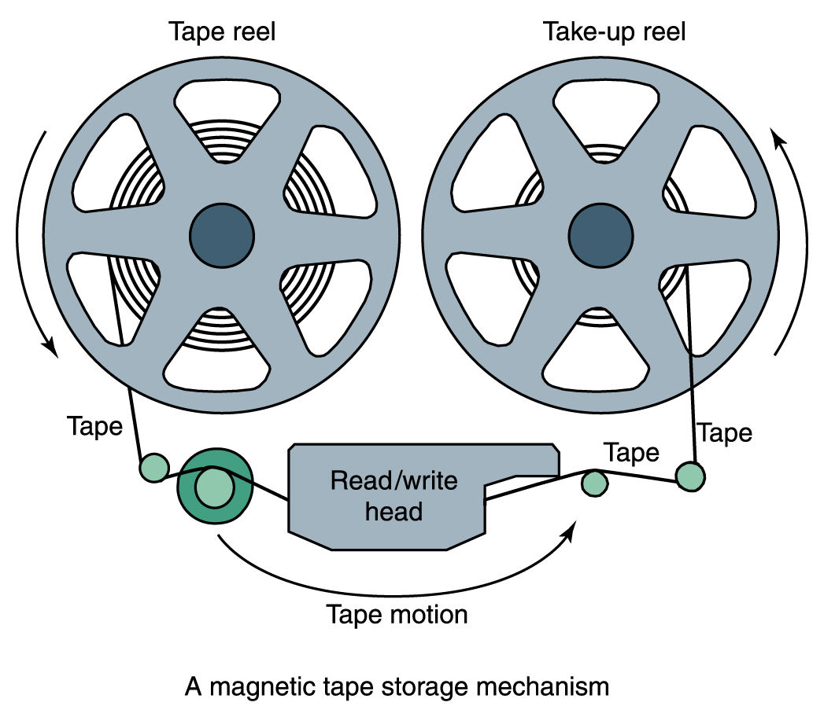
Magnetic Tape
The first truly mass auxiliary storage device was the magnetic tape drive
A magnetic tape

Slide 59
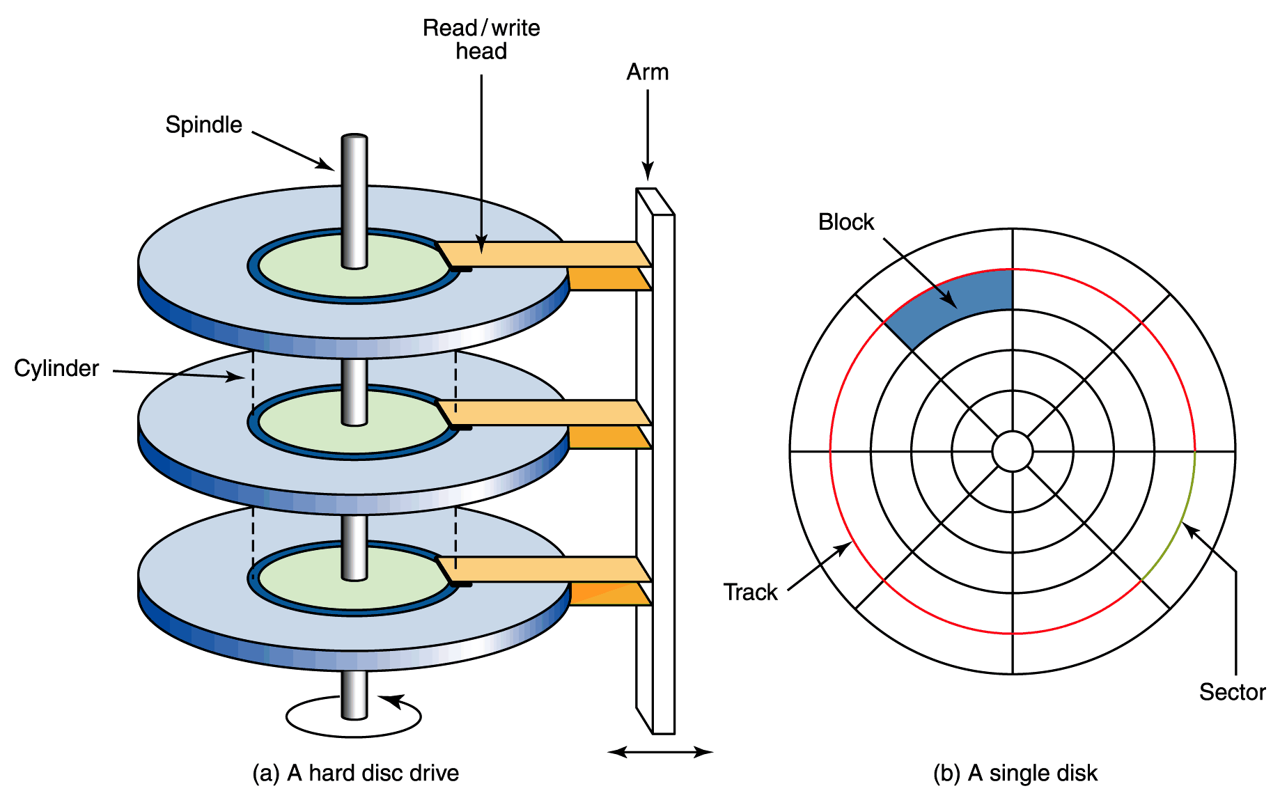
Magnetic Disks
A read/write head travels across a spinning magnetic disk, retrieving or recording data
Figure 5.8
The organization of a magnetic disk

Slide 60
Compact Disks
A CD drive uses a laser to read information stored optically on a plastic disk
CD-ROM is Read-Only Memory
DVD stands for Digital Versatile Disk

Slide 61
Are All Architectures the von Neumann Architecture?
No.
One of the bottlenecks in the von Neuman Architecture is the fetch-decode-execute cycle.
With only one processor, that cycle is difficult to speed up.
I/O has been done in parallel for many years.
Why have a CPU wait for the transfer of data between the memory and the I/O devices?
Most computers today also multitask – they make it appear that multiple tasks are being performed in parallel (when in reality they aren’t as we’ll see when we look at operating systems).
But, some computers do allow multiple processors.

Slide 62
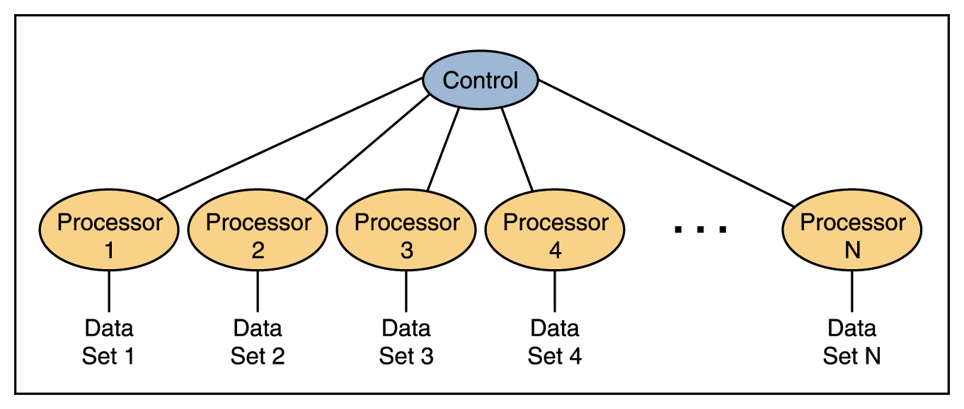
Synchronous processing
One approach to parallelism is to have multiple processors apply the same program to multiple data sets
Figure 5.6 Processors in a synchronous computing environment

Slide 63
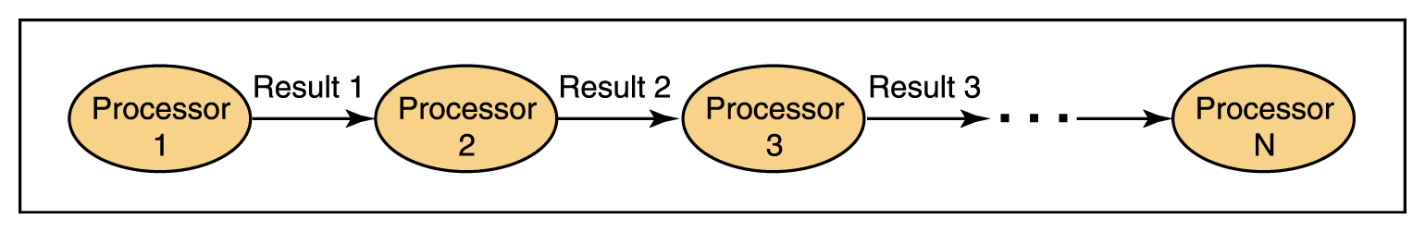
Pipelining
Arranges processors in tandem, where each processor contributes one part to an overall computation
Figure 5.7 Processors in a pipeline

Slide 64
Shared-Memory
Shared Memory
Processor
Processor
Processor
Processor
Local
Memory2
Local
Memory3
Local
Memory4
Local
Memory1
Different processors do different things to different data.
A shared-memory area is used for communication.

Slide 65
Comparing Various Types of Architecture
Typically, synchronous computers have fairly simple processors so there can be many of them – in the thousands.
  One has been built by Paracel (GeneMatcher) with over 1M processors.
  Used by Celera in completing the description of the human genome sequencing
Pipelined computers are often used for high speed arithmetic calculations as these pipeline easily.
Shared-memory computers basically configure independent computers to work on one task.
  Typically, there are something like 8, 16, or at most 64 such computers configured together.
Some recent parallel computers used for gaming such as PlayStation are partially based on this architecture.

Slide 66
Comparing Various Types of Architecture – a simple example
Solve the following problem:
  Given n integers, see if the integer k is in the collection
Do this with a von Neumann machine.
Do this with a synchronous machine.
Do this with a pipelined machine.
Do this with a shared-memory machine.

