Slide 1
CHAPTER 6
INTRODUCTION TO SYSTEM SOFTWARE AND VIRTUAL MACHINES

Slide 2
VIRTUAL MACHINES
The machine we "built" is not the machine you "see" when you sit and start typing on the keyboard.
The hardware at the lowest level consists of:
binary representations: data
instructions
circuits built from gates: test for equality
full adder
decoder
multiplexor
units built from circuits and buses: memory
processor : control unit
ALU
I/0 system

Slide 3
INSTRUCTIONS AND PROGRAMS
Each computer model has its own machine language.
The machine instruction format is designed by the computer designer.
The format chosen for an instruction determines
the number of operations directly supported in hardware
(called hardwired instructions)
and
the size of the addressing space.

Slide 4
OUR COMPUTER
It is a 1-address machine that uses the format:
op code - 4 bits
address - 12 bits
These sizes imply:
1) There are at most 16 possible operations
2) There are at most 2¹² = 2² 2¹⁰ = 4K addressable memory locations.

Slide 5
A typical example of machine op codes
The machine code has the format opcode X , where X is an address:
0000 con(X) -> R [con(X) is the contents of X]
0001 R -> con(X)
0010 0 -> con(X)
0011 R + con(X) ->R
0100 con(X) + 1 -> con(X)
0101 R – con(X) -> R
0110 con(X) – 1 -> con(X)
0111 if con(X) > R then GT = 1 else 0
if con(X) = R then EQ = 1 else 0
if con(X) < R then LT = 1 else 0

Slide 6
A typical example of machine op codes- con't:
1000 Get the next instruction from X
1001 If GT = 1, get the next instruction from X
1010 If EQ = 1, get the next instruction from X
1011 If LT = 1, get the next instruction from X
1100 If EQ = 0, get the next instruction from X
1101 Get an integer value from the standard input device and store it in X
1110 Output in decimal notation the value stored at X
1111 Halt

Slide 7
An Example of a Machine Code Program – in red (look on previous slides or pg 248 for meaning of opcodes):
Address: In decimal
0000 0000 0000 0110 0000 0000 0000 0
0011 0000 0000 0101 0000 0000 0001 1
0001 0000 0000 0111 0000 0000 0010 2
0100 0000 0000 0111 0000 0000 0011 3
1111 0000 0000 0000 0000 0000 0100 4
0000 0000 0000 0100 0000 0000 0101 5
0000 0000 0000 1000 0000 0000 0110 6
0000 0000 0000 0000 0000 0000 0111 7
Blanks are just to make the values more readable. Of course, these could be written hex!

Slide 8
An Example of a Machine Code Program – in red (look on previous slides or pg 248 for meaning of opcodes):
Meaning:
0000 0000 0000 0110 con(6) -> R (i.e. 8 -> R)
0011 0000 0000 0101 R + con(5) -> R (i.e. 8+4->R)
0001 0000 0000 0111 R ->con(7) (i.e. 12 -> con(7))
0 0000 0000 0111 con(7)+1->con(7) (i.e. 12+1
->con(7))
1111 0000 0000 0000 halt
0000 0000 0000 0100 4
0000 0000 0000 1000 8
0000 0000 0000 0000 0
Note: The first 5 lines are instructions- the last 3 are data.

Slide 9
MACHINE LANGUAGE PROGRAMMING
Computers can only execute machine language programs.
Although humans CAN program in a machine language, there are some difficulties if we can only do these types of programs:
1) Writing and reading binary numbers is error prone and difficult. (Hexadecimal notation helps, but it doesn't eliminate the problems).
2) Remembering operations as binary numbers is unintuitive, to say the least!
3) Converting data and addresses to binary form is not fun.

Slide 10
4) Numeric addresses make it difficult to modify programs:
Example: (written in base 10 and using mnemonics for the opcodes)
0: load 5
1: add 4
2: store 6
3: halt
4: data 4
5: data 8
6: data 0
Now we decide to add an
increment to
what was just stored.
The addresses need to change!
0: load 6
1: add 5
2: store 7
3: increment 7
4: halt
5: data 4
6: data 8
7: data 0
Now we notice we have no output so we need to change the program again!

Slide 11
WHY NOT HAVE THE COMPUTER HELP WITH THE MACHINE LANGUAGE CODING?
1) Why should we remember 0000 is load and 0011 is add?
Use the words LOAD( or load) and ADD (or add) when coding and write a program* that will translate
LOAD to 0000
and ADD to 0011
*This program, called an assembler would be written in machine language, as that is all that is available.

Slide 12
2) Why not use labels to mark address locations when we code? Then we can refer to addresses by symbolic names, not numbers.
and we can have the assembler not only translate these commands appropriately, but it could translate the data we write in base 10 into the necessary binary notation:
Example:
load x
add y
...
y:
x: ......
Labels can be any string of letters and digits.
A colon is used to separate a label from the location it references.
Example:
load x
add y
...
y: .data 4
x: .data 8

Slide 13
3) We need to distinguish commands to be executed and commands to the assembler to do something.
Commands to the assembler are called pseudo-ops and are written with a period in front of them:
Examples:
.data 8 Convert to data representing 8:
0000 0000 0000 1000
.begin The next line will be placed at address 0 and the PC will be set to 0.
.end This is the end of the program and data.
If an operating system was running, there would be a command replacing the .end to return control to the operating system.

Slide 14
OP CODES (i.e. 1-Address Operation Codes)
REF: page 220-221, Fig 5.19
Arithmetic OpCodes
0000 load
0001 store
0010 clear
0011 add
0100 increment
0101 subtract
0110 decrement
I/0 OpCodes
1101 in
1110 out
Logic/Control OpCodes
0111 compare
1000 jump
1001 jumpgt
1010 jumpeq
1011 jumplt
1100 jumpneq
1111 halt

Slide 15
NOW WE CAN WRITE AND MODIFY PROGRAMS WITH LESS CONCERN ABOUT BINARY NUMBERS!
.begin
load x
add y
store z
increment z
halt
y: .data 4
x: .data 8
z: .data 0
.end
Note:
Indentations are NOT significant
Watch the syntax for periods and colons
Each referenced location must have a unique label
.begin
load x
add y
store z
halt
y: .data 4
x: .data 8
z: .data 0
.end

Slide 16
HOW DIFFICULT IS IT TO WRITE THE ASSEMBLER--- the program which translates assembly language programs into machine language?
The algorithm for the assembler is given on pages 260 and 262 of the text.
Remember, the assembler is written in machine language as the computer can only execute machine language programs.
After the assembler is written, however, we can write in assembly language and have the assembler translate our code to machine language to run!

Slide 17
THE ASSEMBLER
Definition: A pass for a translator is one reading of the source program and some manipulation of it.
Pass 1:
Uses a location counter to count the number of assembly language instructions that are not pseudo-ops.
Builds the symbol table which records all labels and the line location which they mark.

Slide 18
AN EXAMPLE OF PASS 1 OF THE ASSEMBLER
Input:
Output: the symbol table
.begin
load x
add y
store z
increment z
halt
y: .data 4
x: .data 8
z: .data 0
.end
y 5
x 6
z 7
label location

Slide 19
Pass 2: Complete the translation
Output: the object code (i.e. the machine code translation)
Input: the source code and the symbol table
.begin
load x
add y
store z
increment z
halt
y: .data 4
x: .data 8
z: .data 0
.end
0000 0000 0000 0110
0011 0000 0000 0101
0001 0000 0000 0111
0100 0000 0000 0111
1111 0000 0000 0000
0000 0000 0000 0100
0000 0000 0000 1000
0000 0000 0000 0000
y 5
x 6
z 7

Slide 20
SLIDES 16-28 ARE VERY, VERY IMPORTANT!!
Why?
  In those slides we will translate each pseudocode statement introduced earlier into machine language code.
  This will mean we can program in machine language.
  Since we have seen how algorithms are what allow us to solve problems using the computer and pseudocode can be used to describe algorithms, this will say that machine language can be used to describe and, consequently, implement algorithms.

Slide 21
EXAMPLES OF PSEUDOCODE WRITTEN IN ASSEMBLY CODE
Recall the types of pseudocode instructions we had are listed in Figure 2.9 on page 53 of our text.
1) Computation: Set the value of "variable" to arithmetic exptression.
Set the variable myex to the sum of a + b - c.
...
load a
add b
subtract c
store myex
...
a:
b:
c:
myex:
Note that multiply and divide are not supported by hardware in our computer.
We have to write software, as you may do in the lab, to do operations that are not supported by hardware.

Slide 22
2) Input/output: Get, input, print, output ...
Get values for x and y.
Print values for x and y.
in x
in y
out x
out y
Note: x and y label a location somewhere.
Print the message 'Hello!'
We can't do this with our simulated computer as we are storing only positive integers, not characters (or fractional numbers).
Note, however, that our simulated computer does convert numbers to characters in order to print the numbers--- i.e. 34 is printed as the ASCII code for 3 followed by the ASCII code for 4 (otherwise, the number 34 wouldn't show on your screen!). The screen displays ASCII codes.

Slide 23
Input a value for myconst
and add 3 to it.
Input values for a, b, and c.
Compute x = a - (b - c)
in myconst
load myconst
add three
store myconst
...
myconst: .data 0
three: .data 3
in a
in b
in c
load b
subtract c
store temp
load a
subtract temp
store x
...
a: .data 0
b: .data 0
c: .data 0
temp: .data 0
Assign yrconst a value of 5 and output it.
out yrconst
...
yrconst: .data 5

Slide 24
3) Conditional: If Boolean-Expression then
first set of operations
else
second set of operations
If x = y then
add 3 to x
else
add 1 to y
output y
output x
load x
compare y
jumpneq else
add three
store x
jump outif
else: increment y
out y
outif: out x
...
three: .data 3
and, you need locations for x and y.
Note: increment and decrement do memory adds!

Slide 25
Another approach to
load x
compare y
jumpneq else
add three
store x
jump outif
else: increment y
out y
outif: out x
...
three: .data 3
load x
compare y
jumpeq ifpart
increment y
out y
jump outif
ifpart: add three
store x
outif: out x
...
three: .data 3
Note:
x is in R already

Slide 26
4) Iterative:
while Boolean-Expression do
set of operations
end loop
loop: load y
compare x
jumpgt endloop
jumpeq endloop
load x
add two
store z
out z
increment x
jump loop
endloop: out x
...
two: .data 2
while x < y do
compute z = x + 2
out z
increment x
end loop
out x
Exit loop if
x ≥ y

Slide 27
loop: load x
compare y
jumplt endloop
jumpeq endloop
add two
store z
out z
increment x
jump loop
endloop: out x
...
two: .data 2
Another approach to:
loop: load y
compare x
jumpgt endloop
jumpeq endloop
load x
add two
store z
out z
increment x
jump loop
endloop: out x
...
two: .data 2
Exit: If x ≥ y
Exit: If y ≤ x

Slide 28
5) Iterative: Repeat until Boolean-Expression
set of operations
end loop
Repeat until x > = 5
in y
z = y + x
add 1 to x
end loop
print z
loop: in y
load y
add x
store z
increment x
load five
compare x
jumplt loop
out z
...
five: .data 5

Slide 29
Another example:
Get N, A₀, A₁, A₂, ..., A_{N}
in N
loop: load N
compare i
jumpgt gotdata
in A
... do something with A
increment i
jump loop
gotdata:
...
N: .data 0
i: .data 0
The problem here is until we know N, we don't know how many variables to allocate.
But, in most of the algorithms we've seen, there is no need to input all the variables A_{i} at the beginning.
So, something like the following usually works:

Slide 30
What if the following can't be handled the way we did on the last slide?
Get N, A₀, A₁, A₂, ..., A_{N}
1) If you can bound the size of N, then you can preallocate that many memory locations for the variables.
2) You can use techniques to dynamically allocate memory which we won't study here.
Note what all of the previous slides say:
If we could store characters and fractional numbers, every algorithm we studied in Chapters 1-3 could be written in any machine language similar to the one used by our simulator!

Slide 31
WOULD IT BE HARD TO EXPAND OUR COMPUTER TO HANDLE CHARACTERS AND FRACTIONAL NUMBERS?
No.
Characters are just numbers so the storage is not a problem.
Compare would work the same and, obviously, add, subtract, etc. don't make sense for characters.
The in and out commands would need to be changed so conversions between the ASCII representation of a character and the numeric binary representation would not take place ---i.e. the external representation for a character is the same as the internal one.

Slide 32
For fractional numbers we would need to add two new operations:
ADDF - add fractional numbers
SUBTRACTF - subtract fractional numbers
and, of course for these and ADD and SUBTRACT, we would have to allow negative numbers to be handled.
The full adder can be modified to do the addition (and consequently the subtraction) of any signed fractional number.

Slide 33
CONCLUSION:
We can write algorithms in
pseudocode
or machine language
Consequently,
algorithms can be run on a computing agent built similar to our computer!

Slide 34
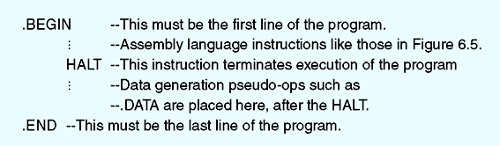
Figure 6.6
Structure of a Typical Assembly Language Program

Slide 35
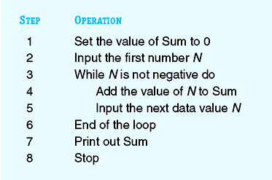
A Complete Assembly Program - Development
Figure 6.7
Algorithm to Compute the Sum of Numbers

Slide 36
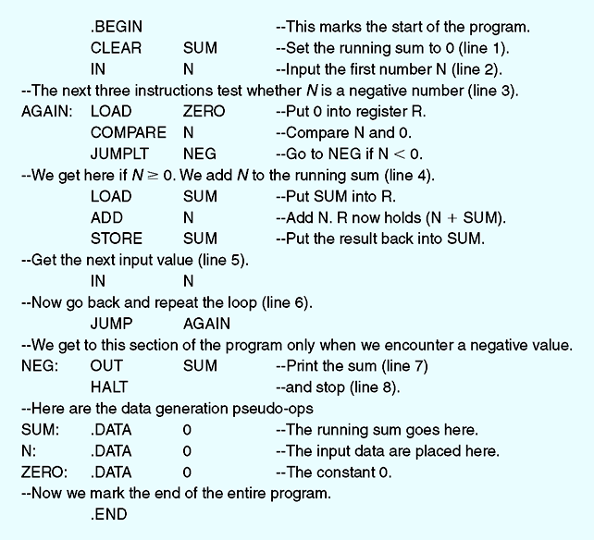
Figure 6.8 Assembly Language Program to Compute the Sum of Nonnegative Numbers
Note the comments starting with --

Slide 37
Translation and Loading
Before a source program can be run, an assembler and a loader must be invoked
Assembler
  Translates a symbolic assembly language program into machine language
Loader
  Reads instructions from the object file and stores them into memory for execution

Slide 38
Translation and Loading (continued)
Assembler tasks
  Convert symbolic op codes to binary
  Convert symbolic addresses to binary
  Perform assembler services requested by the pseudo-ops – instructions to the assembler
  Put translated instructions into a file for future use

Slide 39
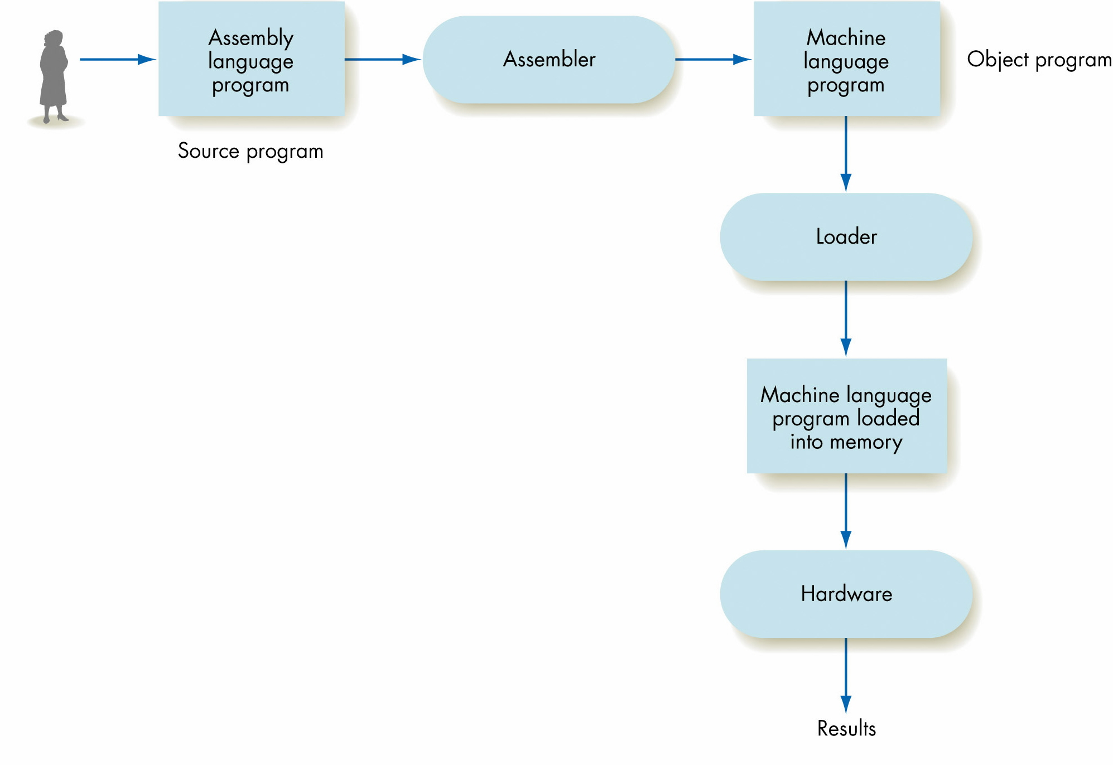
Figure 6.4
The Translation/Loading/Execution Process

Slide 40
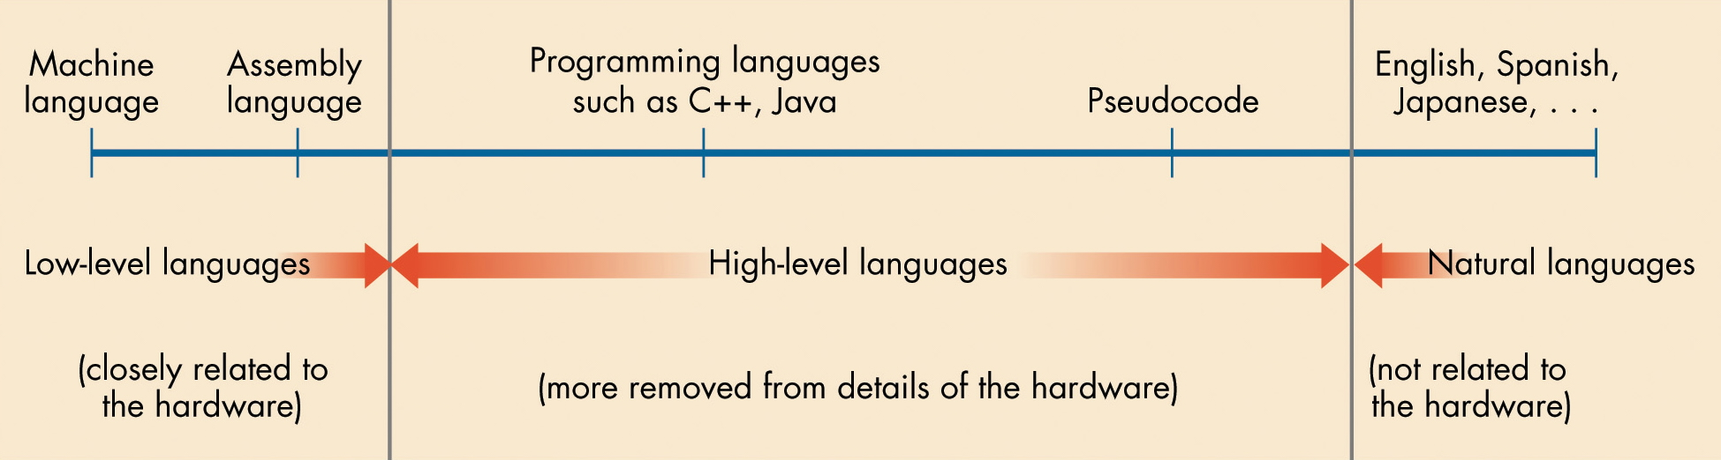
Figure 6.3
The Continuum of Programming Languages

Slide 41
Von Neumann computer
  “Naked machine”
  Hardware without any helpful user-oriented features
  Extremely difficult for a human to work with
An interface between the user and the hardware is needed to make a Von Neumann computer usable

Slide 42

SYSTEM SOFTWARE
An assembler is an example of a program that is system software
i.e. software that transforms the hardware into a virtual machine that is more compatible with our human way of working.
system software
user
interface
hardware

Slide 43
A NICE ANALOGY- a car
Car hardware includes
the internal combustion engine
tires
distributor
windows
A car virtual machine includes
dashboard with it gauges
buttons for controlling windows

Slide 44
THE VIRTUAL MACHINE
Set of services and resources created by the system software.
On the same hardware, different system software provides a different "look and feel" to the machine.
Example: Windows XP vs a Linux operating system vs Mac OS X

Slide 45
PURPOSE OF THE SYSTEM SOFTWARE
1) Hide the details of the underlying hardware.
2) Present information in a way that humans can understand easily.
Note: "easily" has different definitions in different time periods!
Example: text-based user interface vs graphical user interface (GUI)
3) Allow the user access to the hardware, but not directly.
4) Protect and secure hardware and resources.

Slide 46
Types of System Software
System software is a collection of many different programs
Operating system
  Controls the overall operation of the computer
  Communicates with the user
  Determines what the user wants
  Activates system programs, applications packages, or user programs to carry out user requests

Slide 47
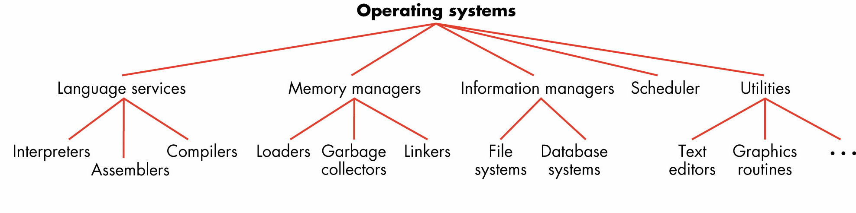

Slide 48
Types of System Software (continued)
User interface
  Graphical user interface (GUI) provides graphical control of the capabilities and services of the computer
Language services
  Assemblers, compilers, and interpreters
  Allow you to write programs in a high-level, user-oriented language, and then execute them

Slide 49
Types of System Software (continued)
Memory managers
  Allocate and retrieve memory space
Information managers
  Handle the organization, storage, and retrieval of information on mass storage devices
I/O systems
  Allow the use of different types of input and output devices

Slide 50
Types of System Software (continued)
Scheduler
  Keeps a list of programs ready to run and selects the one that will execute next
Utilities
  Collections of library routines that provide services either to user or other system routines

Slide 51
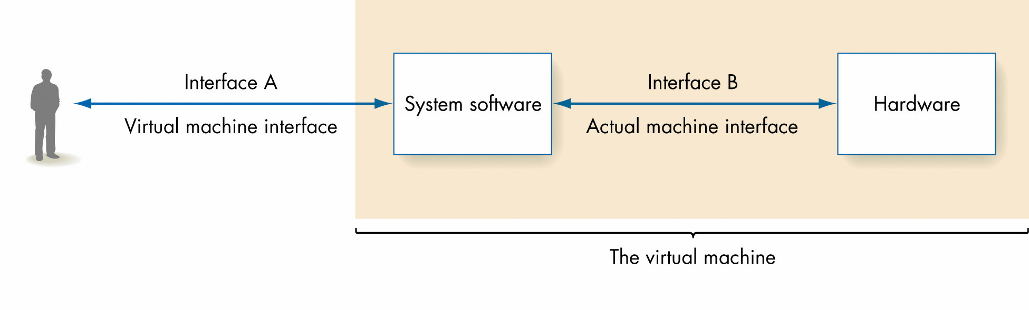
Figure 6.1
The Role of System Software

Slide 52
CONTRAST SYSTEMS WORK WITH APPLICATION WORK
System analysts and system programmers design and write system programs.
Systems managers locate problems in system software and try to correct the problems.
Application analysts, programmers and managers solve problems that help users use a computer to solve problems in other disciplines.
Systems work produces a virtual machine for users and requires an understanding of the computer and its existing system software.
Application work requires that an individual be able to interact well with people in other disciplines.

Slide 53
CONTRAST SYSTEM SOFTWARE WITH APPLICATION SOFTWARE
System software builds the virtual machine and helps with typical computer science tasks such as programming and system maintenance.
Application software allows users to do tasks they need to perform to solve a problem not necessarily in the realm of computer science.
Examples: word processors spreadsheets
games data bases draw maps
Maple web browsers create slides

Slide 54
Sometimes the lines blur between system software and application software, but you usually find computer scientists classifying themselves as
system people
or application people
This just means their dominant work is in the system area or the application area.

Slide 55
Note: Different operating systems can run on the same hardware.
But, you need the particular version for your hardware.
Saying that a "Mac is easier to use than a PC" is a nonsense statement. Both have similar architectures.
The difference lies in the virtual machines presented to the world!
OK to say: "The virtual machine environment created by the Mac operating system is easier to use than the virtual machine environment created by the MS PC operating system."

Slide 56
MAIN FUNCTIONS OF AN OPERATING SYSTEM
Provide a user interface. (Receptionist)
  Establish a "look and feel" for the system.
  Text-based vs GUI (graphical user interface)
  Future: Mainly vocal?
Direct the tasks to be performed. (Dispatcher)
  What do you want to do?
  Provide or deny the service.
Safeguard the computer. (A security guard)
  Control access to the computer.
  Protect the resources of the computer.
  Safeguard the password file.
  Role of encryption.
  Humans- the weakest link.

Slide 57
MAIN FUNCTIONS OF AN OPERATING SYSTEM (continued)
Efficiently allocate resources. (Efficiency expert)
  I/O queues
  Processor allocation: Running, Ready, Running states.
Safe use of resources. (Traffic cop)
  Deadlock- prevention and recovery
These are just the broad outlines of an operating system's responsibilities.
An operating system is one of the most complex and difficult pieces of software to design and code.

Slide 58
CHARACTERISTICS OF OPERATING SYSTEMS (OS)
GUI - Graphical User Interface OS-
Has the capability of using a mouse and emphasizes visual devices such as icons. Examples: System X, newer UNIX versions, Linux, Windows XP(and 95, 98, CE, NT 4.0, 2000)
Multi -User OS -
Multiple users use the computer and run programs at the same time. Examples: All of the above except Windows CE. Special cases include:
Timesharing OS - Use of time slices to service multiple users in the same computer.
Distributed OS -- Computers distributed geographically can operate separately or together.

Slide 59
Multitasking OS-
Allow multiple software processes to be run at the same time. Examples: System X,UNIX, Windows 2000 (and 95, 98, NT 4.0)
Multithreading OS-
Allow different parts of a software program to run
concurrently. Examples: UNIX, Windows 2000 (and 95, 98, NT 4.0)
Multiprocessing OS-
Allows multiple processors to be utilized as one machine. Examples: UNIX, Windows 2000, Windows NT 4.0

Slide 60
Batch system OS-
Jobs are bundled together with the instructions necessary to allow them to be processed without intervention. Often jobs of a similar nature can be bundled together to further increase economy.
This is an older type of operating system. Today, on large systems, jobs can be batched, but you don't see OS that are strictly batch systems anymore.
Real-time OS- Jobs must operate in a timely manner while a user interacts with the operating system.
Note: The terms on the last couple of slides are NOT mutually exclusive.

Slide 61
Historical Overview of Operating Systems Development
First generation of system software (roughly 1945-1955)
  No operating systems
  Assemblers and loaders were almost the only system software provided
Second generation of system software (1955-1965)
  Batch operating systems
  Ran collections of input programs one after the other
  Included a command language

Slide 62
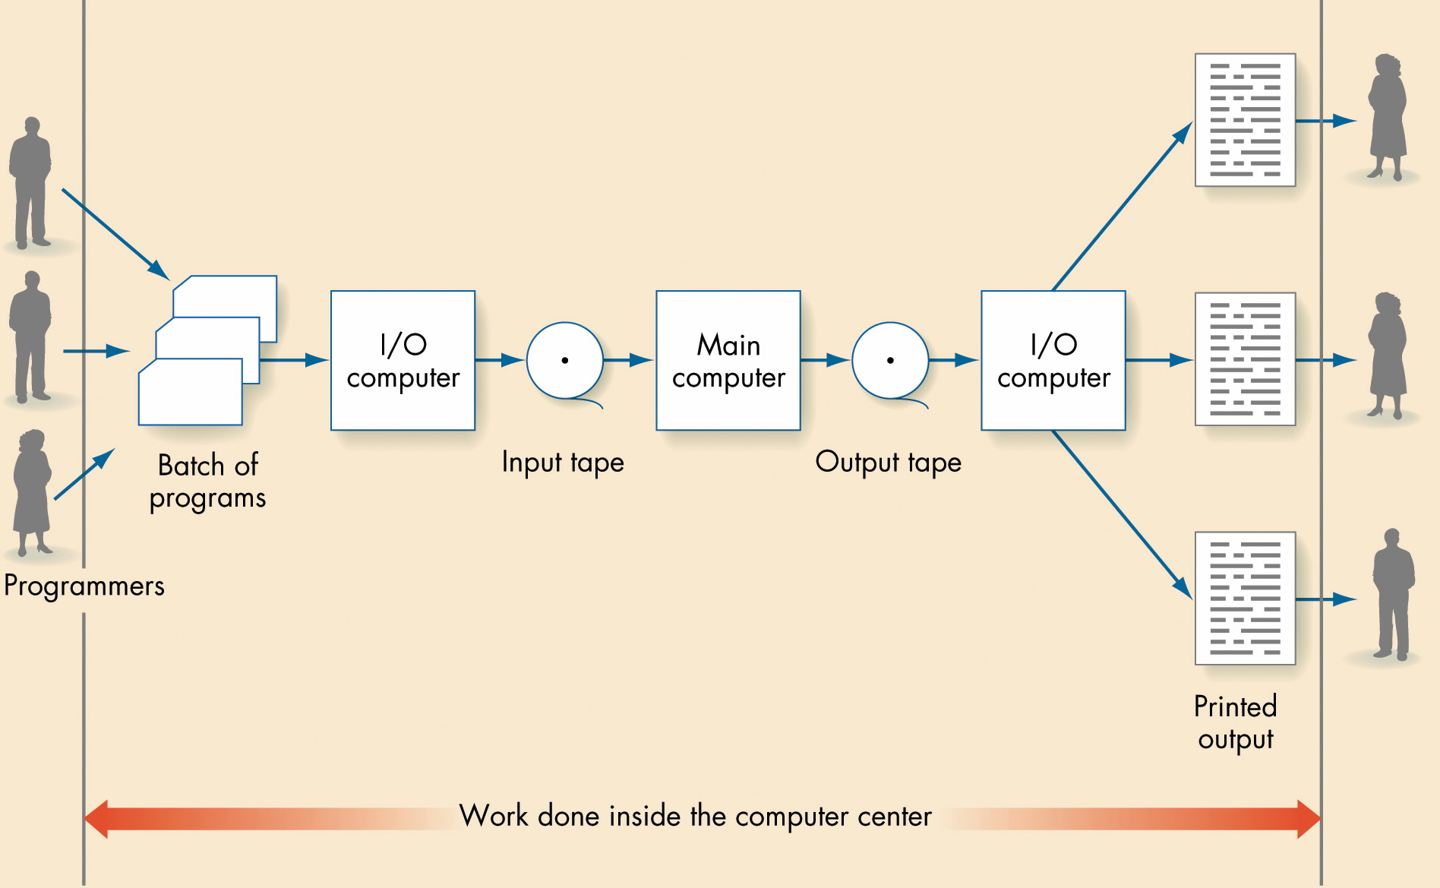
Figure 6.18
Operation of a Batch Computer System

Slide 63
Historical Overview of Operating Systems Development (continued)
Third-generation operating systems (1965-1985)
  Multiprogrammed operating systems
  Permitted multiple user programs to run at once
Fourth-generation operating systems (1985-present)
  Network operating systems
  Virtual environment treats resources physically residing on the computer in the same way as resources available through the computer’s network

Slide 64
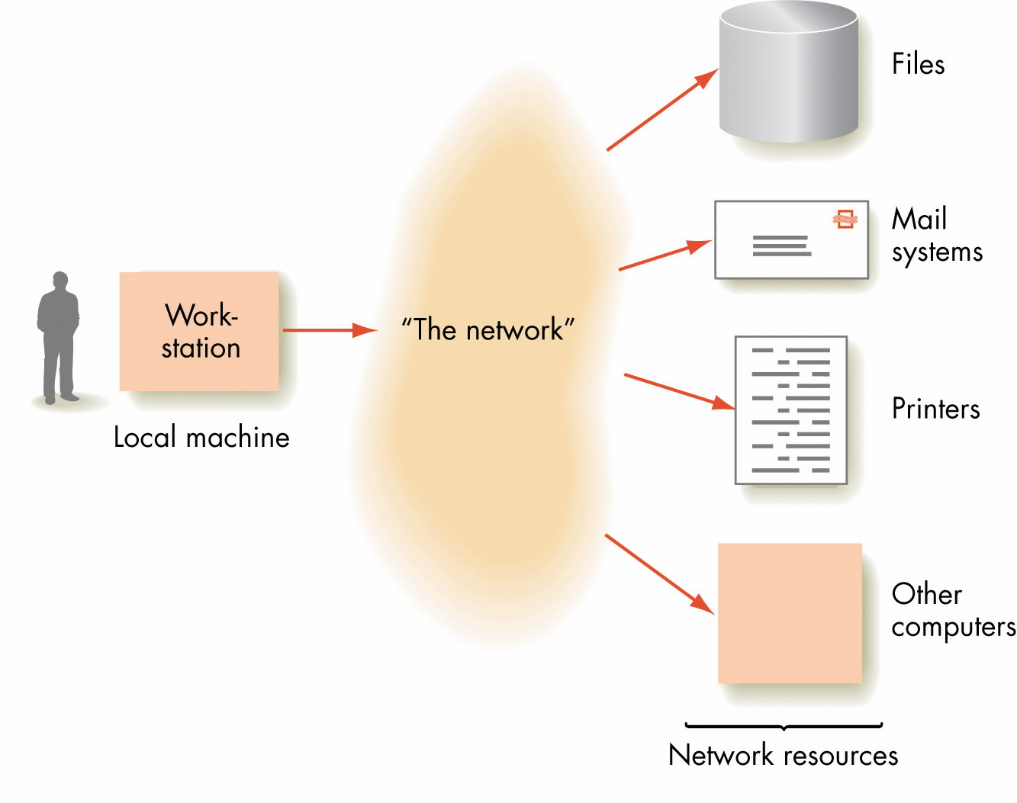
Figure 6.22
The Virtual Environment Created by a Network Operating System

Slide 65
The Future
Operating systems will continue to evolve
Possible characteristics of fifth-generation systems
  Multimedia user interfaces
  Parallel processing systems
  Completely distributed computing environments

Slide 66
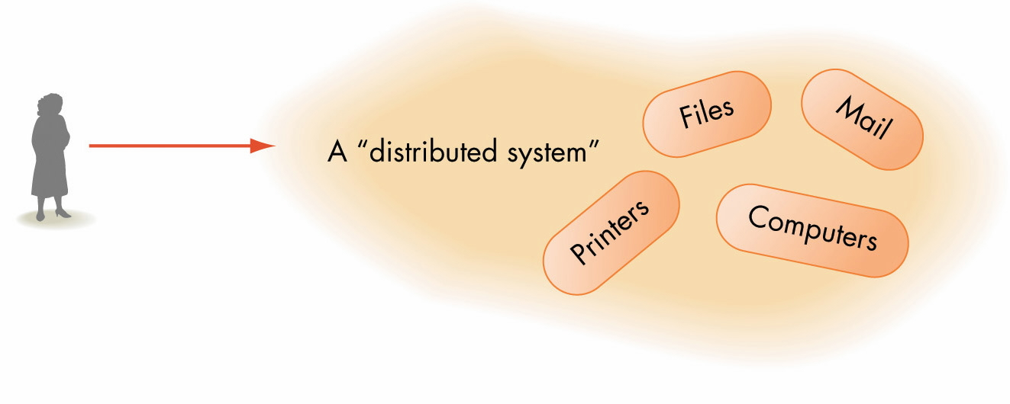
Figure 6.23
Structure of a Distributed System

Slide 67
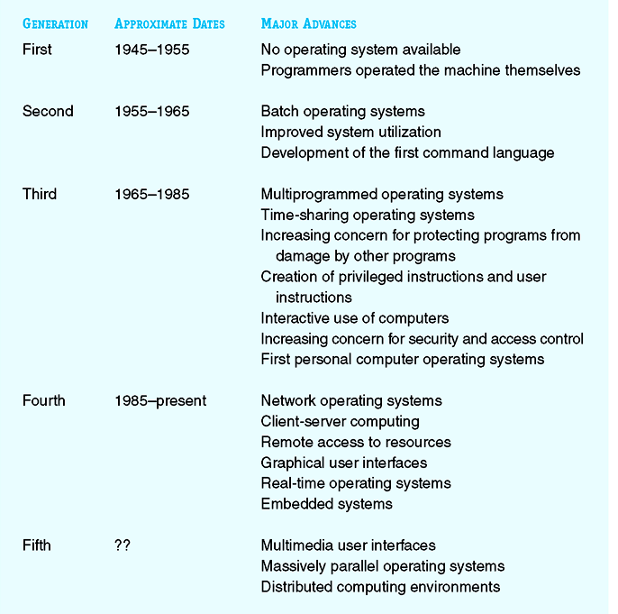
Figure 6.24
Some of the Major Advances in Operating Systems Development

Slide 68
A few specific operating systems examples:
Note: Nothing starts a fight faster than someone arguing for a particular operating system!!
UNIX-
Developed by some of the members of the Multics team at Bell Labs starting in the late 1960's by many of the same people who help created the C programming language.
The UNIX of today is the not just the work of a couple of programmers.
Many organizations, institutes and various other individuals contributed significant additions to the system.
Comes in many variants and is not standardized ---i.e. HP UNIX, SUN UNIX, .... are different at the systems level.
The "look and feel" can be changed by using different shells: C shell, Korn shell, Bash shell, etc.

Slide 69
Linux (lee'nuhks/ or /li'nuks/,_not_/li:'nuhks)
Developed by Linus Torvalds and further enhanced by a number of developers throughout the world.
A variant of UNIX for PCs (as opposed to workstations)
Linux is a freely available multitasking and multiuser operating system.
From the outset, Linux was placed under General
Public License (GPL).
The system can be distributed, used and expanded free of charge. In this way,developers have access to all the source codes, thus being able to integrate new functions easily or to find and eliminate programming bugs quickly.
Drivers for new adapters (SCSI controller, graphics cards, etc.) can be integrated very rapidly.

Slide 70
Microsoft Windows CE 1.0
Was originally released in 1996 to compete in the Palm Device Assistant Category.
Windows CE has many of the same features as Windows 95.
Windows 2000 Professional
Windows 2000 is based on the Windows NT Kernel
and is sometimes referred to as Windows NT 5.0.
Windows 2000 contains over 29 million lines of code
mainly written in C++ (8 million of those lines are written for drivers.)
Windows 2000 was by far one of the largest commercial projects ever built until Windows XP was released.

Slide 71
Mac OS X, version 10.1
Is one of the latest public releases of the Apple operating system.
Some features of earlier Apple operating systems have become a standard part of GUI (graphical user interface) operating systems such as
icons
mice
point and click maneuvering
Windows XP Professional
Built on the code base of Windows NT® and Windows 2000. The operating system uses a 32-bit computing architecture and a fully protected memory model—features that help make Windows XP Professional the most reliable Windows operating system yet.

Slide 72
Microsoft Vista
The latest operating system from MS.
Microsoft was forced to scrap the first incarnation of Longhorn – now called Windows Vista – after a senior executive warned chairman Bill Gates that it was too complex to work properly.
Jim Allchin, group VP in charge of Windows, told the Wall Street Journal he dropped the bombshell, simply telling Gates "It's not going to work". Longhorn was so complex that Microsoft's developers would never be able to make it run properly, Allchin told Gates.
The root of the problem was Microsoft's historical approach to developing software – the so-called 'spaghetti code culture' – where the company's thousands of programmers would each develop their own piece of code and it would then all be stitched together at the end.
Ref: http://software.silicon.com/os/0,39024651,39152715,00.htm

Slide 73
Comparing the many operating systems:
Check out:
http://en.wikipedia.org/wiki/Comparison_of_operating_systems

