Slide 1
CHAPTER 8 – High-Level Programming Languages
CPSC 171

Slide 2
Chapter Goals
Describe the translation process and distinguish between assembly, compilation, interpretation, and execution
Name four distinct programming paradigms and name a language characteristic of each
Describe the following constructs: input and output, selection, looping, and subprograms
Construct Boolean expressions and describe how they are used to alter the flow of control of an algorithm
Define the concepts of a data type and strong typing
Introduce the Java programming language

Slide 3
Compilers
Compiler A program that translates a high-level language program into machine code
High-level languages provide a richer set of instructions that makes the programmer’s life even easier than working in assembly language.
As long as a compiler for the high-level language is written for a specific computer, programs written in the high-level language will run on that computer.
We say that a high-level language is machine-independent.
Machine language and assembly language are machine-dependent.

Slide 4
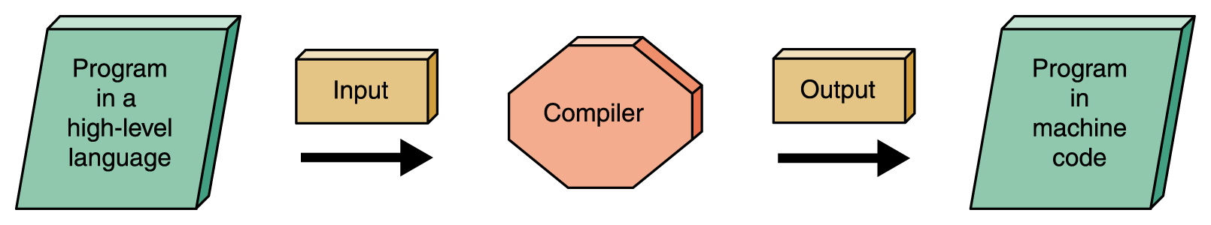
Compilers
Figure 8.1 Compilation process

Slide 5
Interpreters
Interpreter A translating program that translates and executes the statements in sequence
  An assembler or compiler produces machine code as output and that output is then executed in a separate step
  An interpreter translates a statement and then immediately executes the statement
  Interpreters can be viewed as simulators

Slide 6
Java
Introduced in 1996
Portability (i.e. machine-independence) was of primary importance
Java is compiled into a standardized machine language called Bytecode
A software interpreter called the JVM (Java Virtual Machine) takes the Bytecode program and executes it

Slide 7
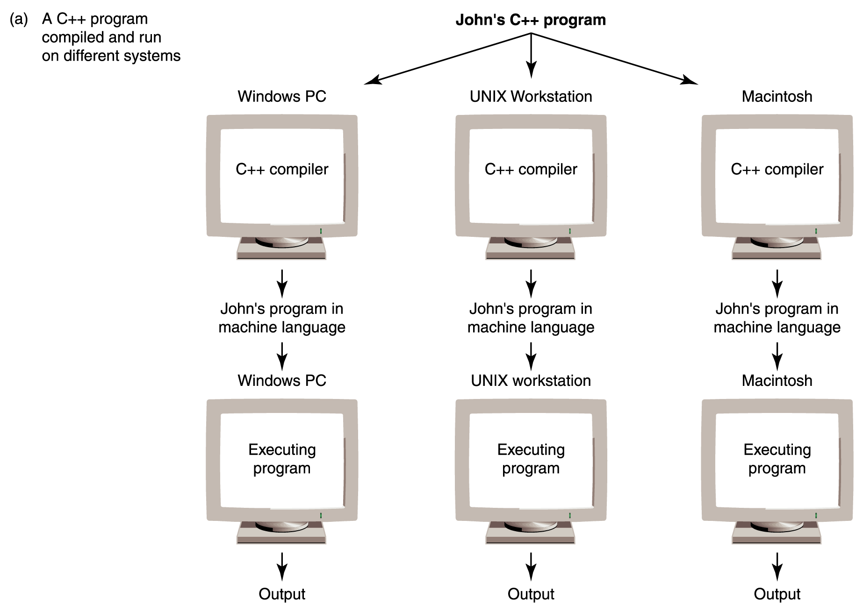
Programming Language Paradigms
Figure 8.2
Portability provided by standardized languages versus interpretation by Bytecode

Slide 8
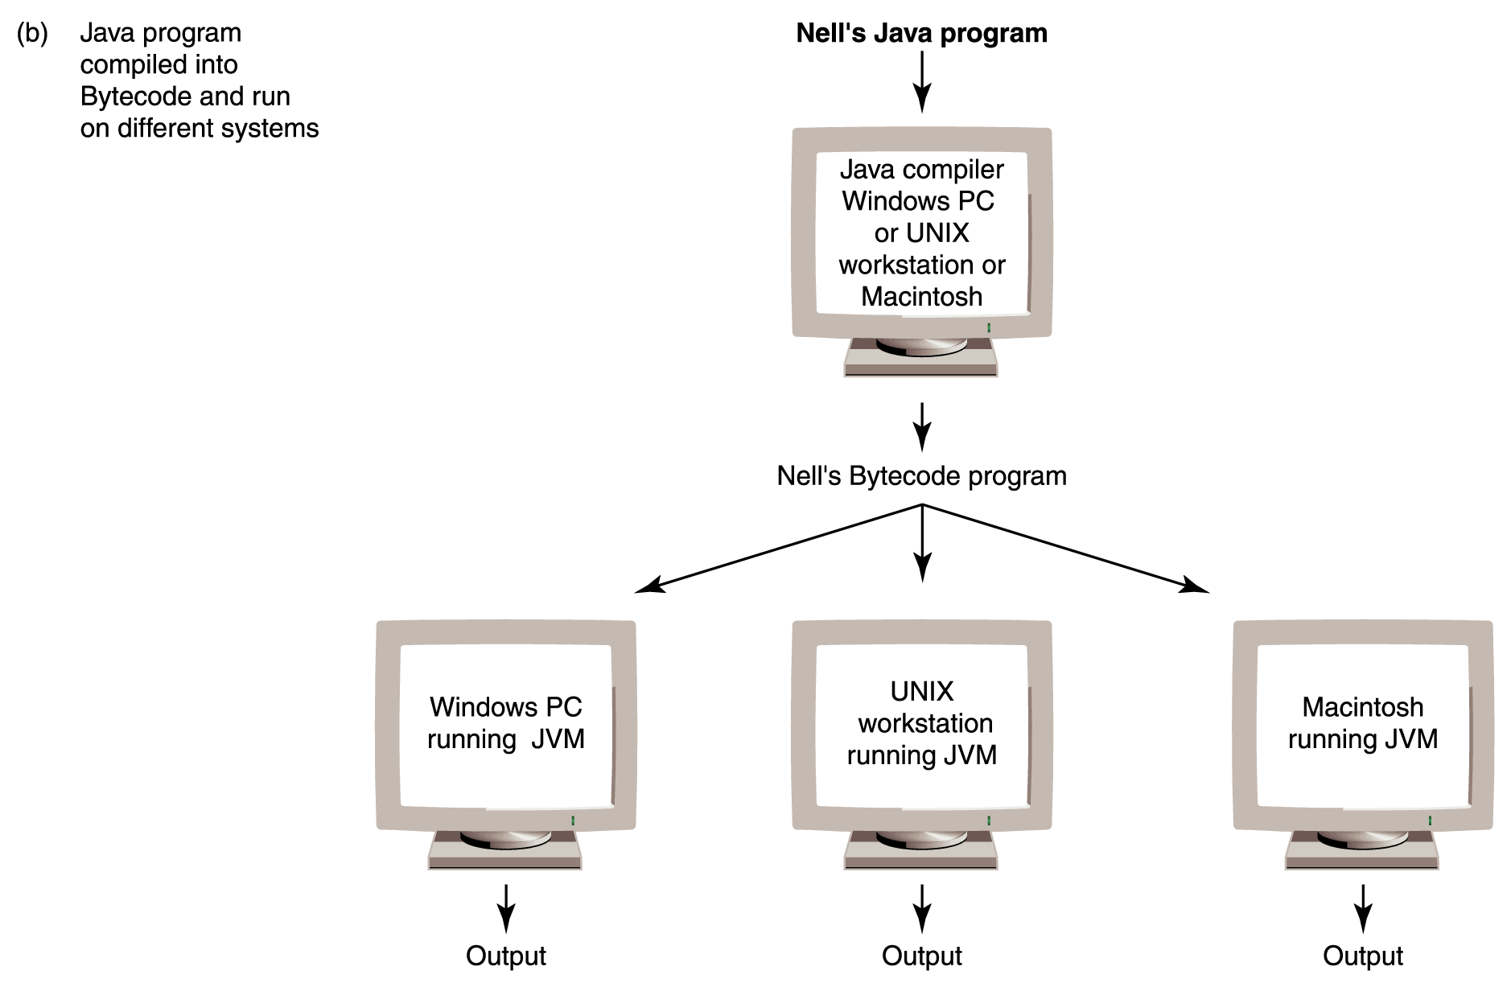
Programming Language Paradigms
Figure 8.2
Portability provided by standardized languages versus interpretation by Bytecode

Slide 9
Four Programming Language Paradigms
Imperative or procedural model
  FORTRAN, COBOL, BASIC, C, Pascal,
  Ada, and C++
Functional model
  LISP, Scheme (a derivative of LISP), and ML
Logic programming model
  PROLOG
Object-oriented model
  SIMULA and Smalltalk
  C++ is as an imperative language with some object-oriented features
  Java is an object-oriented language with some imperative features

Slide 10
Functionality of Imperative Languages
Imperative languages typically use the following types of instructions:
Sequencing Execute statements in sequence until an instruction is encountered that changes this sequencing
Selection Decide which action to take
Iteration (looping) Repeat an action
Both selection and iteration require the use of a Boolean expression

Slide 11
An Introduction to the Imperative Features of Java
Many, but not all, high-level languages have imperative features.
Java is object-oriented also, but we will delay discussing that part of the language initially.
First, we will concentrate on the imperative features that Java shares with C++.
Almost all of the early high-level languages were imperative languages.

Slide 12
Structure of Java Program
// Prologue comment – what the program does
// Written by J. Q. Programmer, 10/20/01
public class Name{ // class name starts with a capital letter
public static void main (String[ ] args) {
statement1; // Semicolon separates statements
statement 2; // Program body
….
} //end of method main's definition
} //end of the class definition

Slide 13
Variable
Variable A location in memory that contains a data value and is referenced by an identifier
In assembly language, a variable corresponds to a data memory location that is tagged with a label. The label is the identifier.
For example,
count .data 5
In our assembly language, we had no rules for forming identifiers, but in most high level languages, only certain combinations of characters can be used.

Slide 14
Java Rules for Creating Identifiers
Use any combination of digits, letters, and _ (the underscore symbol), but don't start with a digit.
Java is a case-sensitive language--- i.e. each of the following is different:
  this THIS thIS ThIs ...
An identifier can be of any length.
A programmer-chosen identifier may not be a reserved word---i.e. a word in the Java language such as class, public, int, etc.

Slide 15
Strong Typing
Strong typing The requirement that only a value of the proper type can be stored into a variable
Data type A description of the set of values and the basic set of operations that can be applied to values of the type
Java is strongly typed.

Slide 16
Primitive Data Types in Java and Many Other High-Level Programming Languages
Integer numbers
Real numbers
Characters
Boolean values
Strings

Slide 17
Integers
Typically these are whole numbers, their negatives, and zero.
The range allowed varies depending upon how many bytes are assigned to represent an integer value
Some high-level languages support several integer types of different sizes – i.e. short, long, ....
Operations that can be applied to integers are the standard arithmetic (add, subtract, multiply, divide) and relational operations (equality, less than, less than or equal to, greater than, greater than or equal to, inequality).

Slide 18
Reals
These are typically fractional numbers.
Like the integer data type, the range varies depending on the number of bytes assigned to represent a real number
Many high-level languages support two sizes of real numbers
The operations that can be applied to real numbers are the same as those that can be applied to integer numbers
Recall- To a computer scientist, 2 and 2.0 are different as they are stored differently! The first is an integer; the second is a real.

Slide 19
Characters
It takes one byte to represent characters in the ASCII character set
Two bytes are needed to represent characters in the Unicode character set
Our English alphabet is represented in ASCII, which is a subset of Unicode
Applying arithmetic operations to characters doesn’t make much sense
Comparing characters does make sense, so the relational operators can be applied to characters
The meaning of “less than” and “greater than” when applied to characters is “comes before” and “comes after” in the character set

Slide 20
Boolean
The Boolean data type consists of two values: true and false
Not all high-level languages support the Boolean data type
If a language does not support a Boolean type, then you can simulate Boolean values by saying that the Boolean value true is represented by 1 and false is represented by 0

Slide 21
Strings
A string is a sequence of characters considered as one data value
For example: “This is a string.”
  Contains 17 characters: one uppercase letter, 12 lowercase letters, three blanks, and a period
Not all languages support strings as a data type.
The operations defined on strings vary from language to language They include
  concatenation of strings (i.e. pasting them together),
  comparison of strings in terms of lexicographic order (i.e. alphabetical order)
  the extracting of substrings.

Slide 22
Declarations
Declaration A statement that associates an identifier with a variable, an action, or some other entity within the language that can be given a name so that the programmer can refer to that item by name

Slide 23
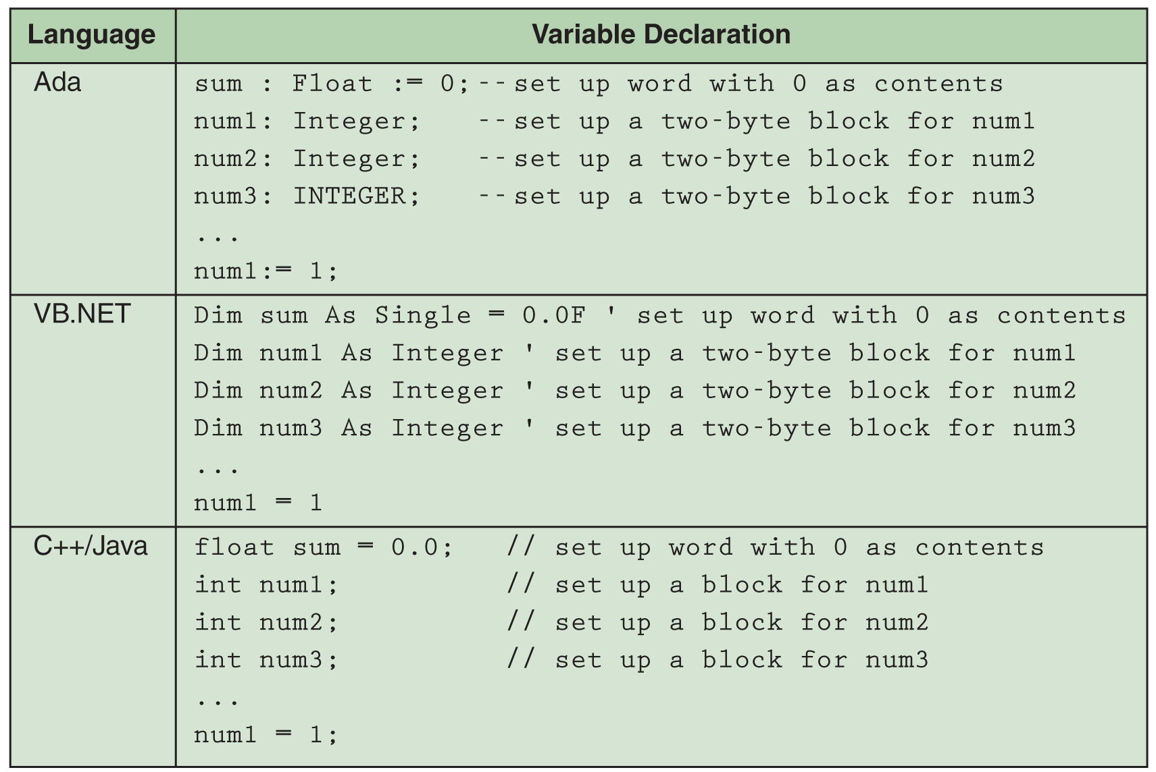
Declarations
8-26

Slide 24
Declarations in Java
Each identifier (variable) must be declared.
A variable declaration consists of a data type followed by a list of one or more identifiers of that type.
Java has many "primitive" data types that can be used. Ones we will use:
int amount; // integer declaration
double size, height; // real declaration
char answer; // character declaration
String Name; // string declaration
The computer needs to know the type that the bits represent.

Slide 25
Assignment statement
Assignment statement An action statement (not a declaration) that says to evaluate the expression on the right-hand side of the symbol and store that value into the memory location named on the left-hand side

Slide 26
Assignments in Java
variable = expression;
Format:
Examples:
int A, B, C; //declarations
char letter = ‘A’; // declaration and assignment
B=2; //assignments
C=5;
A = B + C;
A = A + 1; // This is a valid assignment
Arithmetic operations: +, -, *, /, %

Slide 27
Constants
Named constant A location in memory, referenced by an identifier, that contains a data value that cannot be changed during the run of the program.
Format: final type variable = value;
Examples: final double PI = 3.14;
final String myName = “Irina”;
final int courseID = 171;

Slide 28
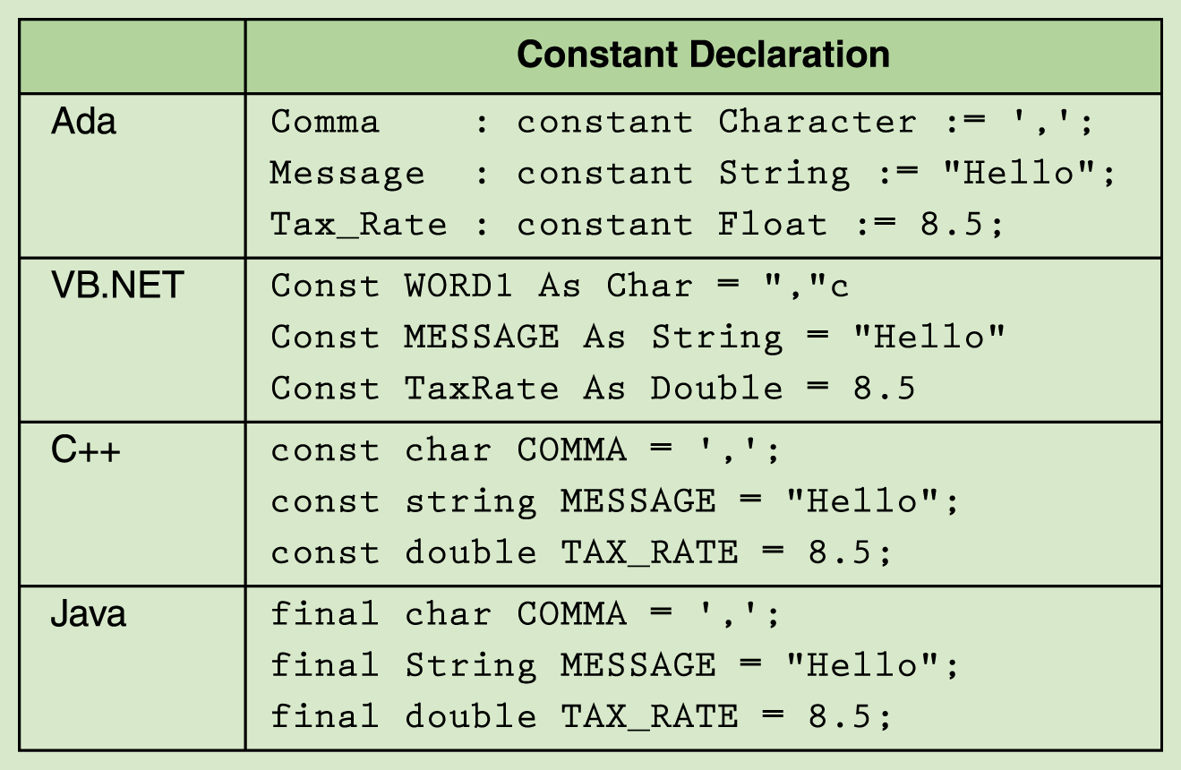
Assignment Statement
Page 238

Slide 29
Practice Problems
NewNumber and Next are integer variables in a Java program. Write a statement to assign the value of NewNumber to Next.
What will be the value of Average after the following statements are executed?
Next = New Number;
The value of average is 55 (integer division), but it is stored as a double – i.e. 55.0
int Total = 277, Number = 5;
double Average;
Average = Total / Number;

Slide 30
Input in Java
Until Version 5.0, Java was not easy to use for keyboard input. Consequently, the text introduced a class called Console to make input simpler. This is not a standard class in the Java language.
This class allows prompting and input to occur at the same time using :
readInt, readDouble, readChar
Example:
double speed = Console.readInt("Enter the speed in mph: ");
You need to know this only so you can read the programs in the text. We will use a different class as we will use Version 5.0 of Java.

Slide 31
Practice Problem
Declare an integer value called quantity.
Write a statement using the Console class that prompts the user to enter an integer value in a previously declared variable called quantity.
int quantity;
quantity = Console.readInt(“Enter an integer value for quantity.”);

Slide 32
Output in Java
Format System.out.println(string);
If the string is empty, a blank line is printed.
The string can be composed using the concatenation operation, +, that combines values and strings.
Example:
  int i = 10;
  int j = 20;
  System.out.println("This will output the value of i " + i + " and the value of j " + j + ". ");
  Be careful: If you include blanks when you split a string for output:
  System.out.println(“Doing this could put extra blanks
  where you don’t want them”);

Slide 33
println vs print
System.out.println(string);
prints the string and then issues a CR character which brings the cursor down to the next line.
System.out.print(string);
prints the string and leaves the cursor at the end of the string.
This one is used when prompting for input.

Slide 34
Practice Problems
A program has computed a value for the variable average that represents the average high temperature in San Diego for the month of May. Write an appropriate output statement.
What will appear on the screen after the execution of the following statement?
System.out.println(“This is”+” goodbye”+”, Steve”);
System.out.println(“The average high temperature is “ + average);
This is goodbye, Steve

Slide 35
We'll Use a Class Introduced in Java 5.0 for Input – Namely, the Scanner class
// Example of use of scanner
import java.util.Scanner; //input the Scanner library
public class Example2
{
public static void main(String[] args)
{
Scanner sc = new Scanner(System.in);
System.out.print("Enter the first number ");
int first = sc.nextInt();
System.out.print("Enter the first number ");
int second = sc.nextInt();
int sum = first + second;
System.out.println("The sum is " + sum);
}
}

Slide 36
Input Summary
Import the Scanner class with:
import java.util.Scanner;
Set up the input sream:
Scanner stdin = new Scanner(System.in);
where stdin is your choice of a name for the scanner.
To input anything, first issue a prompt:
System.out.print("Enter and describe it here> ");

Slide 37
Input Using the Scanner Class
To input an integer:
anint = stdin.nextInt();
or
int anint = stdin.nextInt();
if the variable anint is not declared.
To input a double:
double adouble =stdin.nextDouble();
To input a string:
String astring = stdin.nextLine();
This stores in astring everything from the scanner to the end of the line.

Slide 38
Handling char Data
Scanner sc = new Scanner(System.in);
System.out.print("Answer yes or no:");
ans = sc.next(); //reads next string from the line
Now to see what the answer is, you must test if the variable ans is a y or not. There are two ways to do this:
if (ans.charAt(0) == 'y') ….
or
if (ans.equals("y")) …
Caution- watch the type of quote.
' ' denotes a character
" " denotes a string
Most of my examples on the slides will use the Console class as the code is a bit smaller and fits on the slides better.

Slide 39
Control Structures
Control structure An instruction that determines the order in which other instructions in a program are executed
Structured programming A programming methodology in which each logical unit of a program should have just one entry and one exit
Sequence, selection statements, looping statements, and subprogram statements are control structures
Both selection and iteration require the use of a Boolean expression

Slide 40
Boolean Expressions
A Boolean variable is a location in memory that can contain either true or false.
Typically, false is represented as a 0 and true as a 1 or any nonzero integer.
Boolean expression A sequence of identifiers, separated by compatible operators, that evaluates to true or false Boolean expression can be
  A Boolean variable
  An arithmetic expression followed by a relational operator followed by an arithmetic expression
  A Boolean expression followed by a Boolean operator followed by a Boolean expression

Slide 41
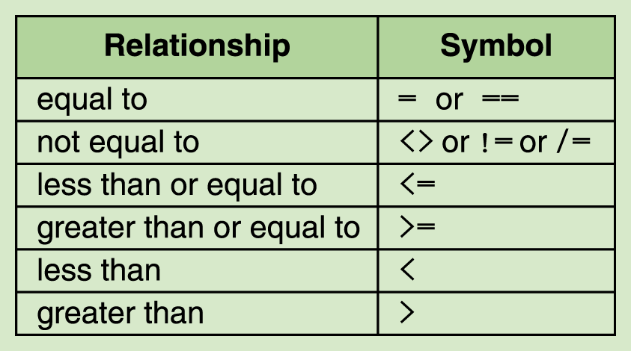
Boolean Expressions
A relational operator between two arithmetic expressions is asking if the relationship exists between the two expressions
For example,
xValue < yValue
An answer is true or false.
Java
==
!=
Caution: equal to is ==, not =
in Java.

Slide 42
Boolean Operators in Java
Operator | Symbol
! | not
&& | and
|| | or
Be careful to not use a single & or a single | as those are different operations.
True or false for a = 2; b = 3; and c = -1
1. (a < b) && (a > c)
2. (a != b+c) || (b-c > a)
3. !(a+b > c) || (a <= b)
4. (a-b >= c) || a>c && b-2< c
Answers:
true
true
true
4. true

Slide 43
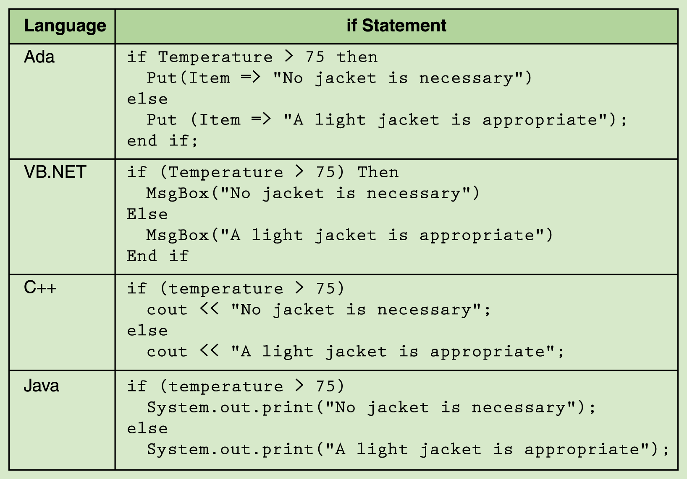
Selection Statements
The if statement allows the program to test the state
of the program variables using a Boolean expression

Slide 44
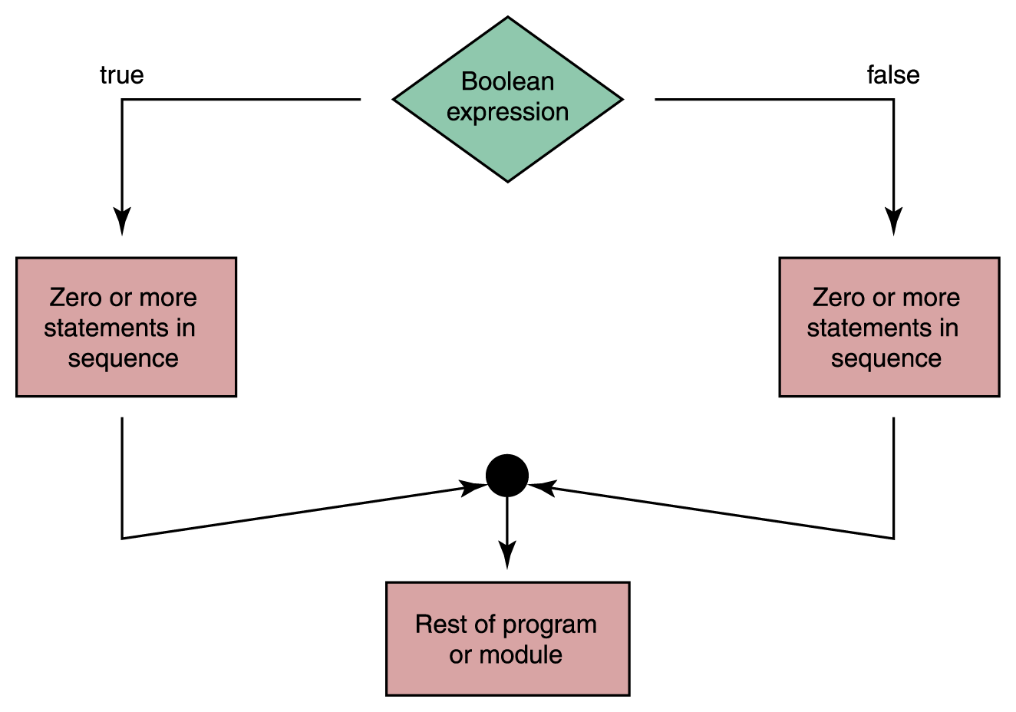
Selection Statements
Flow of control of
if-then-else statement

Slide 45
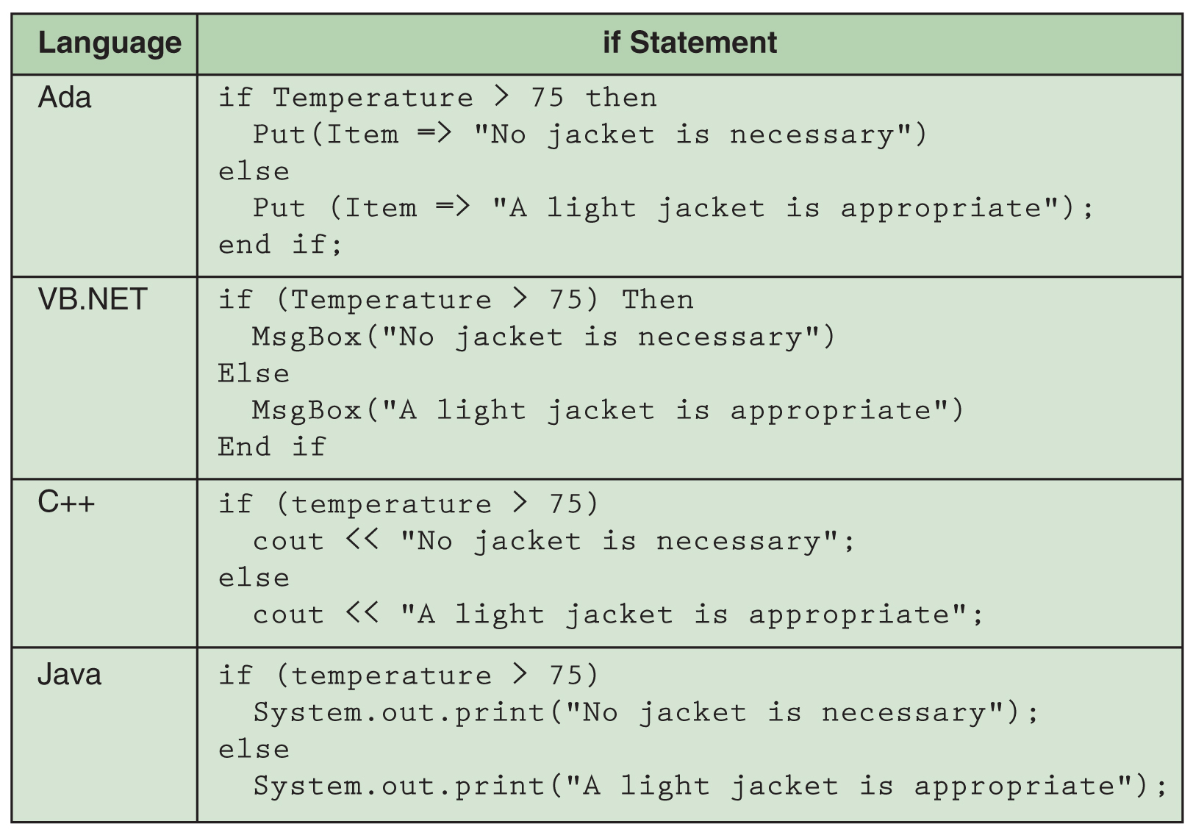
Selection Statements

Slide 46
Selection in Java
Example:
Format:
    if (Boolean expression)
    { First set of statements}
    else
    {Second set of statements}
    if (A > B)
    { Max = A;
    Min = B; }
    else
    { Max = B;
    Min = A;}
Important Note: The Boolean condition is in parentheses, else part may be absent, no brackets are necessary if a set consists of one statement.

Slide 47
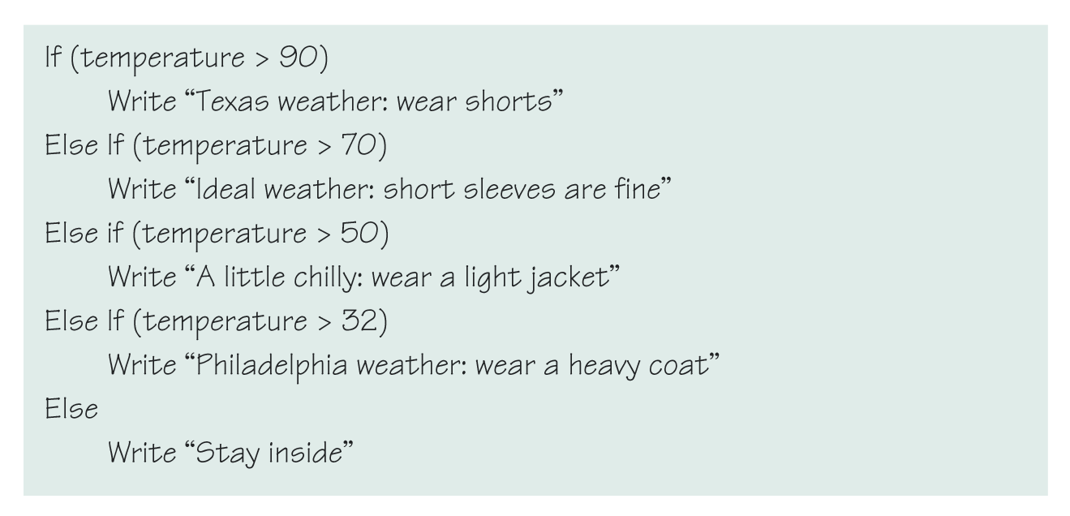
Selection Statements in Pseudocode

Slide 48
Same in Java
if (temp > 90)
System.out.println(“Texas weather: wear shorts”);
else if (temp > 70)
System.out.println(“Ideal weather: short sleeves are fine”);
else if (temp > 50)
System.out.println(“A little chilly: wear a light jacket”);
else if (temp > 32)
System.out.println(“Texas weather: wear a heavy coat”);
else
System.out.println(“Stay inside”);

Slide 49
Practice Problem
What is the output from the following section of code?
int number1 = 15;
int number2 = 7;
if ( number1 >= number2)
System.out.println(2*number1);
else
System.out.println(2*number2);
30

Slide 50
Practice Problem
What is an output from the following section of code?
int quotaThisMonth = 7;
int quotaLastMonth =quotaThisMonth + 1;
if ( ( quotaThisMonth > quotaLastMonth) ||
(quotaLastMonth >=8))
{ System.out.println(“Yes”);
quotaLastMonth = quotaLastMonth + 1;
}
else
{ System.out.println(“No”);
quotaThisMonth = quotaThisMonth + 1;}
Yes

Slide 51
Practice Problems
What is the output from the following code segments?
int a = 1, b = 2, c=3;
if (a < b) System.out.println(“Yes”);
else System.out.println(“No’);
System.out.println(“OK”);
Yes
OK
int a = 1, b = 2, c=3;
if (a > b) System.out.println(“Yes”);
System.out.println(“OK”);
OK

Slide 52
Other Selection Commands
The if-then-else statement is a 2-way branching command.
Most languages provide an additional multiway branching command which is called something such as a switch or a case statement.
We won’t introduce the syntax for those here.
As we know from the earlier comment that said which commands sufficed to write any algorithm, we know the if-then-else is all we need really.
The other selection commands just make some coding a bit easier for the programmer.

Slide 53
Suppose we encounter a 4-way branch situation:
if class is | output
1 | freshman
2 | sophomore
3 | junior
4 | senior
If statements can be nested in order to provide multiway branches.
if (class == 1) System.out.println(“freshman”);
else if (class == 2) System.out.println(“sophomore”);
else if (class == 3) System.out.println(“junior”);
else if (class == 4) System.out.println(“senior”);

Slide 54
if (class == 1) System.out.println(“freshman”);
else if (class == 2) System.out.println(“sophomore”);
else if (class == 3) System.out.println(“junior”);
else System.out.println(“senior”);
if (class == 1) System.out.println(“freshman”);
if (class == 2) System.out.println(“sophomore”);
if (class == 3) System.out.println(“junior”);
if (class == 4) System.out.println(“senior”);
if (class == 1) System.out.println(“freshman”);
else if (class == 2) System.out.println(“sophomore”);
else if (class == 3) System.out.println(“junior”);
else if (class == 4) System.out.println(“senior”);
Compare these three pieces of code:
Do they print the same thing for all values of class?
Do they do the same amount of work?

Slide 55
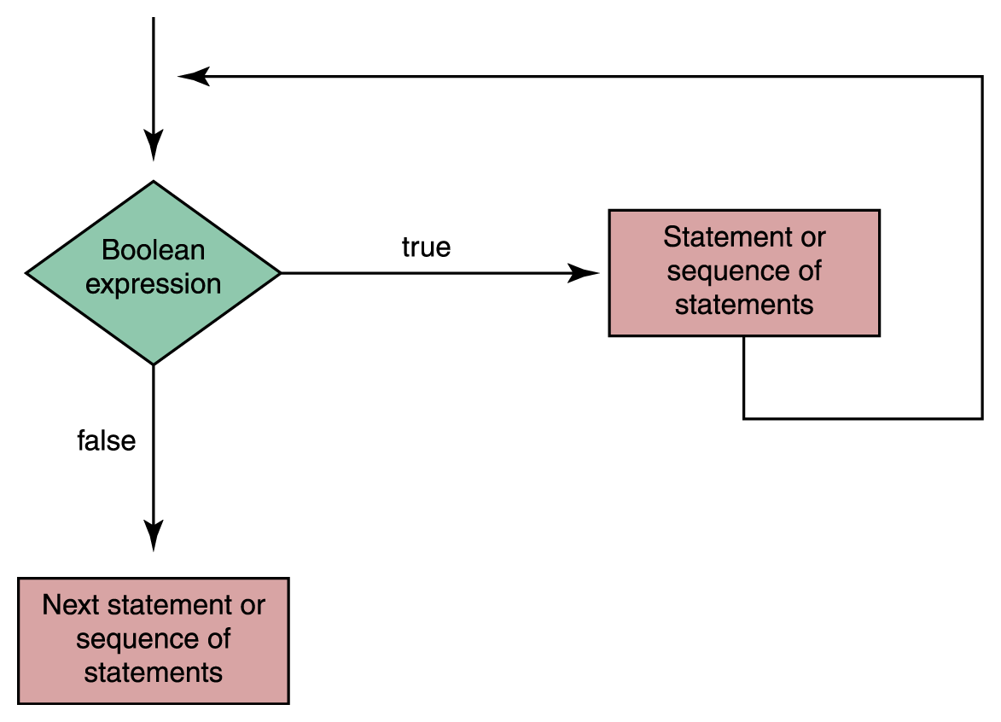
Looping Statements
The while statement is used to repeat a course of action
There are two distinct types of repetitions:
  Count-controlled loops
  Event-controlled loops

Slide 56
Count-Controlled Loops
Repeat a specified number of times
Use of a special variable called a loop control variable
int count = 1
while (count <= limit)
{
…
count = count +1;
}

Slide 57
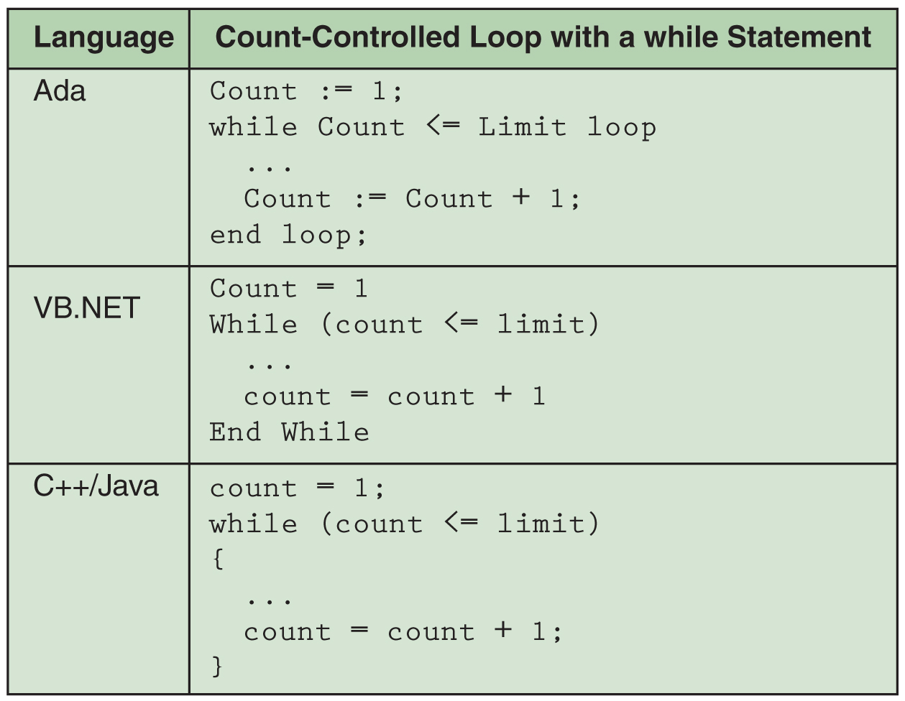
Count-controlled loops

Slide 58
Looping Statements
Event-controlled loops
  The number of repetitions is controlled by an event that occurs within the body of the loop itself
int n = Console.readInt(“Enter an integer”); // initialize event
while (n >=0) // Test event
{
… // Body of loop
n = Console.readInt(“Enter an integer”); // Update event
}

Slide 59
Practice Problem
What is an output from the following section of the code?
int scores =1;
while (scores < 20)
{
scores = scores +2;
System.out.println(scores);
}
3 5 7 9 11 13 15 17 19 21

Slide 60
Practice Problem
How many times will the statement with the comment be executed in the following section of code?
int left=10;
int right =20;
while (left <=right)
{
System.out.println(left); // This statement
left = left +2;
}
10 12 14 16 18 20 – six times

Slide 61
Additional Looping Commands
The while loop is known as a pretest loop.
The condition is tested before the loop is encountered. If the condition is false, the loop is not entered.
We saw earlier that the while loop was the only loop that was needed to write any algorithm.
However, most languages provide at least two other kinds of loops:
  A posttest loop (often called something like a repeat-until loop.)
  A special count-controlled loop where the counter is initialized, tested, and incremented automatically (often called something like a for loop).
We won’t show those here.

Slide 62
Storing Data in More Complex Structures Than a Single Cell
We often need data stored in structures more complicated than single cells.
All programming languages have some basic structures.
Modern programming languages have many types of complex structures than can be used.
For example, if you wanted to maintain a list of students in a class and their grades, you might want to keep such information as the following:

Slide 63
CPSC 171 Grades
Surname
First name
Middle initial
Email address
Lab1
...
Lab k
Homework
Test 1
Test 2
Test 3
Final
Course
Although many of these could be handled with a single variable for each, if we have a lot of Lab grades, using a different variable for each grade is a pain.

Slide 64
Multiple Data That is Similar
Suppose we had many, many pieces of data such as grades, and we needed 1000 of these.
Would you want to use grade0, grade1, grade2, ..., grade999 for variable names?
Think of the fact that you would need to declare all of these.
If you wanted to input values you would have to do 1000 input statements.
Output for all would require 1000 output statements.
And, even worst, think of trying to find the average of all of these – you would need a huge arithmetic statement
  total = (grade0 + grade1 + ... + grade999)/1000;
  and programming languages can’t deal with ...
Almost all languages support something to handle this.

Slide 65
Arrays
An array is a named collection of homogeneous items in which individual items are accessed by their place within the collection
The place within the collection is called an index
  int[] myArray = new int[10];
  // creates an array of 10 integers
  myArray[0]=1;
  // set the first element to 1
  myArray[8]=myArray[0];
  // set the next to last element to
  // the value of the first element
myArray
1 |  |  |  |  |  |  |  | 1

Slide 66
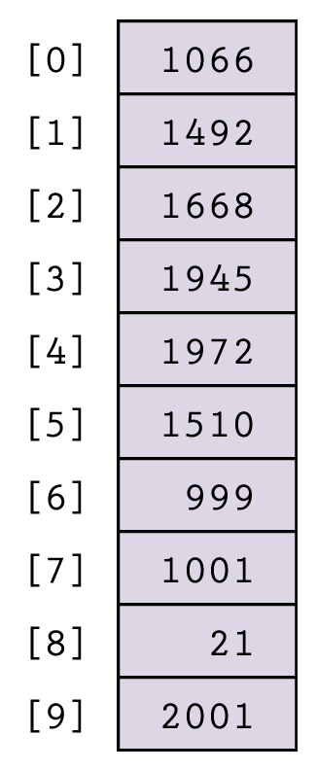
An Array That Has Been Given Values i.e. Initialized
Indices
…

Slide 67
Now We Can Handle the Grade Average Problem – Note the use of the index!!!
int[] grades = new int[1000]; //assumes integer grades
int count = 0, sum = 0;
double average;
//get input and add at same time
while (count <= 1000) {
System.out.println(“Enter the grade for student “ + count);
grade[count] = Console.readInt(“>");
sum = sum + grade[count];
count = count + 1;
}
average = sum/1000.0;
Note: The <= would allow a reference to grade[1000] which doesn't exist.
Change to < (or declare grades as new int[1001])

Slide 68
The Index of an Array Can Be Computed!!!
Thus, this is a legal reference:
  myArray[i+j]
Any time you have a lot of variables which are storing the same kind of data, using an array helps you
  declare the variables easily
  do computing with loops
  do I/O with the variables.
The kind of array introduced so far has one index and is called a 1-dimensional array.
Most languages support an arbitrary large number of arrays.

Slide 69
Two Dimensional Arrays
double [ ] [ ] myTable = new double [2] [3];
This reserves memory for keep 6 real numbers sequentially.
But, we can think of them as displayed in a table with 2 rows and 3 columns.
myTable[0][2] = 2.3;
0 1 2
 |  | 2.3
0
Remember, numbering
Starts with zero!
1

Slide 70
Summary So Far
We can do input and output.
We can assign values to variables within the program.
We can direct the flow of control by using conditional and iterative statements.
Other things to remember:
  a prologue comment to explain what the program does and the author.
  the class header public class ClassName
  the main method header
  public static void main (String[] args)
  variable declarations.

Slide 71
More Practice Problems
Write a complete Java program to read the user’s first and last initials and write them.
// Program to read and write user’s initials
// Author’s name here 10/19/05
public class Initials{
public static void main (String[ ] args) {
char FisrtInitial, SecondInitial;
FirstInitial = Console.readChar("Enter the first initial ");
SecondInitial = Console.readChar("Enter the second initial ");
System.out.println(FirstInitial + “.” + SecondInitial + “.”);
} }

Slide 72
More Practice Problems
Write a complete Java program that asks for the price of an item and the quantity to purchase, and writes the cost.
// Program to compute the cost
// Author’s name here 10/19/05
public class Cost {
public static void main (String[ ] args) {
double price;
int amount;
price = Console.readDouble("Enter the price");
amount = Console.readInt("Enter the amount");
System.out.println(“The cost is “ + (price * amount));
}
}

Slide 73
More Practice Problems
Write a complete Java program that asks for a number. If the number is less than 5, it is written, otherwise twice that number is written.
// Program to process a number
// Author’s name here 10/19/05
public class Number {
public static void main (String[ ] args) {
int number;
number = Console.readInt("Enter an integer number");
if (number < 5)
System.out.println(number);
else System.out.println((2*number));
}
}

Slide 74
More Practice Problems
Write a complete Java program that asks for a positive integer n, and then writes all the numbers from 1 up to and including n.
// Program to print integers from 1 to n
// Author’s name here 10/19/05
public class PrintIntegers {
public static void main (String[ ] args) {
int n, k = 1;
n = Console.readInt("Enter a positive integer");
while (k <= n) {
System.out.println(k);
k=k+1; }
}
}

Slide 75
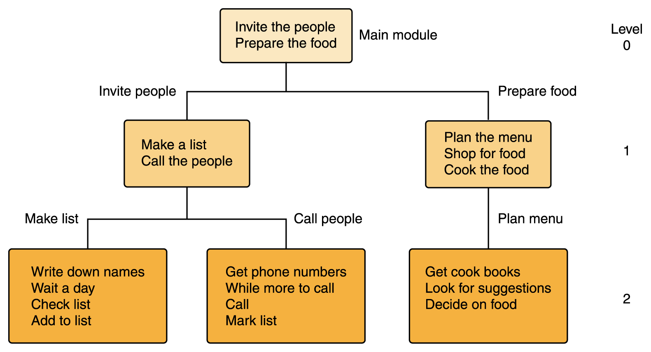
Subprograms
Let's plan a party. To do this, we have several tasks to do which could be thought of as organized in a hierarchical fashion.

Slide 76
Subprograms
This type of break down is critical in allowing us to write very large programs when teams of people must work on the design and the coding.
In fact, such a break down is useful for the single programmer as it allows us to take a complex task and break it into simpler tasks which we can conceptualize and handle easier.
In fact, in science we often do this: Solve simpler problems and combine solutions to handle harder problems!!!

Slide 77
Subprograms
Most programming languages provide some means of “modularizing” or subdividing the code into subunits.
These subunits are called by different names: functions, subroutines, subprograms, procedures, methods, etc.
In the cases¹ we will consider here, there is a
  calling program – the code that explicitly invokes or calls the subprogram
  the subprogram – the code that begins executing when called
  ¹ There are other ways to call a subprogram. For example, it might be called by an event such as a mouse click. That type of subprogram is used a lot in graphics work.

Slide 78
Subprograms
Basically, in our situation, there are two types of subprograms:
  1) Those that do a particular task, which may include output, but do not return any value to the calling program when completed.
  2) Those that do a particular task, which may include output, but they return one or more values to the calling program when completed.
  Java calls both of these methods.
  To distinguish them you could say
  (1) is a void method and (2) is a value-returning method.
In both cases the subprogram may need to receive values from the calling program called arguments.

Slide 79
Examples of Java Methods You Have Already Seen
System.out.println(“Try it.”);
is a call to a void method. The method prints the argument it is given, the string “Try it.”, but does not return anything to the program that called it.
speed = Console.readInt("Enter the" + "speed in mph: ");
is a call to a value-returning method. The method outputs the prompt, “Enter the speed in mph: “, inputs the user’s value, and returns the value to the calling program which stores it in its variable speed.

Slide 80
Java Has Many Pre-Defined Libraries of Methods the Programmer Can Use
System.out.println(“Ans: ” + Math.pow(3.0, 4.0) + “ and ” + Math.sqrt(25.0));
uses a pre-defined library named Math to provide many methods (which mathematicians typically call functions).
Math.pow(3.0, 4.0)
returns the value 3⁴ as a double – i.e. 81.0.
Math.sqrt(25.0)
returns the square root of 25 as a double – i.e. 5.0.
So, the println command would print
Ans: 81.0 and 5.0

Slide 81
Pictorially – How a Subprogram Interacts With Its Calling Program
calling program
(1)
The order of execution is shown by the numbers.
call
(5)
arguments
(2)
optionally – returned values
(4)
The calling program executes up to the call point – jumps to the subprogram - executes the subprogram
- returns to the line after the calling point.
A subprogram
(3)

Slide 82
AN Example Using a Subprogram
// Program to show use of a value-returning Java method
// Given an input value, the method doubles the value.
// Author’s name here 10/19/07
public class callSubValueReturning{
public static double twice(double n)
{
return 2* n;
}
public static void main(String[] args){
int number;
number = Console.readInt("Enter a number: ");
System.out.println(“2 times " + number +
" is " + twice(number));
}
}
call
Note that at the call, number becomes the value of n.

Slide 83
AN Example Using a Subprogram
// Program to show use of a void Java method
// Given an input value, the method doubles the value.
// Author’s name here 10/19/05
public class callSubVoid{
public static void twice(double n)
{
System.out.println(“2 times " + n +
" is " + 2*n);
}
public static void main(String[] args){
int number;
number = Console.readInt("Enter a number: ");
twice(number);
}
}
call
Note that at the call, number becomes the value of n.

Slide 84
Some Terminology Concerning Subprograms
public static void twice(double n)
{ System.out.println(“2 times " + n +
" is " + 2*n); }
Called a parameter
twice(number); //the call
Called an argument
We say the argument is passed to the method.

Slide 85
Arguments Need Not Match Parameters Except by Type and Position
public static void example (double a, int b, char c) {
System.out.println(a + “ “ + b + “ “ + c); }
What happens with the following calls?
example(3.14, 2, ‘a’);
example(5.16,-3, ‘b’);
Prints
3.14 2 a
5.16 -3 b

Slide 86
Recursion
Methods can call themselves in Java. This is an alternate control structure to looping.
Such methods are called recursive methods.
Each recursive method must have at least two cases:
1) A base case is a very simple case for which we can produce a result.
2) A general case which solves the problem by using cases of smaller size.

Slide 87
A Problem
We want to input numbers and print them out in the reverse order in which they were input. Numbers will be integers. We do not know how many numbers will be input, but the number 0 will terminate the input.
How could we do this?
Observe with what we know so far, we could use an array to hold the numbers, but to do this we would need to know at least a bound on how many numbers would be input because arrays have to have space pre-allocated.
Another way, which is really better, is to do a recursive method.

Slide 88
A Recursive Solution to Our Problem
public class showRecursion {
public static void printit (int n)
{ int k;
if (n ==0) return;
else { k = Console.readInt("Enter a number: ");
printit(k);
System.out.println(k);}}
public static void main(String[] args){
int number;
  printit(1); }} //note- this can be any nonzero number
Input will be 4, 8, 2, 0
Output should be
0
2
8
4
Note corrections on slide to printit(1) call. To see why 0 IS printed, see the trace that follows.

Slide 89
A Recursive Solution to Our Problem – A Trace
public class showRecursion {
public static void printit (int n)
{ int k;
if (n ==0) return;
else { k = Console.readInt("Enter a number: ");
printit(k);
System.out.println(k);}}
public static void main(String[] args){
int number;
  printit(1); }} //note- this can be any nonzero number
  =========================================
printit(1) call

Slide 90
A Recursive Solution to Our Problem – A Trace
public class showRecursion {
public static void printit (int n)
{ int k;
if (n ==0) return;
else { k = Console.readInt("Enter a number: ");
printit(k);
System.out.println(k);}}
public static void main(String[] args){
int number;
  printit(1); }} //note- this can be any nonzero number
  ==========================================
printit(1) call: n is 1

Slide 91
A Recursive Solution to Our Problem – A Trace
public class showRecursion {
public static void printit (int n)
{ int k;
if (n ==0) return;
else { k = Console.readInt("Enter a number: ");
printit(k);
System.out.println(k);}}
public static void main(String[] args){
int number;
  printit(1); }} //note- this can be any nonzero number
  ==========================================
printit(1) call: n is 1

Slide 92
A Recursive Solution to Our Problem – A Trace
public class showRecursion {
public static void printit (int n)
{ int k;
if (n ==0) return;
else { k = Console.readInt("Enter a number: ");
printit(k);
System.out.println(k);}}
public static void main(String[] args){
int number;
  printit(1); }} //note- this can be any nonzero number
  ==========================================
printit(1) call: n is 1 k is 4

Slide 93
A Recursive Solution to Our Problem – A Trace
public class showRecursion {
public static void printit (int n)
{ int k;
if (n ==0) return;
else { k = Console.readInt("Enter a number: ");
printit(k);
System.out.println(k);}}
public static void main(String[] args){
int number;
  printit(1); }} //note- this can be any nonzero number
  ==========================================
printit(1) call: n is 1 k is 4
printit(4) call:

Slide 94
A Recursive Solution to Our Problem – A Trace
public class showRecursion {
public static void printit (int n)
{ int k;
if (n ==0) return;
else { k = Console.readInt("Enter a number: ");
printit(k);
System.out.println(k);}}
public static void main(String[] args){
int number;
  printit(1); }} //note- this can be any nonzero number
  ==========================================
printit(1) call: n is 1 k is 4
printit(4) call: n is 4

Slide 95
A Recursive Solution to Our Problem – A Trace
public class showRecursion {
public static void printit (int n)
{ int k;
if (n ==0) return;
else { k = Console.readInt("Enter a number: ");
printit(k);
System.out.println(k);}}
public static void main(String[] args){
int number;
  printit(1); }} //note- this can be any nonzero number
  ==========================================
printit(1) call: n is 1 k is 4
printit(4) call: n is 4 k is 8

Slide 96
A Recursive Solution to Our Problem – A Trace
public class showRecursion {
public static void printit (int n)
{ int k;
if (n ==0) return;
else { k = Console.readInt("Enter a number: ");
printit(k);
System.out.println(k);}}
public static void main(String[] args){
int number;
  printit(1); }} //note- this can be any nonzero number
  ==========================================
printit(1) call: n is 1 k is 4
printit(4) call: n is 4 k is 8
printit(8) call:

Slide 97
A Recursive Solution to Our Problem – A Trace
public class showRecursion {
public static void printit (int n)
{ int k;
if (n ==0) return;
else { k = Console.readInt("Enter a number: ");
printit(k);
System.out.println(k);}}
public static void main(String[] args){
int number;
  printit(1); }} //note- this can be any nonzero number
  ==========================================
printit(1) call: n is 1 k is 4
printit(4) call: n is 4 k is 8
printit(8) call: n is 8 k is 2

Slide 98
A Recursive Solution to Our Problem – A Trace
public class showRecursion {
public static void printit (int n)
{ int k;
if (n ==0) return;
else { k = Console.readInt("Enter a number: ");
printit(k);
System.out.println(k);}}
public static void main(String[] args){
int number;
  printit(1); }} //note- this can be any nonzero number
  ==========================================
printit(1) call: n is 1 k is 4
printit(4) call: n is 4 k is 8
printit(8) call: n is 8 k is 2
printit(2) call:

Slide 99
A Recursive Solution to Our Problem – A Trace
public class showRecursion {
public static void printit (int n)
{ int k;
if (n ==0) return;
else { k = Console.readInt("Enter a number: ");
printit(k);
System.out.println(k);}}
public static void main(String[] args){
int number;
  printit(1); }} //note- this can be any nonzero number
  ==========================================
print(1) call: n is 1 k is 4
print(4) call: n is 4 k is 8
Print(8) call: n is 8 k is 2
Print(2) call: n is 2 k is 0

Slide 100
A Recursive Solution to Our Problem – A Trace
public class showRecursion {
public static void printit (int n)
{ int k;
if (n ==0) return;
else { k = Console.readInt("Enter a number: ");
printit(k);
System.out.println(k);}}
public static void main(String[] args){
int number;
  printit(1); }} //note- this can be any nonzero number
  ==========================================
printit(1) call: n is 1 k is 4
printit(4) call: n is 4 k is 8
printit(8) call: n is 8 k is 2
printit(2) call: n is 2 k is 0
printit(0) call: n is 0 (return to last call – i.e. after call to printit)

Slide 101
A Recursive Solution to Our Problem – A Trace
public class showRecursion {
public static void printit (int n)
{ int k;
if (n ==0) return;
else { k = Console.readInt("Enter a number: ");
printit(k);
System.out.println(k);}}
public static void main(String[] args){
int number;
  printit(1); }} //note- this can be any nonzero number
  ==========================================
printit(1) call: n is 1 k is 4
printit(4) call: n is 4 k is 8
printit(8) call: n is 8 k is 2
printit(2) call: n is 2 k is 0
return to last call
OUTPUT
0

Slide 102
A Recursive Solution to Our Problem – A Trace
public class showRecursion {
public static void printit (int n)
{ int k;
if (n ==0) return;
else { k = Console.readInt("Enter a number: ");
printit(k);
System.out.println(k);}}
public static void main(String[] args){
int number;
  printit(1); }} //note- this can be any nonzero number
  ==========================================
printit(1) call: n is 1 k is 4
printit(4) call: n is 4 k is 8
printit(8) call: n is 8 k is 2
return to last call
OUTPUT
0
2

Slide 103
A Recursive Solution to Our Problem – A Trace
public class showRecursion {
public static void printit (int n)
{ int k;
if (n ==0) return;
else { k = Console.readInt("Enter a number: ");
printit(k);
System.out.println(k);}}
public static void main(String[] args){
int number;
  printit(1); }} //note- this can be any nonzero number
  ==========================================
printit(1) call: n is 1 k is 4
printit(4) call: n is 4 k is 8
return to last call
OUTPUT
0
2
8

Slide 104
A Recursive Solution to Our Problem – A Trace
public class showRecursion {
public static void printit (int n)
{ int k;
if (n ==0) return;
else { k = Console.readInt("Enter a number: ");
printit(k);
System.out.println(k);}}
public static void main(String[] args){
int number;
  printit(1); }} //note- this can be any nonzero number
  ==========================================
printit(1) call: n is 1 k is 4
return to last call
OUTPUT
0
2
8
4

Slide 105
A Recursive Solution to Our Problem – A Trace
public class showRecursion {
public static void printit (int n)
{ int k;
if (n ==0) return;
else { k = Console.readInt("Enter a number: ");
printit(k);
System.out.println(k);}}
public static void main(String[] args){
int number;
  printit(1); }} //note- this can be any nonzero number
  ==========================================
OUTPUT
0
2
8
4

Slide 106
Often See Recursive Definitions of Functions
For example, n! (read n factorial) is defined as
n! = (n-1)! * n if n > 0
0! = 1
This can be written as method as:
public static int factorial (int n) {
if (n < 0)
{ System.out.println(“Factorial is defined for nonnegative numbers only. Try again.”)
return;
}
else if (n == 0) return 1;
else return n * factorial(n-1);
}

Slide 107
An Interesting Problem – The Tower of Hanoi
This problem has a simple recursive solution, but trying to solve it with loops, while possible, is very hard.
Problem: We have 3 posts, labeled A, B, and C.
On post A, is a collection of disks, each of different diameter. They are stacked so the largest disk on the bottom; the next to the largest is on top of it, and so on up to the smallest disk on top.
The problem is to move the disks, one at a time, from A to C so they will be stacked the same as on A.
While B can be used in the solution, at no time may a larger disk be placed on a smaller disks.
No disks may be placed on the table – they must be moved between A, B, and C.
Try this for n disks where n is small.
See: http://www.mazeworks.com/hanoi/

Slide 108
Things to Remember About Writing a Recursive Method
You must have a simple case or cases that can be solved easily. (The base case(s))
Handle the base case(s) first with the THEN part of an IF-THEN-ELSE command.
Assume a helper can solve a case if you only have n-1 things to handle. Let the helper handle those cases.
Construct a solution for handling n things out of the solution to handle n-1 things.

Slide 109
Pseudocode for Solution
Have 3 posts: source, temp, dest
Number of disks is n.
If n is 0, return.
else
1) Have helper move n-1 disks from source to temp using dest as intermediate post.
2) Move 1 disk from source to dest and print information about this.
3) Have helper move n-1 disks from temp to dest using source as intermediate post.
.

Slide 110
The Tower of Hanoi Solution
public class TowerOfHanoi{
public static void hanoi (char source, char temp, char destination,int nodisks)
{if (nodisks == 0) return;
else {
hanoi(source,destination,temp,n-1);
System.out.println(“Move disk from “
+ source + “ to “ + destination);
hanoi(temp,destination,source,n-1);
}}
public static void main(String[] args){
int n; //number of disks for starting
n = Console.readInt(“How many disks? > ");
hanoi(‘A’, ‘B’, ‘C’, n);
}}

