Slide 1
CHAPTER 13-14 + Some Other Application Areas
CPSC 171
Professor: Oberta A. Slotterbeck (Obie)
Computer Science Department
Hiram College
obie@hiram.edu

Slide 2
Chapter 13
Artificial Intelligence (AI)
Nell Dale • John Lewis

Slide 3
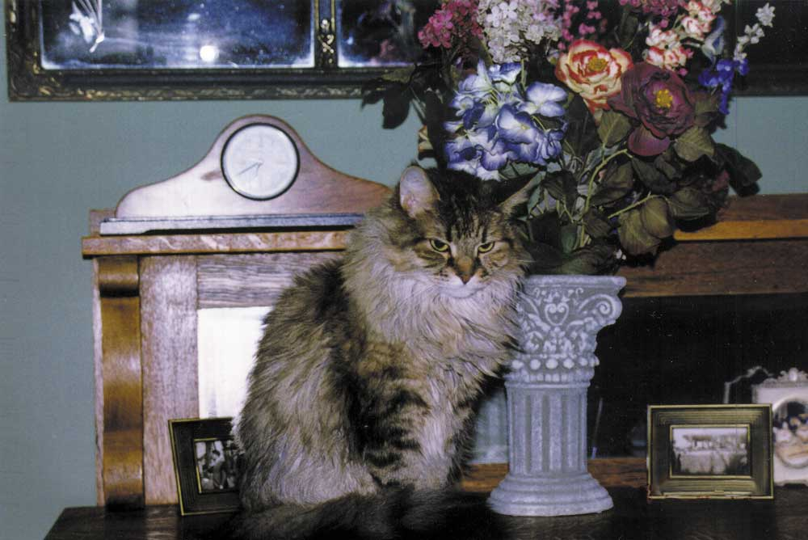
One area: Computer Vision
A computer can do some things better than a human can
  Adding a thousand four-digit numbers
  A computer could do it in a fraction of a second without error
But, we do some things a
lot better.
For example, point out
the cat in the picture
  A computer could have
  difficulty making that
  identification

Slide 4
The field of artificial intelligence (AI) is the study of computer systems that attempt to model and apply the intelligence of the human mind
There are many sub-areas of interest. Computer Vision is just one.
We will do a fast survey of other areas.

Slide 5
Can a Machine Pass The Turing Test
In 1950 English mathematician Alan Turing wrote a landmark paper that asked the question: Can machines think?
How will we know when we’ve succeeded?
The Turing test is used to empirically determine whether a computer has achieved intelligence

Slide 6
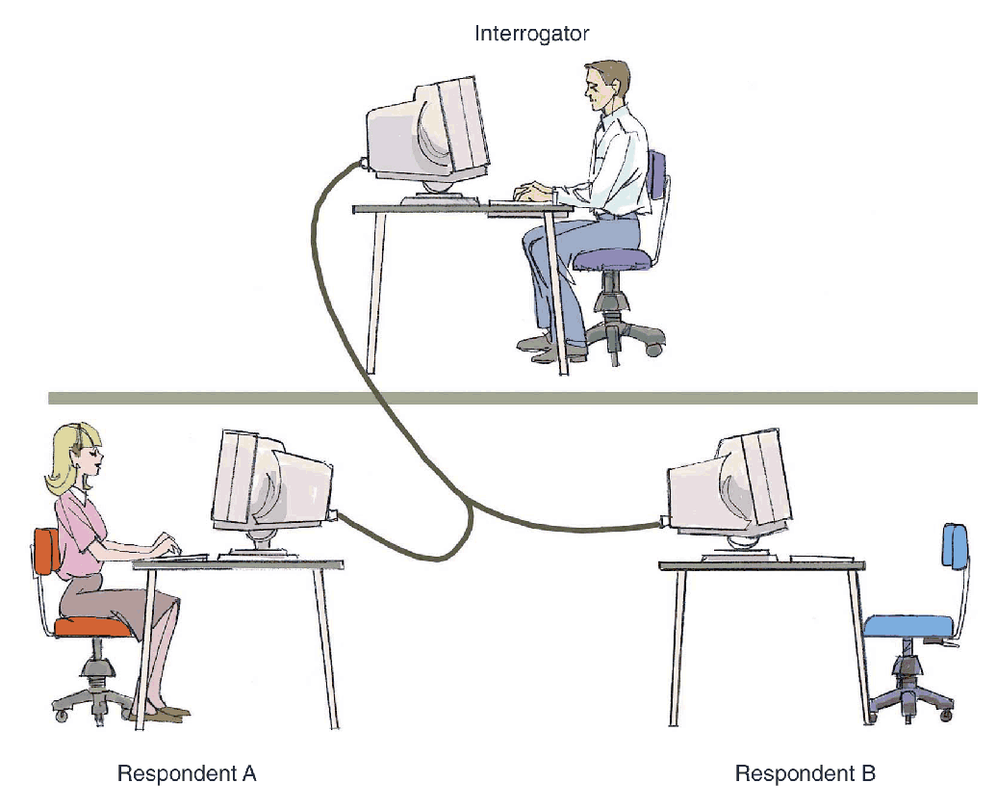
The Turing Test
Figure 13.2
In a Turing test, the interrogator must determine which respondent is the computer and which is the human

Slide 7
The Turing Test
A computer that passes the Turing test would demonstrate weak equivalence, meaning that the two systems (human and computer) are equivalent in results (output), but they do not arrive at those results in the same way
Strong equivalence indicates that two systems use the same internal processes to produce results

Slide 8
What is AI?
AI Artificial Intelligence (AI) is the area of computer science focusing on creating hardware and software that can engage in behaviors that humans consider intelligent.
The term AI was introduced in 1956 John McCarthy at the Massachusetts institute of Technology (MIT).
Researchers all over the world are trying to create systems which can mimic human thought, understand speech, beat the best human chess player, and countless other feats never before possible.

Slide 9
Some researchers believe that to be intelligent is to be able to learn.
This is why humans are intelligent.
We all make mistakes, yet we learn from our mistakes and then try to correct and prevent them from happening again.
There are programs that learn from their errors in limited domains.

Slide 10
AI is Concerned with Complicated Knowledge Representation
The knowledge we need to represent an object or event varies based on the situation
There are many ways to represent knowledge
  Natural language
  Though natural language is very descriptive, it doesn’t lend itself to efficient processing

Slide 11
Semantic Networks – one way to represent knowledge
A semantic network is a knowledge representation technique that focuses on the relationships between objects
A directed graph is used to represent a semantic network or net

Slide 12
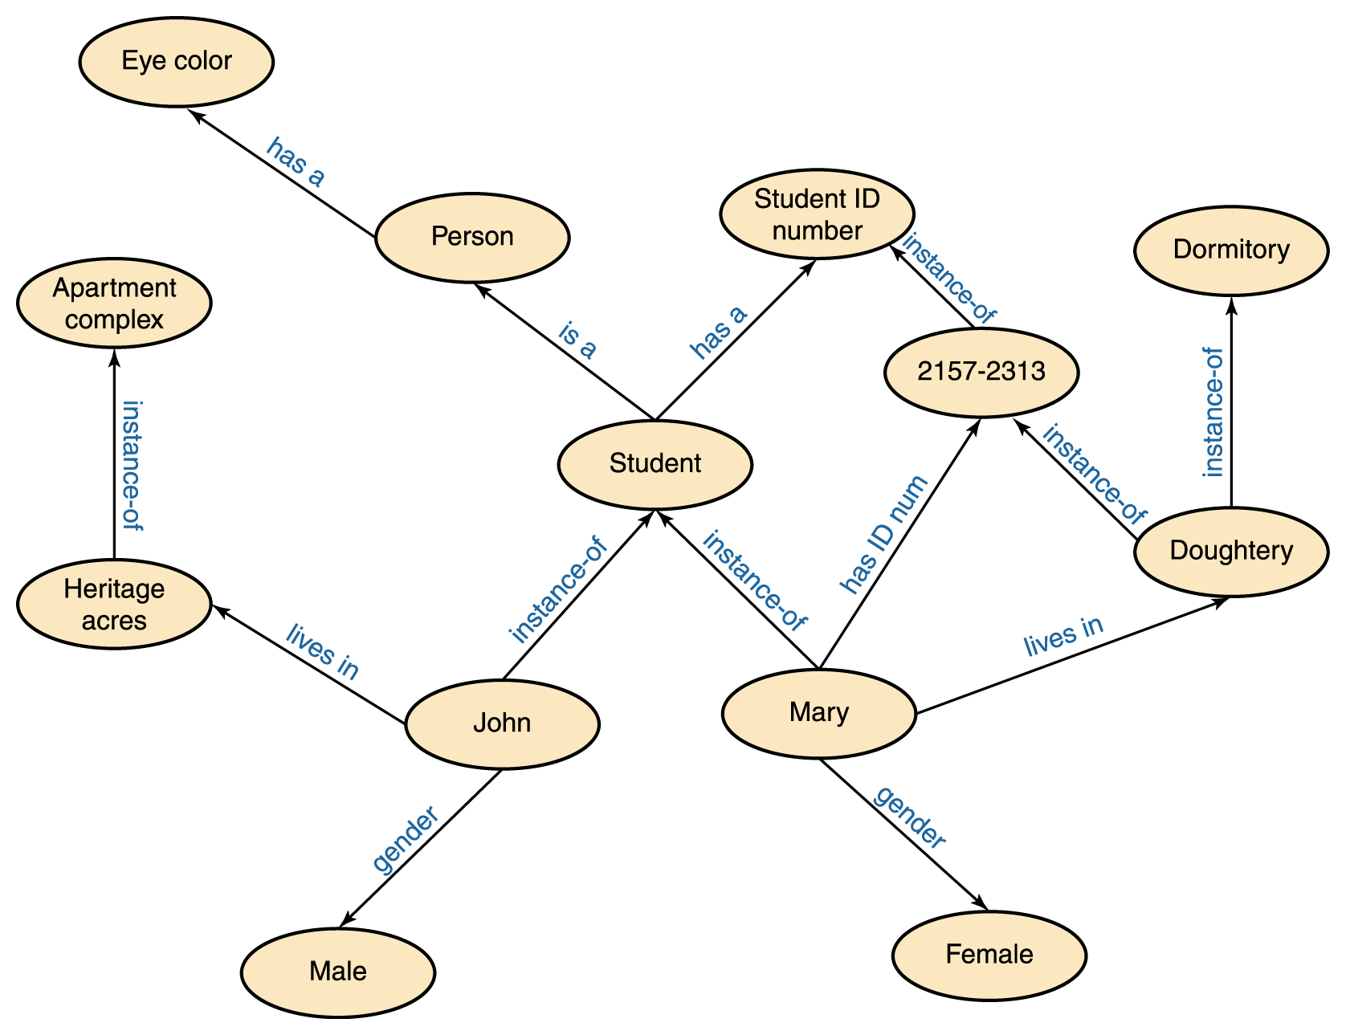
Semantic Networks
Figure 13.3 A semantic network

Slide 13
Semantic Networks
The relationships that we represent are completely our choice, based on the information we need to answer the kinds of questions that we will face
The types of relationships represented determine which questions are easily answered, which are more difficult to answer, and which cannot be answered

Slide 14
Search Trees – another way of representing knowledge particularly for 2 person games such as chess
Search tree: a structure that represents all possible moves in a game, for both you and your opponent
The paths down a search tree represent a series of decisions made by the players

Slide 15
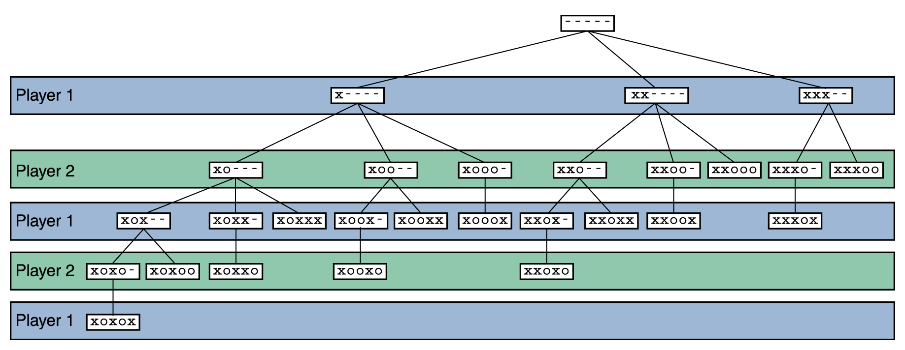
Search Trees
Figure 13.4 A search tree for a simplified version of Nim

Slide 16
Search Trees
Search tree analysis can be applied nicely to other, more complicated games such as chess
Because these trees are so large, only a fraction of the tree can be analyzed in a reasonable time limit, even with modern computing power
However, a computer program has succeeded in beating the top ranked human chess player in tournament play.

Slide 17
Playing Chess
Many people still view chess as an "intellectual" game and anyone who plays it at the masters level is very, very smart.
Creating an intelligent chess-playing algorithm seems easy; let the computer calculate all possible moves, and it will never lose.
But, I would hope by now you would realize it is not that simple.
The number of nodes in a full chess search-tree, which shows all possible positions during a game of chess, is evaluated at about 10¹²⁰.

Slide 18
Playing Chess
Using the fastest computers available today, it should take some 10¹⁰⁰ years to develop all of it.
Our universe will probably be long gone by then, but then again computers will in time become faster.
But even assuming that a computer could calculate the whole tree in reasonable time, would it then be intelligent?
Should another person who beats Kasparov in chess be considered intelligent?
So what about a computer program? Is a computer program that has the full table of possible moves in advance and beats Kasparov, intelligent?

Slide 19
Playing Chess
AI scientists are allowed to imitate human behaviour, but are not forced to use the human model.
Having a perfect memory is within the definition of AI, so the above super computer might still be termed intelligent.
How do we minimize the turn time, without crippling it too far?
After all, a program that plays randomly and loses every time will not be very attractive.

Slide 20
Playing Chess
What we need is a clever search engine, which will know how to eliminate losing options, and find reasonable moves, within reasonable time (say, 10 minutes), using reasonable resources.
The factor that makes AI unique, different from other search methods (like in graph theory), is the use of heuristics to shorten search time.
Heuristics is the AI buzzword for knowledge.
A search algorithm which uses a Heuristic function is called an informed search, because it is using knowledge.

Slide 21
Human vs Machine
IBM created a chess computer and chess software, christening the system Deep Blue.
In 1996, a match was arranged between reigning chess world champion Garry Kasparov and Deep Blue.
During the first game of a six game match against Deep Blue, Kasparov lost.
This marked the first time that a world champion chess player fell to defeat before a chess computer.

Slide 22
Human vs Machine
However, Kasparov would rebound and win three of the remaining games in the match.
Two of the remaining games in the match between Kasparov and Deep Blue ended in a draw.
Kasparov and an updated Deep Blue met again for a match a year late, in 1997.
In this match, Deep Blue possessed updated chess software.
The match ended in favor of Deep Blue 3 to 2 with 1 draw.

Slide 23
Human vs Machine
Arguably, following the 1997 match between the human world chess champion and Deep Blue, the best chess player in the world was a machine.
Of course, this conclusion has been stoutly debated.
Deep Blue retired following the 1997 re-match with Kasparov.
However, machine - human chess matches continue to be had with regularity around the world with the chess computer coming out on top with continuing frequency.

Slide 24
Latest History of Chess Tournaments – Human vs Machine
From May 13 to May 18, 2002, a match between Grandmaster Mikhail Gurevich and Junior 7 was held in Greece. Junior won with 3 wins and 1 draw.
From January 26 to February 7, 2003, Kasparov played Deep Junior 7 in New York. The match ended in a draw. Kasparov won game 1. Deep Junior won game 3. The rest of the games (games 2, 4, 5, and 6) a draw.
On November 11-18, 2003, Kasparov played X3dFritz in New York. The match was tied 2-2. Fritz won the 2nd game. Kasparov won the 3rd game. Games 1 and 4 were a draw.

Slide 25
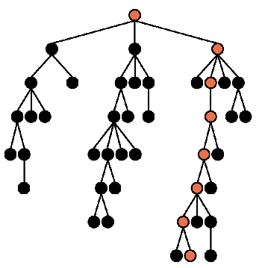
Trees are used for Game Analysis
Of course, listing all possible moves is impossible in most games.
AI attempts to only selectively look at moves.

Slide 26
Expert Systems
A knowledge-based system is a software system that embodies and uses a specific set of information from which it extracts and processes particular pieces
Expert system: usually embodies the knowledge of a specialized field, modeling the expertise of a professional in that field
  An expert system uses a set of rules to guide its processing
  The inference engine is the part of the software that determines how the rules are followed

Slide 27
Expert Systems – a simple example
Example: What type of treatment should I put on my lawn?
  NONE—apply no treatment at this time
  TURF—apply a turf-building treatment
  WEED—apply a weed-killing treatment
  BUG—apply a bug-killing treatment
  FEED—apply a basic fertilizer treatment
  WEEDFEED—apply a weed-killing and fertilizer combination treatment

Slide 28
Expert Systems (cont.)
Boolean variables
  BARE—the lawn has large, bare areas
  SPARSE—the lawn is generally thin
  WEEDS—the lawn contains many weeds
  BUGS—the lawn shows evidence of bugs

Slide 29
Expert Systems (cont.)
Some rules
  if (CURRENT – LAST < 30) then NONE
  if (SEASON = winter) then not BUGS
  if (BARE) then TURF
  if (SPARSE and not WEEDS) then FEED
  if (BUGS and not SPARSE) then BUG
  if (WEEDS and not SPARSE) then WEED
  if (WEEDS and SPARSE) then WEEDFEED

Slide 30
Expert Systems (cont.)
An execution of our inference engine
  System: Does the lawn have large, bare areas?
  User: No
  System: Does the lawn show evidence of bugs?
  User: No
  System: Is the lawn generally thin?
  User: Yes
  System: Does the lawn contain significant weeds?
  User: Yes
  System: You should apply a weed-killing and fertilizer combination treatment.

Slide 31
Actual Examples of Expert Systems
The best-known and most typical was Mycin.
Its job was to diagnose blood infections and recommend treatments, given lab data about tests on cultures taken from the patient, etc.
One of the earliest expert systems was Dendral.
It was designed to analyse mass spectra.
For the purpose of this description, a mass spectrum is a particular trace or analytical record formed when a molecule is bombarded with electrons.
Each molecule has its own spectrum, determined by the way it breaks into fragments when hit.

Slide 32
Actual Examples of Expert Systems
Chemists have charts of mass spectra for some common molecules. And they know some general rules that determine how a given type of molecule will break up, and what kind of spectrum it will give. But identifying a new molecule from its spectrum is not easy.
Dendral was able to do this automatically.
Mycin has never been used for real diagnosis, perhaps partly because of fears over who'd be legally responsible for mistakes.
However, experiments have shown it performs as well as experts in the area.

Slide 33
Actual Examples of Expert Systems
Dendral was used by many chemists at Stanford, but probably never outside acadamia.
Prospector, another expert system, took geological information about rock formations, chemical content, etc, and advised on whether there were likely to be exploitable mineral deposits nearby.
Popular accounts of AI say that Prospector (in 1978-ish) discovered a hundred-million-dollar deposit of molybdenum.
Certainly, this ``fact'' helped raise business interest in expert systems.

Slide 34
Actual Examples of Expert Systems
But the deposit was never exploited
It may be that Prospector misadvised on the value or ease of extraction of this deposit.
XCON is often mentioned because it was one of the most successful expert systems: it performed a task that couldn't be done manually or with a conventional computer program.
It helped "configure'' computer systems for DEC (who make VAXes amongst other things).

Slide 35
Actual Examples of Expert Systems
Summary of configuration problem:
When you buy a big computer, you need to order lots of parts: processor, power supplies, cables, discs, memory, etc.
All this must be wired up sensibly, and arranged in the right kind of cabinet.
For any set of parts, there are many ways to do this; complicated by the vast number of similar but not identical discs, memories etc that the company DEC could sell.

Slide 36
Actual Examples of Expert Systems
DEC was finding that their customers made mistakes in ordering; technicians failed to catch these errors, and made mistakes themselves in designing the configuration; so they decided to design a program to do it.
XCON took about 3 years to get right, but it eventually handled, according to one writer, most (90% passing; those that couldn't be handled were sent to a human configurer.
DEC said it had saved them significant quantities of cash.

Slide 37
Another AI Area of Study: Artificial Neural Networks
Attempts to mimic the actions of the neural networks of the human body
Let’s first look at how a biological neural network works
  A neuron is a single cell that conducts a chemically-based electronic signal
  At any point in time a neuron is in either an excited or inhibited state

Slide 38
Artificial Neural Network (cont.)
  A series of connected neurons forms a pathway
  A series of excited neurons creates a strong pathway
  A biological neuron has multiple input tentacles called dendrites and one primary output tentacle called an axon
  The gap between an axon and a dendrite is called a synapse

Slide 39
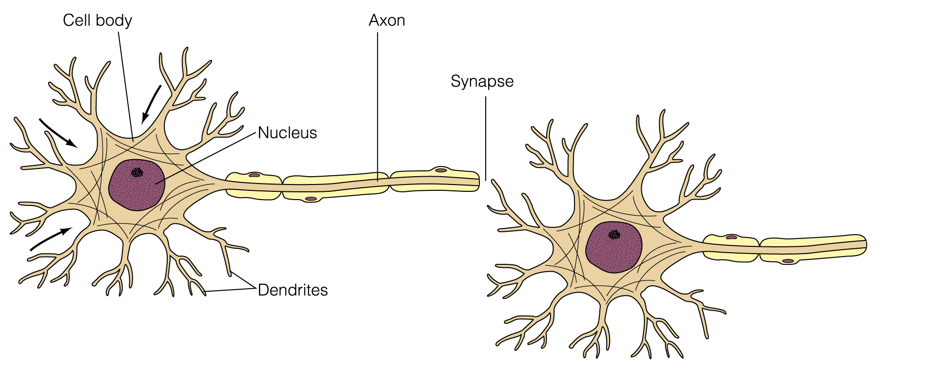
Artificial Neural Network (cont.)
Figure 13.6 A biological neuron

Slide 40
Artificial Neural Network (cont.)
A neuron accepts multiple input signals and then controls the contribution of each signal based on the “importance” the corresponding synapse gives to it
The pathways along the neural nets are in a constant state of flux
As we learn new things, new strong neural pathways in our brain are formed

Slide 41
Artificial Neural Networks
Each processing element in an artificial neural net is analogous to a biological neuron
  An element accepts a certain number of input values and produces a single output value of either 0 or 1
  Associated with each input value is a numeric weight

Slide 42
Artificial Neural Networks
  The effective weight of the element is defined to be the sum of the weights multiplied by their respective input values
    v1*w1 + v2*w2 + v3*w3
  Each element has a numeric threshold value
  If the effective weight exceeds the threshold, the unit produces an output value of 1
  If it does not exceed the threshold, it produces an output value of 0

Slide 43
Artificial Neural Networks
The process of adjusting the weights and threshold values in a neural net is called training
A neural net can be trained to produce whatever results are required
For example, one IRC last year demonstrated that a neural network could recognize different letters.

Slide 44
An Area of Great Interest: Natural Language Processing
There are three basic types of processing going on during human/computer voice interaction
  Voice recognition—recognizing human words
  Natural language comprehension—interpreting human communication
  Voice synthesis—recreating human speech
Common to all of these problems is the fact that we are using a natural language, which can be any language that humans use to communicate

Slide 45
Voice Synthesis
There are two basic approaches to the solution
  Dynamic voice generation
  Recorded speech
To generate voice output using dynamic voice generation, a computer examines the letters that make up a word and produces the sequence of sounds that correspond to those letters in an attempt to vocalize the word
Human speech has been categorized into specific sound units called phonemes

Slide 46
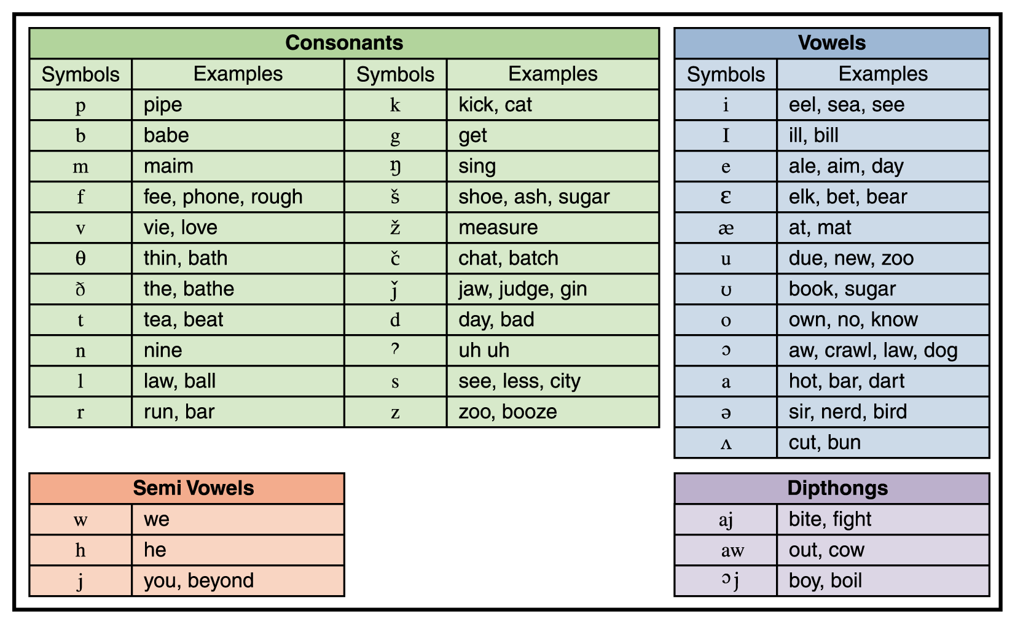
Voice Synthesis
Figure 13.7 Phonemes for American English

Slide 47
Voice Synthesis
The other approach to voice synthesis is to play digital recordings of a human voice saying specific words
  Telephone voice mail systems often use this approach: “Press 1 to leave a message for Alex Wakefield”

Slide 48
Voice Synthesis (cont.)
Each word or phrase needed must be recorded separately
Furthermore, since words are pronounced differently in different contexts, some words may have to be recorded multiple times
  For example, a word at the end of a question rises in pitch compared to its use in the middle of a sentence

Slide 49
Voice Recognition – a Difficult Problem
The sounds that each person makes when speaking are unique
We each have a unique shape to our mouth, tongue, throat, and nasal cavities that affect the pitch and resonance of our spoken voice
Speech impediments, mumbling, volume, regional accents, and the health of the speaker further complicate this problem

Slide 50
Voice Recognition (cont.)
Furthermore, humans speak in a continuous, flowing manner
  Words are strung together into sentences
  Sometimes it’s difficult to distinguish between phrases like “ice cream” and “I scream”
  Also, homonyms such as “I” and “eye” or “see” and “sea”
Humans can often clarify these situations by the context of the sentence, but that processing requires another level of comprehension
Modern voice-recognition systems still do not do well with continuous, conversational speech

Slide 51
Natural Language Comprehension
Even if a computer recognizes the words that are spoken, it is another task entirely to understand the meaning of those words
  Natural language is inherently ambiguous, meaning that the same syntactic structure could have multiple valid interpretations
  A single word can have multiple definitions and can even represent multiple parts of speech
  This is referred to as a lexical ambiguity
  Time flies like an arrow.

Slide 52
Natural Language Comprehension
A natural language sentence can also have a syntactic ambiguity because phrases can be put together in various ways
I saw the Grand Canyon flying to New York.
Referential ambiguity can occur with the use of pronouns
The brick fell on the computer but it is not broken.

Slide 53
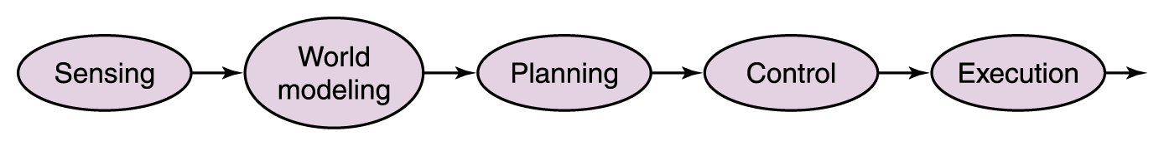
Robotics – Another AI Area
Mobile robotics is the study of robots that move relative to their environment, while exhibiting a degree of autonomy
In the sense-plan-act (SPA) paradigm the world of the robot is represented in a complex semantic net in which the sensors on the robot are used to capture the data to build up the net

Slide 54
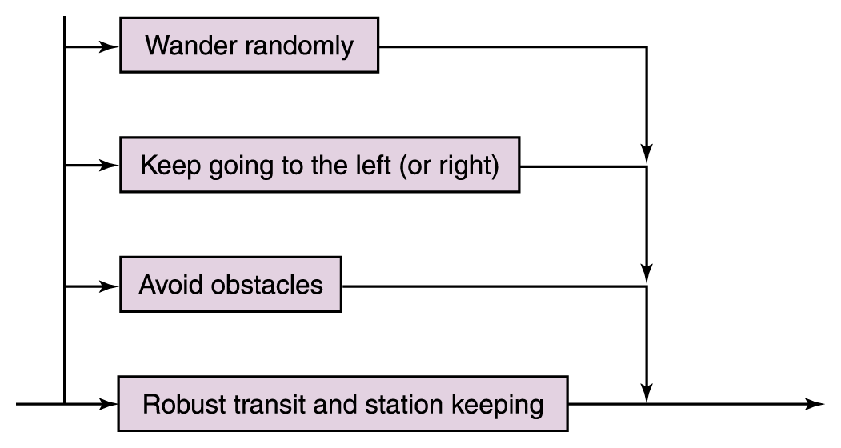
Subsumption Architecture
Rather than trying to model the entire world all the time, the robot is given a simple set of behavFRCL 105 Robot Pet Show
You are all invited to a "Robot Pet Show" put on by the students in FRCL 105 "Robots: Our New Best Friends?" Each team of students has developed a robot that they will present and demonstrate in Colton 106, at 6:30PM on Thursday, November 20. The format will be 5 minute presentations by 4 teams, followed by an "open house" where the robots will be demonstrated. Refreshments will be served.
Come see the robots designed, built and programmed by the students in FRCL 105!
Ellen Walker
iors each associated with the part of the world necessary for that behavior
Figure 13.9
The new control paradigm

Slide 55
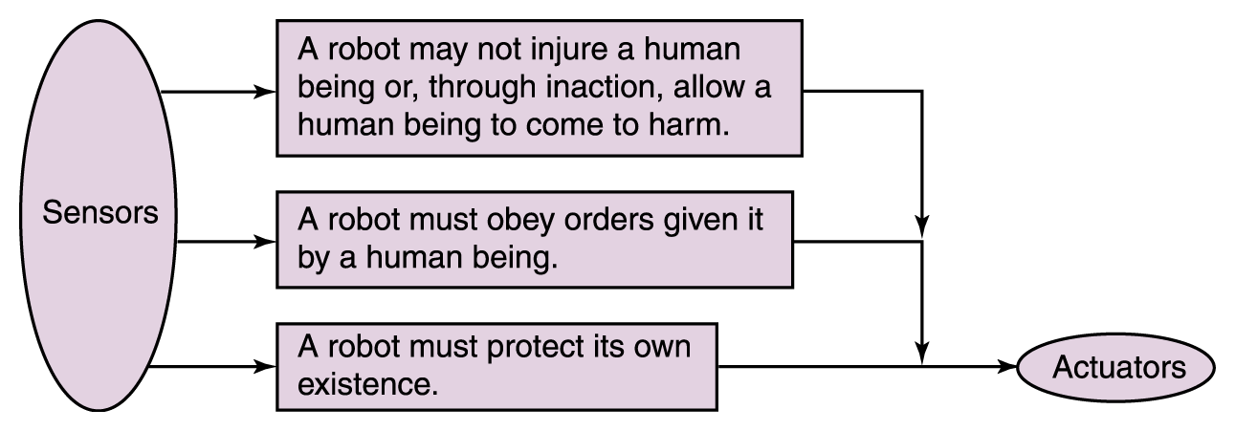
Subsumption Architecture
Figure 13.10 Asimov’s laws of robotics are ordered.

Slide 56
Don't Forget - FRCL 105 Robot Pet Show
You are all invited to a "Robot Pet Show" put on by the students in FRCL 105 "Robots: Our New Best Friends?" Each team of students has developed a robot that they will present and demonstrate in Colton 106, at 6:30PM on Thursday, November 20. The format will be 5 minute presentations by 4 teams, followed by an "open house" where the robots will be demonstrated. Refreshments will be served.
Come see the robots designed, built and programmed by the students in FRCL 105!
Ellen Walker

Slide 57
Also, Computer Science Department's
Integrated Research Components In
CPSC 352: Computer Security
Wednesday, November19, 2008, Colton 106,6:00 PM – 7:30 PM
Come to one or all – schedule will be followed exactly
Refreshments will be served
Presenting:
6:00-6:30 Timothy J. Posta
"Your every move, known! Keystroke logging"
6:30-7:00 Matthew Young
"A study of malware on the Gnutella Network using LimeWire"
7:00-7:30 Stefan Maurer
"How hard/easy is it to penetrate a system's AV software?"

Slide 58
And, Don't Forget:
After the IRC presentation Wednesday, Nov 19, at 8 pm, Tim Posta will field questions about cs171 concepts you want clarified in preparation for the final.
This will be in C-103.

Slide 59
Some Other Applications

Slide 60
Computer Security
Many topics are examined, but let’s look at only one in light of recent events on campus- passwords

Slide 61
Good Passwords
Need to mix, if the system allows it, upper and lower case letters, digits, and special characters.
Random characters are very good, but hard to remember.
A good approach in choosing is a passphrase.
Example, choose a phrase that includes some word for which you can substitute digits and special characters:
  This is not a good phrase at Hiram to use.
  Decide on some algorithm for extracting the characters – say take the first letter of each word and substitute @ for “at”, 2 for “to”, and ! for “not”. Use case and punctuation as in sentence.
  Password is then
  Ti!agp@H2u.

Slide 62
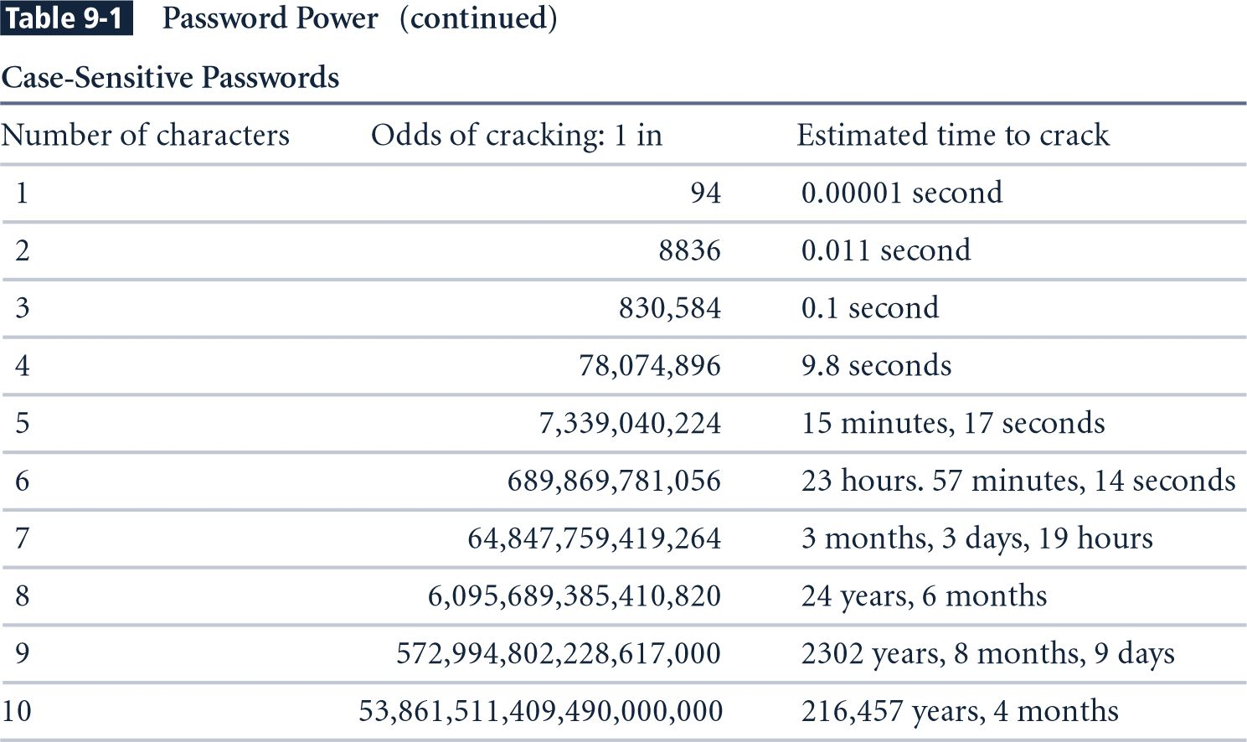
Password Power (2)
Notes:
Estimated Time to Crack is based on a Pentium 4 computer performing 8 million guesses per second. The estimates take into consideration all keyboard characters, some of which are not allowed by some systems.

Slide 63
Social Engineering Defined
Social engineering is the art of manipulating people into performing actions or divulging confidential information.
While similar to a confidence trick or simple fraud, the term typically applies to trickery for information gathering or computer system access and in many cases the attacker never comes face-to-face with the victim.
http://en.wikipedia.org/wiki/Social_engineering_(computer_security)

Slide 64
Social Engineering Techniques
Manipulate legitimate system users to allow
access or divulge confidential information
Exploits people's trust and good nature
Difficult to defend against once you add users to the system
More common than movie-style hacks (i.e., breaking cryptography)
  Usually refers to access to computer systems but may be used in other domains as well

Slide 65
Case Study – Passwords for Candy
More than 70% of people would reveal their computer password in exchange for a bar of chocolate, a British survey has found
The survey also showed that 34% of respondents volunteered their password when asked without even needing to be bribed.
A second survey found that 79% of people unwittingly gave away information that could be used to steal their identity when questioned.
http://news.bbc.co.uk/2/hi/technology/3639679.stm

Slide 66
Recent Experiment at Hiram
Description of experiment - techniques used:
  Phishing attack
    To everyone
    To specific individuals
  Collecting passwords to determine frequency of use
  Ask to use computer to print a paper as drive wasn’t working and insert a CD or memory stick.
  Phony anti-virus software to install and insert a CD or memory stick to wipe out a specific virus.
  “Would you like to see this funny picture I just found?” or “Would you mind proofreading an essay for me real quickly? It is pretty short and shouldn’t take too long at all.” Insert a CD or memory stick.

Slide 67
Graphics and
Computer-Aided Design (CAD)
Graphics is the language of communications for engineers, designers, and architects
Computer-aided design (CAD) refers to a system that uses computers with advanced graphics hardware and software to create precision drawings or technical illustrations

Slide 68
Graphics and
Computer-Aided Design (CAD)
CAD systems can be broadly classified as two-dimensional (2-D) CAD and three-dimensional (3-D) CAD
There are three methods of modeling in three dimensions
  Wireframe modeling
  Surface modeling
  Solid modeling

Slide 69
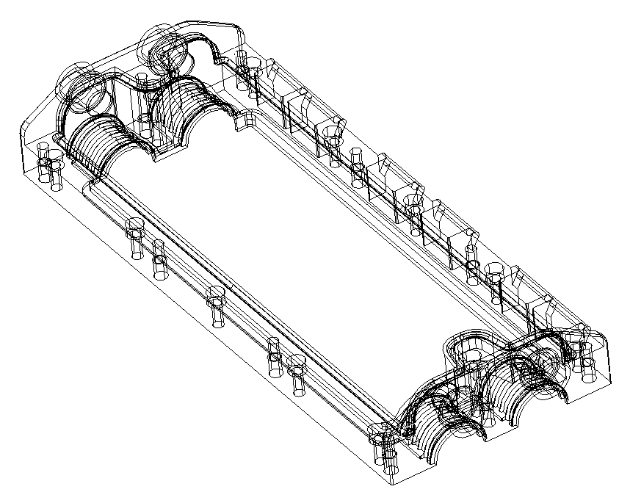
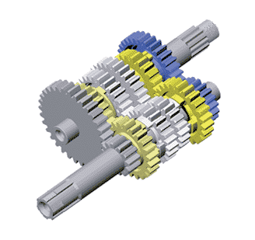
Graphics and
Computer-Aided Design (CAD)
Geometric modeling techniques

Slide 70
Basic Ray Tracing: Introduction
In “normal” rendering:
  We deal with a series of objects, made of primitives.
  For each primitive, we determine which pixels it affects, if any.
Ray tracing turns this around:
  We deal with pixels, one by one.
  For each pixel, we ask what we see (which primitive?) when we look at it.

Slide 71
Basic Ray Tracing: Tracing A Ray
The way we determine what we see when we look at a pixel is to draw an imaginary ray from the viewing position, through the pixel, into the scene.
  We ask which objects in the scene the ray hits.
  The first hit is the one that counts.
Image
Scene objects
Current pixel
First hit

Slide 72
Basic Ray Tracing: Tracing A Ray
What do we do when we have a hit?
  We determine what color the object is at that point.
  Light sources and the object’s normal may affect the computation.
Ray tracing allow us to produce very realistic images, but the technique is computationally expensive.

Slide 73
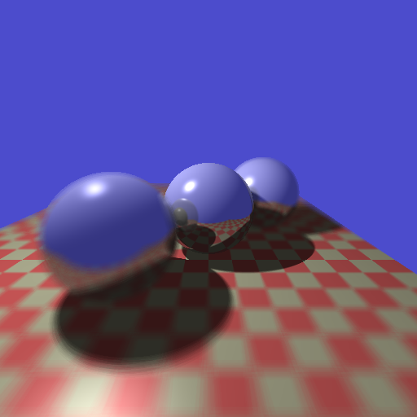
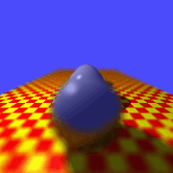
Raytracing
From Alan Watt, “3D Computer Graphics”

Slide 74

Refraction
Henrik wann Jensen, http://www.gk.dtu.dk/~hwj

Slide 75
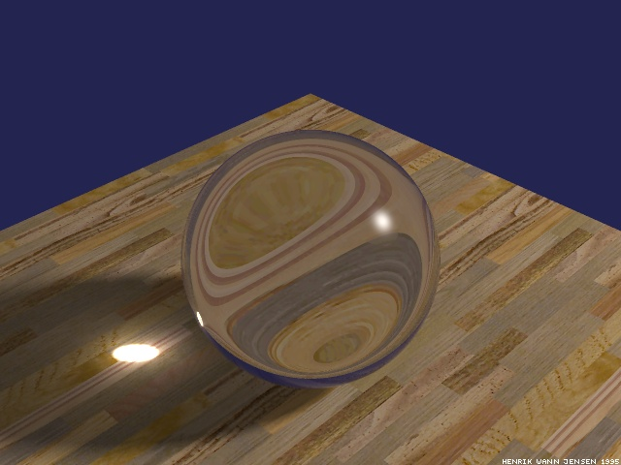
Refraction
Henrik wann Jensen, http://www.gk.dtu.dk/~hwj

Slide 76
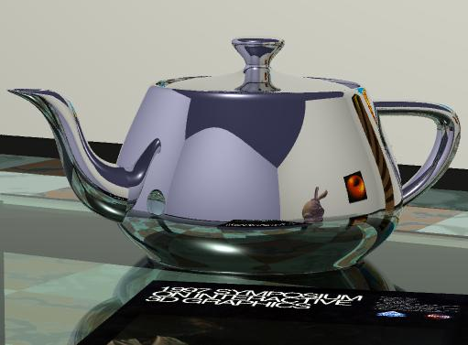
Reflections

Slide 77
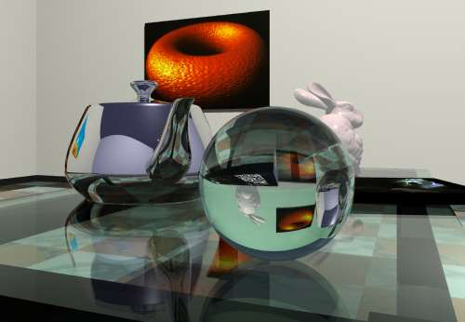
Complex Scenes

Slide 78

Complex Scenes

Slide 79
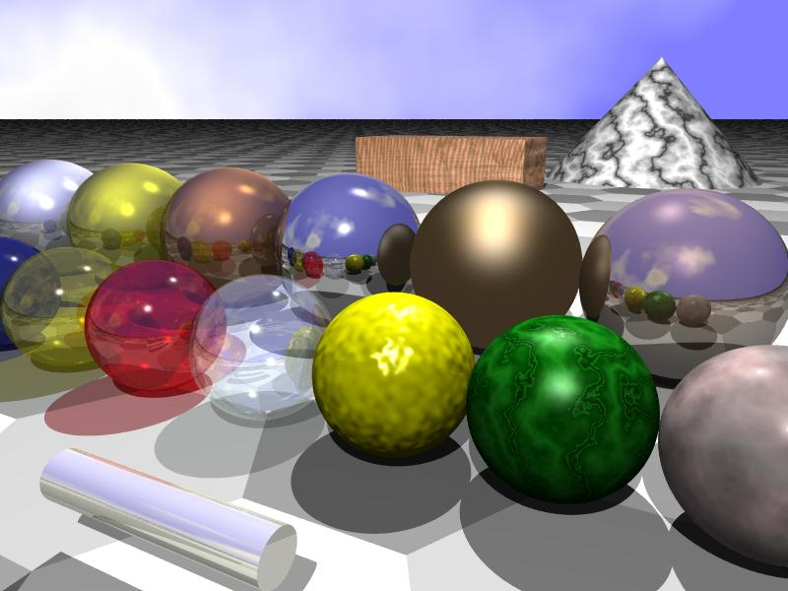
Many Interesting Features
http://math.hws.edu/eck/cs324/s04/lab6/starter.jpg

Slide 80
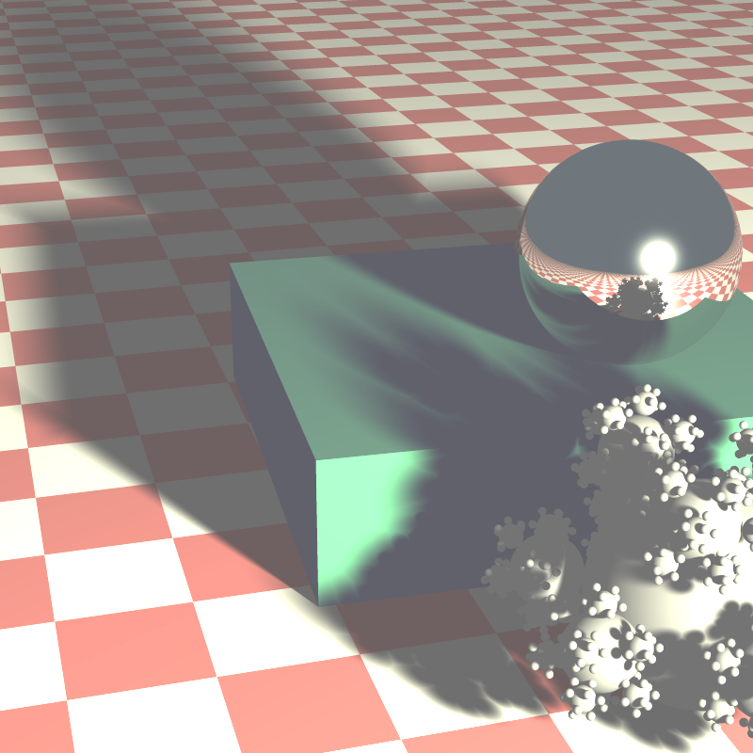
Soft Shadows

Slide 81


Slide 82
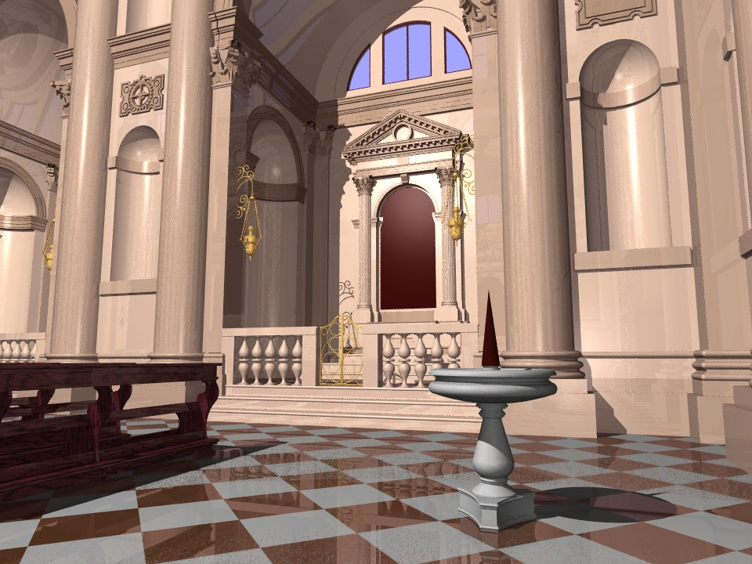

Slide 83
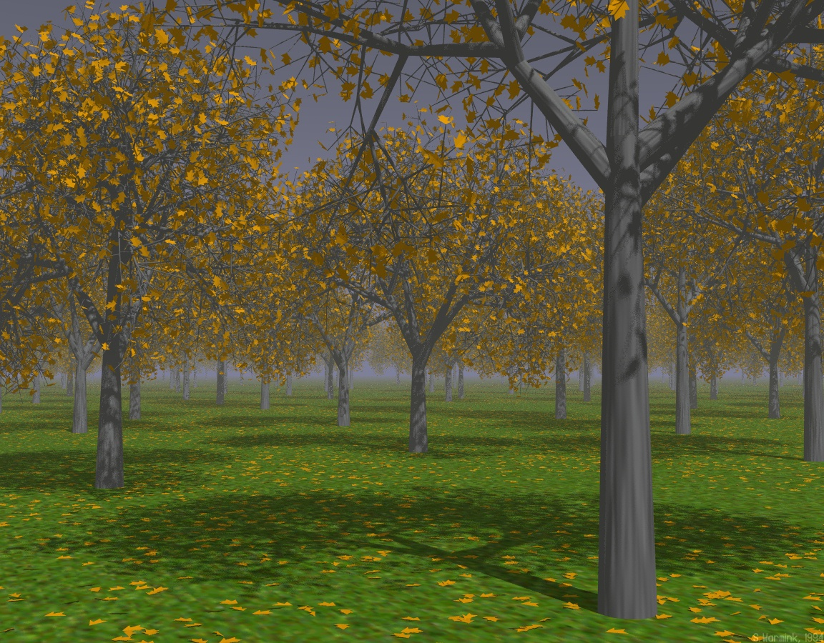

Slide 84
Chapter 14
Simulation
Nell Dale • John Lewis

Slide 85
What Is Simulation?
Simulation: a model of a complex system and the experimental manipulation of the model to observe the results
  Systems that are best suited to being simulated are dynamic, interactive, and complicated
A model is an abstraction of a real system
  It is a representation of the objects within the system and the rules that govern the interactions of the objects

Slide 86
Constructing Models
Continuous simulation
  Treats time as continuous and expresses changes in terms of a set of differential equations that reflect the relationships among the set of characteristics
  Meteorological modeling falls into this category

Slide 87
Constructing Models
Discrete event simulation
  Made up of entities, attributes, and events
  An entity represents some object in the real system that must be explicitly defined
  An attribute is some characteristic of a particular entity
  An event is an interaction between entities

Slide 88
Queuing Systems
A queuing system is a discrete-event model that uses random numbers to represent the arrival and duration of events
  made up of servers and queues of objects to be served
  The objective of a queuing system is to utilize the servers as fully as possible while keeping the wait time within a reasonable limit

Slide 89
Meteorological Models
Meteorological models are based on the time-dependent partial differential equations of fluid mechanics and thermodynamics
Initial values for the variables are entered from observation, and the equations are solved to define the values of the variables at some later time

Slide 90
Meteorological Models
Computer models are designed to aid the weathercaster, not replace him or her
  The outputs from the computer models are predictions of the values of variables in the future
  It is up to the weathercaster to determine what the values mean

Slide 91
Queuing Systems
To construct a queuing model, we must know the following four things
  The number of events and how they affect the system in order to determine the rules of entity interaction
  The number of servers
  The distribution of arrival times in order to determine if an entity enters the system
  The expected service time in order to determine the duration of an event

Slide 92
Hurricane Tracking
The modules for hurricane tracking are called relocatable models, because they are applied to a moving target
The Geophysical and Fluid Dynamics Laboratory (GFDL) developed the most recent hurricane model in order to improve the prediction of where a hurricane would make landfall

Slide 93
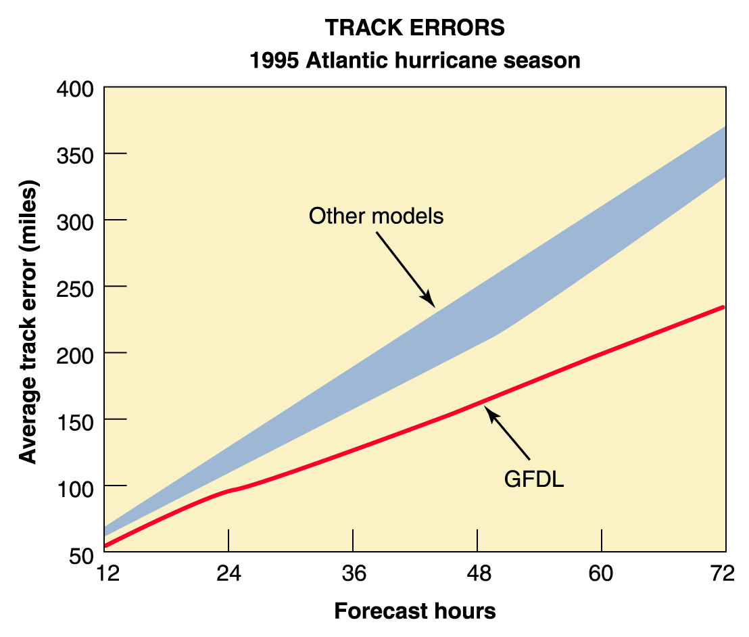
Hurricane Tracking
Figure 14.2 Improvements in hurricane models

