Slide 1

3D Input and Output
&
Multimedia and Interactivity
Chapters 9 & 11

Slide 2
3D Input

Slide 3
3D Input is a Major Challenge, But It is Becoming Better!
In the past, the main input devices were the mouse, the keyboard, and other 2D devices such as a light pen, stylus, etc.
3D input devices exist today, but are still costly and geared to the high end user.
Non-standardization is a major problem- no single device has emerged as the preferred 3D input device.
Some games have experimented with 3D joysticks, 3D mice, force-feedback devices, and gloves.

Slide 4
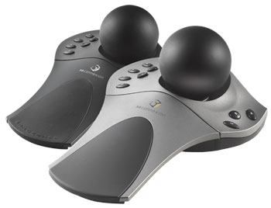
Example: 3Dconnexions' SpaceBall series
The SpaceBall 5000 provides a two-handed work style . It is used to position, view and navigate 3D models and data sets, while an incorporated mouse is used to
simultaneously select, create, edit and annotate.
About $650+

Slide 5
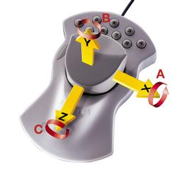
Example: A 3Dconnexion Spacemouse
Users control three-dimensional movements by working with the spring-mounted cap. Slight finger pressure on the cap will control an object in up to 6 degrees of freedom (X, Y, Z, pitch, roll, and yaw movement) simultaneously.
About $540+

Slide 6
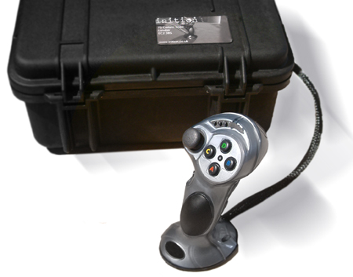
Example: Inition’s 3D Joystick for Large Screen and Cave Graphics
The inition 3DiStick is the ultimate in versatile and robust input devices, allowing six degrees of freedom, X,Y,Z translation as well as pitch, roll and yaw with an eight way thumb 'top hat', trigger and additional user programmable buttons.
About $2250+

Slide 7
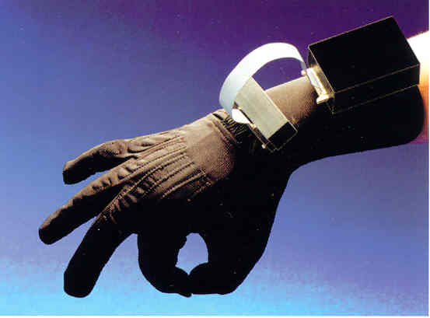
Data Glove
The data glove is a glove which is equipped with a tracking sensor. The (unconstrained) movements of the user's hand in 3D space are sensed and used to control the application. Data gloves are most often used in VR applications. They might be equipped with tactile feedback capabilities

Slide 8
3D Scanners and Motion Capture Systems
Most are still expensive, but they are being used extensively in the entertainment, scientific visualization, and health-safety fields.
Again, the lack of standardization causes major problems:
  Difficulty in interfacing with 3D programs.
  Lack of standards on file formats.
  See little shake down in the companies manufacturing these yet.
  High costs.

Slide 9
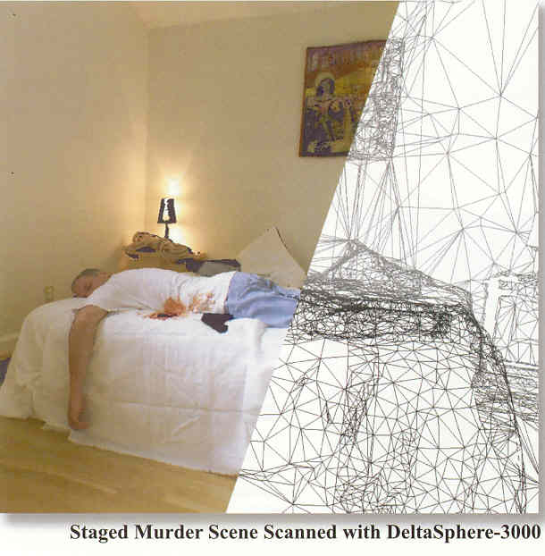
3D Scanners
A portable unit, the DeltaSphere, is placed on a tripod, connected to a PC laptop, and scans using a laser.
An entire room (360°) can be captured in black and white in 20-40 minutes without user intervention.
Color takes longer.

Slide 10
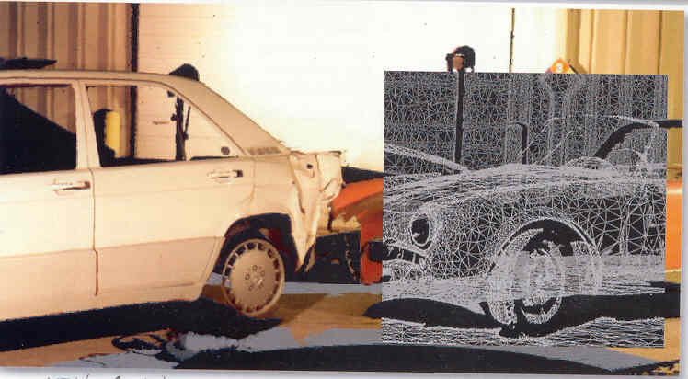
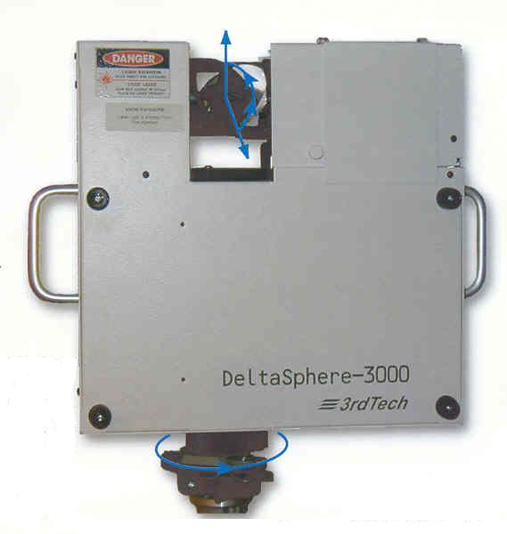
DeltaSphere 3D Scanner
About 45K for black and white unit; 55K for color (with academics getting a 15% discount)!
Watch a video of another manufacturer’s unit in operation at http://www.polhemus.com/streamingvideo.htm

Slide 11
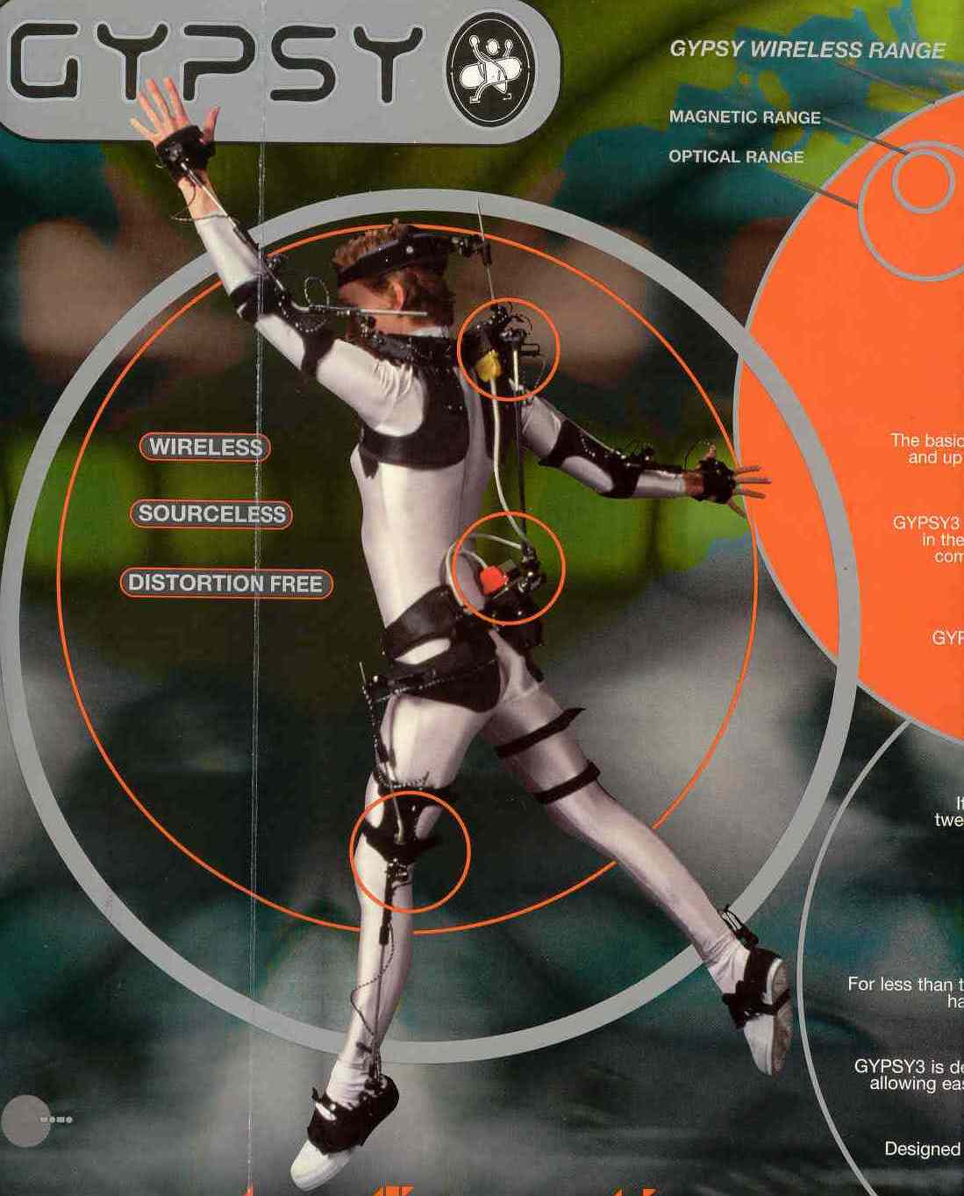
3D Motion Trackers and Capture
Just one of the many systems available (~$60K+/suit)
This one claimed it could capture in the range of 0.5 miles outdoors.
Suit is 15.5 lbs without batteries (but ships at 44 lbs!)
Has 43 motion sensors which include 17 joints.
8 suits can be captured simultaneously.

Slide 12
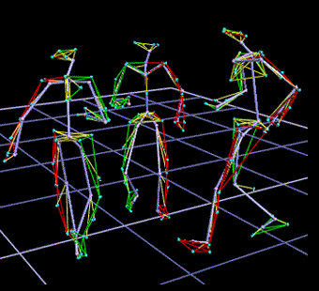
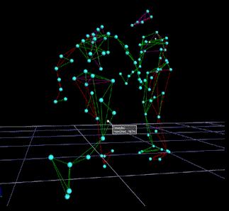
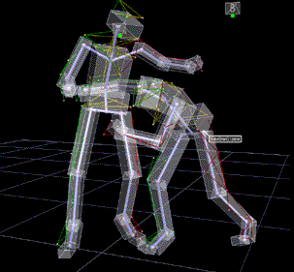
What You See From Capture

Slide 13
Force-feedback Devices
Designed to provide the sensation of touch for the user while doing input.
Called haptic user interfaces (HUIs)
Currently, the most sophisticated ones can be rather awkward to use, but there are some low cost models available now.
Find very interesting ones in arcade games and research labs.

Slide 14
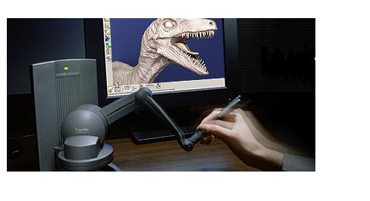
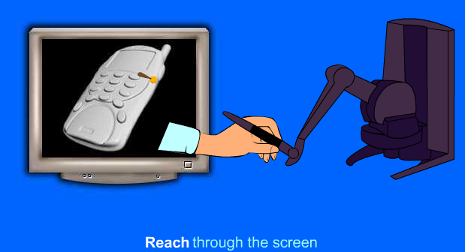
SensAble Technologies
Came from research at MIT.
Still needs to be programmed.
Source: http://www.sensable.com/#

Slide 15
3D Output

Slide 16
Perceiving Depth
We perceive depth because we receiving overlapping views from two eyes which are looking at two slightly different perspective views.
The sense of space from the two eyes is reinforced by the changing relationships of near and far objects as people turn their heads.
But, normally on the screen, you have only one version of a scene.
Of course, two views can be produced on the screen and your mind can fuse them into a single image with depth (called stereopsis)

Slide 17
Stereo Viewers – Many Approaches
Display side by side and have person focus on a spot in between the two images.
Put one image on top of the other in different colors (normal red and blue) and view with stereo glasses that polorize differently.
“First studied by Charles Wheatstone, (1802-1875), who published his discovery of stereograms in a remarkable paper to the Royal Society in 1838. After discussing the method of preparing and viewing the stereograms in the first few pages, he went on to the important matter of what his experiments showed about binocular vision. In fact, they overturned all existing theories and led to a better appreciation of the nature of the visual sense.”
[Source:
http://www.du.edu/~jcalvert/optics/stereops.htm ]

Slide 18
Often See 3D Output in Virtual Reality (VR) Settings
There are four key elements to a virtual reality experience:
  1) A virtual world
  2) Users believe they are immersed in the world (hopefully both mentally and physically)
  3) Users receive sensory feedback
  4) Users can interact with the world.
Theoretically, graphics is not a requirement for VR, although the term as now come to imply that realistic graphics is provided.
Classic computer games such as The Oregon Trail, Adventure, and Zork create their worlds by textual descriptions, not graphics.
Most computer games today technically meet the above definition.

Slide 19
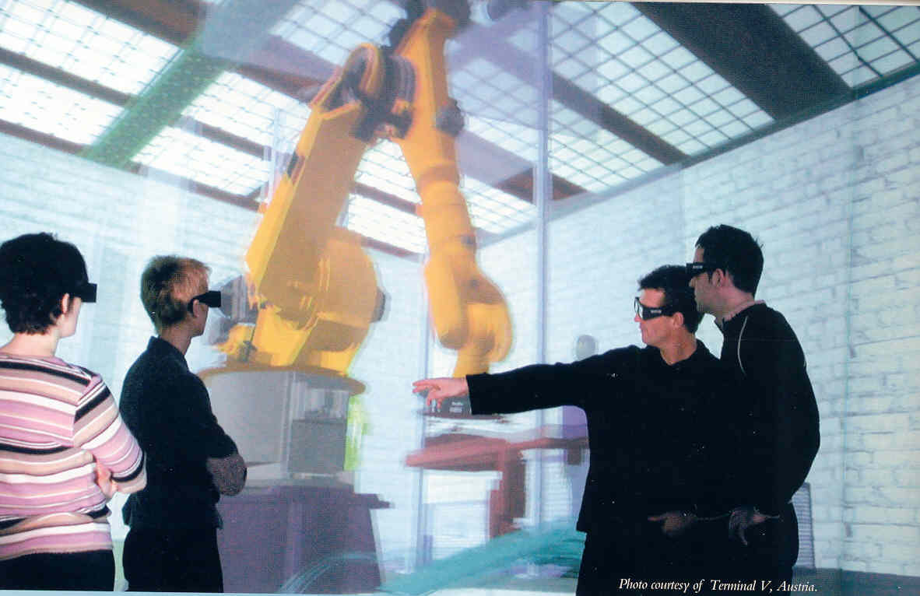
Many Wish to Reserve VR for Large Immersion Systems
Using stereo glasses to see the 3D world and interact with it.
Source: Barco brochure. Credits this to Terminal V in Austria.

Slide 20
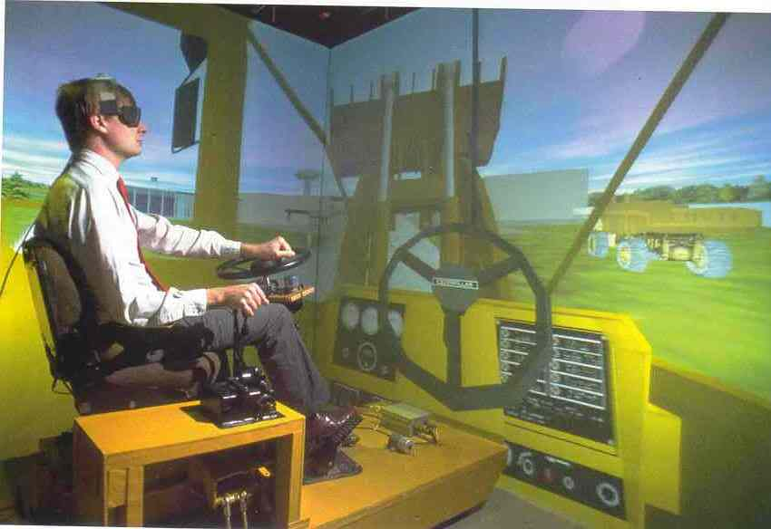
A Caterpillar Virtual Prototyping System in a CAVE VR Display
Source: Plate 4, Sherman, William R. and Alan B. Craig, “Understanding Virtual Reality”, Morgan Kaufmann, 2003.

Slide 21
What is a CAVE?
Plato, in his famed Republic, introduced "The Allegory of the Cave" through which he was able to explore the concepts of reality and human perception.
In his exploration, Plato used the analogy of a man who defined the foundation of his reality by the dancing shadows of firelight which shone upon the walls of his cave.
From this analogy, Thomas DeFanti and Dan Sandin conceived the idea of the Cave Automatic Virtual Environment (CAVE) in the Spring of 1991.
Graduate candidate Carolina Cruz-Neira and several other collaborators endeavored to realize this dream in the later half of 1991.
Source: http://cave.ncsa.uiuc.edu/about.html

Slide 22
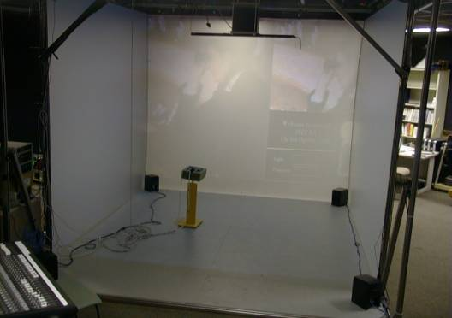
Unveiling of First Cave
Working at the Electronic Visualization Laboratory (EVL) at the University of Illinois in Chicago, the first prototype of the CAVE was built and unveiled as part of the Showcase feature at the ACM SIGGRAPH convention in 1992 .
Source: ibid

Slide 23
The CAVE
It was a small room, approximately ten feet-wide on each side, with three walls and a floor although larger ones now exist.
Projectors, situated behind the walls, projected computer-generated imagery onto the walls and floor.
Two perspective-corrected images were drawn for each frame, one for the right eye and one for the left.
Special glasses were worn that ensured that each eye saw only the image drawn for it.
This created a stereoscopic effect where the depth information encoded in the virtual scene was restored and conveyed to the eyes of those using it.
The CAVE must reproduce information in real-time, as you move about in the CAVE. To achieve this remarkable feat, a complex network of computer hardware and software was created.
Source: Ibid

Slide 24
Why Use the CAVE?
An atmospheric scientist can actually "climb inside" of a hurricane and visualize its complex and chaotic elements from any angle or visual perspective.
A biological researcher, examining a tightly coiled strand of DNA, can virtually "unravel" this strand and manipulate it in an environment that preserves the critical depth information of the data.
It became a part of fiction with its introduction into the popular TV series "Star Trek: The Next Generation“. The crew finds relaxation and entertainment on their starship's "HoloDeck" -- a walk-in theater where interactive 3-D holograms create the illusion of strolling through a lush tropical forest, or sailing over the Bounding Main aboard an 18th-century schooner.

Slide 25
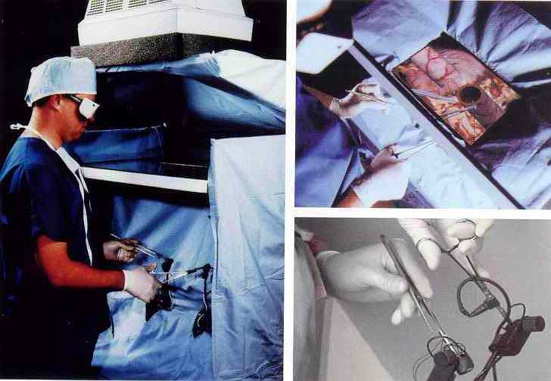
The Possibilities for Education are Enormous
Here a doctor interacts via touch and sight with a virtual patient in an operation through an environment at Univ of NC.

Slide 26
Actually, Quite a Few Artists Have Used VR
Ones mentioned in your text:
  Char Davies – discussed earlier
  Benjamin Britton
  For a rather comprehensive list see
  http://www.teachers.ash.org.au/mrlaneis/ozedweb_it_virtual_reality_url_persons.
  which lists over 30 artists (and artists/scientists) involved with VR although many of the links have been lost since this summer.

Slide 27
3D Printing
Technically, often called automatic fabrication –
the creation of a 3D model from the image in a 3D program.
Used a lot in CAD/CAM systems to create models from engineering images.
3D printing technology is used to build physical models from sketches, blueprints, 3D scans, CAD files and many other formats.
Using a computer and proper software, a 3D mesh is created to represent the object to be printed.
This mesh data is then sent as many thin horizontal slices to the “printer”, which interprets the data and joins together liquid and powder materials to form complex parts layer by layer. Where an ordinary printer lays down a single layer of ink on a single sheet of paper, these printers add the extra dimension by printing layer after layer in a vat of starch or plaster until you have a physical model that accurately reflects the original design.

Slide 28
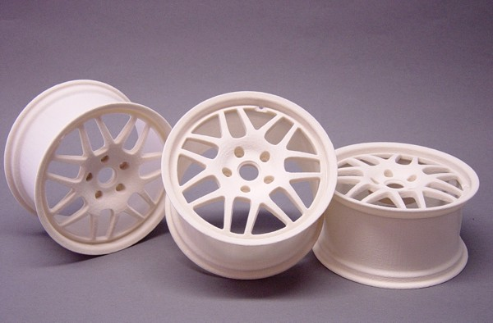
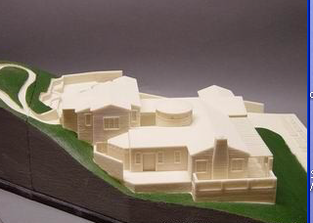
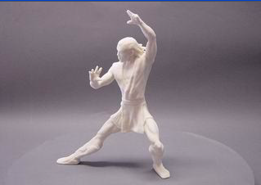
Parts with a wide variety of sizes, strengths, flexibility and surface finish can be produced with this method:
Source: Roundstone Digital advertising

Slide 29
Multimedia

Slide 30
Multimedia : Working with more than one medium
Certainly not a novel concept.
However, computer-based multimedia is really hitting its stride.
As computers become faster, we will see more and more art, graphics, scientific visualization etc. that utilizes images, sound, interactivity, in a collage sense.
We already discussed some of this throughout the various chapters in the textbook, especially the one on the web.
Today if you don’t have a broadband connection and a powerful computer with excellent sound capabilities, you are “multimedia challenged”!

Slide 31
What Lies in the Future?
No one can predict exactly even for 15 years in the future.
Think back to what was happening in the computer world in 1990.
Since that time:
  First GUI for navigating Internet was created (1991) – Mosaic
  Netscape was released. (1991)
  Introduction of Sound Blaster Pro (1991)
  Wolfenstein 3D the computer game which started the first person shooter genre on the PC (1992)
  Toy Story- the first computer generated full length movie was released (1995)
  Java, a graphics-based programming language, was introduced (1995).

Slide 32
For the Moment We Can Say
Machines and peripherals will become faster and cheaper.
3D will become much more accessible.
Personally, I predict VR games will become routine in the not too distant future --- whether or not that will translate into VR being used more by artists, I don’t know.
Artists will become increasingly familiar with computer techniques, and you’ll see more and more uses of computers in the visual arts.
There will probably, however, be a backlash to go back to the roots of art on the part of some artists.

