Slide 1
CHAPTER 5-6
Overview – Details Later

Slide 2
Chapter 5- Overview

Slide 3
REMEMBER ...
Computer science is the study of algorithms including
* Their formal and mathematical properties--- Chpts 1-3
* Their hardware realizations --- Chpts 4-5
Their linguistic realizations.
Their applications.
We continue with a study of the hardware and the building of a virtual machine in Chapter 5.

Slide 4
THE HARDWARE WORLD
We began to turn the abstract entity called a computing agent into a computer and a computer system in Chapter 4.
Chapter 4 dealt with the hardware design at the logical level by looking at
the internal representation of data
the building of circuits for carrying out fundamental operations.
In biology, this would be like studying DNA, genes, cells, and tissues.

Slide 5
Chapter 5 will deal with the organization of the computer systems.
We will build a computer logically.
Chapter 5 in biology would describe how our organs (heart, lungs, etc.) and bodily systems (circulator, respiratory, etc.) are built from the basic units.
There are many different computer systems on the market, manufactured by many different vendors, yet MOST follow the same basic organization.

Slide 6
COMPUTER ARCHITECTURE
There are many different computers:
Multi-million dollar supercomputers
Million dollar mainframes
Minicomputers
Workstations
Laptops
Less than $100 hand held personal digital assistants
Although the price tags on these and the speed, capacity, and software differ significantly, they MOST are basically designed the same.

Slide 7
VON NEUMANN ARCHITECTURE
There are 3 major units in a computer tied together by buses:
1) Memory The unit that stores and retrieves instructions and data.
2) Processor: The unit that houses two separate components:
The control unit: Repeats the following 3 tasks repeatedly
Fetches an instruction from memory
Decodes the instruction
Executes the instruction
The arithmetic/logic unit (ALU): Performs mathematical and logical operations.
3) Input/Output (I/O) Units: Handles communication with the outside world.

Slide 8
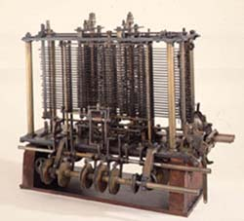
Von Neumann Architecture
The architecture is named after the mathematician, John Von Neumann, who supposedly proposed storing instructions in the memory of a computer and using a control unit to handle the fetch-decode-execute cycle:
fetch an instruction
decode the instruction
execute the instruction
Interestingly, a similar architecture was proposed in 1830 by Charles Babbage for his Analytic Engine:
Portion of the mill of the Analytical Engine with printing mechanism, under construction at the time of Babbage’s death. © Science Museum/Science & Society Picture Library
ALU mill
memory store
control unit operator (process cards storing instructions)
I/O units output (typewriter)

Slide 9
Pictorial View of
Computer Organization
Memory
Processor
Input / Output
Control
Unit
ALU

Slide 10
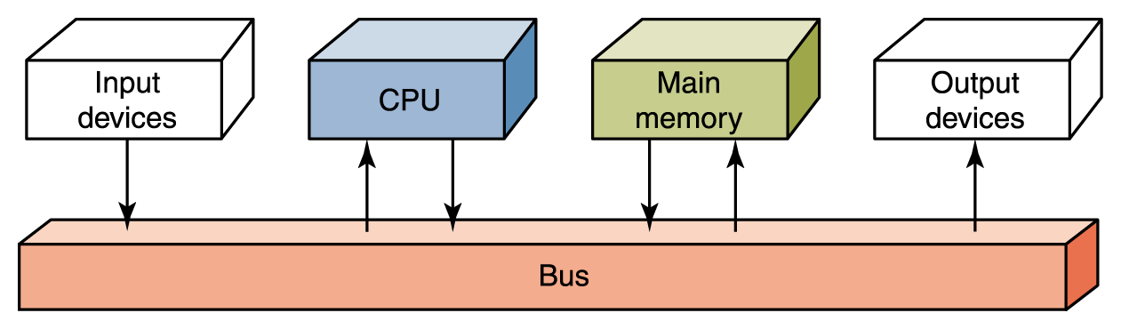
Flow of Information
The parts are connected to one another by a collection of wires called a bus
Processor
Figure 5.2 Data flow through a von Neumann architecture

Slide 11
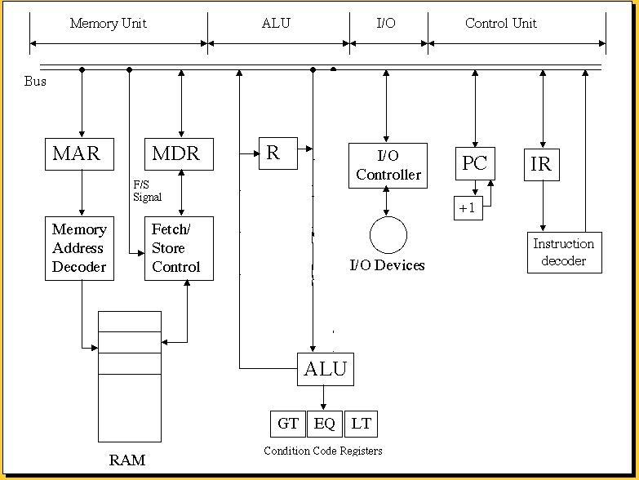
THE UNITS OF A COMPUTER
(Note this MODIFIES Figure 5.18 on page 220

Slide 12
RAM and ROM
RAM stands for Random Access Memory
  Inherent in the idea of being able to access each location is the ability to change the contents of each location
ROM stands for Read Only Memory
  The contents in locations in ROM cannot be changed
RAM is volatile, ROM is not
  This means that RAM does not retain its bit configuration when the power is turned off,
  but ROM does

Slide 13
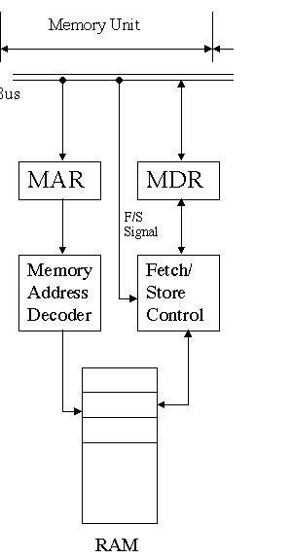
MEMORY UNIT
(or RAM- Random Access Memory)
Each cell has an address, starting at 0 and increasing by 1 for each cell.
A cell with a low address is just as accessible as one with a high address- hence the name RAM.
The width of the cell determines how many bits can be read or written in one machine operation & is normally a power 2
A cell is typically a byte today

Slide 14
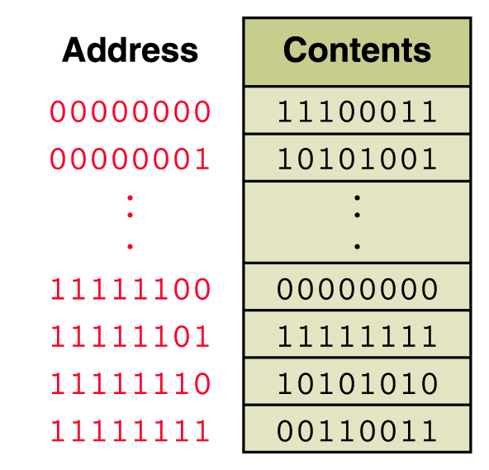
Memory
Memory is a collection of cells,
each with a unique physical address
The size of a cell is normally a power of 2, typically a byte today.

Slide 15
Memory
A cell is the smallest addressable unit of memory – i.e. one cell can be read from memory or one cell can be written into memory, but nothing smaller.

Slide 16
What is a Register?
Data can be moved into and out of registers faster than from memory.
If we could replace all of memory with registers, we could produce a very, very fast computer ...
But, the price would be terribly prohibitive.
Most computers have quite a few registers that serve different purposes.
We’ll see how the MAR and the MDR are used.

Slide 17
Another Type of Memory : Cache
Cache speed is faster than main memory and slower than registers.
Our lab simulator will not use any cache memory, but computers today do use it.
To speed up retrievals from memory, items are prefetched into cache memory and then, when needed by the CPU, they are retrieved from cache memory rather than memory.
However, to keep things simple, we’ll assume fetches will occur from main memory.

Slide 18
THE UNITS OF A COMPUTER
MEMORY:
Stores and retrieves instructions and data.
We saw in Chapter 4 that numbers and characters (the data) can be represented in binary formats.
Instructions are also represented in binary form:
Different computers use different instruction sets and formats. We will use a very simple, generic format for what is called a 1-address machine:
op code of 4 bits
address of 12 bits
Other machines use 2-address, 3-address, and mixed format instructions. A 2-address memory will be discussed later.

Slide 19
OP CODES (i.e. 1-Address Operation Codes)
REF: page 220-221, Fig 5.19
Arithmetic OpCodes
0000 load
0001 store
0010 clear
0011 add
0100 increment
0101 subtract
0110 decrement
I/0 OpCodes
1101 in
1110 out
Logic/Control OpCodes
0111 compare
1000 jump
1001 jumpgt
1010 jumpeq
1011 jumplt
1100 jumpneq
1111 halt
We will see how these are used later.

Slide 20
STRUCTURE OF RANDOM ACCESS OR MAIN MEMORY
1 bit
one memory cell
Memory
W bits wide
addresses:
0
1
2
•
•
•
2^{N}- 1
MAR -N bits
Memory Address Register
•
•
•
MDR- kW bits
Memory Data Register

Slide 21
ALL A COMPUTER DOES IS ...
Repeat forever (or until you pull the plug or the system crashes)
1) FETCH
2) DECODE
3) EXECUTE

Slide 22
How does the memory unit work?
Trace the following operation:
s
Store data D in memory location 0.
0
0
D
0
D
D
D
D

Slide 23
How does the memory unit work?
Trace the following operation:
f
1) Fetch data D from memory location 1.
2) Obtain an instruction I from memory
location 7.
1
D
How does the computer distinguish
between 1) and 2) above?
D
I
We need to look at the control unit.

Slide 24
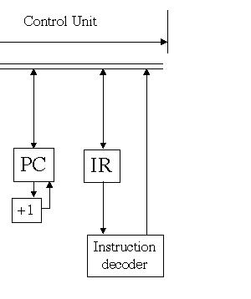
How Does the Control Unit Work?

Slide 25
Control Unit
A Control Unit is the unit that handles the central work of the computer.
There are two registers in the control unit
  The instruction register (IR) contains the instruction that is being executed
  The program counter (PC) contains the address of the next instruction to be executed
The ALU and the control unit together are called either the
  Processor
  Central Processing Unit (i.e., CPU)

Slide 26
How Does the Control Unit Work?
Once the instruction is fetched, the PC is incremented.
The PC holds the address of the next instruction to be executed.
Whatever is stored at that address is assumed to be an instruction.

Slide 27
THE CONTROL UNIT
IR
PC
0 01 1 | address
+1
instruction
decoder
line 3
Trace what happens during
fetch
decode
execute
enable add
Note: The PC is incremented after each fetch.

Slide 28
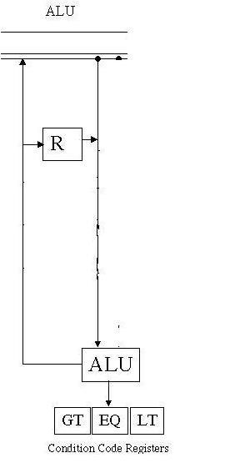
THE ARITHMETIC-LOGIC UNIT
(ALU)
The text shows multiple registers which is typical.
However, we are working with a 1-address machine which has a single system register R.
Other registers are attached to the ALU, namely ALU1 and ALU2 in the simulator.

Slide 29
THE CONDITION CODE REGISTER part of the ALU
Whenever a
COMPARE X
command is executed, a condition code (which is a single bit) is set (to a 1). These codes are used to control JUMP commands.
GT is set if CON(X) > R
1) if address 1 holds 15 and address 2 holds 12?
EQ is set if CON(X) = R
LT is set if CON(X) < R
What happens with the sequence:
LOAD 1
COMPARE 2
JUMPGT 5
2) if address 1 holds 12 and address 2 holds 15?

Slide 30
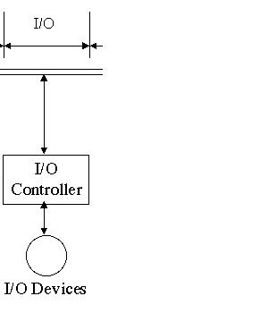
LAST, BUT NOT LEAST, THE I/O DEVICES
Pictorially, these look the simplest, but in reality, they form the most diverse part of a computer.
Includes:
keyboards, monitors, joysticks, mice, tablets, lightpens, spaceballs, ....

Slide 31
Input/Output Units
An input unit is a device through which data and programs from the outside world are entered into the computer
  Keyboard, the mouse, and scanning devices
An output unit is a device through which results stored in the computer memory are made available to the outside world
  Printers and video display terminals

Slide 32
I/O UNITS
Processor
Memory
I/O buffer
Each device is different, but most are interrupt driven.
This means when the I/O device wants attention, it sends a signal (the interrupt) to the CPU.
Control-logic
I/0 device

Slide 33
NOW USE THE COMPLETE ARCHITECTURE TO TRACE THE ACTIONS TAKEN FOR EXECUTING
IN X
OUT X
LOAD X
STORE X
INCREMENT X
We already have done:
ADD X
COMPARE X
JUMP X
JUMPLT X

Slide 34
IN X
s
X
D
D
IN X
D

Slide 35
OUT X
f
X
D
D
OUT X
D

Slide 36
LOAD X
f
X
D
D
LOAD X
D

Slide 37
STORE X- you should be able to do this now

Slide 38
ADD X
f
D
E+D
X
E
E
D
ADD X
E+D
ALU1 & ALU2
D
E+D

Slide 39
INCREMENT X
X
INCR X
D+1
D

Slide 40
COMPARE X
D
COMP X
as with other
ops fetch D
D
Set these according to comp op

Slide 41
JUMP X
X
JUMP X

Slide 42
JUMPLT X
If LT = 1, move X to PC

Slide 43
The Jump Commands
Allow us to construct branches and loops as we will see.
Their purpose is to change the PC – program counter
JUMP X – always change PC to address X
JUMPGT X – change PC to address X if and only if GT= 1
JUMPEQ X - change PC to address X if and only if EQ = 1
JUMPLT X - change PC to address X if and only if LT = 1
JUMPNEQ X - change PC to address X if and only if EQ = 0

Slide 44
Secondary Storage Devices
Because most of main memory is volatile and limited, it is essential that there be other types of storage devices where programs and data can be stored when they are no longer being processed
Secondary storage devices can be installed within the computer box at the factory or added later as needed

Slide 45
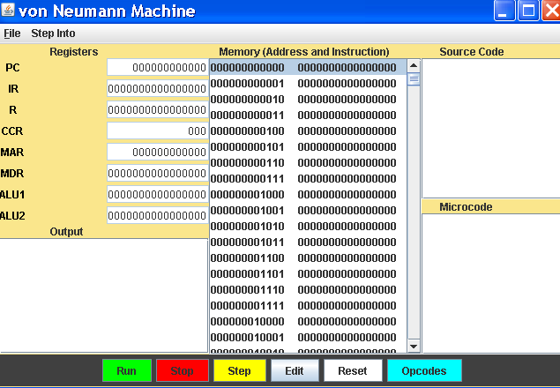
The Lab Simulator

Slide 46
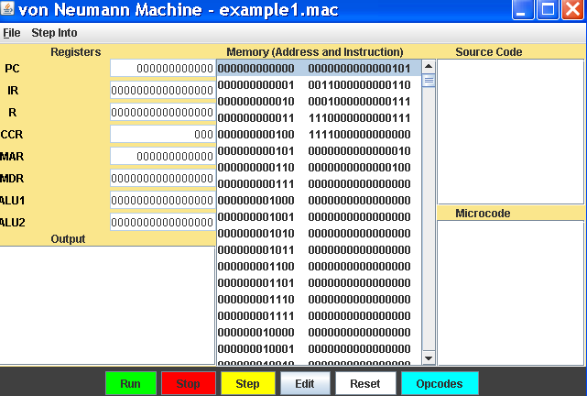
After Loading a Program

Slide 47
Chapter 6- Overview

Slide 48
VIRTUAL MACHINES
The machine we "built" is not the machine you "see" when you sit and start typing on the keyboard.
The hardware at the lowest level consists of:
binary representations: data
instructions
circuits built from gates: test for equality
full adder
decoder
multiplexor
units built from circuits and buses: memory
processor : control unit
ALU
I/0 system

Slide 49
INSTRUCTIONS AND PROGRAMS
Each computer model has its own machine language.
The machine instruction format is designed by the computer designer.
The format chosen for an instruction determines
the number of operations directly supported in hardware
(called hardwired instructions)
and
the size of the addressing space.

Slide 50
OUR COMPUTER
It is a 1-address machine that uses the format:
op code - 4 bits
address - 12 bits
These sizes imply:
1) There are at most 16 possible operations
2) There are at most 2¹² = 2² 2¹⁰ = 4K addressable memory locations.

Slide 51
A typical example of machine op codes
The machine code has the format opcode X , where X is an address:
R is the single register used by ALU
0000 con(X) -> R [con(X) is the contents of X]
0001 R -> con(X)
0010 0 -> con(X)
0011 R + con(X) ->R
0100 con(X) + 1 -> con(X)
0101 R – con(X) -> R
0110 con(X) – 1 -> con(X)
0111 if con(X) > R then GT = 1 else 0
if con(X) = R then EQ = 1 else 0
if con(X) < R then LT = 1 else 0

Slide 52
An Example of a Machine Code Program – in red (look on previous slides or pg 248 for meaning of opcodes):
Address: In decimal
0000 0000 0000 0110 0000 0000 0000 0
0011 0000 0000 0101 0000 0000 0001 1
0001 0000 0000 0111 0000 0000 0010 2
0100 0000 0000 0111 0000 0000 0011 3
1111 0000 0000 0000 0000 0000 0100 4
0000 0000 0000 0100 0000 0000 0101 5
0000 0000 0000 1000 0000 0000 0110 6
0000 0000 0000 0000 0000 0000 0111 7
Blanks are just to make the values more readable. Of course, these could be written hex!

Slide 53
An Example of a Machine Code Program – in red (look on previous slides or pg 248 for meaning of opcodes):
Meaning:
0000 0000 0000 0110 con(6) -> R (i.e. 8 -> R)
0011 0000 0000 0101 R + con(5) -> R (i.e. 8+4->R)
0001 0000 0000 0111 R ->con(7) (i.e. 12 -> con(7))
0 0000 0000 0111 con(7)+1->con(7) (i.e. 12+1
->con(7))
1111 0000 0000 0000 halt
0000 0000 0000 0100 4
0000 0000 0000 1000 8
0000 0000 0000 0000 0
Note: The first 5 lines are instructions- the last 3 are data.

Slide 54
MACHINE LANGUAGE PROGRAMMING
Computers can only execute machine language programs.
Although humans CAN program in a machine language, there are some difficulties if we can only do these types of programs:
1) Writing and reading binary numbers is error prone and difficult. (Hexadecimal notation helps, but it doesn't eliminate the problems).
2) Remembering operations as binary numbers is unintuitive, to say the least!
3) Converting data and addresses to binary form is not fun.

Slide 55
4) Numeric addresses make it difficult to modify programs:
Example: (written in base 10 and using mnemonics for the opcodes)
0: load 5
1: add 4
2: store 6
3: halt
4: data 4
5: data 8
6: data 0
Now we decide to add an
increment to
what was just stored.
The addresses need to change!
0: load 6
1: add 5
2: store 7
3: increment 7
4: halt
5: data 4
6: data 8
7: data 0
Now we notice we have no output so we need to change the program again!

Slide 56
WHY NOT HAVE THE COMPUTER HELP WITH THE MACHINE LANGUAGE CODING?
1) Why should we remember 0000 is load and 0011 is add?
Use the words LOAD( or load) and ADD (or add) when coding and write a program* that will translate
LOAD to 0000
and ADD to 0011
*This program, called an assembler would be written in machine language, as that is all that is available.

Slide 57
2) Why not use labels to mark address locations when we code? Then we can refer to addresses by symbolic names, not numbers.
and we can have the assembler not only translate these commands appropriately, but it could translate the data we write in base 10 into the necessary binary notation:
Example:
load x
add y
...
y:
x: ......
Labels can be any string of letters and digits.
A colon is used to separate a label from the location it references.
Example:
load x
add y
...
y: .data 4
x: .data 8

Slide 58
3) We need to distinguish commands to be executed and commands to the assembler to do something.
Commands to the assembler are called pseudo-ops and are written with a period in front of them:
Examples:
.data 8 Convert to data representing 8:
0000 0000 0000 1000
.begin The next line will be placed at address 0 and the PC will be set to 0.
.end This is the end of the program and data.
If an operating system was running, there would be a command replacing the .end to return control to the operating system.

Slide 59
OP CODES (i.e. 1-Address Operation Codes)
REF: page 220-221, Fig 5.19
Arithmetic OpCodes
0000 load
0001 store
0010 clear
0011 add
0100 increment
0101 subtract
0110 decrement
I/0 OpCodes
1101 in
1110 out
Logic/Control OpCodes
0111 compare
1000 jump
1001 jumpgt
1010 jumpeq
1011 jumplt
1100 jumpneq
1111 halt

Slide 60
NOW WE CAN WRITE AND MODIFY PROGRAMS WITH LESS CONCERN ABOUT BINARY NUMBERS!
.begin
load x
add y
store z
increment z
halt
y: .data 4
x: .data 8
z: .data 0
.end
Note:
Indentations are NOT significant
Watch the syntax for periods and colons
Each referenced location must have a unique label
.begin
load x
add y
store z
halt
y: .data 4
x: .data 8
z: .data 0
.end

Slide 61
HOW DIFFICULT IS IT TO WRITE THE ASSEMBLER--- the program which translates assembly language programs into machine language?
The algorithm for the assembler is given on pages 260 and 262 of the text.
Remember, the assembler is written in machine language as the computer can only execute machine language programs.
After the assembler is written, however, we can write in assembly language and have the assembler translate our code to machine language to run!

Slide 62
SLIDES 16-28 ARE VERY, VERY IMPORTANT!!
Why?
  In those slides we will translate each pseudocode statement introduced earlier into machine language code.
  This will mean we can program in machine language.
  Since we have seen how algorithms are what allow us to solve problems using the computer and pseudocode can be used to describe algorithms, this will say that machine language can be used to describe and, consequently, implement algorithms.

Slide 63
EXAMPLES OF PSEUDOCODE WRITTEN IN ASSEMBLY CODE
Recall the types of pseudocode instructions we had are listed in Figure 2.9 on page 53 of our text.
1) Computation: Set the value of "variable" to arithmetic exptression.
Set the variable myex to the sum of a + b - c.
...
load a
add b
subtract c
store myex
...
a:
b:
c:
myex:
Note that multiply and divide are not supported by hardware in our computer.
We have to write software, as you may do in the lab, to do operations that are not supported by hardware.

Slide 64
2) Input/output: Get, input, print, output ...
Get values for x and y.
Print values for x and y.
in x
in y
out x
out y
Note: x and y label a location somewhere.
Print the message 'Hello!'
We can't do this with our simulated computer as we are storing only positive integers, not characters (or fractional numbers).
Note, however, that our simulated computer does convert numbers to characters in order to print the numbers--- i.e. 34 is printed as the ASCII code for 3 followed by the ASCII code for 4 (otherwise, the number 34 wouldn't show on your screen!). The screen displays ASCII codes.

Slide 65
Input a value for myconst
and add 3 to it.
Input values for a, b, and c.
Compute x = a - (b - c)
in myconst
load myconst
add three
store myconst
...
myconst: .data 0
three: .data 3
in a
in b
in c
load b
subtract c
store temp
load a
subtract temp
store x
...
a: .data 0
b: .data 0
c: .data 0
temp: .data 0
Assign yrconst a value of 5 and output it.
out yrconst
...
yrconst: .data 5

Slide 66
3) Conditional: If Boolean-Expression then
first set of operations
else
second set of operations
If x = y then
add 3 to x
else
add 1 to y
output y
output x
load x
compare y
jumpneq else
add three
store x
jump outif
else: increment y
out y
outif: out x
...
three: .data 3
and, you need locations for x and y.
Note: increment and decrement do memory adds!

Slide 67
Another approach to
load x
compare y
jumpneq else
add three
store x
jump outif
else: increment y
out y
outif: out x
...
three: .data 3
load x
compare y
jumpeq ifpart
increment y
out y
jump outif
ifpart: add three
store x
outif: out x
...
three: .data 3
Note:
x is in R already

Slide 68
4) Iterative:
while Boolean-Expression do
set of operations
end loop
loop: load y
compare x
jumpgt endloop
jumpeq endloop
load x
add two
store z
out z
increment x
jump loop
endloop: out x
...
two: .data 2
while x < y do
compute z = x + 2
out z
increment x
end loop
out x
Exit loop if
x ≥ y

Slide 69
loop: load x
compare y
jumplt endloop
jumpeq endloop
add two
store z
out z
increment x
jump loop
endloop: out x
...
two: .data 2
Another approach to:
loop: load y
compare x
jumpgt endloop
jumpeq endloop
load x
add two
store z
out z
increment x
jump loop
endloop: out x
...
two: .data 2
Exit: If x ≥ y
Exit: If y ≤ x

Slide 70
5) Iterative: Repeat until Boolean-Expression
set of operations
end loop
Repeat until x > = 5
in y
z = y + x
add 1 to x
end loop
print z
loop: in y
load y
add x
store z
increment x
load five
compare x
jumplt loop
out z
...
five: .data 5

Slide 71
Another example:
Get N, A₀, A₁, A₂, ..., A_{N}
in N
loop: load N
compare i
jumpgt gotdata
in A
... do something with A
increment i
jump loop
gotdata:
...
N: .data 0
i: .data 0
The problem here is until we know N, we don't know how many variables to allocate.
But, in most of the algorithms we've seen, there is no need to input all the variables A_{i} at the beginning.
So, something like the following usually works:

Slide 72
What if the following can't be handled the way we did on the last slide?
Get N, A₀, A₁, A₂, ..., A_{N}
1) If you can bound the size of N, then you can preallocate that many memory locations for the variables.
2) You can use techniques to dynamically allocate memory which we won't study here.
Note what all of the previous slides say:
If we could store characters and fractional numbers, every algorithm we studied in Chapters 1-3 could be written in any machine language similar to the one used by our simulator!

Slide 73
WOULD IT BE HARD TO EXPAND OUR COMPUTER TO HANDLE CHARACTERS AND FRACTIONAL NUMBERS?
No.
Characters are just numbers so the storage is not a problem.
Compare would work the same and, obviously, add, subtract, etc. don't make sense for characters.
The in and out commands would need to be changed so conversions between the ASCII representation of a character and the numeric binary representation would not take place ---i.e. the external representation for a character is the same as the internal one.

Slide 74
For fractional numbers we would need to add two new operations:
ADDF - add fractional numbers
SUBTRACTF - subtract fractional numbers
and, of course for these and ADD and SUBTRACT, we would have to allow negative numbers to be handled.
The full adder can be modified to do the addition (and consequently the subtraction) of any signed fractional number.

Slide 75
CONCLUSION:
We can write algorithms in
pseudocode
or machine language
Consequently,
algorithms can be run on a computing agent built similar to our computer!

