Slide 1
Project Requirements

Slide 2
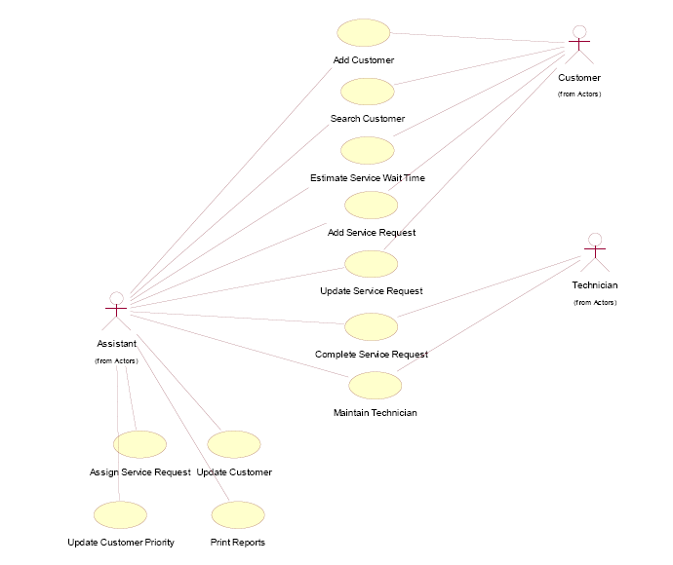
Overall use-case diagram for
Osric’s Office Appliances and Decor

Slide 3
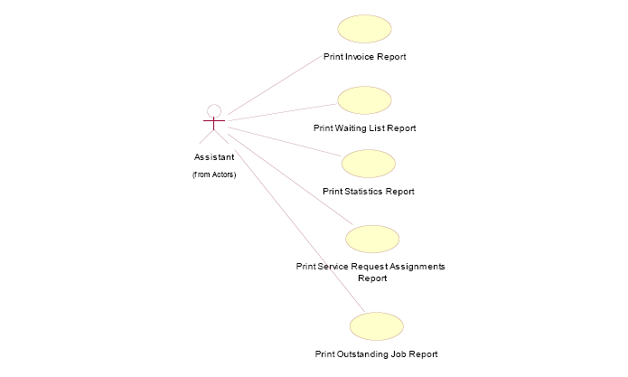
Use-case diagram showing the five Print Reports use cases

Slide 4
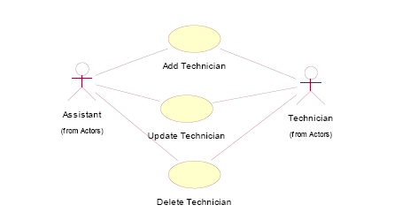
Use-case diagram showing three Maintain Technician use cases

