Slide 1
CONVERSING WITH A COMPUTER
DEALING WITH A
A MODERN DAY TOWER OF BABEL
Dr. Oberta A. Slotterbeck
(Obie)
Computer Science Department
Hiram College

Slide 2
WHAT LANGUAGE SHOULD WE USE TO “CONVERSE” WITH A COMPUTER?
The computer’s native language ---- machine language?
A mnemonic version of machine language --- assembly language?
A high level computer language
Speech? --- just recognize, not understand
Natural language --- with understanding?

Slide 3
THE LOGICAL STRUCTURE OF RANDOM ACCESS OR MAIN MEMORY
1 bit
one memory cell
Memory
W bits wide
addresses:
0
1
2
•
•
•
2^{N}- 1
1100111....000111
1 BIT is a 0 or a 1
All data and all instructions for a computer are encoded as sequences of bits
i.e. the native language of a computer is a sequence of bits!
0011001....111011
•
•
•

Slide 4
The computer’s native language ---- machine language
BIT = Binary digIT (i.e. a 0 or 1)
A computer works in base 2 (or binary)-i.e. it is used to form its native language.
Counting in base 2 from 0 to 10 we would count:
  0, 1, 10, 11, because 10 is one 2,
11 is one 2 plus one 1
  100, 101, 110, 111,
  because 100 is one 2² or 4,
  101 is one 2² plus one 1
  1000, 1001, 1010

Slide 5
The computer’s native language ---- machine language
Forming binary numerals is similar to what we do in base 10 when we use place values to form numerals:
  347 (base 10) means 3·10² + 4·10 + 7
  while 101 (base 2) means 1·2² + 0·2 + 1
To avoid confusing binary numerals with base 10 numerals which represent other numbers, we could write a 2 as a subscript:
  0₂, 1₂, 10₂, 11₂, 100₂, 101₂, 110₂, 111₂, 1000₂, 1001₂, 1010₂

Slide 6
Instructions have different formats for different machines; we will use a 1-address machine format:
4 bits for opcode | 8 bits for address
opcode = a code for an operation that the computer can execute
address = location where one operand for the operations exists.
Examples:
0000 means load
0011 means add
The location of a second operand if it is needed is a single register called R.

Slide 7
A SIMPLE MACHINE LANGUAGE PROGRAM FOR OUR HYPOTHETICAL COMPUTER
This is all the computer
"understands":
It means:
0000 0000 0101
0011 0000 0110
0001 0000 0111
1110 0000 0111
1111 0000 0000
0000 0000 0010
0000 0000 0011
0000 0000 0000
Load the value at address 5 into R.
Add the value at 6 to the value in R.
Store the value in R at address 7.
Print the value at address 7.
Halt.
2
5
2
R = a register
3
R’s contents are shown in base 10 although they are really stored in base 2.
0
5

Slide 8
opcode address
0010 0000 1100 --set sum to 0
1101 0000 1101 --input first number
0000 0000 1110 --put 0 in the register
0111 0000 1101 --compare N and 0
1011 0000 1010 --jump to NEG if N < 0
0000 0000 1100 --put SUM in the register
0011 0000 1101 --add N so register holds N+ SUM
0001 0000 1100 --put result back into SUM
0101 0000 1101 --get the next value
1000 0000 0010 --repeat the loop
1110 0000 1100 --print the sum
1111 0000 0000 --and stop
0000 0000 0000 --hold the sum
0000 0000 0000 --hold input data
0000 0000 0000 --the constant 0
LANGUAGE:
A MACHINE LANGUAGE
Program: Adds non-negative integers

Slide 9
Machine language programs do NOT require translation.
They are written in the "native language" of a specific computer.
Everything executed on a computer is in its machine language.
BUT
1. WHY SHOULD WE HUMANS HAVE TO REMEMBER THAT
0000 means LOAD
0001 means STORE
2. WHY SHOULD WE HUMANS HAVE TO REMEMBER ADDRESSES WRITTEN AS
00000000 00001111
00000001 00010000
when we write instructions and input or output data?

Slide 10
WHAT LANGUAGE SHOULD WE USE TO “CONVERSE” WITH A COMPUTER?
The computer’s native language ---- machine language
A mnemonic version of machine language --- assembly language
A high level computer language
Speech --- just recognize, not understand
Natural language --- with understanding

Slide 11
A mnemonic version of machine language --- assembly language
opcode mnemonic symbolic-address
0000 LOAD X 1000 JUMP X
0001 STORE X 1001 JUMPGT X
0010 CLEAR X 1010 JUMPEQ X
0011 ADD X 1011 JUMPLT X
0100 INCREMENT X 1100 JUMPNEQ X
0101 SUBTRACT X 1101 IN X
0110 DECREMENT X 1110 OUT X
0111 COMPARE X 1111 HALT

Slide 12
--Program to compute the sum of non-negative integers
. BEGIN --start of program
CLEAR SUM --set sum to 0
IN N --input first number
AGAIN: LOAD ZERO --put 0 in the register
COMPARE N --compare N and 0
JUMPLT NEG --jump to NEG if N < 0
LOAD SUM --put SUM in the register
ADD N --add N so register holds N+ SUM
STORE SUM --put result back into SUM
IN N --get the next value
JUMP AGAIN --repeat the loop
NEG: OUT SUM --print the sum
HALT --and stop
SUM: .DATA 0 --hold the sum
N: .DATA 0 --hold input data
ZERO: .DATA 0 --the constant 0
END --mark physical end of program
LANGUAGE:
AN ASSEMBLY LANGUAGE
Program: Same as before

Slide 13
BUT, WHILE ASSEMBLY LANGUAGE IS EASIER FOR US TO UNDERSTAND, THERE IS A COST.
ASSEMBLY LANGUAGE MUST BE TRANSLATED
BEFORE A COMPUTER CAN UNDERSTAND IT
Assembly language
program
LOAD X
TRANSLATOR
(Assembler)
Machine language
program
0000 00001011

Slide 14
WHAT LANGUAGE SHOULD WE USE TO “CONVERSE” WITH A COMPUTER?
The computer’s native language ---- machine language
A mnemonic version of machine language --- assembly language
A high level computer language
Speech --- just recognize, not understand
Natural language --- with understanding

Slide 15
A High Level Computer Language
A few of the ~2350 possible languages!!!
FORTRAN
ALGOL 60
COBOL
BASIC
PL/1
ALGOL-68
Pascal
C
Modula-2
Ada
Smalltalk
C++
Python
Visual Basic
Java
SQL
Perl
HTML
LISP
SCHEME
APL
ML
PROLOG
Occam II
Linda
High Performance Fortran
Plus library enhancements: Ex. OpenGL

Slide 16
BUT, WHILE HIGH LEVEL LANGUAGES ARE EASIER FOR US TO UNDERSTAND, THERE IS A COST.
HIGH LEVEL LANGUAGES MUST BE TRANSLATED
BEFORE A COMPUTER CAN UNDERSTAND THEM
AND THE TRANSLATION IS MORE DIFFICULT THAN FOR ASSEMBLY LANGUAGES
Machine language
program
0000 00001011
0011 00001101
0001 00001110
High level language
program
X = A + B;
TRANSLATOR
(Compiler)

Slide 17
ADVANTAGES DISADVANTAGES
OF HIGH LEVEL LANGUAGES
Compilers must be written for each machine.
Syntax can be picky.
Most are quite complex and take a while to learn.
Everyone argues about which is the "best" language!
Different languages have different advantages so knowing just one is not wise.
No binary to decimal conversions.
Tend to be closer in syntax to human languages
Are syntactically independent of the computers.
Shorter code than the machine language code equivalent.
Can design abstractly.

Slide 18
#include <iostream>
using namespace std;
int main() {
int sum = 0, number;
cout << “Please enter numbers to add; “;
cout << “terminate with a negative number .” << endl;
cin >> number;
while (number >= 0) {
sum = sum + number;
cin >> number;}
cout << “The sum is “ << sum << endl;}
//A program to add non-negative integers
Program: Same as before
LANGUAGE: C++

Slide 19
IDENTIFICATION DIVISION.
PROGRAM-ID. SUM-OF-PRICES.
AUTHOR. JANE DOE
ENVIRONMENT DIVISION.
CONFIGURATION SECTION.
SOURCE-COMPUTER. VAX-11.
OBJECT-COMPUTER. VAX-11.
INPUT-OUTPUT SECTION.
FILE CONTROL.
SELECT INP-DATA ASSIGN TO INPUT.
SELECT RESULT-FILE ASSIGN TO OUTPUT.
DATA DIVISION.
FILE SECTION.
FD INP-DATA LABEL RECORD IS OMITTED.
01 ITEM-VALUE.
02 ITEM PICTURE 999999.
FD RESULT-FILE LABEL RECORD IS OMITTED.
01 RESULT-LINE PICTURE X(132).
LANGUAGE: COBOL
Program: Almost the same, but does file input as that is very common in COBOL programs.

Slide 20
WORKING-STORAGE SECTION.
77 SUM PICTURE 999999999, VALUE 0, USAGE IS COMPUTATIONAL.
01 SUM-LINE.
02 FILLER VALUE ‘ Sum = ‘ PICTURE X(12).
02 SUM-OUT PICTURE ZZZZZZZZ9
01 ITEM-LINE.
02 ITEM-OUT PICTURE X(30).
PROCEDURE DIVISION.
START.
OPEN INPUT INP-DATA AND OUTPUT RESULT-FILE.
READ-DATA.
READ INP-DATA AT END GO TO PRINT-LINE.
ADD ITEM TO SUM.
MOVE VALUE TO SUM.
WRITE RESULT-LINE FROM ITEM-LINE.
GO TO READ-DATA.
PRINT-LINE.
MOVE TOT TO SUM-OUT.
MOVE COUNT TO COUNT-OUT.
WRITE RESULT-LINE FROM SUM-LINE.
CLOSE INP-DATA AND RESULT-FILE.
STOP RUN.

Slide 21
PROGRAM MAIN
PARAMETER (MAXSIZE = 99)
REAL A(MAXSIZE)
100 READ *, K
IF (K .LE. 0 .OR. K .GT. MAXSIZE) STOP
READ *, (A(I), I=1, K)
PRINT *, (A(I), I=1, K)
PRINT *, ‘SUM = ‘, SUM(A,K)
GO TO 100
END
FUNCTION SUM(V,N)
REAL V(N)
SUM = 0.0
DO 200 I = 1, N
200 SUM = SUM + V(I)
RETURN
END
LANGUAGE:
FORTRAN 77
Program: Same as before

Slide 22
//A program to add non-negative integers
(define (adder input-list)
(cond (( null? input-list) 0)
(else (+ (car input-list)
(adder (cdr input-list))))))
invoke in an interpreter with:
(adder (list (3 4 5 10 23 14 -3)))
LANGUAGE: SCHEME
Program: Same as before

Slide 23

LANGUAGE: APL
)CLEAR
∇ RES ← PRIMES N; T
RES ← 2, T ← 3
→ 0 X ι N = ρ RES
T ← T + 2
→ 3 X ι V/O = RES | T
RES ← RES, T
→ 2
∇

Slide 24
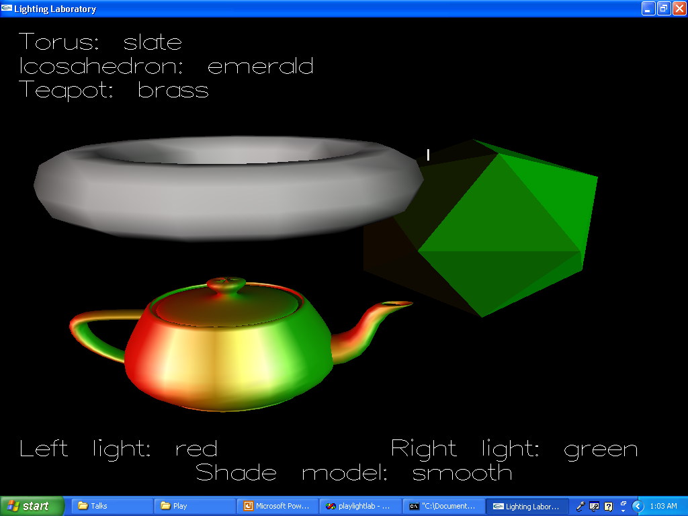
WITH ADDITIONAL LIBRARIES, SUCH AS OPENGL, ADDED TO C++ WE CAN PRODUCE INTERESTING GRAPHICS

Slide 25
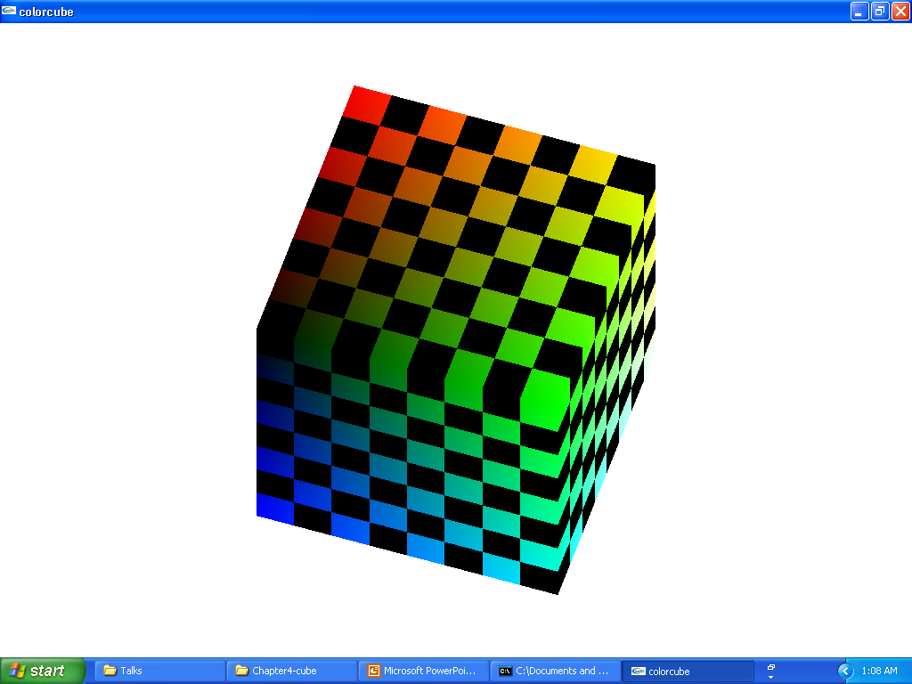
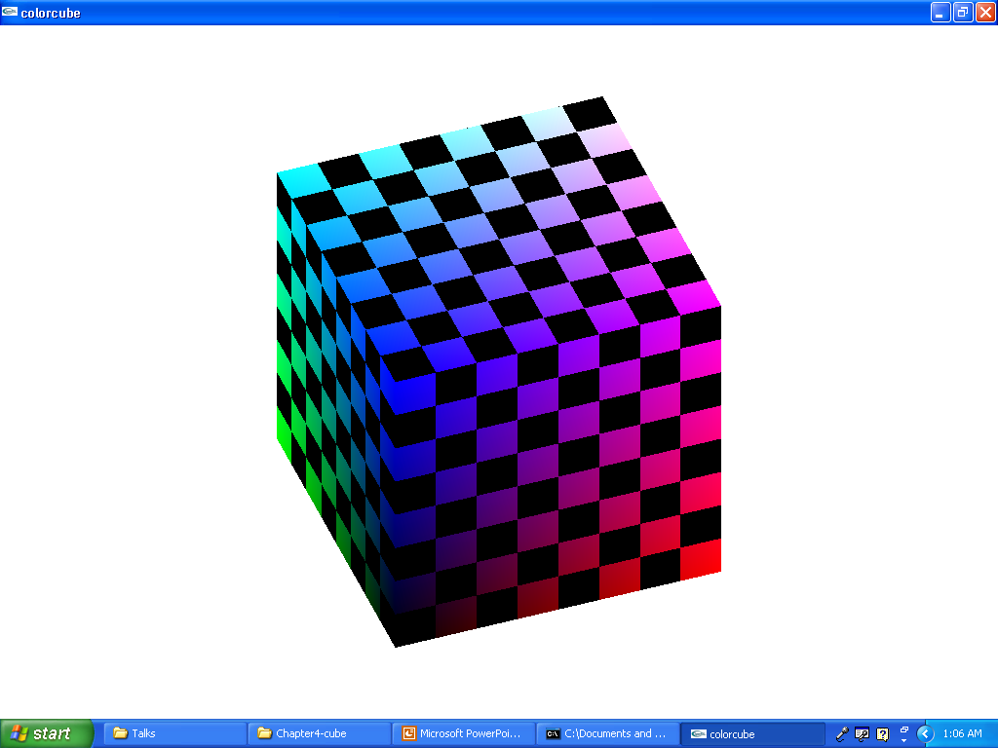
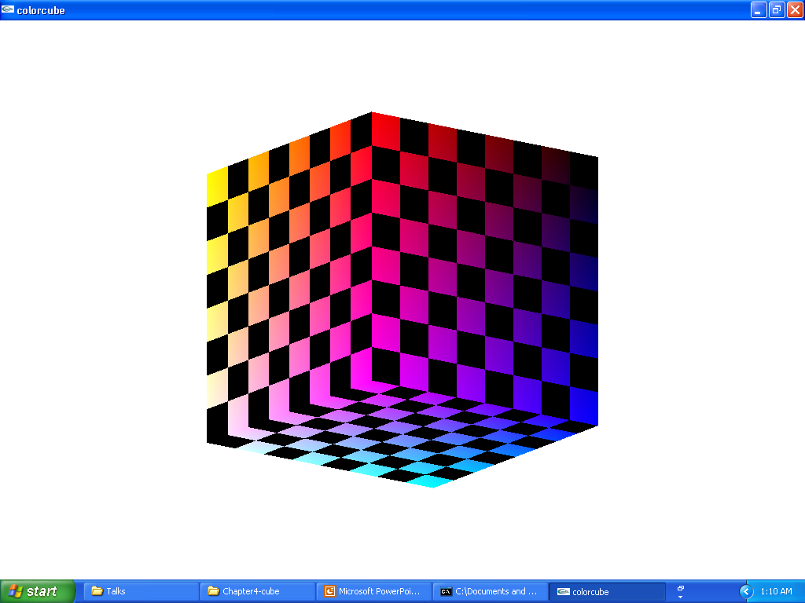
AND EVEN ANIMATIONS
(SEVERAL VIEWS OF A ROTATING CUBE)

Slide 26
WHAT LANGUAGE SHOULD WE USE TO “CONVERSE” WITH A COMPUTER?
The computer’s native language ---- machine language
A mnemonic version of machine language --- assembly language
A high level computer language
Speech --- just recognize, not understand
Natural language --- with understanding

Slide 27
dear aunt bombing, white = computer (ViaVoice)
Dear Mommie, yellow = said
This is attempting to use voice recognition software that staff gave me.
This is an attempt to use voice recognition software that Jeff gave me.
I'm not sure how many mistakes it will make a. I am not going to correct
I am not sure how many mistakes it will make. I am not going to correct
any of the mistake accepted for the fact that it said dear aunt in bombing
any of the mistakes except for the fact that is said “dear aunt in bombing”
instead at dear Bonnie. I often forgets to put a. At the end of those at
instead of “dear Mommie”. I often forget to put a period at the end of those
the. You have to actually say the word.
lines. You have to actually say the word period.
…
They hello to India and sell bonds and Sunday at all the other part for me.
Say hello to Athena and Sylvanius and Sonny and all the other pets for me.

Slide 28
BUT, THIS STILL ISN’T THAT IMPRESSIVE
Voice recognition software just translates sounds into characters.
It does not assign meaning to the words.
To truly converse with a computer, there has to be meaning (or semantics) attached to the words and these meanings must affect the way the computer reacts.
Natural languages have the problem that multiple meanings can be attached to the same sequence of words, depending upon the context being assumed by both the speaker and the listener.

Slide 29
WHAT LANGUAGE SHOULD WE USE TO “CONVERSE” WITH A COMPUTER?
The computer’s native language ---- machine language
A mnemonic version of machine language --- assembly language
A high level computer language
Speech --- just recognize, not understand
Natural language --- with understanding

Slide 30
IDEALLY:
Computer. I am going to give you some numbers. Compute their sum.
Computer. Here’s my tax data. Calculate my income tax.
Computer. Read these articles and classify them as
interesting,
possibly interesting,
and interesting.
Computer. Locate all data on quinces and choose a menu for a dinner party for 16 that showcases quinces in some way.

Slide 31
COMPUTER LANGUAGES
VS
NATURAL LANGUAGES
Computer languages are context-free.
Natural languages are context-sensitive.
Exact definitions of these words are in terms of grammar characteristics, but let’s see some of the problems with natural language sentences.

Slide 32
TIME FLIES LIKE AN ARROW
CAN BE INTERPRETED IN AT LEAST THREE DIFFERENT WAYS:
1. Time goes by swiftly, just as an arrow does.
2. Time swimmers like a runner, with a stop watch.
3. Fruit flies like an apple.

Slide 33
So, WHAT LANGUAGE SHOULD WE USE TO “CONVERSE” WITH A COMPUTER?
1) Machine language?
2) Assembly language?
3) A high level computer language?
4) Speech --- just recognize?
5) Natural language --- with understanding?
It depends:
Designers of computers use 1 and 2 today.
Many people use 3 extensively.
Many people are trying to work with 4.
And 5--- herein lies some interesting research topics!!!!

Slide 34
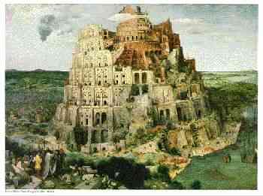
Pieter D.A. Brueghel’s
“Tower of Babel”

Slide 35
CARE TO CONVERSE FURTHER
(WITH A HUMAN ) :
obie@hiram.edu
Interested in seeing one list of languages and a list of free compilers?
http://cuiwww.unige.ch/OSG/info/Langlist
What to see these slides again? They are at:
http://cs.hiram.edu/~obie/talks/babel.ppt
For more about our department and the college, monitor
http://cs.hiram.edu
and http://www.hiram.edu

