Slide 1
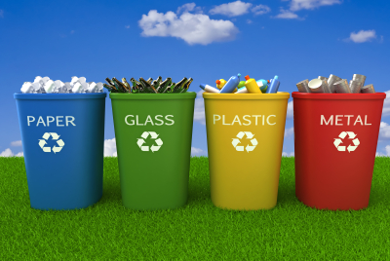

Let’s start waste recycling in Tbilisi!
with

Slide 2

Waste recycling,
what is it?

Slide 3
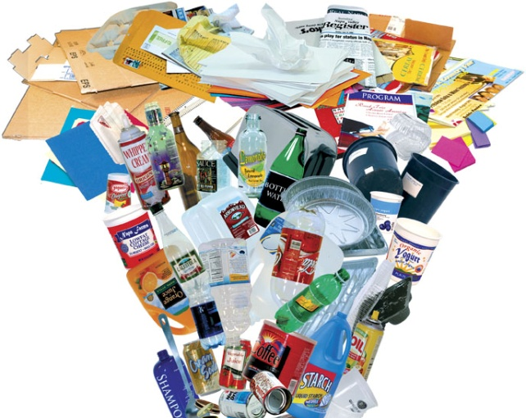

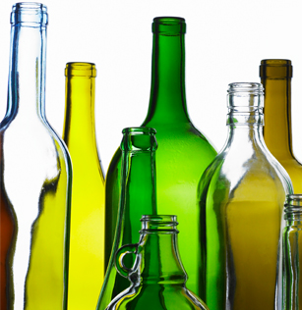
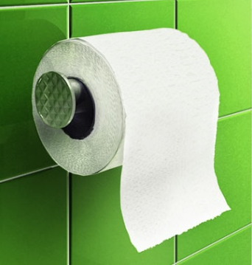
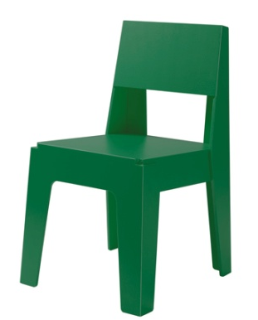
What is recycling?
To reuse or transform waste into new products

Slide 4
Why recycle?

Slide 5
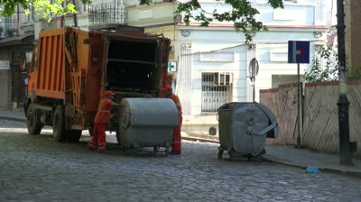
Where does our waste go?
Almost all waste we produce in Georgia goes into landfills

Slide 6
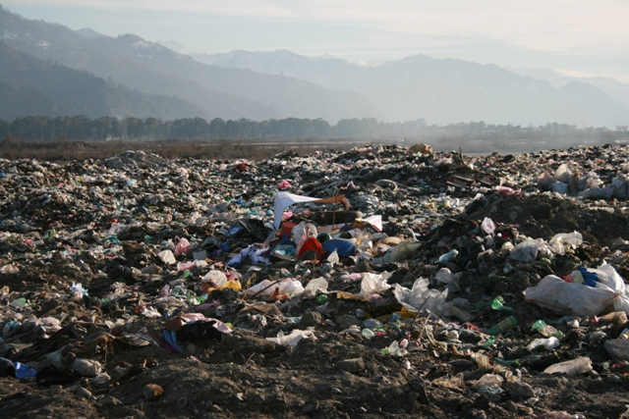
Landfill
Filling landfills is not nice for the environment

Slide 7
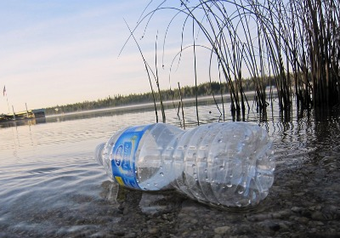
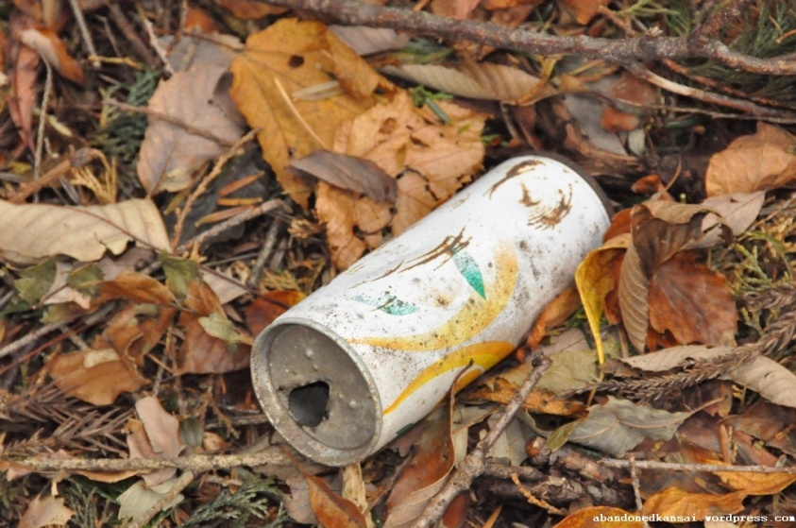
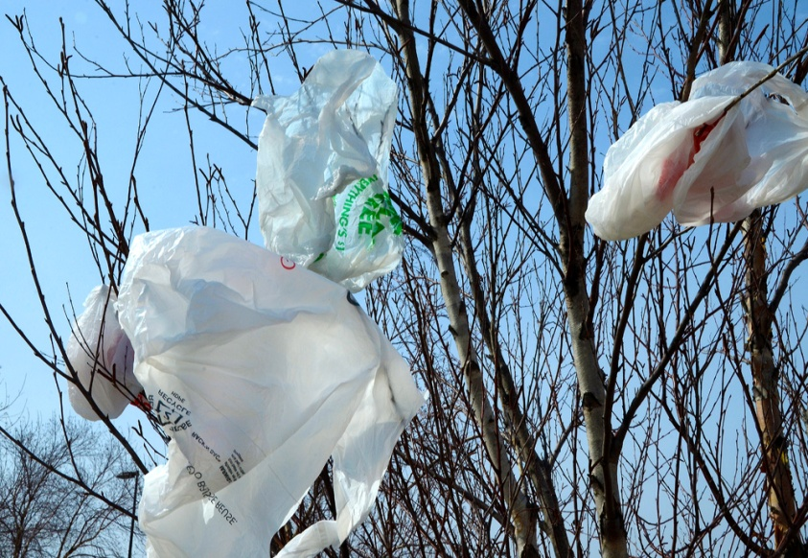
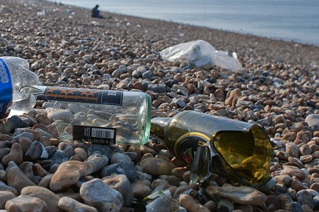
How long does it take to decompose?
Aluminum Can - 200-500 years
Plastic Bottles - 450 years
Glass - never
Plastic Bags - 200-1000 years

Slide 8
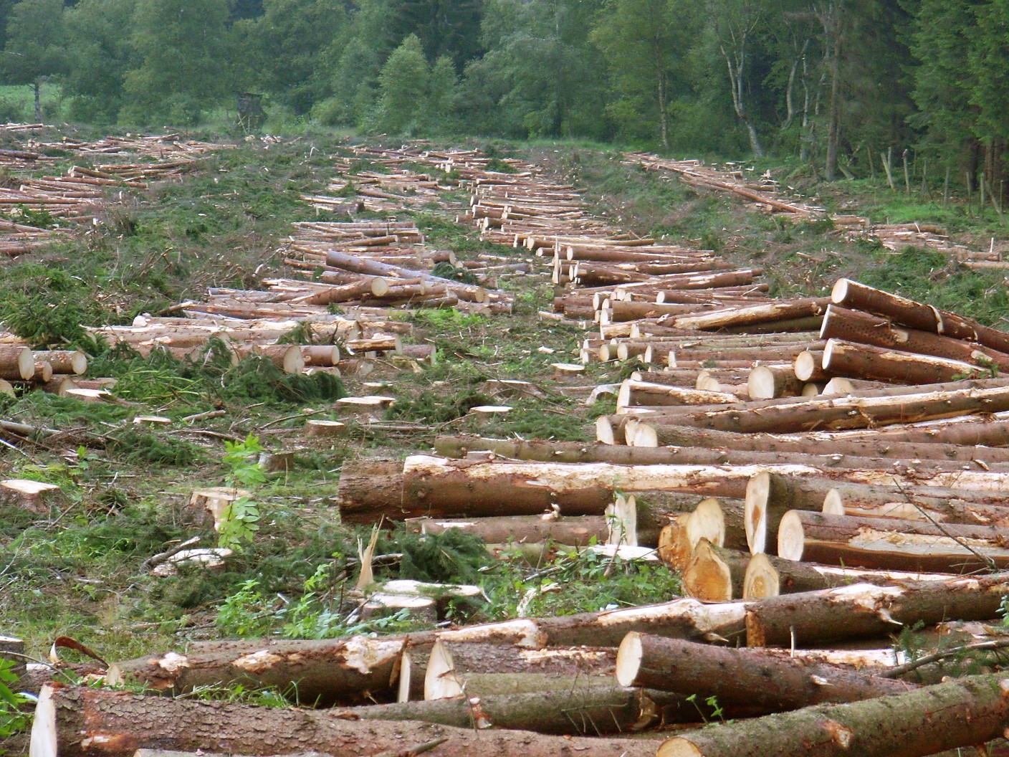
Recycling saves resources
Save paper, save trees !
Recycling 1 ton of paper saves 13 trees and 30,000 litres of drinking water

Slide 9
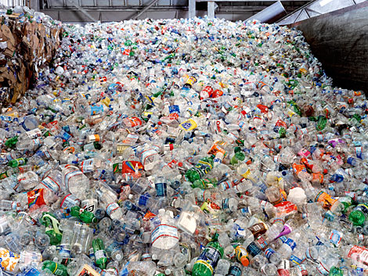

Recycling saves resources
Save plastic, save energy !
1 recycled plastic bottle would save enough energy to power a 60-watt light bulb for 3 hours

Slide 10
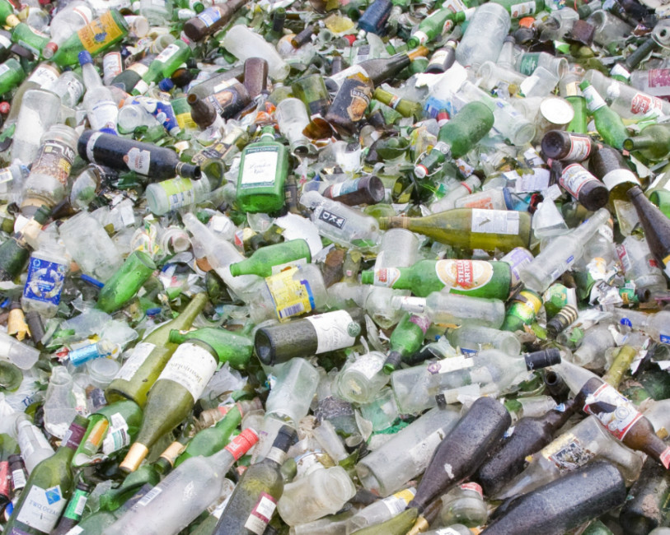
Recycling saves resources
Save glass, save energy !
Making new bottles with recycled glass saves 25% energy

Slide 11
How and What
to recycle?

Slide 12
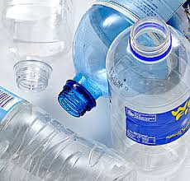
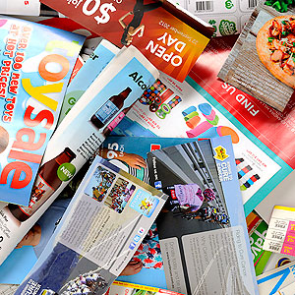
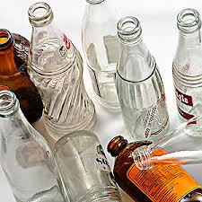
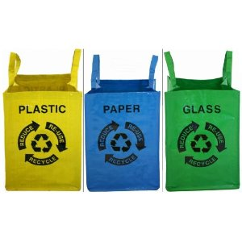
Waste separation
First let’s separate our various waste at home, at school

Slide 13
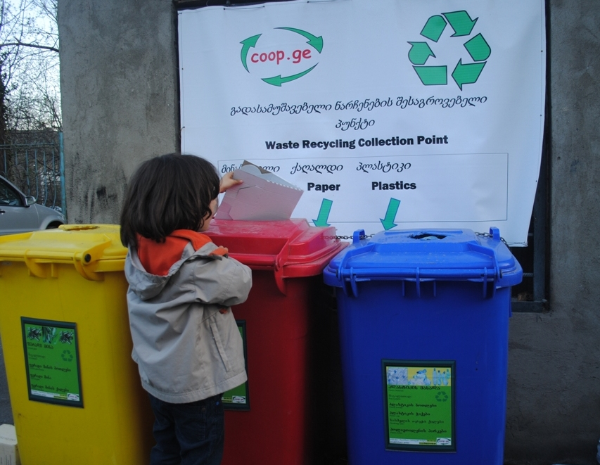
Waste disposal
Dispose your separated waste in specific containers

Slide 14
And then,
what happens?

Slide 15
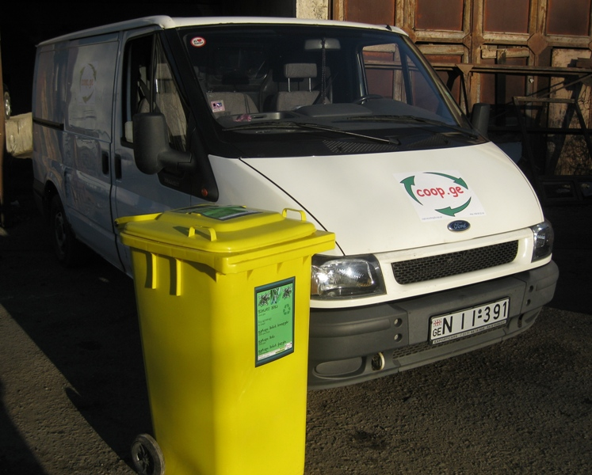
Collection of waste
A company comes to pick up the waste and send it to recycling factories

Slide 16
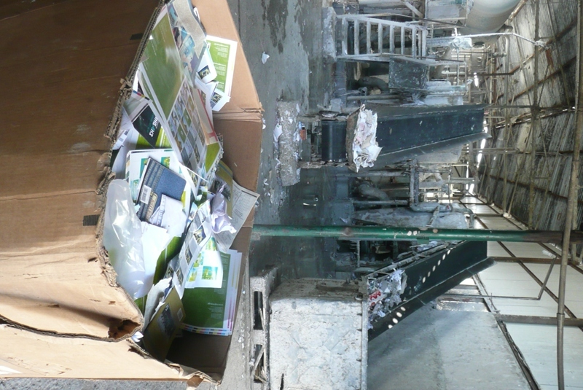
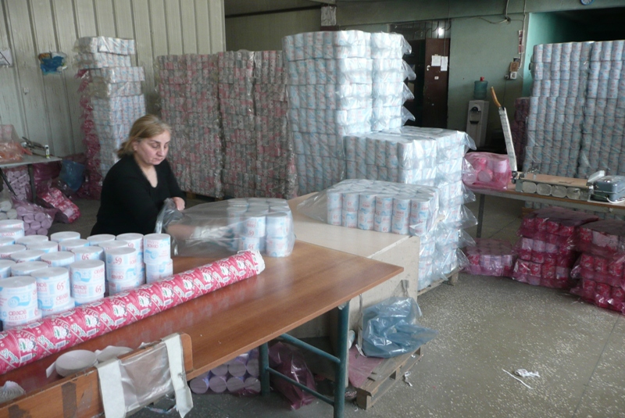
PAPER recycling
With PAPER, a factory in Tbilisi produces toilet paper

Slide 17
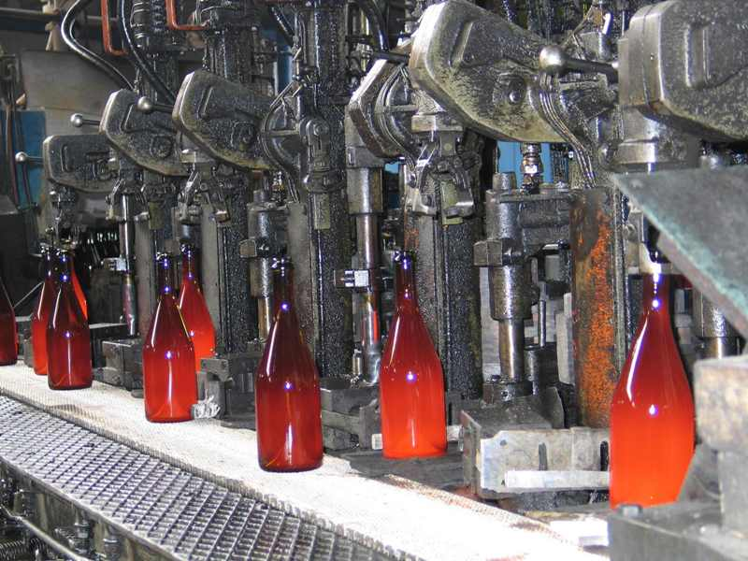
GLASS recycling
With GLASS, a factory in Ksani makes new bottles

Slide 18
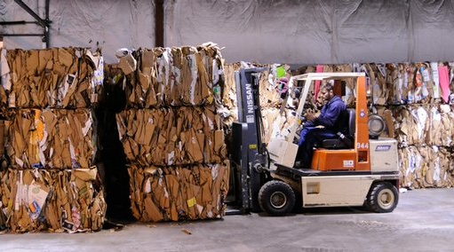
CARDBOARD recycling
With CARDBOARD, a factory in Tserovani produces new cardboard

Slide 19
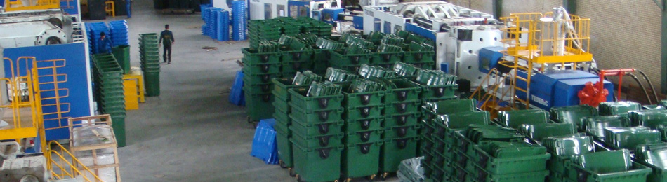
PLASTIC recycling
With PLASTIC, a factory in Iran makes new containers

