Slide 1

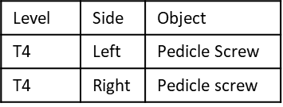

POSTERIOR
LIST of ALL OBJECTS/Procedures
“Op Note Posterior Function
Create first paragraphs.
Pass all_objects_to_add to:
All_objects_to_Add
Level | Side | Object
T3 | Left | TP_hook
T4 | Left | Pedicle Screw
T4 | Right | Pedicle_screw
L3 | Central | Laminectomy
L4 | Left | foraminotomy
L4 | Left | TLIF
EG:
“op_note_procedure_paragraphs_function”
Posterior Spinal Instrumentation
Decompression
Interbodies
Identifies procedures as distinct or to combine multiple rows into one paragraph
Groups the procedures and creates nested df with individual df for each grouped procedure. Individual df’s contain procedure by level
Establishes paragraph intro
Level | Side | Object
T3 | Left | TP_hook
T4 | Left | Pedicle Screw
T4 | Right | Pedicle_screw
Level | Side | Object
L3 | Central | Laminectomy
L4 | Left | foraminotomy
Level | Side | Object
L3 | Left | TLIF
Pass Nested Df + procedure category + combined or distinct to:
Create_full_paragraph_statement_function
“Combine” Procedures
Divides into Combine or Distinct Paragraphs to run different functions
Create nested df grouped only by objects. So this has of levels and side for each specific object and pass to:
“Distinct” Procedures (e.g. PSO, interbody)
Posterior Spinal Instrumentation
Interbodies
Op_note_technique_distinct_statement
Op_note_technique_combine_statement
Create Text paragraph for the object
Create text that specifies a technique for the specific object and combines the levels and any other additional info (e.g. screw size)

Slide 2
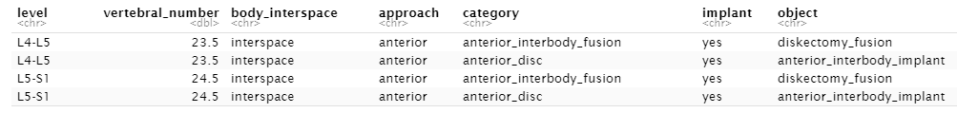


ANTERIOR
All_objects_to_Add
LIST of ALL OBJECTS/Procedures
Creates:
Op_note_anterior_function
all_anterior_procedures_paragraphs_function
anterior_create_full_paragraph_statement_function
Create first paragraphs.
Pass all_objects_to_add to function.
Create closing paragraph
Identifies procedures as distinct or to combine multiple rows into one paragraph
Groups the procedures and creates nested df with individual df for each grouped procedure. Individual df’s contain procedure by level
Establishes paragraph intro
Divides into Combine or Distinct Paragraphs to run different functions
Pass Nested Df + procedure category + combined or distinct to:
“Distinct” Procedures (e.g. PSO, interbody)
“Combine” Procedures
op_note_object_combine_paragraph_function
anterior_op_note_distinct_paragraph_function
Create nested df grouped only by objects. So this has of levels and side for each specific object and pass to:
Create Text paragraph for the object
Create text that specifies a technique for the specific object and combines the levels and any other additional info (e.g. screw size)

