Slide 1
Forecasting Volatility for a Short-Vol Strategy on USO
EWMA, Rolling GARCH(1,1), and a COT Positioning Filter
Time Series Econometrics · MSQF · Spring 2026

Slide 2
Agenda
1. Project overview and motivation
2. Data sources (Bloomberg + CFTC + options vendor)
3. Strategy design — short ATM straddle, hedge, stop
4. Time series methods — EWMA and rolling GARCH(1,1)
5. Layer 1 (EWMA) and Layer 2 (GARCH) results
6. Robustness tests — windows, refit, thresholds, subperiods
7. COT positioning as an exploratory risk filter
8. Limitations and next steps
MSQF · Time Series Econometrics Final Project

Slide 3
Project Overview
Connecting volatility forecasting to a tradable P&L outcome
Goal: build a disciplined short-volatility strategy on the USO oil ETF, with timing driven by time-series volatility forecasts.
Core question: does forecasting realized volatility (EWMA / GARCH) and comparing it to implied volatility produce a persistent edge?
Three-layer build:
Layer 1 — short ATM straddle baseline with an EWMA-based timing filter.
Layer 2 — replace EWMA with a rolling GARCH(1,1) forecast.
Layer 3 — add a COT positioning veto as an exploratory risk filter.
Time series methods are the heart of the project — option strategy is the vehicle through which the forecast quality is measured.
MSQF · Time Series Econometrics Final Project

Slide 4
Why Short Volatility on USO?
Persistent vol risk premium meets a regime-shifting underlying
Crude oil volatility carries a persistent risk premium: implied vol tends to exceed realized vol on average, especially in calm regimes.
USO is a liquid, listed-options vehicle on WTI exposure — accessible without a futures account, and with publicly available chains.
Oil is heavily news-driven (OPEC, geopolitics, refinery cycles). Vol forecasting is hard precisely because of regime shifts — which makes it a real test of EWMA vs GARCH.
Key challenge: short straddles are short gamma and short vega. Without timing, premium collected in calm years is given back in spike years (Russia/Ukraine 2022, Iran/Israel 2024).
Practical use: a vol-selling sleeve in a multi-strategy book, sized small, with disciplined entry filters and stop-losses to cap tail trades.
MSQF · Time Series Econometrics Final Project

Slide 5
Data Sources
Three independent sources stitched on a daily index
WTI / USO price data — Bloomberg BDH:
CL1, CL2, CO1, OVX, USO close/bid/ask/volume; 2010-01-05 → 2026-04-10.
Backtest restricted to 2020-05-04 → 2026-04-10 (post 1-for-8 USO reverse split).
COT positioning — CFTC weekly disaggregated report via Bloomberg:
Managed Money (MM) and Non-Commercial (NC) net positioning, Total OI.
Tuesday positioning, released Friday — we apply a 7-day lag to avoid look-ahead.
USO option chains — external vendor:
28 quarterly CSVs; ~2,015,055 rows of bid/ask/IV/Greeks across all strikes/expiries.
Filtered to bid ≥ 0, ask > 0, post-split window.
Mid prices = (bid + ask) / 2; mid IV = (iv_bid + iv_ask) / 2.
Cleaning choices: post-split alignment, drop quote-stale rows, EWMA seed = sample variance of first 20 returns to limit warm-up bias.
MSQF · Time Series Econometrics Final Project

Slide 6
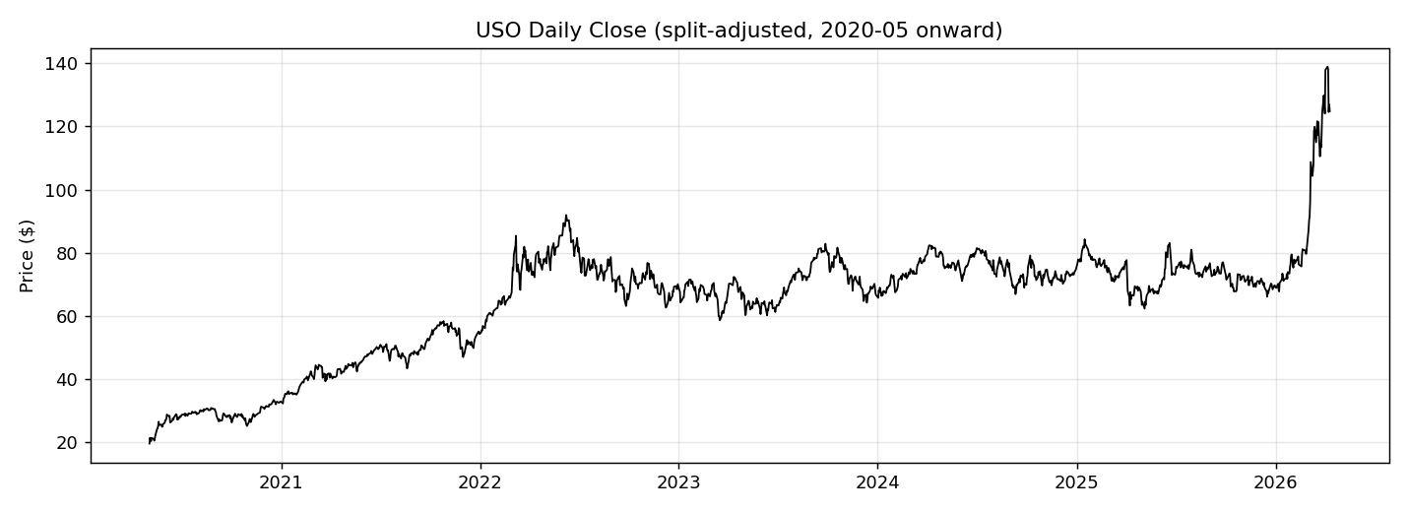
Strategy Design — Short ATM Straddle
Monthly cadence, defined exit rules, explicit cost model
On entry day, sell 1 ATM call + 1 ATM put with ~30 DTE (21–45 day window).
Premium received at the bid; daily MTM at the mid; exit at the ask.
1 contract = 100 shares of underlying.
Entry pacing: re-enter every ~21 trading days (no overlapping trades).
Exit: 5 trading days before expiry, or on stop-loss.
Stop-loss rule: exit if straddle ask ≥ 2× initial premium received.
Hedge: daily rebalance of USO shares to delta-neutral (when enabled).
Transaction costs: 5 bps on USO notional traded for hedge rebalances; bid/ask slippage already captured in entry/exit prices.
MSQF · Time Series Econometrics Final Project

Slide 7
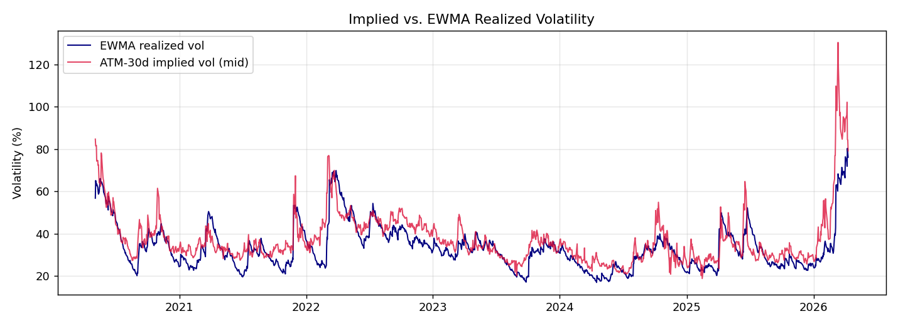
Strategy Design — Entry Filter
Trade only when implied vol is rich relative to the forecast
Conditional entry: only sell vol when implied is rich vs forecasted realized.
Filter rule: IV(ATM) / σ̂_forecast > threshold (default 1.10).
EWMA branch (Layer 1): σ̂ from λ = 0.94 EWMA of daily log returns.
GARCH branch (Layer 2): σ̂ from rolling GARCH(1,1) one-step forecast.
Same backtest engine for both — only the forecast series changes.
Threshold > 1 keeps trades only when IV looks ≥ 10% above forecasted realized vol (i.e. options are rich), which is the structural source of edge.
Strategies tested across the project:
A — naked straddle, no filter (B + delta hedge)
C — EWMA filter, no hedge (D + hedge + stop)
E — GARCH filter, no hedge (F + hedge + stop)
G — F + COT positioning veto (Layer 3 exploratory)
MSQF · Time Series Econometrics Final Project

Slide 8
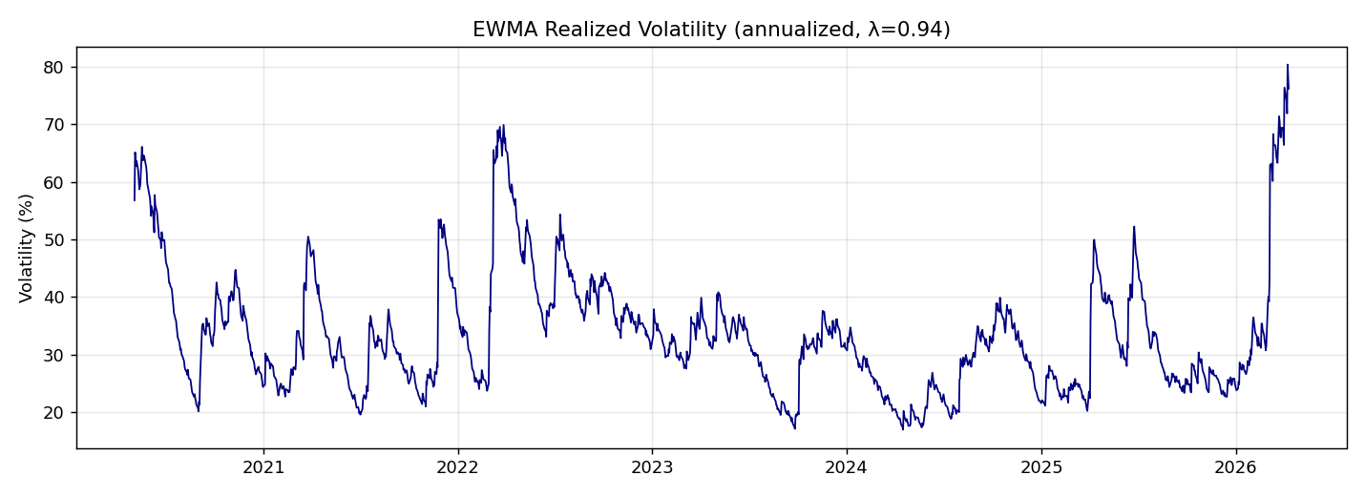
Time Series Method 1 — EWMA Volatility
Recursive smoother — simple, stable, but not mean-reverting
RiskMetrics-style EWMA on daily log returns:
σ²_t = λ · σ²_{t−1} + (1 − λ) · r²_t
λ = 0.94 (RiskMetrics default; ~75-day half-life).
Seeded with the sample variance of the first 20 returns to avoid warm-up bias.
Strengths:
Single parameter, fully recursive, no estimation step → robust and stable.
No forecast distribution assumption — purely a smoothing filter.
Weaknesses:
Cannot mean-revert: forecast slowly trails realized after a spike.
No conditional fat-tail or persistence parameter — one number for everything.
Use here: the published Layer 1 baseline filter.
MSQF · Time Series Econometrics Final Project

Slide 9
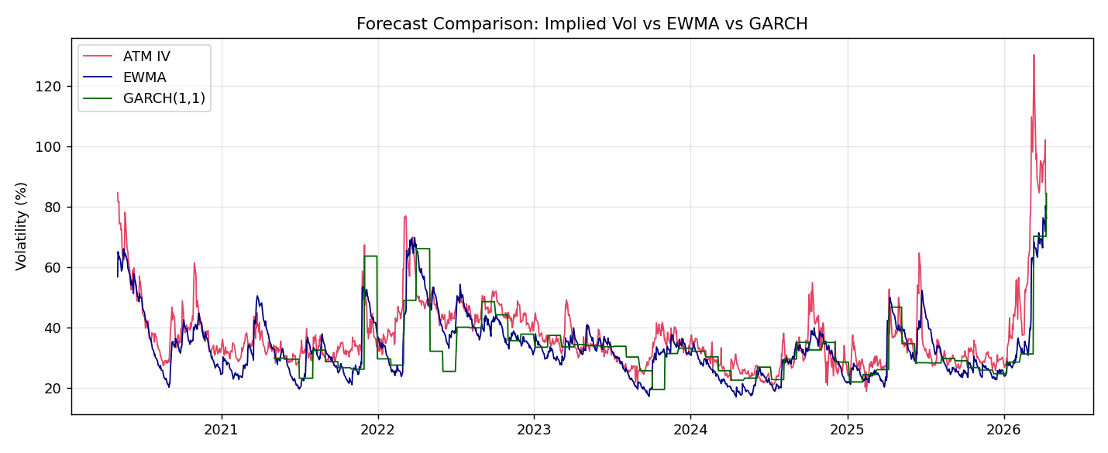
Time Series Method 2 — Rolling GARCH(1,1)
Rolling refit captures regime shifts with a 1-step forecast
Standard GARCH(1,1) on daily log returns (zero-mean, normal innovations):
σ²_t = ω + α · r²_{t−1} + β · σ²_{t−1}
Rolling estimation:
Fit window = 252 trading days (~1 year).
Refit every 21 trading days (~monthly).
Forecast horizon = 1 day, used at trade-decision time.
Estimation as of t uses returns through t−1 only — no look-ahead.
Why GARCH for short-vol timing:
Captures volatility clustering and mean reversion explicitly.
Reacts to a vol spike without permanently re-leveling like EWMA.
Provides a richer conditional model — α + β captures persistence.
Implemented with the `arch` package; returns rescaled by 100 for fit stability.
MSQF · Time Series Econometrics Final Project

Slide 10
EWMA vs GARCH — Forecast Signal Comparison
Both forecasts track realized vol; GARCH mean-reverts faster after spikes, producing fewer but more selective entries.
MSQF · Time Series Econometrics Final Project

Slide 11
Layer 1 Results — EWMA Baseline
Sample: 2020-05-04 → 2026-04-10 · 1 contract per trade
Strategy | Trades | Total P&L | Sharpe | Max DD | Worst Trade | Win %
A — naked straddle | 74 | −$2,378 | −0.28 | −$5,069 | −$3,375 | 67.6%
B — + delta hedge | 74 | −$4,961 | −0.33 | −$8,643 | −$6,144 | 64.9%
C — + EWMA filter | 58 | −$104 | −0.01 | −$4,700 | −$2,865 | 65.5%
D — + hedge + filter + stop | 58 | +$557 | +0.05 | −$4,859 | −$1,668 | 58.6%
Naked + unconditional selling loses money (A, B).
Delta hedging alone makes things worse — it converts gamma into realised P&L without a timing edge to offset it.
EWMA filter is the main improvement: skipping the worst 16 trades flips the Sharpe from −0.28 to ≈ 0; adding a stop-loss tightens the worst trade by 50%.
MSQF · Time Series Econometrics Final Project

Slide 12
Layer 2 Results — GARCH Extension
Same engine, mechanics, hedge, and stop — only the forecast changes
Strategy | Trades | Total P&L | Sharpe | Max DD | Worst Trade | Win %
D — EWMA + hedge + stop | 58 | +$557 | +0.05 | −$4,859 | −$1,668 | 58.6%
E — GARCH filter, no hedge | 47 | +$1,587 | +0.22 | −$3,621 | −$3,359 | 76.6%
F — GARCH + hedge + stop | 47 | +$4,987 | +0.53 | −$2,360 | −$1,676 | 70.2%
GARCH cuts trade count by ~20% by being more selective in calm regimes.
Sharpe rises 10× over EWMA-D; max drawdown halves; worst trade is comparable.
F is the headline result of the project: hedge + stop + GARCH timing.
MSQF · Time Series Econometrics Final Project

Slide 13
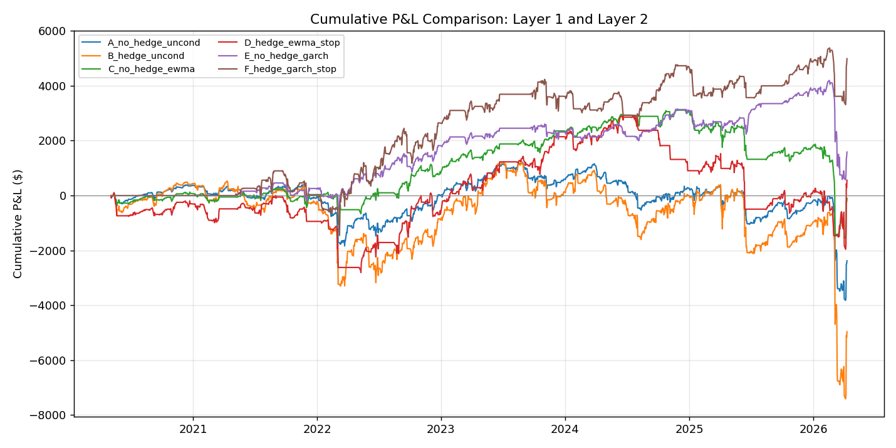
Cumulative P&L — All Methods
GARCH-timed strategies (E, F) extend the equity curve through 2024–25 where EWMA-timed strategies stall.
MSQF · Time Series Econometrics Final Project

Slide 14
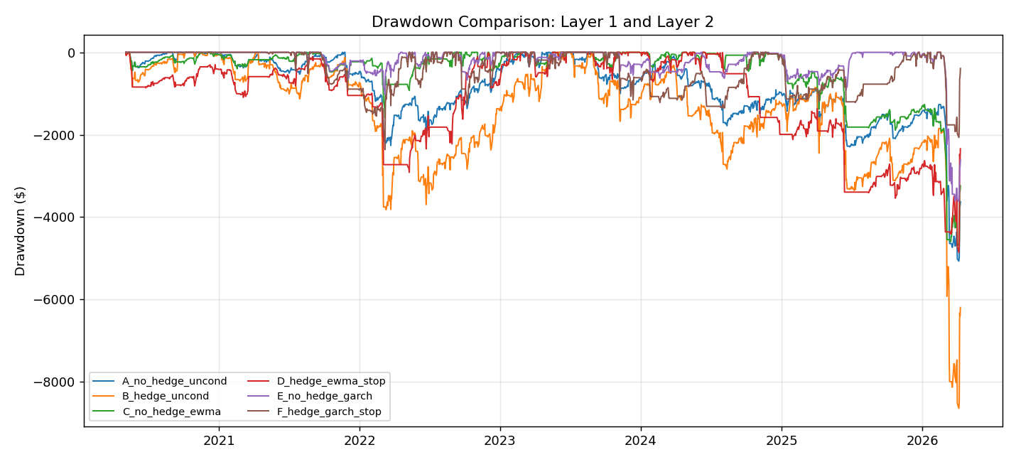
Drawdown Comparison
Hedged + GARCH (F) keeps the deepest drawdown at ~$2,400 vs ~$8,600 for the naked hedged baseline (B).
MSQF · Time Series Econometrics Final Project

Slide 15
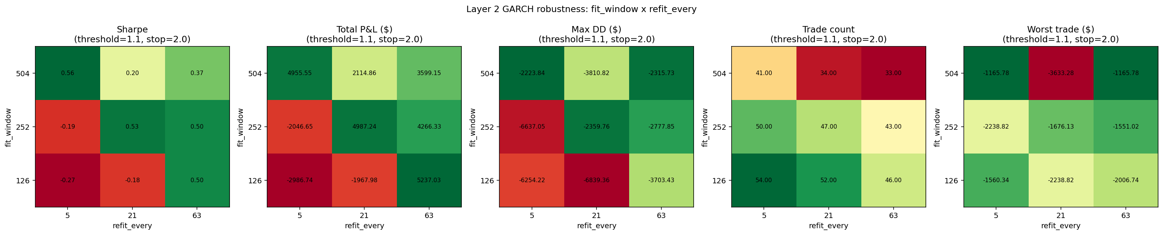
Robustness — GARCH Fit Window × Refit Frequency
Sharpe stable across most W × R cells. Failure mode: short window (W=126) + frequent refits (R=5) overfits the recent regime.
MSQF · Time Series Econometrics Final Project

Slide 16
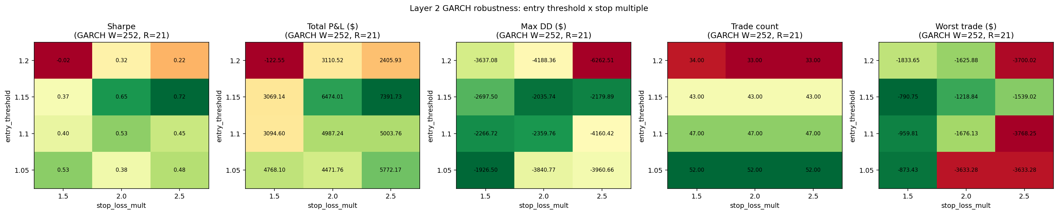
Robustness — Entry Threshold × Stop-Loss Multiple
At W=252 / R=21, Sharpe is positive across nearly all (threshold × stop) cells — the baseline is not a single lucky setting.
MSQF · Time Series Econometrics Final Project

Slide 17
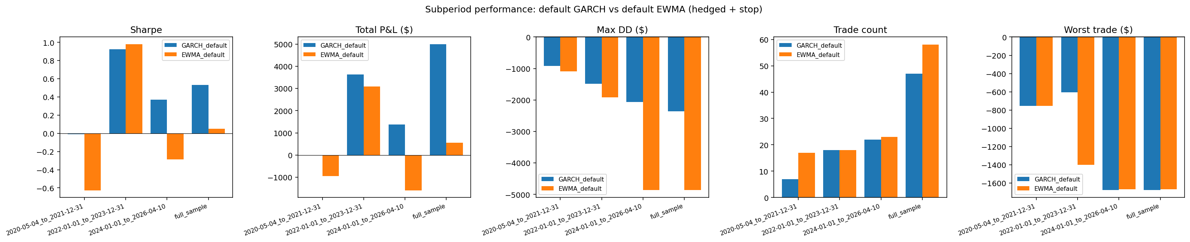
Robustness — Subperiod Performance
GARCH-default is positive in every subperiod; EWMA-default is propped up by 2022–23 alone and negative in 2024–26.
MSQF · Time Series Econometrics Final Project

Slide 18
Robustness — What the Tests Tell Us
The headline GARCH result survives sensible perturbations
108-cell GARCH grid: fit window {126, 252, 504} × refit {5, 21, 63} × threshold {1.05, 1.10, 1.15, 1.20} × stop {1.5, 2.0, 2.5}.
Sharpe distribution: mean +0.17, median +0.23, range −0.71 to +0.77.
68% of cells are profitable; 19/108 beat the published 0.53.
Default cell sits inside the bulk, not at an extreme.
EWMA grid (36 cells) is bimodal-flat: median Sharpe ≈ 0.04, max 0.45.
Confirms GARCH dominates EWMA across the parameter space, not at one point.
Subperiod splits show GARCH is positive in 2020–21, 2022–23, and 2024–26;
EWMA is negative in 2020–21 and 2024–26 — its full-sample 0.05 leans on 2022–23 alone.
Bottom line: the GARCH result is structurally stable, not a parameter artefact.
MSQF · Time Series Econometrics Final Project

Slide 19
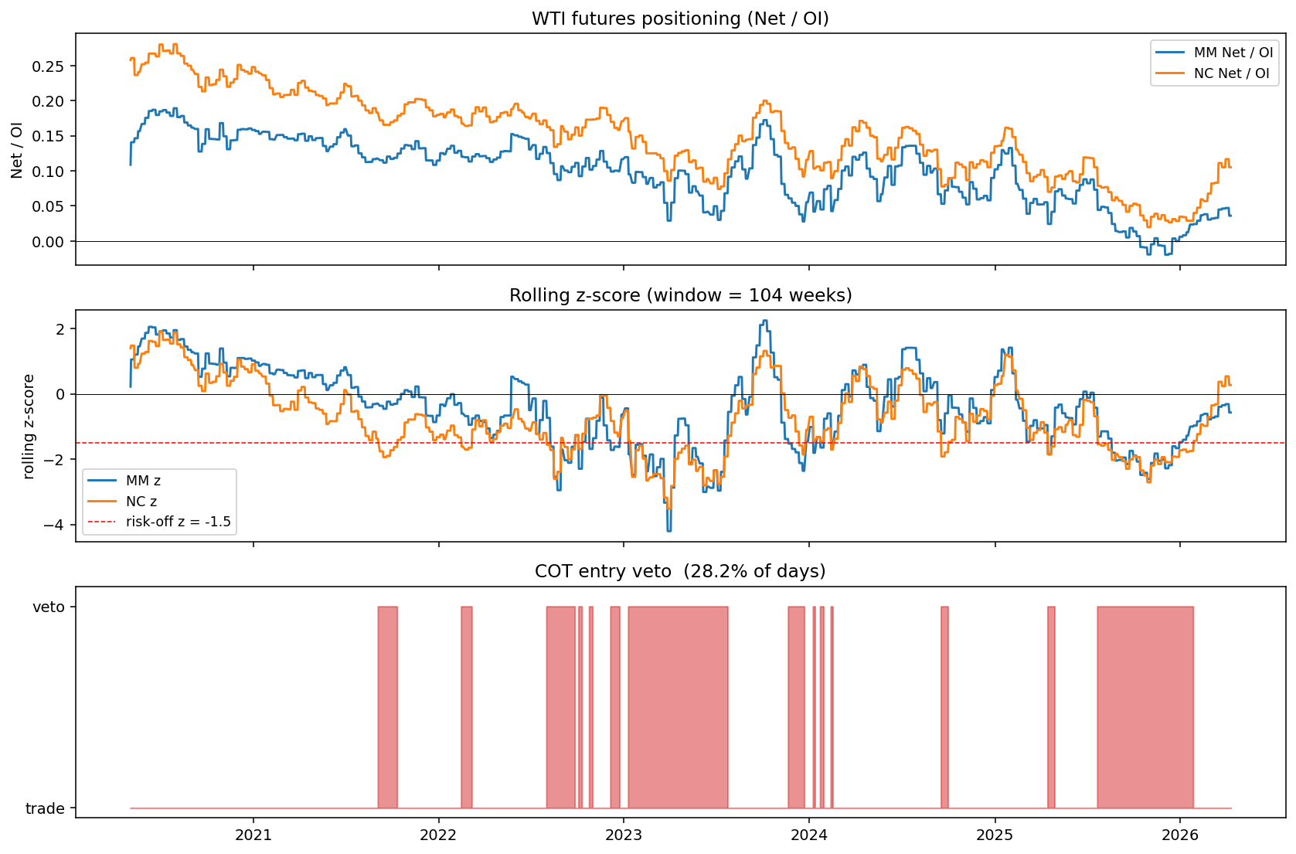
COT Positioning — Exploratory Risk Filter
Net positioning, rolling z-score, and the resulting veto window
CFTC weekly disaggregated report:
Managed Money (MM) Net / OI — speculator positioning.
Non-Commercial (NC) Net / OI — broader speculator class.
Hypothesis: do not sell vol when speculators are extremely short.
Crowded short positioning has historically preceded sharp vol expansions.
Construction:
Rolling 104-week z-score of MM and NC Net / OI.
Risk-off veto if MM-z OR NC-z < threshold.
7-day release lag applied — uses only reports public by trade date.
Layer 3 strategy G = Layer 2 strategy F + COT veto.
MSQF · Time Series Econometrics Final Project

Slide 20
Layer 3 Result — COT Filter (Exploratory)
No COT cell beats the unfiltered GARCH baseline (Sharpe 0.53)
z-window (w) | risk-off z | veto % | Trades | Total P&L | Sharpe | Max DD
52 | −1.0 | 45% | 31 | +$2,982 | +0.32 | −$3,235
52 | −1.5 | 25% | 39 | +$1,727 | +0.20 | −$2,772
104 | −1.0 | 47% | 26 | +$564 | +0.06 | −$3,069
104 | −1.5 | 28% | 37 | +$3,769 | +0.39 | −$3,414
156 | −1.0 | 48% | 26 | +$1,244 | +0.13 | −$4,997
156 | −1.5 | 29% | 35 | +$1,912 | +0.23 | −$2,604
F (no COT) — baseline | — | 0% | 47 | +$4,987 | +0.53 | −$2,360
Filter throws away enough good trades that gross premium collected falls more than it cuts losers — net Sharpe drops in every cell.
Honest negative result: with this construction, COT positioning is orthogonal to the GARCH IV-vs-realized signal but not additive on top of it.
Reported as exploratory rather than production — sensitivity grid is the main message.
MSQF · Time Series Econometrics Final Project

Slide 21
Limitations
Where the result is fragile
Capital and margin: short straddles are short gamma and short vega; broker margin easily dwarfs notional premium received.
The dollar P&L numbers are per-1-contract — capital intensity is the unmodelled cost.
Tail risk: a single fat-tail event can erase years of premium. Stop-loss caps the trade-level loss but not the gap risk overnight or on weekend headlines.
Transaction-cost model is simple: 5 bps on hedge notional, mid-quote MTM, bid/ask on entry/exit. Real execution would face slippage and venue spreads.
Model risk:
EWMA — single λ, no fat-tail or asymmetry.
GARCH — symmetric, normal innovations; misses leverage effect and jumps.
Sample size: ~6 years and ~50 trades per timed strategy — wide confidence intervals around the headline Sharpe of 0.53.
Parameter risk: 144-cell sweep helps but is not a true cross-validation.
Data scope: USO ≠ WTI futures; tracking error from roll, expense ratio, and creation/redemption mechanics is not modelled.
MSQF · Time Series Econometrics Final Project

Slide 22
Potential Next Steps
From a single-asset prototype to a robust, capacity-aware sleeve
Expand robustness:
Walk-forward / out-of-sample splits beyond simple subperiod cuts.
Bootstrap confidence intervals on Sharpe by resampling trades.
Improve the volatility model:
EGARCH and GJR-GARCH for the leverage effect (likely larger in equities/oil).
HAR-RV using realized variance from intraday data, if obtainable.
Heavier-tailed innovations (Student-t) inside the same arch framework.
Richer signals:
Option skew and term-structure features (vol-of-vol, contango of variance).
COT change-in-position rather than levels (momentum of speculator flows).
Use COT as a sizing input rather than a binary veto.
Execution and capital realism:
Margin-aware sizing; explicit capital base; risk budgeting per trade.
Slippage scaling with size and realised vol; weekend gap modelling.
Extend universe: SPY, GLD, TLT vol-selling sleeves; broader commodity vol.
MSQF · Time Series Econometrics Final Project

Slide 23
Key Takeaways
Timing matters most — and GARCH does timing better than EWMA in this sample
Unconditional short-vol on USO loses money over 2020–26.
Delta hedging without a timing edge converts gamma into negative P&L.
EWMA timing flips the strategy from clearly losing to roughly break-even — timing is the main source of edge, not hedging.
Rolling GARCH(1,1) substantially improves on EWMA: Sharpe rises from 0.05 → 0.53, max drawdown halves, and the curve is positive in every subperiod.
Robustness sweep (108 GARCH cells) shows the result is structurally stable, not a single-point fluke; failure modes are interpretable (short window + frequent refits).
COT positioning is interesting but doesn't add value as a binary veto on top of GARCH — useful exploratory signal, not a production filter in this version.
Honest scope: the project is a forecasting study with a tradable yardstick. The volatility model quality is what drives the differences between layers.
MSQF · Time Series Econometrics Final Project

Slide 24
Thank you
Questions and discussion

