Slide 1
Group 5 - Project

Slide 2
US E-Commerce Trend
1
Over the past 10 years

Slide 3
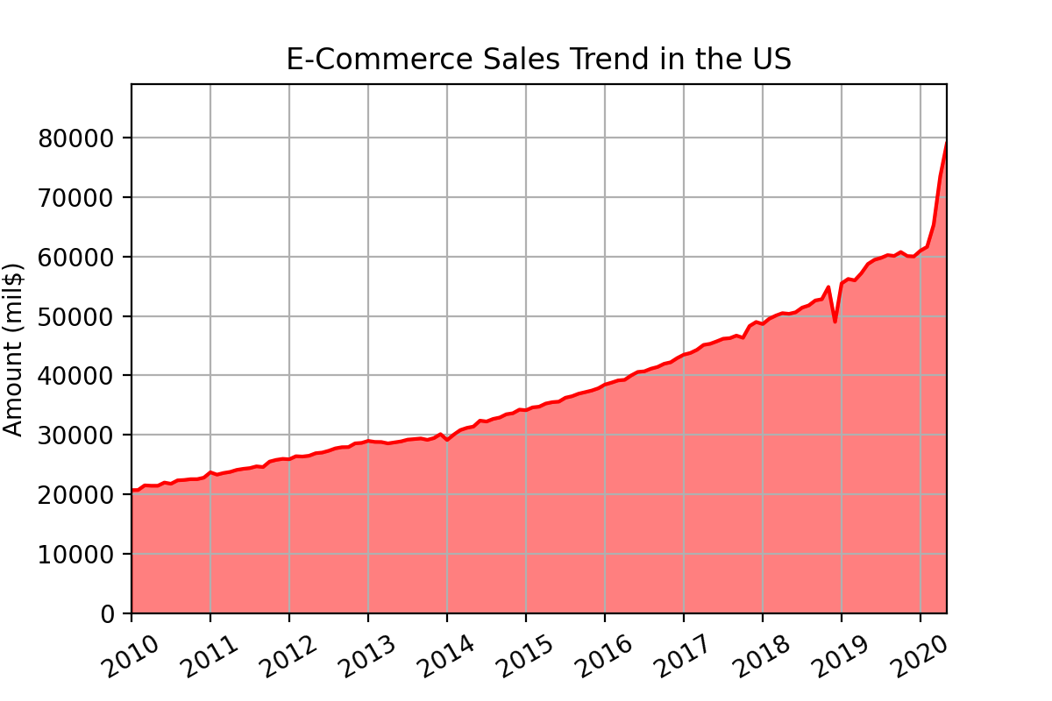
Sales Trend Over the past 10 years
Notes:
Our goals are analyzing e-commerce sales trends over the past 10 years, and finding out the effects of COVID-19 on the E-commerce sales trend.

Slide 4
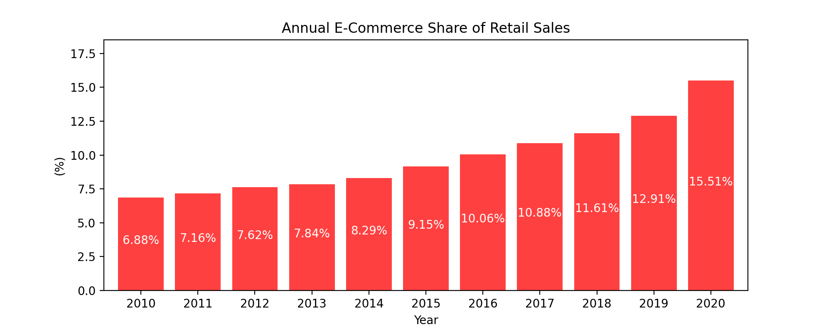
Annual E-Commerce Share of Retail Sales
Notes:
Our goals are analyzing e-commerce sales trends over the past 10 years, and finding out the effects of COVID-19 on the E-commerce sales trend.

Slide 5
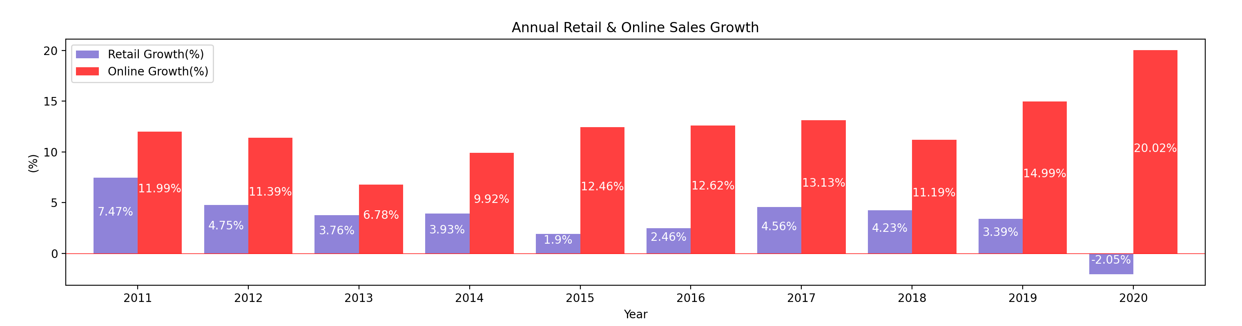
Comparing Retail to Online Sales Growth
* 2020 : Jan. - May
Notes:
Our goals are analyzing e-commerce sales trends over the past 10 years, and finding out the effects of COVID-19 on the E-commerce sales trend.

Slide 6
Sales Trend Summary
a
B
c
Notes:
Our goals are analyzing e-commerce sales trends over the past 10 years, and finding out the effects of COVID-19 on the E-commerce sales trend.

Slide 7
COVID19 impacting on E-Commerce
2

Slide 8
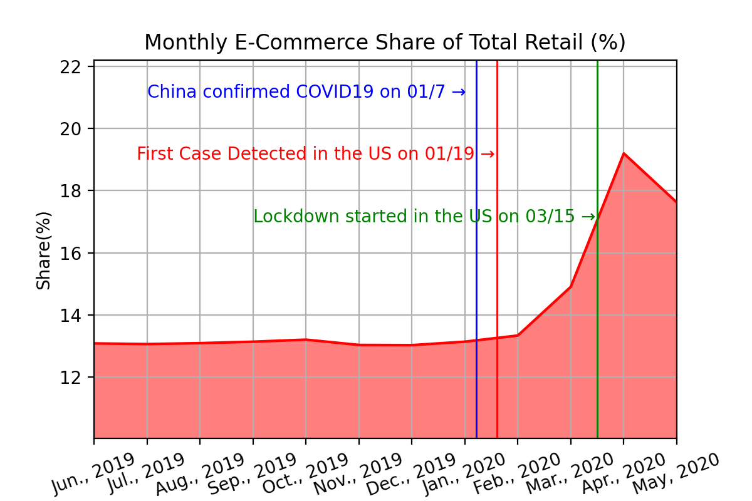
Monthly E-Commerce Share
Notes:
Our goals are analyzing e-commerce sales trends over the past 10 years, and finding out the effects of COVID-19 on the E-commerce sales trend.

Slide 9
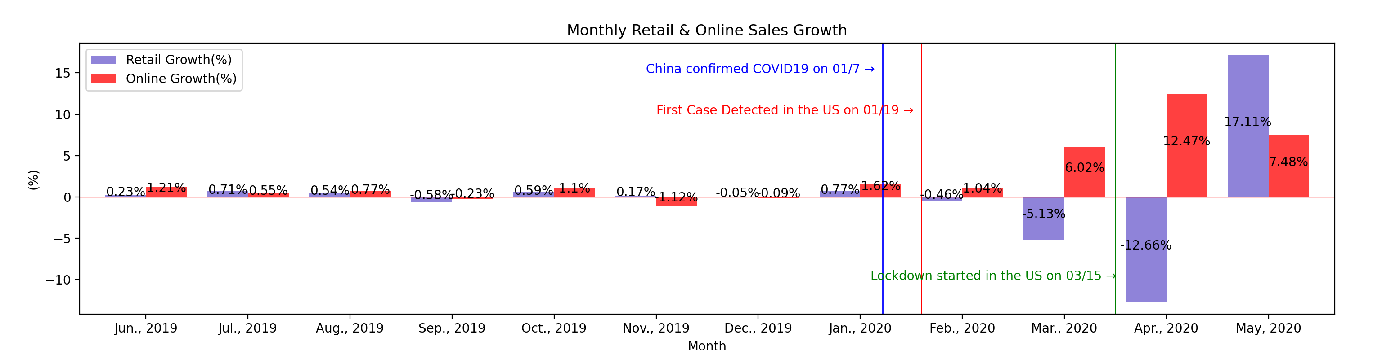
Monthly Retail and Online Sales Growth
Notes:
For that, we need datasets or apis to analyze, but unfortunately, we couldn’t find so far.

