Slide 1
sigstore policy controller
2023/01

Slide 2

Sigstore policy controller (1)
The policy-controller admission controller can be used to enforce policy on a Kubernetes cluster based on verifiable supply-chain metadata from cosign.
policy-controller also resolves the image tags to ensure the image being ran is not different from when it was admitted.
it will only validate resources in namespaces that have chosen to opt-in.
This can be done by adding the label policy.sigstore.dev/include: "true" to the namespace resource.

Slide 3
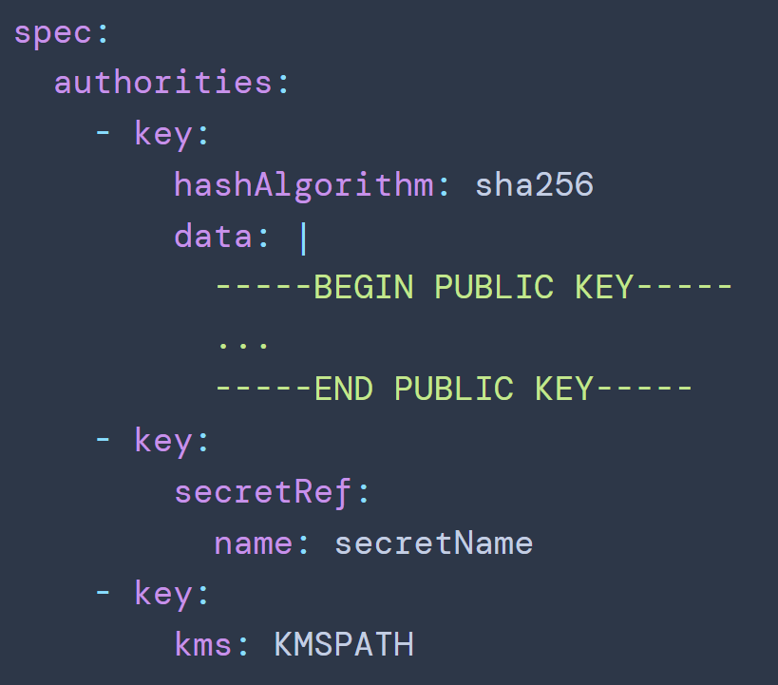
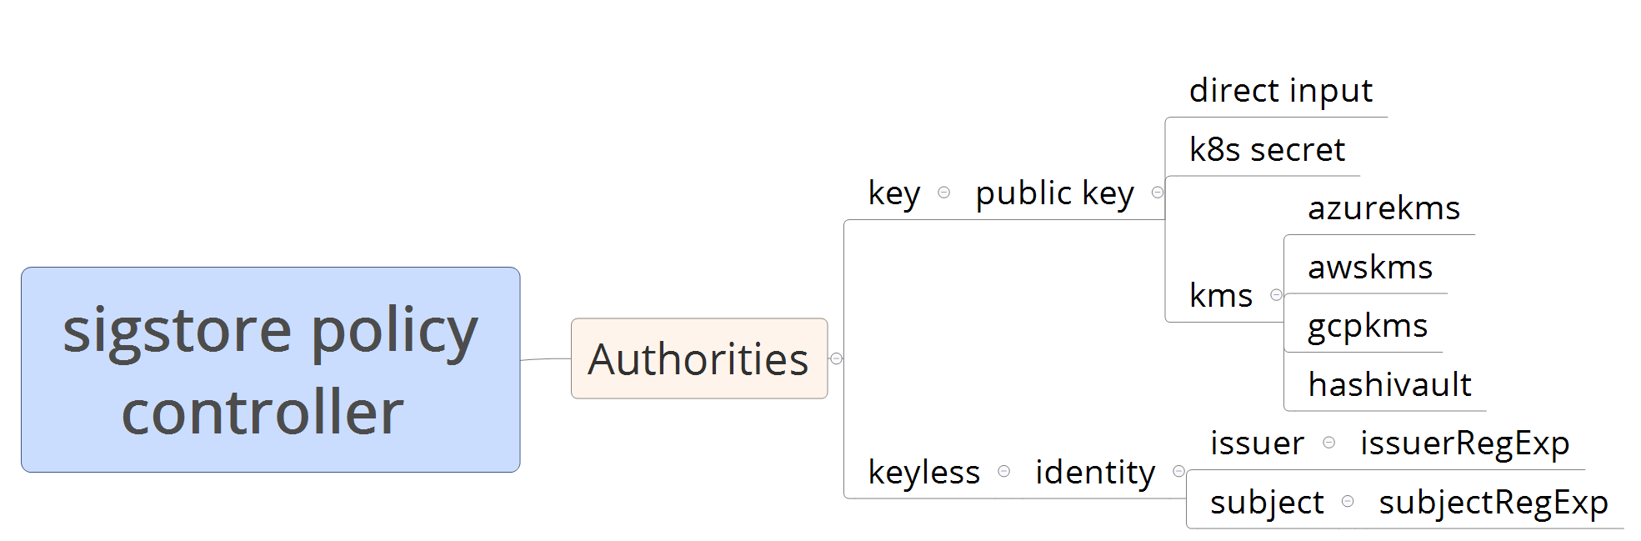
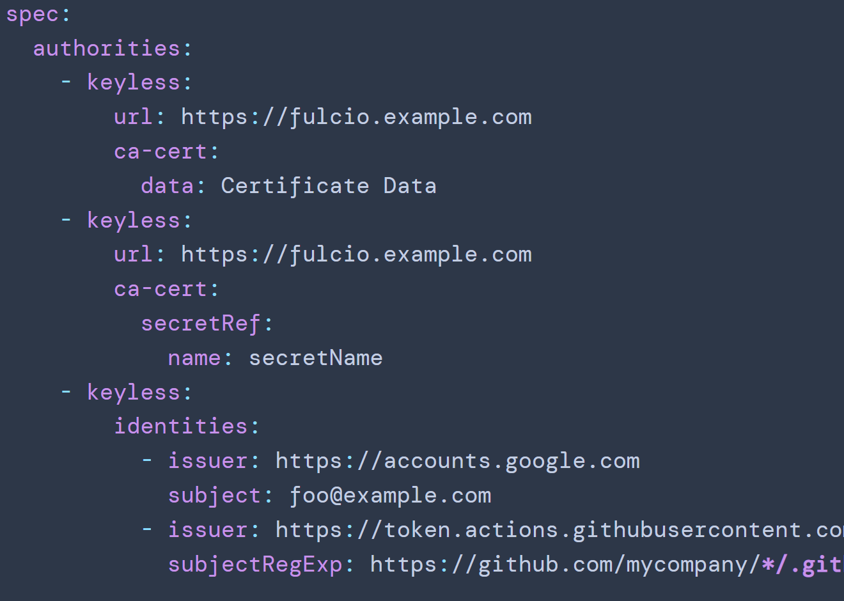
User specified policy

Slide 4
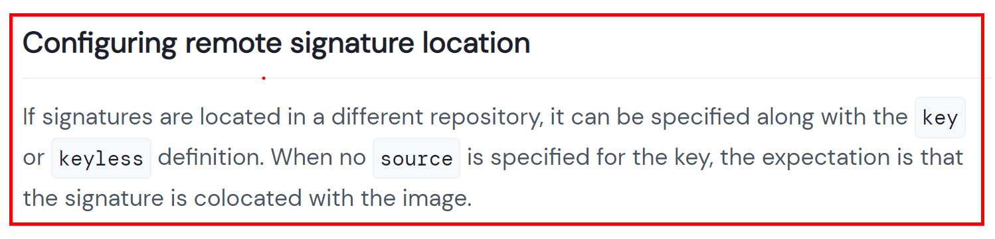
Sigstore policy controller (2)
Configuring remote signature location
If signatures are located in a different repository, it can be specified along with the key or keyless definition. [Reference]
Configure SignaturePullSecrets
If the signatures / attestations are in a different repo or they use different PullSecrets
Configuring Certificate Transparency Log
CTLog specifies the URL to a certificate transparency log that holds signature and public key information.

Slide 5
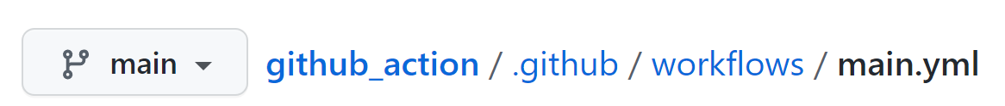
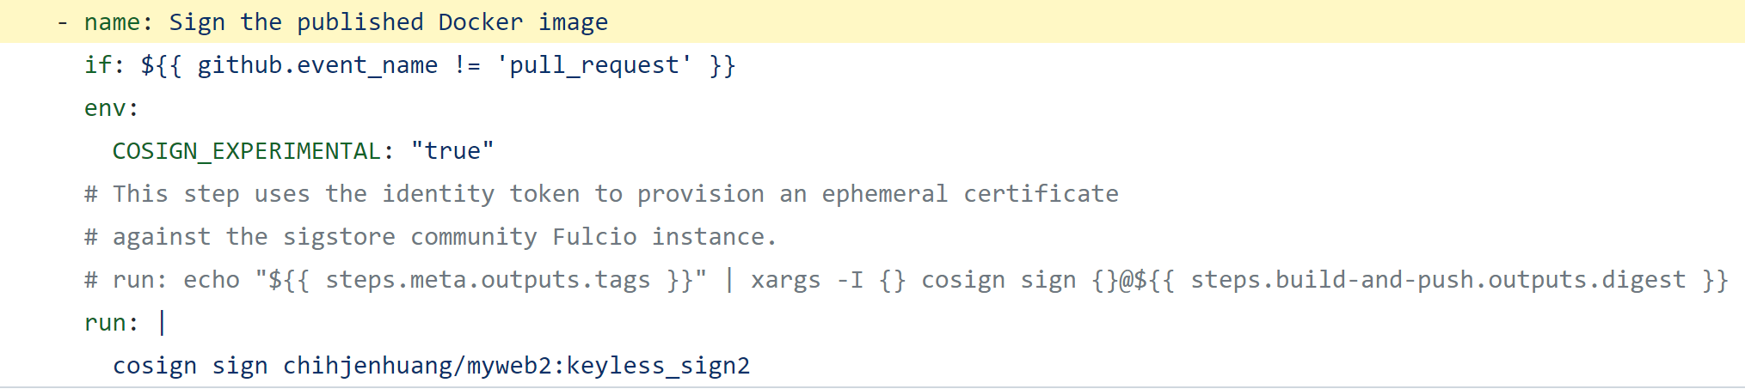

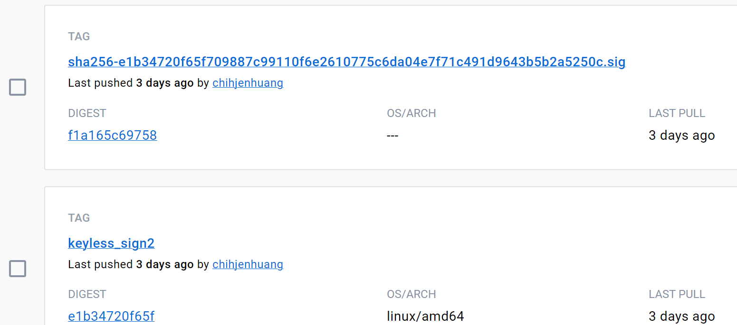
sign in GitHub Action (1)

Slide 6
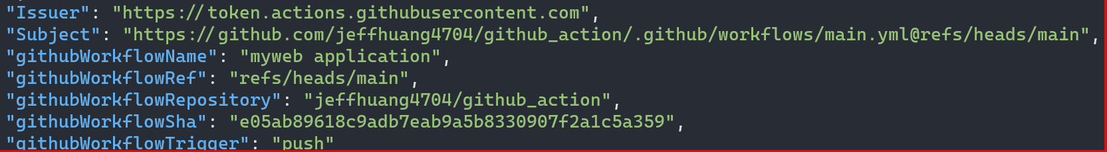
sign in GitHub Action (2)

