Slide 1
UI performance for v5.2
2023/03

Slide 2
Agenda
Background
cases and its simple description
Improvement plan

Slide 3
Background
Some pages has big data in nature and REST Api return in one shot
Big size return issues
User experience : slow initial page loading
Funcaionality: cause problem due to ingress controller size limit
Case | Description
#6276 | Error while trying to load Vulnerabilities Page
#6186 | Security Risks > Compliance failed to load Manager backend service is throwing multiple timeout for the request HttpRequest
#6183 | slow webUI loading time experience - load "security risks -> vulnerabilities"
#6152 | Security Risks > Vulnerabilities, NeuVector takes 15-20 seconds to respond
#6090 | Long image compliance page is slow
#5423 | Vulnerabilities tab takes almost 8 minutes to load.
#5404 | ui is unable to do anything display large number of groups (load the 150k groups)

Slide 4


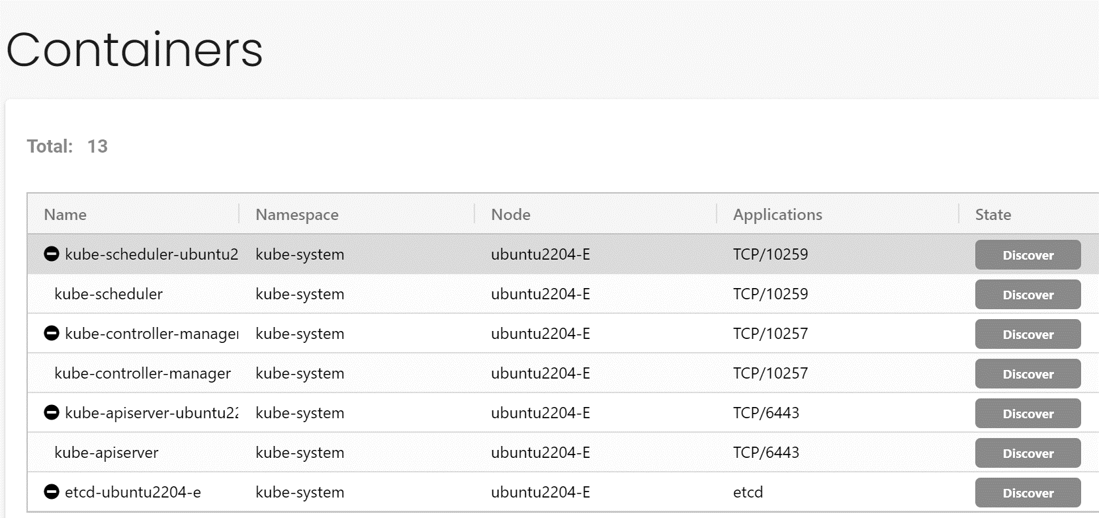
Improvement plan
Assumption
We want to keep the most part of current UI layout
The table still contains all data (current behaivor)
Instead of do a generic solution, do specific targeted solution for slow pages
according to reported cases
Leverage existing batch load (pagination) design
all data still shown in page
ex: container page
Dividing big part into chunks
CVE (in vulnerability page)
Add summary for quick filter, so it can be searched in initial batch load
combine required fields

Slide 5
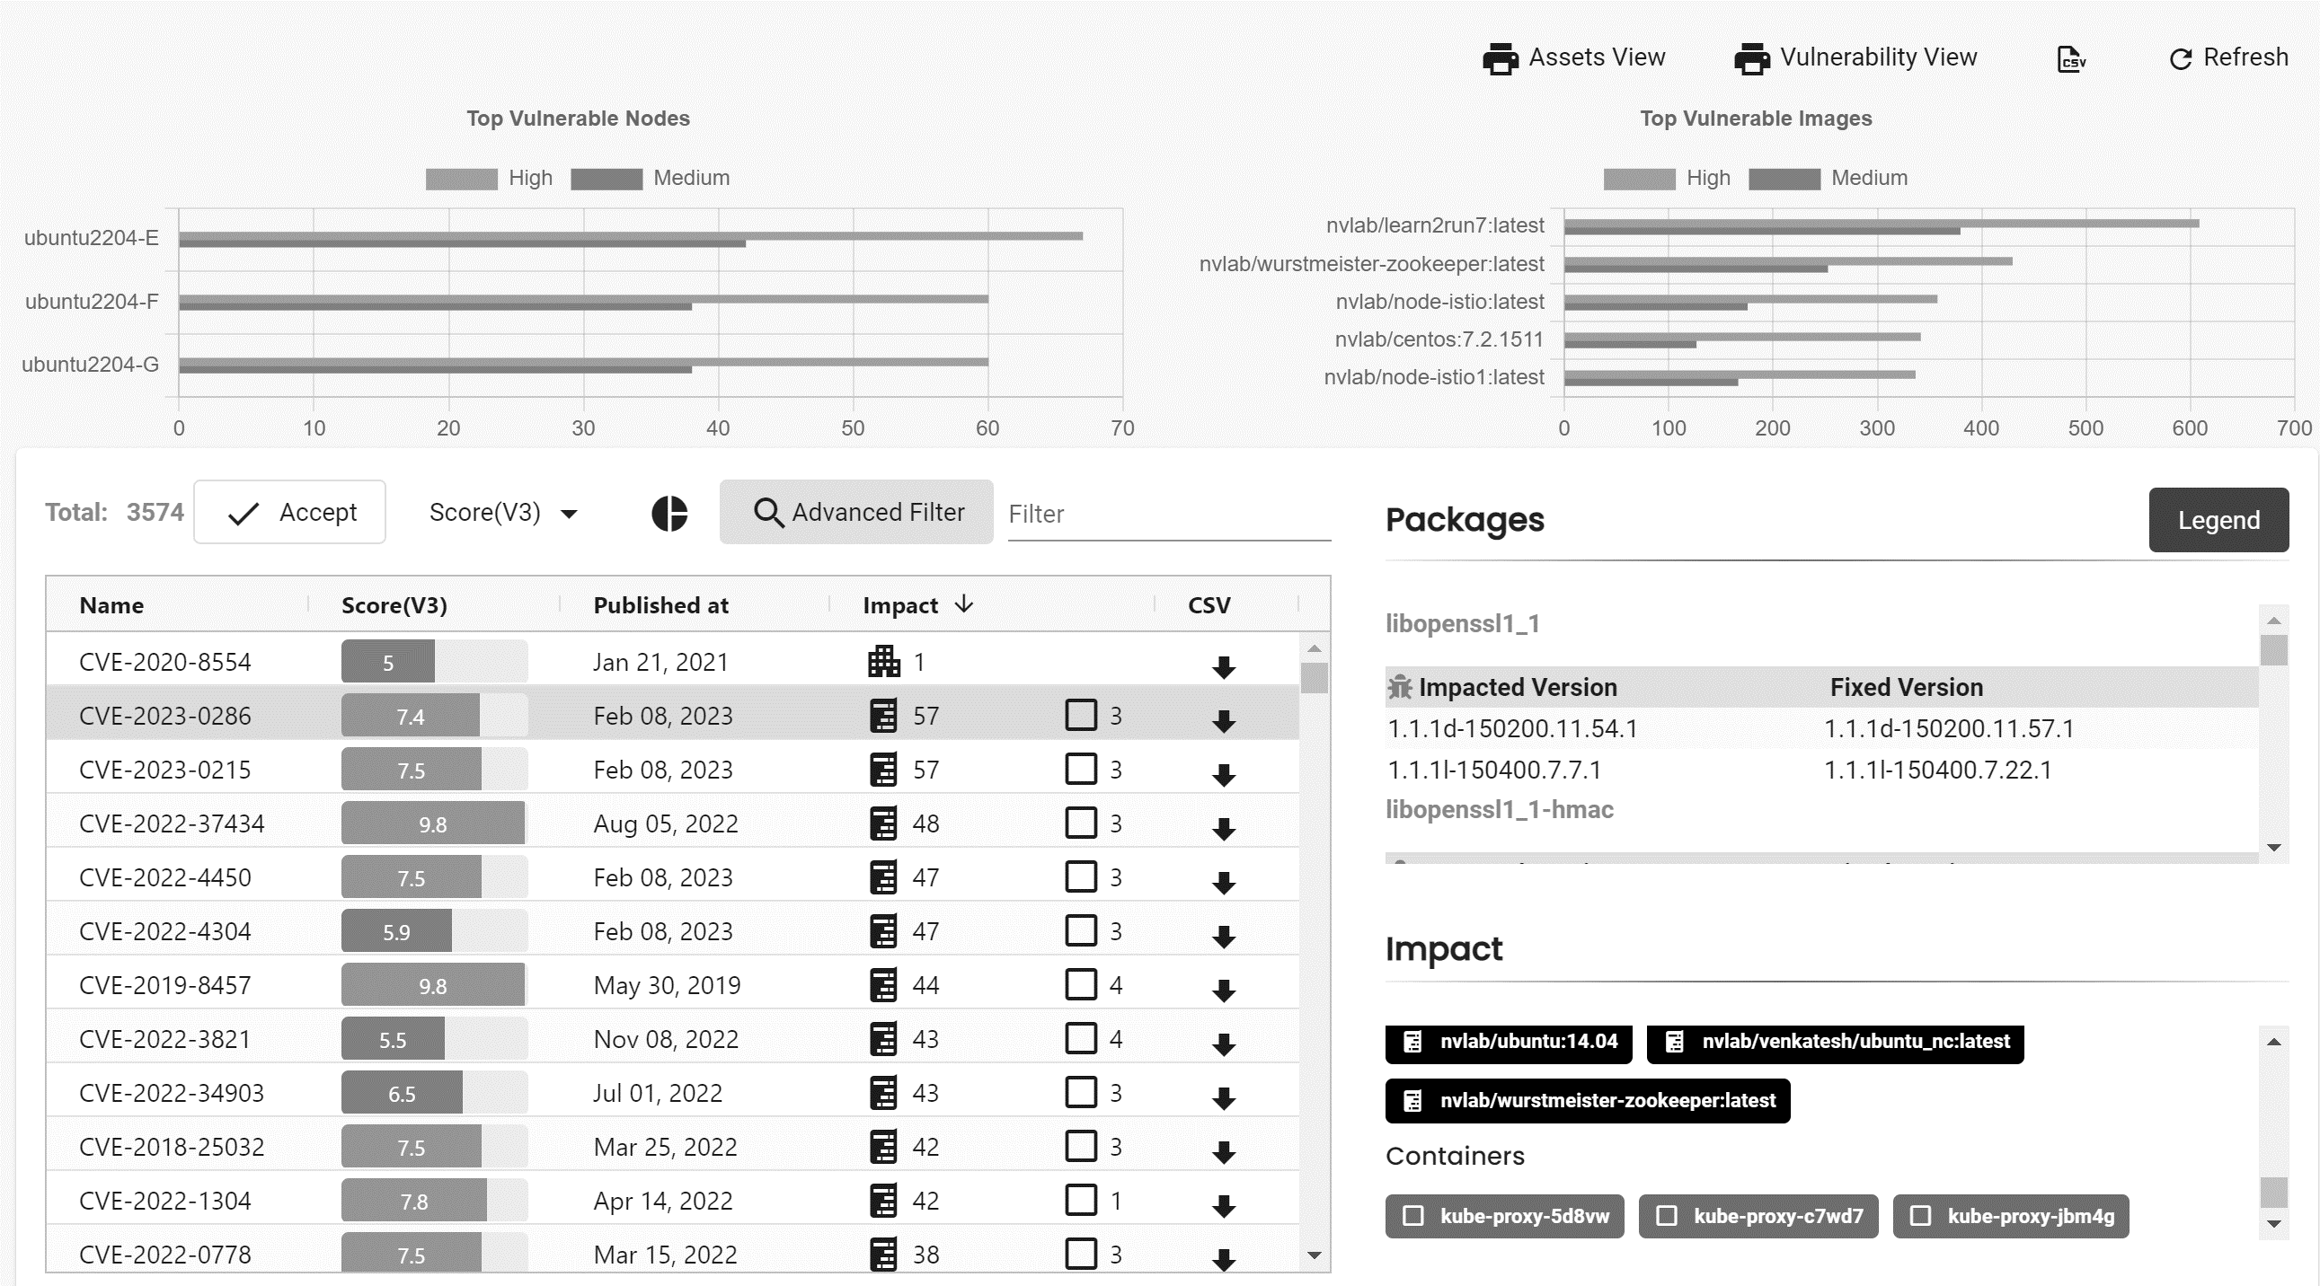
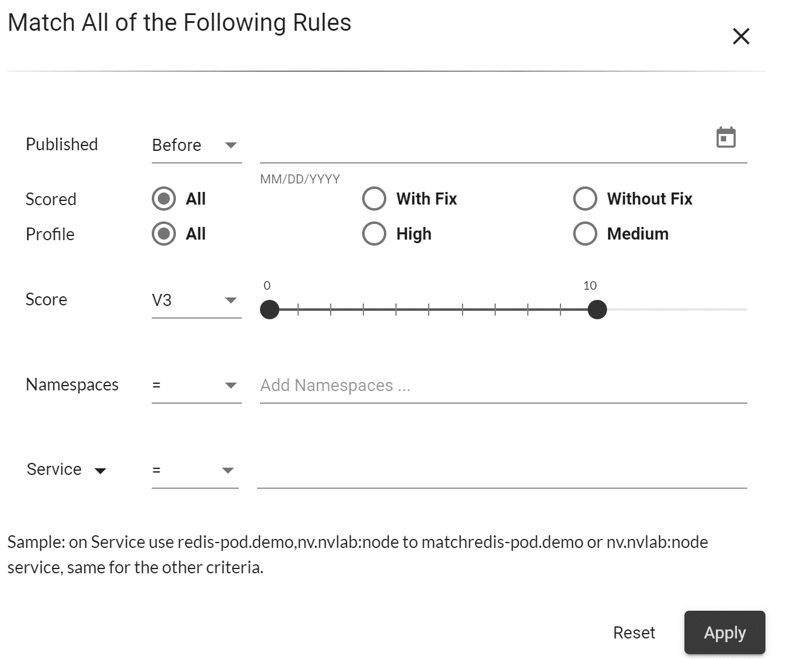
Security Risks > Vulnerabilities
advanced filter
quick filter
full export
partial export
advanced filter

Slide 6
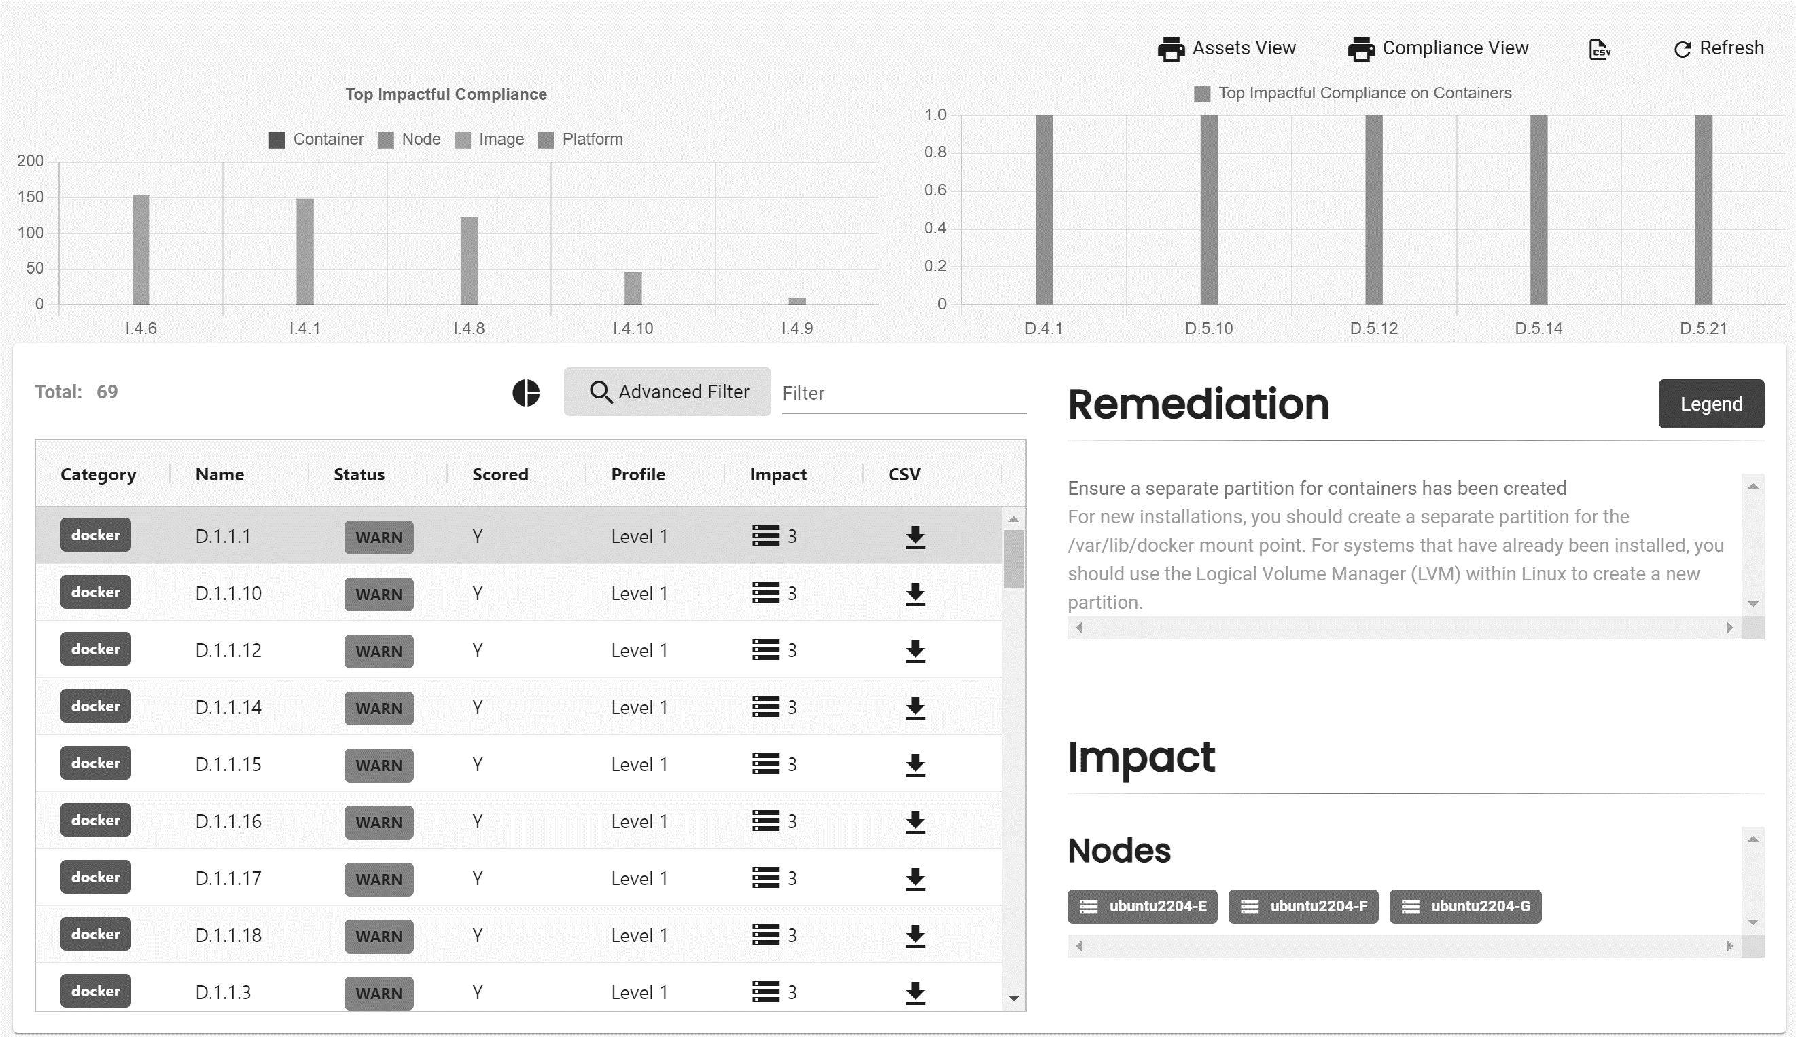
Security Risks > Compliance

Slide 7
add groups page

Slide 8
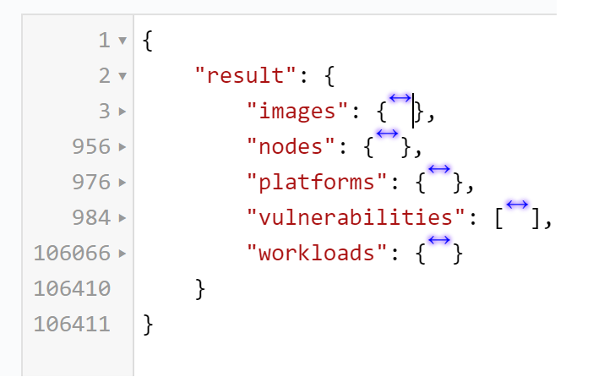
endpoint: v1/scan/asset

