Slide 1
Hypermedia Design
Seven-step design of an
agent performance API
Assignment 6.2 Jeff Shepherd

Slide 2
Topics
The use case: Agent performance
The seven-step design procedure
Return on investment
Summary

Slide 3
Use cases: Reporting agent performance
The following are fictional use cases for the real world problem of supplying agent statistics in a call-center environment.
GCC, Generic Call Center, would like to provide an API that would support reporting of agent statistics.
Use case 1: Agents want to know how they are performing – does their handle-time meet goals? Are they managing personal breaks well? Will they make bonus?
Use case 2: Supervisors want to know if any agent requires coaching to improve performance.
Use case 3: Operations managers want to gauge agent workload for adjusting schedules and staffing levels.

Slide 4
The Seven-Step Design Procedure
The seven-step design procedure includes the following:
List the semantic descriptors
Draw a state diagram
Reconcile names
Choose a media type
Write a profile
Implement the API
Publish the billboard URL

Slide 5
List Semantic Descriptors
Descriptors identify an item
Standard, recognizable descriptors should be used when possible. Examples include “collection” and “item.”
In our example API the following are the semantic descriptors
Agent – an employee of GCC
Id – the employee’s ID
fullName – the employee’s full name
Collection – a list of status keys
Item – an item containing a code and duration
Code – a code that indicates the agent status, like “onInteraction,” and “onBreak.”

Slide 6
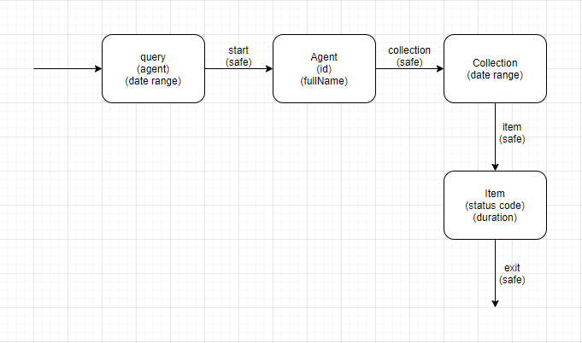
Draw a state diagram
The second step is to draw a state diagram
The diagram will show link relations between descriptors
Every http request made is represented by an arrow
The diagram indicates the home page with an arrow from “out of nowhere.”

Slide 7
Reconcile names
Custom names can be used
However, it may be useful to re-use industry and domain names that are well defined.
For example, IANA (Internet Assigned Numbers Authority), has defined a list of link relation names such as Collection and Item
Although, unwritten, identifiers like “agent” are in common use in the call center industry.
Specific recommendations are collection and item for collections; replies for messages; first, last, next, and prev for pagination; and edit and edit-media for unsafe operations.
Uncommon names will need to be defined.

Slide 8
Choose a media type
Examples of media types include Collection+JSON, AtomPub, Odata, HTML, and HAL.
Read-only APIs should consider HTML, HAL, or JSON-LD
If unsafe transitions are included, consider adding Hydra or using Collection+JSON
Collection+JSON is the media type chosen by the fictional API of this presentation.
It allows simple, minimal representation like this example:
{ “collection” :
{
“agent”: { {“id”: <id>}, {“fullName”: <fullname>}}
}
}

Slide 9
Write a profile
Server responses will include link to one or more profiles
The profile explains the API semantics
If you re-used a profile from another source, include a link to that source.
The profile can be machine-readable or only human-readable.
A human readable profile is simply a web page defining the link relations and descriptors
Machine readable profiles will need to use ALPS, JSON-LD context or XMDP microformat.

Slide 10
Implement the API
Implementation details will depend on the language and the developers writing the API.
Our example API would include methods to return representations for the following: an agent, an agents collection of status keys within a date range, and individual status items from the collection.
Also, in our example, access would be restricted based on need to know. For example, agent Jack does not need access to agent Jill’s statuses but their supervisor needs access to both agent’s stats.
Following the You-Ain’t-Gonna-Need-It (YAGNI) principle, it should implement only the required features.

Slide 11
Publish
Publish the billboard URL
Publish the profile
Register new media types, if any
Register new link relations
The example API is designed only for internal use by the company, Generic Call Center. So in this case, the internal documentation would be what is required.
This particular API would probably only be used by the folks who wrote it, but could be expanded.

Slide 12
Return on investment
The return on the investment is that the API is accessible to others with minimal fuss
This one API would could be used multiple applications, reducing duplication of effort and duplication of code.
The API can be made available to clients and business partners
Through the use of profiles, others can determine the purpose of the API and how to use it.
The API can be expanded to include new functionality in the future without altering existing functionality and with established semantics.

Slide 13
Sources
Amundsen, M. (2013). Collection+JSON Document Format. http://amundsen.com/media-types/collection/format/
Richardson, L., & Amundsen, M. (2013). RESTful Web APIs. O’Reilly

