Slide 1


Slide 2
What is DevOps?
Stands for ‘development and operations’.
DevOps is an operational philosophy that promotes better communication between development team and operations team as more elements of operations become programmable.
The DevOps approach seeks to meld application development and deployment into a more streamlined process by automating some of the operation team’s responsibilities.
Helps the operations’ tasks to keep in pace with agile software development.

Slide 3
What is Chef?
Chef is an automation platform that configures and manages your infrastructure.
Chef transforms infrastructure into code.

Slide 4
How Chef works?
Chef Framework is a combination of Chef Server, nodes and workstation.
Chef server manages the nodes that make up the infrastructure.
Chef-client tool must be installed on all the nodes.
Chef Server contains the configurations information called Cookbook.
<contd..>

Slide 5
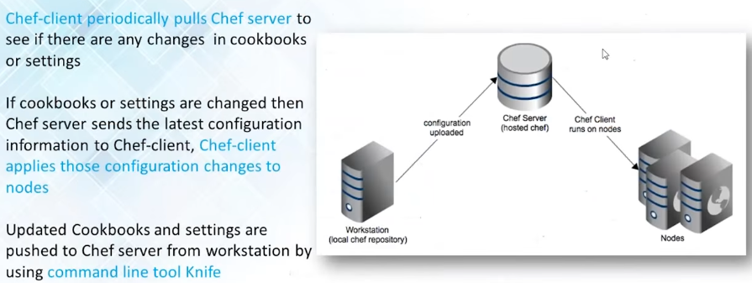

Slide 6
Open Source Chef vs Enterprise Chef
Open Source Chef
No support
Wide user community
Enterprise Chef
Provides Chef add-ons(eg Reporting, Analytics etc.) and support
2 types : Hosted Chef (chef server is cloud hosted and completely managed by Chef) and On Premises Chef (chef server is setup within customer’s private infrastructure)
Free upto 5 nodes

Slide 7
System Requirements
Chef Server can be installed only on 64 bit linux machines
Chef Client supports all platforms

Slide 8
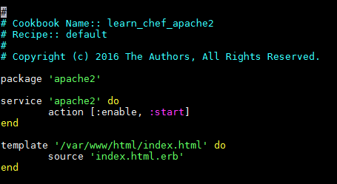
Recipies and Cookbooks
A recipe is a file that contains the chef code. It has ‘.rb’ extension.
Cookbooks are collection of recipe files. The recipe file called ‘default.rb’ will be the first recipe file to get executed.

Slide 9
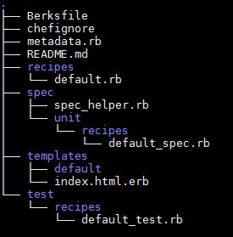

Slide 10

Chef Resources
A resource is a statement of configuration policy that describes the desired state for a configuration item.
Egs of chef resources are package, service, templates, directory etc.

Slide 11

Chef Attributes
Create a directory ‘attributes’ in cookbook. Inside it create default.rb file
Helps us to specify harcoded values that need to be used in the chef code.
<%= default[‘mysql’][‘username’] %> will fetch the value of that variable.
Chef also provides some inbuilt attributes that provide information of the nodes. For eg <%= node['ipaddress'] %> will output the corresponding ip address of the node when chef code runs in that node.

Slide 12
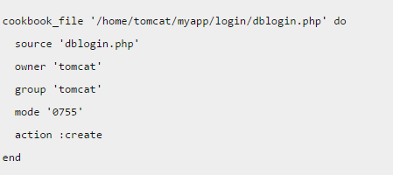
Chef Files Server
Create a directory called files in your cookbook and place the static files that you want to copy into your nodes. Eg tomcat config files
Inside recipe file we could refer to these files :

Slide 13
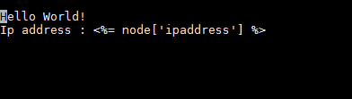
Template files
Templates are used to generate dynamic content from static files.
Create a directory called templates in your cookbook and create the template files in that directory. The extension for template files is ‘.erb’
Eg : Creating dynamic index file for tomcat
index.html.erb :

Slide 14

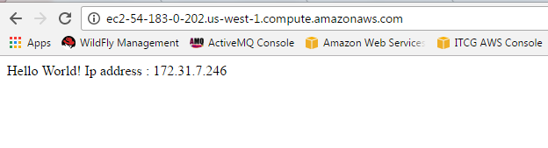

Slide 15
Chef Supermarket
Contains cookbooks contributed by chef developers
https://supermarket.chef.io/
Could reuse these cookbooks for our requirement
To download a cookbook into our workstation execute the command :
knife cookbook site download <cookbook-name>

Slide 16
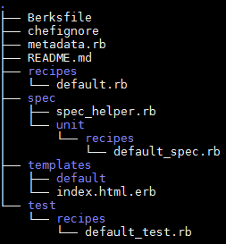
Setting up
Switch to sudo user and install chef development kit on the Chef workstation.
Make a work directory for chef. We will put all the cookbooks and fire the chef commands from this directory.
Create a directory called cookbooks and execute the command : chef generate cookbook <cookbook-name>
learn_chef_apache2 :

Slide 17

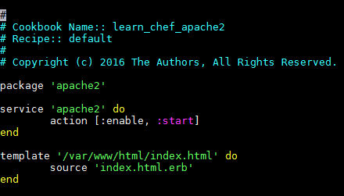
4) Generate a template file and edit its contents : chef generate template <cookbook-name> <file-name>
index.html.erb :
5) Edit the default.rb file.

Slide 18
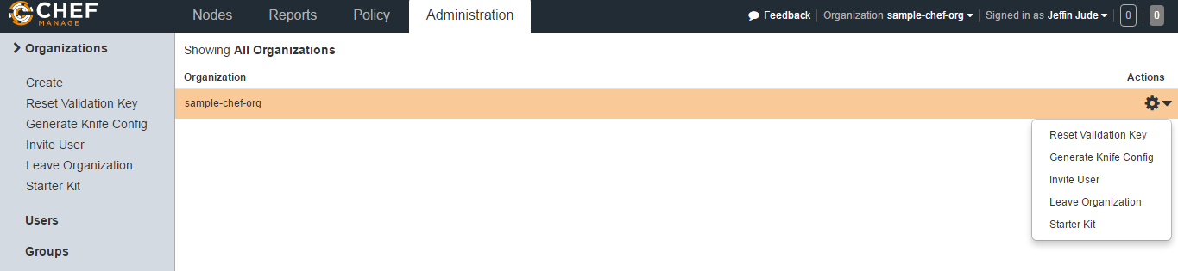
6) Signup for a hosted chef server in ‘manage.chef.io’.
7) Create an organization.
8) Download the starter kit for that organization. It contains the pem files and other credentials to connect to this chef server.

Slide 19
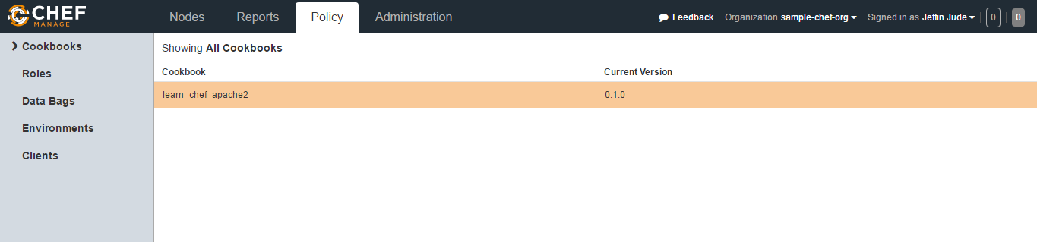
9) Extract the contents of the downloaded chef-starter kit and copy them into our chef working directory in the workstation machine. Chef starter kit contains the pem file which will allow the workstation to connect to the chef server.
10) Execute the command : knife cookbook upload <cookbook-name>

Slide 20
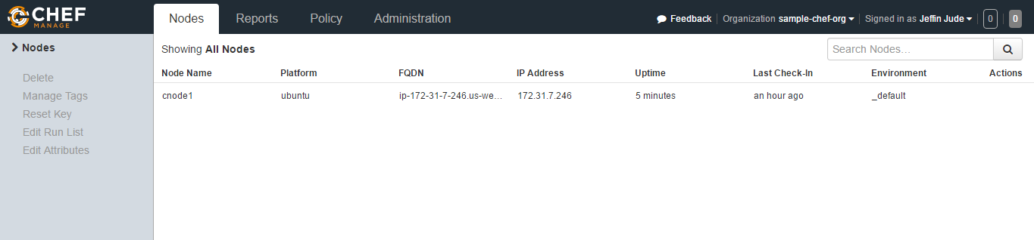
11) Connect a node to chef server so that the chef server could manage it.
knife bootstrap ec2-54-67-74-215.us-west-1.compute.amazonaws.com -x ubuntu -i /home/ubuntu/pemstoconnect/itcgbastion.pem --sudo --node-name cnode1 --run-list 'recipe[learn_chef_apache2]‘

Slide 21
12) On executing the bootstrap command for the first time chef-client will get automatically installed on the node machine.
13) Every 30 minutes the chef-client will run and sync in with the chef server.
To manually run chef-client in the node execute the command on the node machine :
chef-client --runlist 'recipe[<cookbook-name>]'

Slide 22
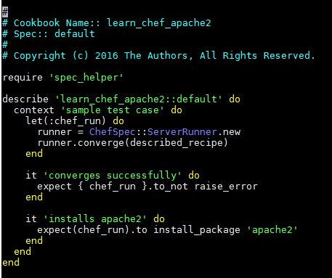
Unit testing recipies

Slide 23
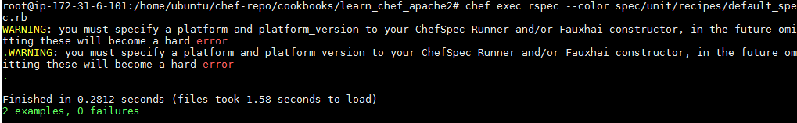
To run the unit test make sure you are in the cookbook directory and execute the command :
chef exec rspec --color spec/unit/recipes/default_spec.rb

Slide 24
Thank You

