Slide 1

MET 451: Aviation Meteorology
(3 Credit Hours)
Jeffrey N. A. Aryee (PhD)
Meteorology & Climate Science Programme
Department of Physics, KNUST, Ghana
e-mail: jeff.jay8845@gmail.com
https://github.com/jeffjay88/Aviation-Meteorology
Google Classroom Code: 63zl2i

Slide 2
LECTURE 7

Slide 3
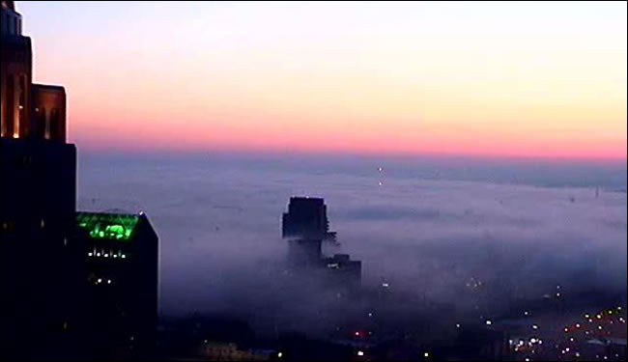
Synoptic Weather Considerations: Forecasting Fog and Low Stratus;
To assess whether a fog or stratus event is possible, you must evaluate the synoptic-scale influences that will drive the local conditions. Most of these are forced primarily by advective or dynamic processes (although radiation does play a role).
Radiation fog cannot form unless the necessary conditions and key ingredients coincide. When they do, radiative cooling and formation of a stable layer precede fog formation. Surface heat exchange is an important factor influencing these processes.

Slide 4
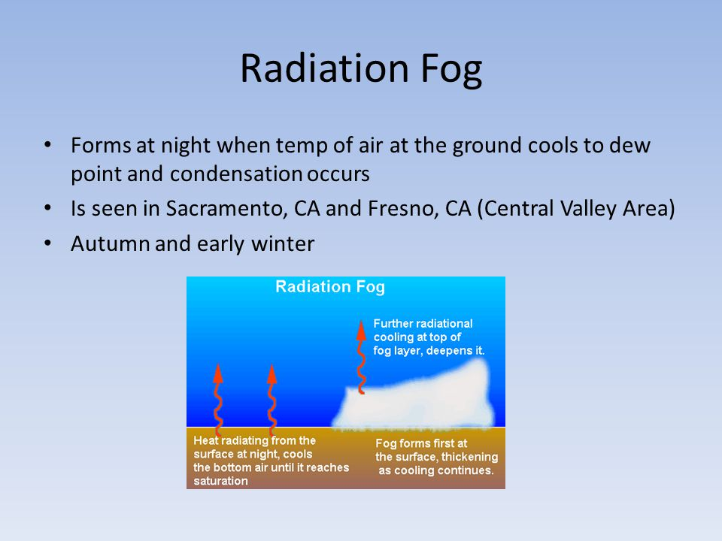
The key low-level ingredients required to generate a radiation fog are
moisture,
rapid cooling, and
calm or light winds.
Low-level anticyclones can create favourable conditions for radiation fog by suppressing surface winds and drying the air aloft through subsidence. Dry air aloft enhances radiative cooling at the surface.
Radiation fog is very unlikely to form unless there is sufficient moisture in the boundary layer. Such moisture may be advected into an area, or derived through daytime evaporation from surface sources such as wetlands or wet soil.

Slide 5
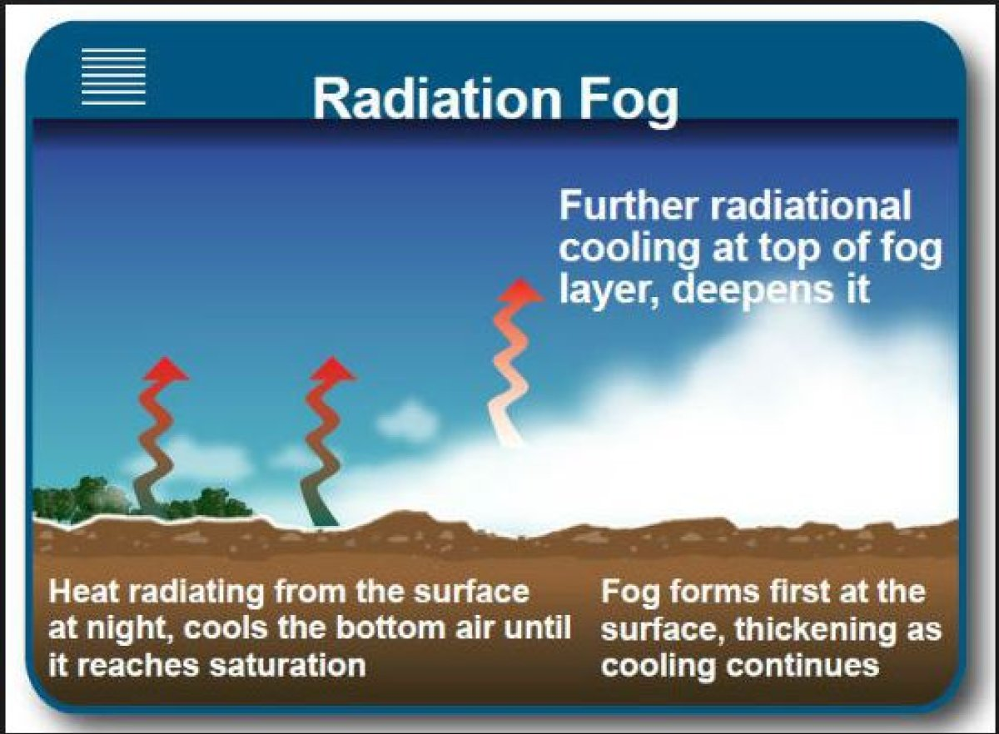
Radiation Fog Formation
After daytime heating ends, clear, dry conditions above the boundary layer hasten cooling at and near the surface.
When skies are overcast, less than 10 percent of the radiation emitted by the earth escapes to space.
Most of the radiation is absorbed and/or reflected by carbon dioxide, water vapor, and cloud droplets in overcast skies.
However, clear skies allow as much as 20 to 30 percent of the radiation to escape the atmosphere.
Because winds create turbulent mixing, calm or light winds at the surface maximize radiative cooling.

Slide 6

As the energy escapes, the ground surface cools rapidly and induces cooling of the lowest few meters of the atmosphere, creating a shallow surface-based inversion.
If there is enough water vapor in the air and enough cooling at the surface, the low-level air eventually reaches saturation.
When afternoon temperatures are cool prior to nightfall, the time required to reach saturation on a clear night is shortened.

Slide 7
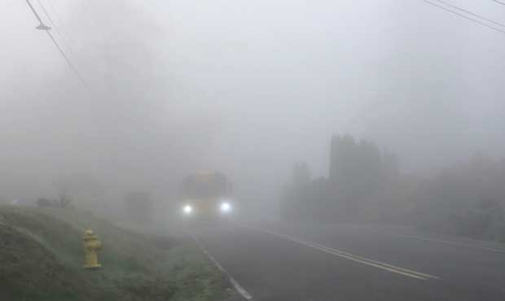
Key Process: Stable Layer Formation
As cooling continues, water vapor in the air near the surface begins to condense onto objects as dew or deposit itself as frost.
This process dries the lowest few meters of the atmosphere, while weak turbulent diffusion continues to transport moist air toward the surface.
Continued cooling in this layer causes it to become increasingly stable and resistant to the effects of weak turbulent mixing near the surface.
Eventually, the near-surface turbulence (small-scale mixing several centimeters, not wind-induced mixing) ceases altogether, and with it, the formation of dew or frost at the surface. As cooling continues, excess water vapor in the saturated layer just above the surface then begins to condense into fog droplets.

Slide 8

Secondary Factor: Surface Heat Exchange
Different surfaces cool at different rates, depending on the surface type and thermal conductivity beneath the surface. Highly conductive surfaces, such as pavement, cool more slowly after nightfall because heat conducted upward from below the surface offsets radiative cooling at the surface. Turf has a lower conductivity than pavement, so it cools more rapidly, allowing the air in contact with it to reach saturation more quickly.
Surface snow cover is often associated with radiation fog. There are three primary reasons for this.
First, snow absorbs much less solar radiation than other surfaces, and a portion of the energy that is absorbed is used for melting and/or sublimation. This limits heating on the afternoon prior to fog formation.
Second, snow cover also insulates the ground at night, limiting the upward flux of heat from beneath the snow.
Third, nighttime radiative cooling occurs more quickly over snow cover than soil or vegetative surfaces.

Slide 9
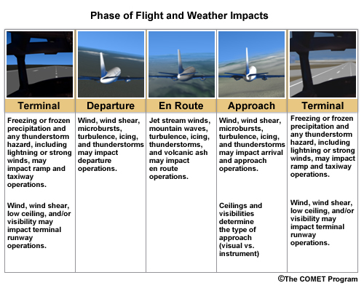
How Weather Impacts the National Airspace System (NAS)
Weather impacts on traffic capacity during the three critical phases of flight: terminal, departure/arrival, and en route.
Each phase of flight has different sensitivities to weather. The actual impact depends on several factors, including the type of aircraft, geographical attributes at and near the terminal, physical layout of terminal, pilots' abilities/qualifications, and instrumentation of both the aircraft and the airport.

Slide 10

How various Federal Aviation Administration (FAA) operational facilities manage traffic to mitigate various impacts and meet NAS capacity demands
For them, weather is like any other type of air traffic—it occupies space in the NAS and generally needs to be separated from the other traffic. It is, in one sense, just another "user" of the NAS.
Weather is the largest uncontrolled user of the NAS! Just as the FAA works to keep controlled users at safe distances from each other, they also aim to keep aircraft and weather at safe distances.
WEATHER
If weather is the only "user" of the NAS in a particular area, it isn't significant to air traffic management, no matter how severe or interesting it is to a meteorologist. Conversely, relatively minor weather events that occur in an area with a lot of traffic, particularly if that area is already at or near its capacity, can be tremendously important to the FAA.

Slide 11


Slide 12
RECAP OF LECTURE
Radiation Fog
Weather Impacts on the National Airspace System (NAS)

