Slide 1

MET 451: Aviation Meteorology
(3 Credit Hours)
Jeffrey N. A. Aryee (PhD)
Meteorology & Climate Science Programme
Department of Physics, KNUST, Ghana
e-mail: jeff.jay8845@gmail.com
https://github.com/jeffjay88/Aviation-Meteorology
Google Classroom Code: 63zl2i

Slide 2
LECTURE 5

Slide 3
Recommended Links and Media
https://www.youtube.com/watch?v=9I40DQcK_6U
https://www.youtube.com/watch?v=TJ2Xgn-E8WA

Slide 4
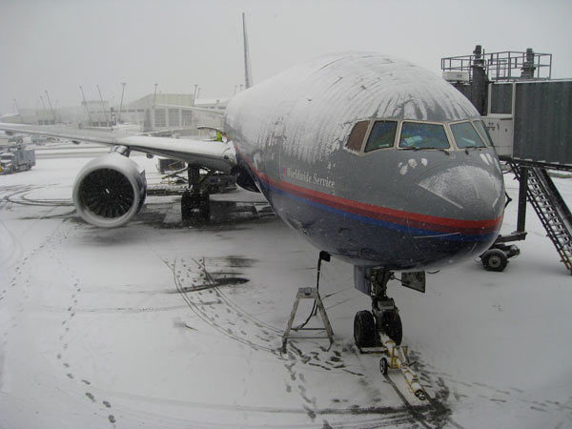
ICING
Icing occurs if precipitation aggregates on the aircraft or at or within parts of it.
There are several impact mechanism.
The dominant one is that super-cooled liquid water impinges on the aircraft and freezes instantaneously.
Icing may occur
- in-flight or at the surface: - ground icing.

Slide 5
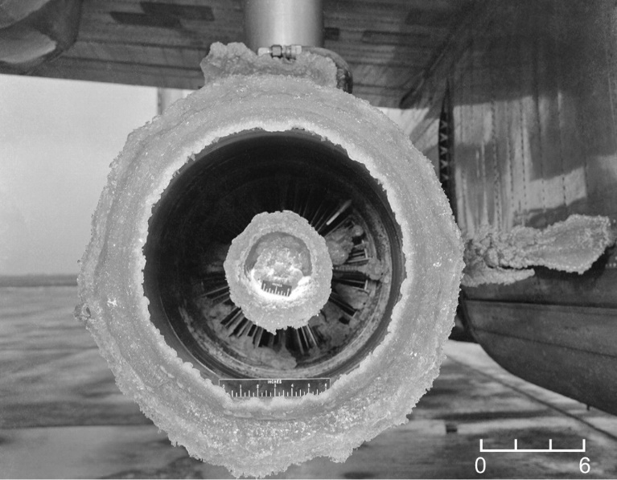
Icing may be categorized into:
airframe icing
engine icing
Normally, forecasts of icing are for airframe icing only.
There are three strategies to cope with aircraft icing:
aircraft must be certified for icing,
(ii) aircraft have to be cleaned of ice prior to take-off (clean wing principle),
(iii) aircraft are equipped with de-icing equipment.

Slide 6


Airframe icing normally occurs when the ambient air temperature is below 0° C and super-cooled water droplets are present.
TYPES
Rime Ice – white, porous, opaque, brittle and rough, so disruptive to airflow. This occurs at low temperatures (<10°C).
Clear Ice (also known as glaze ice) – clear, tough, adhesive, dense, heavy and smooth so little effect on airflow. It occurs usually at warm temperatures >10°C.

Slide 7

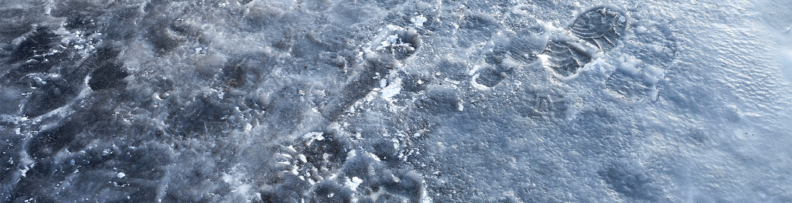
SLD- super-cooled large drops or drizzle drops- with diameters ranging between 50 and 500 μm. SLD may flow after impingement behind the protected zones on the wing and freeze there. If supercooled rain drops with diameter larger than 500 μm hit the aircraft, extreme accretion of ice may occur (freezing rain).
Hoar frost – thin ‘coating’ occurring in the absence of rain or cloud usually when aircraft is parked outside on cold winter nights.
Rain and snow mixed (sleet) is similar to freezing rain and can also lead to ‘pack snow’ that can block air intakes and other aircraft openings

Slide 8
Examples of: a) rime icing; b) clear (glaze) icing; c) mixed icing; d) freezing rain.

Slide 9
Effects on Aircraft
Small super-cooled cloud droplets freeze rapidly on contact with the aircraft, trapping in the ice to give a deposit of white rime on forward-facing surfaces. Larger droplets take longer to freeze, spreading out across the airframe before solidifying.
The intensity of icing is defined as follows:
Light Accumulation rate may create a problem if flight in this environment exceeds 1 hour.
Moderate Rate of accumulation is such that even short encounters are potentially hazardous. Anti-icing equipment must be used.
Droplet trajectories in the vicinity of an airfoil
Severe Rate of accumulation is such that use of anti-icing equipment fails to reduce or control the hazard. Immediate diversion from the region is necessary.

Slide 10
Aside from meteorological factors, the rate of ice build-up on the airframe also depends on the characteristics of the aircraft. Fast aircraft with thin wing cross-sections are more susceptible to deteriorating aerodynamics, and hence are more susceptible to ice accretion.
Helicopters are particularly vulnerable to icing, since build-up of ice on the rotors can lead to imbalance, de-stabilising the aircraft.

Slide 11
Class Discussion
Airframe icing is a serious aviation hazard. How???

Slide 12
The possible range of effects on an aircraft are listed below:
Reduction in the aerodynamic properties
Change in flight performance
Increase in weight and uneven loading
Engine intakes become blocked
Undercarriage retraction/extension problems
Control surfaces jam or become stiff
Pitot tubes become blocked
Communications affected
Vision impaired

Slide 13

HAZARDOUS EFFECT OF AIRCRAFT ICING
Increases stalling speed
Destroys optimal aerodynamic flow over the aircraft
Increases drag
Decreases lift
Causes engine failures
Causes propeller vibration
Reduces visibility
horizontal: due to precipitation
Vertical: due to obscuring cloud
In jet engines, damages compressor blades and interferes with
- Control surfaces and landing gears
Instrument readings (eg air speed, altitude and vertical speeds)
Communication system

Slide 14
Empirical Forecasting Techniques
Severity of airframe icing is dependent on temperature, liquid water content, droplet size and vertical motion. To determine the above, it is necessary to utilise actual and forecast vertical profiles of the atmosphere, rainfall radar and satellite imagery together with knowledge and understanding of the characteristics of different types of cloud.
Forecast considerations
In considering the likelihood of icing, the following factors should be considered:
For icing to occur super-cooled water must be present in the
atmosphere (liquid water droplets with a temperature below 0° C).
Notes:
14

Slide 15
The more super-cooled water there is present (Super Cooled Liquid Water Content), the more significant is the icing risk. SLWC decreases with decreasing temperature.
The larger the super-cooled water droplet, the more significant the risk.
Only very small droplets seem to remain super-cooled below -20° C, hence the worst icing is likely between 0 C and -15 C.
Super-cooled water droplets cannot exist with temperatures below -40° C.

Slide 16
Water phase changes in relation to falling temperature with height
Notes:
16

Slide 17
Probability and intensity of icing associated with different cloud types
Cloud type | Probability of icing | Intensity of icing | Likely Icing Type | Water content gm-3
CB | High | SEV | All | 0.2– 4.0
CU | MOD/High | MOD/SEV | Clear | 0.2-0.6
NS | High | SEV | All | 0.2-4.0
SC, AC | MOD | Rarely more than MOD* | Mixed | 0.1– 0.5
AS | Low | MOD/light | Rime | 0.1– 0.3
ST | Low | Light | Rime | 0.1– 0.5
Note that: (a) prolonged flight within a super-cooled, layered cloud can give rise to a greater degree of icing than suggested here.
(b) stratocumulus (SC) can sometimes give unexpected severe icing, particularly when it lies in a sub-zero layer just below an inversion over the sea.
Notes:
17

Slide 18
Notes:
18

Slide 19
Other factors
Risk and severity of icing increases in sub-zero clouds over hills and mountains due to vertical motion.
The source and nature of SLD is still under investigation. But observations tell that shear layers close to the top of a cloud supercooled cloud are prone for SLD.
The same holds for overshooting cumulus tops.
The impact of SLD on aircraft performance varies with type. Typically, smaller aircraft, such as turboprop, are more susceptible to SLD icing.
Risk and severity of icing increases in sub-zero clouds over and downwind of significant bodies of (non-frozen) water due to higher SWLC and larger super-cooled water droplets.
Friction induces kinetic heating raising airframe temperature. eg +1° C at 100 kt and +25° C at 500 kt.

Slide 20
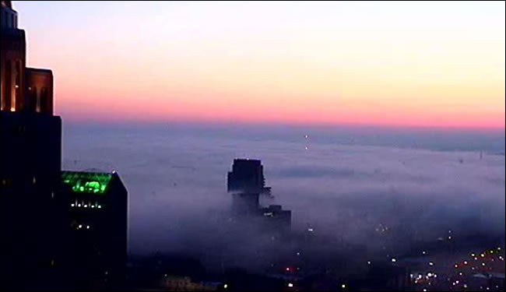
Synoptic Weather Considerations: Forecasting Fog and Low Stratus;
To assess whether a fog or stratus event is possible, you must evaluate the synoptic-scale influences that will drive the local conditions. Most of these are forced primarily by advective or dynamic processes (although radiation does play a role).
Radiation fog cannot form unless the necessary conditions and key ingredients coincide. When they do, radiative cooling and formation of a stable layer precede fog formation. Surface heat exchange is an important factor influencing these processes.

Slide 21
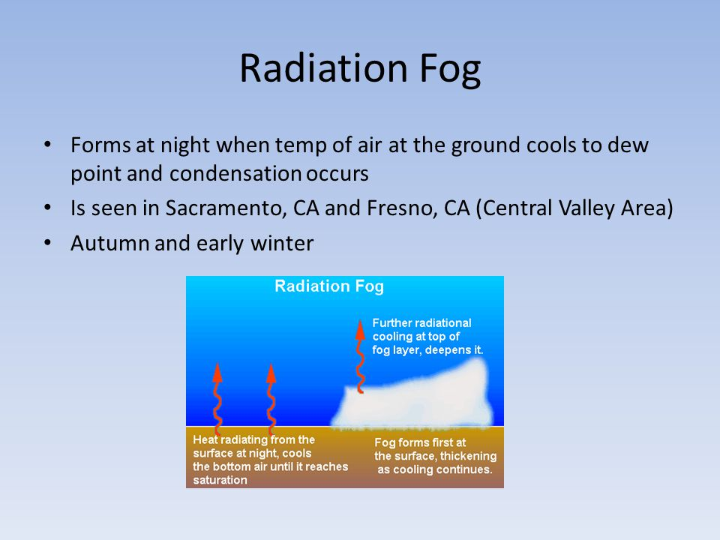
The key low-level ingredients required to generate a radiation fog are
moisture,
rapid cooling, and
calm or light winds.
Low-level anticyclones can create favourable conditions for radiation fog by suppressing surface winds and drying the air aloft through subsidence. Dry air aloft enhances radiative cooling at the surface.
Radiation fog is very unlikely to form unless there is sufficient moisture in the boundary layer. Such moisture may be advected into an area, or derived through daytime evaporation from surface sources such as wetlands or wet soil.

Slide 22


Slide 23
RECAP OF LECTURE
Icing
Radiation Fog and Low Stratus

