Slide 1

MET 451: Aviation Meteorology
(3 Credit Hours)
Jeffrey N. A. Aryee (PhD)
Meteorology & Climate Science Programme
Department of Physics, KNUST, Ghana
e-mail: jeff.jay8845@gmail.com
https://github.com/jeffjay88/Aviation-Meteorology
Google Classroom Code: 63zl2i

Slide 2
LECTURE 2

Slide 3
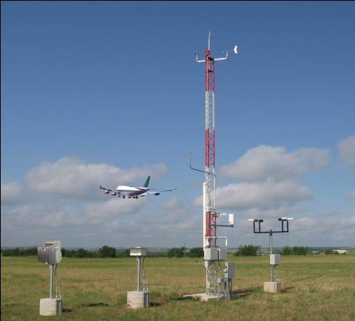
Aviation Weather Observation
Aviation Weather Observation is used to report the various meteorological elements which collectively describe the atmosphere as observed and evaluated from the observer’s position.
The meteorological elements normally observed are: Wind, Visibility, Present Weather, Sky Condition, Temperature, Dew Point, Altimeter Setting, and Remarks.
The type of report shall be METAR for a routine report and SPECI for a special report.

Slide 4
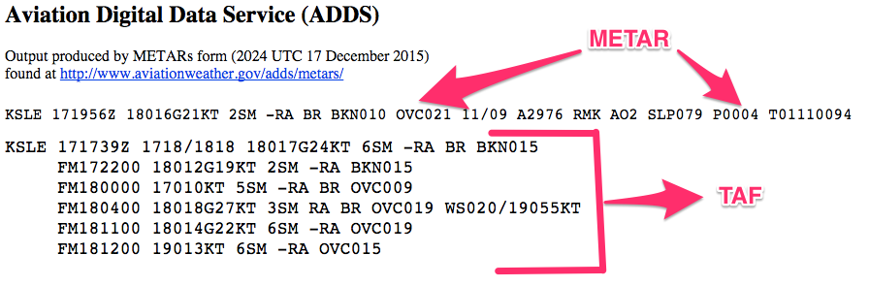
METAR/SPECI is the international standard code for hourly and special surface weather observations.
The METAR acronym [Meteorological Terminal Aerodrome Report] roughly translates from the French as Aviation Routine Weather Report. A special report, SPECI, is merely a METAR-formatted report which is issued on a non-routine basis as dictated by changing meteorological conditions. The SPECI acronym roughly translates as Aviation Selected Special Weather Report.
The format of the SPECI report is similar to that of the METAR and the elements used have the same meaning.

Slide 5
METAR is a routine scheduled observation and is the primary observation code for reporting surface meteorological data.
METAR contains a report of wind, visibility, present weather, sky condition, temperature, dew point, and altimeter setting collectively referred to as “the body of the report.”
Additionally, information that elaborates on data in the body of the report may be appended to the METAR. This significant information can be found in the section referred to as “Remarks.”

Slide 6
SPECI is an unscheduled observation. SPECI observations are taken when specific weather conditions have been met or observed (noted).
SPECI reports shall contain all the data elements found in a METAR report (except single-element special) plus additional plain language information that elaborates on data in the body of the report.
All SPECIs shall be made as soon as possible after the relevant special criteria are met or observed.
Whenever SPECI criteria are met or observed at the time of a METAR, the type of report shall be METAR. Single-element special observations are authorized to be taken for tornadic activity and volcanic eruptions.

Slide 7
Content and Format of the Manual METAR/SPECI
1. Identification of the type of report: METAR or SPECI
2. location indicator (ICAO airport code): CCCC
eg. Kotoka International Airport has the station code DGAA
3. Time of the observation; YYGGggZ
“YY” is the day of the month and “GGgg” is the time. The times entered are in reference to the 24-hour clock.
YY - two-digit date
GG - two-digit hour
gg - two-digit minutes
Z - letter indicator for UTC

Slide 8
Wind Group - dddff(f)Gfmfm(fm)KT
Wind Direction - ddd
The direction is reported using three characters. When using direct reading dials, you determine the wind direction by averaging the direction over a 2-minute period. The true wind direction is reported in tens of degrees using three digits. The third character will always be a zero.
If the direction was determined to be variable (VRB) and the wind speed is 6 knots or less, the speed is appended to the VRB, e.g., VRB05. However, wind directions should be reported whenever they can be determined even when the wind speed is 6 knots or less, e.g., 00000KT, 15003KT
Wind Speed – ff(f)
The speed of wind is also reported with two or three characters. The magnitude of the wind speed must be stated with its reporting unit provided at the end of the wind group.
Wind speed can be reported in knots (KT) or mile per second (MPS).

Slide 9
Wind Gusts - Gfmfm(fm)
Reporting gusts is a bit challenging. The wind gust is coded in two or three digits immediately following the wind speed. The wind data for the most recent 10 minutes are evaluated.
Gusts are indicated by rapid fluctuations in wind speed with a variation of 10 knots or more between peaks and lulls. The speed of the gust shall be the maximum instantaneous wind speed. The letter “G” is placed right before the wind gust speed in the transmitted coded report;
Examples of Transmitted/Coded Data: 31015G25KT 090115G125KT
Trial Question
Class should interpret these first few lines of weather observation code below for October 1, 2019
METAR DGAA 011600Z 31020G35KT

Slide 10
Variable Wind Direction - dndndnVdxdxdx
If the wind direction varies by 60° or more and wind speed is >6 knots, a variable wind group is also reported. The extreme values are coded using three digits for each direction (remember: tens of degrees, last digit is always a zero). A “V” separates the two extreme values.
The directional variation shall be coded in a clockwise direction (remember: it can vary by more than 60°).
Example: If wind is variable from 180° to 250° at 10 knots, it would be coded as: 21010KT 180V250
Trial Question
Class should interpret these first few lines of weather observation code below for October 1, 2019
METAR DGAA 011415Z 18012G30KT 100V220

Slide 11
Prevailing Visibility (VVVVSM)
Visibility can be quoted in meters or statute miles (SM).
Eg. 7SM represents prevailing visibility of 7 statute miles.
When visibility is greater or equal to 10 kilometers, it is coded as 9999.
Runway Visual Range (RVR) RD_{R}D_{R}/V_{R}V_{R}V_{R}V_{R}
The 10-minute average runway visual range is reported when prevailing visibility is 1 mile or less, and/or the runway visual range is 6000 feet or less.
Eg. R06/1200N - Visibility of 1200 meters on runway 6 and not changing significantly.
D indicates downward trend, U upward trend, and N no change.

Slide 12
Reporting CAVOK
CAVOK stands for Ceiling And Visibility OK, indicating no cloud below 5,000 ft (1,500 m) or the highest minimum sector altitude and no cumulonimbus or towering cumulus at any level, a visibility of 10 km (6 mi) or more and no significant weather change at or in the aerodrome’s vicinity.

Slide 13
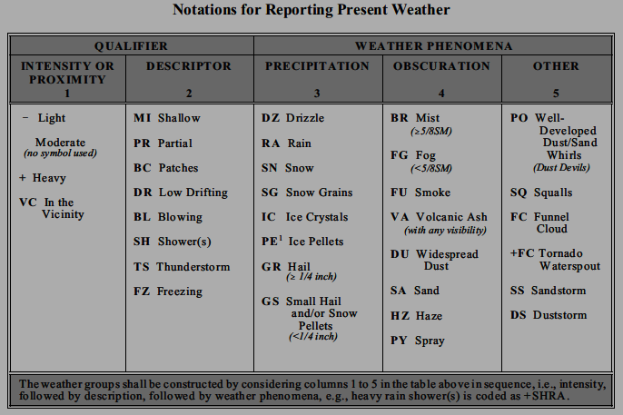
Eg. -SHRA: (-) is the designator for light. Precipitation will either be light (-), moderate ( ), or heavy (+) based on certain criteria that must be met. SH means showers and RA means rain. So the present weather is a light rain shower.

Slide 14

Sky / Cloud Cover (N_{s}N_{s}N_{s}h_{s}h_{s}h_{s})
Sky cover amounts are cumulative. Therefore layer amounts include the sum of any layers below. Codes for sky cover amounts are:
SKC (sky clear)
FEW (few, <1 to 2 oktas)
SCT (scattered, 3 to 4 oktas)
BKN (broken, 5 to <8 oktas)
OVC (overcast, 8 oktas)
VV (sky obscured) [Clouds cannot be seen because of fog or heavy precipitation, so vertical visibility is given instead.]
Cloud height is reported in 3 digits in hundreds of feet. Eg. 028 denotes 2800 feet.
You will often have more than 1 designator (i.e. SCT035 BKN090 OVC140)
Significant Clouds such as TCU (Towering Cumulus), CB (Cumulonimbus), or ACC (Altocumulus Castellanus) will be found on the end of a category (i.e. SCT035TCU)

Slide 15
Temperature and Dewpoint (T'T'/T'_{d}T'_{d})
Temperature and Dewpoint are coded as T'T'/T'_{d}T'_{d} in degree Celcius.
Eg. 15/08
15represents the temperature in Celcius
08represents the dewpoint in Celcius
If the temperature or dewpoint falls below 0 there will be an "M" before it (i.e. 03/M02). "M" means minus.

Slide 16
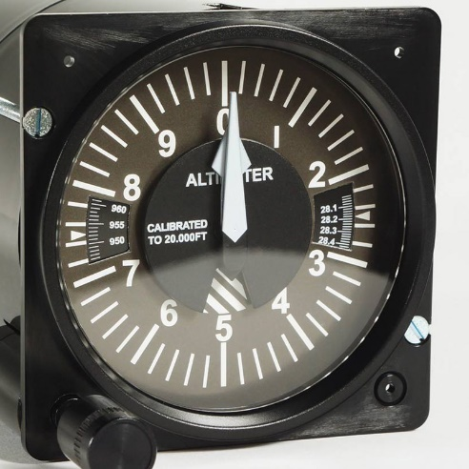
Altimeter reading (AP_{H}P_{H}P_{H}P_{H})
A simply stands for Altimeter, denoting pressure reading in inches of mercury.
Eg. 3016 means 30.16 inches of mercury for the pressure.
Some countries use "Q" which indicates hectopascals.
REMARKS (RMK)
RMK simply means REMARKS and marks the end of the standard METAR observation and the beginning of the remarks that are put in as necessary.
Eg. RMK A02 SF5NS3
A02 means that the site is automated and has a precipitation sensor. If it were AO1, there would be no precip sensor. This does not mean the site is un-manned. If there is an AUTO after the ID in the metar obs, then there is no observer.
SF5NS3 means 5 oktas Stratus fractus and 3 oktas Nimbostratus

Slide 17


Slide 18
RECAP OF LECTURE 2
CODING AND DECODING METAR AND SPECI

Slide 19
ASSESSMENT ON LECTURE 2
GROUP PRESENTATION ON TERMINAL AERODROME FORECAST (TAF)
Submission Deadline: Next Class (October 8, 2019)

