Slide 1

MET 451: Aviation Meteorology
(3 Credit Hours)
Jeffrey N. A. Aryee (PhD)
Meteorology & Climate Science Programme
Department of Physics, KNUST, Ghana
e-mail: jeff.jay8845@gmail.com
https://github.com/jeffjay88/Aviation-Meteorology
Google Classroom Code: 63zl2i

Slide 2
LECTURE 4

Slide 3
Recommended Links and Media
https://slideplayer.com/slide/5256008/
https://www.youtube.com/watch?v=yozcYm5o4-8
https://www.youtube.com/watch?v=kdAiKYWAlok
https://www.youtube.com/watch?v=jgSZG9SqN_s
https://www.youtube.com/watch?v=57SCwCtGHg4

Slide 4
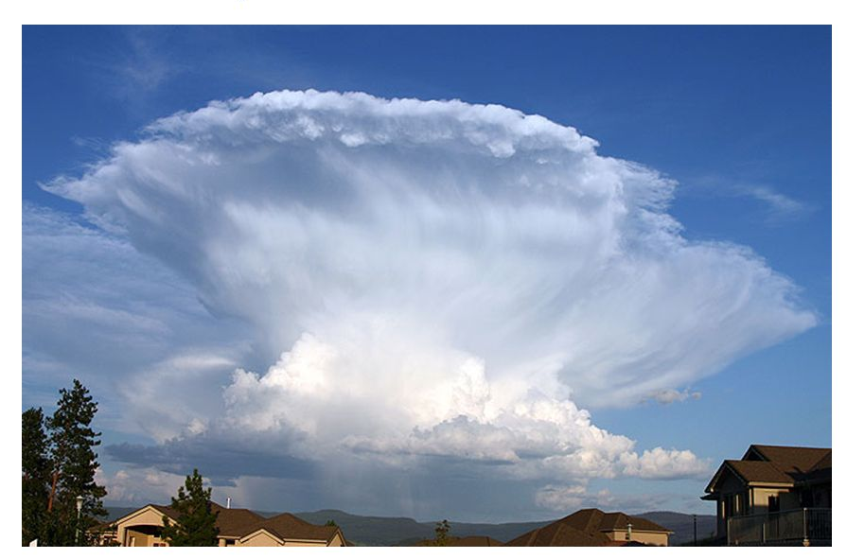
THUNDERSTORMS AND DEEP CONVECTION
One of the greatest dangers to aviation is thunderstorm.
Dangers associated are not always recognized by the aviators / avionics and possible evasive action is not readily carried out leading to disastrous results.
Thunderstorms present some of the worst dangers in aviation. The effects they have are most likely to be found in the form of turbulence, downburst, microburst, tornadoes, icing, lightning, hail, heavy rain, surface wind gusts, runway contamination, low status and bad visibility.

Slide 5
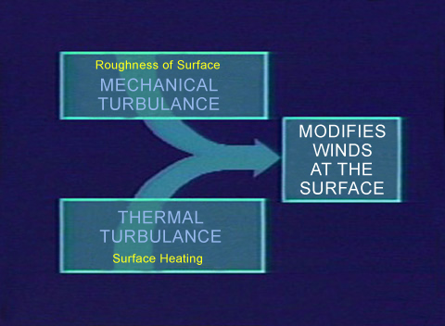
Turbulence
Turbulence is irregular motion of air in the atmosphere.
The principal sources of turbulence are
thermal,
mechanical,
acting separately or in combination.
Turbulence significance to the operation of aircraft depends to some extent on the aircraft size, wing span size, weight and speed of motion of the aircraft.

Slide 6
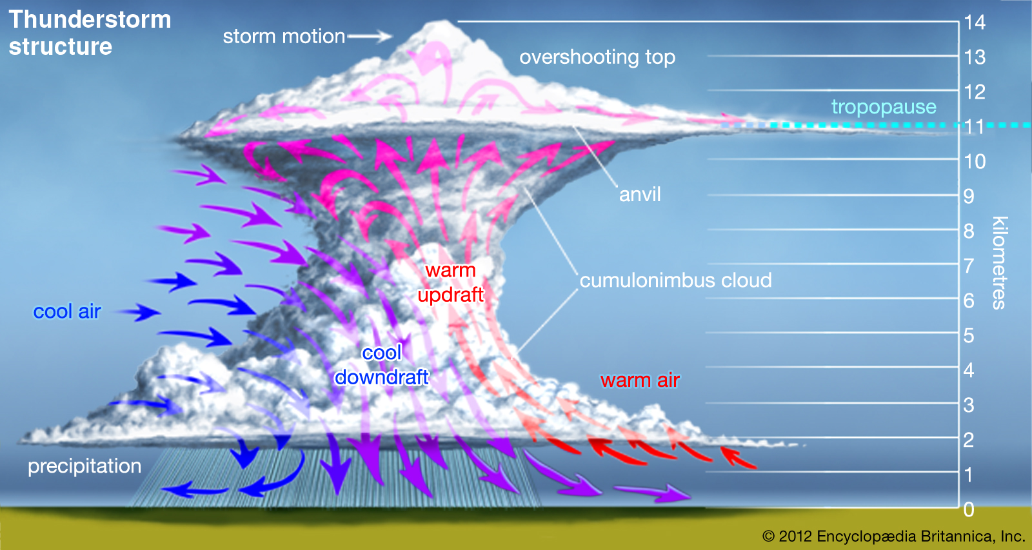
Thermal turbulence
Occur at the edges of up-currents and down-currents in a convective regime, as follows:
In cloud.
Outside Cb, particularly in clear air around anvil and just above storm top.
In dry thermals below cloud base, or in a cloudless atmosphere over any heated land mass. Over deserts, dry convection may reach 5-7 km.
In downdraughts appearing with the onset of precipitation; these spread out at the surface to produce a squall-line close to the shower area.

Slide 7
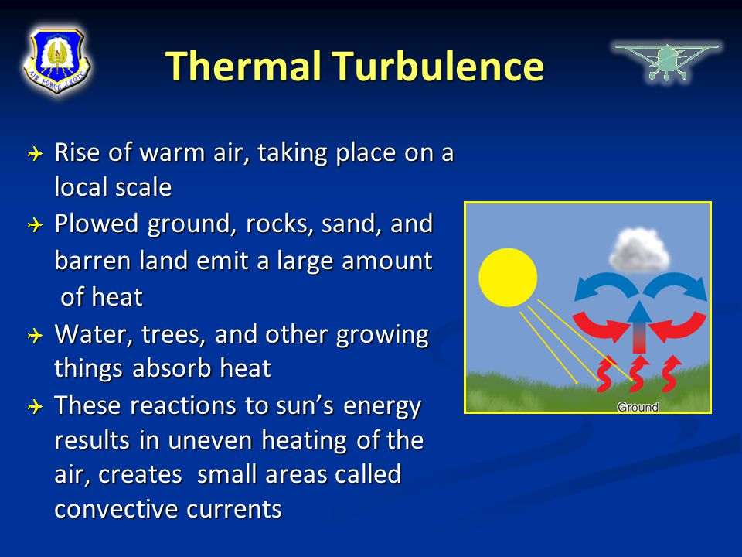
Thermal turbulence
Thermal turbulence can reach heights exceeding 12 km in the temperate latitude and 18 km in some tropical areas.
Magnitude of typical vertical currents in convective cloud
Regime Vertical Velocity (knots) Description of turbulence Sc / Ac light to moderate
dry thermals 1-5 light to moderate
cumulus 1-3 light
cumulus 3-10 moderate
cumulonimbus 10-25 severe
downdraught 3-15 moderate to severe
extreme downdraught up to 40 extreme

Slide 8

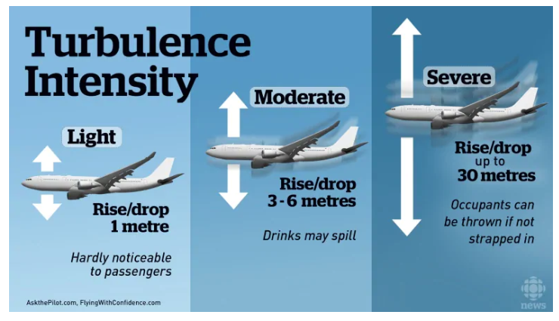
Thermal turbulence over land has a marked diurnal variation, with a maximum during the afternoon and a minimum overnight. Thunderstorms, in contrast, may last during the whole night and propagate over large distances of several hundred kilometers.
Class Discussion
Thermal turbulence over land has a marked diurnal variation, with a maximum during the afternoon and a minimum overnight.
Effects on Aircraft
Convective turbulence will result in ‘bumpiness’ in flight.
Ultimately, depending on aircraft type, severe turbulence may cause structural damage to an aircraft. Airlines are most concerned with injuries to passengers which may lead to costly compensation claims.
Dry thermals are felt as light to moderate turbulence.

Slide 9
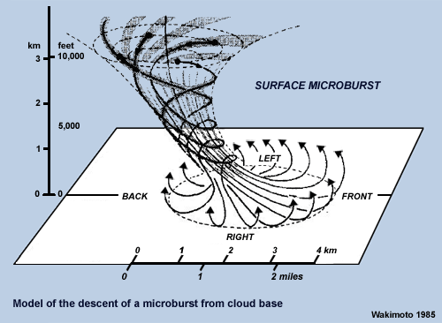
One should also note that updraught speed usually varies strongly across an updraught. Thus, an aircraft flying through a convective updraught will feel not only the convective turbulence within the cloud, but also the acceleration due to the varying vertical wind speed along its cloud transect.
Additionally, in association with large storms, strong downdraughts or micro-bursts can occur producing a violent outflow of air which spreads outward on hitting the ground. Downdraughts, can result in fatal accidents, particularly for small aircraft.
Updraught strength varies from 1 m/s in fair weather cumuli, to 5 m/s in shower clouds up to 65 m/s in severe Cumulonimbus. Downdraughts vary in a similar way with a maximum observed value of -25 m/s in CB

Slide 10
Empirical Forecasting Techniques
Criteria for forecasts of hazardous low-level wind shear/turbulence
One or more of the following to be satisfied:
Mean surface wind ≥ 20 kt
Magnitude of vector difference between mean surface wind and gradient (2000 ft) wind ≥ 40 kt.
Thunderstorms or heavy showers within 10 km.
Significant wind shear has already been reported by aircraft in the vicinity.
Look-up table as guide to the intensity of turbulence typically associated with various convective motions.
Regime Vertical velocity (kt) Turbulence
Small/medium Cumulus 2-6 Light
Towering cumulus 6-20 Moderate
Cumulonimbus 20-50 Severe
Severe storms 40-130 Extreme
Dry thermals 2-10 Light/Moderate
Downdraughts 6-30 Moderate/Severe
Downdraughts up to 50 Extreme

Slide 11
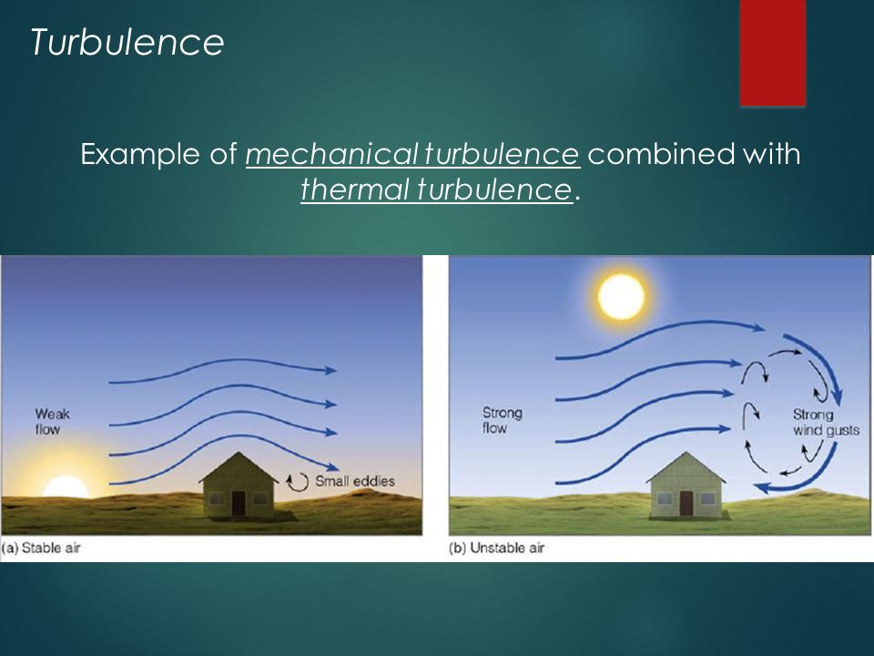
Mechanical turbulence
When surface features and objects, such as, mountains, tall buildings, landscape, etc. cause the obstruction of air.
Mechanical turbulence may also be found close to the edge of the jet-stream at tropopause heights.
Mechanical turbulence include low-level turbulence, mountain wave and rotor-zone turbulence, etc.
Low level turbulence
Close to the ground, mechanical turbulence is also often referred to as low-level turbulence results solely from shear.
Surface friction is the primary cause of the vanishing wind at the surface. Within the boundary layer and typically at night a low-level-jet may be found, which also might produce turbulence.

Slide 12
The intensity of mechanical turbulence depends upon: wind strength, terrain roughness and atmospheric stability near the surface.
In general, the stronger the wind and the rougher the terrain, the more intense the turbulence experienced. Light winds over a smooth sea give the least turbulence.
The steeper the lapse rate, the more readily vertical gusts develop and thus the more vigorous the turbulence is. In more stable air, vertical eddies are suppressed and turbulence is more damped.

Slide 13
Empirical forecasting techniques
Given that the forecaster is confident in the forecast of wind speed, an estimation of likely turbulence is possible, and is indicated in the table below.
Model winds are often very good guidance, but the forecaster must be aware of the limitations in the resolution of model orography. It is often useful to take the 925 hPa wind as gradient, and work out a corresponding surface wind manually.

Slide 14

Effects on Aircraft
Results in ‘bumpiness’ in flight.
The intensity of turbulence will increase in accordance with the wind strength, terrain roughness and atmospheric stability near the surface, as well as, flight speed.
For any given intensity of turbulence, the faster the aircraft flies, the more it will be accelerated. Ultimately, depending on aircraft type, severe turbulence may cause structural damage to an aircraft.

Slide 15
Orographic turbulence
If surface roughness increases and characteristic roughness heights increase as well, eg. over cities, forests, small hills and larger hills, and finally mountains, the airflow suffers large corresponding displacements from its original level.
Dependent upon the stability of the air mass, this may result in triggering convection, with its attendant turbulence; it also may generate gravity waves, in this case, mountain waves, or may tend to return the airflow to its original level giving ‘standing waves’ and rotors.
Katabatic and anabatic winds may develop to give a flow of wind where none was expected. Strong katabatic winds may be found along and at the foot of glaciers, and valley wind systems enhanced by cold air to be considered.

Slide 16
Mountain waves and associated turbulence may be pronounced when the following conditions are all satisfied:
A wind speed of 20 knots or more at hill-crest level, with speed increasing with height but with little change of direction (strong waves are often associated with jet streams).
A stable layer somewhere between hill-crest level and a few thousand feet above.
Turbulence may be experienced in association with mountain wave motions, particularly if the vertical currents are strong and the wavelength is short.
Turbulence-prone areas are most likely to be near wave crests and troughs, while at mid-levels, the flow may be quite smooth and laminar. As with all gravity waves, mountain waves may also break causing then severe turbulence.
Turbulent rotors in the lower troposphere are usually associated with high-amplitude lee waves.

Slide 17
Rotor streaming
The term "rotor streaming" is used by forecasters to describe re-circulations associated with lee waves which are associated with strong turbulence and a high degree of wind variability.
To generate rotor streaming the required conditions are:
strong winds (>20-25 kt), at the top of the boundary layer,
typically just below a sharp inversion;
a low level neutral layer capped by a marked inversion 1.5 to 2
times the height of the hills;
a marked decrease in wind speed, accompanied by a large
change in direction, at a height 1.5 to 2 times the height of the hills;
a stable air mass, above the well mixed lowest layer.

Slide 18
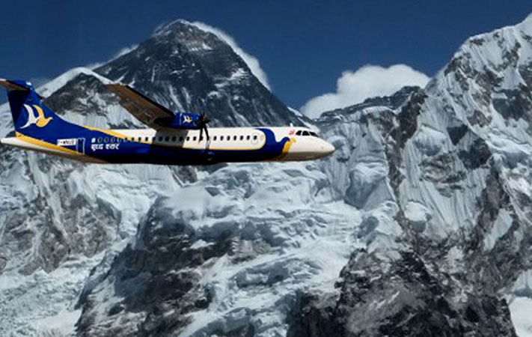
Effects on Aircraft
Mountain waves can be both an advantage and a disadvantage to aviation, mostly however the latter is the case.
Experienced glider pilots look for the updraught side of mountain waves in order to gain altitude. With very high ascent rates, they can be very useful in gaining height quickly. Within such updraughts, the flight may well be very smooth.
There are several inherent dangers.
1) The rapid change in height can mean that a pilot caught unawares may very quickly conflict with aircraft at different flight levels, and more importantly, if caught in a downdraught may rapidly erode any terrain clearance margins, and ultimately cause impact with the ground. Such effects will be most pronounced if the aircraft track is parallel with the ridge. Mountain wave activity is noted on aviation charts when vertical velocities reach and exceed 500 ft per minute

Slide 19
2) The laminar and smooth flow will break down to give rotors in the crests of the first one or two lower level waves of the flow – turbulence should be expected to be severe in these regions, and may or may not be marked with ‘roll cloud’.
3) If the wavelength is short, then an aircraft travelling swiftly through and perpendicular to the wave-train will experience a prolonged series of rapid fluctuations of vertical velocity. This will result in turbulent flight.
Rotor streaming, and surface rotors are extremely hazardous to aircraft. Aircraft may simply not be able to stabilise their approach. Not only may wind direction change abruptly (windshear) causing marked changes in lift and drift, but the aircraft also may be affected by strong updraughts and downdraughts.

Slide 20
Empirical Forecasting Techniques
The synoptic situations where orographic turbulence tends to be marked are:
around a deep low pressure, due to the strength of the wind;
ahead of a warm front, where stable air aloft causes air to be squeezed over extended mountain ridges. This can give wind speeds of more than twice the gradient wind at the hill top, and may generate rotor activity;
in strong winds in a stable warm sector with intense summer heating.
Associated NWP products
As a first approximation the 925 hPa and 850 hPa wind fields are usually good guidance for the general flow across mountainous areas, it has limitations though. The forecaster should have a good grasp of the country’s topography. The forecaster should also pay close attention to appropriate tephigrams (actual and forecast).

Slide 21


Slide 22
RECAP OF LECTURE
Aviation Hazards : Thunderstorms and Deep Convection
Turbulence
Effects of Turbulence on Aircraft
Forecasting Techniques

