Slide 1

MET 451: Aviation Meteorology
(3 Credit Hours)
Jeffrey N. A. Aryee (PhD)
Meteorology & Climate Science Programme
Department of Physics, KNUST, Ghana
e-mail: jeff.jay8845@gmail.com
https://github.com/jeffjay88/Aviation-Meteorology
Google Classroom Code: 63zl2i

Slide 2
LECTURE 5

Slide 3
Recommended Links and Media
https://www.youtube.com/watch?v=NPsas4Uswv8
https://www.youtube.com/watch?v=yZNliKTGrdc
https://www.youtube.com/watch?v=S5tN9nVLgcM

Slide 4
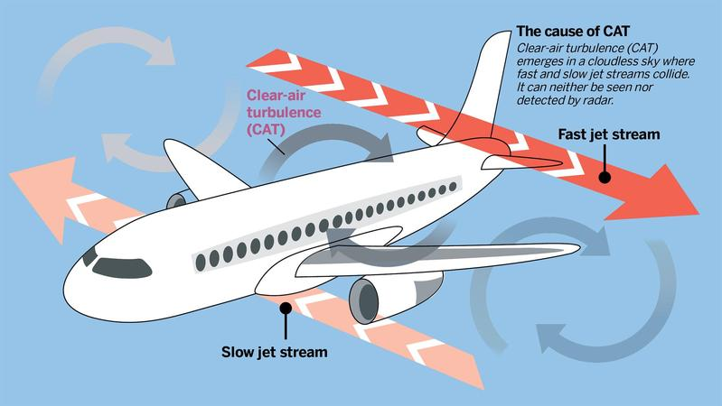
CLEAR AIR TURBULENCE (CAT)
CAT is the term used to describe medium- or high-level turbulence produced in regions of marked wind shear. As its name suggests, this often - though not necessarily- occurs in the absence of cloud, making it difficult to detect visually.
Effects on Aircraft
As with all turbulence types, the degree of turbulence is categorised by the ICAO definitions. Although the aircraft is at height on most occasions, severe turbulence must never be trivialised. In extremes, structural damage may occur.
For civil aviation, passengers may be made uncomfortable, or suffer injuries when not wearing their seat belts.

Slide 5
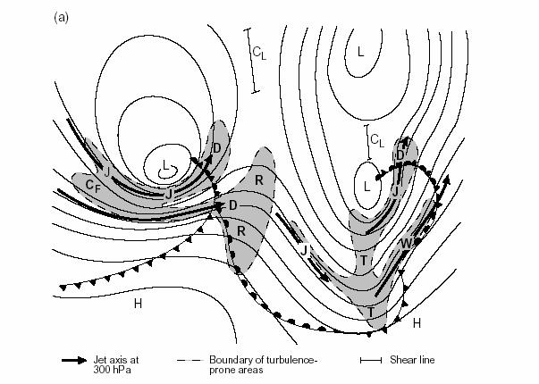
CLEAR AIR TURBULENCE (CAT)
A characteristic pattern of cirrus clouds, known as ‘billows’, is a signal of a region of CAT. The billows are an indication of breakdown into turbulent flow in the form of Kelvin-Helmoltz instability.
Empirical Forecasting Techniques
CAT is often reported;
on the cold side, near and below the core
on the warm side, above the core
near exits with marked curvature and diffluence
at the confluence or diffluence of two jet streams
near sharp upper troughs
around sharp ridges on the warm side of jets
where one jet undercuts another
where the tropopause height fluctuates

Slide 6
Some more characteristics:
If the core speed exceeds 100 kt and vertical windshear 4 kt/1000 ft, forecast moderate CAT within 150 nautical miles.
CAT may occur, or be intensified, over a region of convection, especially embedded frontal convection.
CAT occurs more often over land, especially over mountainous land, than over the sea. 60% of CAT reports are near jet-streams. The severity of CAT may be estimated if the horizontal and vertical windshear values are known
Subjective guide relating CAT to horizontal and vertical wind shear.
 | Moderate | Severe
Horizontal wind shear | 20 kt per degree of latitude | 30 kt per degree of latitude
Vertical wind shear | 6 kt per 1000 ft | 9 kt per 1000 ft

Slide 7
Turbulence within the favourable areas is most likely to occur near the tropopause or other stable layers.
In jet streams, turbulence is generally found in the baroclinic zones above and below the core. There is some tendency for turbulence to be concentrated in the lower zone of cyclonically curved jets and in the upper zone of anticyclonically curved jets.
In terms of temperature, the criterion for moderate or severe turbulence is 5°C or more per 2 deg latitude.
There is some qualitative evidence that turbulence is more likely to be severe within turbulence-prone areas if rapid change or development in the upper air pattern is occurring locally than if the pattern is relatively static.
The incidence of CAT is more frequent over land, particularly over mountains, than over the sea. It is not possible to give precise quantitative values to this difference but it is suggested that a factor of 3 or more over most land areas, increasing perhaps to 10 over very mountainous areas, is reasonable.
CAT appears to affect a relatively small area and occur temporarily although the factors leading to CAT are present all the time. Hence only in a small percentage of CAT forecast will there in fact be turbulence reports by aircraft.

Slide 8
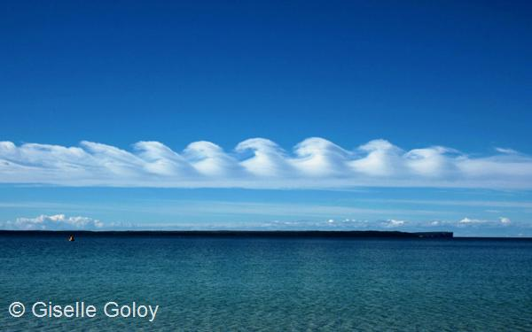
Associated NWP products
For high level jet-streams, appropriate geopotential height (gph) fields, combined with isotach and streamline analysis can help diagnose areas of likely CAT. Consider how ridges and troughs are developing in the model, and apply the empirical techniques above to the model fields.

Slide 9
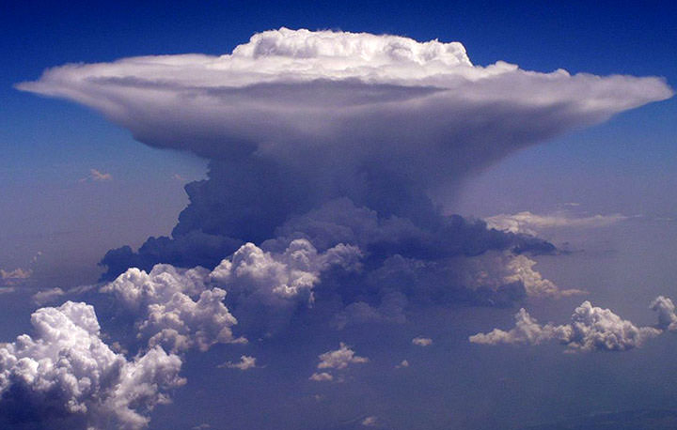
CUMULONIMBUS AND THUNDERSTORMS
Cumulonimbus (CB) clouds are a severe hazard to aviation, due to the likelihood of:
severe turbulence,
severe icing,
micro-bursts giving severe low-level
turbulence;
lightning,
high liquid water content,
hail

Slide 10
Because Cumulonimbus clouds can generate many different types of hazards at the same time and location, they must never be underestimated. Aircraft should avoid flying into areas of known CB activity, especially when such activity may be hidden by obscuring cloud layers.
Whilst individual Cumulonimbus clouds may have a lifetime of 1½ hours, the most intense Cumulonimbus development and thunderstorm/lightning activity is associated with Multi-Cell Convective systems which may develop further into Super-cells. Such systems are long lived due to the spawning of daughter cells and may last for many hours.

Slide 11

Class Discussion
In what way does lightning impact on the aviation industry?

Slide 12
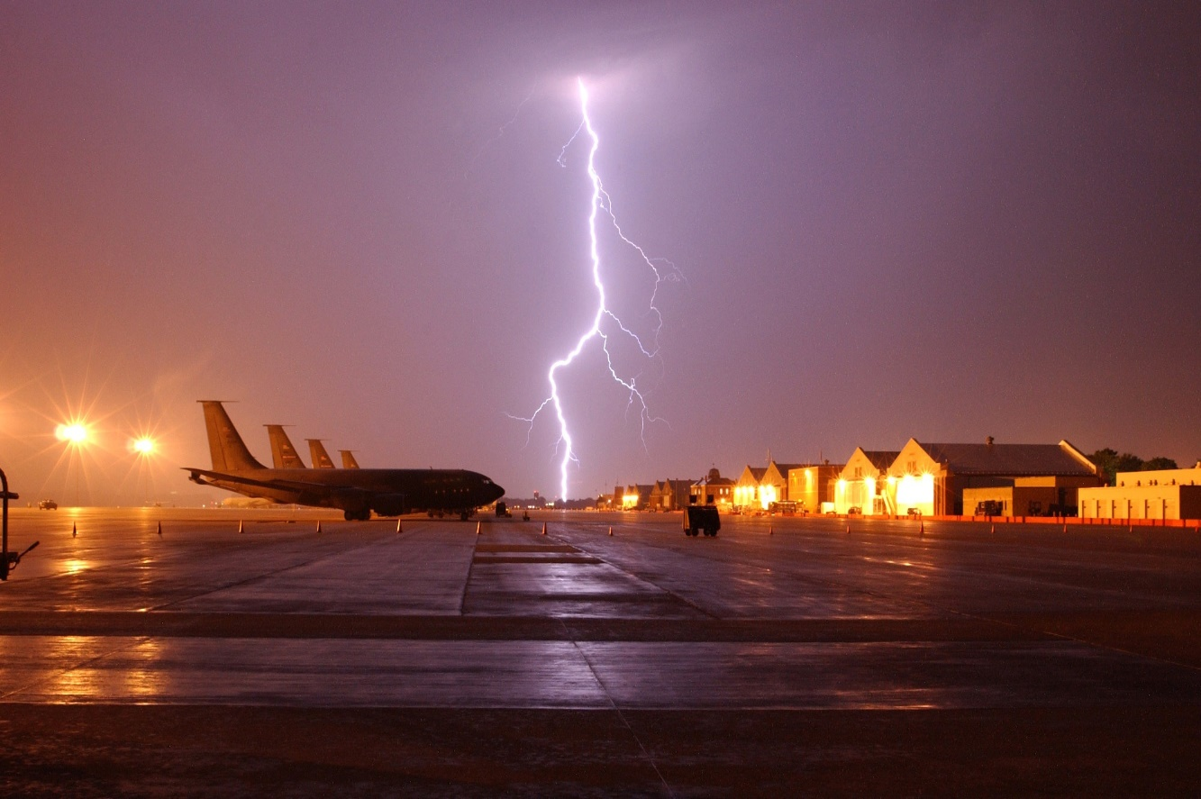
Thunderstorms and Lightning
Lightning can occur in and near Cumulonimbus clouds including the anvil layers and the sub-anvil atmosphere.
Effects on aircraft
Lighting strikes on modern composite materials will cause de-lamination of the material. If such strikes are upon structurally important areas of the aircraft, its integrity may be compromised. For this reason, lightning strikes on composite helicopter blades are particularly hazardous.

Slide 13
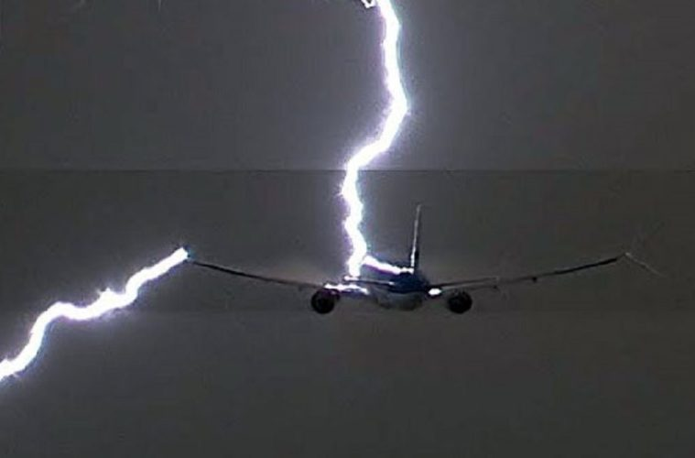
Following a lightning strike,
electrical/electronic systems may fail, with circuit breakers tripping. Magnetic compasses will become untrustworthy.
Radio communications and navigation equipment may be adversely affected.
The Automatic Direction Finder (ADF) will often point into the storm’s centre.
Notes:
13

Slide 14
Lightning: Aircraft Damage
Direct Damage:
Puncturing the fuselage
Burning, melting or distorting aircraft parts
Indirect damage:
Temporary or permanent damage to avionics
Fire in the fuel system
Temporary blinding of the pilot
Visual or instrument

Slide 15
Diagnosis of Hazard Using Appropriate Imagery
Satellite imagery, especially loops, can help identify developing convective cloud.
Infra red imagery can give estimates of cooling tops, and an approximate value for the cloud top temperature.
Water vapour imagery can help identify areas of high Positive Vorticity Advection which may favour Cumulonimbus, and thunderstorm/lightning, development.
The monitoring with a weather radar is an essential tool in monitoring the development of convective cells. The colour code representing rainfall rates can be used as an assessment of the likelihood of lightning.

Slide 16
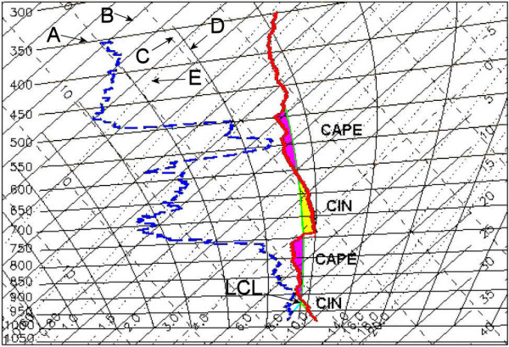
Empirical Forecasting Techniques
Elements that assist the forecaster in assessing the likelihood, or not, of thunderstorm and lightning activity include, but are not limited to:
Tephigram constructions, both on actual and forecast profiles.
Examine depth of convection and check thunderstorm
occurrence according to local criteria.
Convection ascending to and through the minus 20° C isotherm.
Monitoring for regions of decreasing θw with height to diagnose areas of Potential Instability.
‘Shallow moist’ zones associated with split cold fronts are always worth studying.

Slide 17
Consider the effects of nil, uni-directional, or directional wind shear through the cloud depth.
Consideration of instability indices such as CAPE and Equivalent Potential Temperature values.
CAPE ( Jkg-1 ) | Atmospheric State
0 | stable
0-1000 | marginally unstable
1000 – 2500 | moderately unstable
2500 – 3500 | very unstable
≥ 3500 | extremely unstable

Slide 18
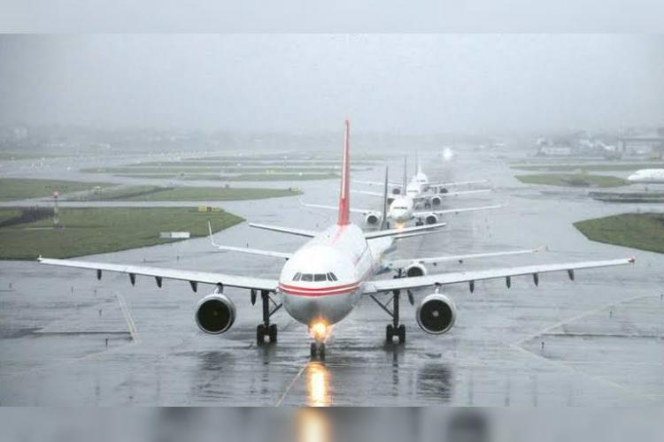
Heavy rain
There is no agreed international definition regarding rainfall intensity. Some use the following criteria:
Heavy rain is defined as rates in excess of 4 mm per hour.
Heavy showers are defined as rates in excess of 10 mm per hour. For aviation purposes rain rates are essentially a measure of rain water content.
Effects on Aircraft
Heavy or very heavy rates of rainfall will clearly have a detrimental impact on general visibility. However, in addition to any true meteorological reduction of visibility, raindrops impacting the windscreen/canopy will additionally reduce visibility. Windscreen wipers (if fitted) may not be able to fully cope with the rainfall rate.

Slide 19
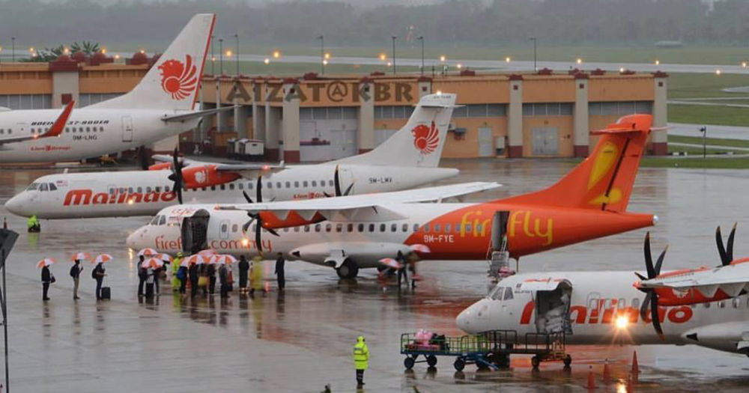
Light, non pressurised aircraft may allow water ingestion into the cabin/cockpit/engine compartments with subsequent risks to electronic equipment during heaviest rain rates
Civil airliner engines are tested and certified to ensure that engines will normally not ‘flame out’ under conditions of intense rainfall and water ingestion
Runway flooding, or areas of deep standing water will affect braking action, and may result in asymmetric braking and possible sliding off runways.
Low cloud (stratus pannus) may form in periods of moderate or heavy rain, when it had not previously been expected

Slide 20
Diagnosis of Hazard Using Appropriate Imagery
Rainfall radar is invaluable for diagnosing areas of rainfall and the intensity of that rainfall.
Satellite imagery can assist in showing areas of cooling (and therefore ascending and developing) cloud tops. Combining the various wavelengths sensed by a meteorological satellite (RGB products) may prove increasingly useful in determining areas of precipitation, and general development.
When analyzing such data, the forecaster should be mindful of the development of daughter cells, and the triggering of quite separate cells elsewhere, i.e. storms may not appear to move with the general wind flow or ‘steering level’.
Notes:
20

Slide 21
Empirical Forecasting Techniques
Look out for and consider those occasions where high values of Positive Vorticity Advection and Warm Advection coincide as being the most likely areas to generate heavy rainfall – both from stratiform and convective cloud.
Remember that orography will enhance rainfall on the windward side of hills and mountains.
Associated NWP Products
Basic model output data will provide values for expected dynamic rainfall/convective rainfall rates at specified times, and for accumulated totals over specified periods.
Always be aware of the limitations of model data and that such rates will be averaged over a gridbox. Consider the effects of enhanced rainfall on windward slopes.

Slide 22
Turbulence associated with clouds types
St – slight Ci, Cs, Cc, Ac, As – nil or slight except when Ac occurs or when merging into Cb Sc – moderate Ns – moderate but may be severe near base Cu, TCu, Cb – Generally severe but may be catastrophic and include the downbursts described below and the internal up/downdraughts.
Surface winds of thunderstorms may be both high velocity and extremely turbulent, originating from the downdraughts of cold, dense air. When thunderstorms are about light aircraft should not be airborne.

Slide 23
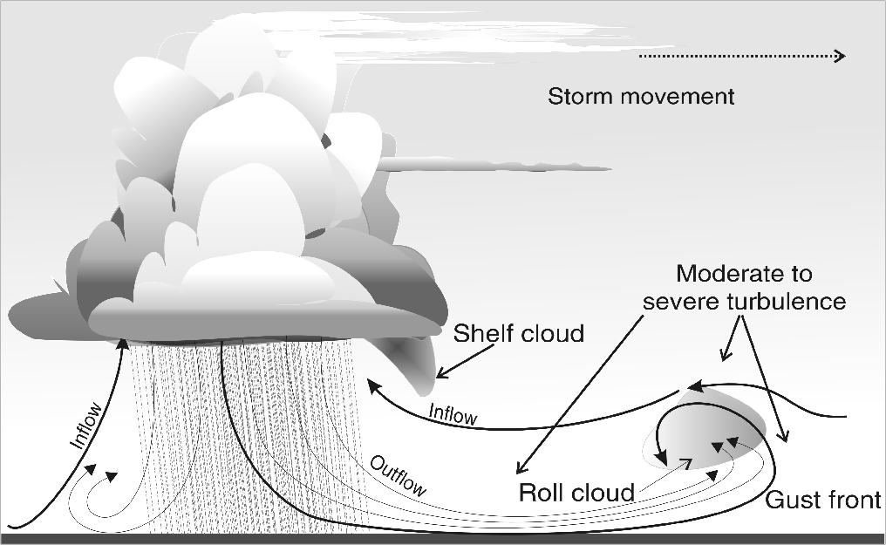
Turbulence Associated with a Downdraft
Thunderstorm out - flow :
Associated with low - level windshear
Capable of upsetting the flight of an aircraft , sometime disastrously

Slide 24
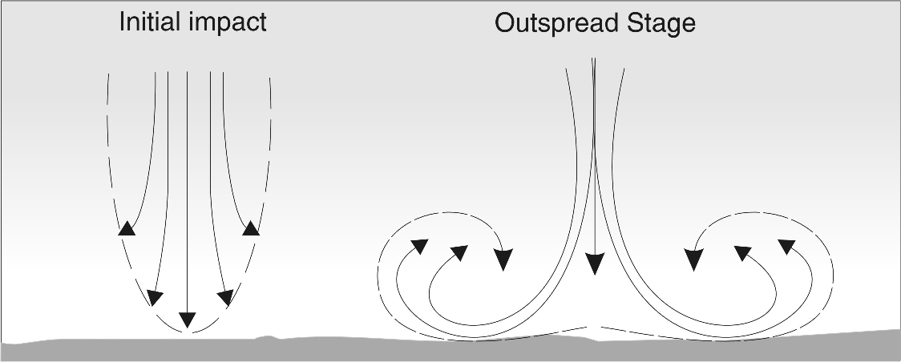
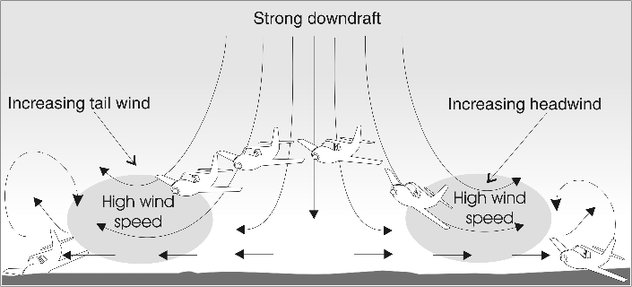
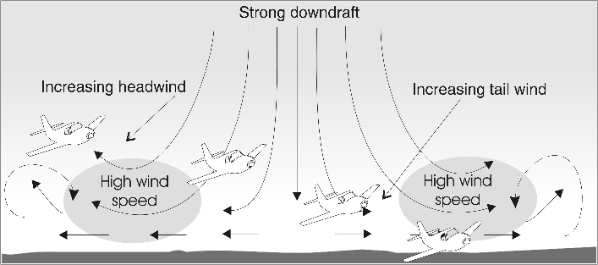
Down burst Schematic diagram
Effects on Landing and Taking Off

Slide 25
Vertical wind shear is usually detrimental to early development of Cb cells, however if there is:
strong vertical wind shear, backing and strengthening with height,
associated with a deep surface layer of warm moist air below a mid-level layer of dry air,
with an inversion separating the layers,
and a rapid decrease in temperature with height above the inversion,
then the ideal conditions are created for a severe multicell storm. Or a supercell storm if the surface wind is greater than 20 knots and the vertical wind shear exceeds about five knots for each 3000 feet.
The capping inversion keeps the lid on development until the lifting force builds up sufficiently to burst through the inversion and great buoyancy develops in the colder upper layer. Upper level divergence and a jet stream will also enhance the vertical motion.

Slide 26
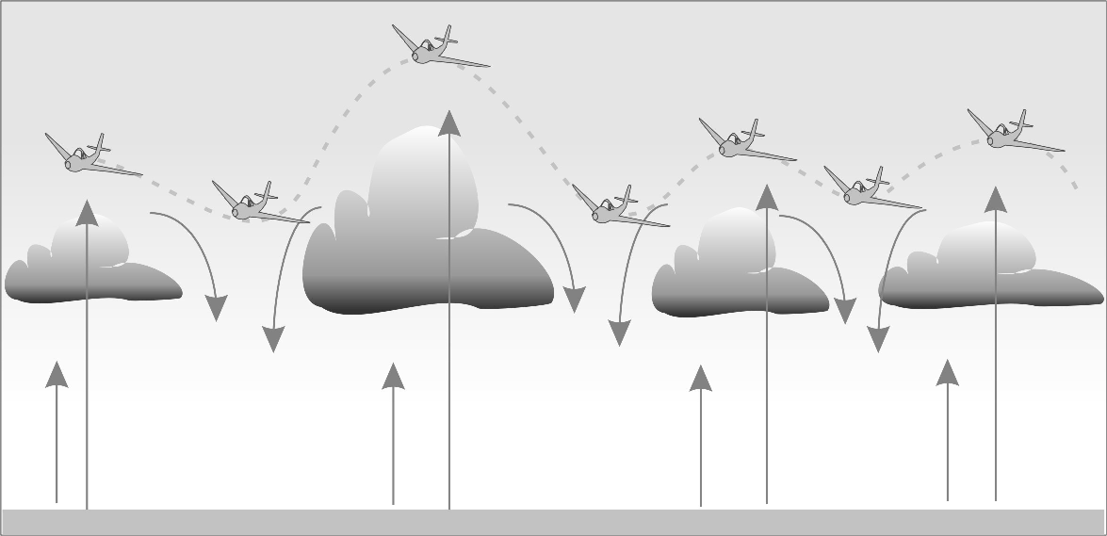
Vertical Motion Close to Convective Clouds
Air craft deviations due to convective up and down motion

Slide 27
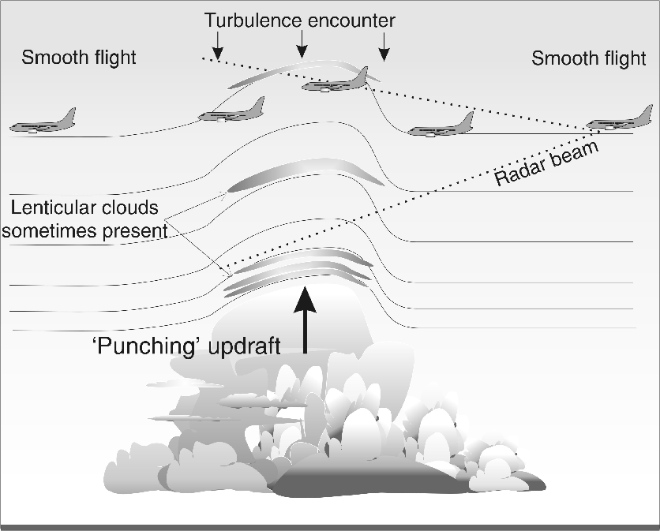
Cruising Above Cumulonimbus Tops

Slide 28


Slide 29
RECAP OF LECTURE
Clear Air Turbulence
Cumulonimbus Clouds and Thunderstorms
Lightning
Heavy Rains

