Slide 1

MET 451: Aviation Meteorology
(3 Credit Hours)
Jeffrey N. A. Aryee (PhD)
Meteorology & Climate Science Programme
Department of Physics, KNUST, Ghana
e-mail: jeff.jay8845@gmail.com
https://github.com/jeffjay88/Aviation-Meteorology
Google Classroom Code: 63zl2i

Slide 2
LECTURE 3

Slide 3
Recommended Links
https://www.youtube.com/watch?v=Duug7p7V9mo
https://www.youtube.com/watch?v=12kpSywMph4
https://www.youtube.com/watch?v=DBdEtFjDZCY
https://www.youtube.com/channel/UCATwvEbTo31R8RnBY4tX0ZA

Slide 4
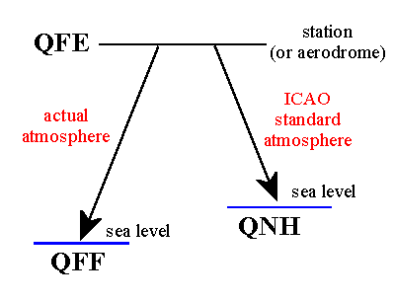
Q-scale Pressure (QNH, QFE, QFF)
QFE is the pressure at the station (or aerodrome) level.
QNH is the mean sea level pressure, derived by applying ICAO's standard atmosphere (ISA) corrections to QFE.
QFF is the mean sea level pressure, derived by taking into account the actual temperature conditions.
Example
If an airfield is 270 ft above sea level and the pressure here is 1000 mb then 1000 is the QFE.
Sea level is below the airfield so sea level pressure will be more than the airfield pressure. Sea level pressure can be calculated by using the standard lapse rate of 1 mb per 27 feet.
270 / 27 = 10 mb
Thus, sea level pressure will be 1000 + 10 = 1010 (10 more than 1000). This is the QNH.

Slide 5
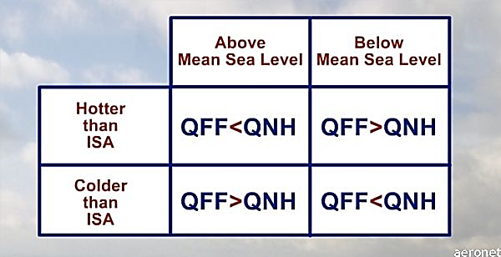
In cold and dense air, pressure changes more rapidly. Considering the above example, in case of colder than standard temperature, the pressure change will be more than 10 mb (as calculated above). Assuming that the change in pressure is 20 mb, the pressure will now be 1000 + 20 = 1020 mb. This is QFF. Thus in colder than standard temperature QFF is more than QNH.
In warm and less dense air, pressure changes less rapidly. If by applying the standard lapse rate, the pressure change was 10 mb, then for warmer than standard temperature, it will be less than 10. Assume it to be 5 mb. So if QNH is 1000 + 10 = 1010 by applying the standard lapse rate, then QFF will be 1000 + 5 = 1005 when temperature is warmer than standard. That means QFF is less than QNH in warmer than standard temperature.

Slide 6
However, for an airfield below mean sea level things are opposite.
Example If an airfield is 270 ft below sea level and the pressure here is 1000 mb then 1000 is the QFE. Sea level is above the airfield, so sea level pressure will be less than the airfield pressure. Sea level pressure can be calculated by using the standard lapse rate of 1 mb per 27 feet.
270 / 27 = 10 mb
Thus, sea level pressure will be 1000 - 10 = 990 mb (10 less than 1000). This is the QNH. In cold and dense air, pressure changes more rapidly. Thus, in case of colder than standard temperature, the pressure change will be more than 10 mb (as calculated above).
Assuming that the change in pressure is 20 mb, the pressure will now be 1000 - 20 = 980 mb. This is QFF. Thus in colder than standard temperature QFF is less than QNH. In warm and less dense air, pressure changes less rapidly.

Slide 7
STUDENT PRESENTATION ON TERMINAL AERODROME FORECAST (TAF)

Slide 8


Slide 9
RECAP OF LECTURE 3
Q-scale Pressure (Altimeter Setting)
Overview of TERMINAL AERODROME FORECAST (TAF)

Slide 10
ASSESSMENT ON LECTURE 3
1. Decode the following Aerodrome forecast for Jomo Kenyatta International Airport:
TAF: HKJK 021100Z 0212/0318 06015G25KT 9999 FEW027 BECMG 0220/0223 01005KT CAVOK BECMG 0308/0311 SCT027
Check next page for continuation of assessment

Slide 11
ASSESSMENT ON LECTURE 3
2. Write the statement below in coded form (TAF)
This report was made at Murtala Muhammed International Airport (DNMM) on the 20th of September at 10:00 UTC
Forecast valid from 20 at 12 UTC to 21 at 18 UTC
Wind 10 kt from the South/Southwest
Visibility: 8000 m
Broken clouds at a height of 1100 ft Few clouds at a height of 1900 ft, Cumulonimbus.
Probability 30% :
Temporary from 20 at 12 UTC to 20 at 16 UTC
Visibility: 5000 m
Broken clouds at a height of 900 ft Few clouds at a height of 1800 ft, Cumulonimbus. thunderstorm, rain

Slide 12
ASSESSMENT ON LECTURE 3
Becoming from 20 at 17 UTC to 20 at 19 UTC
Wind 2 kt from variable directions
Scattered clouds at a height of 900 ft
Probability 30% from 20 at 21 UTC to 21 at 01 UTC
Visibility: 5000 m
Broken clouds at a height of 800 ft Few clouds at a height of 1800 ft, Cumulonimbus.
thunderstorm, rain
Submission Deadline: Monday, October 14, 2019 | 23:59 UTC

