Slide 1

MET 256: WEATHER FORECASTING AND OBSERVATION
Jeffrey N. A. Aryee (PhD)
Meteorology & Climate Science Programme
Department of Physics, KNUST, Ghana
e-mail: jeff.jay8845@gmail.com
Google Classroom Code: qpbx2mj
https://github.com/jeffjay88/MET256_WEATHER_FORECASTING_AND_OBSERVATIONS_LECTURE_SERIES

Slide 2
Course Content (Overview)
Fundamentals of Weather Forecasting and Observation
Atmospheric Motion; Thermal Processes; Moist Processes; Clouds: Frontal cirrus associated with mid-latitude meteorology,
Observations: Meteorological instruments: Looking at instruments at the Meteorological Synoptic Station, understand how they work, understand how to take observations from the instruments; Map reading,
Plotting practice: codes, charts, tephigrams;
Simple Forecasting exercises.

Slide 3
Recommended Literature
Meteorology of Tropical West Africa; The Forecasters’ Handbook. Edited by Douglas J. Parker and Mariane Diop-Kane.

Slide 4
Second Semester Highlights
February 24 – 28, 2020 - Quiz 1
March 16 – 20, 2020 - Mid-Semester Examination Week
March 23 – 27, 2020 - Mid-Semester Break
April 20 – 24, 2020 - Quiz 2
May 4 – 15, 2020 - Second Semester Examinations
May 16, 2020 - End of Second Semester
7 Lecture Series (1 Field Observation Practical Class)
6 or 7 Assignments (To Be Given After Every Lecture Series & Submitted At Start of Next Lecture or As Specified by Lecturer)
2 Quizzes

Slide 5
LECTURE 1 (FUNDAMENTALS OF WEATHER FORECASTING AND OBSERVATION)

Slide 6
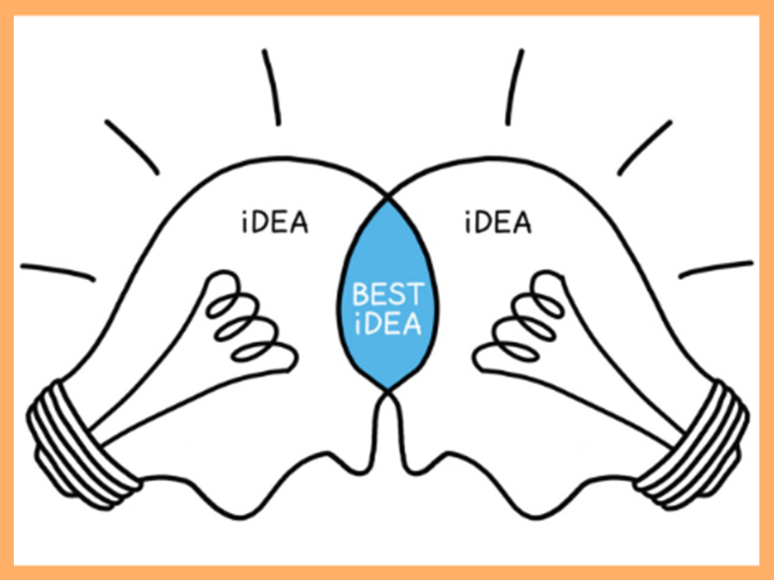
Brainstorm Questions
Weather & Climate
Meteorology
Weather Forecasting
Meteorological Weather Observation

Slide 7
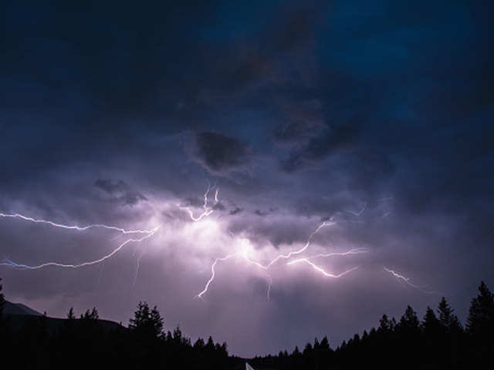
Weather
The atmospheric condition of a particular place at a particular time. This includes the temperature, wind, snow, rain, or anything else happening outside..
Weather Forecasting
Prediction of the weather through application of the physics principles, supplemented by a variety of statistical and empirical techniques. In addition, weather forecasting includes predictions of changes on Earth’s surface caused by atmospheric conditions—e.g., snow and ice cover, storm tides, and floods.
Application of current technology and science to predict the state of the atmosphere for a future time and a given location.
Weather forecasts are made by collecting as much data as possible about the current state of the atmosphere and using understanding of atmospheric processes to determine future atmospheric evolution.

Slide 8
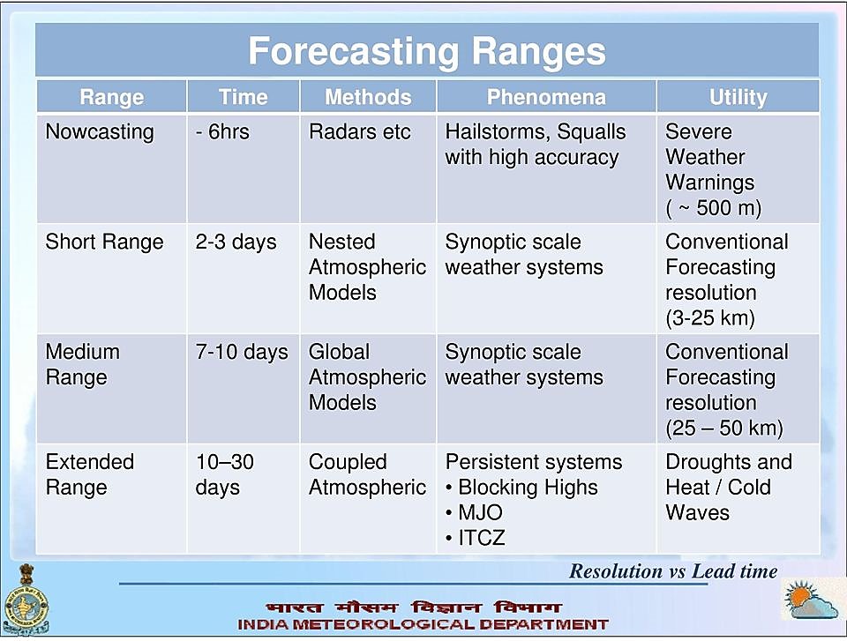
Scales / Ranges of Weather Forecasting

Slide 9
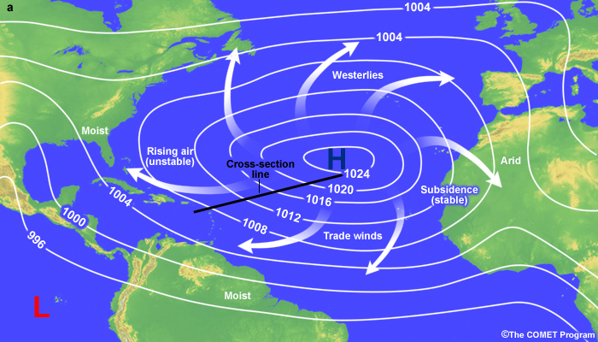
Relevance of Weather Forecasting
Reliable weather forecasts aid in deploying effective preparedness and rapid response actions in all facets of life.

Slide 10

Challenges of Weather Forecasting
The chaotic nature of the atmosphere and incomplete understanding of the processes mean that forecasts become less accurate as the range of the forecast increases.
Interaction of complex weather systems.
Sparse observation network, especially the upper air network.
Computational expensiveness of numerical weather prediction models.
Climate change makes some aspect of weather forecasting increasingly difficult.

Slide 11
Meteorological Observations

Slide 12
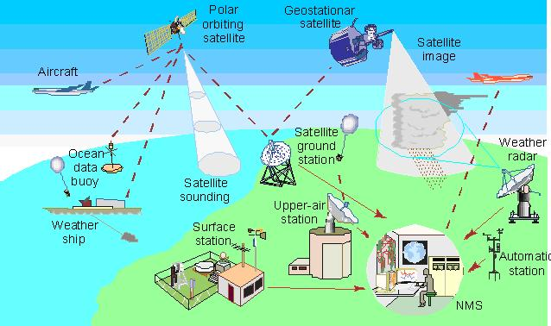
Meteorological (and related environmental and geophysical) observations are made for various reasons. These include, but are not limited to:
real-time preparation of weather analyses, forecasts and severe weather warnings
the study of climate
local weather-dependent operations (local aerodrome flying operations, construction work on land and at sea)
climatological, hydrological and agricultural meteorology
research in meteorology and climatology
Advice on good practices for meteorological measurements and observations reports are published by the World Meteorological Organization (WMO) for the Commission for Instruments and Methods of Observation (CIMO) on technical conferences, instrumentation, and international comparisons of instruments.

Slide 13

Metadata
Users of meteorological observations often need to know the actual exposure, type and condition of the equipment and its operation; and perhaps the circumstances of the observations. This is now particularly significant in the study of climate, in which detailed station histories have to be examined.
Metadata should be kept concerning all of the station establishment and maintenance schedule, changes which occur, including calibration and maintenance history and the changes in terms of exposure and staff.

Slide 14
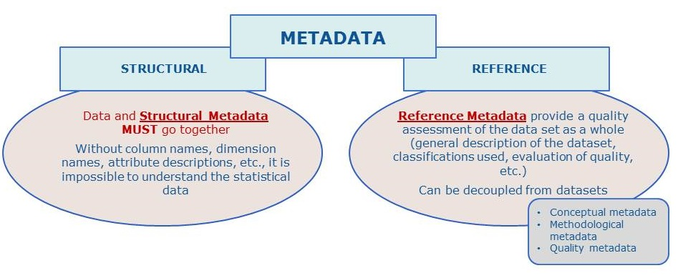
Metadata are especially important for elements which are particularly sensitive to exposure, such as precipitation, wind and temperature. One very basic form of metadata is information on the existence, availability and quality of meteorological data.

Slide 15
Station metadata should contain the following aspects of instrument exposure:
(a) Height of the instruments above the surface (or below it, for soil temperature);
(b) Type of sheltering and degree of ventilation for temperature and humidity;
(c) Degree of interference from other instruments or objects (masts, ventilators);
(d) Microscale and toposcale surroundings of the instrument, in particular:
The state of the enclosure’s surface, influencing temperature and humidity; nearby major obstacles (buildings, fences, trees) and their size;
The degree of horizon obstruction for sunshine and radiation observations;
Surrounding terrain roughness and major vegetation, influencing the wind;
All toposcale terrain features such as small slopes, pavements, water surfaces;
Major mesoscale terrain features, such as coasts, mountains or urbanization.
Most of these matters will be semi-permanent, but any significant changes (growth of vegetation, new buildings) should be recorded in the station logbook, and dated.

Slide 16
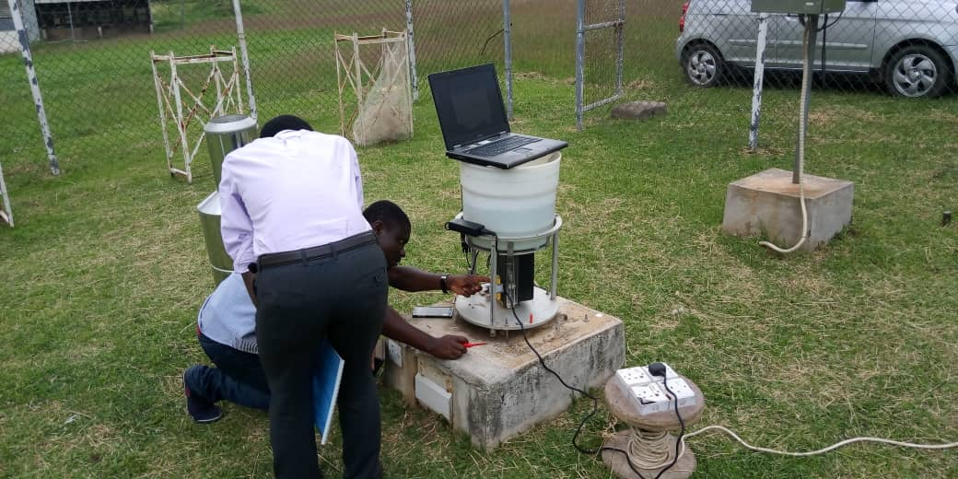
Inspection and maintenance
All synoptic land stations and principal climatological stations should be inspected no less than once every two years. Agricultural meteorological and special stations should be inspected at intervals sufficiently short to ensure the maintenance of a high standard of observations and the correct functioning of instruments.

Slide 17

Inspection and maintenance
The principal objective of such inspections is to ascertain that:
(a) The siting and exposure of instruments are known, acceptable and adequately documented;
(b) Instruments are of the approved type, in good order, and regularly verified against standards, as necessary;
(c) There is uniformity in the methods of observation and the procedures for calculating derived quantities from the observations;
(d) The observers are competent to carry out their duties;
(e) The metadata information is up to date.

Slide 18

Maintenance
Observing sites and instruments should be maintained regularly so that the quality of observations does not deteriorate significantly between station inspections.
Routine maintenance schedules include regular “housekeeping” at observing sites (for example, grass cutting and cleaning of exposed instrument surfaces) and manufacturers’ recommended checks on automatic instruments.
Routine quality control checks carried out at the station or at a central point should be designed to detect equipment faults at the earliest possible stage.
Depending on the nature of the fault and the type of station, the equipment should be replaced or repaired according to agreed priorities and timescales.
As part of the metadata, it is especially important that a log be kept of instrument faults, exposure changes, and remedial action taken where data are used for climatological purposes.

Slide 19
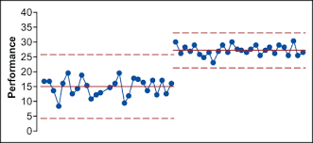
Instrumentation Changes and Homogeneity
The characteristics of an observing site will generally change over time, for example, through the growth of trees or erection of buildings on adjacent plots. Sites should be chosen to minimize these effects, if possible.
Documentation of the geography of the site and its exposure should be kept and regularly updated as a component of the metadata (WMO, 2003b).
It is especially important to minimize the effects of changes of instrument and/or changes in the siting of specific instruments.

Slide 20
Although the static characteristics of new instruments might be well understood, when they are deployed operationally, they can introduce apparent changes in site climatology. In order to guard against this eventuality, observations from new instruments should be compared over an extended interval (at least one year) before the old measurement system is taken out of service.
The same applies when there has been a change of site. Where this procedure is impractical at all sites, it is essential to carry out comparisons at selected representative sites to attempt to deduce changes in measurement data which might be a result of changing technology or enforced site changes.

Slide 21
Source: Aryee et al., 2018

Slide 22


Slide 23
RECAP OF LECTURE 1
Fundamentals of Weather Forecasting and Observation
Ranges of Weather Forecasting
Relevance and Challenges of Weather Forecasting
Meteorological Observations
Metadata
Inspection and Maintenance
Data Homogeneity

