Slide 1

MET 361: Tropical Meteorology
Jeffrey N. A. Aryee (PhD)
Meteorology & Climate Science Programme
Department of Physics, KNUST, Ghana
e-mail: jeff.jay8845@gmail.com
https://github.com/jeffjay88/MET361-TROPICAL_METEOROLOGY_LECTURE_SERIES

Slide 2
LECTURE 4

Slide 3
Recommended Links and Materials
https://www.youtube.com/watch?v=Lc-75bi61KE
https://www.youtube.com/watch?v=Z0yQuq4QdwM
https://www.youtube.com/watch?v=ZQSzzh0gX0Q

Slide 4
Class Discussion
Are there any differences between ITCZ and ITB? Discuss

Slide 5
Inter-tropical convergence zone (ITCZ)
The ITCZ is predominantly an oceanic feature where it tends to be located over the warmest surface waters. Hence, small differences of sea-surface temperature may cause considerable changes in the location of the ITCZ.

Slide 6
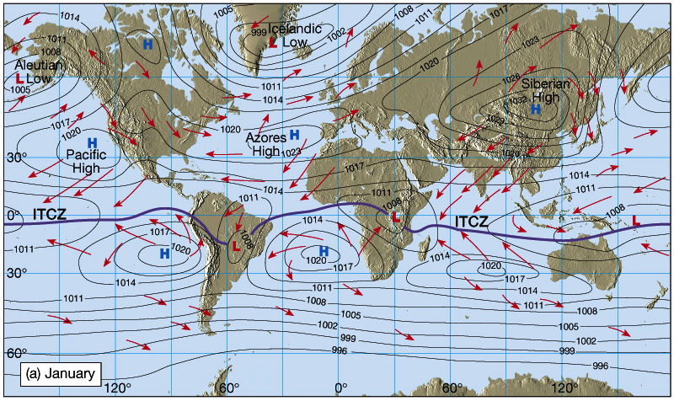
Sea-surface temperature of at least 27.5°C seems to provide a threshold for organized convective activity.
ITCZ is broadly regarded as confluence region for the trade winds of the two hemispheres although there are local departures and deviations.

Slide 7
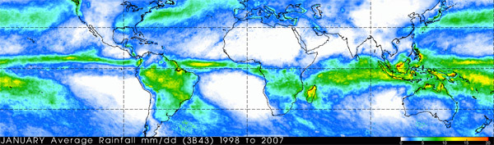
The convective rainfall belt of the ITCZ has very sharply defined latitudinal limits. In other words, moving southwards into the ITCZ, precipitation increases by 440 per cent in a meridional distance of only 330 km.

Slide 8
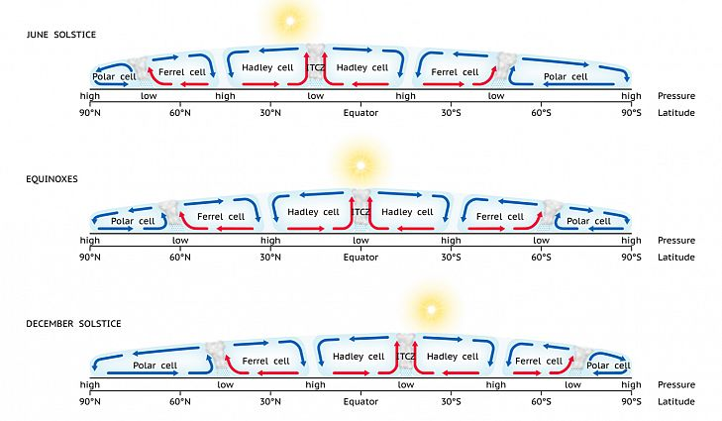
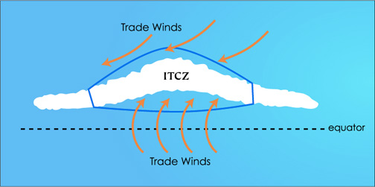
As climatic features, the equatorial trough and the ITCZ are asymmetric about the equator, lying on average to the north. They also move seasonally away from the equator in association with the thermal equator (zone of seasonal maximum temperature).

Slide 9
Inter-Tropical Boundary (ITB).
In West Africa, the ITCZ is locally termed the Inter-Tropical Boundary (ITB) as in Ghana or Inter Tropical Discontinuity (ITD) in Nigeria or (ITF) as in the French countries.
Unlike the ITCZ, the zones of active weather are usually located about 1º (about 110 km) south of the surface position of the ITD with clear or dusty weather on the northern side.

Slide 10
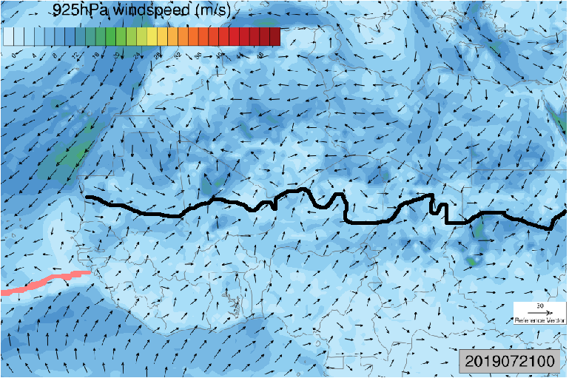
The ITCZ is usually south of the ITB where vigorous tropical disturbances really occur. On satellite images, ITCZ is clearly identified by large convective clouds or cluster of clouds.
The ITB is the zone where the hot dry harmattan air mass from the Sahara in the north converges with the warm, moist monsoon air from the South Atlantic.
Its movement controls the amount, temporal and spatial distribution of rainfall.

Slide 11
The surface position of the ITD is located by the 15 ºC dew-point limit on the synoptic weather chart.
ITB/ITD is a surface of discontinuity in the trade winds systems where there is an abrupt change in the variable wind; hence the name Inter Tropical Discontinuity.
It has almost a zonal orientation and oscillates in the N-S direction in response to the relative position of the apparent movement of the sun.

Slide 12
Equatorial Waves
In the 1980s and 1990s, technology finally enabled us to detect these waves in our atmosphere:
Hovmöller diagrams constructed from infrared satellite imagery reveal well defined bands of cloudiness associated with westward moving disturbances in the equatorial region (~10°S- 10°N) and Selective filtering of precipitable water and infrared satellite data, aimed at identifying these waves, was successful.
Some equatorial waves are observed to be coupled to convection while other waves are not, and waves that are not coupled propagate much more quickly than coupled waves.
Recent analyses of satellite data have linked equatorial waves on the scale of 3,000–4,000 km, period range of 4–5 days, moving with speeds of ~8–10 m s-1 to initiation of tropical cyclones.
All waves result from a disturbance or instability that creates a perturbation on an initially balanced flow. Overshooting of the restoring force acting to eliminate the perturbation creates the wave oscillation.

Slide 13


Slide 14
RECAP OF LECTURE
Inter-tropical Convergence Zone (ITCZ)
Inter-tropical Discontinuity
Their Identification, Differences, etc.

Slide 15
ASSESSMENT ON LECTURE 4
Detail the differences between the ITCZ and ITB.
Deadline: November 19, 2019 (1100 GMT)

