Slide 1

MET 361: Tropical Meteorology
Jeffrey N. A. Aryee (PhD)
Meteorology & Climate Science Programme
Department of Physics, KNUST, Ghana
e-mail: jeff.jay8845@gmail.com
https://github.com/jeffjay88/MET361-TROPICAL_METEOROLOGY_LECTURE_SERIES

Slide 2
LECTURE 3

Slide 3
Recommended Links and Materials
http://www-das.uwyo.edu/~geerts/cwx/notes/chap13/trop_cyclogenesis.html
https://www.youtube.com/watch?v=W2UDbDXXYGE
https://www.youtube.com/watch?v=YtvaX4AE54E

Slide 4
Class Discussion
What is tropical cyclogenesis?

Slide 5
Eastern Pacific: Tropical storms forming in the eastern North Pacific have been identified with both instabilities in the ITCZ and with moist easterly waves and equatorial waves intruding from the Atlantic.

Slide 6
Atlantic Ocean: The monsoon in the Atlantic basin is mainly confined to West Africa. Easterly waves forming here are influenced by local convection and mesoscale systems that initiate near the Aïr Mountains, Jos Plateau, and Guinea Highlands. Another source of Atlantic tropical cyclogenesis is subtropical cyclones which typically form at the equatorward extreme of a midlatitude frontal zone.

Slide 9
The movement of energy from the tropical surface to the atmosphere is an important part of the global energy cycle. We focus here mainly on thermodynamic or static energy, which is a sum of the following:
1.Potential energy, which is associated with the gravitational force or position relative to the centre of the earth
2.Sensible heat or internal energy, which depends on temperature
3.Latent heat, which is absorbed or released during the phase change of water
Thermodynamic energy is conserved by individual air parcels during adiabatic vertical motion and can be described in equation form as:
Dry static energy = sensible heat + geopotential
Moist static energy = sensible heat + geopotential + latent heat

Slide 10
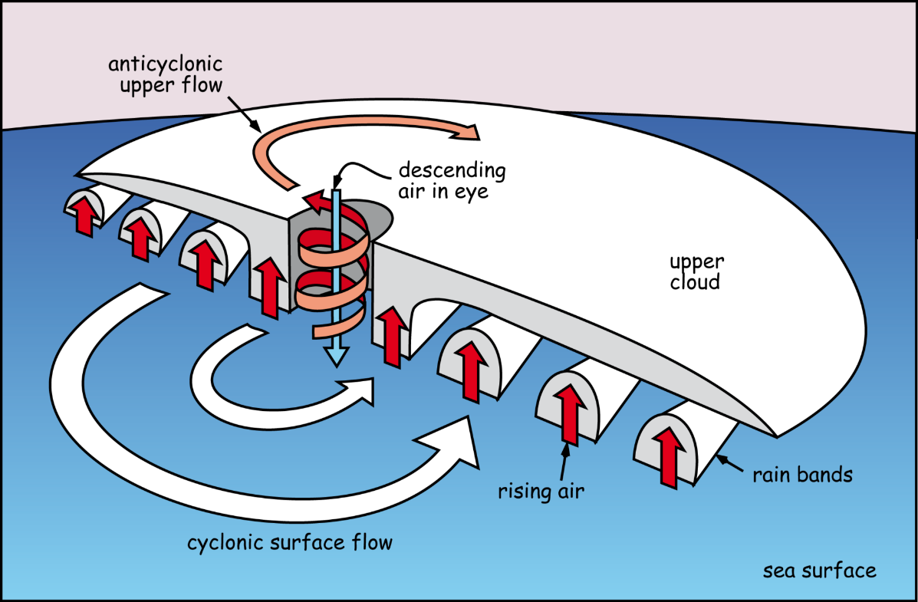
Given a favourable environment, an incipient disturbance may organize into a tropical storm. Maintenance of these favourable environmental conditions for tropical cyclogenesis is ideal for further intensification to the tropical storm stage
The warm ocean waters of the tropics provide the energy source for the tropical cyclone.
Evaporation (latent heat flux) and heat transfer (sensible heat flux) from the ocean surface warm and moisten the tropical storm boundary layer.
The heat and moisture fluxes and the potential energy comprise the moist static energy of the air. Conversion of this moist static energy into kinetic energy via convection is the mechanism by which a tropical cyclone intensifies.

Slide 11
EQUATOR

Slide 12
Global Distribution and Monitoring of Tropical Cyclones
The 20th century tropical cyclones bring devastation to all of the continents with footholds in the tropics: names such as Tracy (Australia), Bhola (Bangladesh), Mitch and Katrina (the Caribbean, Mexico, Central America and the United States) bring to mind tragedy to millions around the world.
Tropical cyclones do not form very close to the equator and do not ever cross the equator;
The western North Pacific is the most active tropical cyclone region. It is also the region with the largest number of intense tropical cyclones (orange through red tracks);
Tropical cyclones in the western North Pacific and the North Atlantic can have tracks that extend to very high latitudes. Storms following these long tracks generally undergo extratropical transition;

Slide 13
The North Indian Ocean (Bay of Bengal and Arabian Sea) is bounded by land to the north and the eastern North Pacific is bounded by cold water to the north. These environmental features limit the lifetimes of storms in these regions.
The Bay of Bengal has about five times as many tropical cyclones as the Arabian Sea. The high mountain ranges and low-lying coastal plains and river deltas of the Bay of Bengal combine to make this region extremely vulnerable to tropical cyclones. Indeed, the two most devastating tropical cyclones on record occurred in this region
Southern Hemisphere tropical cyclones are generally weaker than storms in the North Pacific and Atlantic basins;
The extension of the subtropical jet into tropical latitudes in the Southern Hemisphere acts to constrain the tracks of tropical cyclones. Even so, a few Southern Hemisphere tropical cyclones undergo extratropical transition;
Although rare, systems resembling tropical cyclones can occur in the South Atlantic Ocean and off the subtropical east coasts of Australia and southern Africa.

Slide 14
Tropical cyclone classification schemes for the different regions.
The associated damage of cyclones refers to the expected damage in the maximum wind zone. Damage will vary depending upon:
Distance from the zone of maximum winds;
Exposure of the location (i.e., sheltered or not);
Building standards;
Vegetation type; and
Resultant flooding and wave action.
The effects of storm surge, tide, or wave action are not explicitly included in the classifications.

Slide 15
The End of the Tropical Cyclone Lifecycle: Decay or Extratropical Transition (ET)
When a tropical cyclone moves into a hostile environment it will either decay or undergo extratropical transition. As might be expected, a hostile environment includes at least one of the following:
strong vertical wind shear (in excess of 10-15 m s-1 over a deep layer),
cool ocean temperatures under the storm core (less than 26°C),
dry air intrusion, or landfall.
Cool SST and strong shear are typical of a mid-latitude environment, explaining why this region is generally thought to be a tropical cyclone graveyard. The hostile environment may unbalance the storm so that it ceases to be self-sustaining—and will decay—but intense storms may instead undergo transition into an extratropical cyclone.

Slide 16
Extratropical Transition (ET)
Poleward movement of a tropical cyclone is generally expected to lead to the decay of the system as it encounters the hostile, strongly sheared environment and cooler waters (or land) of the midlatitudes.
The exceptions to this rule are extratropically transitioning tropical cyclones. The process by which an initially tropical cyclone is transformed into an extratropical cyclone is known as Extratropical Transition. Tropical cyclones typically weaken as they recurve, but as they move into the extratropics these systems can re-intensify into intense midlatitude storms with extensive regions of intense rain and larger gale (and even hurricane) force wind areas than their tropical antecedents. The remnant tropical cyclone can also provide a region of enhanced thermal contrast for the later development of an intense midlatitude storm.

Slide 17
The rapid forward speed, the large size of their gale force wind area and intense rainfall region, and extraordinarily large ocean waves created by an ET event can persist long after its "tropical storm" status has been discontinued.
The likelihood of ET for an individual storm depends on
the structure and intensity of the tropical cyclone itself,
its thermodynamic environment (convective forcing),
the structure of the mid-latitude trough (especially the spatial extent and strength of its associated vertical wind shear) interacting with the tropical cyclone, and
the relative location of the tropical cyclone in the trough.

Slide 18
Post-landfall Structure
Two major changes of the storm environment at landfall cause it to weaken:
loss of the ocean energy source and
increased friction.
The resulting changes in storm structure lead to a redistribution of the significant weather associated with the storm.

Slide 19
Evaporation (latent heat flux) and heat transfer (sensible heat flux) from the ocean surface warm and moisten the tropical storm boundary layer, providing energy to feed the clouds that drive the tropical cyclone. Hence, when the storm loses this energy source it begins to weaken. The lack of a moisture source over land weakens the convection and associated subsidence in the eye weakens the upper tropospheric warm core, raising the central pressure of the storm. This increase in the central pressure leads to weaker pressure gradient and weaker gradient wind.
Surface friction effects on the atmosphere increase significantly after landfall. The ocean surface has less drag on the air than the solid land so the storm is able to sustain stronger peak surface winds over water. Land surfaces have a greater "roughness" (due to topography and natural and man-made structures) which leads to greater frictional drag and weaker winds.

Slide 20
Tropical cyclones are the most hazardous tropical weather systems.
Their hazards include: strong winds, storm surge, wind-driven waves, heavy rainfall and flooding, tornadoes, and lightning. The impact of tropical cyclones can be categorized as direct and indirect or secondary impact. Direct impacts include coastal erosion by storm surge and loss of infrastructure from wind stress. Examples of indirect impacts are diseases associated with water contamination, oil price increases when drilling platforms and refineries are damaged or closed, and fires started by live, downed power lines. Economic loss from damage to crops and fisheries where livelihoods are dependent on agriculture, post disaster stress, and insurance rate increases are long term indirect effects. TCs remain a serious threat to society, especially as coastal population growth accelerates—a continuing trend in many locations around the world.

Slide 21


Slide 22
RECAP OF LECTURE
Tropical Cyclogenesis
Tracks and Intensities of Tropical Cyclones
Global Distribution and Monitoring of tropical cyclones
Tropical Cyclone Classification Schemes
End of Tropical Cyclone: Decay or Extra-tropical transition

Slide 23
ASSESSMENT ON LECTURE 3
Why do tropical cyclones not form in the equatorial regions (approximately 5 degrees away from the equator)? Explain.
The mid-latitude environment is generally thought to be a tropical cyclone graveyard. Why?
Deadline: October 17, 2019 (1100 GMT)

