Slide 1

MET 361: Tropical Meteorology
Jeffrey N. A. Aryee (PhD)
Meteorology & Climate Science Programme
Department of Physics, KNUST, Ghana
e-mail: jeff.jay8845@gmail.com
https://github.com/jeffjay88/MET361-TROPICAL_METEOROLOGY_LECTURE_SERIES

Slide 2
LECTURE 2

Slide 3
Scales of Weather Systems
Planetary Scale ~10,000 km
- Equatorial waves
(Kelvin and Rossby waves;
Madden-Julian Oscillation)
Synoptic Scale ~1000 km
Easterly waves, jet streaks
Tropical cyclones
Mesoscale ~100km
–MCSs
– Organized moist convection
Mesoscale ~10km
– Unorganized convection, cumulus congestus
Scales smaller than 2 km defined as micro-scale phenomena

Slide 4
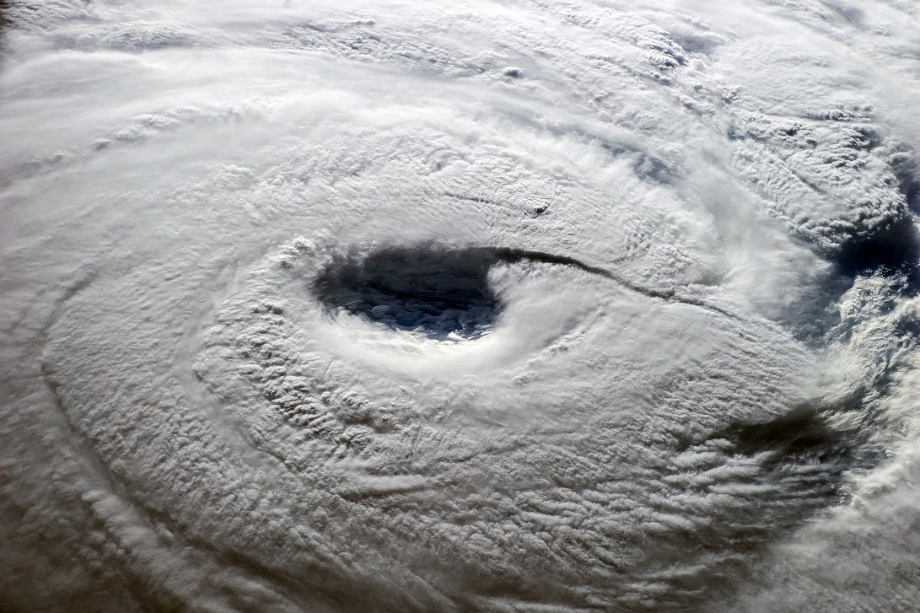
Tropical Cyclone ???
A tropical cyclone is a warm-core, non-frontal, synoptic scale low pressure system that develops over the ocean and has a definite organized surface circulation.
a rapidly rotating storm system characterized by a low-pressure center, a closed low-level atmospheric circulation, strong winds, and a spiral arrangement of thunderstorms that produce heavy rain or squalls.
Warm-core: by definition means that the formation or source region of the developing system is warm enough. This is crucial for increasing intensity of the system with height.

Slide 5
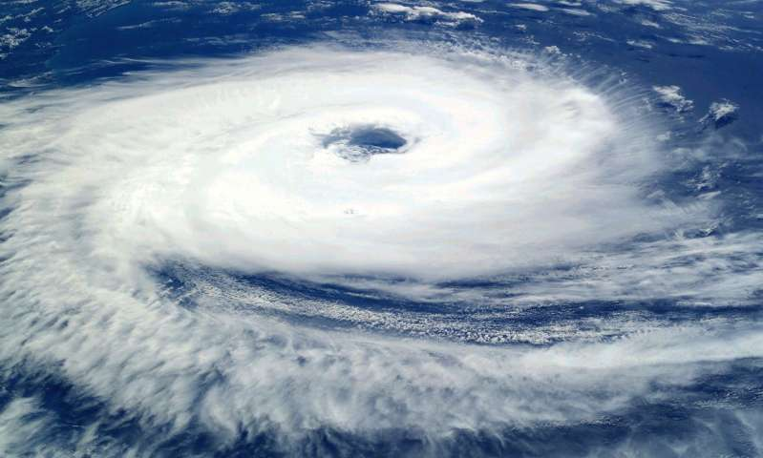
Tropical Cyclone ???
Non-frontal: they do not develop from frontal waves or systems. There are many conditions can lead to the formation of these depressions (low-pressure systems) without frontal characteristics.
Synoptic scale low pressure system: the scale of the low-pressure systems of the lower atmosphere; dimensions typically range from 1000 to 2500 kilometers

Slide 6
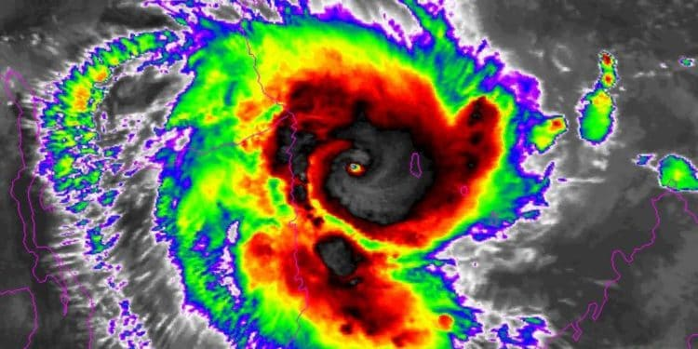
Tropical Cyclone
Tropical cyclones spin counter-clockwise in the Northern Hemisphere (NH) and clockwise in the Southern Hemisphere (SH), with corresponding variations in their spiral rainband structure. In a tropical cyclone, the wind flows inward cyclonically at lower levels, spiraling upward in the zones of deep convection (the central eyewall or the spiral rainbands), spiralling outward aloft, just below the tropopause.

Slide 7
Names of cyclones in Different country
NAME | LOCATION
Hurricane | West Indies and the coast of florida
Typhoon | Philippine Islands, The coast of China and Japan
Cyclone | Bay Of Bengal (India) and the Arabian Sea
Welly-Welly | Northeast and Northwestern coast of Australia
Tornado | USA and Mexico

Slide 8
Lifecycle Of A Typical Tropical Cyclone
Severe Tropical Cyclone
(major hurricane, supertyphoon).
Incipient Disturbance
Tropical Storm
Tropical Cyclone
(hurricane, typhoon)
These stages are associated with changes in the storm intensity and structure.
A tropical cyclone will not develop instantaneously: some intermediate, weaker disturbance is needed to provide the "seed" from which a tropical cyclone can develop.
Having reached its peak intensity at one of these stages for storm intensity classifications, the storm will either decay or undergo extratropical transition.

Slide 9
Class Discussion
Why do tropical cyclones form over ocean rather than on lands?

Slide 10
Key Structural Features of a Mature Tropical Cyclone
A few structural elements are common to all tropical cyclones.
(i) boundary layer inflow,
(ii) eyewall,
(iii) cirrus shield,
(iv) rainbands, and
(v) upper tropospheric outflow are found in all tropical depressions and tropical storms.
As these storms become more intense, a
(vi) clear central eye becomes visible from satellite.

Slide 11
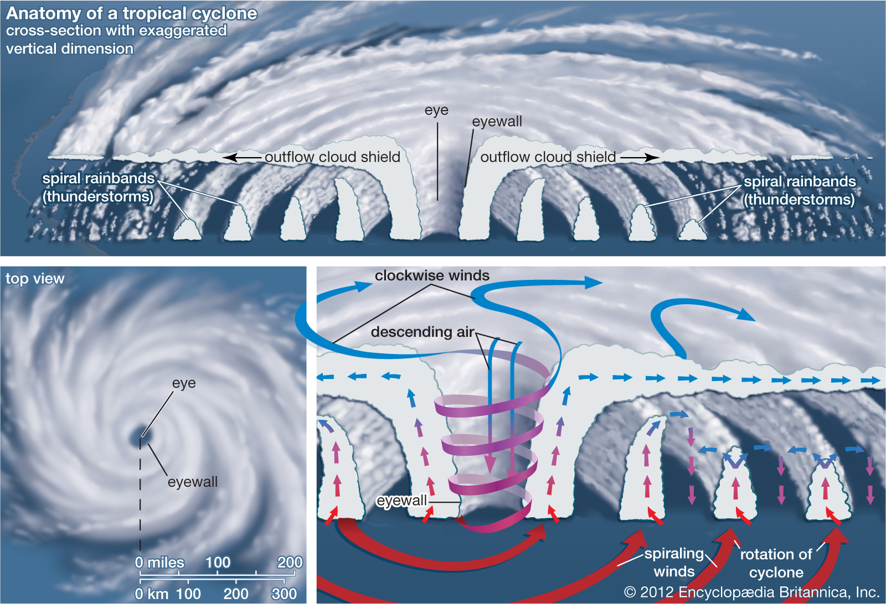

Slide 12
The clear region in the center of a mature tropical storm is known as the eye and is relatively calm with light winds and the lowest surface pressure.
An organized band of thunderstorms immediately surrounds the calm, storm center. This region is the eyewall and the strongest winds are to be found on the inner flank of this thunderstorm annulus.
Friction slows the winds near the surface, resulting in convergence in the cyclonic boundary layer flow which spirals into the eyewall forcing dynamically-driven convection.
Under the eyewall, this convergence is enhanced due to the zone between the moist inward frictional flow and the dry subsident air flowing outwards from the eye

Slide 13
Necessary Conditions for Tropical Cyclone Formation
sufficient ocean thermal energy [SST > 26°C to a depth of 60 m],
enhanced mid-troposphere (700 hPa) relative humidity,
conditional instability
THERMODYNAMIC
CONDITIONS
enhanced lower troposphere relative vorticity
weak vertical shear of the horizontal winds at the genesis site, and
displacement by at least 5° latitude away from the equator.
DYNAMIC
CONDITIONS

Slide 14
The first three thermodynamic parameters measure the ability to support deep convection.
The latter, dynamical parameters, such as vertical wind shear measure the daily likelihood of genesis.
In recent years, a number of tropical cyclones have remained within 5° latitude of the equator, suggesting a need to relax this constraint.

Slide 15
“Necessary but not sufficient” means that all of these conditions must be present simultaneously before tropical cyclogenesis can occur, but even if all of these conditions are met, tropical cyclogenesis may not occur.
Tropical cyclogenesis may therefore be said to have occurred when the tropical storm has become self-sustaining and can continue to intensify without help from its environment (external forcing).

Slide 16


Slide 17
RECAP OF LECTURE
Scales of Weather Systems
Tropical Cyclones
Definitions
Nomenclature
Life cycle
Structural Features
Necessary conditions for TC formation

Slide 18
ASSESSMENT ON LECTURE 2
Why do tropical cyclones dissipate when traversing vast continental lands?
Differentiate between a super cyclone, super-typhoon, a major hurricane and an intense hurricane?
Deadline: October 10, 2019 (1100 GMT)

