Slide 1

MET 361: Tropical Meteorology
Jeffrey N. A. Aryee (PhD)
Meteorology & Climate Science Programme
Department of Physics, KNUST, Ghana
e-mail: jeff.jay8845@gmail.com
https://github.com/jeffjay88/MET361-TROPICAL_METEOROLOGY_LECTURE_SERIES

Slide 2
Course Objective
At the end of this course, students should:-
have a general knowledge of tropical weather systems.
understand the mechanisms driving changes in the tropical systems and their teleconnections.
have understanding of natural and anthropogenic effects on earth system climate, with focus on the tropics.

Slide 3
Course Content (Overview)
Introduction to Tropical Meteorology: Definition of tropical region, review of geostrophic winds
Tropical Deep Convection: thermodynamics and stability, role of wind shear.
Tropical Cyclones: Definition, location, formation, factors, interactions with mid-latitude westerly winds, north-east trade winds, south-west trade winds, effects on weather.
Global Tropical Dynamics: Shallow water model, Fundamental wave models, models of West African Monsoon (WAM), Mean observed structure, role of barotropic and baroclinic instability, links with surface and diurnal cycle, initiation in convection or over hills, interaction with upper levels and genesis of hurricanes.

Slide 4
Recommended Literature
Meteorology of Tropical West Africa; The Forecasters’ Handbook. Edited by Douglas J. Parker and Mariane Diop-Kane.
Jakob, C., 2001: Cloud parametrization - Progress, Problems and Prospects. ECMWF Seminar.
Betts, A. K., and C. Jakob. 2002a & b: Evaluation of the diurnal cycle of precipitation, surface thermodynamics, and surface fluxes in the ECMWF model using LBA data. J. Geophys. Res., 107.
Sobel, A. H. and C. S. Bretherton, 2000: Modeling tropical precipitation in a single column. J. Climate, 13, 4378-4392.
Wheeler, M., G. N. Kilidis and P. J. Webster, 2000: Large-scale dynamical fields asociated with convectively coupled equatorial waves. J. Atmos. Sci., 57, 613-640.

Slide 5
First Semester Highlights
October 17, 2019 - Quiz 1
November 4 – 8, 2019 - Mid-Semester Examination Week
November 11 – 16, 2019 - Mid-Semester Break
November 28, 2019 - Quiz 2
December 9 - 20, 2019 - First Semester Examinations
December 21, 2019 - End of First Semester
7 Lecture Series
7 Assignments (Given After Every Lecture Series & To Be Submitted At Start of Next Lecture or As Specified by Lecturer)
2 Quizzes

Slide 6
LECTURE 1

Slide 7
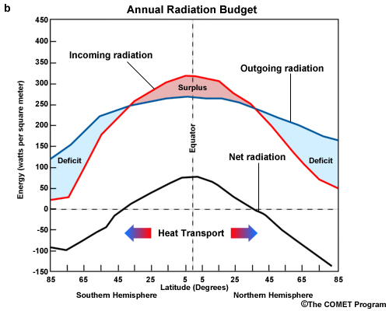
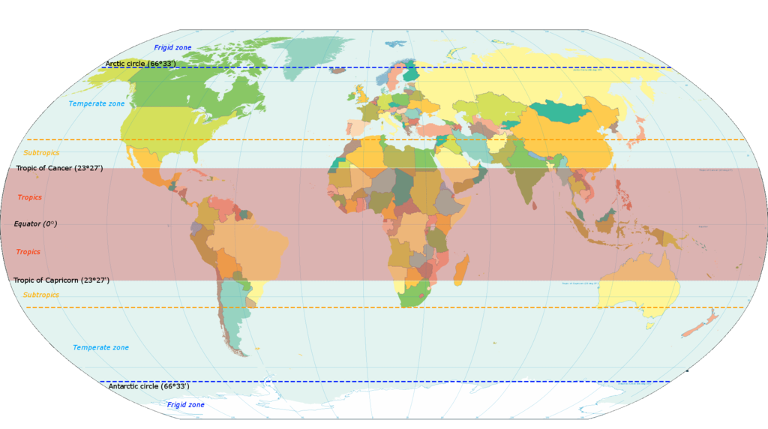
Tropics ???
The portions of the earth bounding the Equator (~ 23º N / S), where the Sun is usually directly overhead.

Slide 8
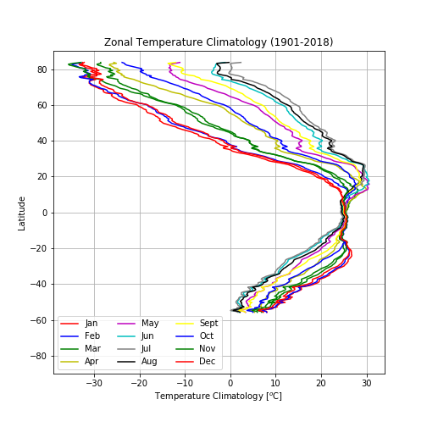
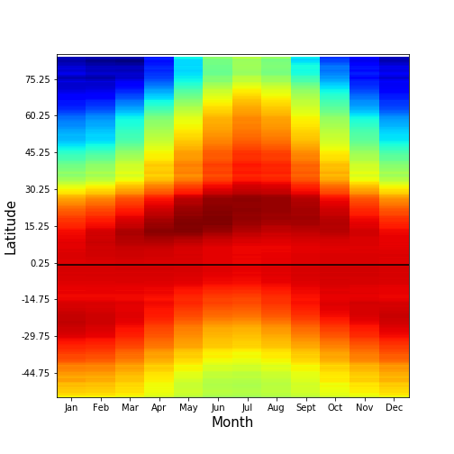
Zonal temperature climatologies from CRU data

Slide 9
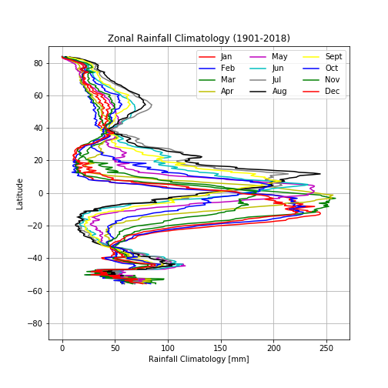
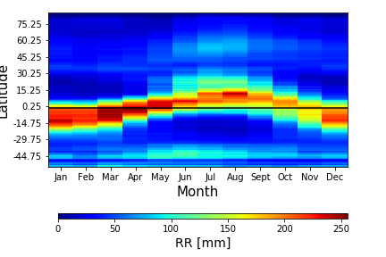
Zonal rainfall climatologies from CRU data

Slide 10
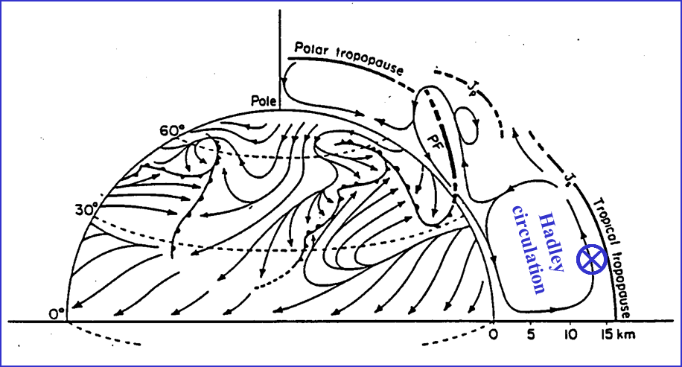
Schematic adapted from Defant (1958)
Riehl (1979) defines the meteorological "tropics" as the parts of the Earth where atmospheric processes differ significantly from those in higher latitudes. With this definition, the dividing line between the "tropics" and the “extratropics” is between the easterly and westerly wind regimes, and thus, varies with longitude and fluctuates seasonally.
Moreover, in reality, no part of the atmosphere exists in isolation and interactions between the tropics and extratropics are important.

Slide 11

Meteorology ???
the science of the atmosphere with primal focus on weather processes and forecasting.
the science of "things in the air“, which include phenomena that are bound by the atmosphere: temperature, air pressure, water vapor, as well as their interaction and spatiotemporal changes.
is a sub-discipline of the atmospheric sciences which deals with chemistry of the atmosphere, the physics of the atmosphere, and weather forecasting.
Meteorology is a physical science -- a branch of natural science that tries to explain and predict nature's behavior based on empirical evidence, or observation.
Tropical Meteorology ???
… meteorology of the tropics.

Slide 12
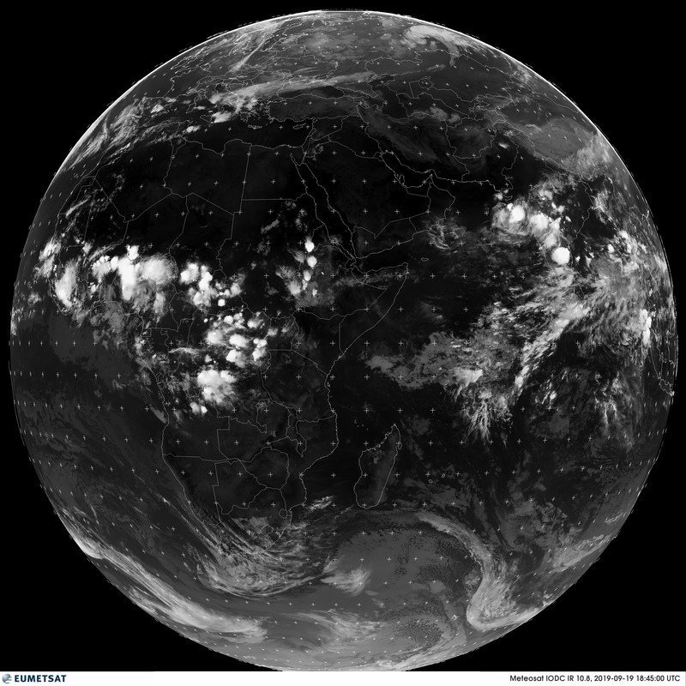
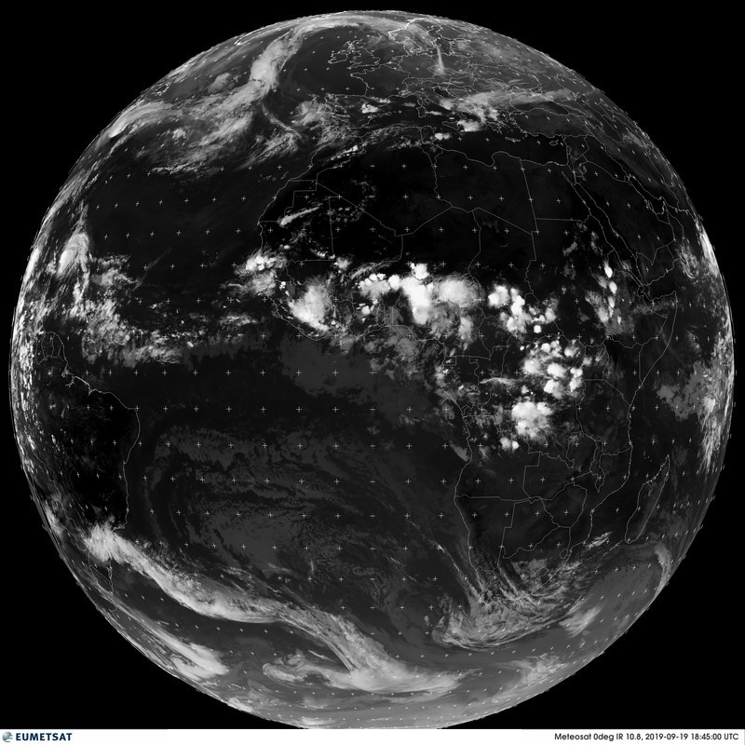
Tropical Overview in Satellite Images
Infrared satellite imagery from geostationary satellites located at different longitudes.
1845 GMT on
September 19, 2019
The white areas in the tropics and subtropics indicate cold cloud tops and correspond with cirrus cloud in the high troposphere. Much of which is produced by deep convection in which air is rapidly ascending.
The individual convective updraughts cover a much smaller fractional area of the area covered by the cirrus, which blows away from the convection. Deep convection is frequently concentrated in clumps referred to as cloud clusters. Sometimes these have the form of organized convective systems, an extreme case being that of a tropical cyclone.

Slide 13
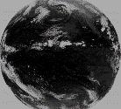
The dark areas in the tropics and subtropics correspond to regions devoid of clouds, or at least high cloud. These are regions in which air is slowly subsiding.
The grey areas, mainly in the subtropics and at higher latitudes correspond with regions of low cloud, typically stratus or stratocumulus or at least high cloud.
The band of white cloud just north of the equator (Figure below) marks the ITCZ. This cloud marks a strip of deep convective systems that constitute the ascending end of the Hadley circulation to be discussed later.

Slide 14
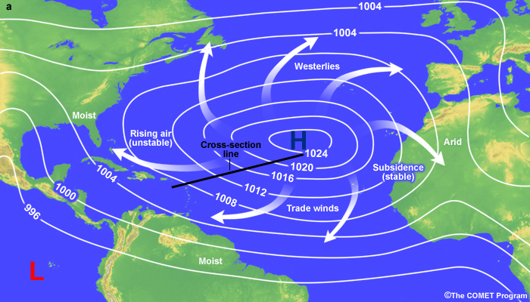
Relevance of Tropical Meteorology
Understanding tropical atmospheric events are necessary determinants of global atmospheric occurrences.

Slide 15

Challenges of Tropical Meteorology
Interaction of complex weather systems.
Sparse observation network, especially the upper air network.
Limited surface to lower-atmospheric information due to limited vertical coverage of satellites.

Slide 16
THE CONCEPT OF GEOSTROPHIC BALANCE

Slide 17

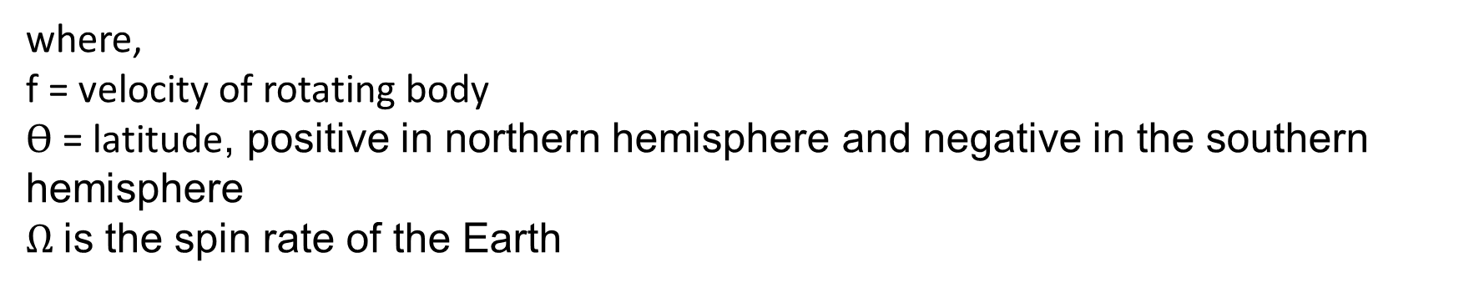
CORIOLIS FORCE
The apparent force that displaces a body in a rotating frame.
Coriolis force deflects winds to the right in the Northern Hemisphere and to the left in the Southern Hemisphere.
Coriolis force is represented mathematically as:
CF $= 2Ω f\sin{ϴ}$
where,
f = velocity of rotating body
$ϴ$ = latitude, positive in northern hemisphere and negative in the southern hemisphere
$Ω$is the spin rate of the Earth

Slide 18
PRESSURE GRADIENT FORCE (PGF)
The force that exists between two regions or bodies of different pressures.
The force between a high and low pressure region.
Note that matter is transported from the high pressure region to the low
LOW
HIGH
PGF

Slide 19
GEOSTROPHIC BALANCE
The balance of pressure gradient force (PGF) by coriolis force.
Class Discussion
Where is Coriolis force greatest – at the poles or towards the Equator? Explain

Slide 20
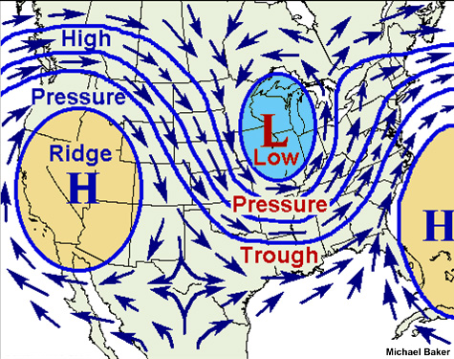
GEOSTROPHIC WINDS
theoretical winds balanced by the Coriolis and Pressure Gradient forces
An air parcel initially at rest will move from high pressure to low pressure because of the pressure gradient force (PGF).
However, as that air parcel begins to move, it is deflected by the Coriolis force to the right in the northern hemisphere (to the left on the southern hemisphere).
As the wind gains speed, the deflection increases until the Coriolis force equals the pressure gradient force. At this point, the wind will be blowing parallel to the isobars. When this happens, the wind is referred to as geostrophic.

Slide 21


Slide 22
ASSESSMENT ON LECTURE 1
With relevant diagram(s), explain how the tropics contribute to the global heat transport.
Imagine a boy on a “merry-go-round” targets a stagnant object and decides to throw a ball at it while the merry-go-round is in motion. What happens to the ball the boy throws at the target while the merry-go-round (i) moves slowly and (ii) moves faster?
What concept does the above illustration depict?
Explain, in brief, the concept of geostrophic winds.

