Slide 1

MET 459: Tropical Climatology
Jeffrey N. A. Aryee (PhD)
Meteorology & Climate Science Programme
Department of Physics, KNUST, Ghana
e-mail: jeff.jay8845@gmail.com
https://github.com/jeffjay88/Tropical-Climatology
Google Classroom code: i0n0ep

Slide 2
Course Content (Overview)
Defining the Tropics? What is Climatology? Elements of Climatology. Introduction to global climatology, Hadley circulation
Jet streams; Special focus on West Africa,
Seasonal cycles of global climate, Regional variations
Monsoons; Characteristics, Focus on West African Monsoon (WAM): Dry/wet season, Mechanisms, Interannual variability;
Teleconnections: ENSO and its global links, NAO; MJO, Intraseasonal effects on WAM Observations (past and future)
Factors controlling interannual variability over Africa, Local and remote SSTs, Soil moisture; Intraseasonal variability:
Climatology aiding forecasting – ‘seamless’ weather and climate prediction

Slide 3
Recommended Literature
Meteorology of Tropical West Africa; The Forecasters’ Handbook. Edited by Douglas J. Parker and Mariane Diop-Kane.

Slide 4
First Semester Highlights
October 18, 2019 - Quiz 1
November 4 – 8, 2019 - Mid-Semester Examination Week
November 11 – 16, 2019 - Mid-Semester Break
November 29, 2019 - Quiz 2
December 9 - 20, 2019 - First Semester Examinations
December 21, 2019 - End of First Semester
6 – 7 Lecture Series
2 Group Presentations
4 Assignments (Given After Every Lecture Series & To Be Submitted At Start of Next Lecture or As Specified by Lecturer)
2 Quizzes

Slide 5
LECTURE 1

Slide 6
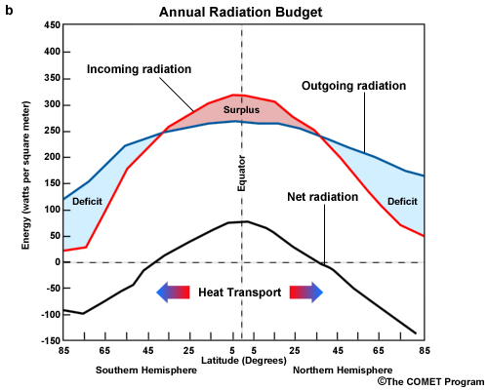
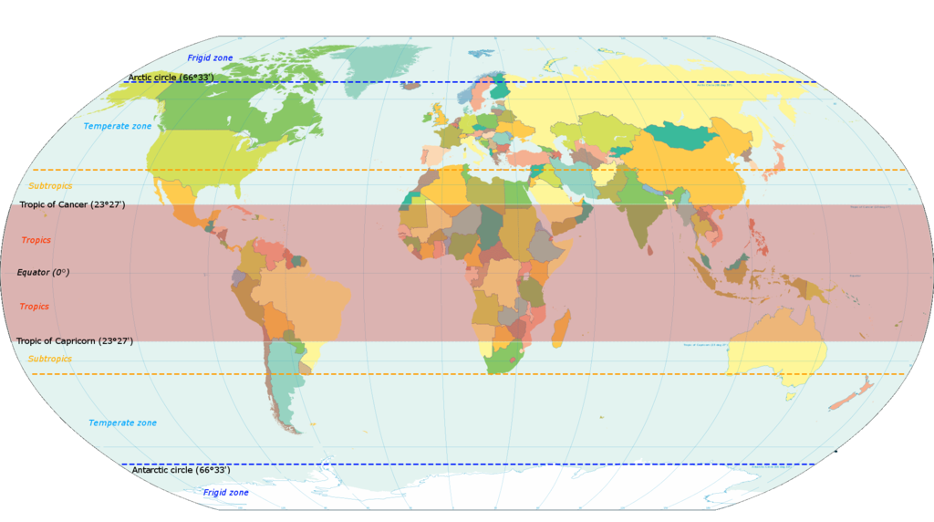
Tropics ???
The portions of the earth bounding the Equator (~ 23º N / S), where the Sun is usually directly overhead.

Slide 7
The region in which winds blow primarily from the east (approximately ± 30° latitude), except for the regional monsoon. The easterly trade winds flow out of the subtropical high into the equatorial trough. They converge at the Inter tropical Convergence Zone (ITCZ), which is usually identified as an intermittent band of clouds in the low pressure belt or equatorial trough.
The region that is better described by a wet and dry season than the four seasons of higher latitudes because annual rainfall varies much more from place to place than annual temperature.

Slide 8
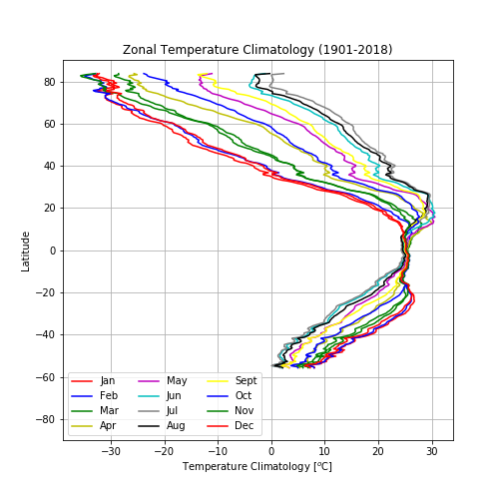
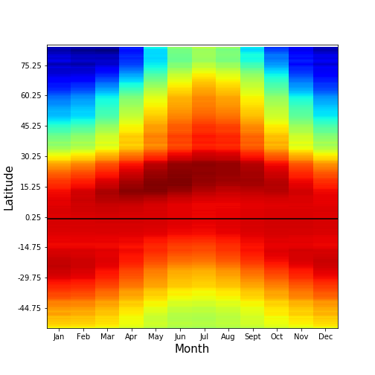
Zonal temperature climatologies from CRU data

Slide 9
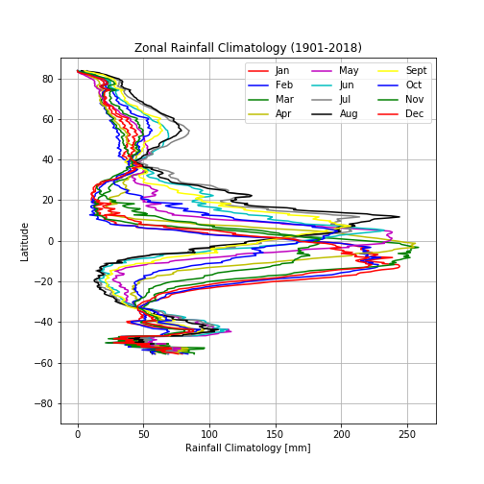
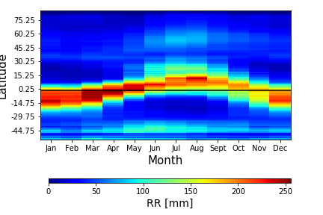
Zonal rainfall climatologies from CRU data

Slide 10
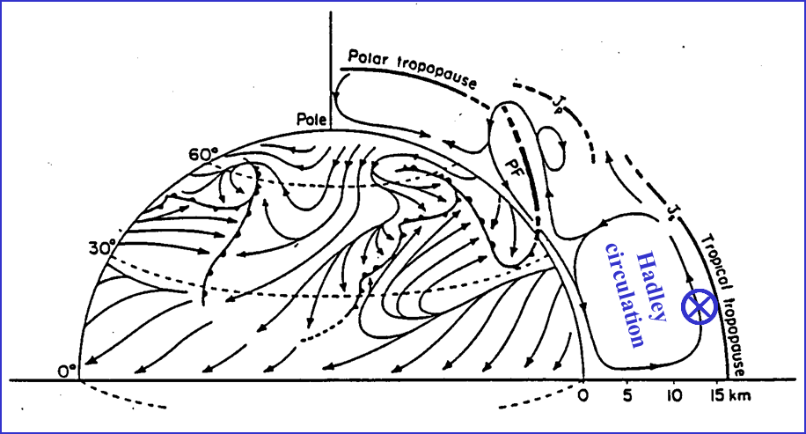
Schematic adapted from Defant (1958)
Riehl (1979) defines the meteorological "tropics" as the parts of the Earth where atmospheric processes differ significantly from those in higher latitudes. With this definition, the dividing line between the "tropics" and the “extratropics” is between the easterly and westerly wind regimes, and thus, varies with longitude and fluctuates seasonally.
Moreover, in reality, no part of the atmosphere exists in isolation and interactions between the tropics and extratropics are important.

Slide 11

Climatology ???
the study of the long-term state of the atmosphere.
Climate is the average weather in any particular region during a given month or season. It is often characterized in terms of long-term (e.g., 30-year) mean temperature, precipitation, wind, humidity, and cloudiness.
Climate can vary from year to year, as well as, change over decades, centuries, millennia and even longer timescales.
Tropical Climatology ???
… climatology of the tropics.

Slide 12
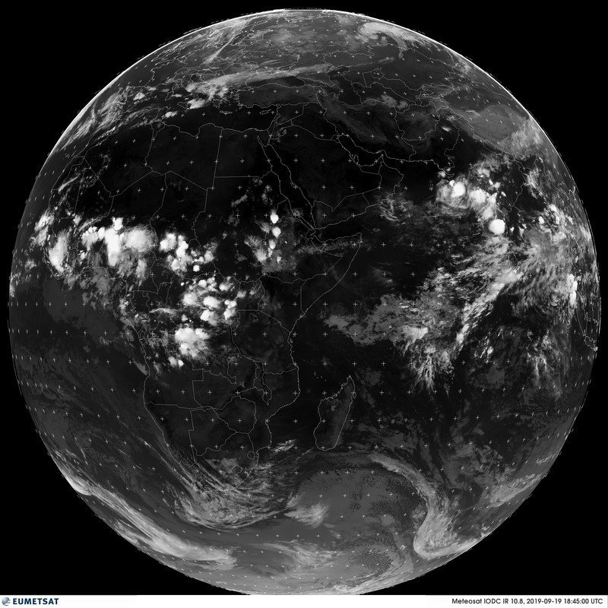
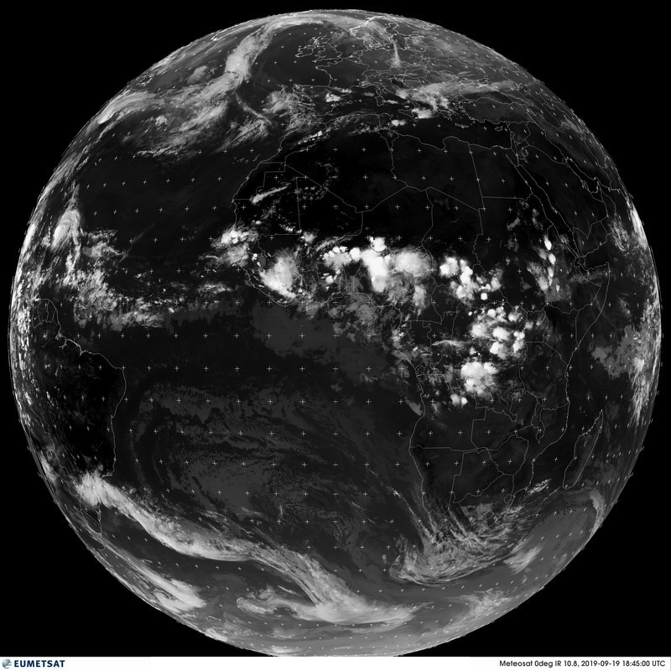
Tropical Overview in Satellite Images
Infrared satellite imagery from geostationary satellites located at different longitudes.
1845 GMT on
September 19, 2019
The white areas in the tropics and subtropics indicate cold cloud tops and correspond with cirrus cloud in the high troposphere. Much of which is produced by deep convection in which air is rapidly ascending.
The individual convective updraughts cover a much smaller fractional area of the area covered by the cirrus, which blows away from the convection. Deep convection is frequently concentrated in clumps referred to as cloud clusters. Sometimes these have the form of organized convective systems, an extreme case being that of a tropical cyclone.

Slide 13
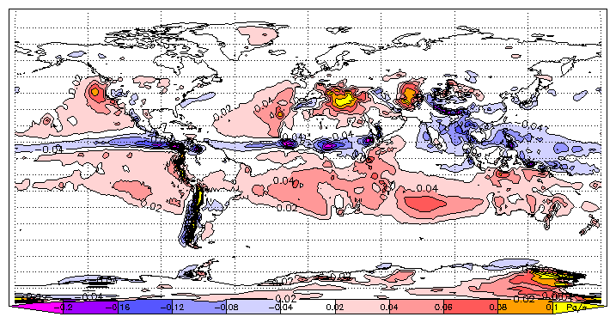

The dark areas in the tropics and subtropics correspond to regions devoid of clouds, or at least high cloud. These are regions in which air is slowly subsiding.
The grey areas, mainly in the subtropics and at higher latitudes correspond with regions of low cloud, typically stratus or stratocumulus or at least high cloud.
The band of white cloud just north of the equator (Figure below) marks the ITCZ. This cloud marks a strip of deep convective systems that constitute the ascending end of the Hadley circulation to be discussed later.

Slide 14
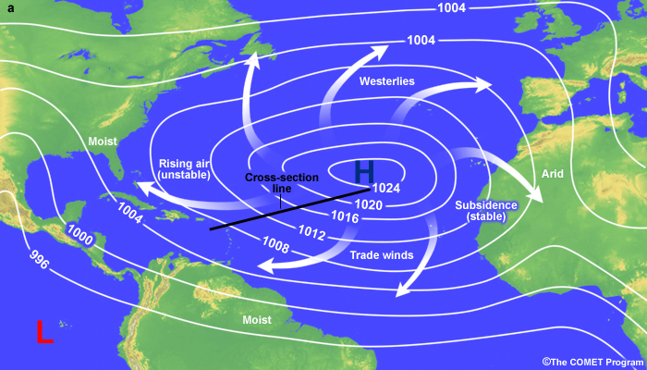
Why Tropical Climatology
Spatiotemporal climate distributions regulate the spatial and temporal characteristics of natural resources, socio-cultural and socio-economic activities, disease occurrences and transport etc. For any proper planning and management of the above it is important to understand the climatic characteristics that control them.

Slide 15
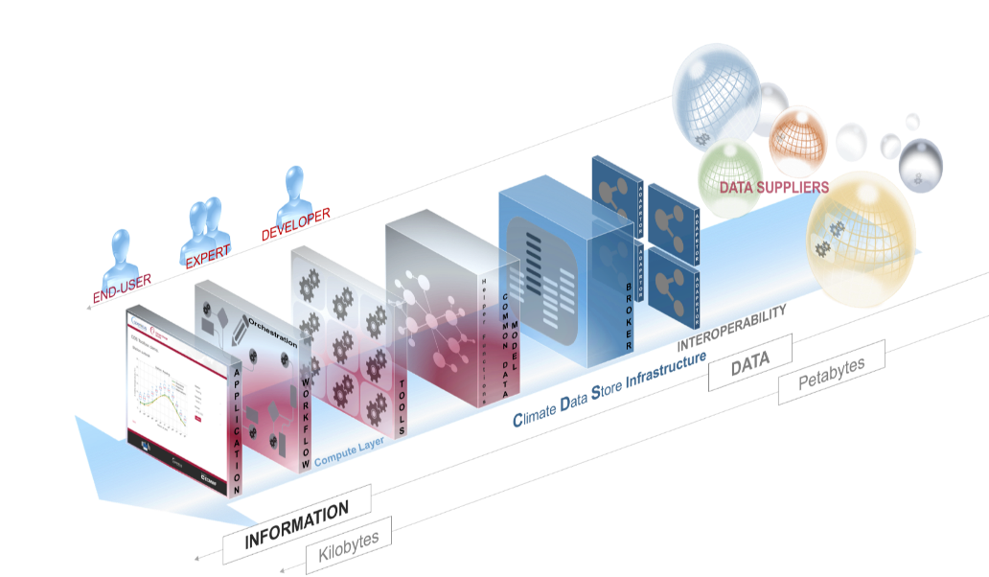
Sources of climatological data
Instrumental, commonly called observational data,
Simulations studies, where a climatic scenario is enacted in the laboratory, this is the basis of most GCMs
Proxy records, which are obtained from elements that may not themselves be climatic elements, but whose characteristics are controlled by those of climate.
Limitations of instrumental climatological data
Spatial discontinuities and other spatial inconsistencies, especially due to poor and sparse data networks.
Temporal discontinuities due to changes in observational schedules and methods, shifting of station sites, urbanization and other human-induced influence.

Slide 16

Climate Elements - 1. Solar Radiation
Solar radiation is the key driver of climate.
Heats the Earth's surface which in turn determines the near-surface air temperature. Heating of the air determines its stability, which affects cloud development and precipitation.
Pressure gradient creation due to differential heating of the Earth's surface, resulting in wind.
drives evaporation, once water is available.

Slide 17
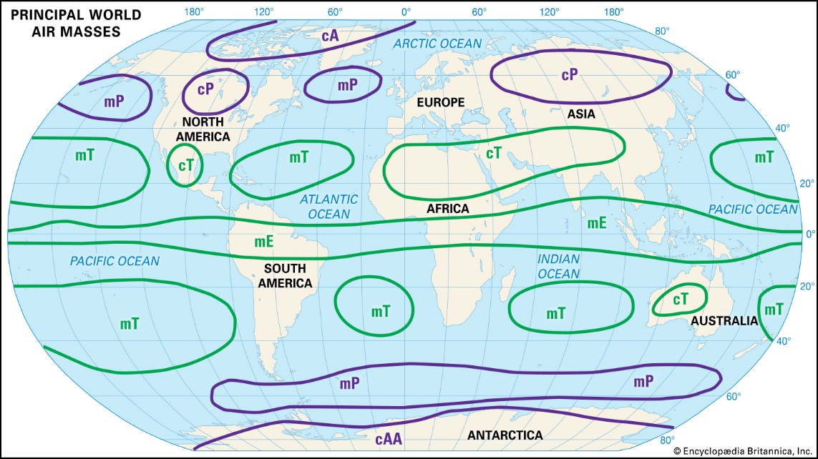
2. Air Mass
An air mass is a body of air extending over a large area (more than 1600km across) and over an area of high pressure that stagnates for several days where surface terrain varies little.
Air mass takes on characteristics of the underlying surface: temperature, moisture (humidity), and lapse rate remain fairly homogeneous throughout the air mass. Horizontal changes of these properties are usually very gradual.
Its location relative to the source regions of air masses in part determines the variation of the day-to-day weather and long-term climate of a place. For instance, the stormy climate of the mid latitudes is as a result of its position in the boundary zone of greatly contrasting air masses called the polar front.

Slide 18
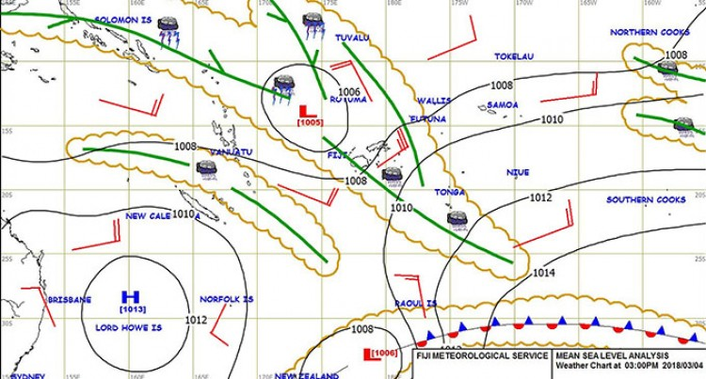
3. Pressure Systems
Pressure systems have a direct impact on the precipitation characteristics of different climate regions.
In general, places dominated by low pressure tend to be moist, while those dominated by high pressure are dry.

Slide 19
The seasonality of precipitation is affected by the seasonal movement of global and regional pressure systems. Climates located at 10º to 15º latitude experience a significant wet period when dominated by the Inter-tropical Convergence Zone and a dry period when the Subtropical High moves into this region.
Pressure dominance also affects the receipt of solar radiation. Places dominated by high pressure tend to lack cloud cover and hence receive significant amounts of sunshine, especially in the low latitudes.

Slide 20
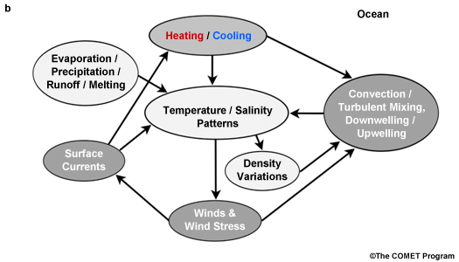
4. Ocean Currents
Ocean currents greatly induce temperature and precipitation variations of a climate. Climates bordering cold currents are drier as cold ocean water stabilizes the air and inhibit cloud formation and precipitation. Air masses travelling over warm ocean currents promote instability and precipitation.
Air traversing cold ocean currents lose energy to the water and thus moderate the temperature of nearby coastal locations. Warm ocean water, on the other hand, keeps air temperatures somewhat warmer than locations just inland from the coast during the winter.
Large-scale ocean dynamics are driven primarily by wind stress at the upper surface as well as net radiation and sensible heat fluxes, and density variations that are due to changes in salinity. Salinity changes are caused by processes such as evaporation, precipitation, and runoff. Heat is transported by convection, turbulent mixing, down-welling, or upwelling.

Slide 21
5. Topography
The orientation of mountains to the prevailing wind affects precipitation. Windward slopes, those facing into the wind, experience more precipitation due to orographic uplift of the air. Leeward sides of mountains are in the rain shadow and thus receive less precipitation.
Air temperatures are affected by slope and orientation as slopes facing into the Sun will be warmer than those facing away.
Temperature also decreases as one move toward higher elevations. Mountains have nearly the same effect as latitude does on climate.

Slide 22


Slide 23
ASSESSMENT ON LECTURE 1
Briefly discuss about the various continental and maritime air masses that influence global weather patterns and climatology.
Submission Deadline: October 3, 2019

