Slide 1

MET 459: Tropical Climatology
Jeffrey N. A. Aryee (PhD)
Meteorology & Climate Science Programme
Department of Physics, KNUST, Ghana
e-mail: jeff.jay8845@gmail.com
https://github.com/jeffjay88/Tropical-Climatology
Google Classroom code: i0n0ep

Slide 2
LECTURE 2

Slide 3
Recommended Videos & Websites
https://www.youtube.com/watch?v=7fd03fBRsuU
https://www.youtube.com/watch?v=xqM83_og1Fc
https://www.youtube.com/watch?v=PDEcAxfSYaI
https://www.youtube.com/watch?v=Lg91eowtfbw
https://www.weather.gov/source/zhu/ZHU_Training_Page/winds/JetStream_Stuff/300_200_chart.htm

Slide 4
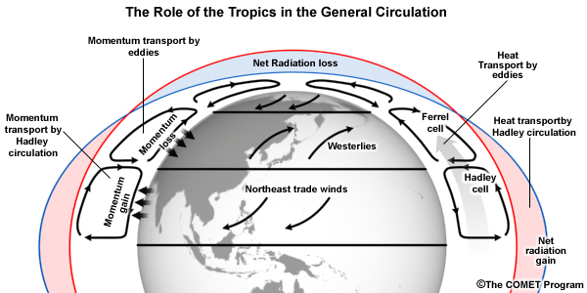
Hadley Circulation
The uneven geographic heating of Earth by the Sun, with warmer temperatures in the tropics than in polar regions, creates a pressure gradient that initiates winds aloft and along the surface.
The general circulation of the atmosphere is a system of high and low surface pressure regions arising from the unequal heating of the surface. Each hemisphere has three cells that redistribute heat.

Slide 5
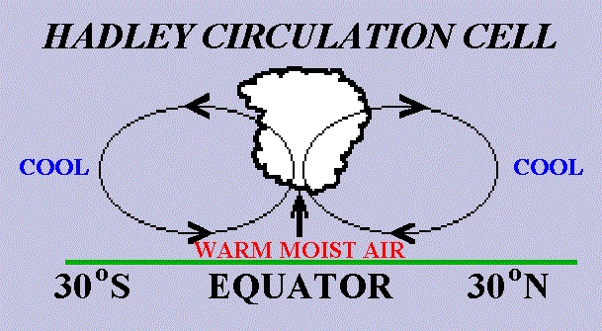
In the Northern Hemisphere, warm tropical air with high pressure aloft flows as upper-level wind from the equator towards the North Pole. As it moves north, the Coriolis force deflects the wind to the east.
This poleward moving air cools as it moves northwards. The column shrinks, the air becomes denser, and surface pressure increases.
The converging masses of air moving from the tropics to middle latitudes further increases surface pressure. This produces a belt of high surface pressure at about latitude 30° N. Air flows along the surface back towards the equator from this high pressure, being deflected to the west by the Coriolis force. These are the northeasterly trade winds. This tropical cell is known as the Hadley circulation.

Slide 6
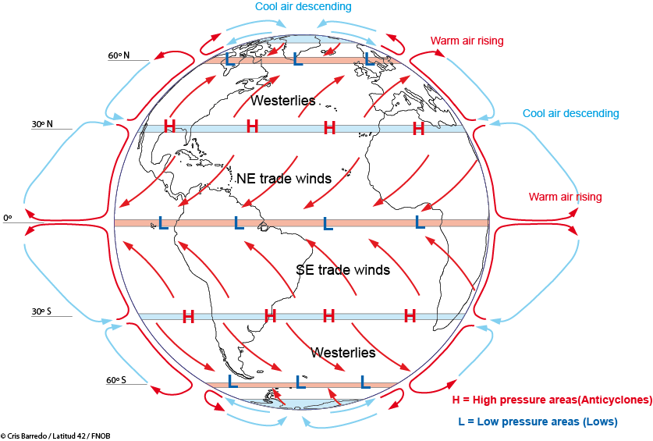
The general circulation of the atmosphere generates semi-permanent pressure systems.
the sub-tropical high pressure cells found at around 30° latitude,
the Inter-tropical Convergence Zone (ITCZ) found near the equator,
the polar front and the associated troughs found at around 60° latitude.

Slide 7
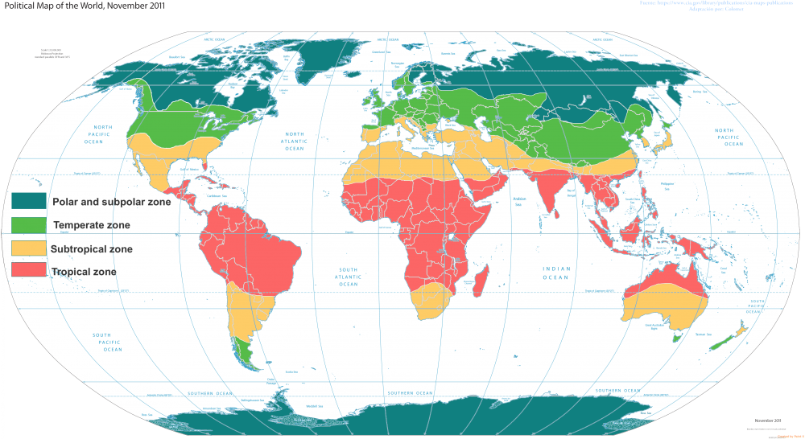
The Major Climatic Zones
The general circulation of the atmosphere accounts for the major climate zones in the world.
Rainfall is abundant where air rises – along the equator – and lacking where air sinks – near latitudes 30° N and 30° S.

Slide 8
In the tropics, the trade winds converge from the northeast in the Northern Hemisphere and the southeast in the Southern Hemisphere on the equator in the intertropical convergence zone. This convergence and lifting of warm, moist air leads to high annual rainfall.
Many tropical regions have wet and dry seasons. This occurs because of seasonal variation in the geographic location of the convergence zone.

Slide 9
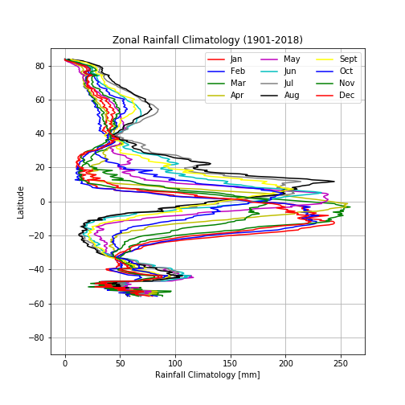
Regions of subsidence, as occurs in high pressure systems, generally have low rainfall. Many of the world’s major deserts – in southwestern United States, North Africa, southern South America, South Africa, and western Australia – are located on the eastern flanks of the subtropical high pressures near latitudes 30° N and 30° S.
Rainfall is also high, though not as high as in the tropics, in the middle latitudes between 40° and 60° where warm moist air clashes with cold air along the polar front.
Class Discussion
Where lies the world’s driest desserts and what accounts for this?

Slide 10
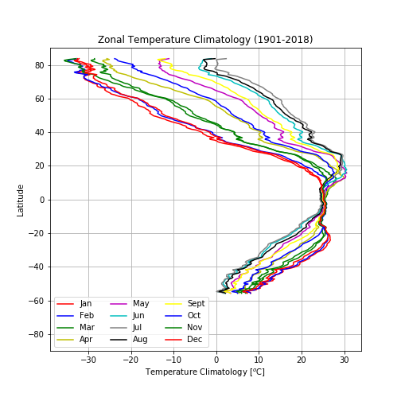
Temperatures are generally distributed in latitudinal bands with warmest temperatures in the tropics and progressively colder temperatures towards the poles.
This reflects latitudinal variation in net radiation and redistribution of energy from atmospheric circulations.

Slide 11
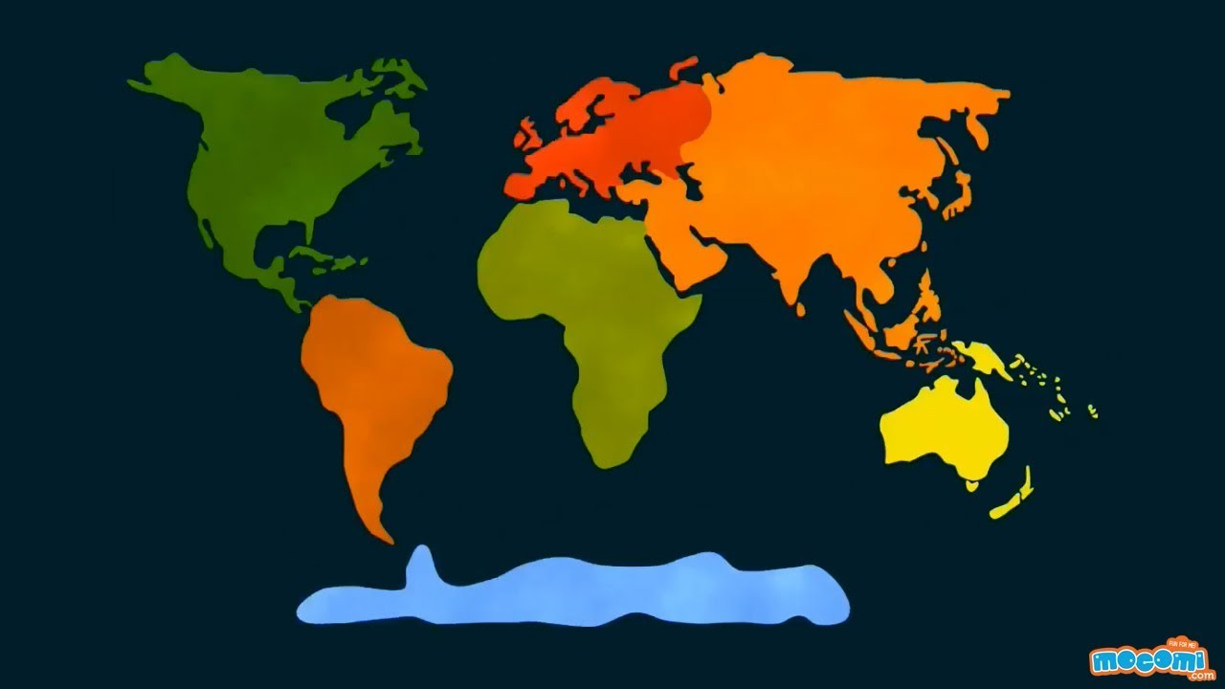
Role of Continents and Oceans
The Southern Hemisphere has contiguous bands of high pressure at latitude 30° S and low pressure at latitude 60° S. These bands are intermingled in the Northern Hemisphere.
This difference arises because of the different distribution of land in the two hemispheres: 70% of all land is in the Northern Hemisphere. Maximum land area is between latitudes 40° N and 75° N, where more than 50% of Earth’s surface area is land. In the Southern Hemisphere, land is generally less than 25% of the surface area. Between latitudes 40° S and 65° S, there is little land.

Slide 12
Continents heat and cool faster than oceans. In January, when northern continents are colder than oceans, high pressure systems form over land; low pressure systems are most pronounced over the northern regions of the Pacific and Atlantic Oceans.
The opposite pattern occurs in summer when northern continents are warmer than oceans. Strong high pressures develop in the North Pacific and North Atlantic; low pressures develop over Asia and North America.
Proximity to oceans also affects temperature. Water has a moderating influence on climate, preventing extreme fluctuations in temperature that arise in interior regions of the continents.

Slide 13
Continents also affect climate through the presence of high mountain ranges. Prominent west-east mountains are the Alps in Europe and the Himalayas in Asia. As air rises over the mountains and cools, the amount of water it can hold decreases. Clouds form and rain falls. Consequently, windward sides of large mountains often receive much more rainfall than leeward sides.
The large heat capacity of oceans creates a thermal inertia. Heat is stored in the summer and released in winter, damping summertime warming and wintertime cooling.
Like the atmosphere, the general circulation of the ocean transports heat from the tropics to Polar Regions. In the Northern Hemisphere, the maximum energy transported by oceans is comparable to atmospheric heat transport (Trenberth and Solomon, 1994). In the Southern Hemisphere, oceanic heat transport is reduced by about one-half and is only about one-half of the atmospheric heat transport.
Oceanic heat transport is the result of two types of circulations: wind-driven surface currents and density-driven thermohaline circulation.

Slide 14
Koppen’s classification map
There are five major climate zones with dominant characteristics.
Humid Tropical Climate: warm year-round; coldest month 18 °C or warmer.
Dry Climate: deficient precipitation throughout the year.
Moist Subtropical Mid-Latitude Climate: warm to hot summers with mild winters; coldest month above 0 °C but below 18 °C; warmest month above 10 °C.
Moist Continental Climate: warm summers and cold winters; coldest month below 0 °C; warmest month above 10 °C.
Polar Climate: extremely cold winters and cold summers; warmest month below 10 °C.

Slide 15
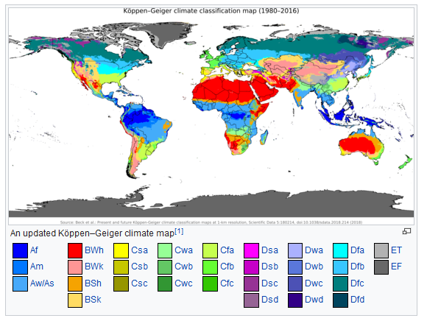
Köppen climate classification scheme symbols description table
1st | 2nd | 3rd
A (Tropical) | f (Rainforest)
 | m (Monsoon)
 | w (Savanna, Wet summer)
 | s (Savanna, Dry summer)
B (Arid) | W (Desert)
 | S (Steppe)
 |  | h (Hot)
 |  | k (Cold)
C (Temperate) | s (Dry summer)
 | w (Dry winter)
 | f (Without dry season)
 |  | a (Hot summer)
 |  | b (Warm summer)
 |  | c (Cold summer)
D (Continental) | s (Dry summer)
 | w (Dry winter)
 | f (Without dry season)
 |  | a (Hot summer)
 |  | b (Warm summer)
 |  | c (Cold summer)
 |  | d (Very cold winter)
E (Polar) | T (Tundra)
 | F (Eternal winter (ice cap))

Slide 16
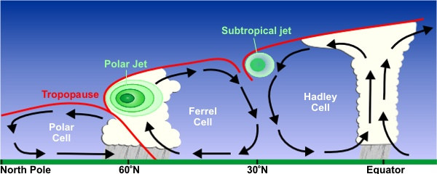
Jet streams
These are fast moving westerly air in the upper atmosphere between 10 km to 15 km aloft. They are located above areas of particularly strong temperature gradients (e.g., frontal zones) where the pressure gradients and the resulting wind speeds increase with increasing height so long as the temperature gradients persist in the same direction.
The minimum wind speed used to analyze the location of the jet stream is 50 knot.
In general, this extends to the tropopause, after which the temperature gradient reverses direction and the wind speeds diminish. Because regions of strong temperature gradients can be created in different ways, there are several classes of jet streams.

Slide 17
Jet Stream Axis: A line of maximum wind speed found at one pressure level.
Jet Stream Core: Used in two ways:
The area along the jet stream axis with the greatest wind speed.
The line of maximum wind speed found in both the vertical and horizontal directions. The jet stream axis is a reflection of the jet stream core at one pressure level.
Jet Streak
This is an area of maximum wind speed along the jet stream axis denoted by a closed isotach. This is a variation on the (a) definition of a jet stream core.

Slide 18
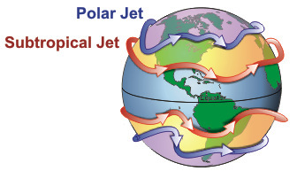
General Structure of a jet stream
The mid-latitude jet stream is a quasi-horizontal band of high speed air in the upper troposphere. It is typically thousands of kilometers in length, hundreds of kilometers in width, and several kilometer deep. It is essentially a flat tubular feature that meanders through the upper portions of the troposphere.
Jet stream isotach analyses usually start at 50 knots or 30 meters/second, depending upon your analysis preference. Maximum wind speeds in jet streaks are typically in the 100 to 200 knot range. Wind speed as high as 300 knots have been observed and 300 knots is considered an approximate upper limit on jet streak speeds.
Strong vertical and horizontal wind shears are found along the jet stream, particularly near jet streaks. Vertical wind shear values are on the order of 5-10 m/s/km while horizontal wind shears are on the order of 5 m/s/100 km. There is cyclonic wind shear on the left side of the jet axis (looking downstream) and anticyclonic wind shear on the right side of the jet axis.

Slide 19
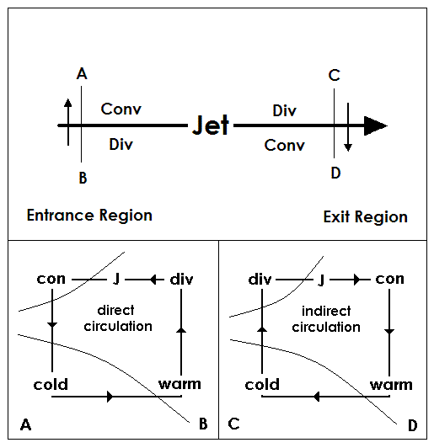
The area upstream from the maximum is called the entrance region and the area downstream from the maximum is called the exit region.
It can be shown dynamically, that for straight flow in the upper troposphere, the
left front and right rear quadrants are areas of divergence. Areas of divergence in the upper troposphere are typically associated with upward synoptic scale vertical motion
right front and left rear quadrants are areas of convergence which are typically associated with downward synoptic scale vertical motion. This combination of rising and sinking air creates a cross axis flow called ageostrophic wind.
The practical implication of these dynamic considerations is that clouds and precipitation are most likely in the left exit and right entrance regions of a jet streak.

Slide 20


Slide 21
RECAP OF LECTURE 2
Hadley Circulation
Major Climatic Zones
Role of Continents and Oceans on Delineating The Climatic Zones
Jet Streams and Jet Streaks

