Slide 1

MET 459: Tropical Climatology
Jeffrey N. A. Aryee (PhD)
Meteorology & Climate Science Programme
Department of Physics, KNUST, Ghana
e-mail: jeff.jay8845@gmail.com
https://github.com/jeffjay88/Tropical-Climatology
Google Classroom code: i0n0ep

Slide 2
LECTURE 3

Slide 3

Tropical Climate
Tropical humid climates occur where temperatures are warm throughout the year.
In the tropical climate zones, seasonal variation in air temperature is minimal – less than a few degrees.
In the tropical rainforest zone, rainfall is abundant throughout the year but may vary seasonally with the position of the intertropical convergence zone. Tropical rainforest climates occur in hot, wet equatorial regions of South America, Africa, southeast Asia, and Indonesia.

Slide 4
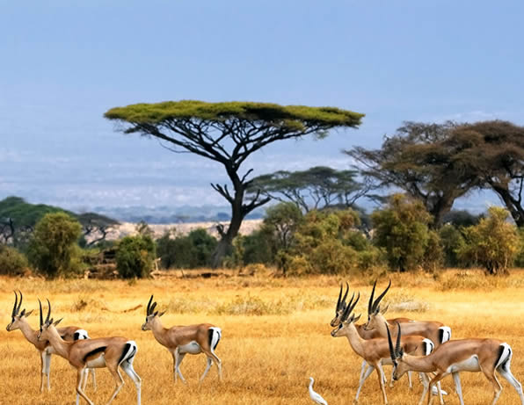
The tropical savanna climate is found in tropical regions that are warm year-round but has a pronounced dry season. The rainy season is from April to October.
Little rainfall occurs in December, January, and February, when the region is under the influence of a subtropical high pressure.
The double peak in summer precipitation reflects the seasonal migration of the intertropical convergence zone across the equator.
Temperatures are warmer during the dry season than in the rainy season when clouds cool the surface.
Tropical savanna climates occur in Central America, to the north and south of the Amazon Basin in South America, to the north and south of the Congo Basin in Africa, east Africa, parts of India and Southeast Asia, and northern Australia.

Slide 5
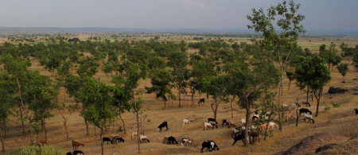
Dry climates
rainfall is sparse throughout the year
are divided into semi-arid and arid climates based on moisture deficiency.
The semi-arid climate occurs in temperate regions – most prominently in the Great Plains of the United States, the steppes of Central Asia, and parts of southern South America, southern Africa, and Australia.
Temperatures are hot during June through August when the clear sky and intense solar radiation heat the surface.

Slide 6

The arid climate of deserts is not only dry, but also hot as solar radiation readily penetrates the clear, dry skies.
Desert climates occur on the eastern flanks of the subtropical high pressures near latitudes 30° N and 30° S – in southwestern United States, North Africa, southern South America, South Africa, and Western Australia.
They are also found in continental areas of the middle latitudes that are far removed from sources of atmospheric moisture – central Asia, central Australia, and the Great Basin of western United States.

Slide 7
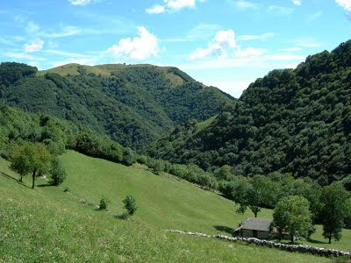
Moist subtropical middle latitude climates
occur in regions with distinct summer and winter seasons, where summers are warm to hot and winters are mild. They are divided into Mediterranean, humid subtropical, and marine zones.
Mediterranean climates occur where a summer dry season is pronounced – in southern California, along coastal areas of the Mediterranean Sea, western parts of South Africa, and Chile. These climates are characterized by mild, moist winters and hot, dry summers.

Slide 8

Humid subtropical climates occur in southeastern United States, eastern China, Japan, and along the southeastern coasts of South America, Africa, and Australia. These climates are located on the western edge of subtropical high pressure areas, which drives warm, moist tropical air towards the middle latitudes, and consequently are characterized by hot, muggy summers. Winters are mild and precipitation is abundant throughout the year. Moderate to pronounced seasonality is a dominant feature of this climate.
Marine climates occur in the Pacific Northwest region of the United States, Western Europe, and western South America in middle latitudes where oceans moderate climate. Marine climates are characterized by mild winters, with temperatures rarely below freezing, cool summers, and abundant precipitation year-round.

Slide 9

Moist continental climate
occurs in the northern regions of North America, Europe, and Asia.
Large seasonal variation in temperature, with moderate to cool summers and cold winters, characterizes the climate. The humid continental subzone is divided into warm summer and cool summer regions based on whether the warmest month is above or below 22 °C.
Farther north, in Alaska, northern Canada, northern Europe, and northern Russia, where the winters are bitterly cold and the summers are cool and short, the climate is subarctic. Precipitation is generally light.

Slide 10
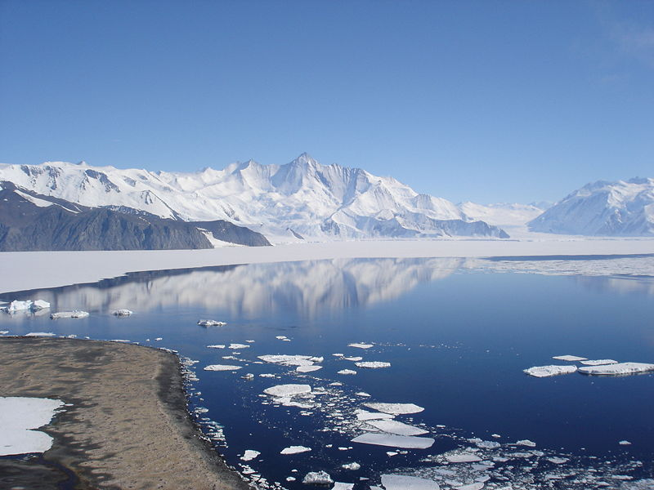
Polar climates
They are found in high latitudes or mountain tops where the warmest month is below 10 °C. Tundra climates are found where plants can still survive in the short summers and long, cold winters. In the extreme cold of Greenland and Antarctica, little vegetation grows and permanent glaciers cover the land.

Slide 11
Climate and vegetation
The natural vegetation of Earth has a distinct geographic pattern that corresponds to climate zones.
Forests grow in tropical rainforest, humid subtropical, marine, and moist continental climates. In these regions, precipitation is abundant year-round.
Trees cannot survive in the bitter cold of tundra climates. Instead, small shrubs, herbaceous plants, and mosses grow in the short summers.
Extensive grasslands occur in semi-arid and savanna climates of central North America, northern and central South America, central and southern Africa, central Asia, and Australia. Here climate is hot and dry.
Short, dense woody bushes form chaparral or ‘Mediterranean’ vegetation in the Mediterranean climate where summers are hot and dry and winters are mild and moist.
Deserts, with sparse or widely spaced scrubby plants, are found in arid climates.
Numerous studies beginning in the 1970s all point to the same conclusion: the geographic distribution of vegetation is an important determinant of regional and global climate. Consequently, natural and human-induced changes in land cover can alter climate.

Slide 12
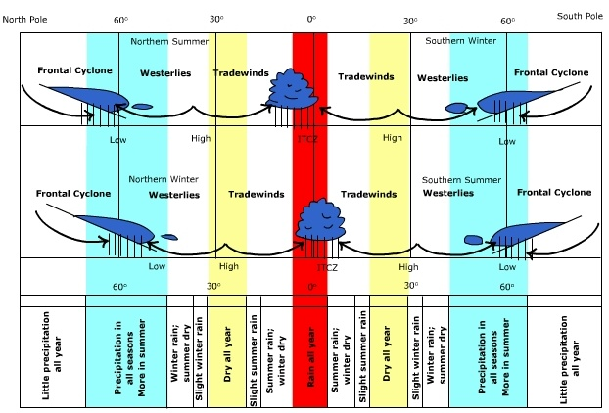
Seasonal migration of surface wind and pressure (Modified from Trewartha, Robinson, Hammond & Horn, 1977)

Slide 13
Class Discussion
Differentiate between West African summer monsoon and winter monsoon.

Slide 14
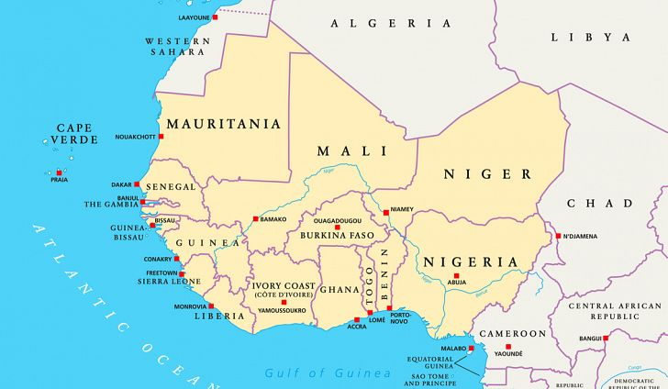
The West African Monsoon
The West African summer monsoon is characterized by a large-scale inflow of warm, very humid, conditionally and convectively unstable airstreams from the equatorial Atlantic across the entire sub region from March to October/November. It is generally a period of widespread and prolonged precipitation.
The winter monsoon is a similar large-scale flow but in the reverse direction i.e. from land to the ocean from the subtropical (Sahara) high-pressure system. Unlike the summer component, the winter monsoon is a period of near total dryness. It is also the period of the harmattan
Important components of the West African monsoon flow include:
Inter- Tropical Discontinuity (ITD),
Subtropical anticyclones and their associated heat lows
Subtropical Jet (STJ)
Troughs extending from mid-latitudes (MLT)
The African Easterly Jet (AEJ),
The Tropical Easterly Jet (TEJ),
African Easterly Waves (AEW),
Types and distribution of vegetation cover and
the soil types.
Orography

Slide 15
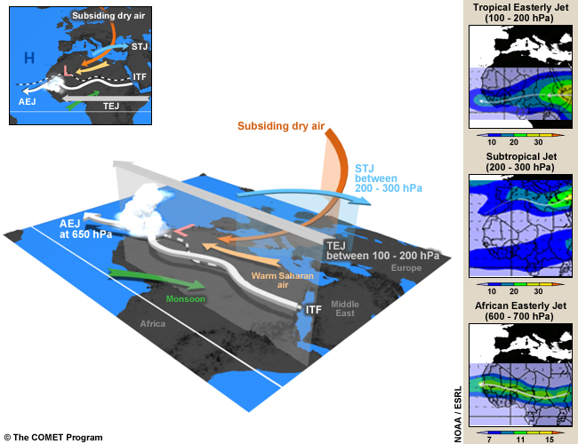
Key Features of the West African Monsoon
Monsoon: The humid and relatively cool southwest monsoon (green arrow) forms when southeasterly flow from the St. Helena High veers to the right after crossing the equator.
The monsoon flow is the main source of moisture for the development of convection over West and part of Central Africa during the rainy season.
Note that a monsoon depth of 1000 to 2000m is required for the initiation of deep convection. The monsoon converges with the Saharan dry air around the intertropical front.

Slide 16
Warm Saharan Air: This is the dry, hot wind (the yellow arrow) from the north that crosses the Sahara and converges with the monsoon over West and part of Central Africa. The dry air forms a dome 4 to 5 km high over the Sahara desert, creating the Saharan heat low. The intensity and location of the heat low affects water vapor transport and convection in West Africa. For example, as the low becomes more intense, the pressure gradient increases between the heat low and the cool Atlantic. This leads to enhanced moisture convergence inland (northward) and more favorable conditions for moist convection.
Intertropical Front (ITF): The ITF, also known as the Intertropical Discontinuity, is the separation zone between the dry Saharan air and the monsoon flow over West Africa. It is generally associated with Saharan heat lows. Convective systems do not develop along the convergence line due to the weak thickness of the monsoon layer in the zone and subsidence in the mid-troposphere. Deep convection is found 3 to 5 degrees south of the ITF

Slide 17
Heat Low: A heat low is an area of high surface temperatures and low surface pressures. (Note that the threshold for pressure values varies throughout the day due to the intense diurnal heat cycle.) Heat lows exist throughout the year and occur where insolation is high and evaporation is low. During the summer, the West African heat low is generally positioned over the Sahara and is often referred to as the Saharan heat low. During this period, the heat low is one of the major dynamic elements of the West African monsoon system.
African Easterly Jet (AEJ): The AEJ is a mid-tropospheric easterly wind maximum located between 700 and 600 hPa over Sahelian Africa during the northern hemispheric summer. The AEJ has mean maximum speeds of 10-13 m/s. The jet is the easterly geostrophic flow response to the strong temperature gradient between warm Saharan air layer and cool monsoon air to the south. African easterly waves, which produce severe thunderstorms, have their maximum amplitude close to the level of the AEJ but south of the AEJ.
African Easterly Waves (AEWs): These are the dominant synoptic weather systems of the summertime West African Monsoon. AEWs are associated with convective heating in the Intertropical Convergence Zone (ITCZ) and instabilities in the AEJ. Africa easterly waves commonly have two vorticity maxima, one at the low-levels in the vicinity of the ITF and one at the AEJ level in the rainy zone south of the jet. Easterly waves are often identified by meridional oscillations in the AEJ.

Slide 18
Subtropical Jet (STJ): This jet, sometimes called the subtropical westerly jet, is a strong westerly wind over the Sahara desert between 200 and 300 hPa. When the STJ is strong, it helps reinforce deep convection in the northern branch of the diverging anticyclonic flow at the top of MCSs over West and part of Central Africa during the rainy season. On the equatorial side of the jet, there’s an area of dry stratospheric subsiding air, which maintains strong stability over the Sahara desert in the mid-troposphere.
Subsidence or Dry Air Intrusion: This is a dry, cold air mass, known as a dry air intrusion in West Africa, which originates from the polar jet. It is transported eastward up to around 0 degrees longitude where it starts to subside and feed into the mid-troposphere over West Africa. A dry air intrusion is identified as a cold air trough that sometimes forms over the northern part of the continent and the Sahara desert. The dry, cold air flow accelerates monsoon inflow into West Africa and plays a key role in the development of strong convective systems in the region.

Slide 19
Tropical Easterly Jet (TEJ): The TEJ is a strong easterly wind flow between 200 and 100 hPa that extends from the Tibetan mountains to Africa and generally exits over the Gulf of Guinea. During the rainy season, it helps reinforce deep convection in the southern branch of the diverging anticyclonic flow on top of MCSs over West and part of Central Africa. When the jet is weak, it can inhibit deep convection.

Slide 20
NWP products
•Mean Sea Level Pressure (MSLP): Check the position of the intertropical front/disturbance and the position, organization, and intensity of heat lows
•Low-level winds (925 and 850 hPa): Analyse the depth, northward extension, and organization of monsoon inflow to check for low-level instability (indicated by vortices and convergence lines)
•Mid-level winds (700 hPa/500hPa): Check for the presence of easterly waves, the African easterly jet, and dry air intrusions
•High-level winds (200 hPa): Check for the tropical easterly jet and extra-tropical troughs
•Relative humidity (850 and 700 hPa): Check humidity availability
•When available, check the following derived products for atmospheric instability: vertical velocity, divergence, and vorticity at 850, 700, and 200 hPa
Check for agreement between the model output and synoptic observations to assess the reliability of the the NWP products.
Note that moderate to fast propagating convective systems, such as squall lines, typically develop between the AEJ and the TEJ.
Step 2: Assess the impact of atmospheric conditions on future weather. Determine if tropospheric dynamics are favourable for the initiation and/or further development of convective systems based on your analysis.
Now we'll apply the process to the case.

Slide 21
EVERY STUDENT SHOULD DOWNLOAD THE MARTIN SOFTWARE FOR THE NEXT CLASS.
http://homepages.see.leeds.ac.uk/~earajr/SWIFT/Summer_School/
For Windows Users: select MARTIN_Windows.exe
For Linux Users: select MARTIN_Linux

Slide 22


Slide 23
RECAP OF LECTURE 2
Climate Zones
Overview of West African Monsoon
Numerical Weather Prediction

Slide 24
ASSIGNMENT
A monsoon depth of 1000 to 2000m is required for the initiation of deep convection. Provide scientific explanation to this statement.
Deadline: Thursday 17th October 2019 | 23:59GMT

