Slide 1
Best Neighborhood Hunting For Constructing A New Indoor Young Children Playing Center
In The City Of Calgary
May 2020

Slide 2


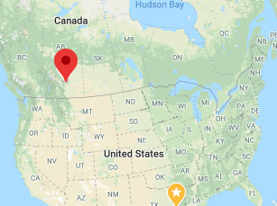
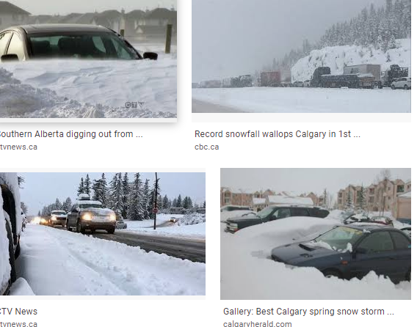
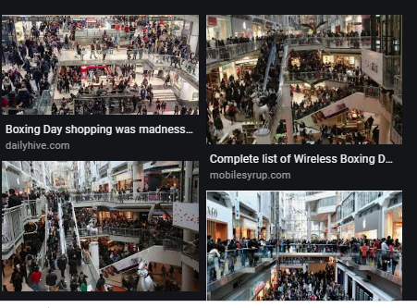
Children Indoor playing facility investing
Calgary is a winter city, last 8 month,
Can get cold for -20 Celsius for two weeks without a break
Packed shopping mall, recreation center….
20-30% population are young children from 0~14
To find a no or less indoor recreation playing center, such as treehouse for toddlers, easy sport center for small kids
Stakeholders and business investor are interested parties.

Slide 3
Data acquisition and wrangling
List of official neighborhood in Calgary from Wikipedia ,
City of Calgary social demographic & economical data, from City Census 2019
Community Crime & Disorder Statistic data from 2012~2019, from Calgary Police Service
Community household average income data
Indoor recreational venue data were collected by using Foursquare API.

Slide 4
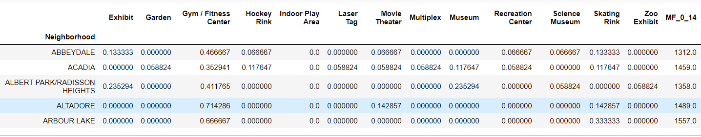
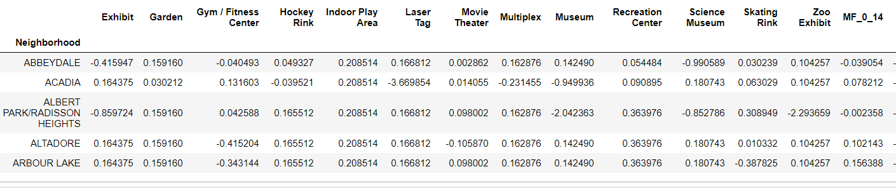
Data Features, Z-score normalization & assign “weight” comparisons & why

Slide 5
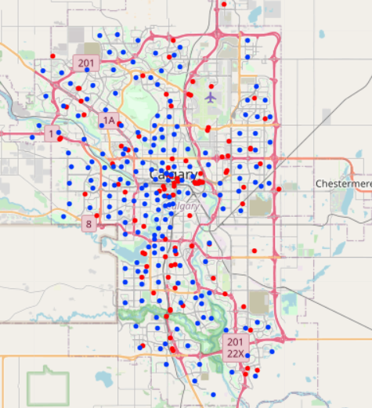
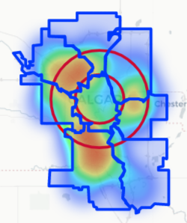
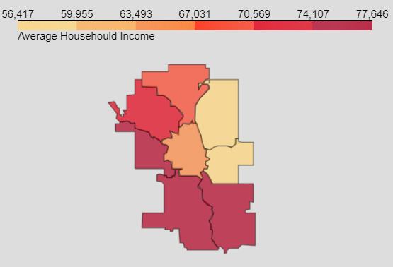
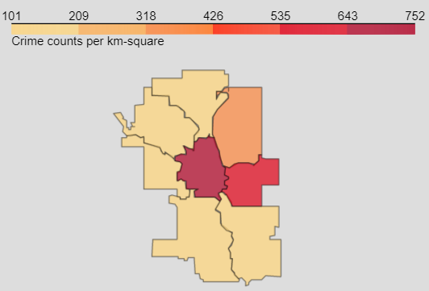
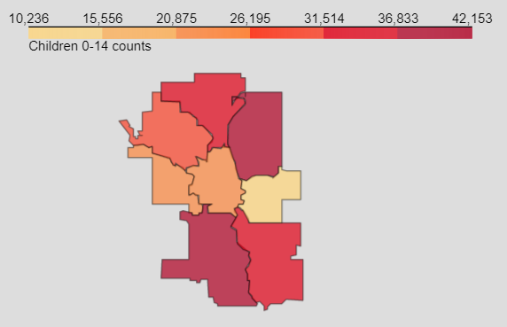
Qualitative data analysis:
City of Calgary neighborhood location map in blue dots & indoor recreation Venues colored in red dots the right show the indoor recreation Venues presented in “heatmap”
City Sector Choropleth overlaid with “income”, “Crime” & “ 0~14 children counts” from left to the right

Slide 6
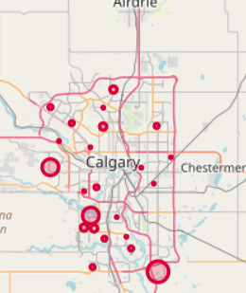
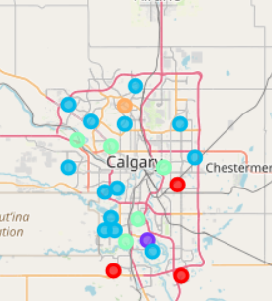
Quantitative data analysis by total score & K-means clustering.

Slide 7
Conclusion and Future Improvement
From the data collected, it is recommended to Build Indoor Playground In Deep South East, South West Of The City, which close to neighborhoods Are Called Abbeydale, Bridlewood, Erin Woods.
Foursquare venue data with fee-paid account & location venues related to indoor recreation facilities to better defined.
To collect more accurate data and to perform trial tests by using different features selections so that the best model can be found.

