Slide 1
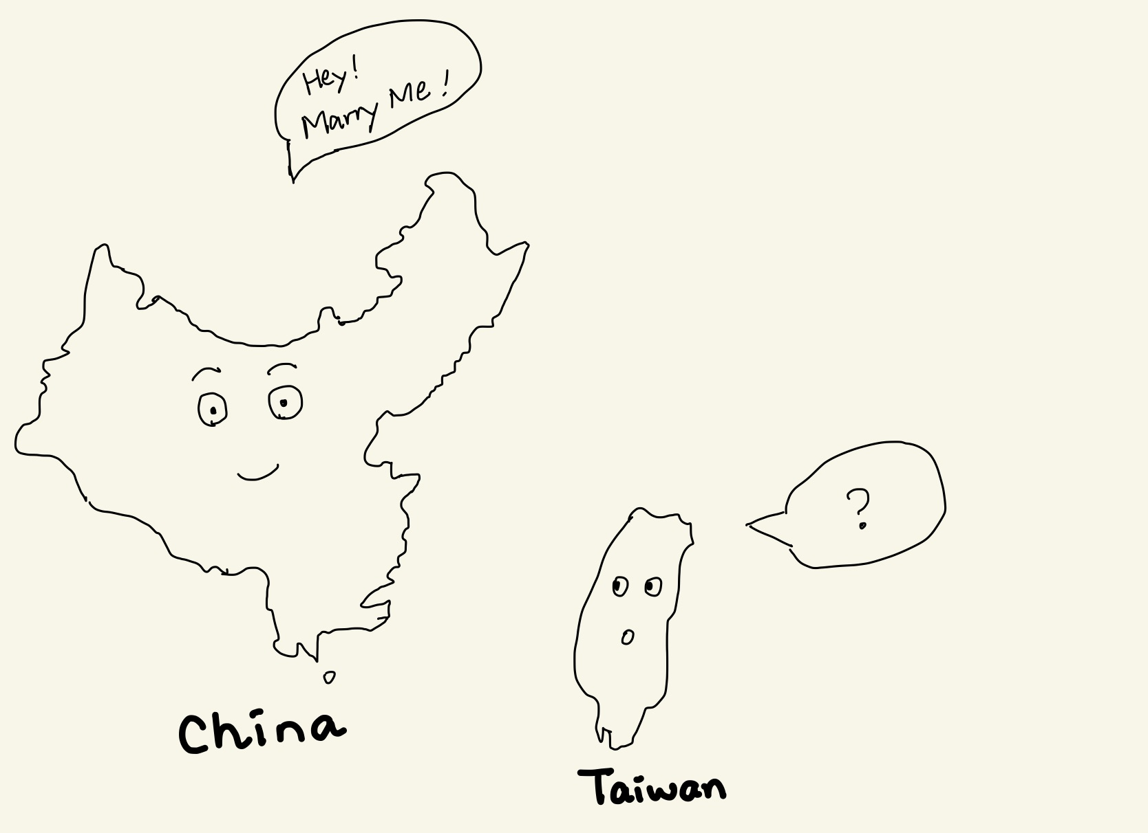
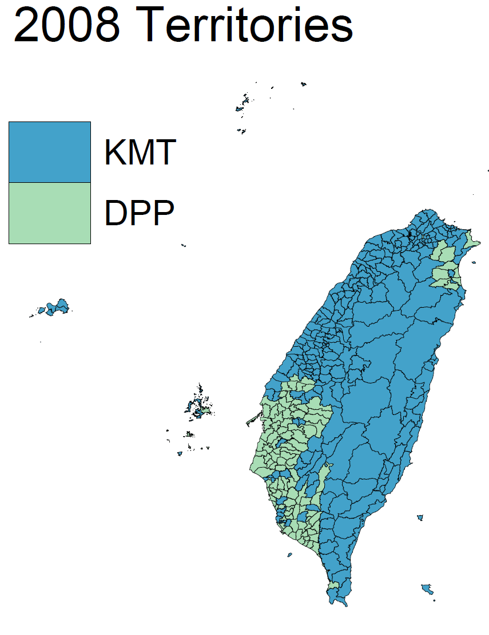
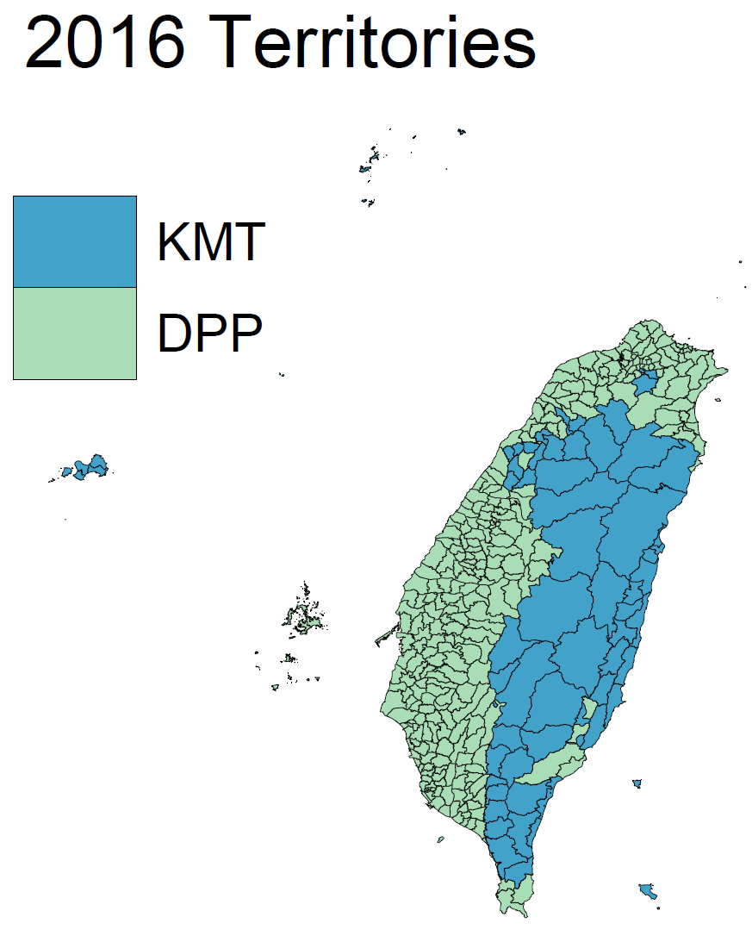
Distance is the Soul of Beauty:
How do Open-broder Policies Realign Political Ideology?
Free Trade Area
Political Integration
Economic Integration
?
Main Question
Do the open-broader policies and FTA help political integration across Taiwan Strait?
E C F A
Economic Cooperation Framework Agreement
Started in 2008
Lower the Trade Barriers
Open Tourism to Taiwan
Methodologies
Theory: Computable General Equilibrium Model
Empirics: Difference-in-difference Model
Data
Input-Output Table
CGE model
Electoral Data
Tourists Data
Conclusions
FTA did not ease the political tension.
The regions more exposed to the Chinese tourists switched to support the against-China political party after ECFA.
Jeffrey Kuo, Economics Ph.D. Candidate https://jeffjkuo.github.io

