Slide 1
Attendance & Course
Management System
NIT Goa | Mobile Application Project
Notes:
Introduce the project — a college-wide mobile app built with Flutter and Firebase for NIT Goa.

Slide 2
The Problem
Challenges with Traditional Register System
Manual paper registers are time-consuming and error-prone
No real-time attendance tracking or percentage calculation
Difficult to search, filter, or export attendance data
Registers can be lost, damaged, or tampered with
Professors spend 10-15 minutes per class on roll calls
Students have ZERO visibility into their attendance percentage
End-of-semester data compilation is tedious and manual
Notes:
Explain the pain points of traditional paper-based attendance that every college faces.

Slide 3
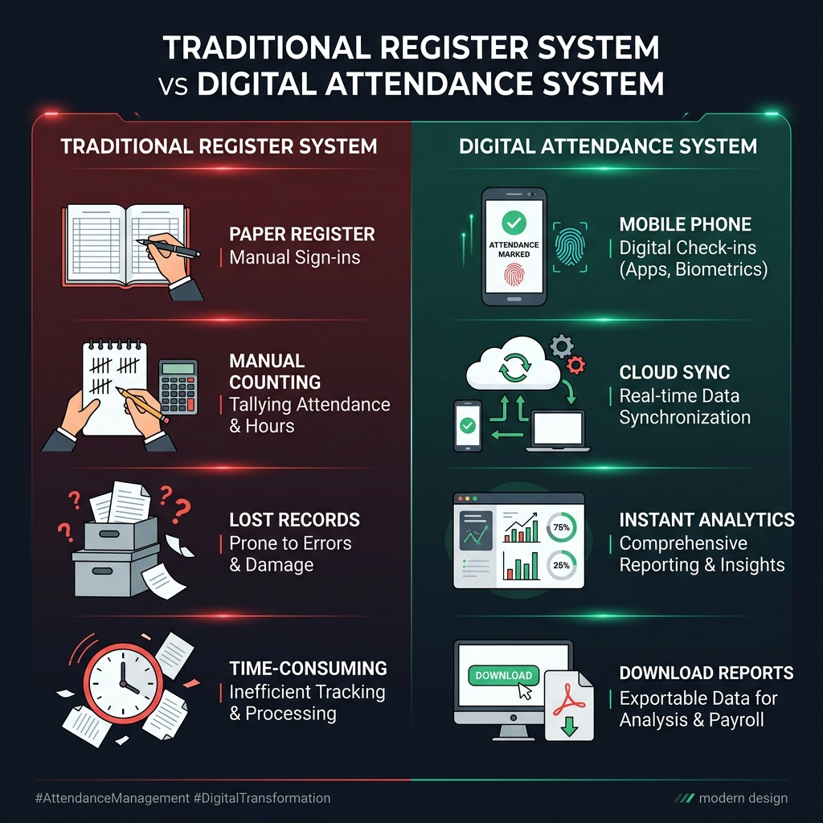
Traditional vs Digital
A complete paradigm shift
Notes:
Show the visual comparison between the old paper system and our new digital solution.

Slide 4
Our Solution
A role-based mobile application for NIT Goa
Cross-platform Flutter app (Android and iOS)
Cloud-powered with Google Firebase (real-time sync)
Secure Google SSO — restricted to @nitgoa.ac.in
5 role-based portals: Moderator, Admin, Professor, CR, Student
Lecture-wise attendance with instant percentage calculation
Downloadable reports in CSV, Excel, and PDF formats
Works offline — syncs automatically when back online
Notes:
Present the solution overview — a complete digital attendance and course management system.

Slide 5
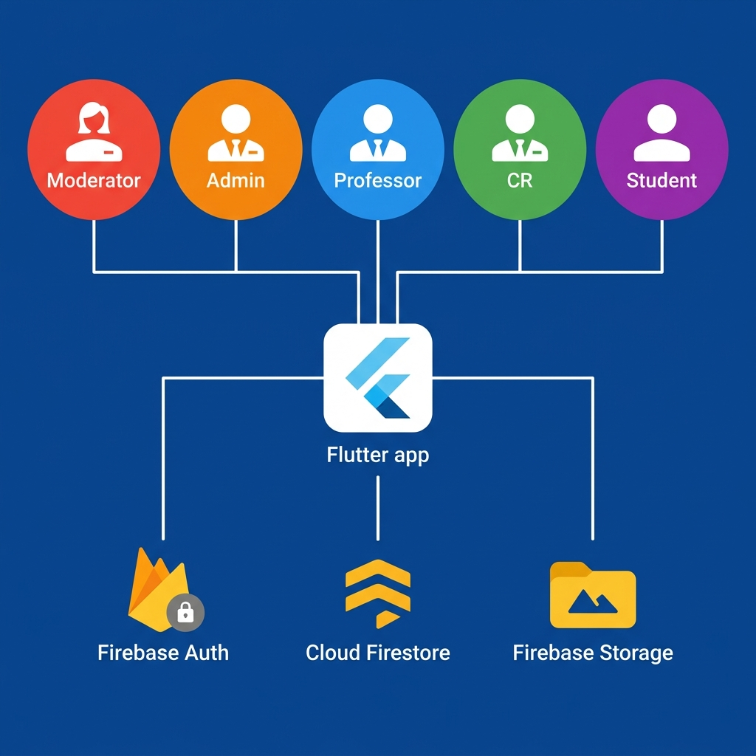
System Architecture
5 roles connected through Flutter and Firebase
Notes:
Walk through the system architecture — 5 user roles, Flutter frontend, Firebase backend with Auth, Firestore, and Storage.

Slide 6
Role-Based Access Control
5 distinct roles with specific permissions
MODERATOR — Manages branches, courses, user roles, CR assignment, semester reset
ADMIN — Assigns professors to courses created by the Moderator
PROFESSOR — Marks attendance, views reports, approves enrollment, downloads data
CR (Class Rep) — Marks attendance, approves enrollment + has Student portal
STUDENT — Enrolls in courses, views attendance percentage, manages profile
Notes:
Walk through each role and their responsibilities in the system.

Slide 7
Key Features
What makes this system powerful
Lecture-wise attendance (multiple sessions per day per course)
Color-coded attendance: Green >80% | Yellow 75-80% | Red <75%
Course enrollment with approval workflow (Professor or CR)
Editable attendance records (by Professor and CR)
First-year section support + branch-wise for Years 2-4
Semester reset with full data archival and download
Offline attendance marking with automatic cloud sync
Export: day-wise, month-wise, full semester (CSV / Excel / PDF)
Notes:
Highlight each feature and explain its benefit to both faculty and students.

Slide 8
Technology Stack
Built with modern, production-grade technologies
Frontend — Flutter (Dart) for cross-platform Android + iOS
Backend — Firebase (Serverless BaaS by Google)
Auth — Firebase Authentication + Google Sign-In
Database — Cloud Firestore (NoSQL, real-time, offline-capable)
Storage — Firebase Storage for export file archives
Offline — Local caching with automatic sync on reconnection
Export — CSV, Excel, PDF packages for report generation
UI — Google Fonts, Shimmer loading, Material Design 3
Notes:
Explain why each technology was chosen — Flutter for cross-platform, Firebase for serverless backend.

Slide 9
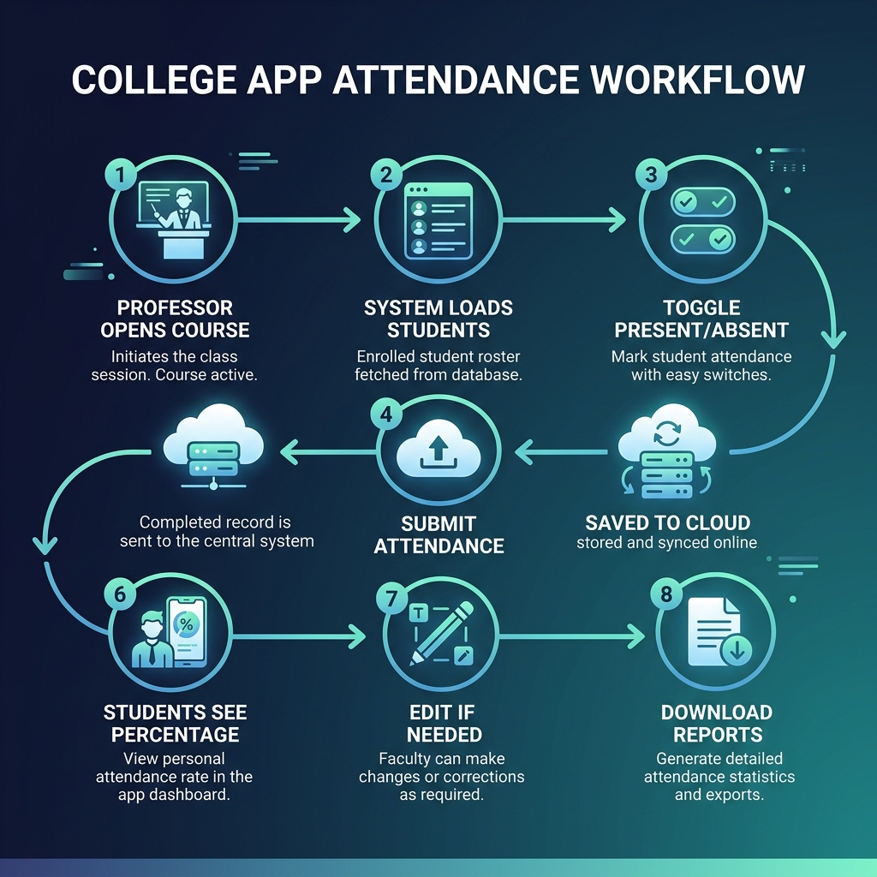
Attendance Workflow
From marking to reporting — 8 simple steps
Notes:
Walk through the complete attendance flow step by step — from marking to export.

Slide 10
Advantages Over Traditional System
9 reasons why digital is the future
SPEED — Attendance in 2-3 min vs 10-15 min with paper
ACCURACY — No miscounting, no illegible handwriting errors
SECURITY — Cloud-backed, tamper-proof, role-restricted access
ANALYTICS — Instant attendance %, color-coded warnings
ACCESSIBILITY — Students check attendance anytime, anywhere
EXPORTABILITY — Download reports in CSV / Excel / PDF instantly
RESILIENCE — Works offline, no risk of lost registers
ECO-FRIENDLY — Zero paper usage, fully digital workflow
ARCHIVAL — Clean semester reset with systematic data backup
Notes:
Emphasize the tangible benefits — speed, accuracy, security, and accessibility.

Slide 11
Data Model and Security
Cloud Firestore — 7 collections with role-based security rules
users — Profiles, roles, academic info (UID-keyed)
branches — Branch definitions (ECE, CSE, ME, etc.)
courses — Course catalog (branch, year, semester, professor)
enrollments — Student-to-Course mappings (approved)
enrollmentRequests — Pending join requests with status tracking
attendanceSessions — Lecture sessions with present/absent stats
records (sub-collection) — Individual student attendance per lecture
Firestore Security Rules — Strict role-based read/write enforcement
Notes:
Show the database structure and how security is enforced through Firestore rules.

Slide 12
Development Roadmap
8-phase approach from foundation to deployment
Phase 1 — Foundation: Flutter + Firebase setup, Auth, Role routing
Phase 2 — Moderator Portal: Branches, Courses, Roles, CR assignment
Phase 3 — Admin Portal: Professor-to-Course assignment
Phase 4 — Professor Portal: Mark / Edit / View attendance, Approvals
Phase 5 — CR Portal: Attendance + Enrollment handling
Phase 6 — Student Portal: Browse courses, Apply, View attendance
Phase 7 — Advanced: Offline sync, Export (CSV/Excel/PDF), Semester reset
Phase 8 — Polish: UI/UX refinement, Testing, Performance optimization
Notes:
Present the phased development plan and timeline.

Slide 13
Thank You
Questions & Discussion
Notes:
Open the floor for questions from the professors.

