Slide 1
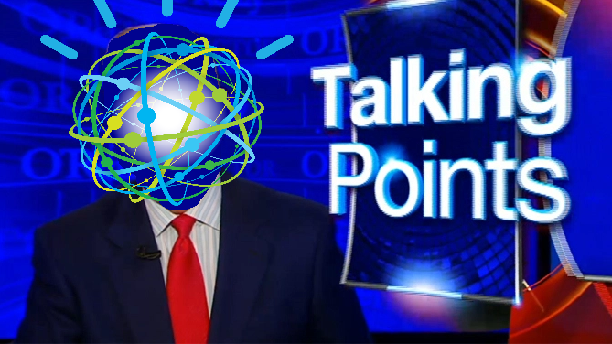
IBM Watson’s Editorial on the National Conventions
Sean Grullon, Ph.D
DataPhilly
September 29th 2016
The Content of this Presentation do not reflect the opinions of the IBM

Slide 2
Outline
What is Watson?
The Watson Developer Cloud
Tone Analyzer Overview
Analysis of the National Convention Speeches

Slide 3
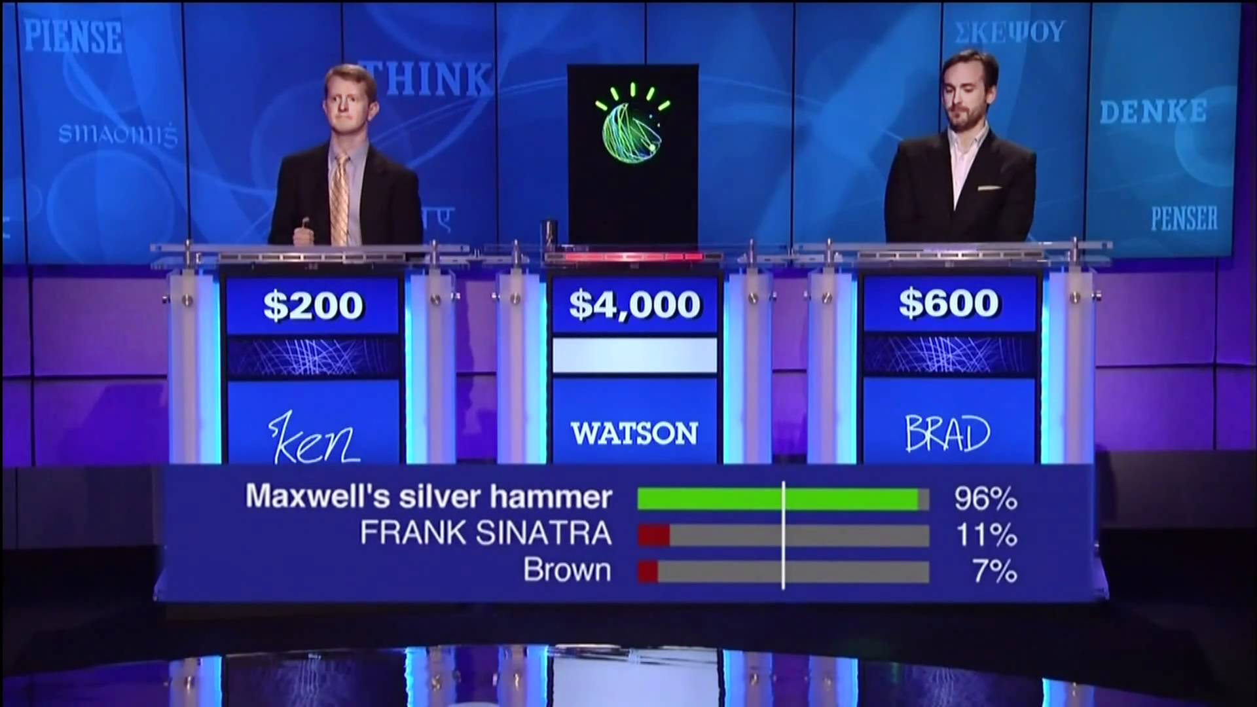

August 2011

Slide 4
Computers are Bad at Natural Language Initial Goal of IBM Watson: Emulate Human Expertise
Natural Language – Language spoken by people as opposed to a “programming language” like C++, JAVA, etc.
Natural Language Processing – algorithms for analyzing and representing natural language for a range of tasks and applications
Given
Rich Questions posed in Natural Language
Over a Broad Domain of Knowledge
Deliver
Precise Answers: Determine what is being asked & give precise response
Accurate Confidences: Determine likelihood answer is correct
Provide Context: Explain why the answer is right
Fast Response Time: Precision & Confidence in seconds
4
Notes:
Automatic Open-Domain Question Answering is represents a very long standing challenge in Computer Science, specifically in the areas of NLP, Information Retrieval and AI.
<go through slide>
4

Slide 5
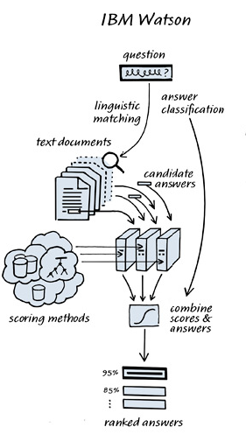
How Watson Works
Watson generates and scores many hypotheses using an extensible collection of Natural Language Processing and Machine Learning Algorithms. These gather and weigh evidence over both unstructured and structured content to determine the answer.
http://blog.stephenwolfram.com/2011/01/jeopardy-ibm-and-wolframalpha/

Slide 6
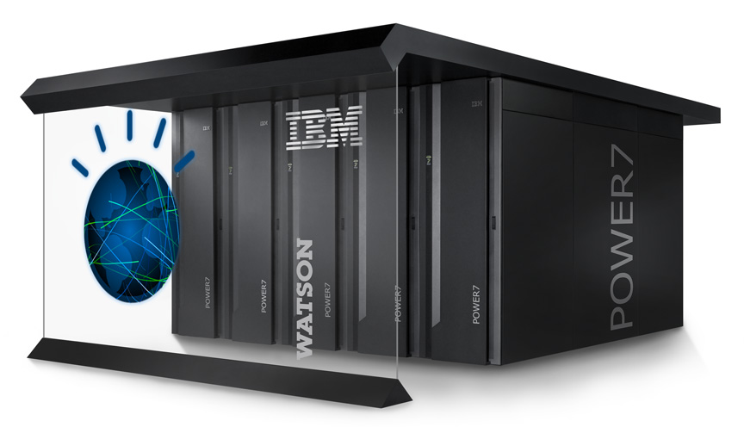

Evolution of Watson
2011
2014
Rack of 90 Power 750 Servers
Massive collection of JAVA libraries executed on a cluster (with a dash of C++ and Prolog)
REST API deployed on a cloud
SDKs available in JAVA, node.js, and Python
Alternatively, send HTTP requests
Next frontier: Unstructured Data (Natural Language Text, Audio, Photos, Video)
IBM coined the phrase Cognitive Computing to describe an adaptive pipeline that combines NLP and ML to handle unstructured data
Term being adopted by industry, for example with Microsoft Cognitive Services

Slide 7
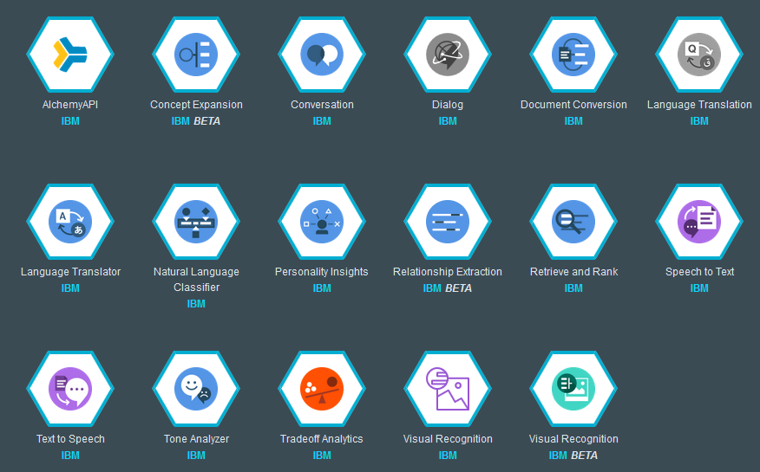
Today: The Watson Developer Cloud
Extract Features from and Model Unstructured Data

Slide 8
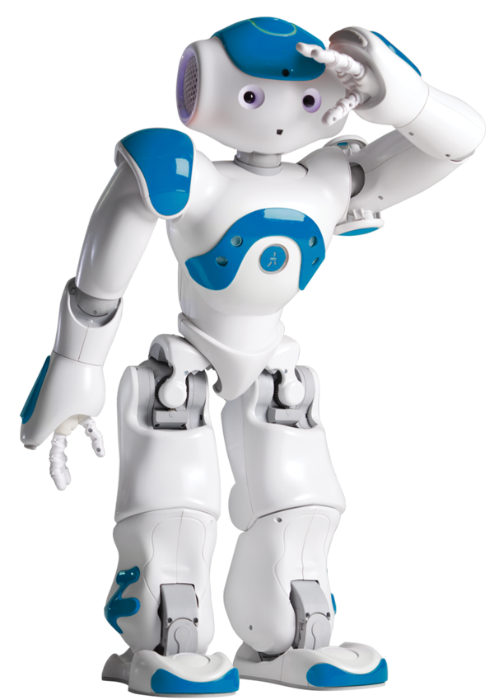
Connie: The Hilton Robot Hotel Concierge Use Case
Watson
Robotics
NL
Classifier
Text
to Speech
Customer
SoftBank
Speech
to Text
Dialog
Tone Analyzer
8

Slide 9
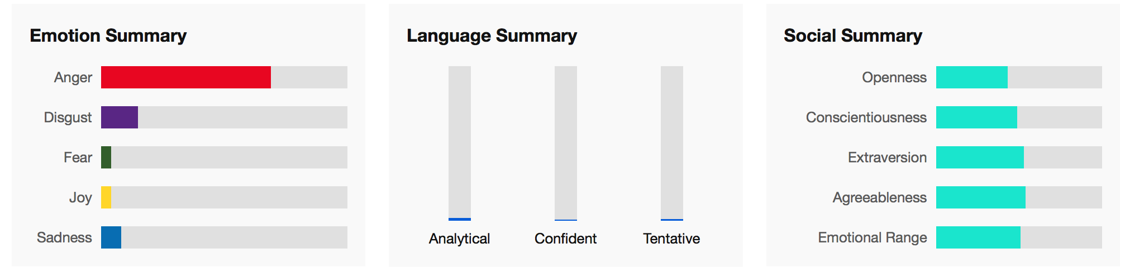
Tone Analyzer models natural language text with three types of communication tones: Social, Emotion, and Language.
Emotion tone is inferred from the different types of emotions and feelings that people express in their language.
Writing tone is concerned with the style of the writing, specifically if the style is analytical, confident or tentative
Social tone looks at the aspects of social propensities that are present, in the areas of openness, conscientiousness, extraversion, agreeableness, or emotional range
9

Slide 10



How Tones Are Computed?
Emotional Tone
The emotion tones are derived from the patterns of using emotional words in people’s writing. We employ ensemble machine learning approaches in our model including matrix factorization, Support-vector-machine and other approaches.
Our current approach extracts the emotional categories based on Robert Plutchik’s “wheel of emotions”
Social Tone
Tone Analyzer derives openness, agreeableness, extroversion, emotional range and conscientiousness from the Big-5 model by mapping the words used with personality traits as proposed by Yarkoni. (Yarkoni, T. Res Pers. 2010 Jun 1; 44(3): 363–373.2010)
Writing Style Tone
Uses natural language process and language parameters and metrics to detect the three writing tones.
Analytical tone ⬅(causation, insight and exclusion); Tentative tone ⬅(inhibition, tentativeness and fillers); confident ⬅(certainty)

Slide 11


Tone Analyzer & Personality Insights in Pop Culture
Harry Potter and Voldemort are the two angriest characters
Ron Weasley serves as comic relief in the movies more than the books
Hermione “outshines Voldemort in assertiveness”
Luke scores high on anger
Yoda and Darth Vader have very close personality types and tones
Han Solo is the most self-conscious character

Slide 12
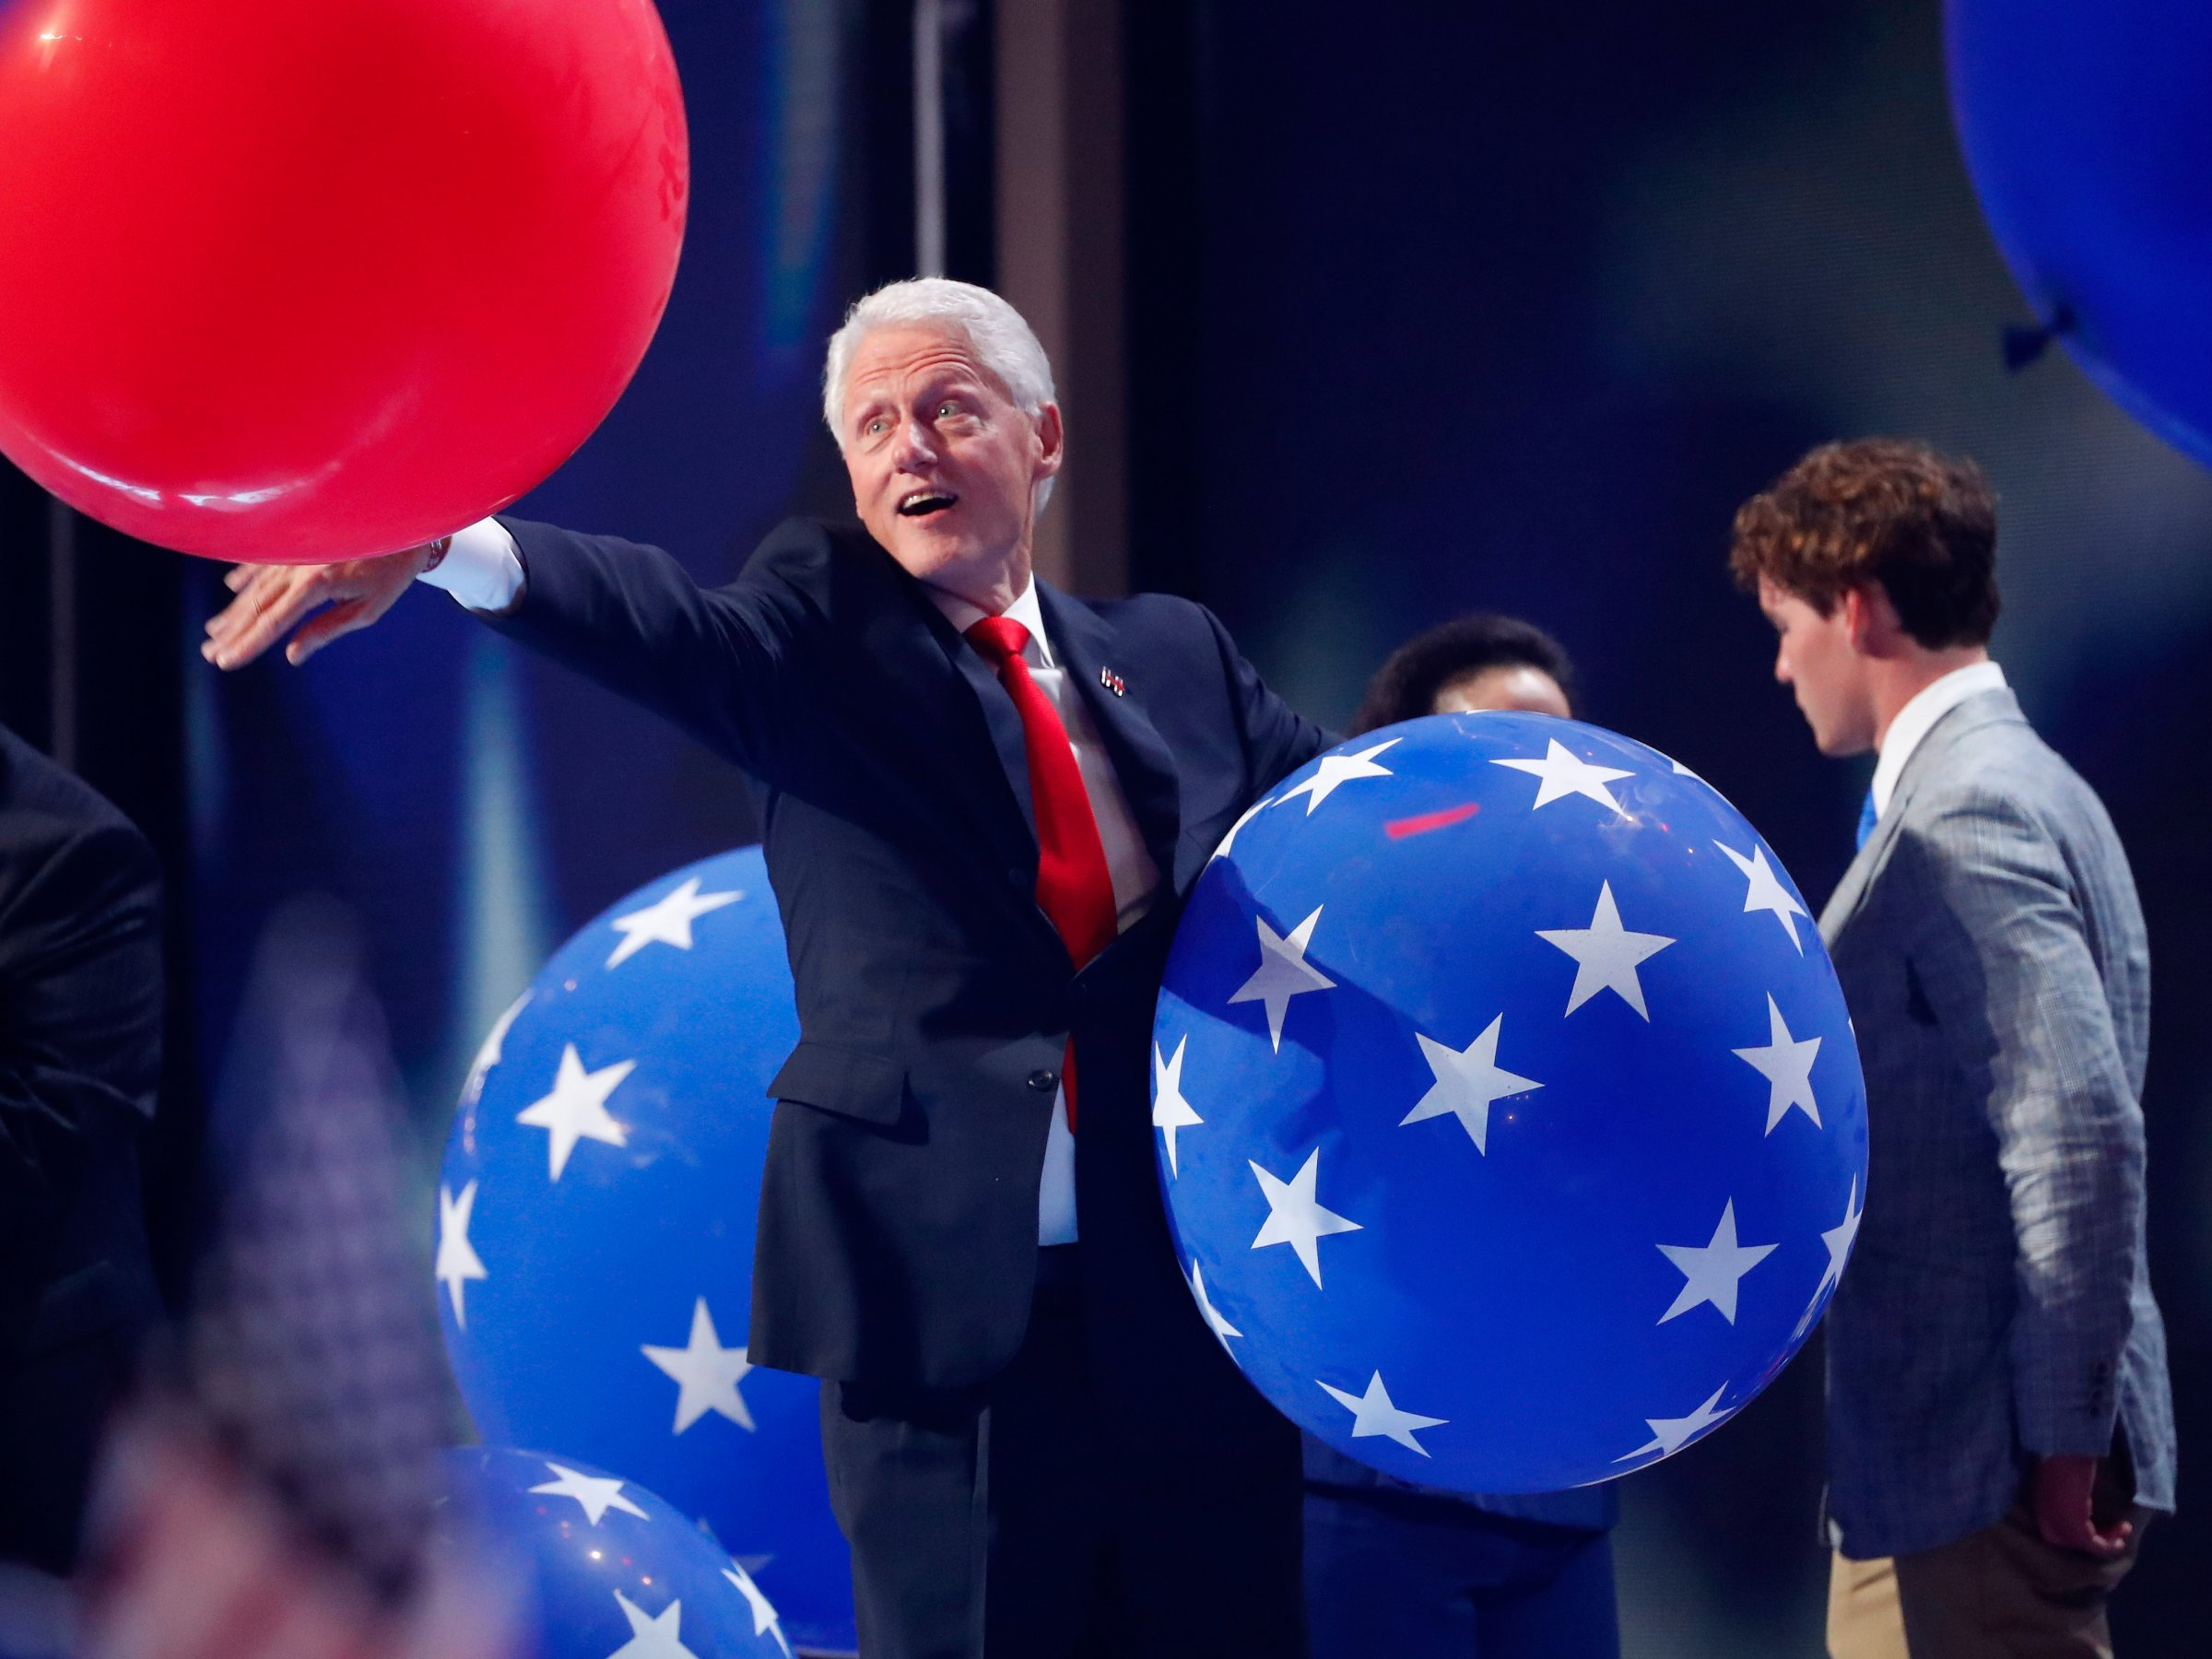
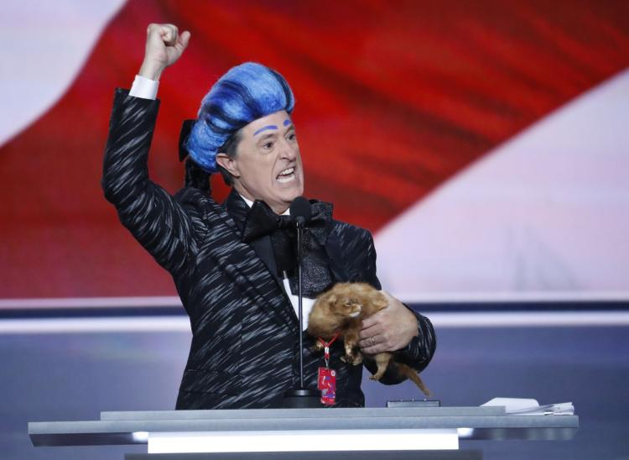
Republican & Democratic National Convention Tone Analysis

Slide 13
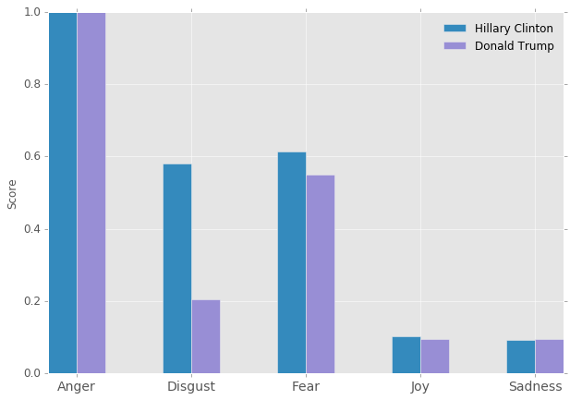
Emotional Tone – Hillary Clinton & Donald Trump

Slide 14
What’s driving Hillary’s Anger?
Job Growth and Wages: “From our inner cities to our small towns, from Indian Country to Coal Country. From communities ravaged by addiction to regions hollowed out by plant closures. I believe America thrives when the middle class thrives. I believe that our economy isn't working the way it should because our democracy isn't working the way it should.”
Donald Trump: “So don't let anyone tell you that our country is weak We're not Don't let anyone tell you we don't have what it takes We do And most of all, don't believe anyone who says “I alone can fix it”. “
Democratic Legacy: “Now, I don't think President Obama and Vice President Biden get the credit they deserve for saving us from the worst economic crisis of our lifetimes Our economy is so much stronger than when they took office.”

Slide 15
What’s driving Hillary’s Disgust?
Donald Trump: “for the past year, many people made the mistake of laughing off Donald Trump's comments , excusing him as an entertainer just putting on a show”
Gun Violence: “You heard, you saw, family members of people killed by gun violence You heard, you saw, family members of police officers killed in the line of duty because they were outgunned by criminals I refuse to believe we can't find common ground here”
What’s driving Hillary’s Fear?
Defense: “Keeping our nation safe and honoring the people who do it will be my highest priority.”
Donald Trump: “Put your faith in him, and you’ll win big? I alone can fix it?“

Slide 16
What’s driving Trump’s Anger?
Weakness(?): “No tolerance for Government Incompetence.”
Lack of order: “Iraq is in Chaos.” “Libya is in Ruins”
Hillary Clinton: “This is the legacy of Hillary Clinton: Death, destruction and terrorism and weakness”.
Gun Violence against the Police: “The number of police officers killed in the line of duty has risen by almost 50 percent compared to this point last year”

Slide 17
What’s driving Trump’s Disgust?
Hillary Clinton: “America is far less safe and the world is far less stable than when Obama made the decision to put Hillary Clinton in charge of America's foreign policy.”
Gun Violence: “The number of police officers killed in the line of duty has risen by almost 50 percent compared to this point last year”
What’s driving Trump’s Fear?
Terrorism: “First, my plan will begin with safety at home which means safe neighborhoods, secure borders, and protection from terrorism.”
Defense: “Iran is on the Path to Nuclear Weapons”
Illegal Immigrants: “Nearly 180,000 illegal immigrants with criminal records, ordered deported from our country, are tonight roaming free to threaten peaceful citizens”

Slide 18
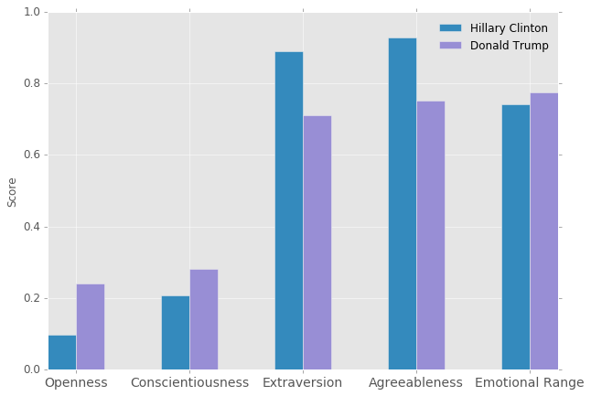
Social Tone – Hillary Clinton & Donald Trump

Slide 19
How is Trump "Agreeable”?
“Every day I wake up determined to deliver a better life for the people all across this nation that had been ignored, neglected and abandoned I have visited the laid-off factory workers, and the communities crushed by our horrible and unfair trade deals. These are the forgotten men and women of our country, and they are forgotten, but they will not be forgotten long”
How is Hillary "Agreeable”?
American Exceptionalism “Freedom and equality, justice and opportunity We should be so proud that these words are associated with us.”

Slide 20
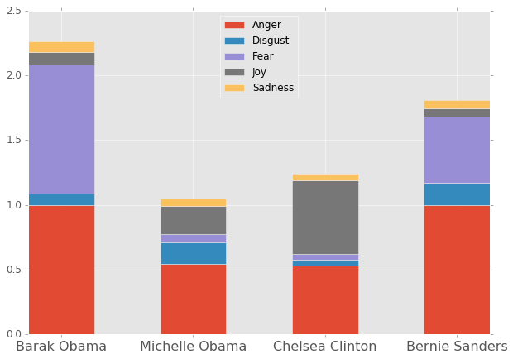
Emotional Tones from the Democratic National Convention

Slide 21
What’s driving Barack Obama’s Anger?
Donald Trump and Republicans: “There were no serious solutions to pressing problems - just the fanning of resentment, and blame, and anger, and hate.”
Previous rivalry with Hillary Clinton: “We battled for a year and a half. Let me tell you, it was tough, because Hillary's tough”
America’s pressing problems: “Sure, we have real anxieties - about paying the bills, protecting our kids, caring for a sick parent. We get frustrated with political gridlock, worry about racial divisions; are shocked and saddened by the madness of Orlando or Nice”.
Defense: “Our troops have pounded ISIL without mercy, taking out leaders, taking back territory. I know Hillary won't relent until ISIL is destroyed”
What’s driving Barack Obama’s Fear?

Slide 22
What’s driving Michelle Obama’s Anger?
Personal attacks: “… protect our girls through the challenges of this unusual life in the spotlight -- how we urge them to ignore those who question their father's citizenship or faith. How we explain that when someone is cruel, or acts like a bully, you don't stoop to their level - no, our motto is, when they go low, we go high.”
Preserving American Exceptionalism: “Because this, right now, is the greatest country on Earth. …. I want a leader who is worthy of that truth, a leader who is worthy of my girls' promise and all our kids' promise”
Her connection with her mother: “Sundays spent together at church, the local library, countless Saturdays finding shapes in the clouds.” - “She loves Elmo, she loves blueberries and above all, she loves Facetiming with Grandma.”
What’s driving Michelle Obama’s Joy?
What’s driving Chelsea Clinton’s Joy?

Slide 23
What is Bernie Sanders Angry about?
Income Inequality: “It is not moral, it is not acceptable, and it is not sustainable that the top 1/10th of 1 percent now owns almost as much wealth as the bottom 90 percent. Or that the top 1 percent in recent years has earned 85 percent of all new income.”
Donald Trump and Republicans: “The Republicans want us to forget that as a result of the greed, recklessness and illegal behavior on Wall Street our economy was in the worst economic downturn since the Great Depression.”
Global Warming: “Hillary Clinton is listening to the scientists who tell us that unless we act boldly to transform our energy system in the very near future, there will be more drought, more floods, more acidification of the oceans, more rising sea levels.”
What’s driving Bernie Sanders’ fear?

Slide 24
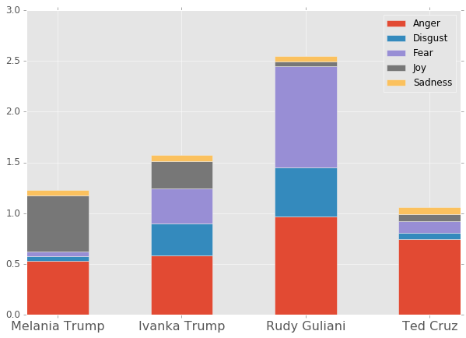
Emotion Tones from the Republican National Convention

Slide 25
What’s driving Melania Trump’s joy?
A charmed life: “My elegant and hard-working mother Amalia introduced me to fashion and beauty” – “After living and working in Milan and Paris, I arrived in New York City twenty years ago, and I saw both the joys and the hardships of daily life”
America is in the wrong direction: “Our country is underperforming and needs new leadership”
Political Hypocrisy: Other politicians see these hardships, see the unfairness of it all, and they say I feel for you. Only my father will say, I’ll fight for you
What’s driving Melania Trump’s Anger?
What’s driving Ivanka Trump’s Anger?

Slide 26
What’s driving Rudy Guliani’s fear?
Terrorism: “To defeat Islamic extremist terrorism we must put them on defense. If they are at war against us-which they have declared-we must commit ourselves to unconditional victory against them”
Crime on police officers: “. They fear for our police officers who are being targeted.”
Obama/Clinton’s actions in the Middle East. “Clinton, and the Obama administration, for political reasons lied about the purpose of the attacks including her lying directly to the families of those who were killed”
The Political Process: “And citizens are furious-rightly furious-at a political establishment that cynically breaks its promises and ignores the will of the people.” – “People are fed up with politicians who don't listen to them, fed up with a corrupt system that benefits the elites, instead of working men and women.”
What’s driving Rudy Guliani’s Anger?
What’s driving Ted Cruz’s Anger?

Slide 27
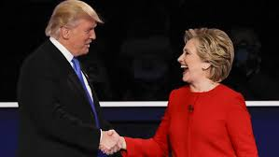
The Presidential Debate

Slide 28
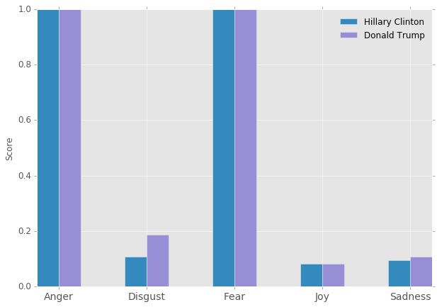
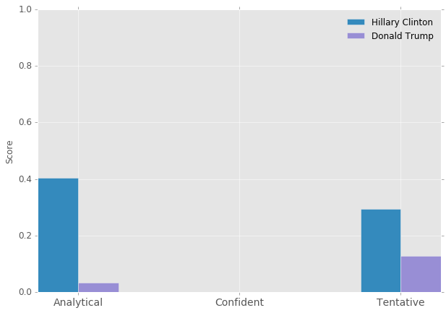
The First Presidential Debate
Emotion Tone
Language Tone

Slide 29
What is Hillary Angry about?
Policy – particularly the Economy “That was in large part because of tax policies that slashed taxes on the wealthy, failed to invest in the middle class, took their eyes off of Wall Street, and created a perfect storm”
Policy – particularly the economy. “So we're now on the precipice of having a potentially much better economy, but the last thing we need to do is to go back to the policies that failed us in the first place”
Analytical: “Independent experts have looked at what I've proposed and looked at what Donald's proposed, and basically they've said this, that if his tax plan, which would blow up the debt by over $5 trillion and would in some instances disadvantage middle-class families compared to the wealthy, were to go into effect, we would lose 3.5 million jobs and maybe have another recession.”
What is Hillary afraid of?
What is Hillary’s overall language tone?

Slide 30
What is Trump Angry about?
Foreign threats stealing from America “We have to renegotiate our trade deals, and we have to stop these countries from stealing our companies and our jobs.”
Hillary Clinton: “why hasn't she made the agreements better?”
Foreign threats stealing from America. “They're devaluing their currency, and there's nobody in our government to fight them.”
“Disastrous Policies/Deals”: “Our energy policies are a disaster”
What is Trump afraid of?
What disgusts Trump?

Slide 31
Thank You!
https://github.com/swbiggs4/WatsonPundit

Slide 32
Appendix

Slide 33
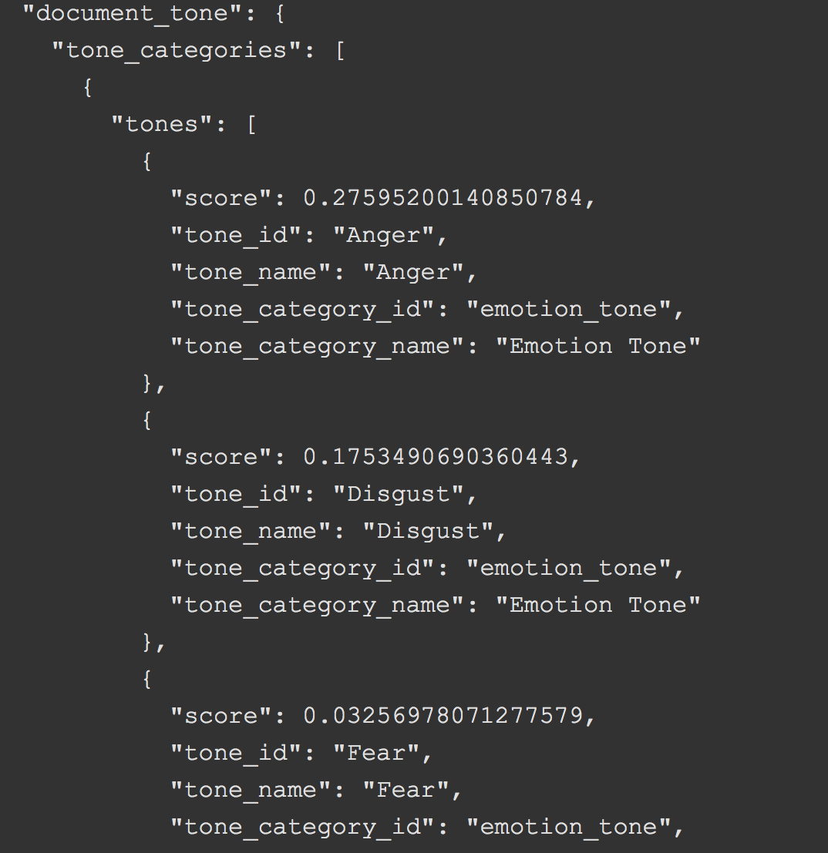



Tone Analyzer takes text inputs in multiple formats and produces JSON outputs the can be exported to various applications
Input parameters
API
JSON Output
Applications
Text data
Analysis Platform
SPSS, Unica,
Cognos, Kenexa
Email, Announcement, Article, Social media,
Linguistic Algorithms
Emotion
Interactive
Visualizations
Social
Text ingest
Writing
Hybrid Mobile
App
Formats:
JSON, HTML, text
The service uses linguistic analysis to detect and interpret emotional, social, and writing cues found in text.
Mobile Web
33
Notes:
The service uses linguistic analysis to detect and interpret emotional, social, and writing cues found in text. This insight can then be used to improve the intended tone of their message

Slide 34
The Difference Between Search & DeepQA
Decision Maker
Has Question
Search Engine
Distills to 2-3 Keywords
Finds Documents containing Keywords
Reads Documents, Finds Answers
Delivers Documents based on Popularity
Finds & Analyzes Evidence
Expert
Decision Maker
Understands Question
Asks NL Question
Produces Possible Answers & Evidence
Considers Answer & Evidence
Analyzes Evidence, Computes Confidence
Delivers Response, Evidence & Confidence

Slide 35
Personality Insights Provides 52 Traits That Can Be Used To Drive Personalization
Big Five personality characteristics represent the most widely used model for generally describing how a person engages with the world. The model includes five primary characteristics, or dimensions:
Agreeableness is a person's tendency to be compassionate and cooperative toward others.
Conscientiousness is a person's tendency to act in an organized or thoughtful way.
Extraversion is a person's tendency to seek stimulation in the company of others.
Emotional Range, also referred to as Neuroticism or Natural Reactions, is the extent to which a person's emotions are sensitive to the person's environment.
Openness is the extent to which a person is open to experiencing a variety of activities.
Needs describe which aspects of a product will resonate with a person. The model includes twelve characteristic needs: Excitement, Harmony, Curiosity, Ideal, Closeness, Selfexpression, Liberty, Love, Practicality, Stability,Challenge, and Structure.
Values describe motivating factors that influence a person's decision making. The model includes five dimensions of human values: Self-transcendence / Helping others, Conservation / Tradition, Hedonism / Taking pleasure in life, Self-enhancement / Achieving success, and Open to change / Excitement.
35
Notes:
Our people analytics technologies take one's linguistic footprints, and analyze them to automatically derive a person's personality, cognitive, and social preferences. Based on the derived preferences, our people engagement technologies will then recommend hyper-personalized products and services to individuals.
Our current set of people analytics technologies use an individual's linguistic footprints (e.g., tweets and Connections blog or forum posts) to automatically derive one's cognitive and social preferences. In particular, we have developed the following analytic appliances:
Big 5 Personality Model: Personality characteristics that differentiate one individual from another. Big 5 (OCEAN) personality is the most studied and well-known personality model.
Basic human values: one's belief and motivators. One could hold numerous values but with varying degrees of importance. Our current model includes 6 dimensions of human values based on Schwartz's work in Psychology.
Fundamental human needs: one's fundamental needs. Our current model is based on Maslow's hierarchy of needs as well as Ford's work on Marketing and consumer-related needs modeling.
Emotional style: how one's emotional or affect states look like and change. This helps us answer questions such as what is the emotional outlook of an individual and how resilient a person is emotionally.
Big 5 Personality Model:
Personal preferences reflecting individual differences
Consistent and enduring
Changes over decades
Link to many aspects of behavior
Brand/product choices
Problem, emotion coping
Relationship selection
Occupational proficiency
Team performance
. . .
Basic Human Values [Schwartz 2006]
by established questionnaires, the Human Values have been demonstrated to encompass various other value propositions and to affect various actions of interest
Values motivate people and guide their actions
Values transcend specific actions and situations
Emotional Style Modeling
Modeling Emotions
PAD (Pleasure, Arousal, Dominance) scales
Pleasure = how pleasant an emotion may be
Arousal = intensity of the emotion
Dominance = controlling and dominant nature of the emotion
Plutchik's Wheel of Emotions
8 primary emotions arranged as opposing pairs
Advanced emotions are composed of 2 neighboring emotions
Modeling Approach
Machine learned from a variety of different data sets, including:
ANEW, LIWC, EARL, LiveJournal, …
Fundamental Needs
Fundamental needs are universal [Aaker 1995, Maslow 1943]
Often change with life events
Link to many aspects in one’s life
Brand/product choices
Occupational choices
Motivation …
Method:
Developed custom survey to acquire ground truth (need data)
Machine-learned model using linguistic features collected in survey data

Slide 36
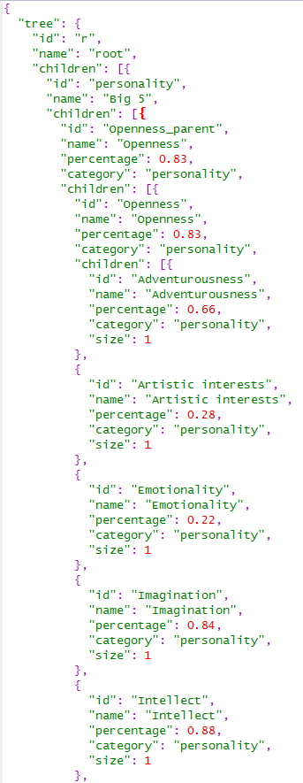
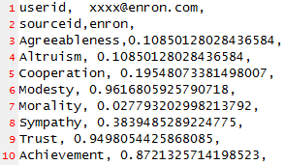
Personality Insights
Takes Input As Text In Multiple Formats & Can Produce Output As JSON/CSV To Be Exported In Various Applications
Input parameters
Portrait API
Implementation
JSON Output
Applications
Text data
SPSS, Unica,
Cognos, Kenexa
Social media, emails, etc.
Generic test ingest
Data Model (JSON)
Interactive
Visualizations
Analysis Platform
Watson
Ecosystem
Formats:
JSON, HTML, text
Linguistic Algorithms
Big 5 Personality
CSV Output
Hybrid Mobile
App
Basic Human Values
Fundamental Needs
Mobile Web
36
Notes:
Integrate User Modeling analytics with your applications using the following two REST API calls*:
Portrait API (POST method) - accepts a list of content items with their metadata and analyzes them returning the results in JSON format. It produces a tree of cognitive and social characteristics including Big 5 personality, Values, and Needs.
Visualize API (POST method) - accepts the output generated by the Portrait API above and produces a visualization of that portrait.
Start explaining this chart left to right:
User Modeling APIs can analyze data from social sites, personal communications, and enterprise data sources
User Modeling Portrait API analyze the data applying innovative approach based on years of experience gain in multiple disciplines.
The out put of User Modeling is flexible: It can be explored with the Visualize API, utilize it on mobile devices, or by using the provided APIs it can be imported into other enterprises’ systems and products such as IBM Unica or other Visual analytical tools.
How to use the User Modeling APIs
Create an instance of the User Modeling service
Bind the service to your application
- For ecosystem users: take the url and credentials information from the Bluemix UI and configure your application to access User Modeling from outside of Bluemix (e.g. Public Cloud, Private Cloud, etc)
- For Bluemix customers: create an application in Bluemix and bind the service instance you created in #1 to it
Build your application
Links to Bluemix documentation, User Modeling docs & samples:
Information about connecting to Bluemix and integrating the User Modeling service into Bluemix applications
Sample source code in Node.js, Java, and Ruby for using User Modeling service in applications

Slide 37
DeepQA: the technology & architecture behind Watson
Learned Models
help combine and weigh the Evidence
model
model
model
Initial
Question
Answer Sources
Evidence Sources
model
model
model
Primary Search
Candidate
Answer
Generation
Answer Scoring
Evidence
Retrieval
Deep Evidence Scoring
model
model
model
Question & Topic Analysis
Question
Decomposition
Hypothesis
Generation
Hypothesis
& Evidence Scoring
Synthesis
Final Confidence Merging & Ranking
Hypothesis
Generation
Hypothesis and Evidence Scoring
Answer & Confidence
Hypothesis
Generation
Hypothesis and Evidence Scoring
Notes:
DeepQA generates and scores many hypotheses using an extensible collection of Natural Language Processing, Machine Learning and Reasoning Algorithms. These gather and weigh evidence over both unstructured and structured content to determine the answer with the best confidence.
DeepQA generates and scores many hypotheses using an extensible collection of Natural Language Processing, Machine Learning and Reasoning Algorithms. These gather and weigh evidence over both unstructured and structured content to determine the answer with the best confidence.
Watson – the computer system we developed to play Jeopardy! is based on the DeepQA softate archtiecture.Here is a look at the DeepQA architecture. This is like looking inside the brain of the Watson system from about 30,000 feet high.
Remember, the intended meaning of natural language is ambiguous, tacit and highly contextual. The computer needs to consider many possible meanings, attempting to find the evidence and inference paths that are most confidently supported by the data.
So, the primary computational principle supported by the DeepQA architecture is to assume and pursue multiple interpretations of the question, to generate many plausible answers or hypotheses and to collect and evaluate many different competing evidence paths that might support or refute those hypotheses.
Each component in the system adds assumptions about what the question might means or what the content means or what the answer might be or why it might be correct.
DeepQA is implemented as an extensible architecture and was designed at the outset to support interoperability.
<UIMA Mention>
For this reason it was implemented using UIMA, a framework and OASIS standard for interoperable text and multi-modal analysis contributed by IBM to the open-source community.
Over 100 different algorithms, implemented as UIMA components, were integrated into this architecture to build Watson.
In the first step, Question and Category analysis, parsing algorithms decompose the question into its grammatical components. Other algorithms here will identify and tag specific semantic entities like names, places or dates. In particular the type of thing being asked for, if is indicated at all, will be identified. We call this the LAT or Lexical Answer Type, like this “FISH”, this “CHARACTER” or “COUNTRY”.
In Query Decomposition, different assumptions are made about if and how the question might be decomposed into sub questions. The original and each identified sub part follow parallel paths through the system.
In Hypothesis Generation, DeepQA does a variety of very broad searches for each of several interpretations of the question. Note that Watson, to compete on Jeopardy! is not connected to the internet.
These searches are performed over a combination of unstructured data, natural language documents, and structured data, available data bases and knowledge bases fed to Watson during training.
The goal of this step is to generate possible answers to the question and/or its sub parts. At this point there is very little confidence in these possible answers since little intelligence has been applied to understanding the content that might relate to the question. The focus at this point on generating a broad set of hypotheses, – or for this application what we call them “Candidate Answers”.
To implement this step for Watson we integrated and advanced multiple open-source text and KB search components.
After candidate generation DeepQA also performs Soft Filtering where it makes parameterized judgments about which and how many candidate answers are most likely worth investing more computation given specific constrains on time and available hardware. Based on a trained threshold for optimizing the tradeoff between accuracy and speed, Soft Filtering uses different light-weight algorithms to judge which candidates are worth gathering evidence for and which should get less attention and continue through the computation as-is. In contrast, if this were a hard-filter those candidates falling below the threshold would be eliminated from consideration entirely at this point.
In Hypothesis & Evidence Scoring the candidate answers are first scored independently of any additional evidence by deeper analysis algorithms. This may for example include Typing Algorithms. These are algorithms that produce a score indicating how likely it is that a candidate answer is an instance of the Lexical Answer Type determined in the first step – for example Country, Agent, Character, City, Slogan, Book etc.
Many of these algorithms may fire using different resources and techniques to come up with a score. What is the likelihood that “Washington” for example, refers to a “General” or a “Capital” or a “State” or a “Mountain” or a “Father” or a “Founder”?
For each candidate answer many pieces of additional Evidence are search for. Each of these pieces of evidence are subjected to more algorithms that deeply analyze the evidentiary passages and score the likelihood that the passage supports or refutes the correctness of the candidate answer. These algorithms may consider variations in grammatical structure, word usage, and meaning.
In the Synthesis step, if the question had been decomposed into sub-parts, one or more synthesis algorithms will fire. They will apply methods for inferring a coherent final answer from the constituent elements derived from the questions sub-parts.
Finally, arriving at the last step, Final Merging and Ranking, are many possible answers, each paired with many pieces of evidence and each of these scored by many algorithms to produce hundreds of feature scores. All giving some evidence for the correctness of each candidate answer.
Trained models are applied to weigh the relative importance of these feature scores. These models are trained with ML methods to predict, based on past performance, how best to combine all this scores to produce final, single confidence numbers for each candidate answer and to produce the final ranking of all candidates.
The answer with the strongest confidence would be Watson’s final answer. And Watson would try to buzz-in provided that top answer’s confidence was above a certain threshold.
----
The DeepQA system defers commitments and carries possibilities through the entire process while searching for increasing broader contextual evidence and more credible inferences to support the most likely candidate answers.
All the algorithms used to interpret questions, generate candidate answers, score answers, collection evidence and score evidence are loosely coupled but work holistically by virtue of DeepQA’s pervasive machine learning infrastructure.
No one component could realize its impact on end-to-end performance without being integrated and trained with the other components AND they are all evolving simultaneously. In fact what had 10% impact on some metric one day, might 1 month later, only contribute 2% to overall performance due to evolving component algorithms and interactions. This is why the system as it develops in regularly trained and retrained.
DeepQA is a complex system architecture designed to extensibly deal with the challenges of natural language processing applications and to adapt to new domains of knowledge.
The Jeopardy! Challenge has greatly inspired its design and implementation for the Watson system.

Slide 38
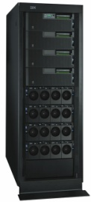

One Jeopardy! question can take 2 hours on a single 2.6Ghz Core Optimized & Scaled out on 2880-Core IBM workload optimized POWER7 HPC using UIMA-AS, Watson answers in 2-6 seconds.
Question
1000’s of
Pieces of Evidence
100s Possible Answers
100,000’s scores from many simultaneous Text Analysis Algorithms
100s sources
built on UIMA for interoperability
Multiple Interpretations
Question & Topic Analysis
Question
Decomposition
Hypothesis
Generation
Hypothesis and Evidence Scoring
Synthesis
Final Confidence Merging & Ranking
built on UIMA-AS for scale-out and speed
Hypothesis
Generation
Hypothesis and Evidence Scoring
Answer & Confidence
. . .
Notes:
_{<click>}
Here is a look at the DeepQA architecture. This is like looking inside the brain of the Watson system from about 30,000 feet high.
Remember, natural language is ambiguous, polysemous, tacit and its meaning is often highly contextual. Bottom line -- the computer needs to consider many possible meanings, attempting to find the inference paths that are most confidently supported by the data.
So, the primary computational principle supported by the DeepQA architecture is to assume and maintain multiple interpretations of the question, to generate many plausible answers or hypotheses and to collect and process many different evidence streams that might support or refute those hypotheses.
Each component in the system adds assumptions about what the question means or what the content means or what the answer might be or why it might be correct.
DeepQA is implemented as an extensible architecture and was designed at the outset to support interoperability.
<UIMA Mention>
For this reason it was implemented using UIMA, a framework and OASIS standard for interoperable text and multi-modal analysis contributed by IBM to the open-source community.
Over 100 different algorithms, implemented as UIMA components, were integrated into this architecture to build Watson.
In the first step, Question and Category analysis, parsing algorithms decompose the question into its grammatical or syntactic components. Other algorithms here will identify and tag specific semantic entities like names, places or dates. In particular the type of thing being asked for, if is indicated at all, will be identified. We call this the LAT or Lexical Answer Type, like this “FISH”, this “CHARACTER” or “COUNTRY”.
In Query Decomposition, different assumptions are made about if and how the question might be decomposed into sub questions. The original and each identified sub part follow parallel paths through the system.
In Hypothesis Generation, DeepQA does a variety of very broad searches for each of several interpretations of the question.
These searches are performed over a combination of unstructured data, natural language documents, and structured data, available knowledge bases.
--
The goal of this step is to generate possible answers to the question and/or its sub parts. At this point there is not a lot of confidence in these possible answers since little intelligence has been applied to understanding the content that might relate to the question. The focus is on generating a broad set of hypotheses, – or for this application what we call “Candidate Answers”.
To implement this step for Watson we used multiple open-source text and KB search components.
The Soft Filtering step in DeepQA, acknowledges that resources are ultimately limited. And some parameterized judgment about which candidate answers are worth pursuing further must be made given constrains on time and available hardware.
Based on a trained threshold for optimizing the tradeoff between accuracy and latency, Soft Filtering uses different light-weight algorithms to judge which candidates are worth gathering evidence for and which should get less attention and continue through the computation as-is. In contrast, if this were a hard-filter those candidates falling below the filter would be eliminated from consideration entirely at this point.
In Hypothesis & Evidence Scoring the candidate answers are scored independently of any additional evidence by deeper analysis algorithms. This may for example include Typing Algorithms. These are algorithms that produce a score indicating how likely it is that a candidate answer is an instance of the Lexical Answer Type determined in the first step – for example Country, Agent, Character, City, Slogan, Book etc.
Many of these algorithms may fire using different resources and techniques to come up with a score. What is the likelihood that “Washington” for example, refers to a “General” or a “Capital” or a “State” or a “Mountain” or a “Father” or a “Founder”?
Evidence, in this case, more documents and or more structured facts, is collected for the many candidate answers. Each of these pieces of evidence are subjected to more algorithms that deeply analyze the evidentiary passages, for example, and score the likelihood that the passage supports or refutes the correctness of the candidate answer.
In the Synthesis step, if the question had been decomposed into sub-parts, one or more synthesis algorithms will fire, with varying levels of certainty, They will apply methods for inferring a coherent final answer from the constituent elements derived from the questions sub-parts.
Finally, arriving at the last step, Final Merging and Ranking, are many possible answers, each paired with many pieces of evidence and each of these scored by many algorithms to produce hundreds of feature scores. All giving some evidence for the correctness of each candidate answer.
Trained models are applied to weigh the relative importance of these feature scores. These models are trained with ML methods to predict, based on past performance, how best to combine all this scores to produce final, single confidence numbers for each candidate answer and to produce the final ranking of all candidates.
The answer with the strongest confidence would be Watson’s final answer. And Watson would try to buzz-in provided that top answer’s confidence was above a certain threshold.
----
The DeepQA system defers commitments and carries possibilities through the entire process while searching for increasing broader contextual evidence and more credible inferences to support the most likely candidate answers.
All the algorithms used to interpret questions, generate candidate answers, score answers, collection evidence and score evidence are loosely coupled but work holistically by virtue of DeepQA’s pervasive machine learning infrastructure.
No one component could realize its impact on end-to-end performance without being integrated and trained with the other components AND they are all evolving simultaneously. In fact what had 10% impact on some metric one day, might 1 month later, only contribute 2% to overall performance due to evolving component algorithms and interactions. This is why the system as it develops in regularly trained and retrained.
DeepQA is a complex system architecture designed to extensibly deal with the challenges of natural language processing applications and to adapt to new domains of knowledge.
The Jeopardy! Challenge has greatly inspired its design and implementation for the Watson system.
38

Slide 39
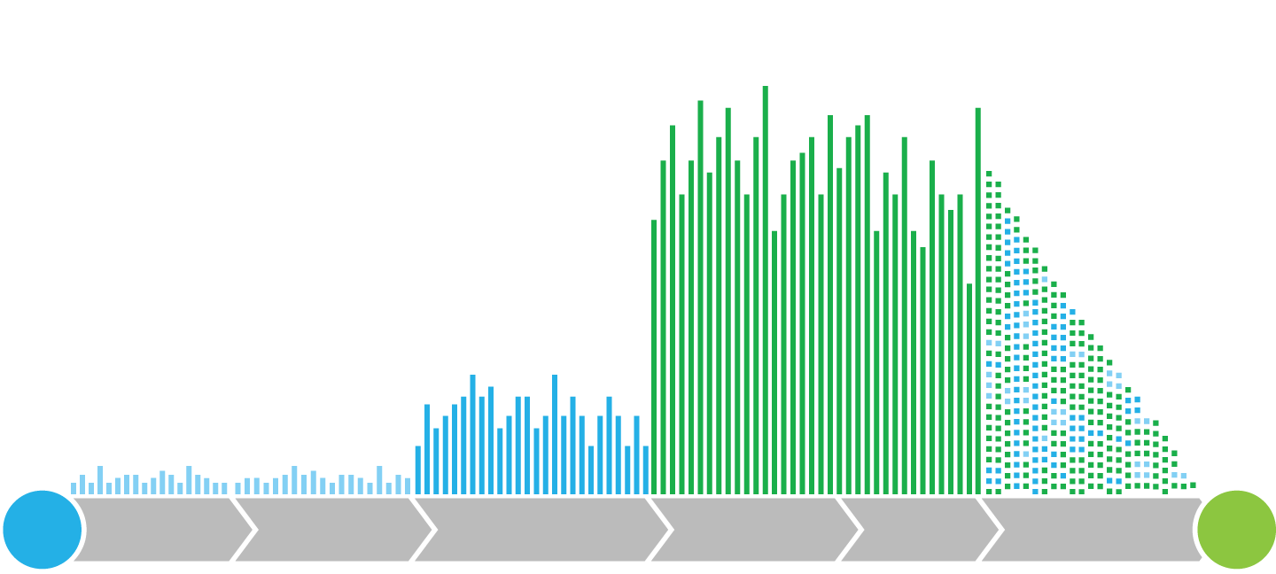
DeepQA Architecture
Multiple interpretations
Hundreds of answer sources
Primary search
Candidate answer generation
Tens of thousands of evidence sources and scores
Answer scoring
Evidence retrieval
Deep evidence scoring
Learned models
Combine and weigh evidence
Natural language processing
Information retrieval
Knowledge representation and reasoning
?
Deep analytics
Machine learning
!
Parallel and distributed computing
Q
Inquiry analysis
Decomposition
Hypothesis generation
Hypothesis and evidence scoring
Synthesis
Final confidence merging and ranking
A

Slide 40
DeepQA: the technology & architecture behind Watson
Learned Models
help combine and weigh the Evidence
model
model
model
Initial
Question
Answer Sources
Evidence Sources
model
model
model
Primary Search
Candidate
Answer
Generation
Answer Scoring
Evidence
Retrieval
Deep Evidence Scoring
model
model
model
Question & Topic Analysis
Question
Decomposition
Hypothesis
Generation
Hypothesis
& Evidence Scoring
Synthesis
Final Confidence Merging & Ranking
Hypothesis
Generation
Hypothesis and Evidence Scoring
Answer & Confidence
Hypothesis
Generation
Hypothesis and Evidence Scoring
Notes:
DeepQA generates and scores many hypotheses using an extensible collection of Natural Language Processing, Machine Learning and Reasoning Algorithms. These gather and weigh evidence over both unstructured and structured content to determine the answer with the best confidence.
DeepQA generates and scores many hypotheses using an extensible collection of Natural Language Processing, Machine Learning and Reasoning Algorithms. These gather and weigh evidence over both unstructured and structured content to determine the answer with the best confidence.
Watson – the computer system we developed to play Jeopardy! is based on the DeepQA softate archtiecture.Here is a look at the DeepQA architecture. This is like looking inside the brain of the Watson system from about 30,000 feet high.
Remember, the intended meaning of natural language is ambiguous, tacit and highly contextual. The computer needs to consider many possible meanings, attempting to find the evidence and inference paths that are most confidently supported by the data.
So, the primary computational principle supported by the DeepQA architecture is to assume and pursue multiple interpretations of the question, to generate many plausible answers or hypotheses and to collect and evaluate many different competing evidence paths that might support or refute those hypotheses.
Each component in the system adds assumptions about what the question might means or what the content means or what the answer might be or why it might be correct.
DeepQA is implemented as an extensible architecture and was designed at the outset to support interoperability.
<UIMA Mention>
For this reason it was implemented using UIMA, a framework and OASIS standard for interoperable text and multi-modal analysis contributed by IBM to the open-source community.
Over 100 different algorithms, implemented as UIMA components, were integrated into this architecture to build Watson.
In the first step, Question and Category analysis, parsing algorithms decompose the question into its grammatical components. Other algorithms here will identify and tag specific semantic entities like names, places or dates. In particular the type of thing being asked for, if is indicated at all, will be identified. We call this the LAT or Lexical Answer Type, like this “FISH”, this “CHARACTER” or “COUNTRY”.
In Query Decomposition, different assumptions are made about if and how the question might be decomposed into sub questions. The original and each identified sub part follow parallel paths through the system.
In Hypothesis Generation, DeepQA does a variety of very broad searches for each of several interpretations of the question. Note that Watson, to compete on Jeopardy! is not connected to the internet.
These searches are performed over a combination of unstructured data, natural language documents, and structured data, available data bases and knowledge bases fed to Watson during training.
The goal of this step is to generate possible answers to the question and/or its sub parts. At this point there is very little confidence in these possible answers since little intelligence has been applied to understanding the content that might relate to the question. The focus at this point on generating a broad set of hypotheses, – or for this application what we call them “Candidate Answers”.
To implement this step for Watson we integrated and advanced multiple open-source text and KB search components.
After candidate generation DeepQA also performs Soft Filtering where it makes parameterized judgments about which and how many candidate answers are most likely worth investing more computation given specific constrains on time and available hardware. Based on a trained threshold for optimizing the tradeoff between accuracy and speed, Soft Filtering uses different light-weight algorithms to judge which candidates are worth gathering evidence for and which should get less attention and continue through the computation as-is. In contrast, if this were a hard-filter those candidates falling below the threshold would be eliminated from consideration entirely at this point.
In Hypothesis & Evidence Scoring the candidate answers are first scored independently of any additional evidence by deeper analysis algorithms. This may for example include Typing Algorithms. These are algorithms that produce a score indicating how likely it is that a candidate answer is an instance of the Lexical Answer Type determined in the first step – for example Country, Agent, Character, City, Slogan, Book etc.
Many of these algorithms may fire using different resources and techniques to come up with a score. What is the likelihood that “Washington” for example, refers to a “General” or a “Capital” or a “State” or a “Mountain” or a “Father” or a “Founder”?
For each candidate answer many pieces of additional Evidence are search for. Each of these pieces of evidence are subjected to more algorithms that deeply analyze the evidentiary passages and score the likelihood that the passage supports or refutes the correctness of the candidate answer. These algorithms may consider variations in grammatical structure, word usage, and meaning.
In the Synthesis step, if the question had been decomposed into sub-parts, one or more synthesis algorithms will fire. They will apply methods for inferring a coherent final answer from the constituent elements derived from the questions sub-parts.
Finally, arriving at the last step, Final Merging and Ranking, are many possible answers, each paired with many pieces of evidence and each of these scored by many algorithms to produce hundreds of feature scores. All giving some evidence for the correctness of each candidate answer.
Trained models are applied to weigh the relative importance of these feature scores. These models are trained with ML methods to predict, based on past performance, how best to combine all this scores to produce final, single confidence numbers for each candidate answer and to produce the final ranking of all candidates.
The answer with the strongest confidence would be Watson’s final answer. And Watson would try to buzz-in provided that top answer’s confidence was above a certain threshold.
----
The DeepQA system defers commitments and carries possibilities through the entire process while searching for increasing broader contextual evidence and more credible inferences to support the most likely candidate answers.
All the algorithms used to interpret questions, generate candidate answers, score answers, collection evidence and score evidence are loosely coupled but work holistically by virtue of DeepQA’s pervasive machine learning infrastructure.
No one component could realize its impact on end-to-end performance without being integrated and trained with the other components AND they are all evolving simultaneously. In fact what had 10% impact on some metric one day, might 1 month later, only contribute 2% to overall performance due to evolving component algorithms and interactions. This is why the system as it develops in regularly trained and retrained.
DeepQA is a complex system architecture designed to extensibly deal with the challenges of natural language processing applications and to adapt to new domains of knowledge.
The Jeopardy! Challenge has greatly inspired its design and implementation for the Watson system.

Slide 41
DeepQA: the technology & architecture behind Watson
1
Initial Question Formulated: “The name of this monetary unit comes from the word for "round"; earlier coins were often oval”
Initial
Question
3
Question & Topic Analysis
Question
Decomposition
It decides whether the question needs to be subdivided.
Watson performs question analysis, determines what is being asked.
2
Notes:
DeepQA generates and scores many hypotheses using an extensible collection of Natural Language Processing, Machine Learning and Reasoning Algorithms. These gather and weigh evidence over both unstructured and structured content to determine the answer with the best confidence.
DeepQA generates and scores many hypotheses using an extensible collection of Natural Language Processing, Machine Learning and Reasoning Algorithms. These gather and weigh evidence over both unstructured and structured content to determine the answer with the best confidence.
Watson – the computer system we developed to play Jeopardy! is based on the DeepQA softate archtiecture.Here is a look at the DeepQA architecture. This is like looking inside the brain of the Watson system from about 30,000 feet high.
Remember, the intended meaning of natural language is ambiguous, tacit and highly contextual. The computer needs to consider many possible meanings, attempting to find the evidence and inference paths that are most confidently supported by the data.
So, the primary computational principle supported by the DeepQA architecture is to assume and pursue multiple interpretations of the question, to generate many plausible answers or hypotheses and to collect and evaluate many different competing evidence paths that might support or refute those hypotheses.
Each component in the system adds assumptions about what the question might means or what the content means or what the answer might be or why it might be correct.
DeepQA is implemented as an extensible architecture and was designed at the outset to support interoperability.
<UIMA Mention>
For this reason it was implemented using UIMA, a framework and OASIS standard for interoperable text and multi-modal analysis contributed by IBM to the open-source community.
Over 100 different algorithms, implemented as UIMA components, were integrated into this architecture to build Watson.
In the first step, Question and Category analysis, parsing algorithms decompose the question into its grammatical components. Other algorithms here will identify and tag specific semantic entities like names, places or dates. In particular the type of thing being asked for, if is indicated at all, will be identified. We call this the LAT or Lexical Answer Type, like this “FISH”, this “CHARACTER” or “COUNTRY”.
In Query Decomposition, different assumptions are made about if and how the question might be decomposed into sub questions. The original and each identified sub part follow parallel paths through the system.
In Hypothesis Generation, DeepQA does a variety of very broad searches for each of several interpretations of the question. Note that Watson, to compete on Jeopardy! is not connected to the internet.
These searches are performed over a combination of unstructured data, natural language documents, and structured data, available data bases and knowledge bases fed to Watson during training.
The goal of this step is to generate possible answers to the question and/or its sub parts. At this point there is very little confidence in these possible answers since little intelligence has been applied to understanding the content that might relate to the question. The focus at this point on generating a broad set of hypotheses, – or for this application what we call them “Candidate Answers”.
To implement this step for Watson we integrated and advanced multiple open-source text and KB search components.
After candidate generation DeepQA also performs Soft Filtering where it makes parameterized judgments about which and how many candidate answers are most likely worth investing more computation given specific constrains on time and available hardware. Based on a trained threshold for optimizing the tradeoff between accuracy and speed, Soft Filtering uses different light-weight algorithms to judge which candidates are worth gathering evidence for and which should get less attention and continue through the computation as-is. In contrast, if this were a hard-filter those candidates falling below the threshold would be eliminated from consideration entirely at this point.
In Hypothesis & Evidence Scoring the candidate answers are first scored independently of any additional evidence by deeper analysis algorithms. This may for example include Typing Algorithms. These are algorithms that produce a score indicating how likely it is that a candidate answer is an instance of the Lexical Answer Type determined in the first step – for example Country, Agent, Character, City, Slogan, Book etc.
Many of these algorithms may fire using different resources and techniques to come up with a score. What is the likelihood that “Washington” for example, refers to a “General” or a “Capital” or a “State” or a “Mountain” or a “Father” or a “Founder”?
For each candidate answer many pieces of additional Evidence are search for. Each of these pieces of evidence are subjected to more algorithms that deeply analyze the evidentiary passages and score the likelihood that the passage supports or refutes the correctness of the candidate answer. These algorithms may consider variations in grammatical structure, word usage, and meaning.
In the Synthesis step, if the question had been decomposed into sub-parts, one or more synthesis algorithms will fire. They will apply methods for inferring a coherent final answer from the constituent elements derived from the questions sub-parts.
Finally, arriving at the last step, Final Merging and Ranking, are many possible answers, each paired with many pieces of evidence and each of these scored by many algorithms to produce hundreds of feature scores. All giving some evidence for the correctness of each candidate answer.
Trained models are applied to weigh the relative importance of these feature scores. These models are trained with ML methods to predict, based on past performance, how best to combine all this scores to produce final, single confidence numbers for each candidate answer and to produce the final ranking of all candidates.
The answer with the strongest confidence would be Watson’s final answer. And Watson would try to buzz-in provided that top answer’s confidence was above a certain threshold.
----
The DeepQA system defers commitments and carries possibilities through the entire process while searching for increasing broader contextual evidence and more credible inferences to support the most likely candidate answers.
All the algorithms used to interpret questions, generate candidate answers, score answers, collection evidence and score evidence are loosely coupled but work holistically by virtue of DeepQA’s pervasive machine learning infrastructure.
No one component could realize its impact on end-to-end performance without being integrated and trained with the other components AND they are all evolving simultaneously. In fact what had 10% impact on some metric one day, might 1 month later, only contribute 2% to overall performance due to evolving component algorithms and interactions. This is why the system as it develops in regularly trained and retrained.
DeepQA is a complex system architecture designed to extensibly deal with the challenges of natural language processing applications and to adapt to new domains of knowledge.
The Jeopardy! Challenge has greatly inspired its design and implementation for the Watson system.
1 0.887 Yen Yes
2 0.197 feudal Japan No
3 0.058 Dollar No
4 0.054 tael No
5 0.027 head No

Slide 42
DeepQA: the technology & architecture behind Watson
5
In creating the hypotheses it will use, Watson consults numerous sources for potential answers…
Initial
Question
Answer Sources
Primary Search
Candidate
Answer
Generation
Question & Topic Analysis
Question
Decomposition
Hypothesis
Generation
4
Watson then starts to generate hypotheses based on decomposition and initial analysis…as many hypothesis as may be relevant to the initial question…
Hypothesis
Generation
Hypothesis
Generation
Notes:
DeepQA generates and scores many hypotheses using an extensible collection of Natural Language Processing, Machine Learning and Reasoning Algorithms. These gather and weigh evidence over both unstructured and structured content to determine the answer with the best confidence.
DeepQA generates and scores many hypotheses using an extensible collection of Natural Language Processing, Machine Learning and Reasoning Algorithms. These gather and weigh evidence over both unstructured and structured content to determine the answer with the best confidence.
Watson – the computer system we developed to play Jeopardy! is based on the DeepQA softate archtiecture.Here is a look at the DeepQA architecture. This is like looking inside the brain of the Watson system from about 30,000 feet high.
Remember, the intended meaning of natural language is ambiguous, tacit and highly contextual. The computer needs to consider many possible meanings, attempting to find the evidence and inference paths that are most confidently supported by the data.
So, the primary computational principle supported by the DeepQA architecture is to assume and pursue multiple interpretations of the question, to generate many plausible answers or hypotheses and to collect and evaluate many different competing evidence paths that might support or refute those hypotheses.
Each component in the system adds assumptions about what the question might means or what the content means or what the answer might be or why it might be correct.
DeepQA is implemented as an extensible architecture and was designed at the outset to support interoperability.
<UIMA Mention>
For this reason it was implemented using UIMA, a framework and OASIS standard for interoperable text and multi-modal analysis contributed by IBM to the open-source community.
Over 100 different algorithms, implemented as UIMA components, were integrated into this architecture to build Watson.
In the first step, Question and Category analysis, parsing algorithms decompose the question into its grammatical components. Other algorithms here will identify and tag specific semantic entities like names, places or dates. In particular the type of thing being asked for, if is indicated at all, will be identified. We call this the LAT or Lexical Answer Type, like this “FISH”, this “CHARACTER” or “COUNTRY”.
In Query Decomposition, different assumptions are made about if and how the question might be decomposed into sub questions. The original and each identified sub part follow parallel paths through the system.
In Hypothesis Generation, DeepQA does a variety of very broad searches for each of several interpretations of the question. Note that Watson, to compete on Jeopardy! is not connected to the internet.
These searches are performed over a combination of unstructured data, natural language documents, and structured data, available data bases and knowledge bases fed to Watson during training.
The goal of this step is to generate possible answers to the question and/or its sub parts. At this point there is very little confidence in these possible answers since little intelligence has been applied to understanding the content that might relate to the question. The focus at this point on generating a broad set of hypotheses, – or for this application what we call them “Candidate Answers”.
To implement this step for Watson we integrated and advanced multiple open-source text and KB search components.
After candidate generation DeepQA also performs Soft Filtering where it makes parameterized judgments about which and how many candidate answers are most likely worth investing more computation given specific constrains on time and available hardware. Based on a trained threshold for optimizing the tradeoff between accuracy and speed, Soft Filtering uses different light-weight algorithms to judge which candidates are worth gathering evidence for and which should get less attention and continue through the computation as-is. In contrast, if this were a hard-filter those candidates falling below the threshold would be eliminated from consideration entirely at this point.
In Hypothesis & Evidence Scoring the candidate answers are first scored independently of any additional evidence by deeper analysis algorithms. This may for example include Typing Algorithms. These are algorithms that produce a score indicating how likely it is that a candidate answer is an instance of the Lexical Answer Type determined in the first step – for example Country, Agent, Character, City, Slogan, Book etc.
Many of these algorithms may fire using different resources and techniques to come up with a score. What is the likelihood that “Washington” for example, refers to a “General” or a “Capital” or a “State” or a “Mountain” or a “Father” or a “Founder”?
For each candidate answer many pieces of additional Evidence are search for. Each of these pieces of evidence are subjected to more algorithms that deeply analyze the evidentiary passages and score the likelihood that the passage supports or refutes the correctness of the candidate answer. These algorithms may consider variations in grammatical structure, word usage, and meaning.
In the Synthesis step, if the question had been decomposed into sub-parts, one or more synthesis algorithms will fire. They will apply methods for inferring a coherent final answer from the constituent elements derived from the questions sub-parts.
Finally, arriving at the last step, Final Merging and Ranking, are many possible answers, each paired with many pieces of evidence and each of these scored by many algorithms to produce hundreds of feature scores. All giving some evidence for the correctness of each candidate answer.
Trained models are applied to weigh the relative importance of these feature scores. These models are trained with ML methods to predict, based on past performance, how best to combine all this scores to produce final, single confidence numbers for each candidate answer and to produce the final ranking of all candidates.
The answer with the strongest confidence would be Watson’s final answer. And Watson would try to buzz-in provided that top answer’s confidence was above a certain threshold.
----
The DeepQA system defers commitments and carries possibilities through the entire process while searching for increasing broader contextual evidence and more credible inferences to support the most likely candidate answers.
All the algorithms used to interpret questions, generate candidate answers, score answers, collection evidence and score evidence are loosely coupled but work holistically by virtue of DeepQA’s pervasive machine learning infrastructure.
No one component could realize its impact on end-to-end performance without being integrated and trained with the other components AND they are all evolving simultaneously. In fact what had 10% impact on some metric one day, might 1 month later, only contribute 2% to overall performance due to evolving component algorithms and interactions. This is why the system as it develops in regularly trained and retrained.
DeepQA is a complex system architecture designed to extensibly deal with the challenges of natural language processing applications and to adapt to new domains of knowledge.
The Jeopardy! Challenge has greatly inspired its design and implementation for the Watson system.

Slide 43
DeepQA: the technology & architecture behind Watson
7
Watson uses Evidence Sources to validate it’s hypothesis and help score the potential answers
Initial
Question
Answer Sources
Evidence Sources
Primary Search
Candidate
Answer
Generation
Answer Scoring
Evidence
Retrieval
Deep Evidence Scoring
8
If the question was decomposed, Watson brings together hypotheses from sub-parts
Question & Topic Analysis
Question
Decomposition
Hypothesis
Generation
Hypothesis
& Evidence Scoring
Synthesis
6
Watson then uses algorithms to “score” each potential answer and assign a confidence to that answer…
Hypothesis and Evidence Scoring
Hypothesis and Evidence Scoring
Notes:
DeepQA generates and scores many hypotheses using an extensible collection of Natural Language Processing, Machine Learning and Reasoning Algorithms. These gather and weigh evidence over both unstructured and structured content to determine the answer with the best confidence.
DeepQA generates and scores many hypotheses using an extensible collection of Natural Language Processing, Machine Learning and Reasoning Algorithms. These gather and weigh evidence over both unstructured and structured content to determine the answer with the best confidence.
Watson – the computer system we developed to play Jeopardy! is based on the DeepQA softate archtiecture.Here is a look at the DeepQA architecture. This is like looking inside the brain of the Watson system from about 30,000 feet high.
Remember, the intended meaning of natural language is ambiguous, tacit and highly contextual. The computer needs to consider many possible meanings, attempting to find the evidence and inference paths that are most confidently supported by the data.
So, the primary computational principle supported by the DeepQA architecture is to assume and pursue multiple interpretations of the question, to generate many plausible answers or hypotheses and to collect and evaluate many different competing evidence paths that might support or refute those hypotheses.
Each component in the system adds assumptions about what the question might means or what the content means or what the answer might be or why it might be correct.
DeepQA is implemented as an extensible architecture and was designed at the outset to support interoperability.
<UIMA Mention>
For this reason it was implemented using UIMA, a framework and OASIS standard for interoperable text and multi-modal analysis contributed by IBM to the open-source community.
Over 100 different algorithms, implemented as UIMA components, were integrated into this architecture to build Watson.
In the first step, Question and Category analysis, parsing algorithms decompose the question into its grammatical components. Other algorithms here will identify and tag specific semantic entities like names, places or dates. In particular the type of thing being asked for, if is indicated at all, will be identified. We call this the LAT or Lexical Answer Type, like this “FISH”, this “CHARACTER” or “COUNTRY”.
In Query Decomposition, different assumptions are made about if and how the question might be decomposed into sub questions. The original and each identified sub part follow parallel paths through the system.
In Hypothesis Generation, DeepQA does a variety of very broad searches for each of several interpretations of the question. Note that Watson, to compete on Jeopardy! is not connected to the internet.
These searches are performed over a combination of unstructured data, natural language documents, and structured data, available data bases and knowledge bases fed to Watson during training.
The goal of this step is to generate possible answers to the question and/or its sub parts. At this point there is very little confidence in these possible answers since little intelligence has been applied to understanding the content that might relate to the question. The focus at this point on generating a broad set of hypotheses, – or for this application what we call them “Candidate Answers”.
To implement this step for Watson we integrated and advanced multiple open-source text and KB search components.
After candidate generation DeepQA also performs Soft Filtering where it makes parameterized judgments about which and how many candidate answers are most likely worth investing more computation given specific constrains on time and available hardware. Based on a trained threshold for optimizing the tradeoff between accuracy and speed, Soft Filtering uses different light-weight algorithms to judge which candidates are worth gathering evidence for and which should get less attention and continue through the computation as-is. In contrast, if this were a hard-filter those candidates falling below the threshold would be eliminated from consideration entirely at this point.
In Hypothesis & Evidence Scoring the candidate answers are first scored independently of any additional evidence by deeper analysis algorithms. This may for example include Typing Algorithms. These are algorithms that produce a score indicating how likely it is that a candidate answer is an instance of the Lexical Answer Type determined in the first step – for example Country, Agent, Character, City, Slogan, Book etc.
Many of these algorithms may fire using different resources and techniques to come up with a score. What is the likelihood that “Washington” for example, refers to a “General” or a “Capital” or a “State” or a “Mountain” or a “Father” or a “Founder”?
For each candidate answer many pieces of additional Evidence are search for. Each of these pieces of evidence are subjected to more algorithms that deeply analyze the evidentiary passages and score the likelihood that the passage supports or refutes the correctness of the candidate answer. These algorithms may consider variations in grammatical structure, word usage, and meaning.
In the Synthesis step, if the question had been decomposed into sub-parts, one or more synthesis algorithms will fire. They will apply methods for inferring a coherent final answer from the constituent elements derived from the questions sub-parts.
Finally, arriving at the last step, Final Merging and Ranking, are many possible answers, each paired with many pieces of evidence and each of these scored by many algorithms to produce hundreds of feature scores. All giving some evidence for the correctness of each candidate answer.
Trained models are applied to weigh the relative importance of these feature scores. These models are trained with ML methods to predict, based on past performance, how best to combine all this scores to produce final, single confidence numbers for each candidate answer and to produce the final ranking of all candidates.
The answer with the strongest confidence would be Watson’s final answer. And Watson would try to buzz-in provided that top answer’s confidence was above a certain threshold.
----
The DeepQA system defers commitments and carries possibilities through the entire process while searching for increasing broader contextual evidence and more credible inferences to support the most likely candidate answers.
All the algorithms used to interpret questions, generate candidate answers, score answers, collection evidence and score evidence are loosely coupled but work holistically by virtue of DeepQA’s pervasive machine learning infrastructure.
No one component could realize its impact on end-to-end performance without being integrated and trained with the other components AND they are all evolving simultaneously. In fact what had 10% impact on some metric one day, might 1 month later, only contribute 2% to overall performance due to evolving component algorithms and interactions. This is why the system as it develops in regularly trained and retrained.
DeepQA is a complex system architecture designed to extensibly deal with the challenges of natural language processing applications and to adapt to new domains of knowledge.
The Jeopardy! Challenge has greatly inspired its design and implementation for the Watson system.

Slide 44
DeepQA: the technology & architecture behind Watson
9
Learned Models
help combine and weigh the Evidence
Using models on the merged hypotheses, Watson can weigh evidence based on prior “experiences”
model
model
model
Initial
Question
Answer Sources
model
model
model
Primary Search
Candidate
Answer
Generation
model
model
model
Question & Topic Analysis
Question
Decomposition
Hypothesis
Generation
Hypothesis
& Evidence Scoring
Synthesis
Final Confidence Merging & Ranking
Hypothesis
Generation
10
Answer & Confidence
Once Watson has ranked its answers, it then provides its answers as well as the confidence it has in each answer.
Hypothesis
Generation
Notes:
DeepQA generates and scores many hypotheses using an extensible collection of Natural Language Processing, Machine Learning and Reasoning Algorithms. These gather and weigh evidence over both unstructured and structured content to determine the answer with the best confidence.
DeepQA generates and scores many hypotheses using an extensible collection of Natural Language Processing, Machine Learning and Reasoning Algorithms. These gather and weigh evidence over both unstructured and structured content to determine the answer with the best confidence.
Watson – the computer system we developed to play Jeopardy! is based on the DeepQA softate archtiecture.Here is a look at the DeepQA architecture. This is like looking inside the brain of the Watson system from about 30,000 feet high.
Remember, the intended meaning of natural language is ambiguous, tacit and highly contextual. The computer needs to consider many possible meanings, attempting to find the evidence and inference paths that are most confidently supported by the data.
So, the primary computational principle supported by the DeepQA architecture is to assume and pursue multiple interpretations of the question, to generate many plausible answers or hypotheses and to collect and evaluate many different competing evidence paths that might support or refute those hypotheses.
Each component in the system adds assumptions about what the question might means or what the content means or what the answer might be or why it might be correct.
DeepQA is implemented as an extensible architecture and was designed at the outset to support interoperability.
<UIMA Mention>
For this reason it was implemented using UIMA, a framework and OASIS standard for interoperable text and multi-modal analysis contributed by IBM to the open-source community.
Over 100 different algorithms, implemented as UIMA components, were integrated into this architecture to build Watson.
In the first step, Question and Category analysis, parsing algorithms decompose the question into its grammatical components. Other algorithms here will identify and tag specific semantic entities like names, places or dates. In particular the type of thing being asked for, if is indicated at all, will be identified. We call this the LAT or Lexical Answer Type, like this “FISH”, this “CHARACTER” or “COUNTRY”.
In Query Decomposition, different assumptions are made about if and how the question might be decomposed into sub questions. The original and each identified sub part follow parallel paths through the system.
In Hypothesis Generation, DeepQA does a variety of very broad searches for each of several interpretations of the question. Note that Watson, to compete on Jeopardy! is not connected to the internet.
These searches are performed over a combination of unstructured data, natural language documents, and structured data, available data bases and knowledge bases fed to Watson during training.
The goal of this step is to generate possible answers to the question and/or its sub parts. At this point there is very little confidence in these possible answers since little intelligence has been applied to understanding the content that might relate to the question. The focus at this point on generating a broad set of hypotheses, – or for this application what we call them “Candidate Answers”.
To implement this step for Watson we integrated and advanced multiple open-source text and KB search components.
After candidate generation DeepQA also performs Soft Filtering where it makes parameterized judgments about which and how many candidate answers are most likely worth investing more computation given specific constrains on time and available hardware. Based on a trained threshold for optimizing the tradeoff between accuracy and speed, Soft Filtering uses different light-weight algorithms to judge which candidates are worth gathering evidence for and which should get less attention and continue through the computation as-is. In contrast, if this were a hard-filter those candidates falling below the threshold would be eliminated from consideration entirely at this point.
In Hypothesis & Evidence Scoring the candidate answers are first scored independently of any additional evidence by deeper analysis algorithms. This may for example include Typing Algorithms. These are algorithms that produce a score indicating how likely it is that a candidate answer is an instance of the Lexical Answer Type determined in the first step – for example Country, Agent, Character, City, Slogan, Book etc.
Many of these algorithms may fire using different resources and techniques to come up with a score. What is the likelihood that “Washington” for example, refers to a “General” or a “Capital” or a “State” or a “Mountain” or a “Father” or a “Founder”?
For each candidate answer many pieces of additional Evidence are search for. Each of these pieces of evidence are subjected to more algorithms that deeply analyze the evidentiary passages and score the likelihood that the passage supports or refutes the correctness of the candidate answer. These algorithms may consider variations in grammatical structure, word usage, and meaning.
In the Synthesis step, if the question had been decomposed into sub-parts, one or more synthesis algorithms will fire. They will apply methods for inferring a coherent final answer from the constituent elements derived from the questions sub-parts.
Finally, arriving at the last step, Final Merging and Ranking, are many possible answers, each paired with many pieces of evidence and each of these scored by many algorithms to produce hundreds of feature scores. All giving some evidence for the correctness of each candidate answer.
Trained models are applied to weigh the relative importance of these feature scores. These models are trained with ML methods to predict, based on past performance, how best to combine all this scores to produce final, single confidence numbers for each candidate answer and to produce the final ranking of all candidates.
The answer with the strongest confidence would be Watson’s final answer. And Watson would try to buzz-in provided that top answer’s confidence was above a certain threshold.
----
The DeepQA system defers commitments and carries possibilities through the entire process while searching for increasing broader contextual evidence and more credible inferences to support the most likely candidate answers.
All the algorithms used to interpret questions, generate candidate answers, score answers, collection evidence and score evidence are loosely coupled but work holistically by virtue of DeepQA’s pervasive machine learning infrastructure.
No one component could realize its impact on end-to-end performance without being integrated and trained with the other components AND they are all evolving simultaneously. In fact what had 10% impact on some metric one day, might 1 month later, only contribute 2% to overall performance due to evolving component algorithms and interactions. This is why the system as it develops in regularly trained and retrained.
DeepQA is a complex system architecture designed to extensibly deal with the challenges of natural language processing applications and to adapt to new domains of knowledge.
The Jeopardy! Challenge has greatly inspired its design and implementation for the Watson system.

Slide 45
DeepQA: the technology & architecture behind Watson
Learned Models
help combine and weigh the Evidence
model
model
model
Initial
Question
Answer Sources
Evidence Sources
model
model
model
Primary Search
Candidate
Answer
Generation
Answer Scoring
Evidence
Retrieval
Deep Evidence Scoring
model
model
model
Question & Topic Analysis
Question
Decomposition
Hypothesis
Generation
Hypothesis
& Evidence Scoring
Synthesis
Final Confidence Merging & Ranking
Hypothesis
Generation
Hypothesis and Evidence Scoring
Answer & Confidence
Hypothesis
Generation
Hypothesis and Evidence Scoring
Notes:
DeepQA generates and scores many hypotheses using an extensible collection of Natural Language Processing, Machine Learning and Reasoning Algorithms. These gather and weigh evidence over both unstructured and structured content to determine the answer with the best confidence.
DeepQA generates and scores many hypotheses using an extensible collection of Natural Language Processing, Machine Learning and Reasoning Algorithms. These gather and weigh evidence over both unstructured and structured content to determine the answer with the best confidence.
Watson – the computer system we developed to play Jeopardy! is based on the DeepQA softate archtiecture.Here is a look at the DeepQA architecture. This is like looking inside the brain of the Watson system from about 30,000 feet high.
Remember, the intended meaning of natural language is ambiguous, tacit and highly contextual. The computer needs to consider many possible meanings, attempting to find the evidence and inference paths that are most confidently supported by the data.
So, the primary computational principle supported by the DeepQA architecture is to assume and pursue multiple interpretations of the question, to generate many plausible answers or hypotheses and to collect and evaluate many different competing evidence paths that might support or refute those hypotheses.
Each component in the system adds assumptions about what the question might means or what the content means or what the answer might be or why it might be correct.
DeepQA is implemented as an extensible architecture and was designed at the outset to support interoperability.
<UIMA Mention>
For this reason it was implemented using UIMA, a framework and OASIS standard for interoperable text and multi-modal analysis contributed by IBM to the open-source community.
Over 100 different algorithms, implemented as UIMA components, were integrated into this architecture to build Watson.
In the first step, Question and Category analysis, parsing algorithms decompose the question into its grammatical components. Other algorithms here will identify and tag specific semantic entities like names, places or dates. In particular the type of thing being asked for, if is indicated at all, will be identified. We call this the LAT or Lexical Answer Type, like this “FISH”, this “CHARACTER” or “COUNTRY”.
In Query Decomposition, different assumptions are made about if and how the question might be decomposed into sub questions. The original and each identified sub part follow parallel paths through the system.
In Hypothesis Generation, DeepQA does a variety of very broad searches for each of several interpretations of the question. Note that Watson, to compete on Jeopardy! is not connected to the internet.
These searches are performed over a combination of unstructured data, natural language documents, and structured data, available data bases and knowledge bases fed to Watson during training.
The goal of this step is to generate possible answers to the question and/or its sub parts. At this point there is very little confidence in these possible answers since little intelligence has been applied to understanding the content that might relate to the question. The focus at this point on generating a broad set of hypotheses, – or for this application what we call them “Candidate Answers”.
To implement this step for Watson we integrated and advanced multiple open-source text and KB search components.
After candidate generation DeepQA also performs Soft Filtering where it makes parameterized judgments about which and how many candidate answers are most likely worth investing more computation given specific constrains on time and available hardware. Based on a trained threshold for optimizing the tradeoff between accuracy and speed, Soft Filtering uses different light-weight algorithms to judge which candidates are worth gathering evidence for and which should get less attention and continue through the computation as-is. In contrast, if this were a hard-filter those candidates falling below the threshold would be eliminated from consideration entirely at this point.
In Hypothesis & Evidence Scoring the candidate answers are first scored independently of any additional evidence by deeper analysis algorithms. This may for example include Typing Algorithms. These are algorithms that produce a score indicating how likely it is that a candidate answer is an instance of the Lexical Answer Type determined in the first step – for example Country, Agent, Character, City, Slogan, Book etc.
Many of these algorithms may fire using different resources and techniques to come up with a score. What is the likelihood that “Washington” for example, refers to a “General” or a “Capital” or a “State” or a “Mountain” or a “Father” or a “Founder”?
For each candidate answer many pieces of additional Evidence are search for. Each of these pieces of evidence are subjected to more algorithms that deeply analyze the evidentiary passages and score the likelihood that the passage supports or refutes the correctness of the candidate answer. These algorithms may consider variations in grammatical structure, word usage, and meaning.
In the Synthesis step, if the question had been decomposed into sub-parts, one or more synthesis algorithms will fire. They will apply methods for inferring a coherent final answer from the constituent elements derived from the questions sub-parts.
Finally, arriving at the last step, Final Merging and Ranking, are many possible answers, each paired with many pieces of evidence and each of these scored by many algorithms to produce hundreds of feature scores. All giving some evidence for the correctness of each candidate answer.
Trained models are applied to weigh the relative importance of these feature scores. These models are trained with ML methods to predict, based on past performance, how best to combine all this scores to produce final, single confidence numbers for each candidate answer and to produce the final ranking of all candidates.
The answer with the strongest confidence would be Watson’s final answer. And Watson would try to buzz-in provided that top answer’s confidence was above a certain threshold.
----
The DeepQA system defers commitments and carries possibilities through the entire process while searching for increasing broader contextual evidence and more credible inferences to support the most likely candidate answers.
All the algorithms used to interpret questions, generate candidate answers, score answers, collection evidence and score evidence are loosely coupled but work holistically by virtue of DeepQA’s pervasive machine learning infrastructure.
No one component could realize its impact on end-to-end performance without being integrated and trained with the other components AND they are all evolving simultaneously. In fact what had 10% impact on some metric one day, might 1 month later, only contribute 2% to overall performance due to evolving component algorithms and interactions. This is why the system as it develops in regularly trained and retrained.
DeepQA is a complex system architecture designed to extensibly deal with the challenges of natural language processing applications and to adapt to new domains of knowledge.
The Jeopardy! Challenge has greatly inspired its design and implementation for the Watson system.

Slide 46
Where did it acquire knowledge?
Three types of knowledge
Domain Data (articles, books, documents)
Training and test question sets w/answer keys
NLP Resources (vocabularies, taxonomies, ontologies)
Wikipedia
Time, Inc.
New York Time
Encarta
Oxford University
Internet Movie Database
IBM Dictionary
... J! Archive/YAGO/dbPedia…
Total Raw Content
Preprocessed Content
17 GB
2.0 GB
7.4 GB
0.3 GB
0.11 GB
0.1 GB
0.01 GB
XXX
70 GB
500 GB

Slide 47
How we convert data into knowledge for Watson’s use
Three types of knowledge
Domain Data (articles, books, documents)
Training and test question sets w/answer keys
NLP Resources (vocabularies, taxonomies, ontologies)
Converted to Indices for search/passage lookup
Named entity detection, relationship detection algorithms
Redirects extracted for disambiguation
Used to create logistic regression model that Watson uses for merging scores
Frame cuts generated with frequencies to determine likely context
Custom slot grammar parsers, prolog rules for semantic analysis
Pseudo docs extracted for Candidate answer generation

