Slide 2
Get your binary on (3)
1011 is
A. 0x0
B. 0x3
C. 0xA
D. 0xB

Slide 3
Binary exercise (8)
What does x & ~(0xF) do?
A. Makes x = 0
B. Clears the least significant 4 bits of x
C. Clears the most significant 8 bits of x
D. Sets the least significant 4 bits of x
E. Sets the most significant 8 bits of x

Slide 4
What are the relative merits?
X & ~(0xF)
X & 0xFFFFFFF0
What does this do?
X & ~((1 << Y) – 1)

Slide 5
Exercises
Implement rotate right (1 position) using shift and | (bitwise or).
Implement rotate left (1 position) with <<, |, & and !
Implement swap with ^ and no temporaries

Slide 6
include/linux/stat.h
#define S_IFMT 00170000
#define S_IFSOCK 0140000
#define S_IFLNK 0120000
#define S_IFREG 0100000
#define S_IFBLK 0060000
#define S_IFDIR 0040000
#define S_IFCHR 0020000
#define S_IFIFO 0010000
#define S_ISUID 0004000
#define S_ISGID 0002000
#define S_ISVTX 0001000
#define S_ISLNK(m) (((m) & S_IFMT) == S_IFLNK)
#define S_ISREG(m) (((m) & S_IFMT) == S_IFREG)
#define S_ISDIR(m) (((m) & S_IFMT) == S_IFDIR)
#define S_ISCHR(m) (((m) & S_IFMT) == S_IFCHR)
#define S_ISBLK(m) (((m) & S_IFMT) == S_IFBLK)
#define S_ISFIFO(m) (((m) & S_IFMT) == S_IFIFO)
#define S_ISSOCK(m) (((m) & S_IFMT) == S_IFSOCK)

Slide 7
#define S_IRWXUGO (S_IRWXU|S_IRWXG|S_IRWXO)
#define S_IALLUGO (S_ISUID|S_ISGID|S_ISVTX|S_IRWXUGO)
#define S_IRUGO (S_IRUSR|S_IRGRP|S_IROTH)
#define S_IWUGO (S_IWUSR|S_IWGRP|S_IWOTH)
#define S_IXUGO (S_IXUSR|S_IXGRP|S_IXOTH)
#define UTIME_NOW ((1l << 30) - 1l)
#define UTIME_OMIT ((1l << 30) - 2l)

Slide 8
Ceil/floor
`floor' and `floorf' find the nearest integer less than or equal to
X. `ceil' and `ceilf' find the nearest integer greater than or equal to X.
For example, ceil(0.5) is 1.0, and ceil(-0.5) is 0.0.

Slide 9
const int vs. #define
Can’t do this.
const int x = 4;
int array[x]; //error
const int y = x; //error
By default rodata is read-only, with hardware memory protection
-fwritable-strings

Slide 10
32b vs. 64b
Integer types:
sizeof(char) = 1
sizeof(short) = 2
sizeof(int) = 4
sizeof(long) = 4
sizeof(long long) = 8
Pointers:
sizeof(void*) = 4
Floating point types:
sizeof(float) = 4
sizeof(double) = 8
sizeof(long double) = 12
Sizes from stddef.h:
sizeof(size_t) = 4
sizeof(ptrdiff_t) = 4
Integer types:
sizeof(char) = 1
sizeof(short) = 2
sizeof(int) = 4
sizeof(long) = 8
sizeof(long long) = 8
Pointers:
sizeof(void*) = 8
Floating point types:
sizeof(float) = 4
sizeof(double) = 8
sizeof(long double) = 16
Sizes from stddef.h:
sizeof(size_t) = 8
sizeof(ptrdiff_t) = 8

Slide 11
#include <stdio.h>
#include <stddef.h>
struct i_c {
int i;
char c;
};
struct c_i {
char c;
int i;
};
struct i_c_c {
int i;
char c;
char d;
};
int main() {
printf("i_c size %d offset of c %d\n", sizeof(struct i_c),offsetof(struct i_c, c));
printf("c_i size %d offset of c %d\n", sizeof(struct c_i),offsetof(struct c_i, i));
printf("i_c_c size %d offset of c %d\n", sizeof(struct i_c_c),
offsetof(struct i_c_c, d));
return 0;
}
malloc returns 8-byte aligned addresses.
Why?

Slide 12
struct { char c; int i; long l; } foo;
sizeof(foo) is
A. 13 bytes
B. 14 bytes
C. 16 bytes
D. 32 bytes
E. 24 bytes

Slide 13
x == (int)(float) x
A. Always
B. Sometimes
C. Never
D. Only when x == 0

Slide 14
2/3 == 2/3.0
A. Yes
B. No

Slide 15
Parameters x in %edi, y in %esi
cmpl %esi, %edi
cmovge %edi, %esi
movl %esi, %eax
ret
What function does this instruction sequence implement? (x86-64 code)

Slide 16
subl %eax, $0xFF
Contents of $eax is 0xF
The ZF, SF, OF condition codes are
A. 0,0,0
B. 0,0,1
C. 0,1,0
D. 0,1,1
E. 1,0,0

Slide 17
During OS boot, some OS code runs in 16-bit mode on an x86.
A. True
B. False

Slide 18
A hardware prefetcher detects patterns in memory references from a given load and issues the load earlier than the instruction executes.
A hardware prefetcher is part of the
A. Architecture
B. Microarchitecture

Slide 19
Condition codes are part of
A. the architecture
B. the microarchitecture

Slide 20
x86 Calling Conventions
ESI, EDI, EBX, and EBP are saved on the stack in callee
The code that saves them is the function prolog and usually is generated by the compiler.
The code that restores them before return in the function epilog, and usually is generated by the compiler.
All other registers are caller saved
EAX holds the return value
Arguments are removed from the stack (stack cleanup)
Done by caller or callee depending on convention

Slide 21
stdcall
Arguments are passed from right to left, and placed on the stack.
Stack cleanup is performed by the called function.
Function name is decorated by prepending an underscore character and appending a '@' character and the number of bytes of stack space required.

Slide 22
stdcall
Arguments are passed from right to left, and placed on the stack.
Stack cleanup is performed by the called function.
;// push arguments to the stack,
;//from right to left
push 3
push 2
; // call the function
call _sum@8
; // copy the return value from
;// EAX to a local variable (int c)
mov dword ptr [c],eax
int __stdcall
sum (int a, int b);
int c = sum (2, 3);

Slide 23
cdecl
Arguments are passed from right to left, and placed on the stack.
Stack cleanup is performed by the caller.
Function name is decorated by prefixing it with an underscore character '_' .

Slide 24
cdecl
Arguments are passed from right to left, and placed on the stack.
Stack cleanup is performed by the caller.
;// push arguments to the stack,
;//from right to left
push 3
push 2
; // call the function
call _sum
; // cleanup the stack by adding
;// the size of the arguments to
;// ESP register
add esp,8
; // copy the return value from
;// EAX to a local variable (int c)
mov dword ptr [c],eax
int __cdecl
sum (int a, int b);
int c = sum (2, 3);

Slide 25
fastcall
First two function arguments of 32 bits or less go in ECX then EDX
All other parameters are pushed on the stack from right to left
Arguments are popped from the stack by the called function.
Function name is decorated by prepending a '@' character and appending a '@' and the number of bytes (decimal) of space required by the arguments.

Slide 26
fastcall
First two function arguments of 32 bits or less go in ECX then EDX (others on stack)
Arguments are popped from the stack by the called function.
;// put the arguments EDX and ECX
mov edx,$3
mov ecx,$2
;// call the function
call @fastcallSum@8
;// copy the return value from
;// EAX to a local variable (int c)
mov dword ptr [c],eax
int __fastcall
sum (int a, int b);
int c = sum (2, 3);

Slide 27
thiscall
Used for C++ member functions
Arguments are passed from right to left, and placed on the stack. this is placed in ECX.
Stack cleanup by the called function
C++ name mangling
struct CSum
{
int sum ( int a,
int b){
return a+b;
}
};
push 3
push 2
lea ecx,[sumObj]
;// CSum::sum
call ?sum@CSum@@QAEHHH@Z
mov dword ptr [s4],eax
int c = Csum::sum (2, 3);

Slide 28
How many basic blocks?
cmpl %eax, %ebx
je 1f
xor %esi, %edi
1:subl %esi,%edi
movl %edi, %eax
A. 1
B. 2
C. 3
D. 4
E. 5

Slide 29
Exam 1
Exam 1 was
A. Easy
B. Medium
C. Hard

Slide 30
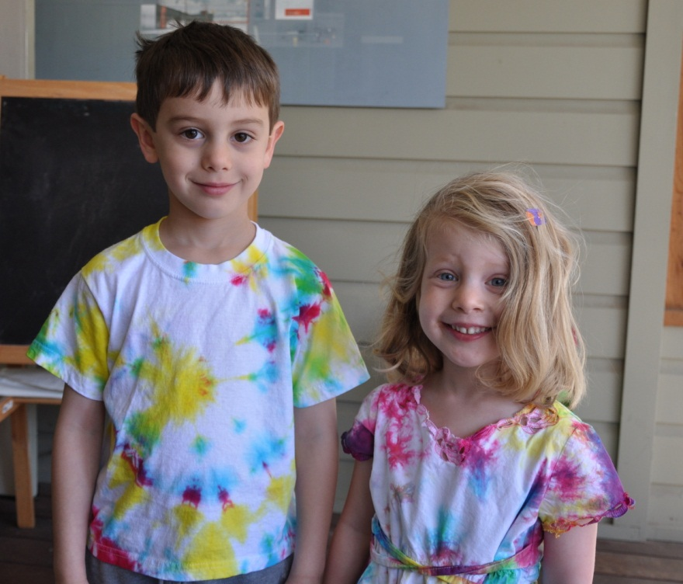

Slide 31
A networking game card claims, “Network packets from your game are prioritized and delivered before other network activity.” The claim is an improvement to
A. Bandwidth
B. Latency

Slide 32
A networking game card claims, “Offloads all network processing to the NPU, freeing up vital CPU resources to boost average frame-rates.” The claim is an improvement to
A. Bandwidth
B. Latency

Slide 33
How many Grateful Dead shows did Professor Witchel attend back in the day?
A. 5
B. 15
C. 55
D. 105
E. 205
F. Counting is so controlling, man. Let the music just flow. But I sure remember Nassau ‘90 with Branford…

Slide 34
ALU ops, 50% of instructions, CPI=1
Branches, 10%
90% correctly predicted
3 cycle penalty when incorrectly predicted
Loads & stores 40%, CPI=1.2
A. What is the overall CPI?
0.5 + 0.4*1.2+0.09+0.03 = 0.98 + 0.12 = 1.1
B. Is it better if we have 95% accuracy, but a 5 cycle branch penalty? A. Yes B. No
0.095 + 0.025 = 0.12, it is the same.

Slide 35
Suppose I want to combine comparisons and branches
rrjne %eax,%ebx Loop
How would this instruction be encoded?
What are the pipelining considerations for this instruction?
What is the average CPI for this instruction?

Slide 36
How many cycles does this loop body take in the common case?
Assuming this snippet is perfectly representative, what is the CPI for each class of instructions? What is the overall CPI?
Make this fast
irmovl $List, %ebx
xor %eax, %eax
Loop:
mrmovl (%ebx), %edx
andl %edx, %edx
jl Done
addl %edx, %eax
irmovl $4, %esi
addl %esi, %ebx
jmp Loop
Done:

Slide 37
A cache with 64 byte lines and 256 sets is how big?
A. 1 KB
B. 2 KB
C. 4 KB
D. 8 KB
E. 16 KB

Slide 38
If you replace a 7200 RPM disk with a 15,000 RPM disk, what have you done?
A. Decreased latency
B. Not changed latency
C. Increased latency
A. Decreased bandwidth
B. Not changed bandwidth
C. Increased bandwidth

Slide 39
Look at this code
Just look at it
I have an L1 cache
Direct-mapped
16-byte lines
1 cycle access time
I have an L2 cache
Direct-mapped
32-byte lines
10 cycles
I have some memory
100 cycles
What will the hit rates be?
What is the AMAT for this code? (assume array[] is the only memory)
Why didn’t I have to tell you the cache size?
int array[N];
int sum;
for (i=0; i < N; i++) {
sum += array[i];
}

Slide 40
I build a two way set associative cache that has a weird replacement policy. It replaces way 0, way 0, then way 1, way 1, then way 0 (twice), etc.
Build a reference stream that is as bad as it gets for this cache (using the smallest number of distinct addresses). Assume the cache is K KB.

Slide 41
Here’s some code
Assume a cache with a 4-word line size
How many cache misses will this code take?
Assume m,n are much larger than the cache
How can I make it better?
sum_cols(int m, int n,
int input[m][n],
int output[n]) {
for (j = 0; j < n; j++) {
int sum = 0;
for (i = 0; i < m; i++) {
sum += input[i][j];
}
output[j] = sum;
}
}

Slide 42
Here’s some code
Assume a cache with a 4-word line size
How many cache misses will this code take?
Assume m,n are much larger than the cache
How can I make it better?
sum_cols(int m, int n,
int input[m][n],
int output[n]) {
for (i = 0; i < n; i++) {
for (j = 0; j < m; j++) {
output[j] += input[i][j];
}
}
}

Slide 43
Here’s some code
Assume a cache with a 4-word line size
How many cache misses will this code take?
Assume m,n are much larger than the cache
How can I make it better?
sum_cols(int m, int n,
int input[m][n],
int output[n]) {
for (j = 0; j < n; j += B) {
for (i = 0; i < m; i++) {
for (jj = j; jj < j + B; jj++)
output[jj] += input[i][j];
}
}
}

Slide 44
clip(int *a, int N) {
int i;
for (i = 0; i < N; i++)
if (a[i] > 0)
a[i] = 0;
}
mat_sum(int a[N][N]) {
int i, j;
int sum = 0;
for (j = 0; j < N; j++)
for (i = 0; i < N; i++)
sum += a[i][j];
}
Write this loop body in y86. Assume int *a is in ebx, and N is in edx.
Suppose 90% of elements in a are > 0, and our standard pipeline
What is the average CPE?
Optimize the average CPE
Suppose I have a cache with 32-byte lines, and a is much larger than the cache
Analyze the cache behavior of this code
Improve this code and redo the analysis

Slide 45
clip(int *a, int N) {
int i;
for (i = 0; i < N; i++)
if (a[i] > 0)
a[i] = 0;
}
mat_sum(int a[N][N]) {
int i, j;
int sum = 0;
for (j = 0; j < N; j++)
for (i = 0; i < N; i++)
sum += a[i][j];
}
Suppose
The performance of clip() is directly proportional to your calculated CPE
The performance of mat_sum() is directly proportional to the number of cache misses
I have a program in which clip() takes 60% of runtime, and mat_sum takes 20%
If I could optimize only one of these, which should I choose to get the best overall performance?

