Slide 1
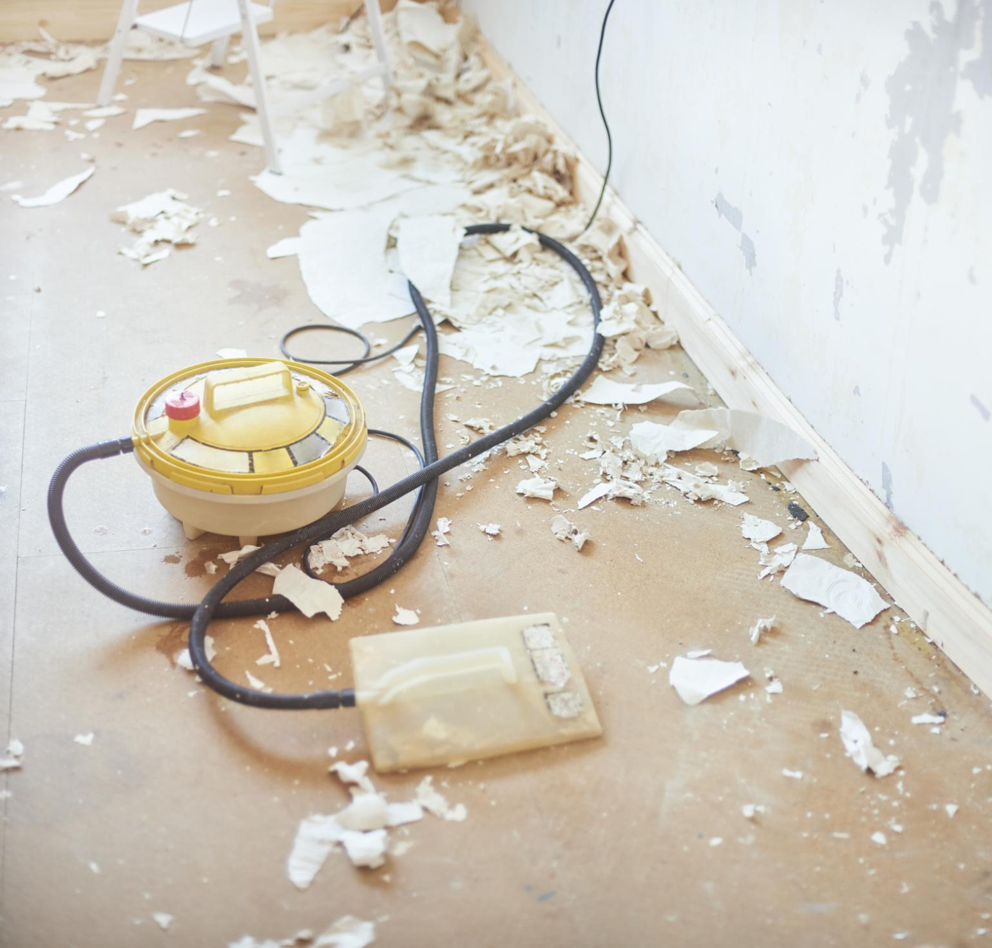
Radon Risk and Recovery Strategy Post-Tornado
Addressing radon hazards after severe storm damage
Notes:
---

Slide 2
Radon Risk in Tornado Recovery
Notes:
Impact of EF3 Tornado on Structures and Radon Exposure

Slide 3
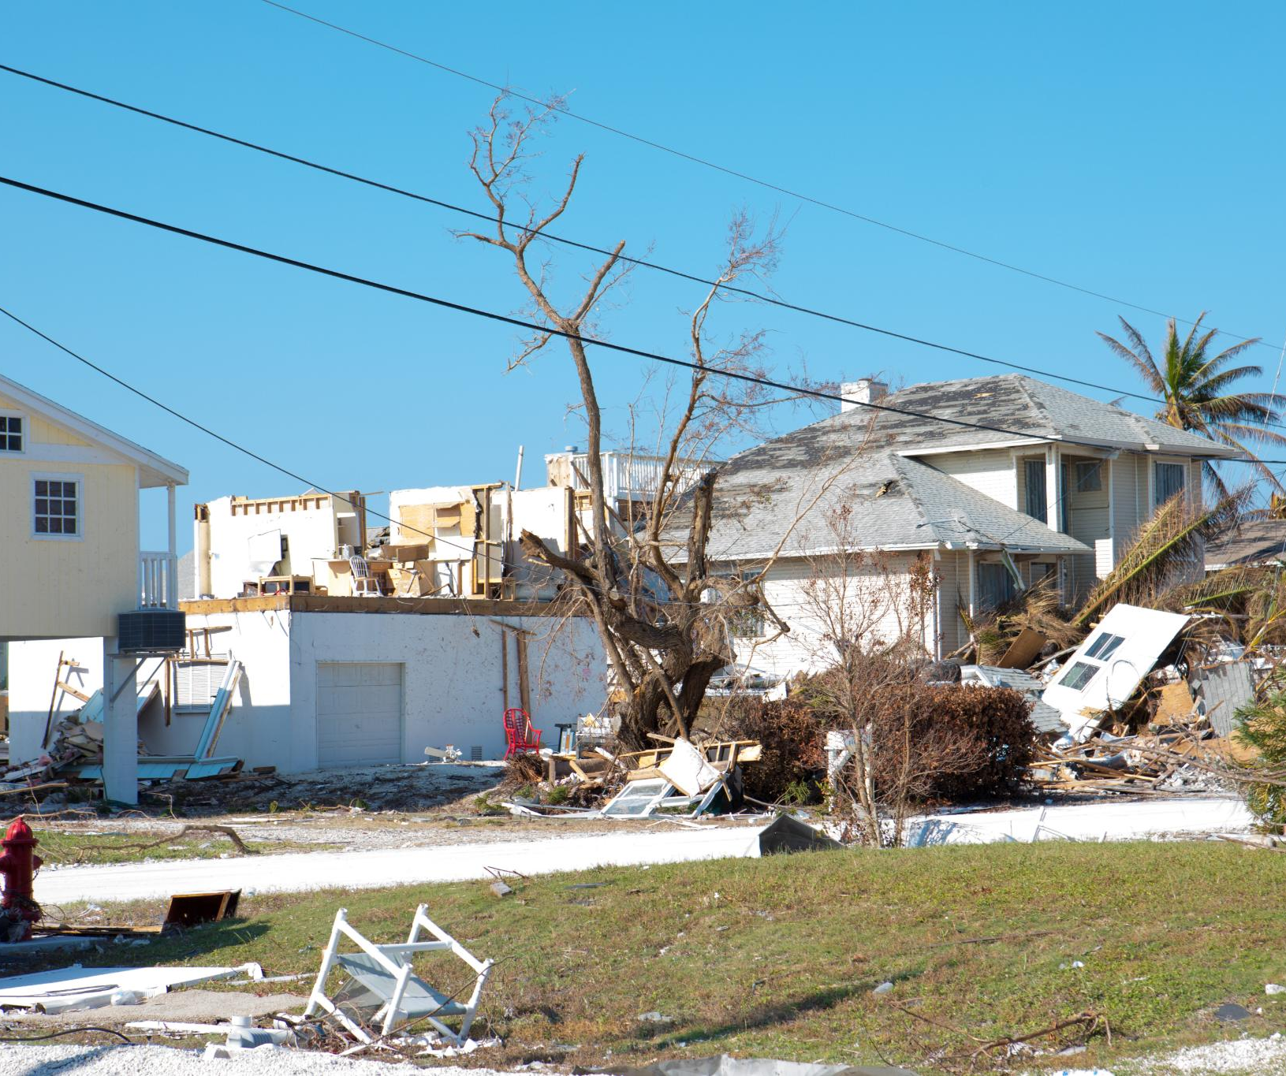
Impact of EF3 Tornado on Structures and Radon Exposure
Structural Damage from EF3 Tornado
  The EF3 tornado severely damaged around 5,000 buildings, compromising structural integrity and safety.
Radon Infiltration Risk
  Radon gas can enter damaged homes through cracks and openings, increasing health risks significantly.
Necessity of Radon Testing
  Integrating radon testing and mitigation in recovery efforts is vital to protect residents from long-term health issues.
Health Impact Awareness
  Addressing radon exposure early can prevent diseases like lung cancer linked to prolonged radon inhalation.
Notes:
The EF3 tornado caused significant structural damage, impacting approximately 5,000 buildings in the affected region. Among these, an estimated 2,800 structures are likely to have elevated radon levels, posing a serious health risk to residents. Radon, a colorless and odorless radioactive gas, can infiltrate homes through cracks and openings in foundations, especially when structural integrity is compromised. Tornado recovery efforts often focus on rebuilding and repairing visible damage, but the hidden threat of radon exposure remains largely overlooked. This creates an urgent need for integrated radon testing and mitigation strategies during reconstruction. Addressing radon risk at this stage can prevent long-term health consequences, including lung cancer, which is strongly associated with prolonged radon exposure. The scale of damage and potential exposure underscores the importance of proactive measures to safeguard community health during recovery operations.

Slide 4
Community Health Disparities
Notes:
Existing Health Challenges and Environmental Legacy

Slide 5

Existing Health Challenges and Environmental Legacy
Health Disparities in North County
  North County residents face a 21-year lower life expectancy compared to neighboring areas, highlighting serious health disparities.
Legacy Environmental Contamination
  Historical uranium exposure has contributed to chronic health issues in the affected communities, worsening health outcomes.
Radon Exposure Risks
  Pre-existing vulnerabilities increase susceptibility to radon exposure, adding to the community’s health risks.
Holistic Mitigation Approach
  Combining environmental cleanup, public health initiatives, and education helps reduce health burdens and promote equity.
Notes:
The affected communities already face significant health disparities, with North County residents experiencing a life expectancy that is 21 years lower than neighboring areas. This disparity is compounded by historical environmental contamination, including legacy uranium exposure, which has contributed to chronic health issues. These pre-existing vulnerabilities make the population particularly susceptible to additional risks such as radon exposure. Addressing these disparities requires a holistic approach that combines environmental remediation, public health interventions, and community education. By integrating radon mitigation into recovery efforts, stakeholders can help reduce cumulative health burdens and promote equity in disaster response. This approach not only addresses immediate risks but also contributes to long-term improvements in community health outcomes.

Slide 6
Radon Burden
Notes:
Health Impact and Prevalence of Radon Exposure

Slide 7
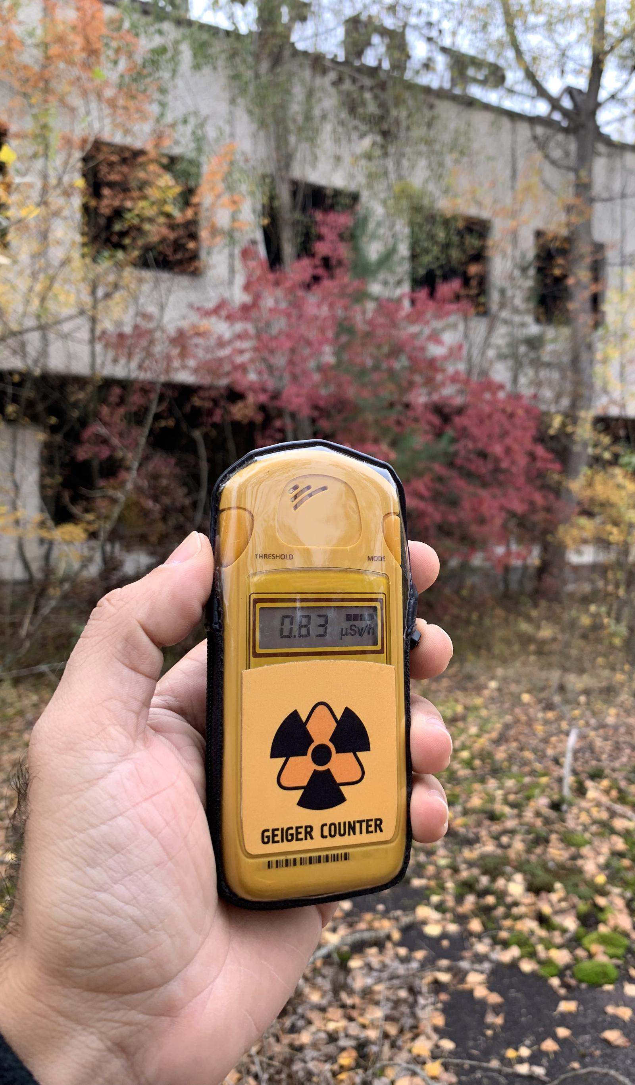
Health Impact and Prevalence of Radon Exposure
Radon Health Risks
  Radon is a leading cause of lung cancer among non-smokers, causing hundreds of cases annually in the region.
Radon Prevalence in Homes
  One in three homes in the affected area exceeds EPA recommended radon levels, increasing risk for residents.
Need for Mitigation
  Effective radon mitigation and public awareness are essential to reduce exposure and prevent future health problems.
Community Health Resilience
  Prioritizing radon risk reduction during recovery boosts community health and lowers cancer incidence.
Notes:
Radon exposure is a leading cause of lung cancer among non-smokers, and its impact in the affected region is substantial. At Mercy Health alone, radon-related lung cancer accounts for an estimated 500 to 625 cases annually. Furthermore, data indicates that one in three homes in the area exceeds the EPA's recommended action level for radon concentration. These statistics highlight the pervasive nature of radon risk and the urgent need for intervention. Without targeted mitigation efforts, the reconstruction process could inadvertently perpetuate exposure, leading to preventable health outcomes. Public awareness campaigns, combined with systematic testing and remediation, are essential to reducing this burden. By prioritizing radon mitigation during recovery, communities can significantly lower future cancer incidence and improve overall health resilience.

Slide 8
Opportunity Window
Notes:
Leveraging Reconstruction for Radon Mitigation

Slide 9

Leveraging Reconstruction for Radon Mitigation
Radon Mitigation in Reconstruction
  Integrating radon-resistant building techniques during post-tornado repairs prevents future health risks cost-effectively.
Collaborative Implementation
  Effective radon mitigation requires cooperation among local authorities, builders, and public health organizations.
Education and Awareness
  Educational programs for homeowners and contractors increase compliance and promote radon safety awareness.
Long-term Health Benefits
  Proactive radon mitigation during reconstruction fosters healthier living environments and reduces cancer risks.
Notes:
The post-tornado reconstruction phase presents a unique opportunity to integrate radon testing and mitigation into building practices. By incorporating radon-resistant construction techniques and remediation measures during repairs, communities can prevent 50 to 100 future cancer cases. This proactive approach is cost-effective compared to retrofitting homes later and ensures long-term safety for residents. Collaboration among local authorities, builders, and public health organizations is critical to implementing these measures effectively. Educational initiatives targeting homeowners and contractors can further enhance compliance and awareness. Seizing this opportunity not only addresses immediate structural concerns but also establishes a foundation for healthier living environments, reducing the cumulative impact of environmental hazards on vulnerable populations.

Slide 10
Radon Canvas Initiative
Notes:
Strategic Framework for Risk Management

Slide 11

Strategic Framework for Risk Management
Risk Mapping and Gap Analysis
  Risk mapping identifies high radon exposure areas while gap analysis reveals testing deficiencies critical for disaster response.
Prioritized Community Outreach
  Outreach efforts focus on vulnerable communities to efficiently allocate resources and improve radon awareness and testing.
Collaborative Stakeholder Engagement
  Collaboration among public health agencies, local governments, and organizations ensures coordinated and effective radon risk management.
Data-Driven Sustainable Model
  Leveraging data-driven strategies supports sustainable radon mitigation models adaptable for future disaster recovery scenarios.
Notes:
The Radon Canvas Initiative is designed to provide a comprehensive framework for managing radon risk in disaster recovery. Key components include risk mapping to identify high-exposure areas, gap analysis to determine testing deficiencies, and prioritized outreach to vulnerable communities. Coordinated response efforts ensure that resources are allocated efficiently and interventions are implemented promptly. This initiative emphasizes collaboration among stakeholders, including public health agencies, local governments, and community organizations. By leveraging data-driven strategies, the Radon Canvas Initiative aims to create a sustainable model for radon mitigation that can be replicated in future disaster scenarios. Its holistic approach addresses both immediate needs and long-term resilience, making it a cornerstone of effective recovery planning.

Slide 12
Technology Solution
Notes:
Radon Canvas Web Application Features

Slide 13

Radon Canvas Web Application Features
Centralized Radon Data
  The app provides detailed neighborhood and household radon risk data with interactive mapping for clear visualization.
Resource Access and Support
  Users can find educational materials and connect with certified mitigation providers for effective radon remediation.
Real-Time Updates and Coordination
  The app offers real-time data updates, enhancing transparency and streamlining stakeholder coordination.
User-Friendly Interface
  Designed for accessibility, the app supports both residents and professionals in managing radon risks easily.
Notes:
The Radon Canvas web application serves as a centralized platform for managing radon risk information. It provides neighborhood-level data, household-specific details, and interactive mapping tools to visualize exposure patterns. Users can access resources, connect with certified mitigation providers, and obtain educational materials to guide remediation efforts. The app also includes reference libraries and real-time updates to support informed decision-making. By integrating technology into recovery efforts, the Radon Canvas app enhances transparency, facilitates community engagement, and streamlines coordination among stakeholders. Its user-friendly interface ensures accessibility for both residents and professionals, making it an essential tool for effective radon risk management.

Slide 14
Implementation Pathway
Notes:
Immediate and Sustained Actions for Success

Slide 15
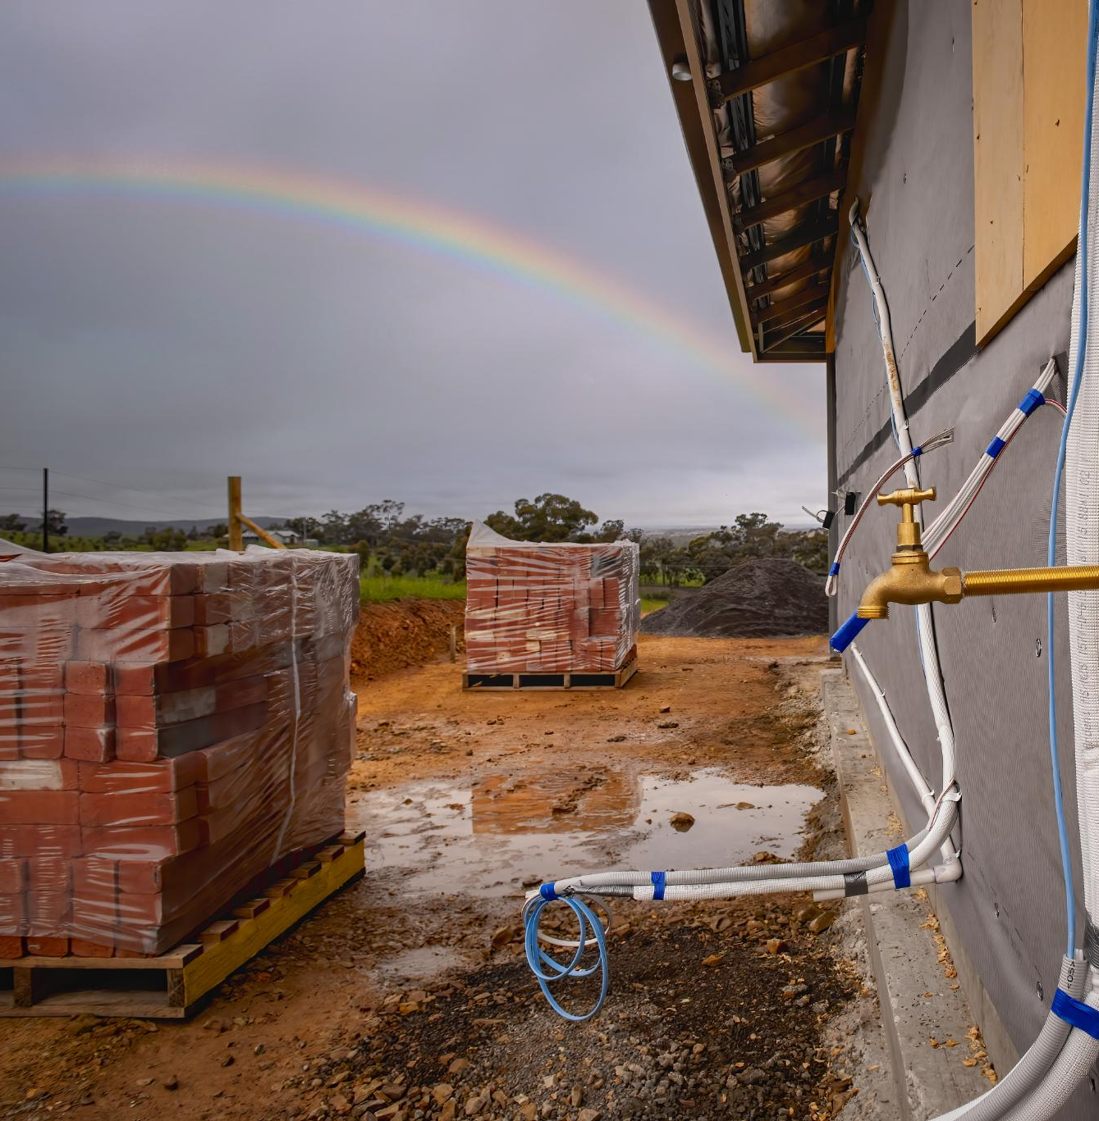
Immediate and Sustained Actions for Success
Immediate Radon Mitigation
  Short-term actions include radon testing in building permits, educational campaigns, and using a radon resource app for awareness.
Sustained Monitoring and Stewardship
  Long-term efforts focus on stewardship programs, automated data collection, and community engagement for continuous progress.
Strategic Framework for Success
  Combining immediate interventions with strategic planning builds a strong framework to reduce radon exposure effectively.
Notes:
The implementation pathway for radon mitigation involves both immediate and long-term actions. In the short term, efforts focus on integrating radon testing into building permits, launching educational campaigns, and deploying the Radon Canvas app to connect residents with resources. These steps ensure rapid response and awareness during the critical reconstruction phase. Sustained actions include establishing stewardship programs, automating data collection, and tracking progress over time. Continuous monitoring and community engagement are essential to maintaining momentum and achieving lasting impact. By combining immediate interventions with strategic planning, stakeholders can create a robust framework for reducing radon exposure and improving public health outcomes.

