Slide 1
T A R G E T G R O U P
Wheelchair-bound children
Mainly associated with:
Cerebral palsy & Duchenne muscular dystrophy

Slide 2
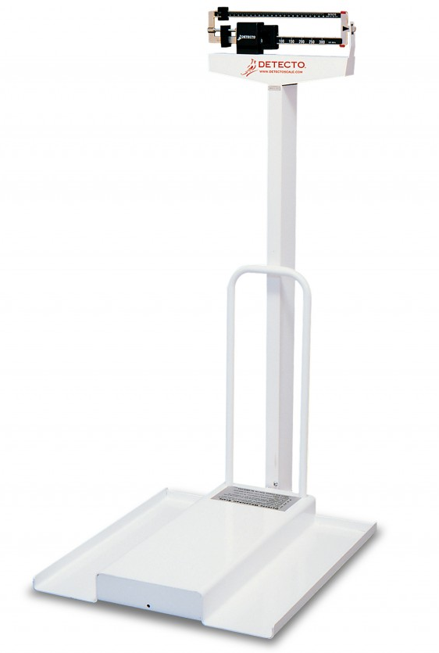
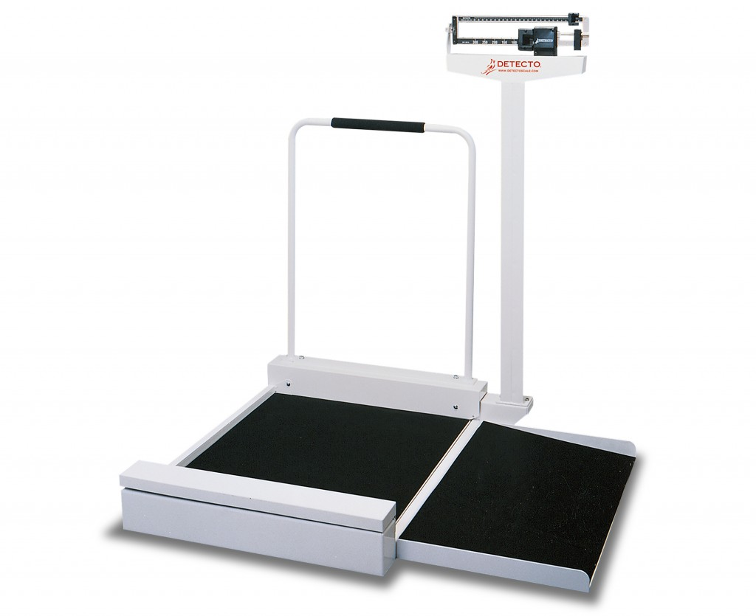
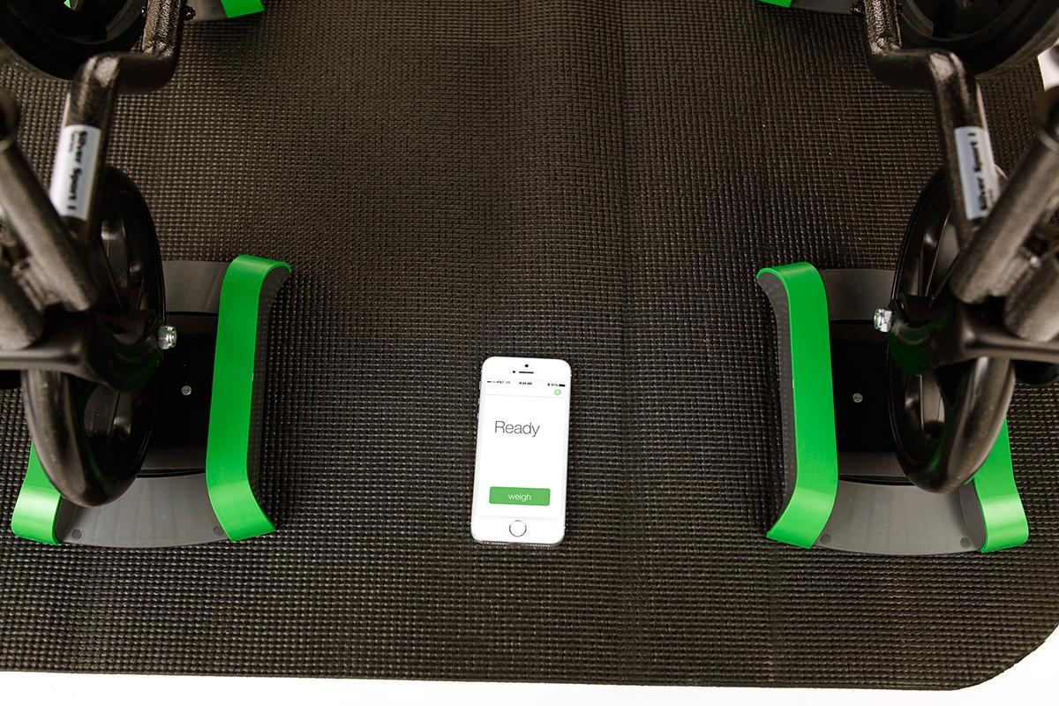
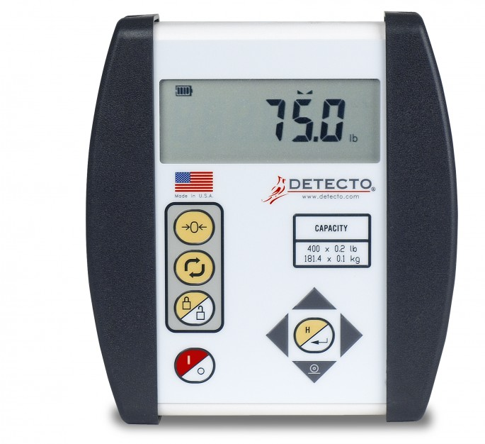
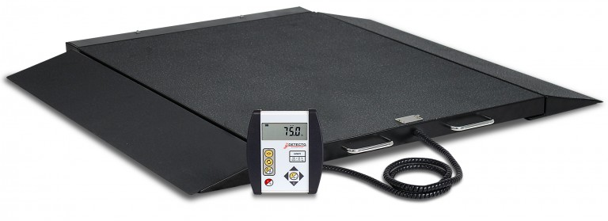
Research - Existing solutions
A R E A S O F I M P R O V E M E N T
Detecto 6500 & LilyPad - need to key in to tare wheelchair weight
LilyPad - tare is linked to one wheelchair
Current UI/UX is not designed with kids in mind
Notes:
Weighing the weight of each wheelchair, and subtracting the value from the overall weight (child + wheelchair)

Slide 3
P R O B L E M S T A T E M E N T
Current procedure for weighing wheelchair bound patients is cumbersome and inefficient, and does not focus on the user-experience of the child

Slide 4
D O C T O R S
C H I L D R E N
Patients have to be hoisted in order to be weighed
Current procedure does not focus on the user-experience of the kid
Current solutions do not remember multiple wheelchair weights
Intimidating for the child - younger children thinks they are getting an injection and becomes afraid
Discomfort of being moved out of the wheelchair then back onto the wheelchair
Need to re-measure the wheelchair weight before weighing the patient then subtracting the weight of the wheelchair
Weighing scale needs to be able to accomodate wheelchair weight of ~158kg (w/o the child)

Slide 5
I D E A / O P P O R T U N I T Y
General weighing scale for all wheelchair types that provides a user-friendly experience for both the doctor and child patients

Slide 6
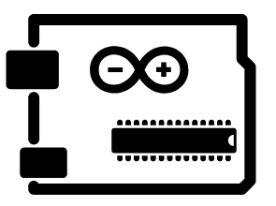




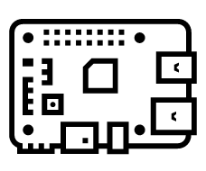
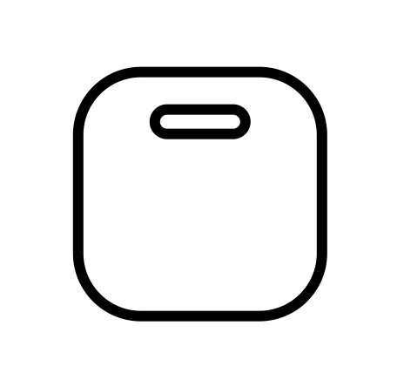
C O M P O N E N T S
Arduino
Raspberry Pi
NFC tag for wheelchair
Weighing scale
Notes:
Hospital wheelchair or personal wheelchair?

Slide 7
A R C H I T E C T U R E
Arduino
Raspberry Pi
NFC tag for wheelchair
Weighing scale
Notes:
Hospital wheelchair or personal wheelchair?

Slide 8
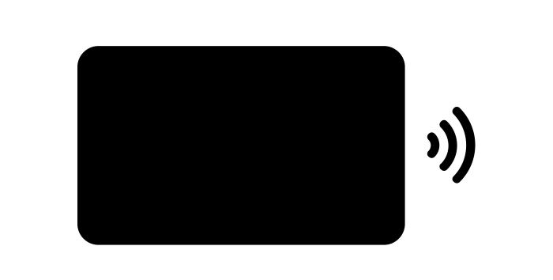
A R C H I T E C T U R E
Arduino
NFC Adapter
Notes:
Hospital wheelchair or personal wheelchair?

Slide 9
C O M P O N E N T S
NTAG213 anti-metal stickers
Compatible with any device
Range: up to 10cm depending on sticker placement and field strength from NFC reader
Can be read quickly
Rewritable up to 100,000 cycles - can update the weight of wheelchairs multiple times
Can be stuck on metal components of wheelchair without electromagnetic interference
Water-resistant
NFC tag for wheelchair
Notes:
Hospital wheelchair or personal wheelchair?

Slide 10
C O M P O N E N T S
IKEA HÄKEN bathroom scale
Rationale: Focus is on uniquely identifying, storing and updating patient’s wheelchair weights
Up to 150kg with 100g increments
Hacked to auto-deduct wheelchair weight
HX711 Amplifier
NFC reader PN532 module for Arduino
Arduino will communicate with Raspberry Pi for some functionality to enhance the child’s experience
For actual product
Should support up to 400kg (Max. wheelchair weight is ~158kg) with 100g increments
Arduino
Raspberry Pi
Weighing scale
Notes:
Hospital wheelchair or personal wheelchair?

Slide 11
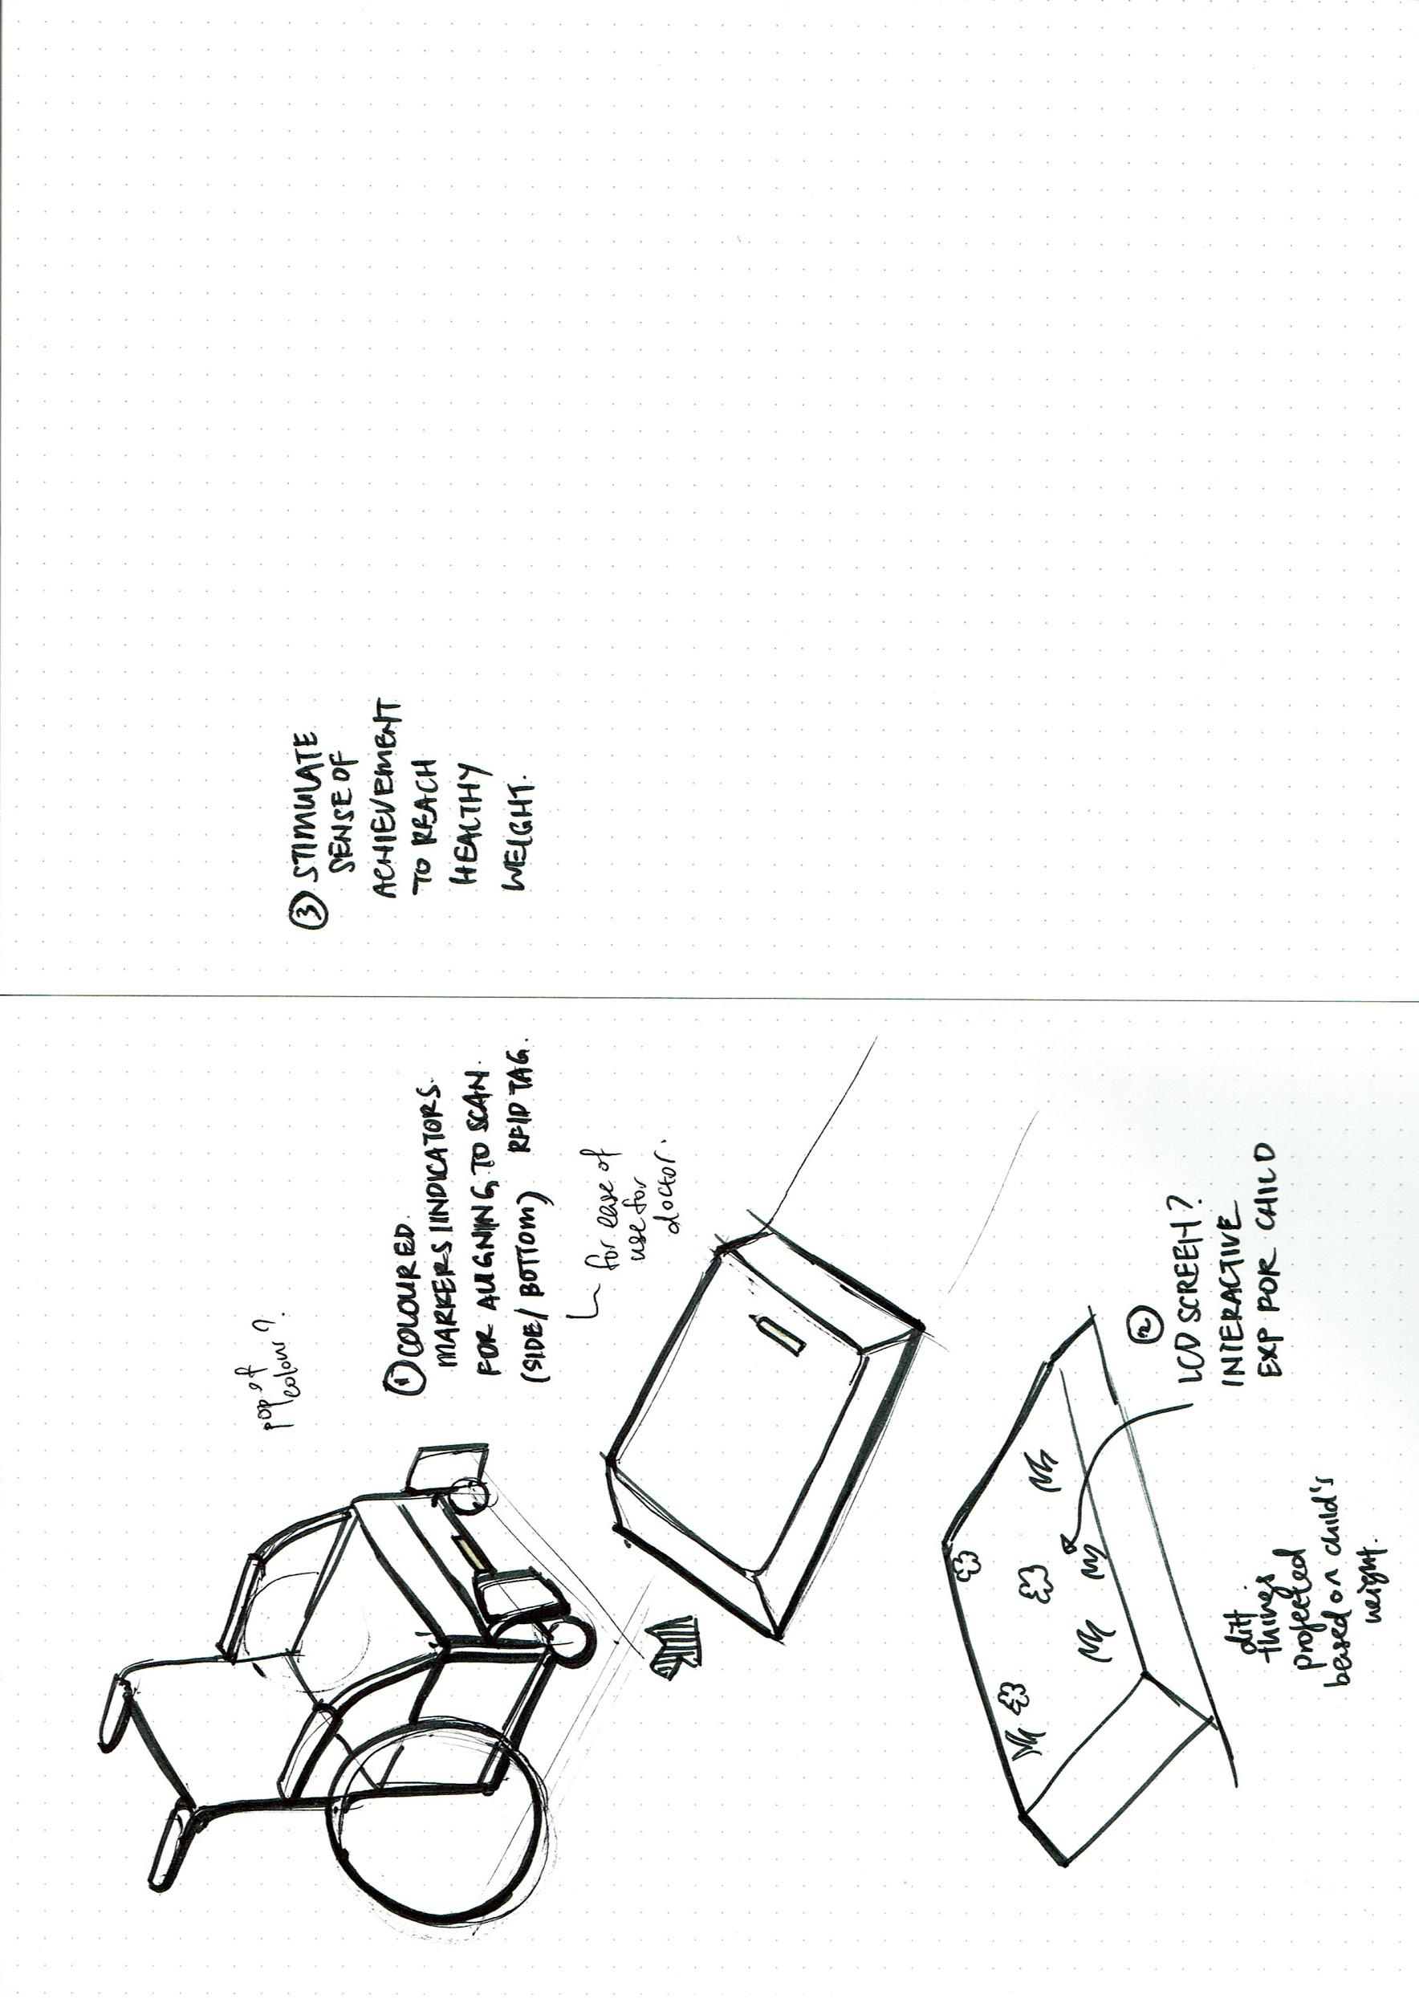
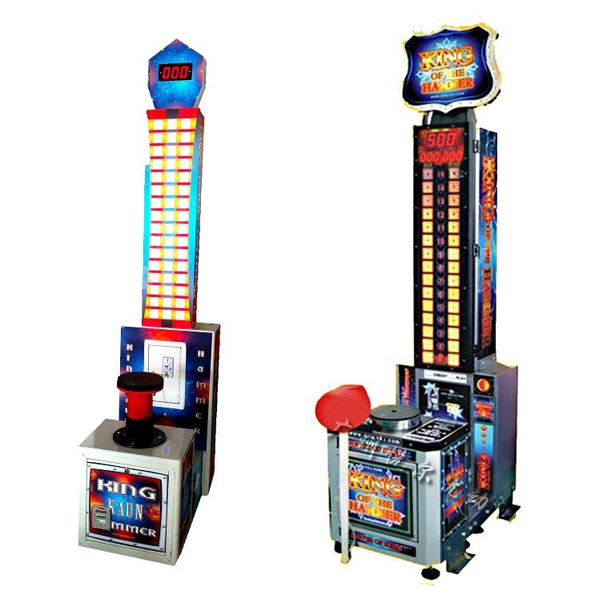
C O M P O N E N T S
Ideation for form/experience
Issue:
Optimizing experience for child based on primary research insights
Issue:
Gamification,etc to stimulate child to achieve healthy weight during their next visit
E.g. Reach the ideal water level, etc
Issue:
Making visual indicator intuitive for use
Notes:
Hospital wheelchair or personal wheelchair?

Slide 12

C O M P O N E N T S
Possibility of an app that can help parents to track their child’s diet (KIV)
Parents can easily create/log a food diary for their child
App can be synced with weighing scale so that the child’s weight can be cross-referenced with their diet (before the visit)
Enables ease of communication between doctors and parents
Value-add
Notes:
Hospital wheelchair or personal wheelchair?

Slide 13


Slide 14
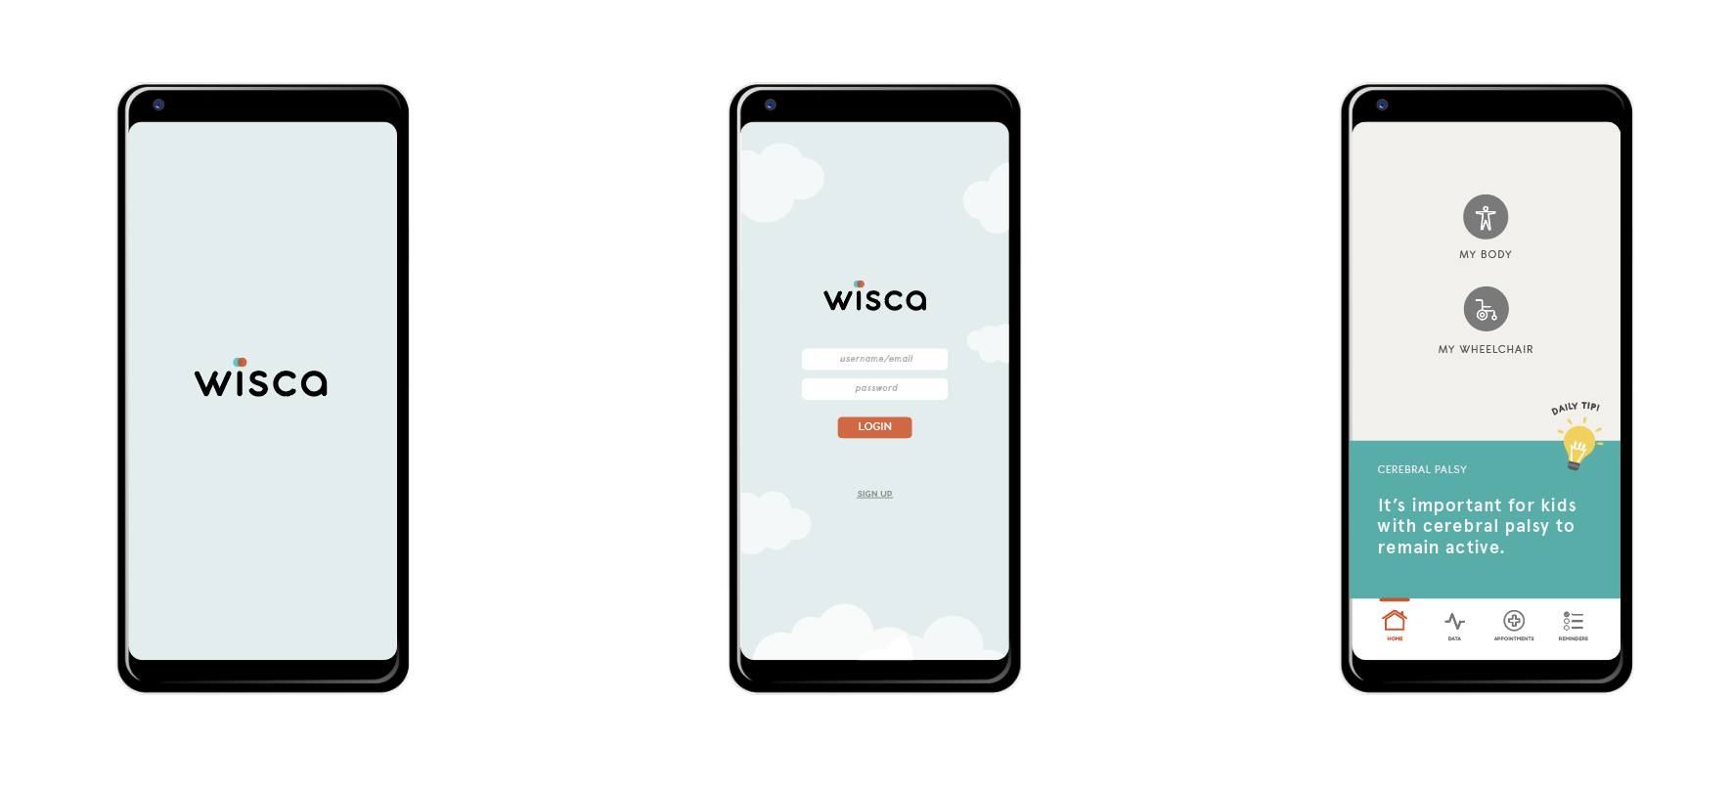
A P P I N T E R F A C E
Designing of the app interface for parents
Notes:
Hospital wheelchair or personal wheelchair?

Slide 15
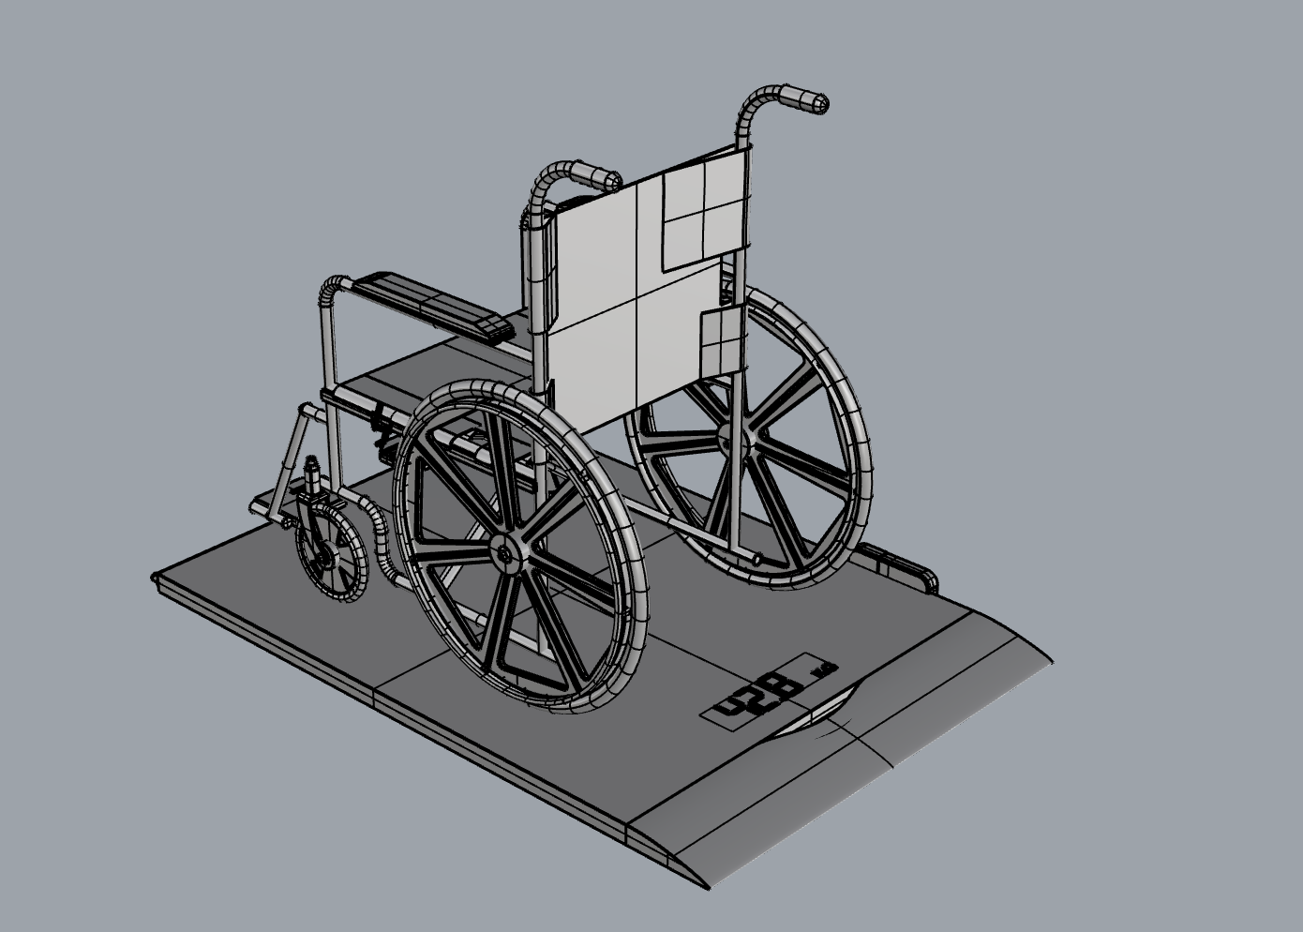
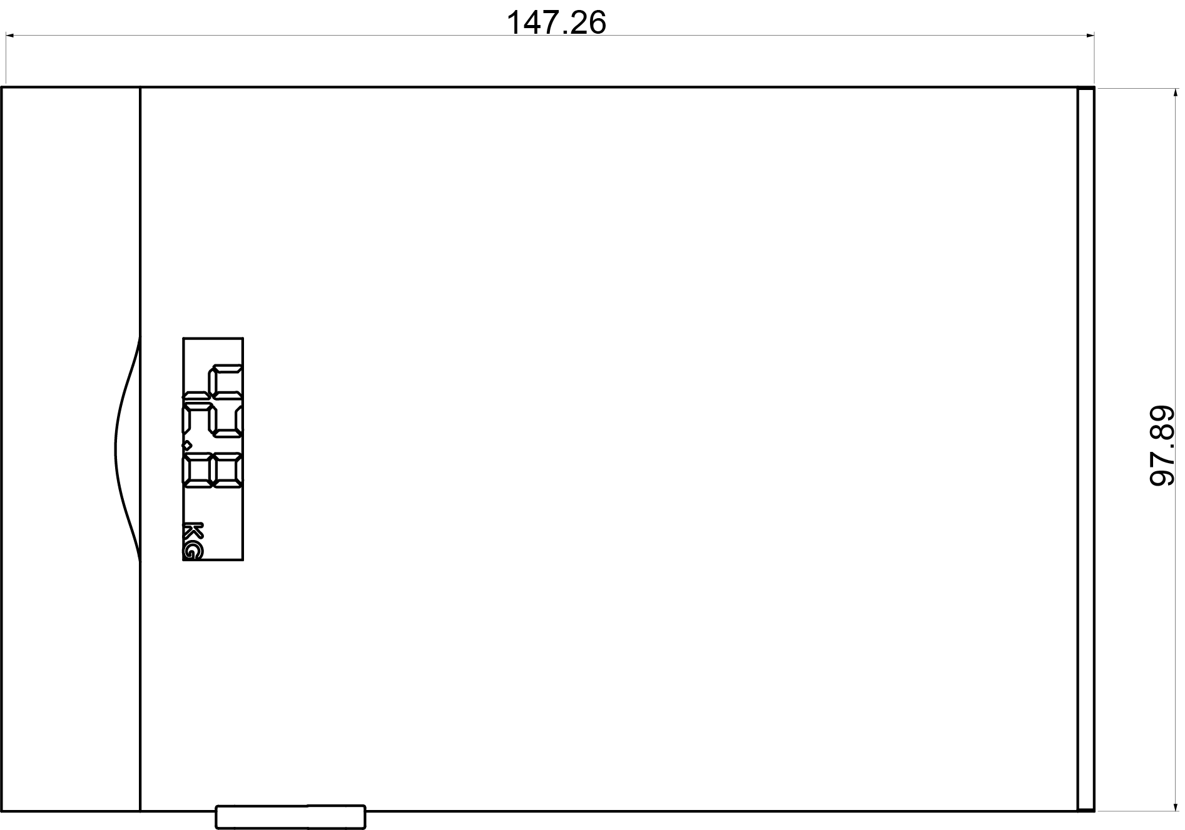
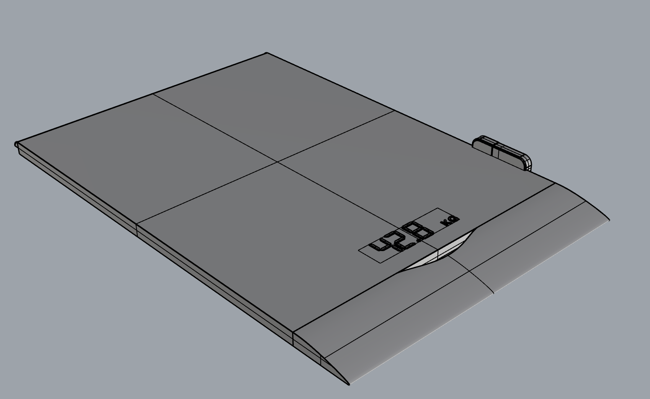
M O D E L L I N G
Dimensions in cm
Notes:
Hospital wheelchair or personal wheelchair?

Slide 16
