Slide 1


Slide 2
T A R G E T G R O U P
Wheelchair-bound children
Mainly associated with:
Cerebral palsy & Duchenne muscular dystrophy

Slide 3
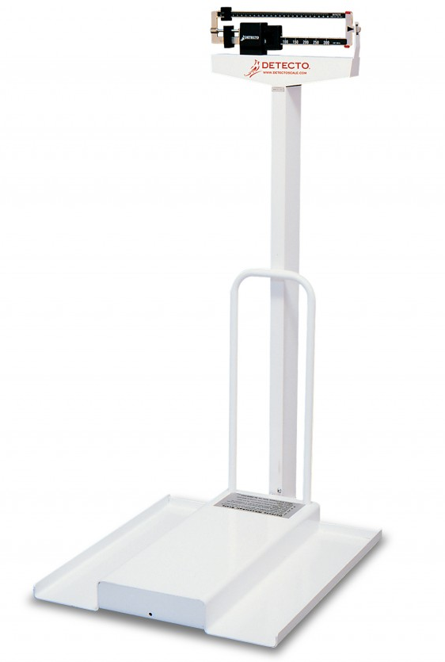
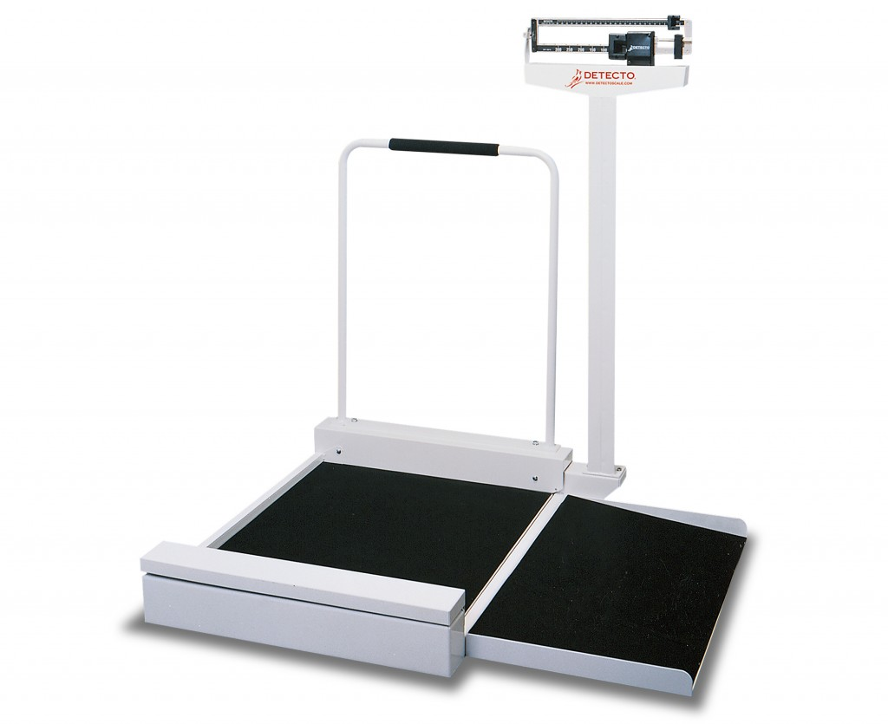
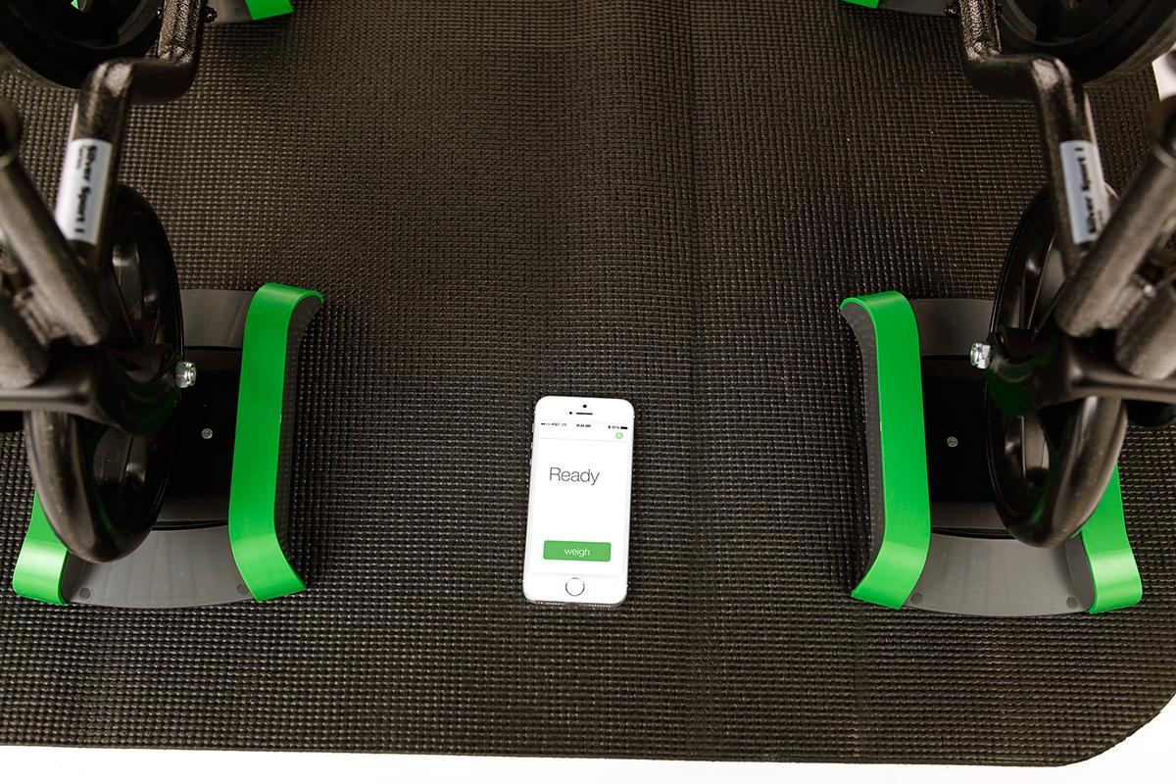
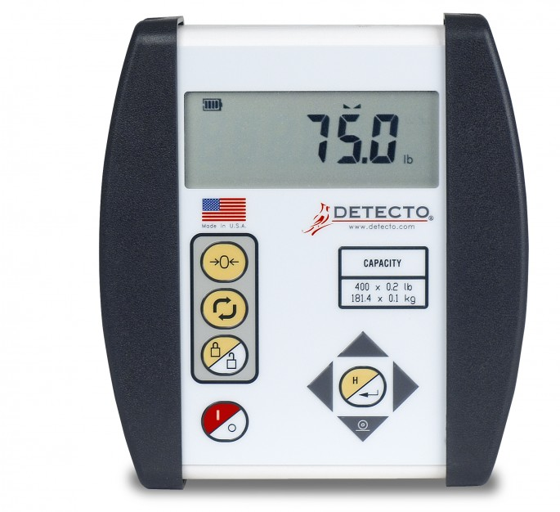
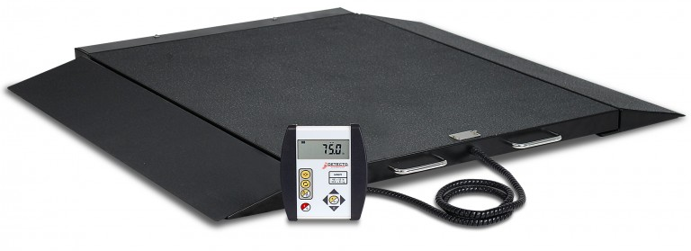
Research - Existing solutions
A R E A S O F I M P R O V E M E N T
Detecto 6500 & LilyPad - need to key in to tare wheelchair weight
LilyPad - tare is linked to one model of wheelchair
Current UI/UX is not designed with kids in mind
Notes:
Weighing the weight of each wheelchair, and subtracting the value from the overall weight (child + wheelchair)

Slide 4
P R O B L E M S T A T E M E N T
Current procedure for weighing wheelchair bound patients is cumbersome and inefficient, and does not focus on the user-experience of the child

Slide 5
D O C T O R S
C H I L D R E N
Patients have to be hoisted in order to be weighed
Current procedure does not focus on the user-experience of the kid
Current solutions do not remember multiple wheelchair weights
Intimidating for the child - younger children thinks they are getting an injection and becomes afraid
Discomfort of being moved out of the wheelchair then back onto the wheelchair
Need to re-measure the wheelchair weight before weighing the patient then subtracting the weight of the wheelchair
Weighing scale needs to be able to accomodate wheelchair weight of ~158kg (w/o the child)

Slide 6
I D E A / O P P O R T U N I T Y
General weighing scale for all wheelchair types that provides a user-friendly experience for both the doctor and child patients

Slide 7



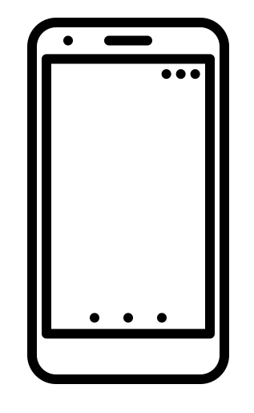

A R C H I T E C T U R E
.
Smart weighing scale
Smartphone
NFC tag for wheelchair
Notes:
Hospital wheelchair or personal wheelchair?

Slide 8
A R C H I T E C T U R E s m a r t w e i g h i n g s c a l e
.
Notes:
Hospital wheelchair or personal wheelchair?

Slide 9

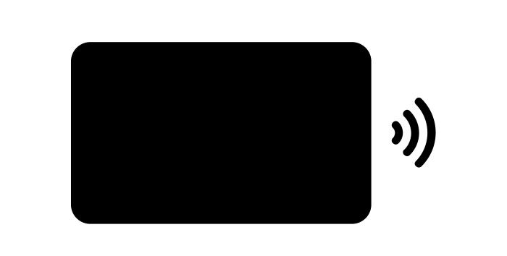

A R C H I T E C T U R E a r d u i n o
Arduino
NFC Adapter
RFID Tag
Notes:
Hospital wheelchair or personal wheelchair?

Slide 10
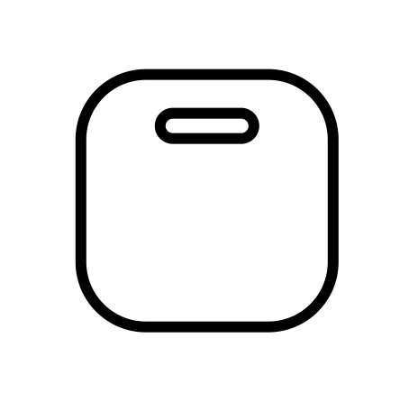
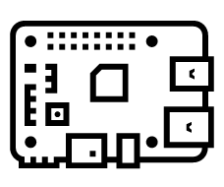



A R C H I T E C T U R E r a s p b e r r y p i
Amplifier (hx711)
LCD Display
Raspberry Pi
Load Cells
Buttons
Notes:
Hospital wheelchair or personal wheelchair?

Slide 11
A R C H I T E C T U R E s m a r t w e i g h i n g s c a l e
Arduino
NFC Adapter
RFID Tag
Buttons
Amplifier (hx711)
LCD Display
Raspberry Pi
Load Cells
Notes:
Hospital wheelchair or personal wheelchair?

Slide 12
A R C H I T E C T U R E s m a r t w e i g h i n g s c a l e
.
Notes:
Hospital wheelchair or personal wheelchair?

Slide 13
F E A T U R E S
Smart Weighing Scale:
Button I/O:
Tare
Register weight of wheelchair
NFC I/O:
Deduct stored weight from displayed weight
Child’s weight is written into NFC
Storage: Persistent weight data is stored on RFID tag, so as to remain air gapped with hospital’s infrastructure
.
Notes:
Hospital wheelchair or personal wheelchair?

Slide 14
F E A T U R E S
Smart Weighing Scale:
Code architecture: Event-driven programming
Raspberry Pi:
Python
Arduino:
C
.
Notes:
Hospital wheelchair or personal wheelchair?

Slide 15
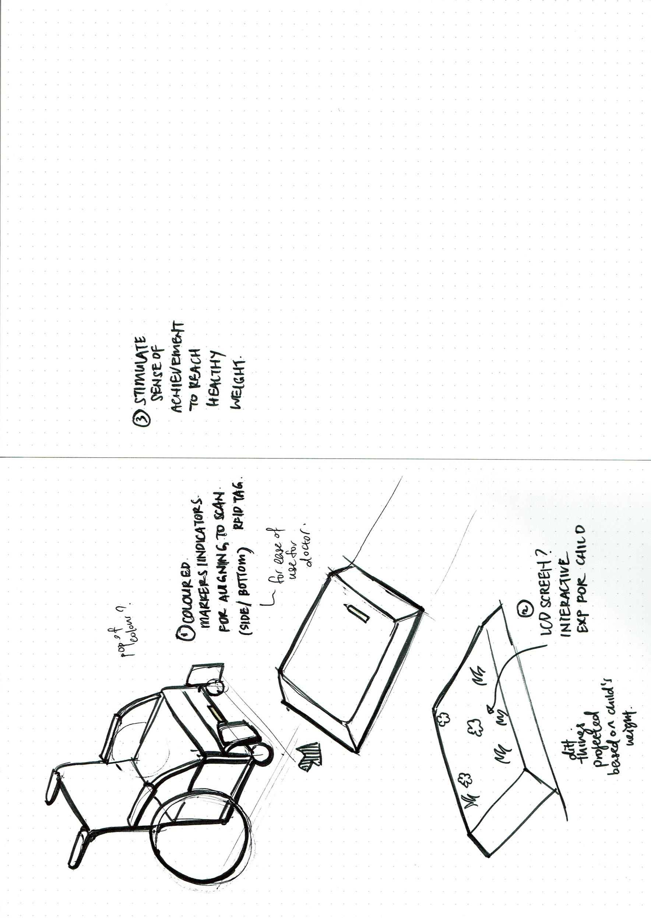
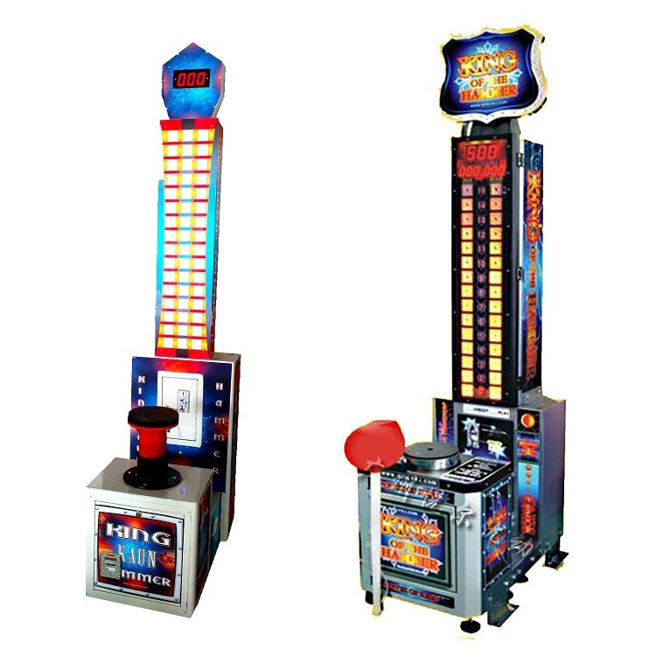
C O M P O N E N T S
Ideation for form/experience
Issue:
Optimizing experience for child based on primary research insights
Issue:
Gamification,etc to stimulate child to achieve healthy weight during their next visit
E.g. Reach the ideal water level, etc
Issue:
Making visual indicator intuitive for use
Notes:
Hospital wheelchair or personal wheelchair?

Slide 16
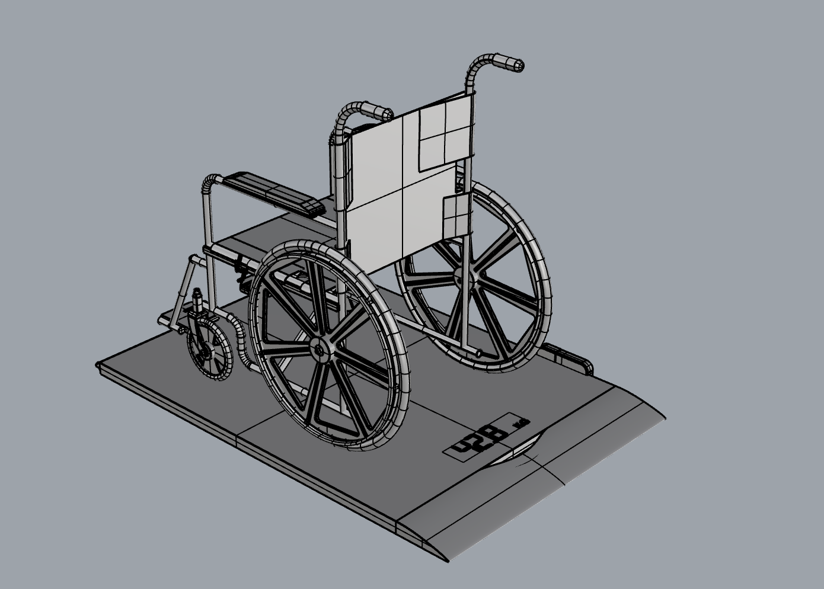
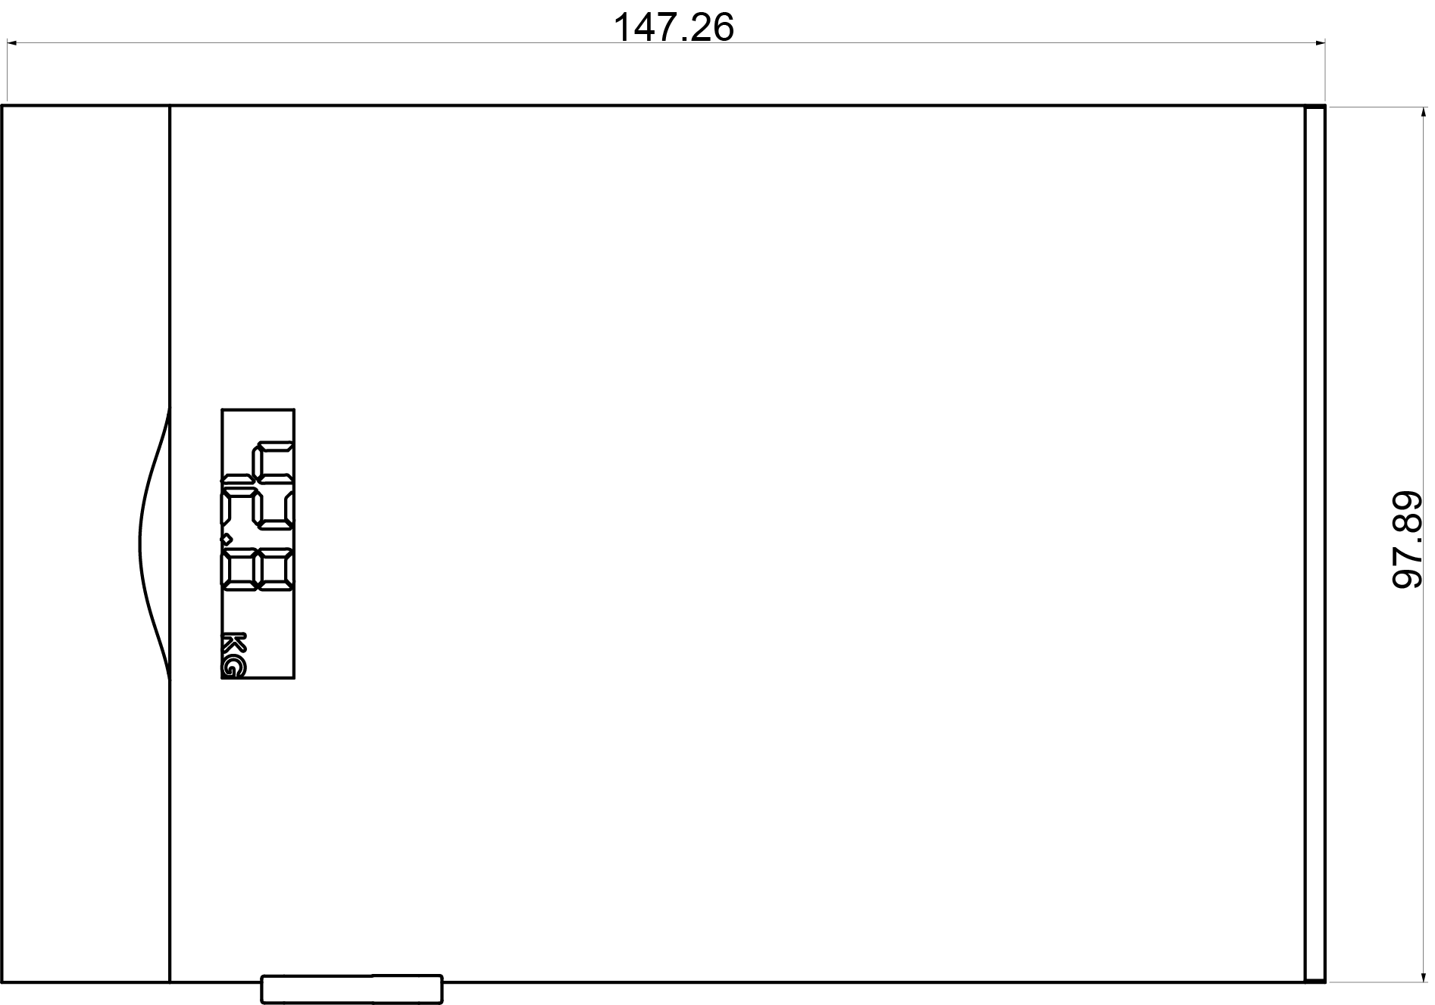
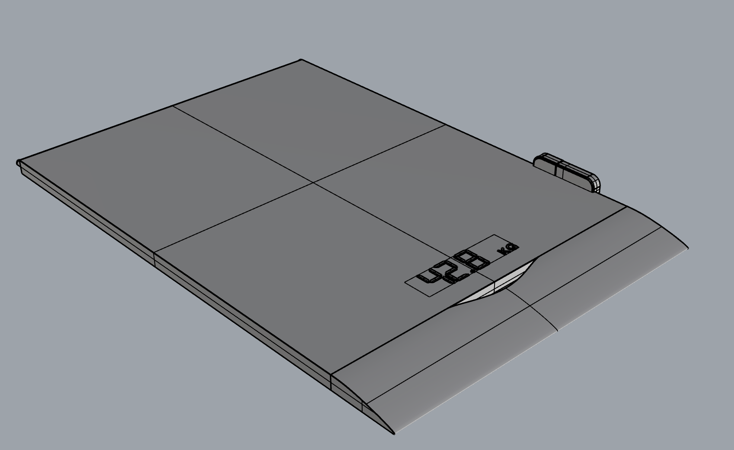
M O D E L L I N G
Dimensions in cm
Notes:
Hospital wheelchair or personal wheelchair?

Slide 17
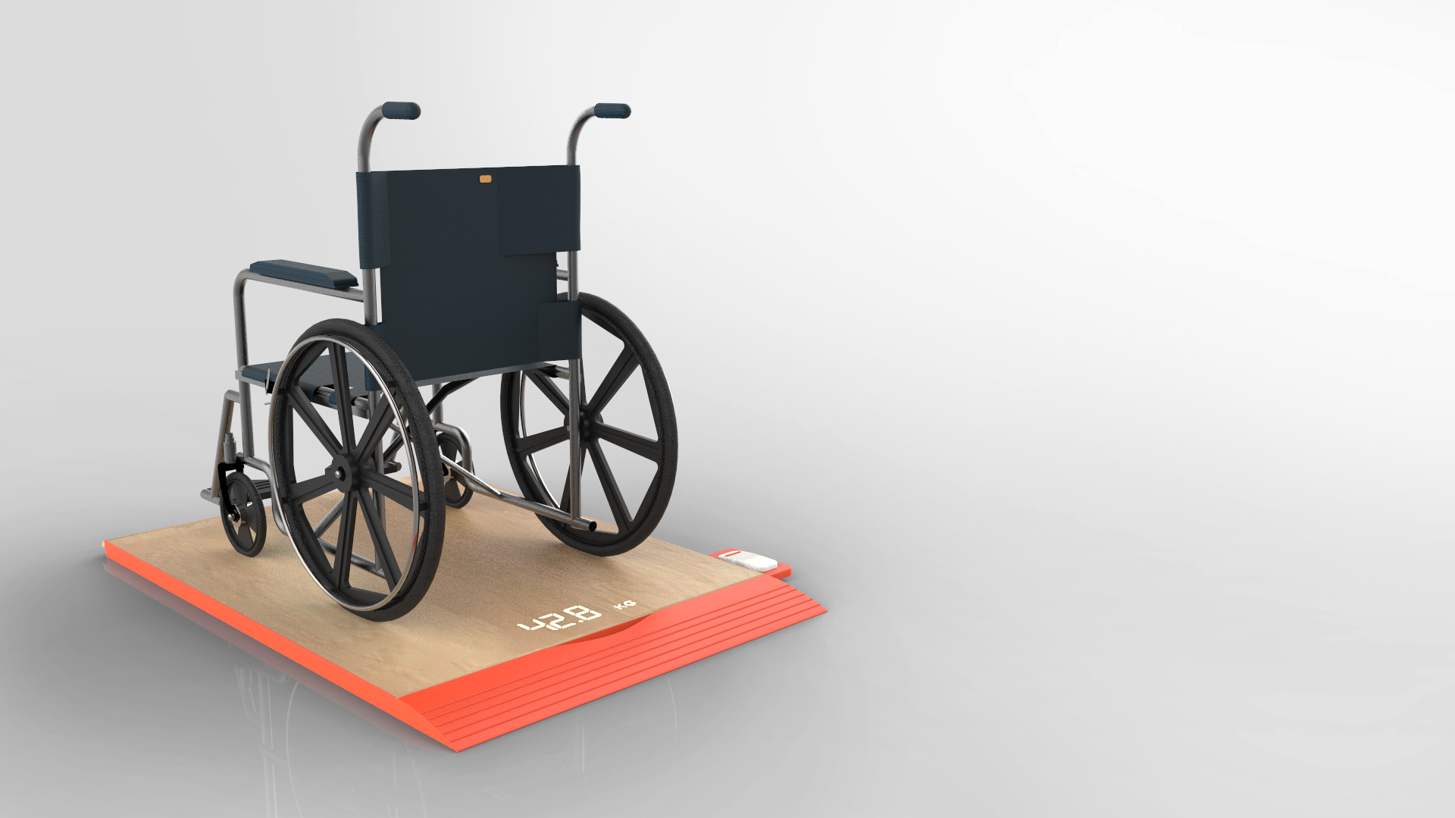


Slide 18
C O M P O N E N T S
NTAG213 anti-metal stickers
Compatible with any device
Range: up to 10cm depending on sticker placement and field strength from NFC reader
Can be read quickly
Rewritable up to 100,000 cycles - can update the weight of wheelchairs multiple times
Can be stuck on metal components of wheelchair without electromagnetic interference
Water-resistant
NFC tag for wheelchair
Notes:
Hospital wheelchair or personal wheelchair?

Slide 19
S M A R T P H O N E
Companion app that helps parents to monitor child’s health
Parents can easily log doctor’s appointments with the child
App can be synced with RFID tag to update weight of wheelchair manually
Helps with transient weight sources e.g. pillows for back support
App can extract and visualise child’s weight stored in RFID tag
Notes:
Hospital wheelchair or personal wheelchair?

Slide 20
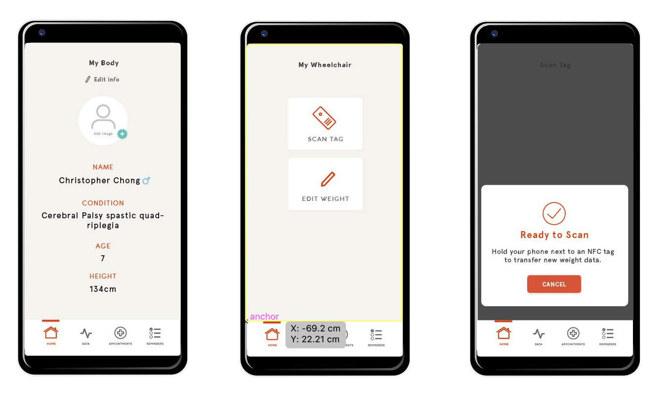
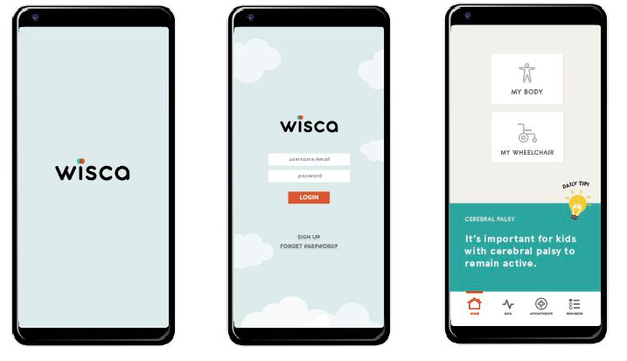
A P P U I M O C K U P S
Notes:
Hospital wheelchair or personal wheelchair?

Slide 21
A P P U I M O C K U P S
Notes:
Hospital wheelchair or personal wheelchair?

Slide 22
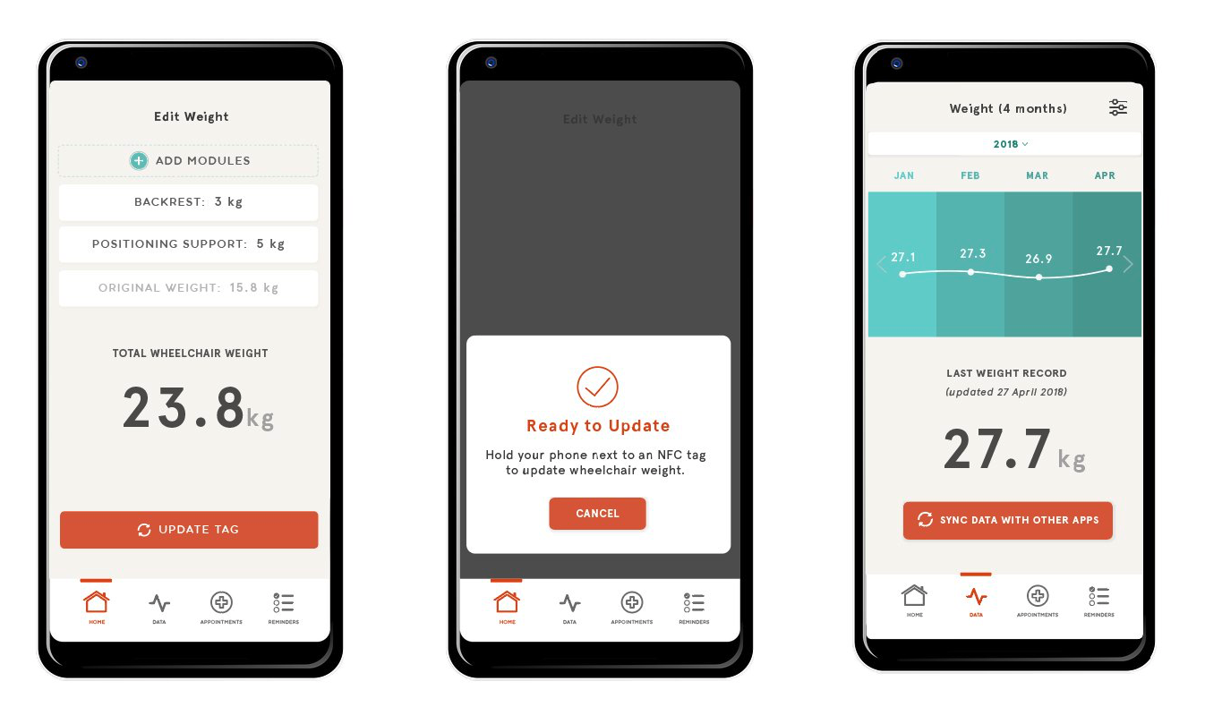
A P P U I M O C K U P S
Notes:
Hospital wheelchair or personal wheelchair?

Slide 23
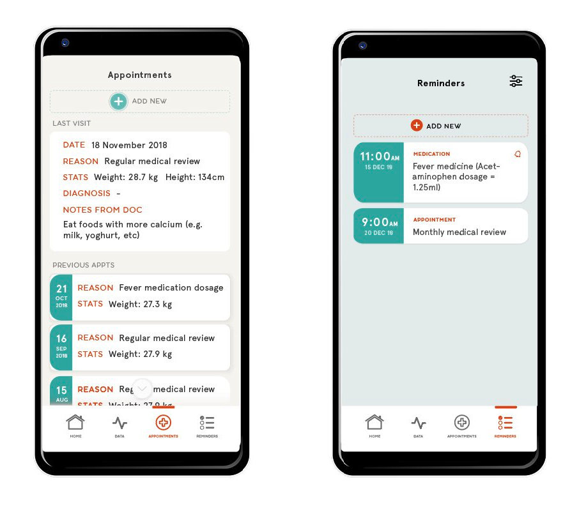
A P P U I M O C K U P S
Notes:
Hospital wheelchair or personal wheelchair?

