Slide 1
Human resources slide 1
DDSAnalytics
Understanding Employee Turnover
Let Data Lead the Way!

Slide 2



Human resources slide 9
Meet The Team
Our Team around the world
Leading Data Scientist who tutored under world renown Data Scientist, Jacquelyn Cheun.
Ganesh
Kodi
Jeff
Leath
Stacey
Smith

Slide 3
Human resources slide 2
AGENDA
Business Objectives
Data Source
Methodology
Evaluation / Results
Summary

Slide 4

Human resources slide 8
Business Objectives
DDSAnalytics
Understanding Turnover
Our team was tasked to conduct Exploratory Data Analysis [EDA] in order to under significant factors that may contribute to employee turnover. A secondary task was to identify any other remarkable trends uncovered during the EDA.

Slide 5
Human resources slide 5
Historic Facts
Data Source
Understanding Employee Turnover
Sourced Historically Accurate Data
HR Data
1,470
Observations
35
Attributes
1,470 Employee Observations
35 Attributes of each Employee

Slide 6
Human resources slide 8
Methodology
Understanding Turnover
Open Source
R
Packages (dplyr, tidyr, ggplot2, gridextra,sqldf,pander, dataMaid)
Reproducible
GitHub, Open Repository
https://github.com/jeffleathMSDS/DDS_CaseStudy2
Steps/Workflow
Step 1: Understanding the problem
Step 2: Collect the raw data
Step 3: Clean the data
Step 4: Explore the data
Step 5: Perform in-depth analysis
Step 6: Interpret Communicate results

Slide 7
Human resources slide 10
Preliminary Analysis
Let Data Lead The Way

Slide 8
Human resources slide 4
Question of Interest: 3.b Top 10 Factors
% of Most Recent Salary Increase:
Work Life Balance:
Daily Rate:
Years in Current Role:
Job Satisfaction
Years last promotion:
 | Mean | Std Deviation | Median | Min | Max
Age | 36.92 | 9.13 | 36 | 18 | 60
Monthly Income | 6,502.93 | 4,707.95 | 4,919 | 1,009 | 19,999
Job Satisfaction | 2.73 | 1.1 | 3 | 1 | 4
Daily Rate | 802.49 | 403.50 | 802 | 102 | 1,499
Salary Hike | 12.21 | 3.60 | 14 | 11 | 25
Work Life Balance | 2.76 | 0.70 | 3 | 1 | 4
Years in Current Role | 4.23 | 3.62 | 3 | 0 | 18
Years Since Last Promotion | 2.18 | 3.22 | 1 | 0 | 15
Working Years | 11.28 | 7.78 | 10 | 0 | 40
Relative Satisfaction | 2.71 | 1.08 | 3 | 1 | 4
Monthly Income:
Total Working Years:
Relationship
Satisfaction:
Age:
N=1,407

Slide 9
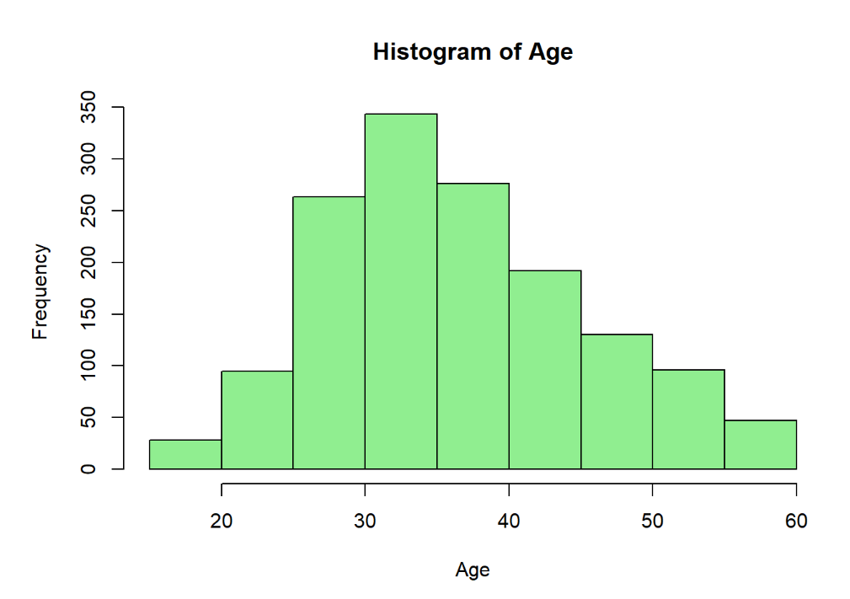

Slide 10
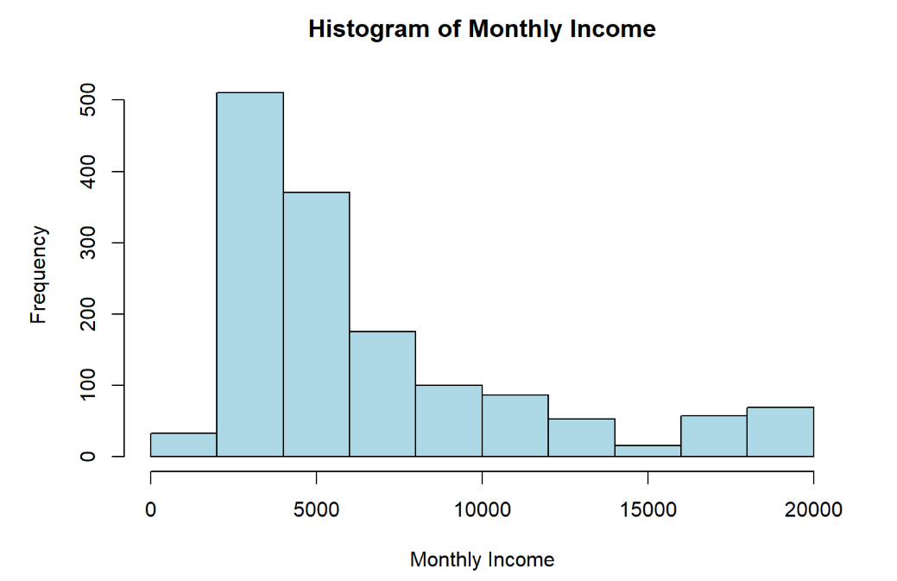

Slide 11
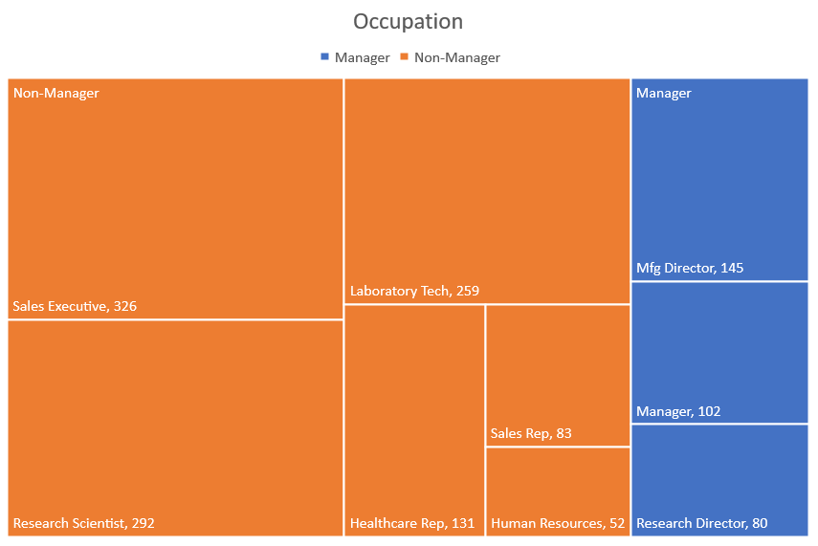
Question of Interest: 3.c, d
Non-Manager, n= 1,143
Manager, n= 327

Slide 12
Human resources slide 10
Deeper Analysis
Let Data Lead The Way

Slide 13
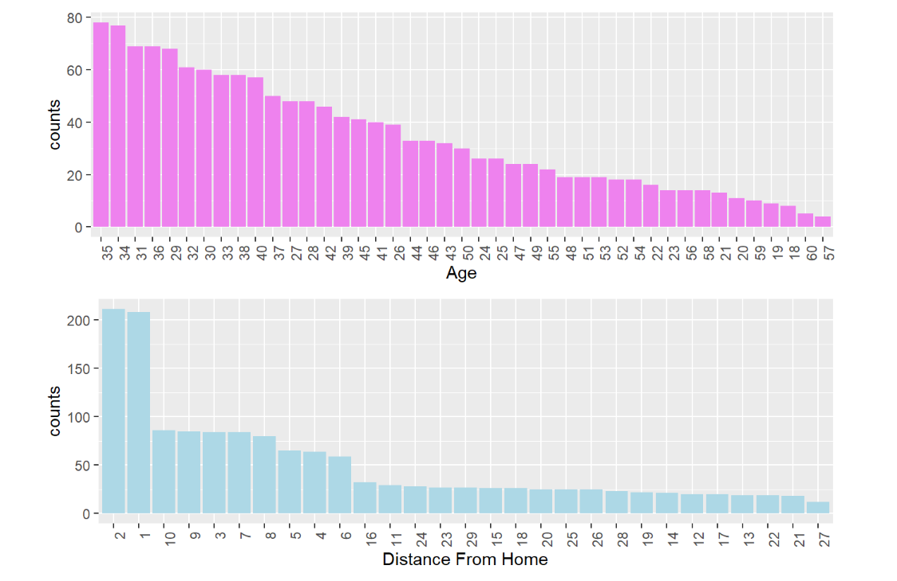
Insights – Workforce Demographics

Slide 14
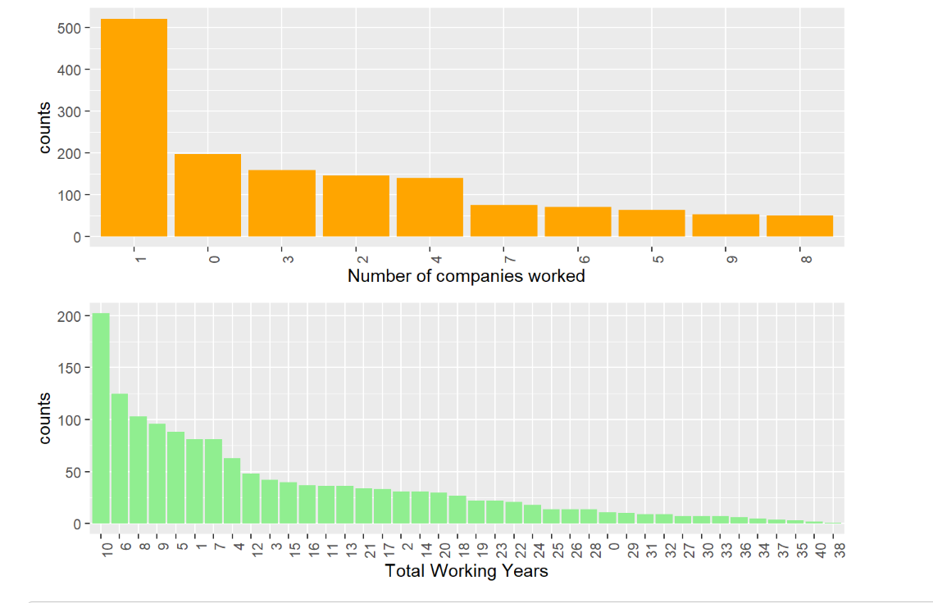
Insights – Workforce Demographics

Slide 15
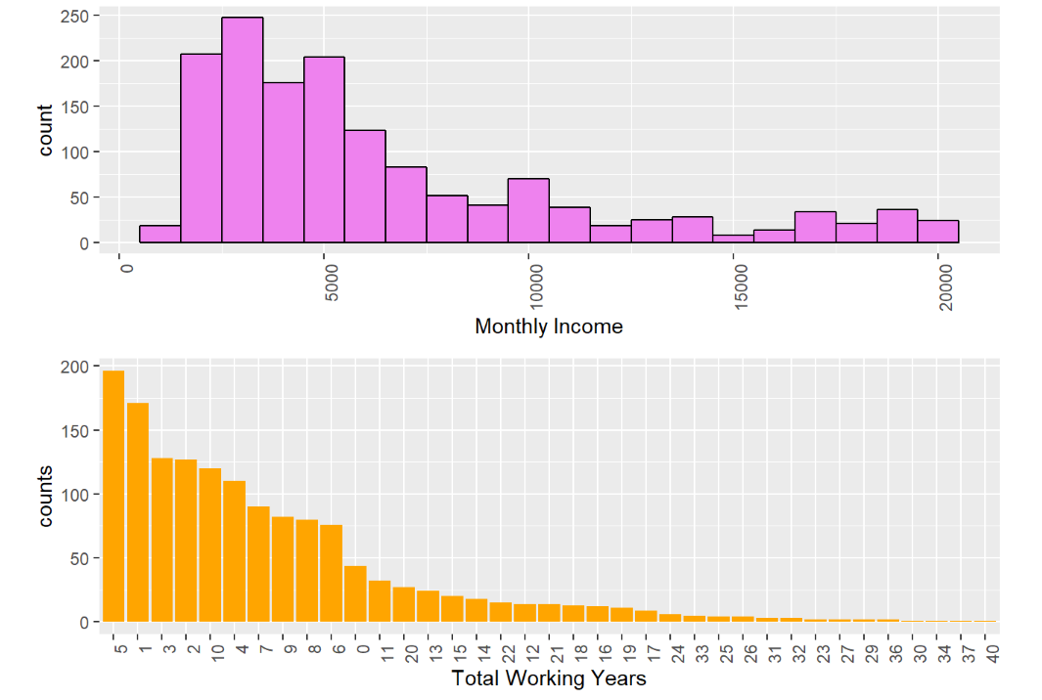
Insights – Workforce Demographics

Slide 16
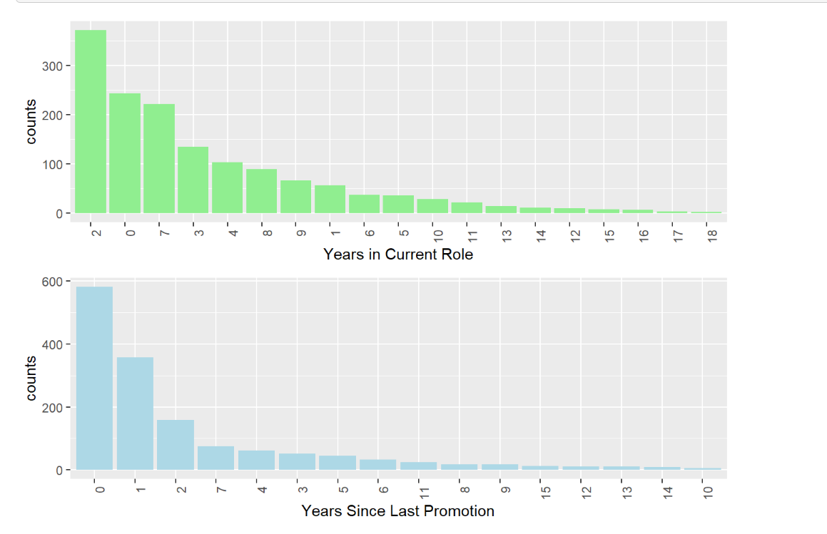
Insights – Workforce Demographics

Slide 17
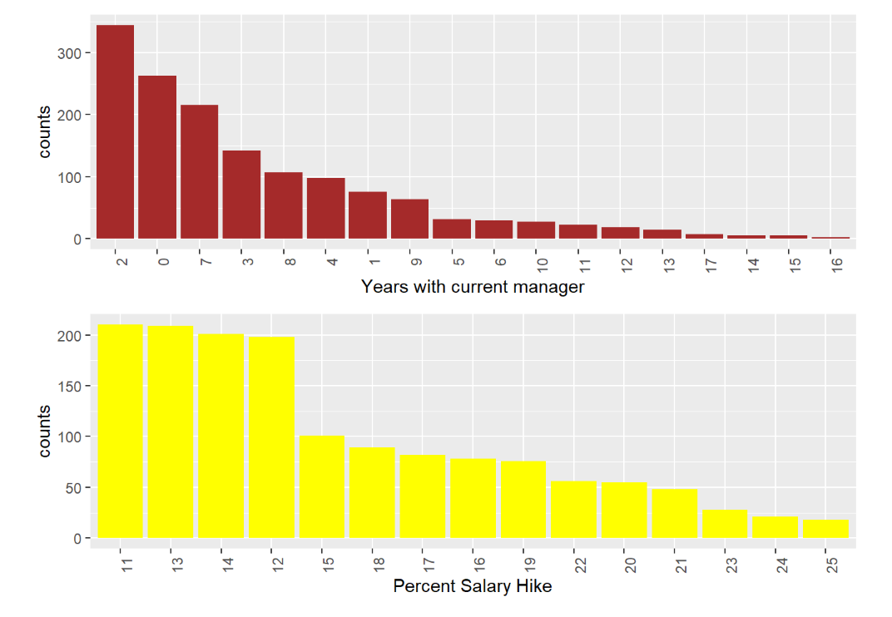
Insights – Workforce Demographics

Slide 18
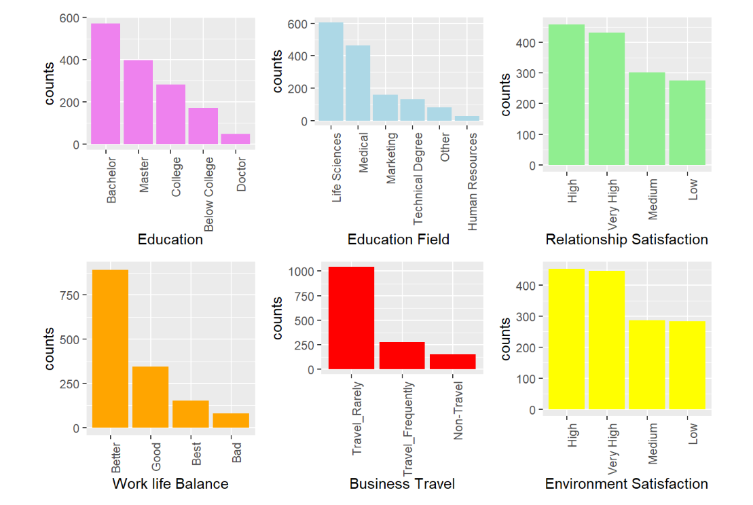
Insights – Workforce Demographics

Slide 19
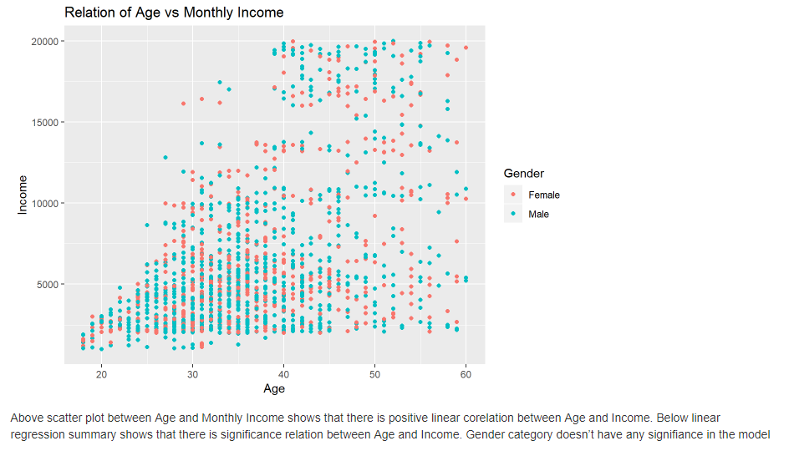

Slide 20
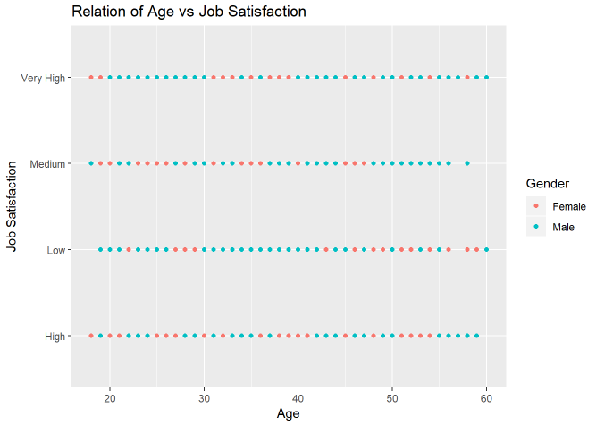
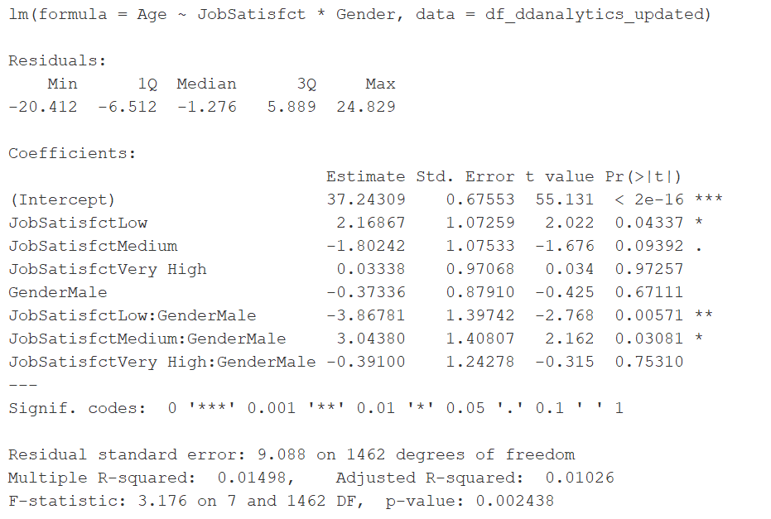
From scatter plot between Age and Job Satisfaction can’t find any linear correlation between them. But linear regression summary shows relation with employees of Low Job Satisfaction level and attrition. Gender category also have slight significance in the model as summary shows that, Male employees of Medium Job Satisfaction also vulnerable to turn over

Slide 21
Human resources slide 10
Summary
Let Data Lead The Way

Slide 22
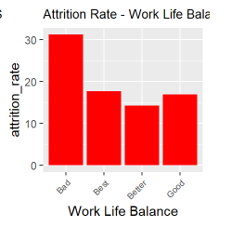
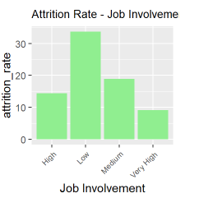
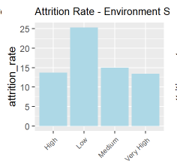
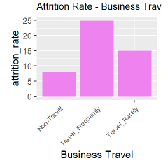
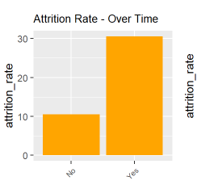
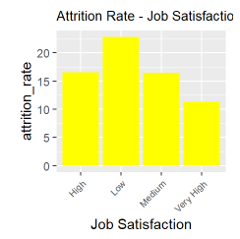
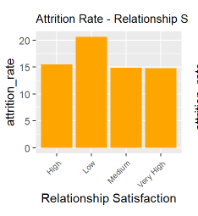
Top Contributors to Turnover

Slide 23
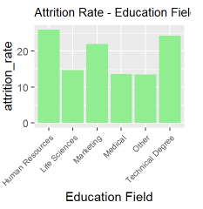
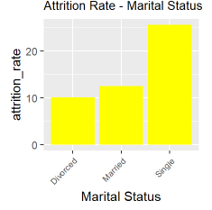
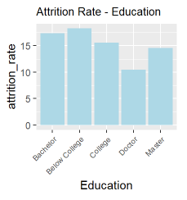
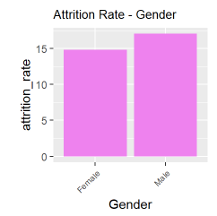
Other Observations

Slide 24
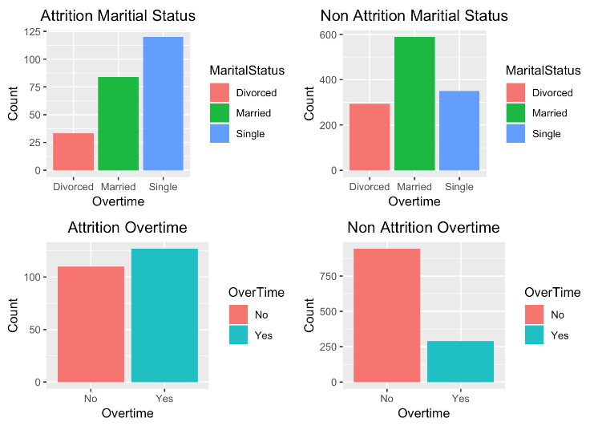
Other Observations

Slide 25
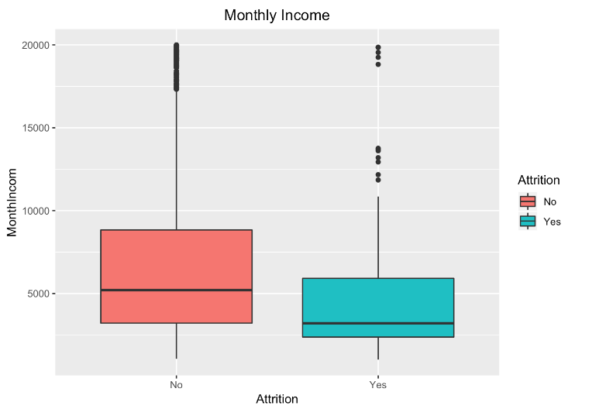
Other Observations

Slide 26
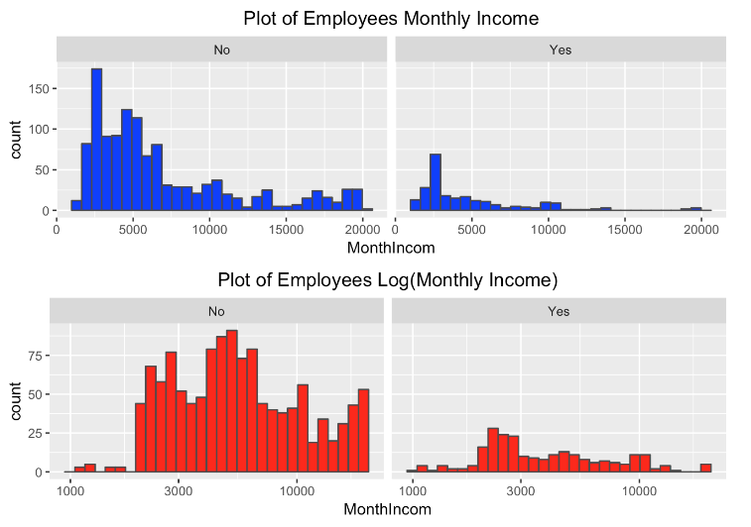
Other Observations

Slide 27
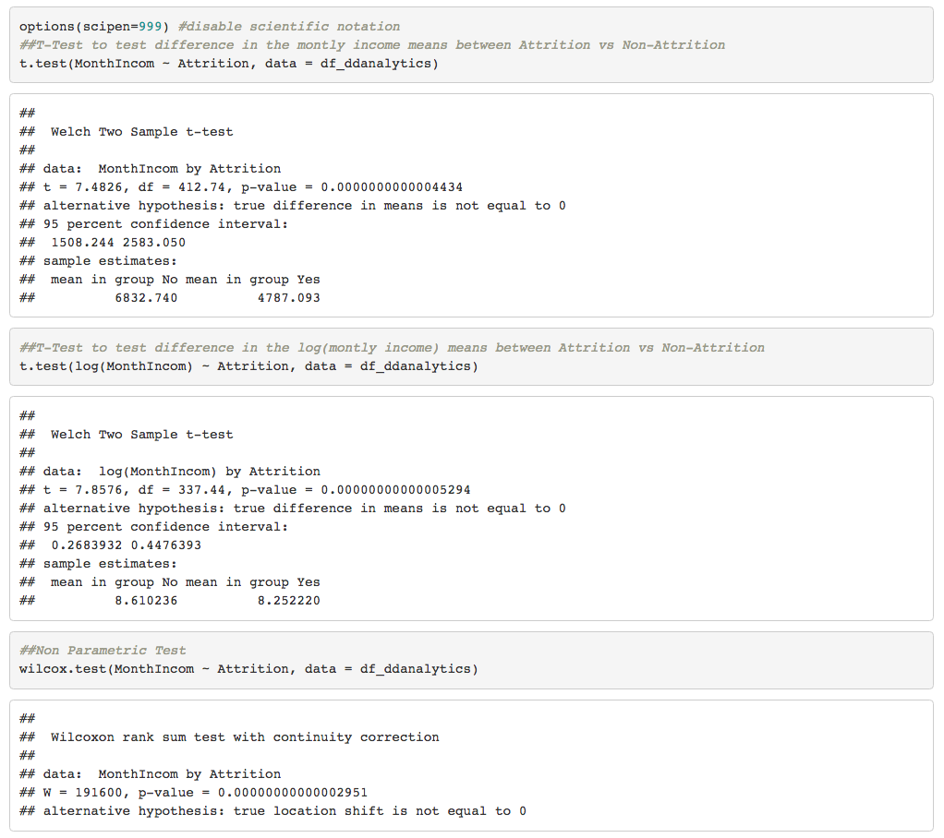
Other Observations

Slide 28
Human resources slide 8
Conclusion
Insights (Top Concerns)
-Work Life Balance (High Travel, Overtime)
-Job Satisfaction (Job Involvement, Relationships)
-Environmental Satisfaction (Job Satisfaction, Relationships)
-Single Employees and overtime
-Income Inequality
Recommendations
-Further Analysis to understand drivers of Overtime and Travel
-Deeper Engagement with the Workforce
-Rewards for overtime, higher pay or time off
-After hours Events for the single employees
-Rewards for overtime should rectify the monthly income inequality
Improvements
-Predictive Advanced Analytics to proactively mitigate turnover
-More frequent collection of unstructured data (i.e. social media) to provide additional perspective

Slide 29
Human resources slide 10
Questions??
https://github.com/jeffleathMSDS/DDS_CaseStudy2
Let Data Lead The Way

Slide 30
Human resources slide 10
Thank You
Let Data Lead The Way

