Slide 1
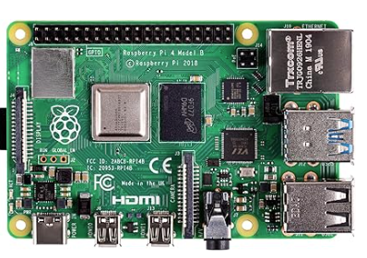
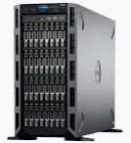
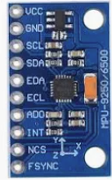
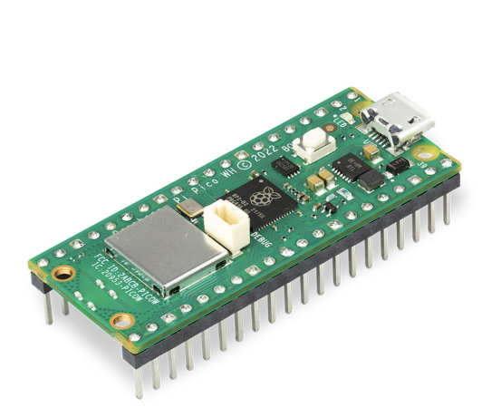
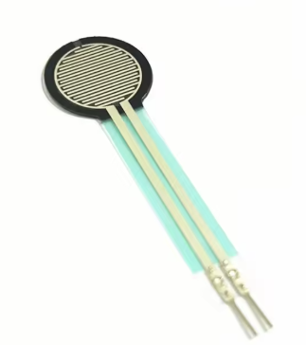
MPU9250
Computing Server
(Now is my PC)
Raspberry Pi 4B
FSR402
Raspberry Pi PICO W

Slide 2
Analogue Signals
=> Digital Data
Force Sensor
main.py
- Force Sensor Data

Slide 3
电路图

