Slide 1
The Lymphocyte Detection Project
Team 6
Detection of lymphocytes in histopathology whole-slide images of breast, colon and prostate cancer, stained with immunohistochemistry
Supervisor: Francesco Ciompi
June 4, 2018

Slide 2
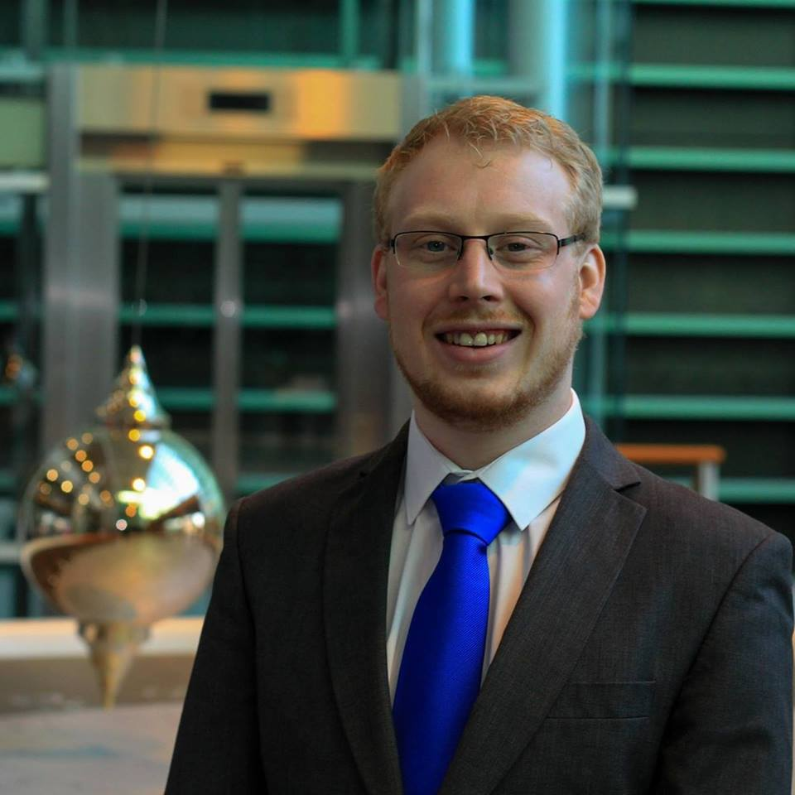


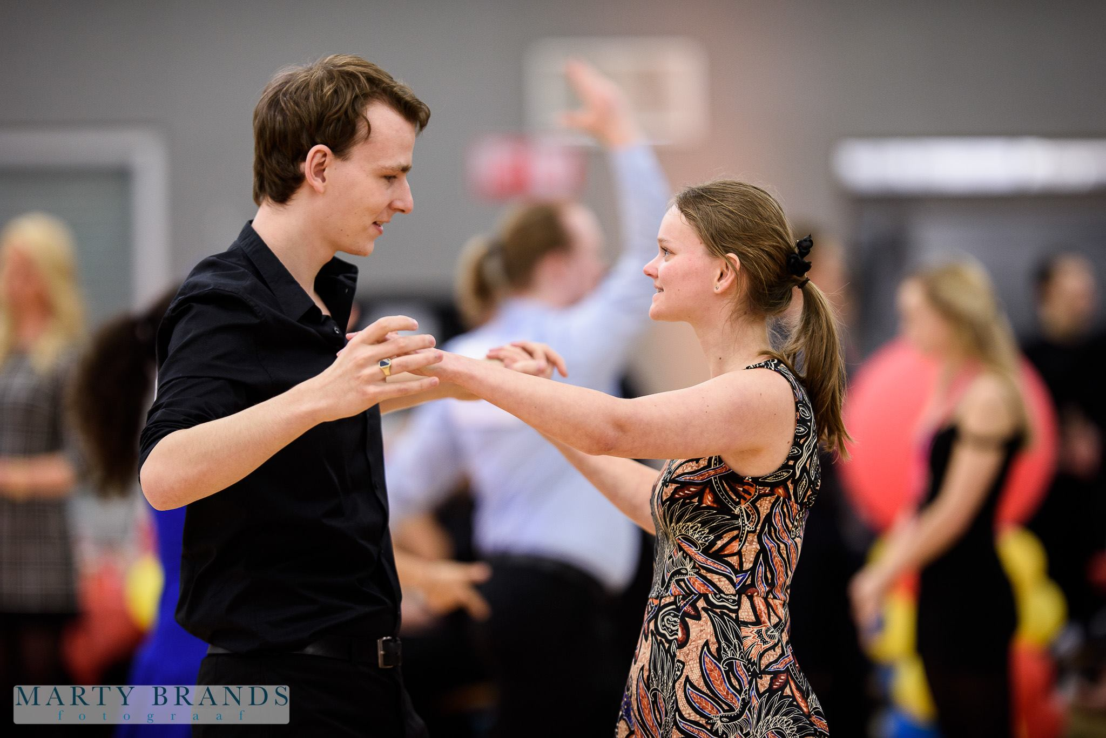
The Boy Band
Gijsbrecht
“My loops are better than numpy”
Software Science
Christoph
“Suspicious hatchet not included”
Data Science
Jeffrey
“They dont dare to give me a nickname”
Data Science
Brian
“The Ladykiller”
Data Science

Slide 3
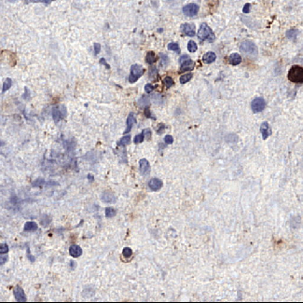
Our Assignment (1)
Scans contain lymphocytes
Breast, colon, and prostate
Strong variations in dimensions
Locations in csv file

Slide 4
Our Assignment (2)
Strong case for counting lymphocytes
Train a model to detect them
Predict and output the coordinates of the centroid of the prediction to a csv file.

Slide 5
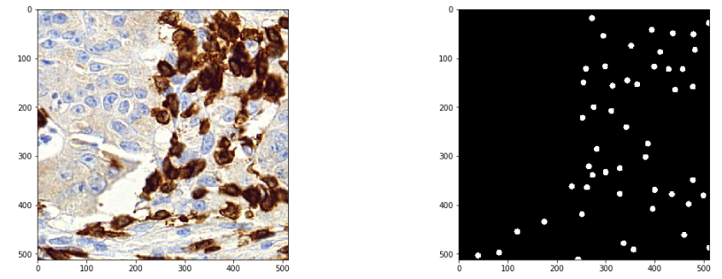
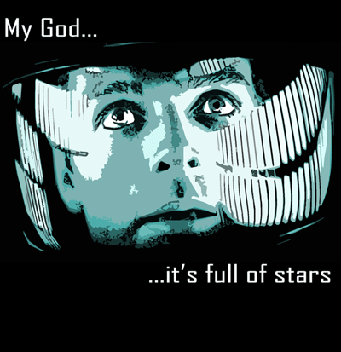
Images And Annotations

Slide 6
Our Approach: Outline
First hunch: Yolo it
“Boxes are stupid anyway though, I’m probably a true believer
in masks except I can’t get YOLO to learn them.”
- Joseph Redmon (on comments received with yolov3)
U-net performed well in literature
Manually annotate images for a mask
Or
Generate masks (saves us work, right?)

Slide 7
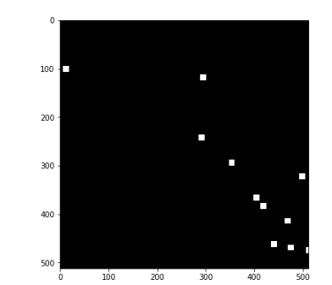
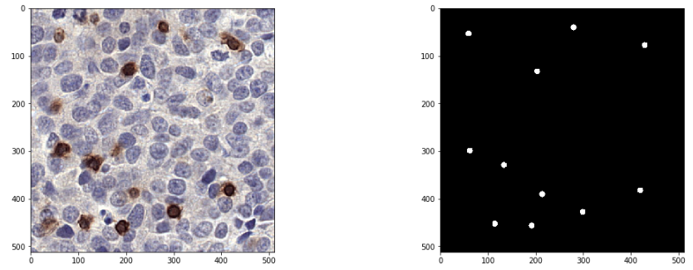
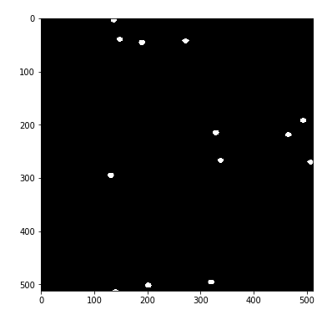
Mask Creation
Square
Circle
Elipsis

Slide 8
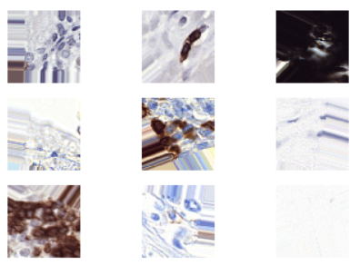
Data Augmentation
The basic stuff (flipping et cetera)
Looking at warping with OpenCV
Shifting wasn’t a great idea ->

Slide 9
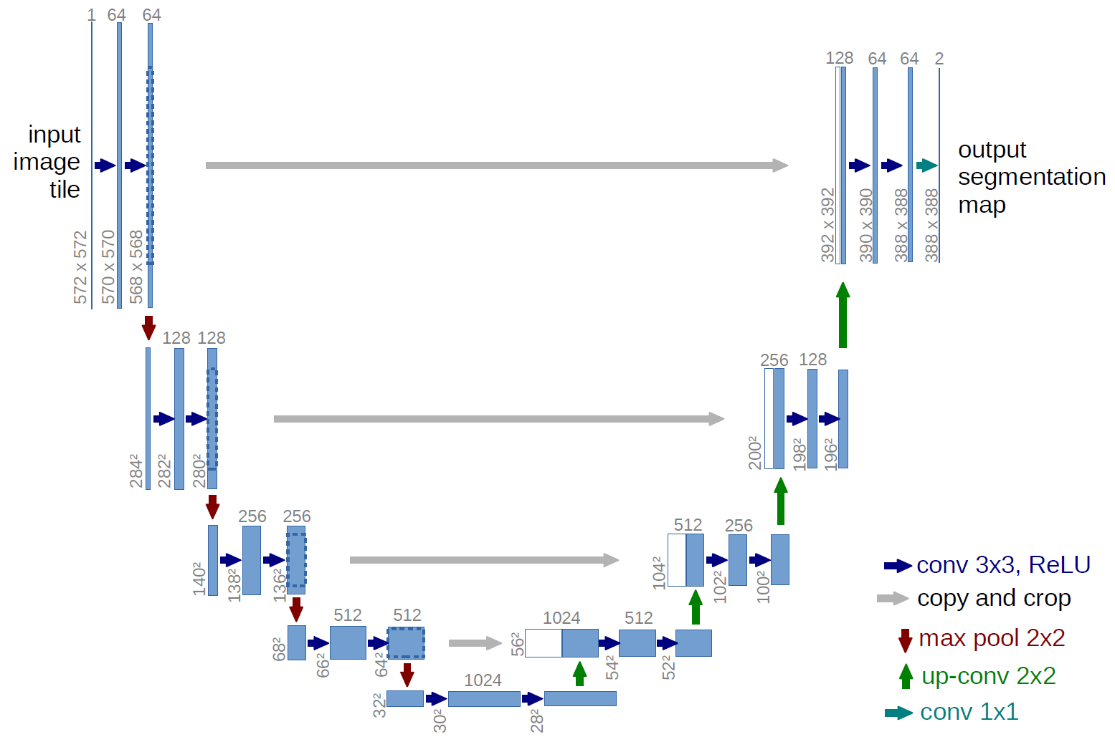
U-Net (1)

Slide 10
U-Net (2)
Ours only goes to 512, but we experiment with different architectures
We train on patches of 512x512

Slide 11
Results So Far

Slide 12
Our Plans For The Rest Of The Course
Figure out different ways to get the center of annotation
Different augmentations - such as warping
Better sampling techniques
Try and evaluate manual annotation
Customize our own loss function with a better penalty for background

